Slide 1
Causal Modeling of Policy Interventions From Treatment–Outcome Sequences
Week 2: June 7th to June 13th

Slide 2
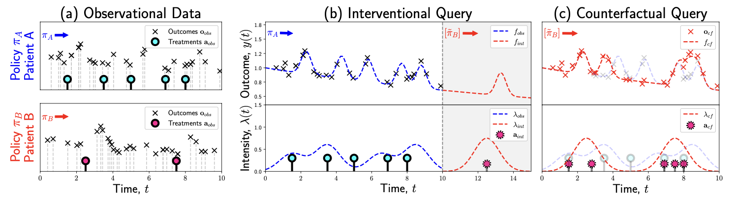
Background
Central question:
“What would happen to the outcome (e.g., patient health)
if we changed the treatment policy?”
=> How can we evaluate the outcome trajectories that would
result from intervening on a treatment policy—when the policy itself is not explicitly recorded and treatment assignments are stochastic rather than fixed?
Goal:
Answering the interventional and counterfactual queries requires modeling policy interventions using a causal model (i.e. int: “What will be the effect of a change to a different policy?”; cf: “What would have happened if a patient had followed a different treatment policy? ”)
=> infer a causal model of recurrent treatments from sequential treatment–outcome data to capture complex, long-term dependencies, which always created by some policy (induces dependencies between past events and future treatments)
Challenges:
Data always created by some policy (induces dependencies between past events and future treatments)
policy itself is generally not recorded and may be known only implicitly from the observed distribution of treatments and outcomes
Limitations of previous methods:
Assume treatment sequences are fixed in advance
Often ignore the fact that real-world treatments are stochastic and dependent on past outcomes
Can't easily be used to simulate or counterfactually reason about different treatment policies
Proposed solution & Contribution:
joint treatment– outcome model: estimate treatment policies and treatment responses in continuous time, by combining a marked point process and a conditional Gaussian process (GP), to estimate future and counterfactual progression
Interventional and counterfactual queries of interventions on policies: an intervention on a treatment policy ⬄ a sequence of stochastic interventions on treatments
Counterfactual sampling of arbitrary point processes: allowing events to depend on past events

Slide 3
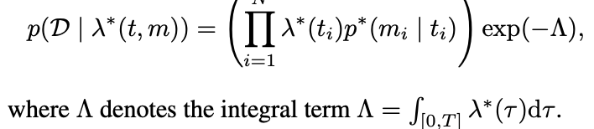


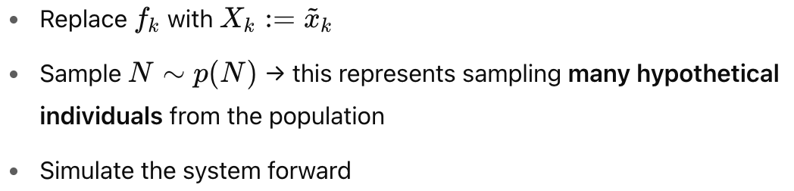
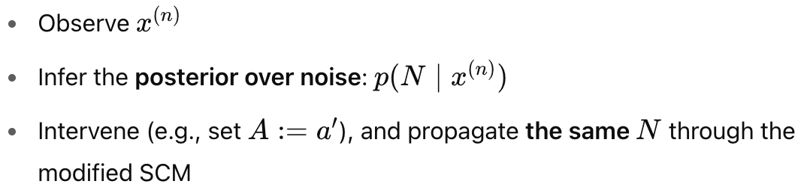



Preliminaries :
Marked Point Process (MPP):
TPP: A point process is described by the conditional intensity function λ∗(t), which defines the instantaneous rate of event occurrence at time t, given the history up to time t.
MPP: Each event is not just a time t_i but also has a mark m_i (e.g., type of event). The joint process is described by:
λ∗(t,m)=λ∗(t)p∗(m∣t)
The likelihood of D observed in the interval [0, T ]:
Causal inference:
PO framework: define causal queries
Interventional queries: "What happens if we do X?"—evaluated using the interventional distribution
Counterfactual queries: (Individual-Level Query) "What would have happened to individual n if they had received a different treatment?"—evaluated using the counterfactual distribution
SCM: provide a generative model of the data; emphasize the distinction between probability distributions by different causal queries
Variables X are generated by structural equations X_k = f_k (parents_k, N_k) with latent noise N∼p(N).
Interventional (Population-Level Query) :
Counterfactual (Individual-Level Query) :
Counterfactual distribution:
Interventional distribution:

Slide 4
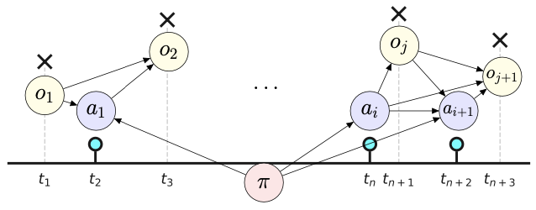

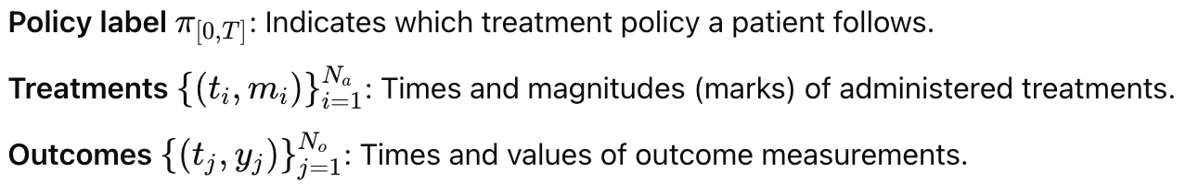




Problem Setting
Data Structure: an observational data set D in a period [0,T]:
Treatment policy: A policy π is defined by its treatment intensity function λ_π^∗​(t,m), which governs when and how likely treatments with mark m are administered at time t.
The policy label π_[0,T]​ is assumed fixed and observed
The treatment intensity λ_π^∗​(t,m) is latent and must be inferred
assume that patients belong to different groups, and each group is characterized by a shared policy (treatment intensity)
Causal objective: answer causal queries about outcomes under hypothetical policy changes
Policy Intervention (Interventional Query):
Change the policy starting at the end of the observation period, τ^~=T, and predict future outcomes under a new policy π~>T; interventional dist:
Policy Counterfactual (Counterfactual Query):
Retrospectively simulate what would have happened from time 0 onward if a different policy π~[0,T]​ had been followed; counterfactual dist:
Causal Assumptions:
Assumption 1: consistency
Assumption 2: positivity
Assumption 3: No Unmeasured Confounding (NUC)
Treatments are conditionally independent of potential outcomes given history.
Assumption 4: Fully-Mediated Policy Effect (The policy π affects outcomes only through the treatment assignments a, not directly.)

Slide 5
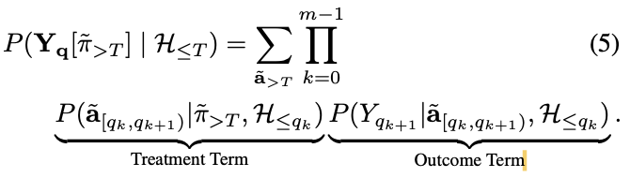
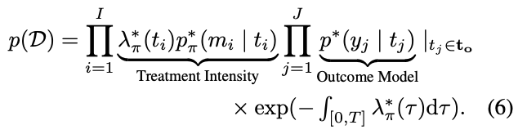
Problem Setting
Main result of Identifiability:
Inspection of potential outcome trajectories Y_{>T} [π _{̃>T} ] at a discrete set of ordered query times q={q1,...,qm} using assumptions {1,2,3,4}
Treatments a_{>τ}​ are stochastically assigned using an intensity function λ_π^∗(t,m) that depends on the past history.; The policy label π determines the treatment intensity.
=>Theorem 1: reformulation of the sequential estimation of treatments and outcomes
The potential outcome query under a new policy π^~_{>T} is equivalent to a sequence of stochastic conditional interventions on future treatments:
Theorem 1 provides identifiability for the interventional distribution; The factorization:
A treatment term: how likely a treatment is given history.
An outcome term: how the outcome evolves given treatments.
Joint Treatment-Outcome Model:
combining a marked point process and a conditional Gaussian process to estimate stat components in (5)
assume that the measurement times of the outcomes are given:
The joint distribution finally:

Slide 6
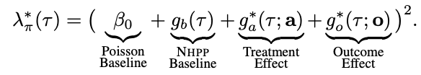
Joint Treatment-Outcome Model
Treatment Intensity Model:
assume the patients who follow the same treatment policy π share the same treatment model, i.e., the same hyperparameters, but the intensity curves may differ because past treatments and outcomes are not the same.
The time-specific intensity is modeled as a square transformation of a latent function g_π^∗(τ)
In the observed dataset, all of these components combine to give a single observed intensity. The model disentangles them via functional priors:
a sum of a constant scalar β0 and three time-dependent functions with GP priors, g_b, g_a^∗, g_o^∗ ∼ GP.
β_0 and 𝑔_𝑏(𝜏):
capture baseline or background variation — what happens even if no prior actions or outcomes occurred:
- allow the model to flexibly explain regular patterns or external noise (like circadian rhythms or hospital shift cycles); capture non-history-driven signal
If only use the history-dependent parts: may over-attribute variation to treatments/outcomes; can lead to bias or overfitting, especially in regions of sparse history.
In causal terms:
The first two terms capture exogenous variation, or structured non-confounding variation;
some math properties of squaring the summation:
Non-Negativity of Intensity
Smooth and Differentiable Modeling
Encouraging Interactions (second-order effects)
follows the CGP-PP model (Causal Gaussian Process Poisson Process) from Liu & Hauskrecht (2019)

Slide 7





Treatment Intensity Model
Prediction pipeline:
Kernel: how similar the current time τ and its history of treatments and outcomes is to other times τ′ and their histories; controls how influence spreads through the data — it determines what counts as “nearby” in your history space.
using a GP to model a latent function f(τ) that controls treatment intensity:
the input to the kernel at time τ is a vector like (1 + 2 ∗ Q_a + 2 ∗ Q_o dimensional vector):
These values define how deep into the past the kernel functions “look”:
τ - t_{a_i}: the time since the i-th most recent treatment
𝑚_𝑖 : its dosage (the “mark”): the appearance of a non-zero dosage mark 𝑚_𝑖 at time 𝑡_𝑖
τ - t_{o_j}: the time since the j-th most recent outcome
𝑦_𝑗: its value.
Retrieval function: outputs both the relative time and the mark of the i th last event of type k ∈ {a, o}
Get kernel function:
Variational Inference:
In exact GP inference, computing the posterior over these latent functions given the data is intractable
Approximate the true posterior over the latent function values f (i.e., values of GP components) given observed data D, by a tractable variational distribution q(f) ≈p(f∣D).
Minimize the KL divergence between q and the true posterior via maximizing the Evidence Lower Bound (ELBO); Using Inducing points: low-rank approximation of the full GP

Slide 8
Treatment Intensity Model
Prediction pipeline:
Kernel: how similar the current time τ and its history of treatments and outcomes is to other times τ′ and their histories; controls how influence spreads through the data — it determines what counts as “nearby” in your history space.
using a GP to model a latent function f(τ) that controls treatment intensity:
the input to the kernel at time τ is a vector like (1 + 2 ∗ Q_a + 2 ∗ Q_o dimensional vector):
These values define how deep into the past the kernel functions “look”:
τ - t_{a_i}: the time since the i-th most recent treatment
𝑚_𝑖 : its dosage (the “mark”): the appearance of a non-zero dosage mark 𝑚_𝑖 at time 𝑡_𝑖
τ - t_{o_j}: the time since the j-th most recent outcome
𝑦_𝑗: its value.
Retrieval function: outputs both the relative time and the mark of the i th last event of type k ∈ {a, o}
Get kernel function:
Variational Inference:
In exact GP inference, computing the posterior over these latent functions given the data is intractable
Approximate the true posterior over the latent function values f (i.e., values of GP components) given observed data D, by a tractable variational distribution q(f) ≈p(f∣D).
Minimize the KL divergence between q and the true posterior via maximizing the Evidence Lower Bound (ELBO); Using Inducing points: low-rank approximation of the full GP

Slide 9
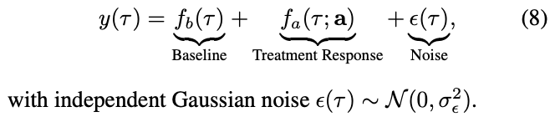
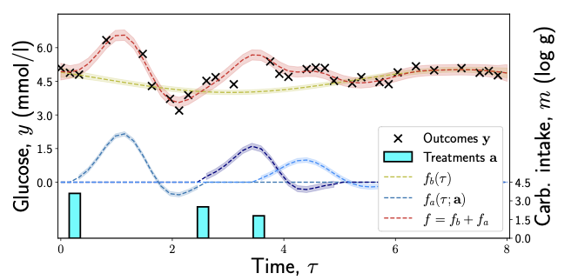

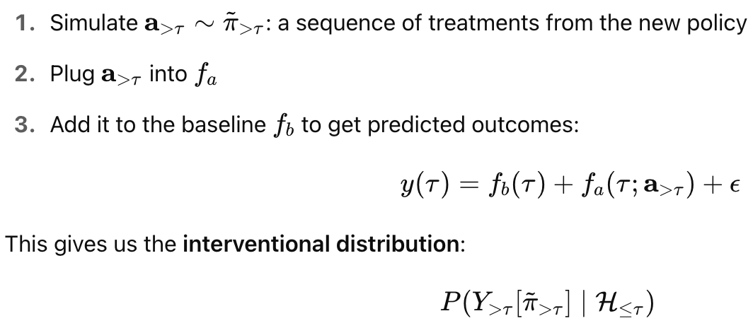
Outcome Model
The outcome trajectory is modeled as:
f_b​(τ): baseline (non-treatment-related) trend over time (e.g. circadian rhythms);
f_a(τ;a): treatment-induced effect
ϵ(τ)∼N(0,σ^2): Gaussian noise
Treatment Response Model: learns how outcomes correspond to (i.e., respond to) past treatments / change over time as a result of treatments
Each treatment (t_i,m_i) contributes some effect into the future
f_m ​(m_i​): scales the treatment’s effect by its dose (mark)
f_t​ (τ ; t_i​): says how that treatment’s effect decays or evolves over time from its administration at t_i

Slide 10


Inference
Computing policy intervention and policy counterfactual queries using joint treatment- outcome model
Policy Intervention:
Objective: Estimate the future outcome trajectory under a new treatment policy π^~, applied after the observation period T.
Method:
Fit the observational data using variational inference → yields an SCM M=(S,p(N))
Apply the new policy π^~, forming an interventional SCM:
By Theorem 1, this is treated as a stochastic intervention on future treatments.
In practice: replace the observed treatment intensity λ_π^∗ with the new intensity λ_{π^~}^∗​, while keeping the outcome model unchanged.
Policy Counterfactual:
Objective: Estimate the outcome under a different policy π~\tilde{\pi}π~, assuming we had followed it all along, starting from time 0.
Method:
Same procedure as policy intervention except:
The generic noise distribution p(N) is replaced by a posterior, individual-specific noise distribution p(N∣D^{(v)}).
The SCM becomes:
Noise variables include:
Outcome noise E_o: derived from the GP and Eq. (8); available in closed form.
Treatment noise E_a: arises from the stochastic sampling of treatments.
The treatment noise is estimated using an extended version of the thinning algorithm (Noorbakhsh & Rodriguez, 2022) adapted for history-dependent processes.

Slide 11
Inference
Identifiability of the policy counterfactual:
Why theorem 1 not sufficient / why violation of identifiability of counterfactual?
In Interventional: You can observe many units with different baseline noise values, each exposed to various treatments.
Over a population, the variation in outcomes gives the model multiple opportunities to disentangle:
- What part of the outcome came from the treatment
- What part was due to latent noise / baseline progression
This is exactly what lets you estimate the average treatment effect across a population, even when f_b (τ) and f_a (τ;a) are flexible (nonparametric, like GPs).
In counterfactual outcomes: only one noise sample.
You fix one individual — so you're conditioning on a single draw of the noise N=N^(i), you observed x^(i).
There’s no variation in noise to help you disambiguate what was due to f_b vs. f_a
Assumptions to ensure identifiability:
Monotonicity: To constrain the counterfactual sampling space, so that when generating counterfactual treatment trajectories under a new policy π^~, only consistent treatment transitions are allowed.
A point accepted (i.e. treated) under π=0 should stay accepted under π=1,
A point rejected under π=1 should stay rejected under π=0.
Separating f_b​ and f_a with functional priors:
Component | Behavior Assumed | Purpose
f_b(τ) | Slow-changing, smooth (e.g., periodic + constant kernel) | Captures long-term baseline patterns
F_a(τ;a) | Fast-changing, sharp (SE kernel centered on treatment time) | Captures short-term treatment response

Slide 12
Limitations and Future work
Scalability of computing
treatment responses: additive, which does not allow for modeling interactions of nearby treatments;
can be improved by integrating more sophisticated kernels into the treatment response function.
Thinning algorithm: slow
Causal assumptions: might violate in real-world data, such as NUC

Slide 13

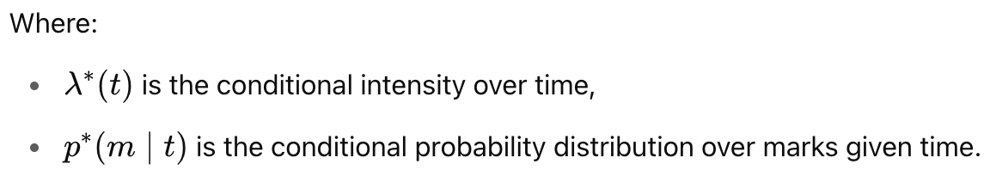
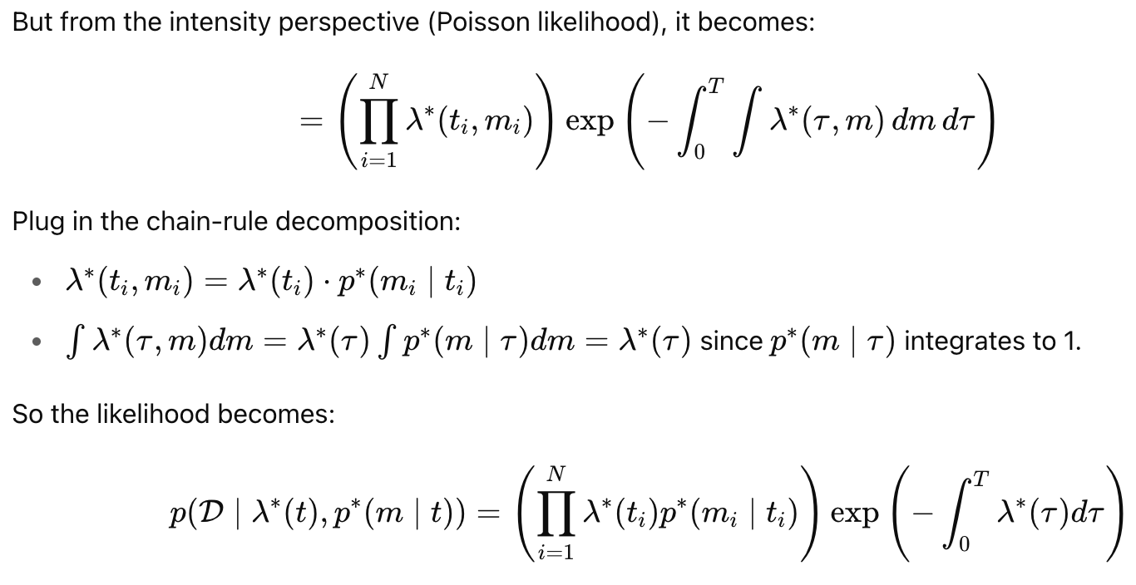
Appendex
MPP:
Intensity function in MPP case by using chain rule:

Slide 14
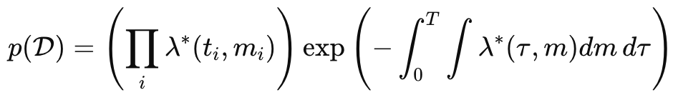
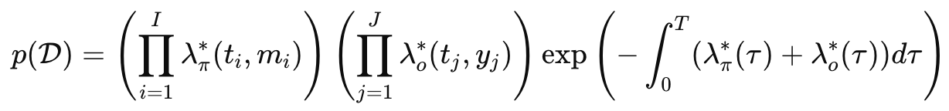

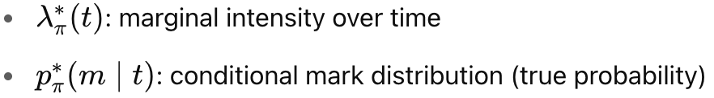
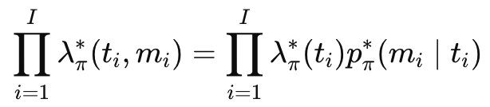

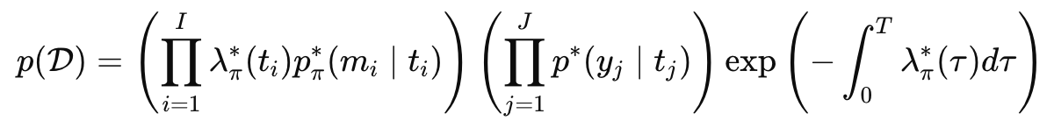
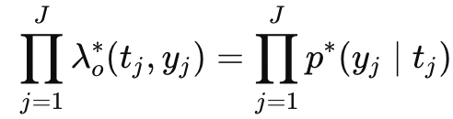
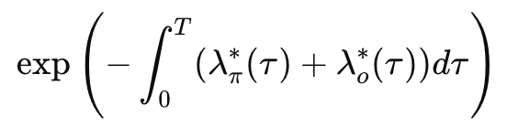
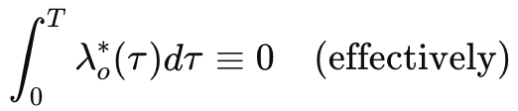
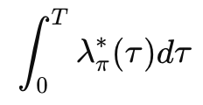
Appendex
How we get (6):
Decompose the treatment intensity
Simplify the outcome intensity term:
Outcome time points t_j are fixed and known:
No randomness over time — only over the outcome marks y
So the temporal intensity is “collapsed” into an indicator
Integral Term Simplification:
λ_o^∗(t) is replaced with an indicator at known outcome times t_j
And these are not random — no stochastic timing
Hence
Hence we got final result (6):
Hence
Hence

