Slide 1
IONIC
Hybrid Mobile Application Framework

Slide 2
SESSION 2
BUILD WITH NATIVE COMPONENT

Slide 3
Build with native component
Geolocation
Social Sharing

Slide 4
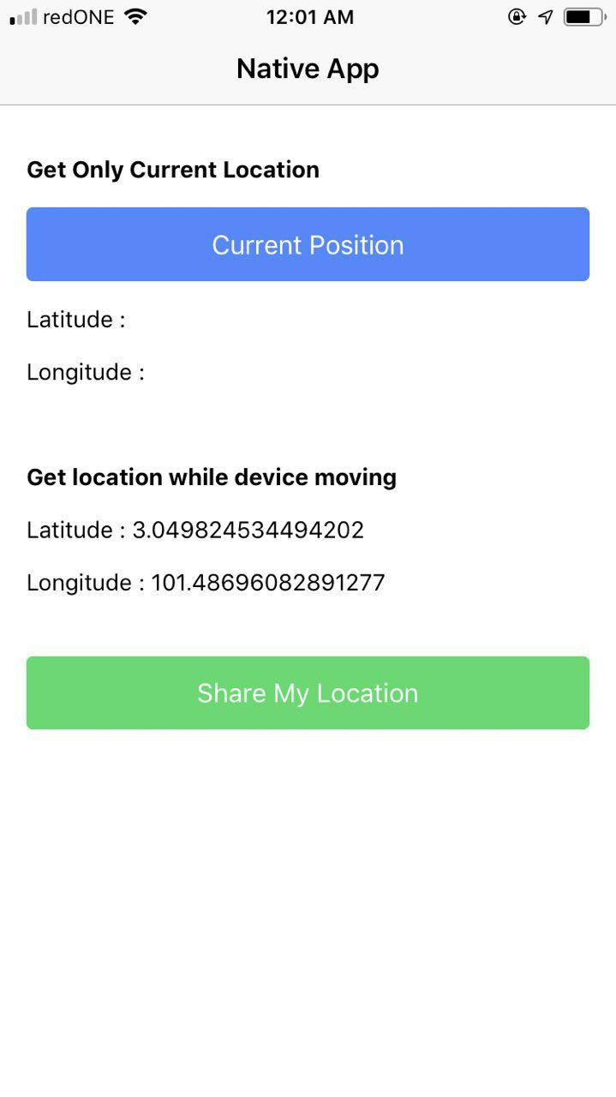
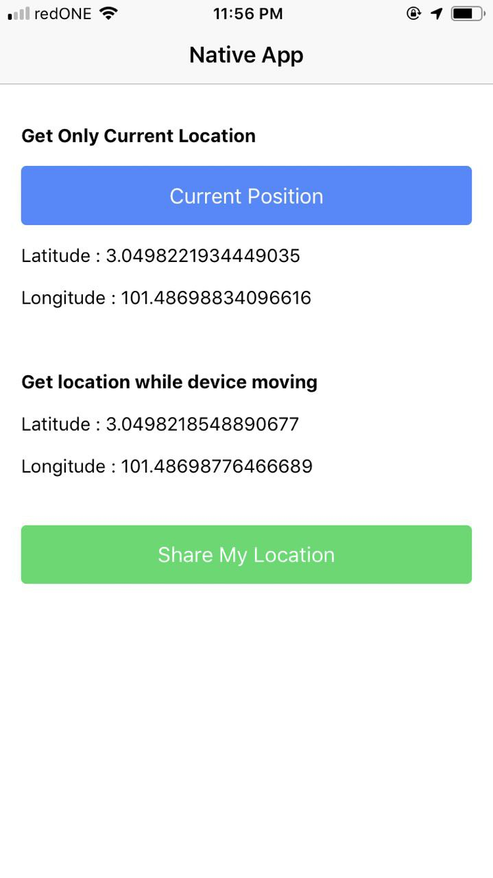
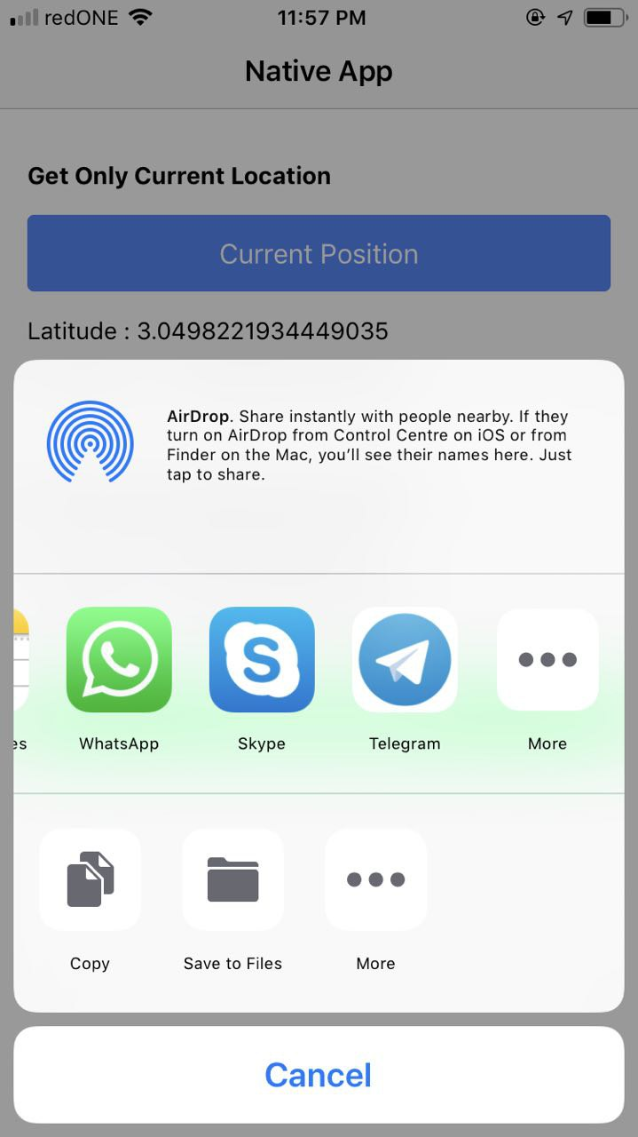
Build with native component

Slide 5
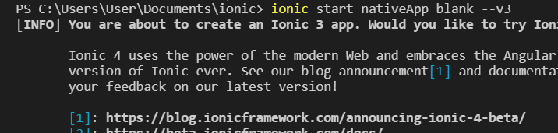
Build with native component
Create New Project <nativeApp>

Slide 6
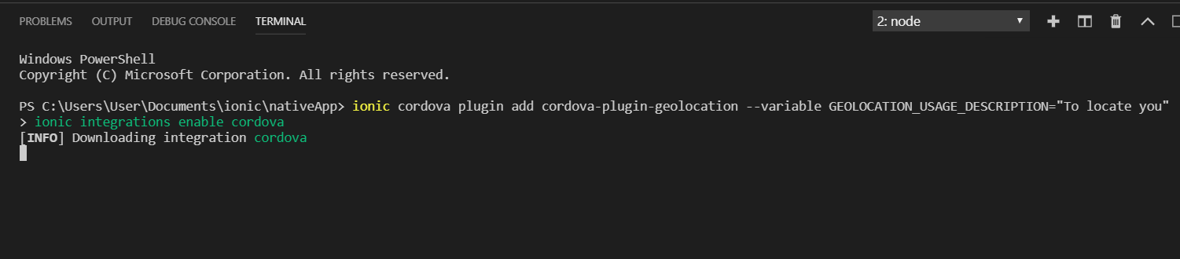
Geolocation
Installation geolocation

Slide 7
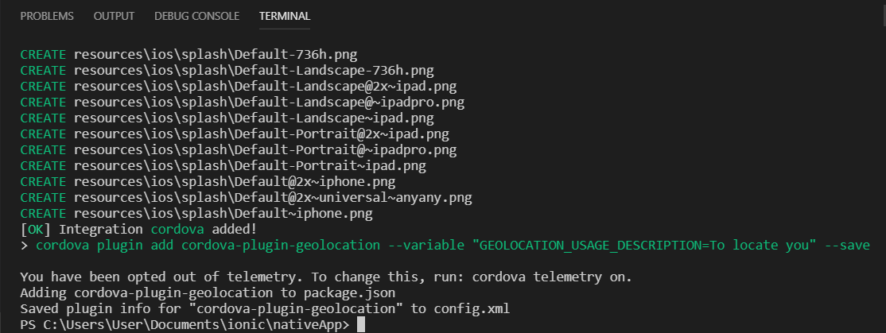
Geolocation

Slide 8
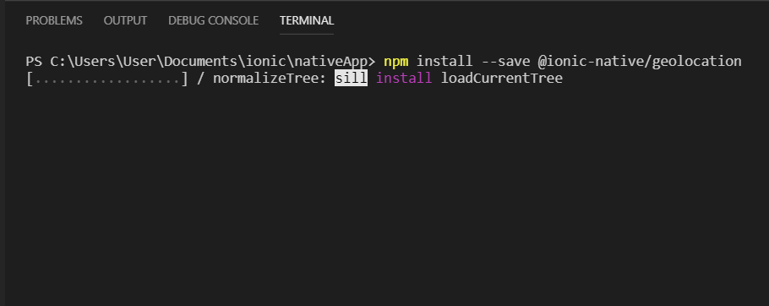
Geolocation
Install geolocation dependency

Slide 9
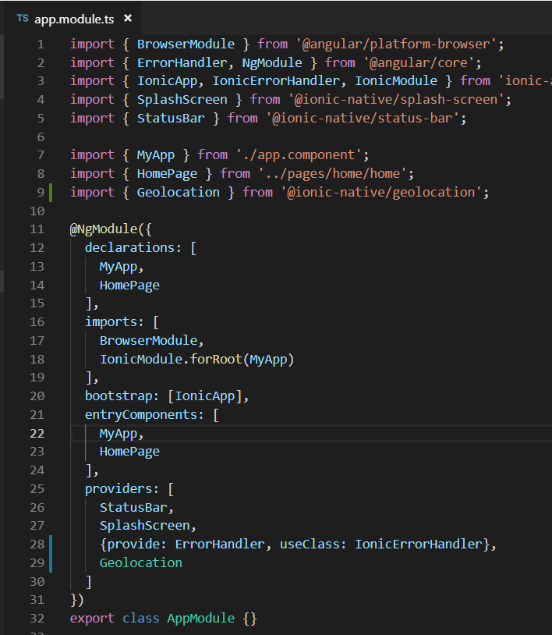
Geolocation
Add geolocation plugin
src/app/app.module.ts

Slide 10
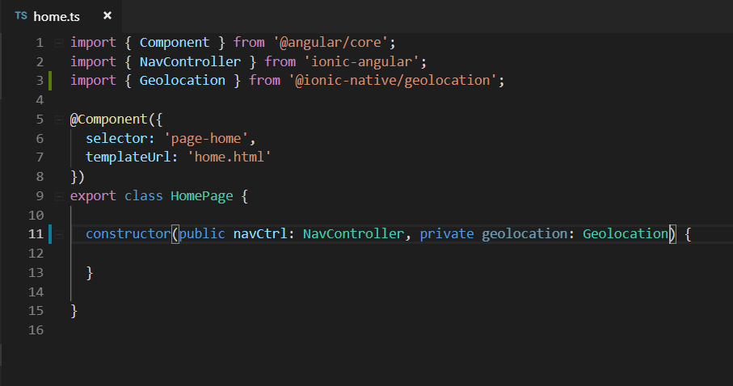
Geolocation
Import geolocation library at home.ts

Slide 11
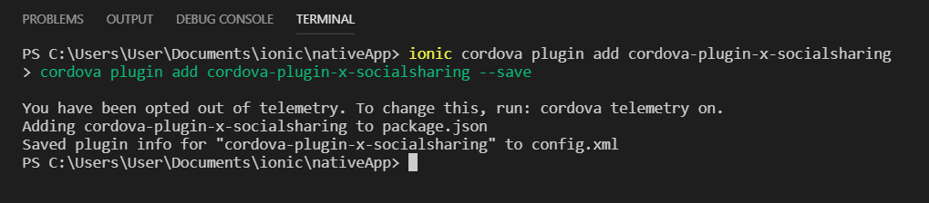
Social Sharing
Installation

Slide 12
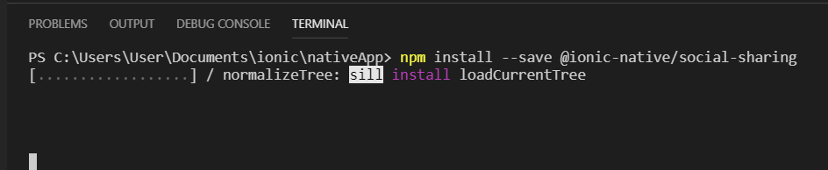
Social Sharing
Installation

Slide 13
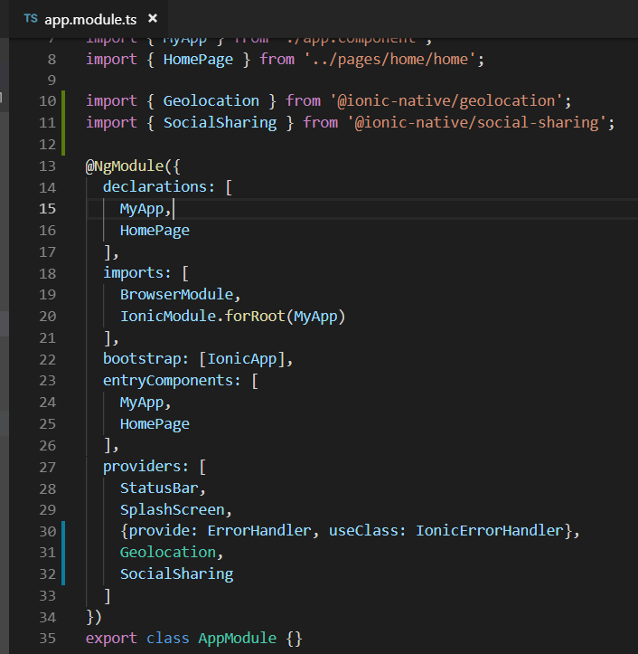
Social Sharing
Add socialSharing plugin
src/app/app.module.ts

Slide 14
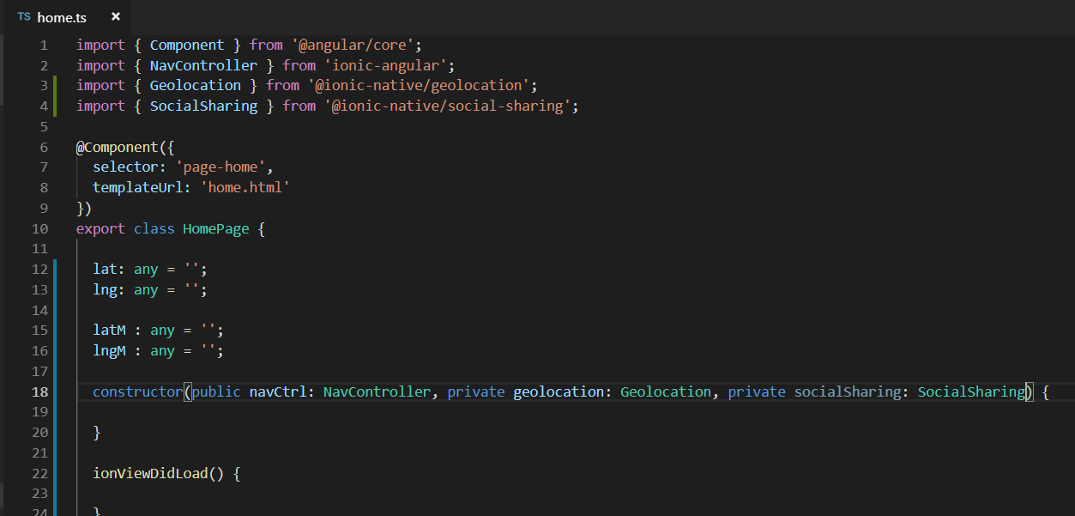
Social Sharing
Add socialSharing library at home.ts

Slide 15
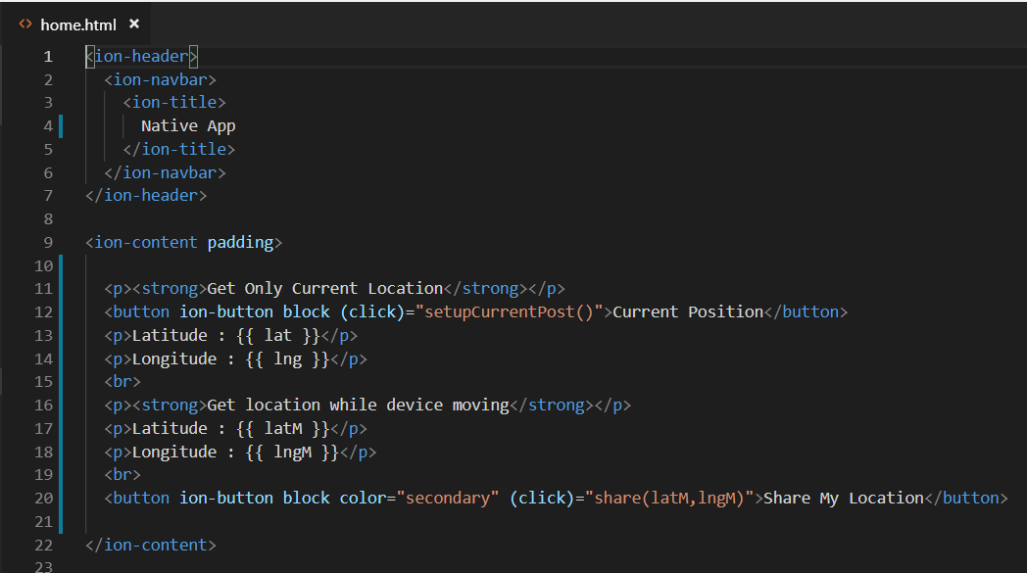
Build with native component
Edit home.html

Slide 16
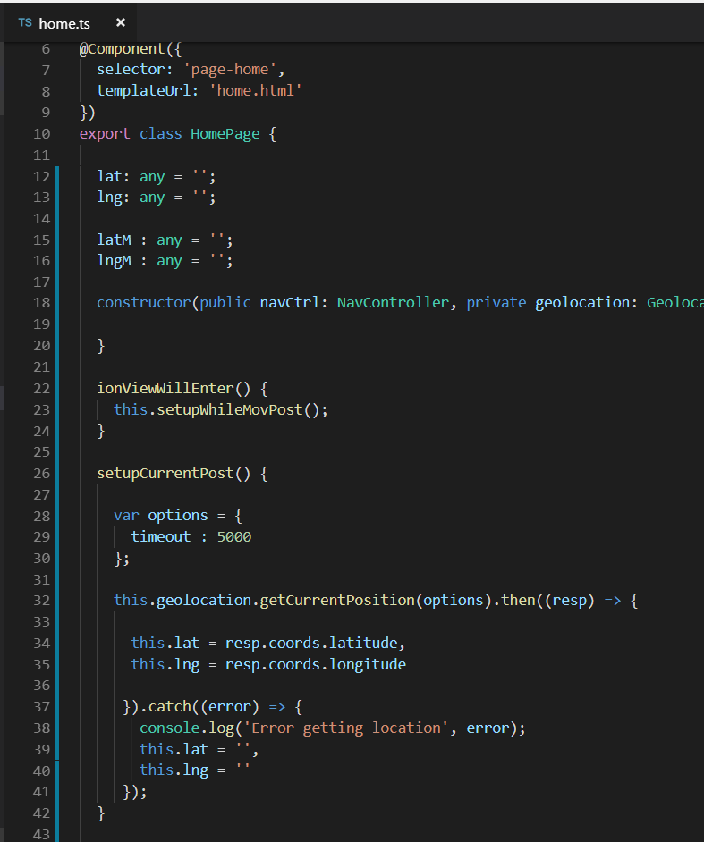
Edit home.ts

Slide 17
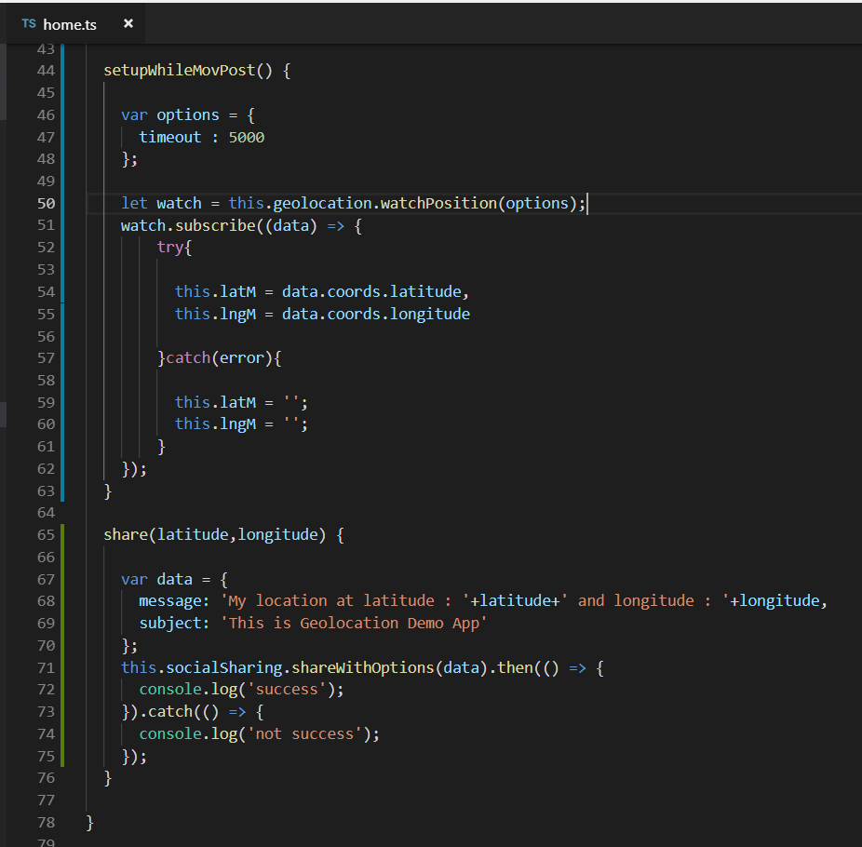

Slide 18
Build with native component
Run on ionic Devv
Done!!

Slide 19
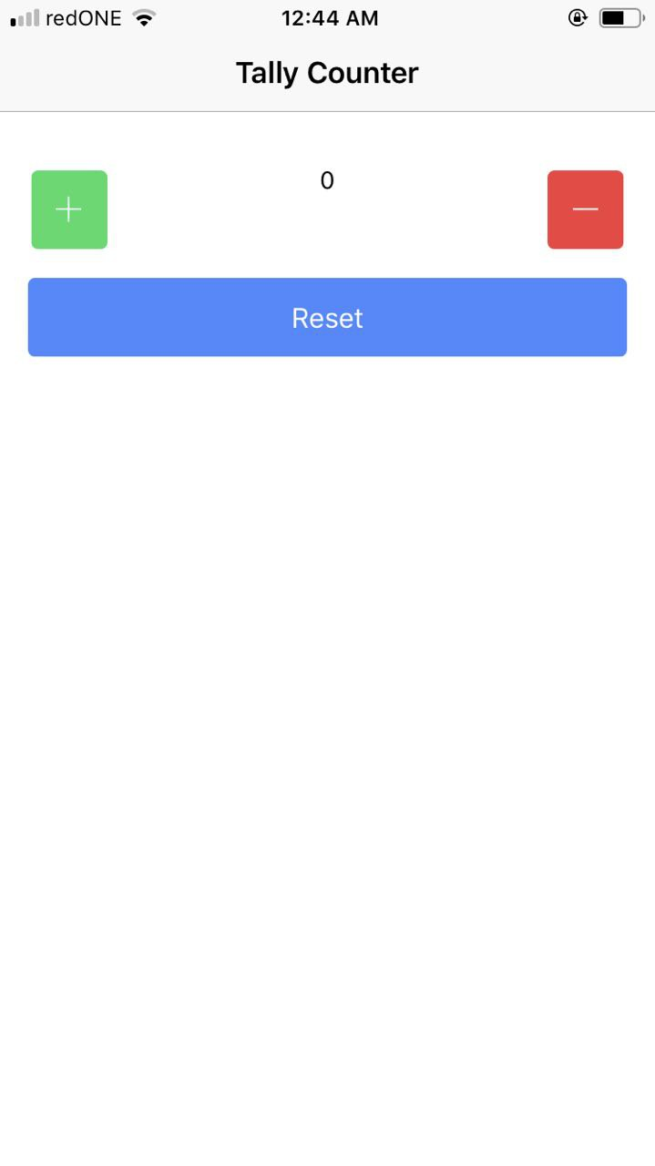
Build Tally Counter App
To prove app’s operation

Slide 20
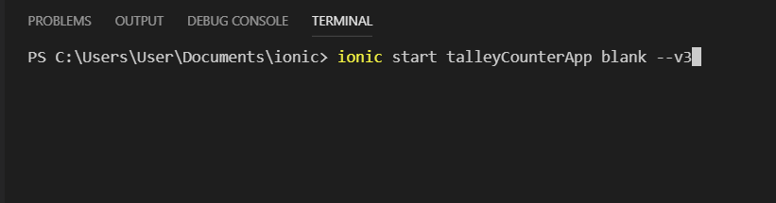
Build Tally Counter App
Setup New Project <talleyCounterApp>

Slide 21
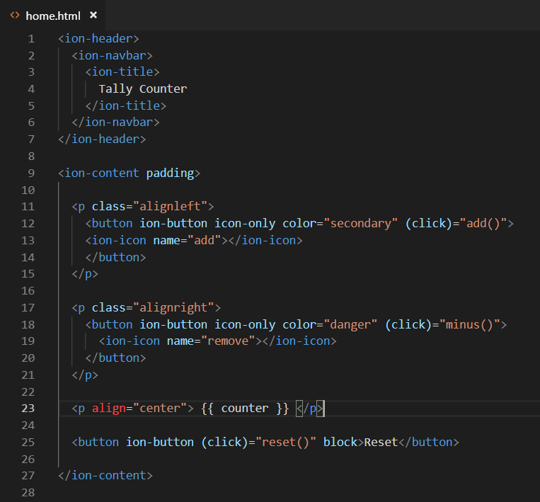

Slide 22
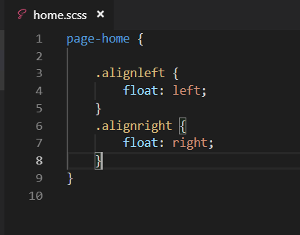

Slide 23
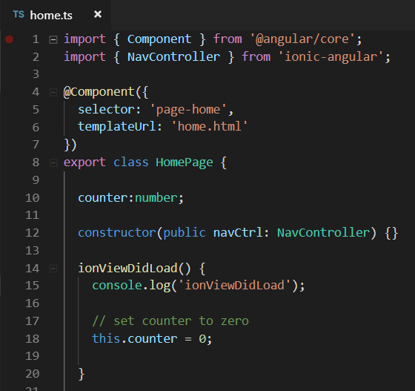
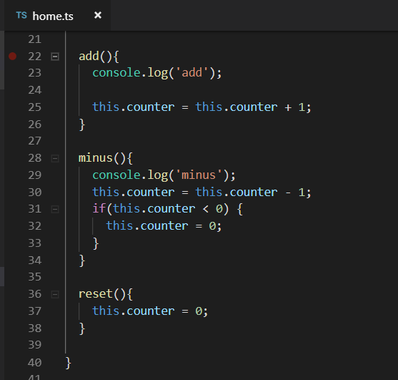

Slide 24
Build Tally Counter App
Run on ionic devv
Done !!!

Slide 25
Exercise 2
Design BMI Calculator where user can input their weight (kg) and height (m) in first page.
Navigate BMI result to second page.
BMI Formula : weight (kg) / height (m) * height (m)
Template : blank page

Slide 26
Reference
https://ionicframework.com/docs/

