Slide 1
IONIC
Hybrid Mobile Application Framework

Slide 2
SESSION 3
CREATING APK FILE (ANDROID PLATFORM)

Slide 3
Outline
APK Definition
Android Studio Installation
JDK Installation
Add Android platform
Generate debug APK
Generate release APK unsigned
Generate release APK

Slide 4
APK Definition
Also known as Android Package Kit (APK), is the package file format used by the Android OS for distribution and installation of mobile apps and middleware

Slide 5
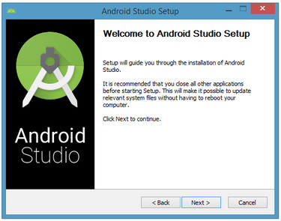
Android Studio Installation

Slide 6
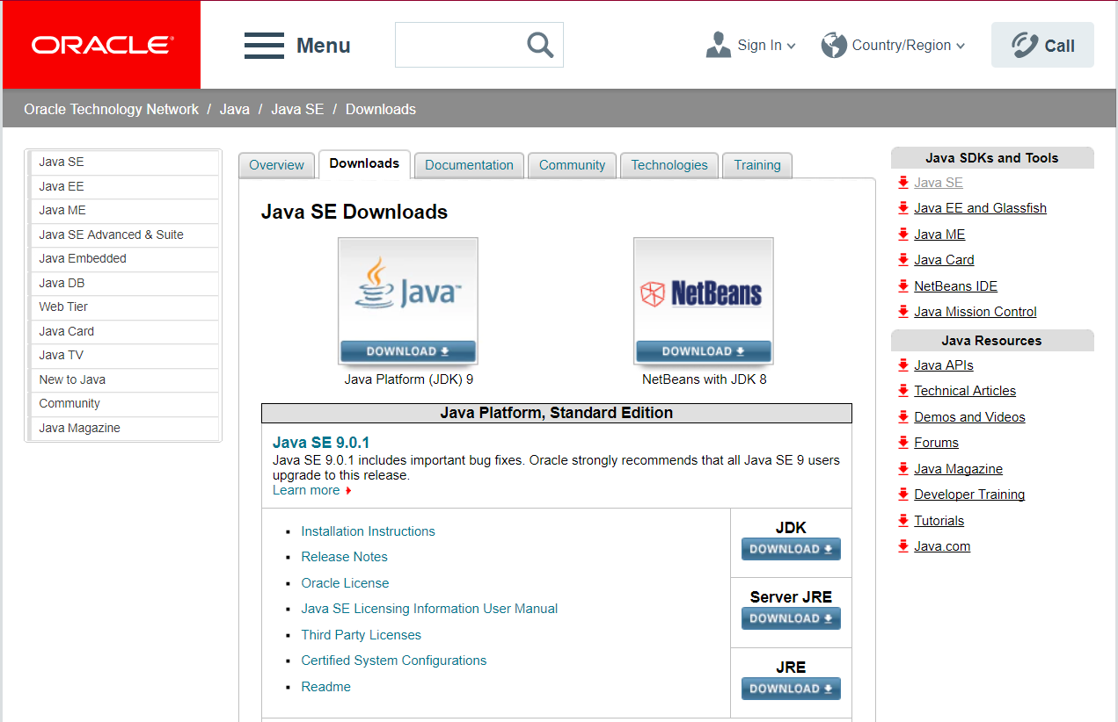
JDK Installation
http://www.oracle.com/technetwork/java/javase/downloads/index.html

Slide 7
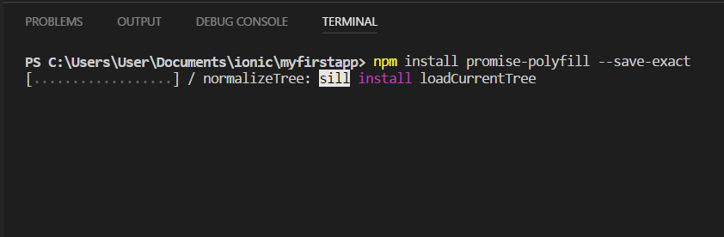
Add Android platform
C:\Users\Username\Documents\ionic\app-name>npm install promise-polyfill –save-exact

Slide 8
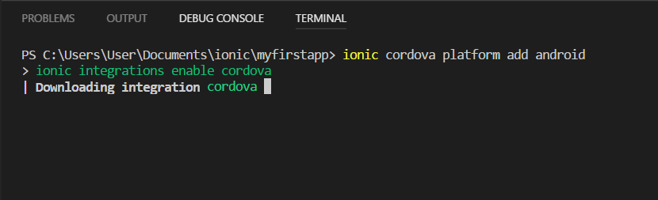
Add Android platform
C:\Users\Username\Documents\ionic\app-name>ionic cordova platform add android

Slide 9
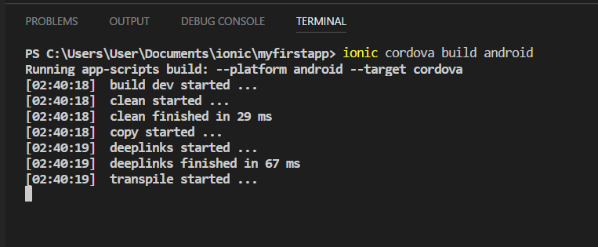
Generate debug APK
C:\Users\Username\Documents\ionic\app-name>ionic cordova build android

Slide 10
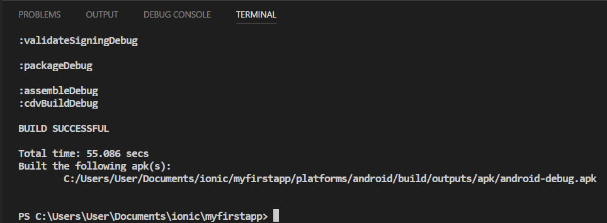
Generate debug APK
Debug APK successful build

Slide 11
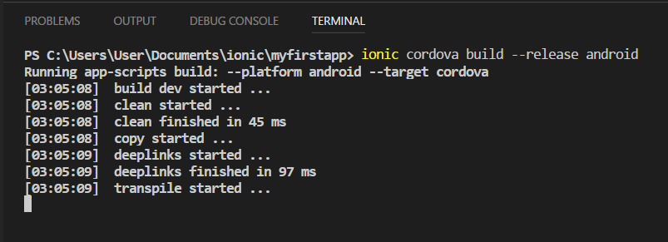
Generate release APK unsigned
C:\Users\Username\Documents\ionic\app-name>ionic cordova build –release android

Slide 12
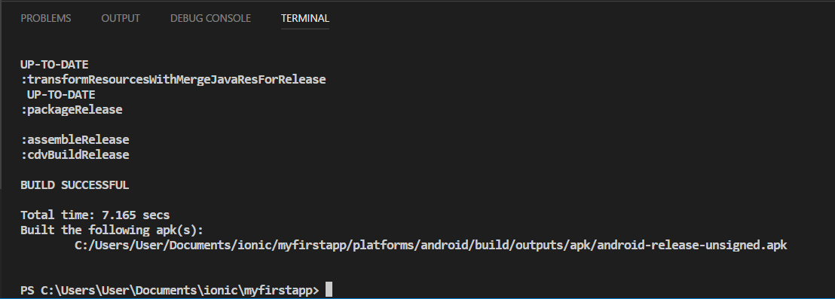
Generate release APK unsigned
Release APK unsigned successful build

Slide 13
Generate release APK
Add path keytool in environment variables
Keystore command + create certificate application
release-signing.properties
Create release APK command

Slide 14
Add path keytool in environment variables
Right click on "This PC" > right-click Properties > Advanced system settings > Environment Variables > select PATH then EDIT.
Add your jre bin folder path to environment variables, it should look like this:
"C:\Program Files\Java\jre1.8.0_40\bin"

Slide 15
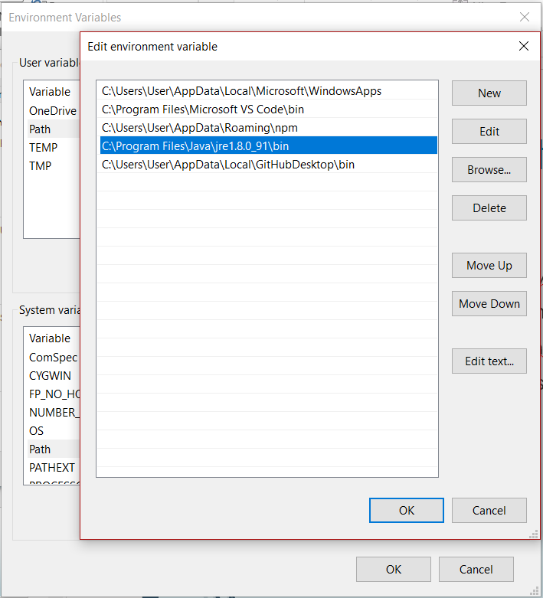

Slide 16
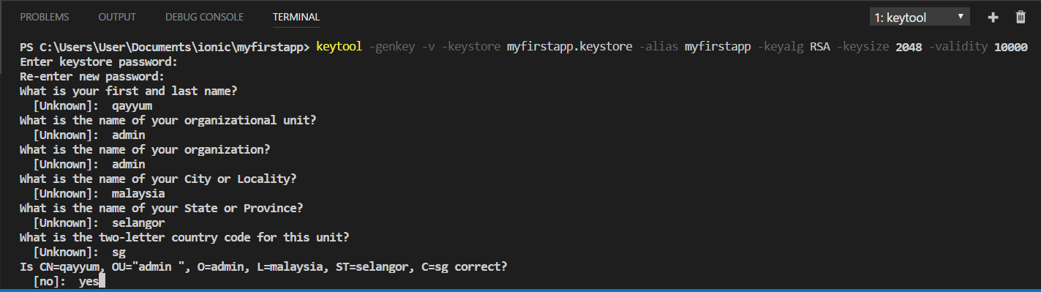
Keystore command + create certificate application
keytool -genkey -v -keystore <variable-name>.keystore -alias <variable-name> -keyalg RSA -keysize 2048 -validity 10000

Slide 17
release-signing.properties
Copy file “release-signing.properties” into folder platform android
Move file <variable-name>.keystore into same file with file “release-signing.properties” and changes extension file into jks
Edit information in file “release-signing.properties”

Slide 18
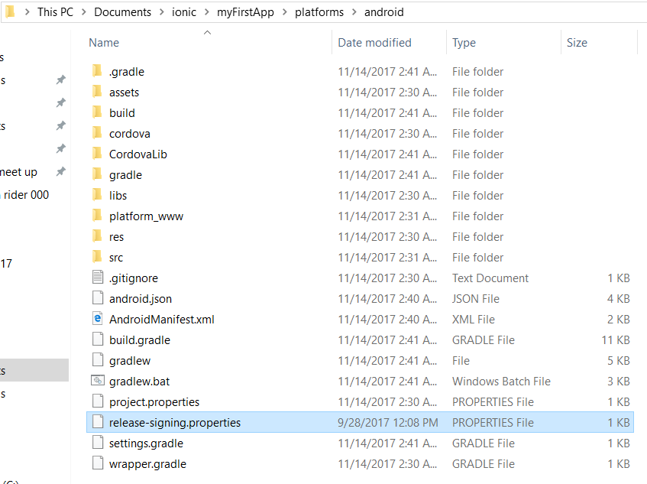
1 - Copy file “release-signing.properties” into folder platform android

Slide 19
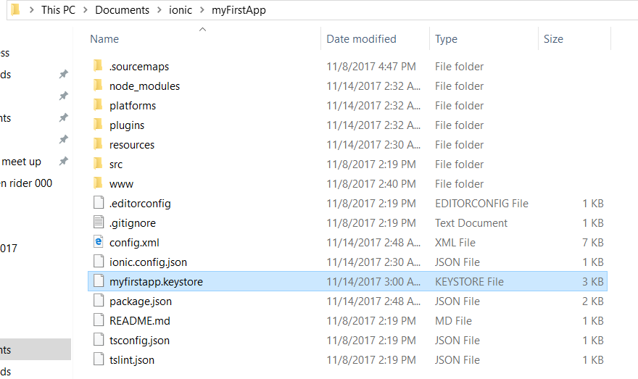
2 - Move file <variable-name>.keystore into same file with file “release-signing.properties” and changes extension file into jks

Slide 20
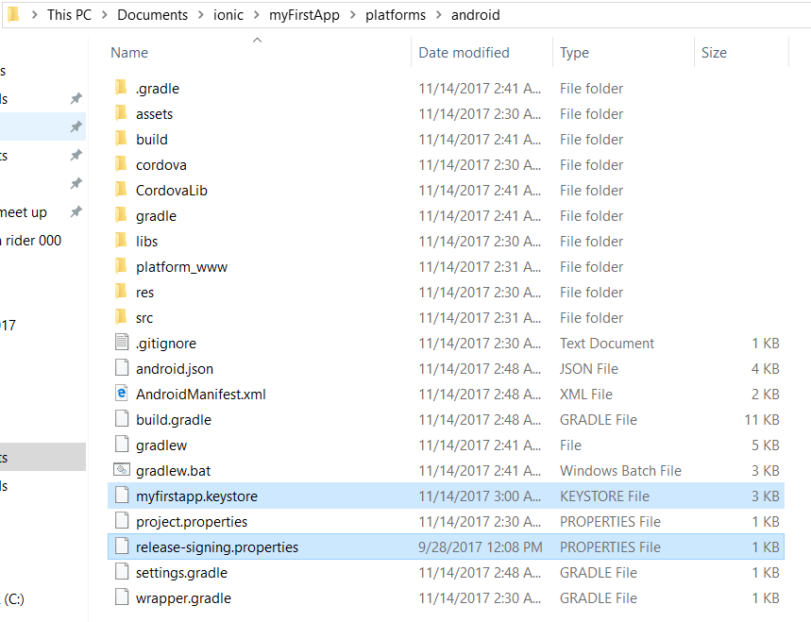
2 – Continue…

Slide 21
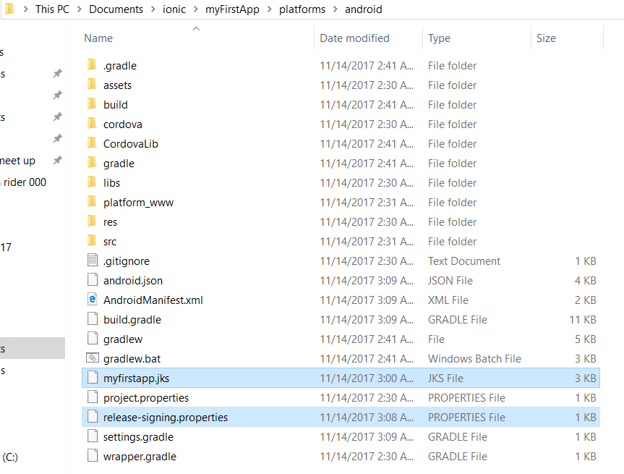
2 – Continue…

Slide 22
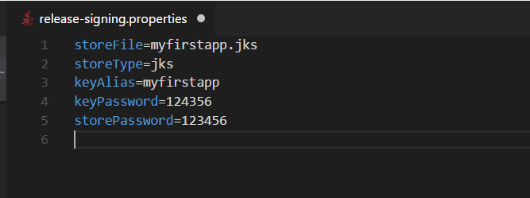
3 - Edit information in file “release-signing.properties”

Slide 23
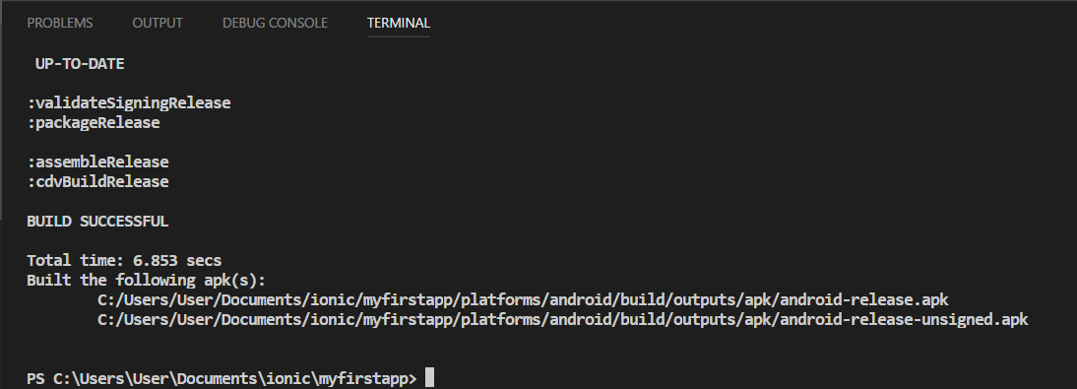
Create release APK command

Slide 24
Done !!!

Slide 25
References
https://play.google.com/apps/publish/signup/
http://www.oracle.com/technetwork/java/javase/downloads/index.html

Slide 26
Thank You !!

Slide 27
Survey
https://goo.gl/forms/dHckw8DN26biBNCz2

