Slide 1
IONIC
Hybrid Mobile Application Framework

Slide 2
SESSION 1
IONIC & BASIC COMPONENTS

Slide 3
INSTRUCTOR BACKGROUND
ABDUL QAYYUM BIN ISHAK
Dip. Computer Science, Ba. (Hons) Computer Science (Data Communication & Networking)
Software Engineer (Front-End iOS Developer)
Mpay Technologies Sdn. Bhd.
MOHAMMAD ASHRAF BIN JEFRIZIN
Dip. Computer Science, Ba. (Hons) Computer Science
Software Engineer (Full-stack Developer)
RapidBus Sdn. Bhd

Slide 4
OUTLINE
Introduction
Installation and Configuration
Building Simple Application
GUI and Component
Build with native component
Build Tally Counter App
Ionic Dashboard
APK Created

Slide 5
Introduction

Slide 6
SOFTWARE’S PLATFORM
Desktop Application
Website Application
Mobile Application

Slide 7
MOBILE APP’S STRUCTURE
FRONT-END + BACK-END = FULLSTACK DEVELOPMENT
API
DB
FRONT-END
BACK-END

Slide 8
MODAL-VIEW-CONTROLLER (MVC)
VIEW
MODAL
DB
CONTROLLER
View
Responsible for rendering of UI
Controller
Responsible to user input (action)
Instructing the Model to respond to the user input
Model
Responsible for storing and retrieving to DB

Slide 9
MODULE OVERVIEW
SCOPE
Windows OS
Android Package Kit (APK)
TOOLS
Node.js
Visual Studio Code
Android Studio
Ionic DevApp (playstore & applestore)

Slide 10
Installation and Configuration

Slide 11
Installation
Node.js
Visual Studio Code
Android Studio

Slide 12
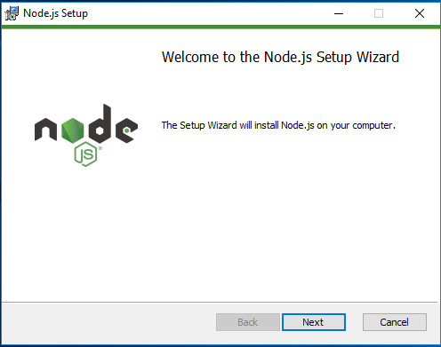
Node.js

Slide 13
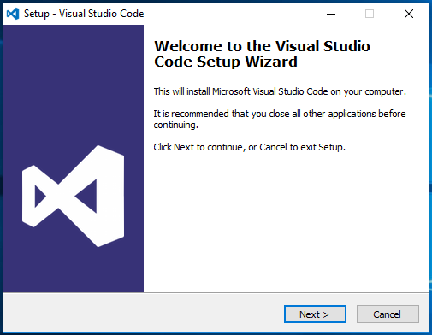
Visual Studio Code

Slide 14
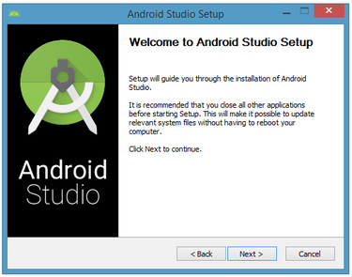
Android Studio

Slide 15
Configuration
Create folder “ionic” at Documents
Open VSCode
Open integrated terminal
Ionic installation
Change directory file
Ionic Template
Ionic Build Outline

Slide 16
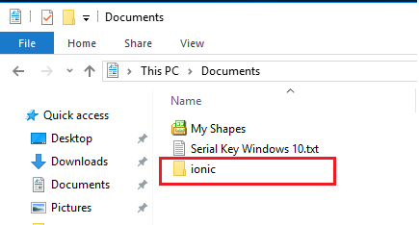
Create folder “ionic” at Documents

Slide 17
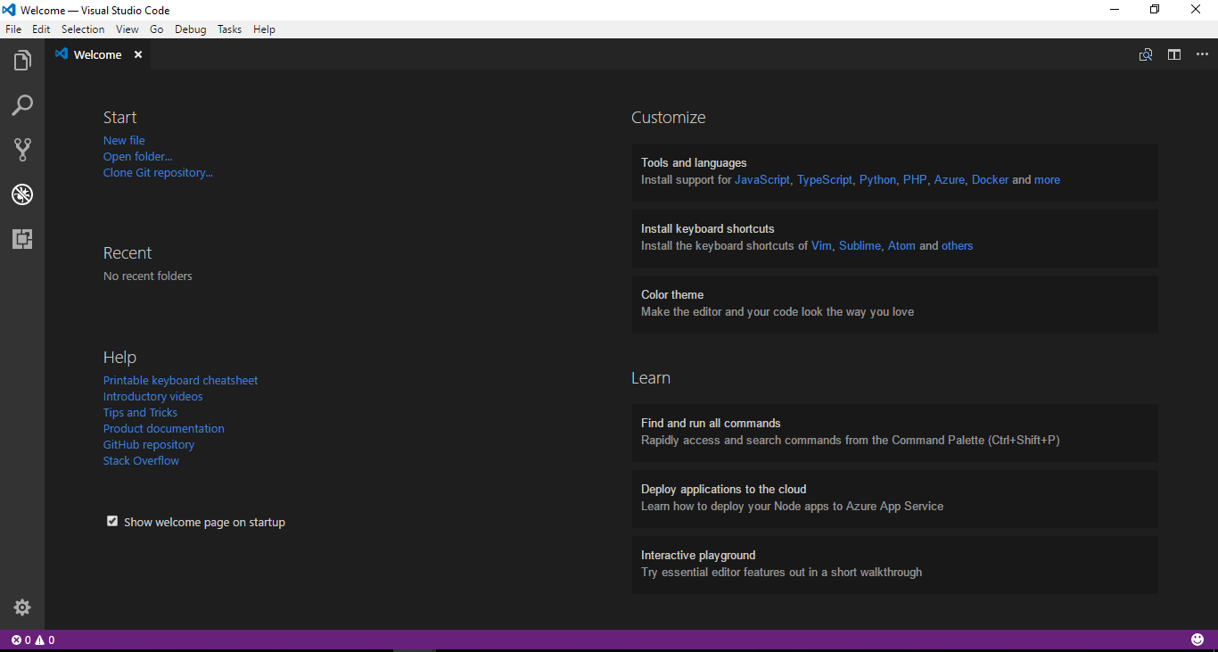
Open VSCode

Slide 18
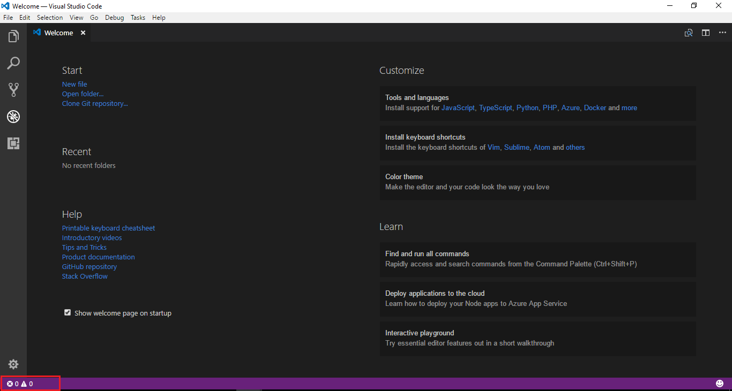
Open integrated terminal
Click here !

Slide 19
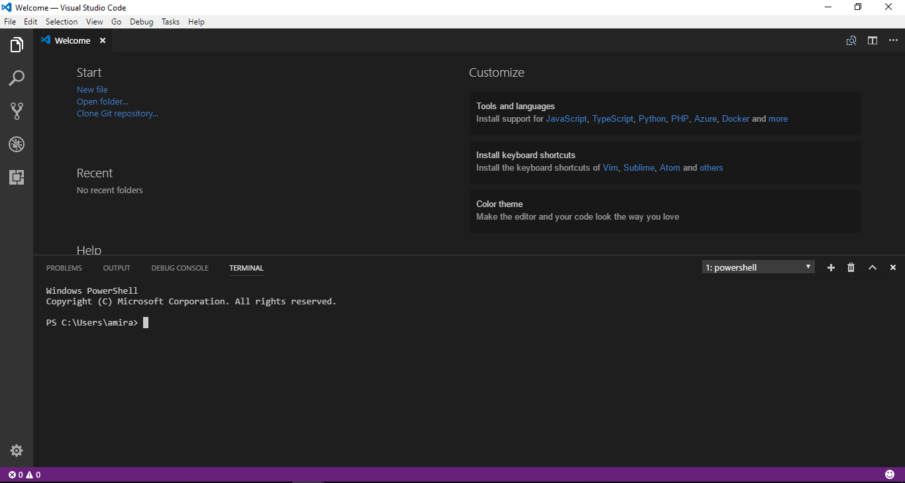
Integrated Terminal

Slide 20
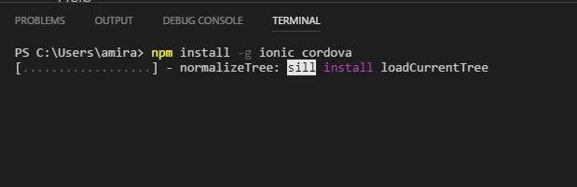
Ionic installation
C:\Users\Username>npm install -g ionic cordova

Slide 21
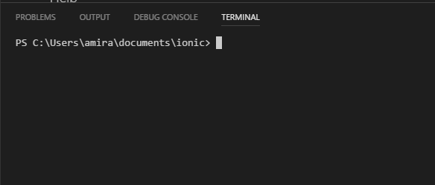
Change directory file
C:\Users\Username\Documents>cd ionic
C:\Users\Username\Documents\ionic>

Slide 22
Ionic Template
Blank App
Tab App
Menu App
C:\Users\Username\Documents\ionic>ionic start “app-name” blank -v3
C:\Users\Username\Documents\ionic>ionic start “app-name” tabs -v3
C:\Users\Username\Documents\ionic>ionic start “app-name” sidemenu -v3

Slide 23
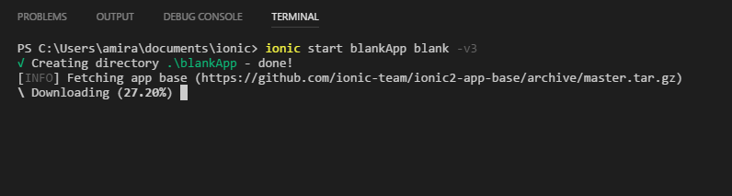
Blank App Template

Slide 24
Start Run Apps
C:\Users\Username\Documents\ionic>cd “app-name”
C:\Users\Username\Documents\ionic\app-name>ionic serve
C:\Users\Username\Documents\ionic\app-name>ionic serve -l
C:\Users\Username\Documents\ionic\app-name>ionic serve -c

Slide 25
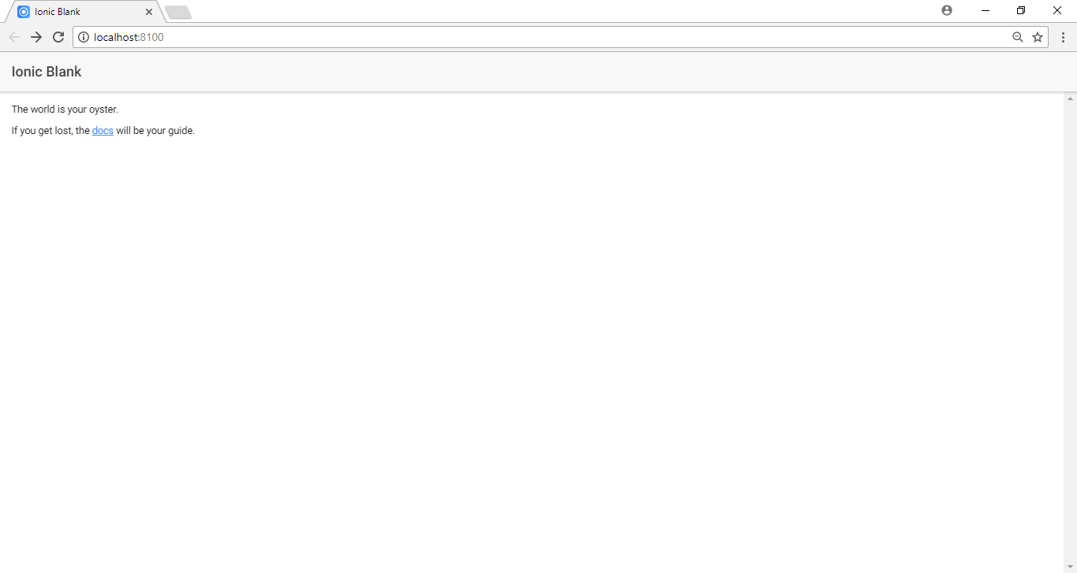
Ionic serve

Slide 26
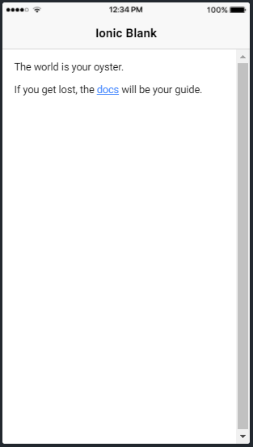
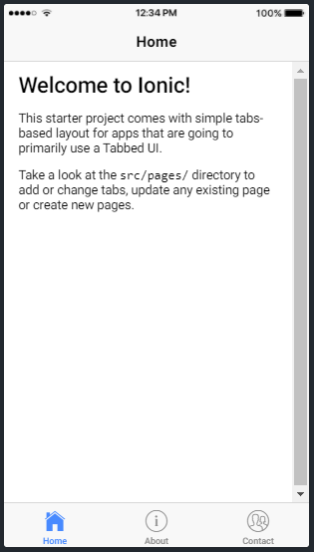
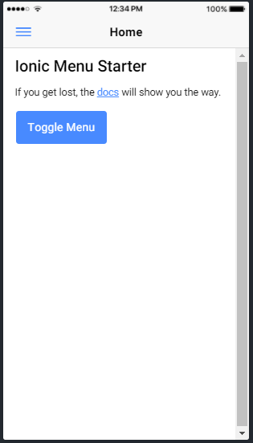
Ionic serve -l

Slide 27
Building Simple Application
GUI and Component
Build with native component
Build Tally Counter App

Slide 28
GUI and Component
Basic Card
Header Card
List Card
Icon
Image
Button
Add new page
Redirect to new page
Input type
Redirect to new page with data
View App using ionic DevApp

Slide 29
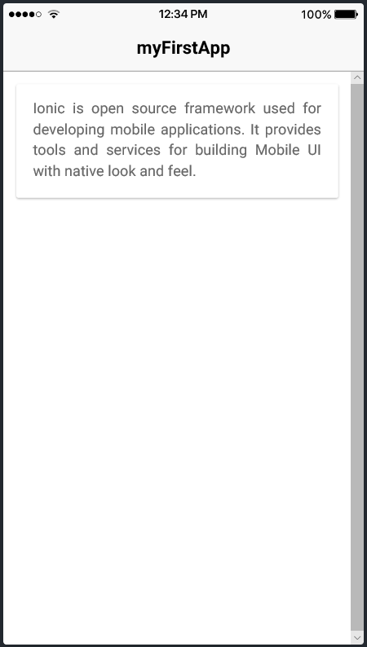
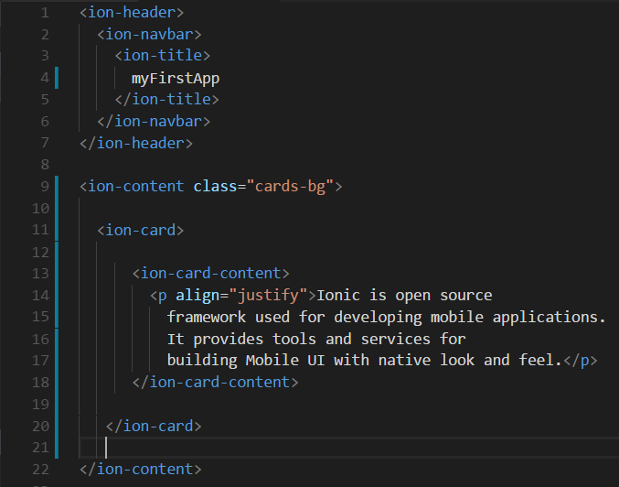
Basic Card

Slide 30
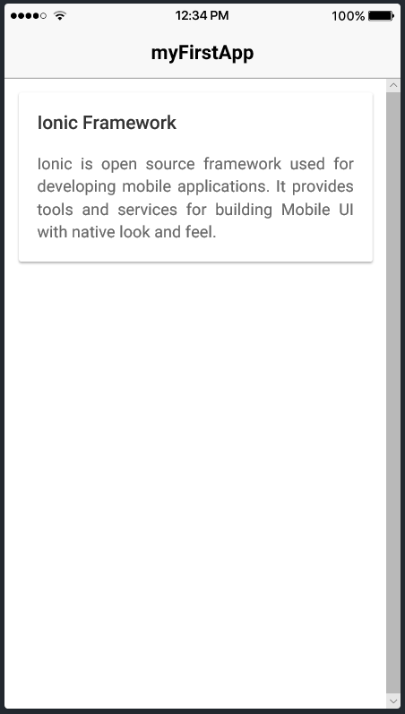
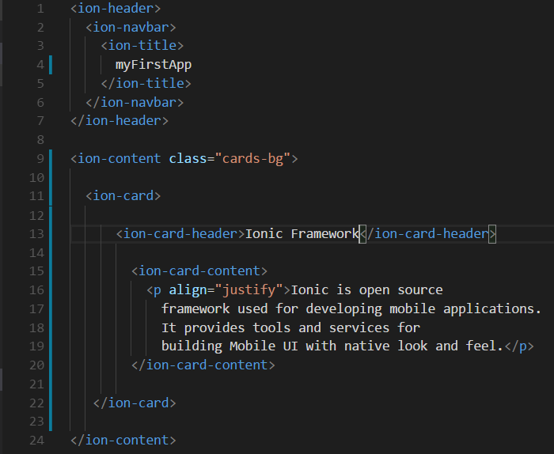
Header Card

Slide 31
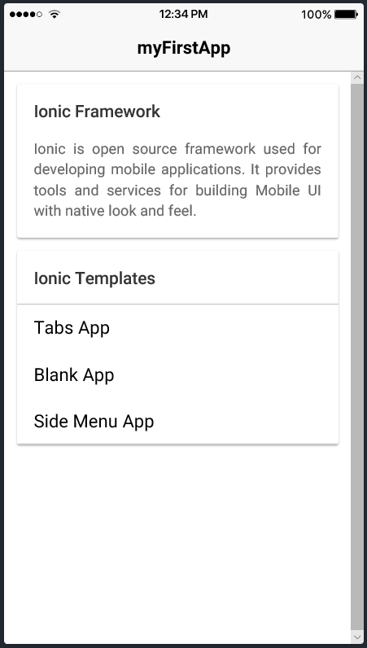
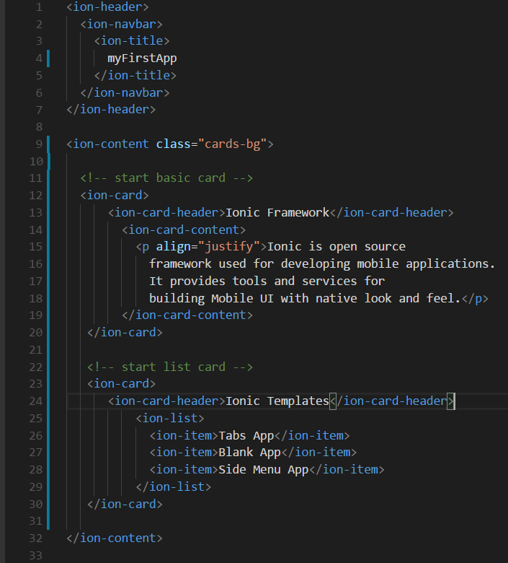
List Card

Slide 32
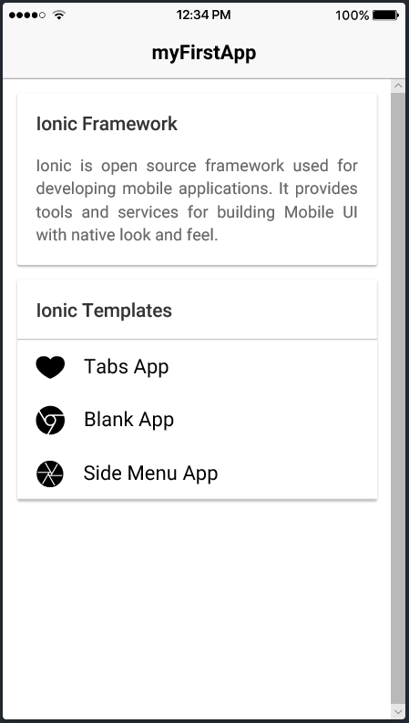
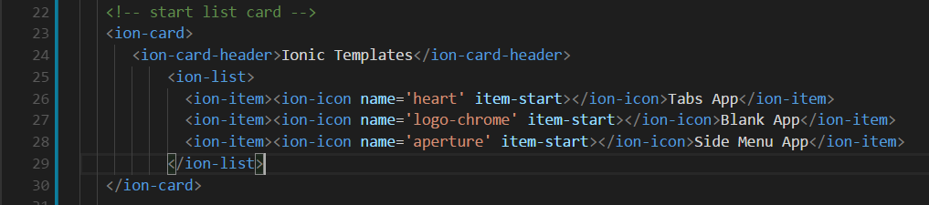
Icon
https://ionicframework.com/docs/ionicons/

Slide 33
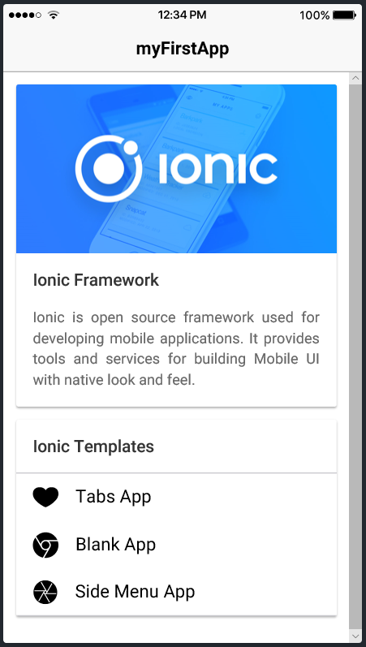
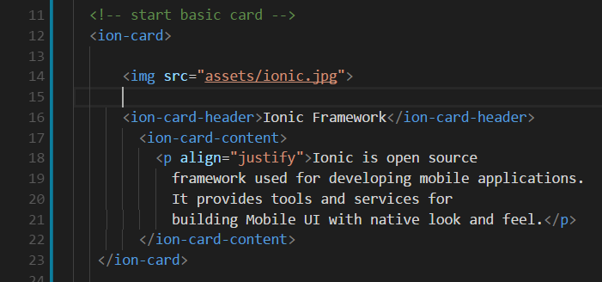
Image
C:\Users\User\Documents\ionic\myFirstApp\src\assets

Slide 34
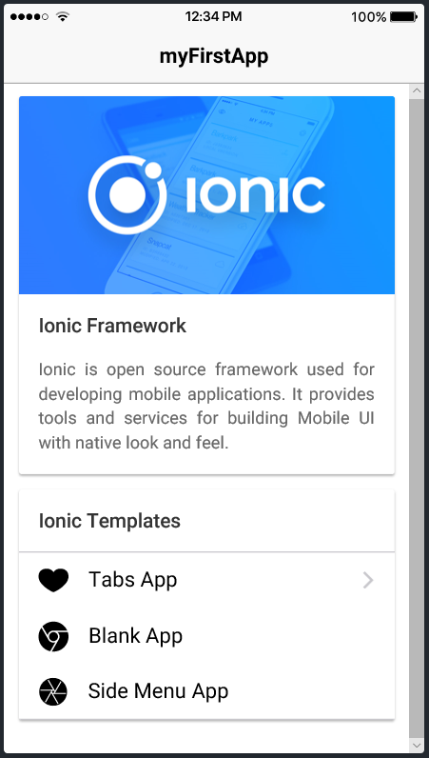
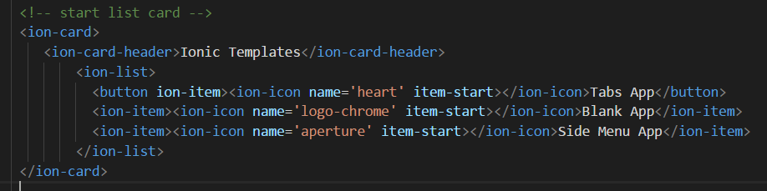
Button
https://ionicframework.com/docs/components/#buttons

Slide 35
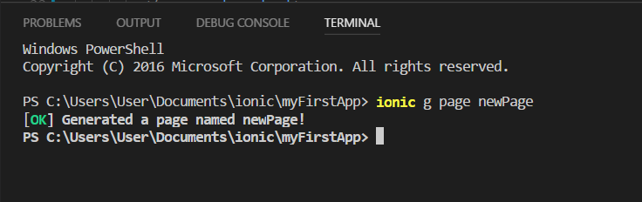
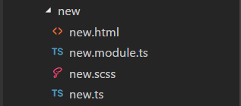
Add New Page
C:\Users\Username\Documents\ionic\myFirstApp>ionic g page <new-name-page>

Slide 36
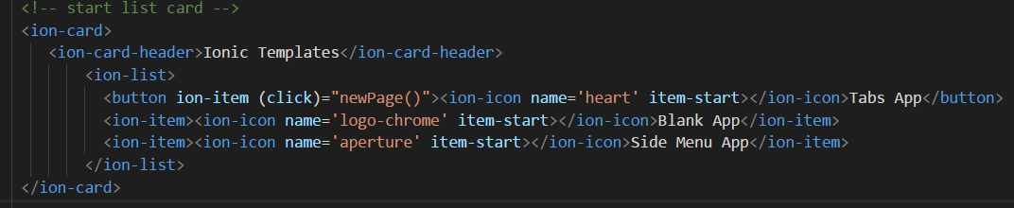
Redirect to New Page
Add link function
<button ion-item (click)="newPage()"><ion-icon name='heart' item-start></ion-icon>Tabs App</button>

Slide 37
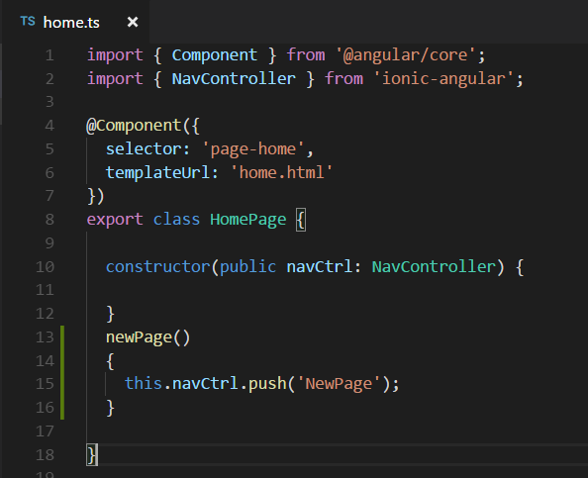
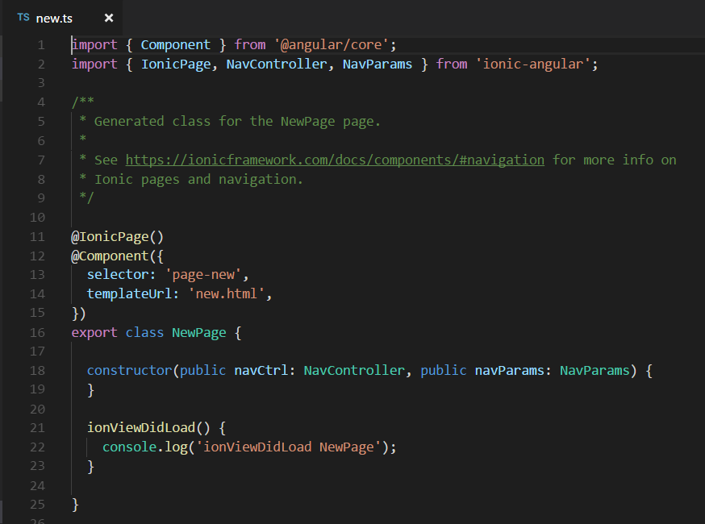
Redirect to New Page
Create function at home.ts
newPage()

Slide 38
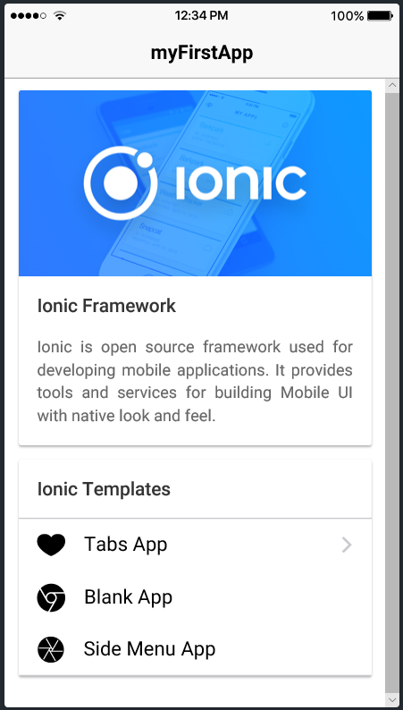
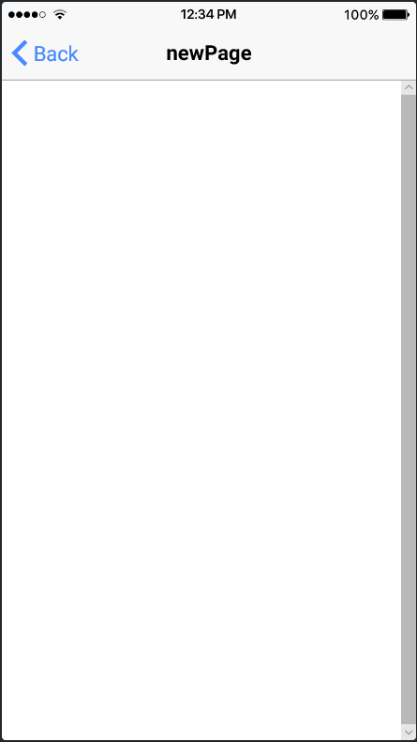
Redirect to New Page
Click here

Slide 39
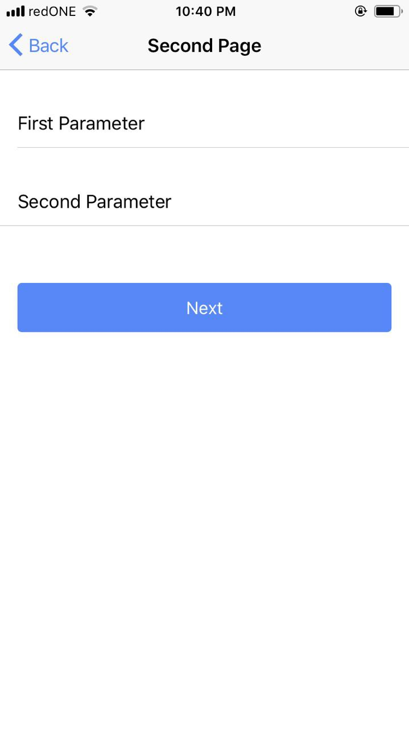
Input type

Slide 40
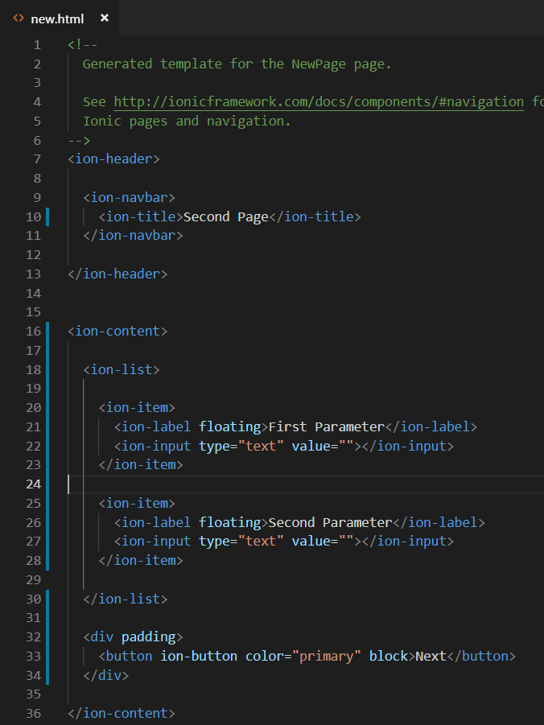
Input type

Slide 41
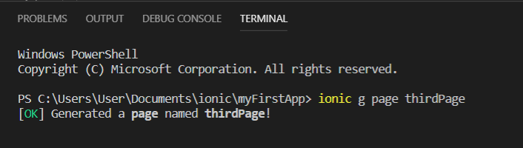
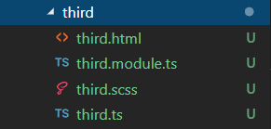
Redirect to New Page with data
Create Third Page

Slide 42
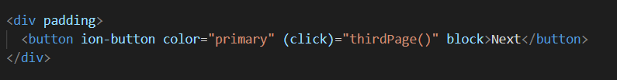
Redirect to New Page with data
Redirect second page to third page

Slide 43
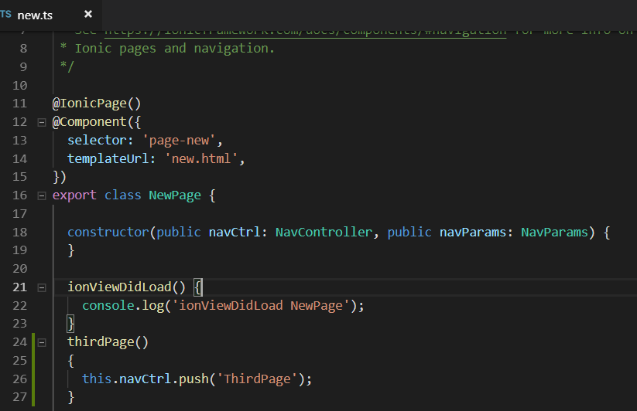
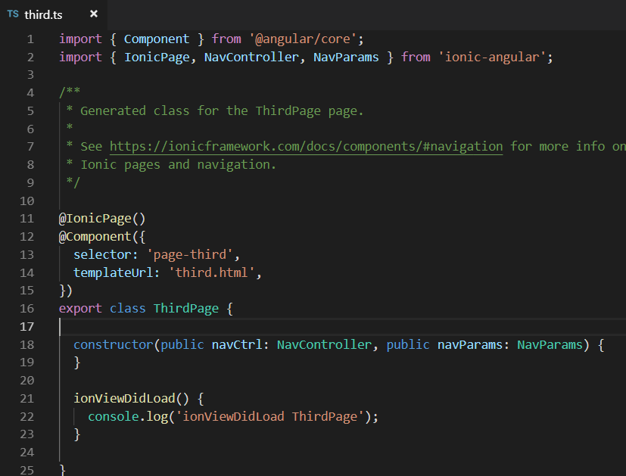
Redirect to New Page with data

Slide 44
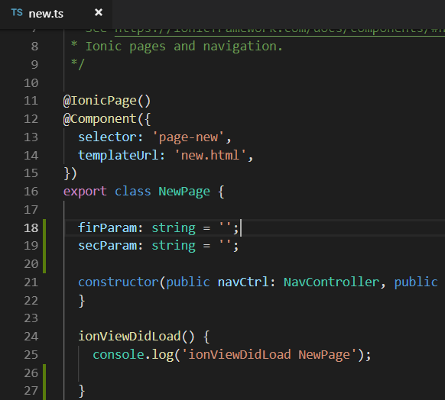
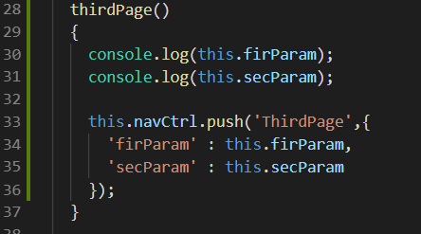
Redirect to New Page with data
Add variable to new.ts
Edit thirdPage function

Slide 45
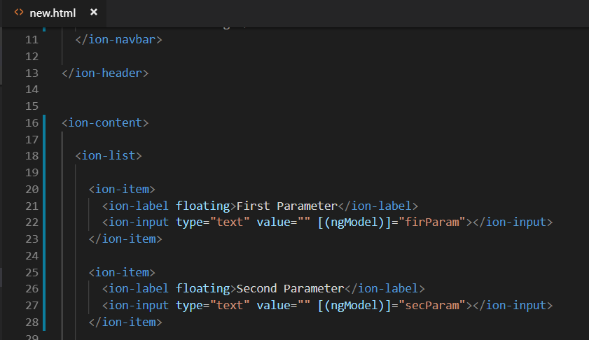
Redirect to New Page with data
Add variable to new.html

Slide 46
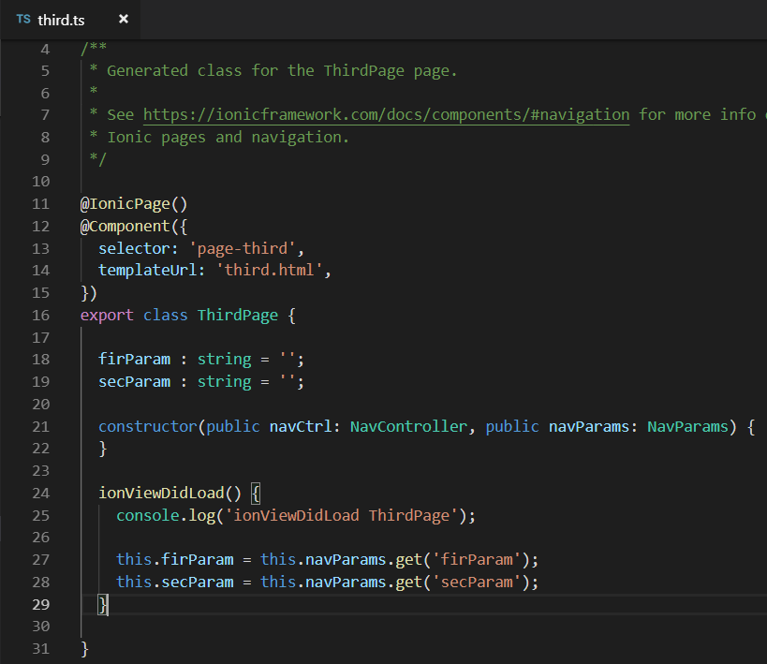
Redirect to New Page with data
Edit third.ts

Slide 47
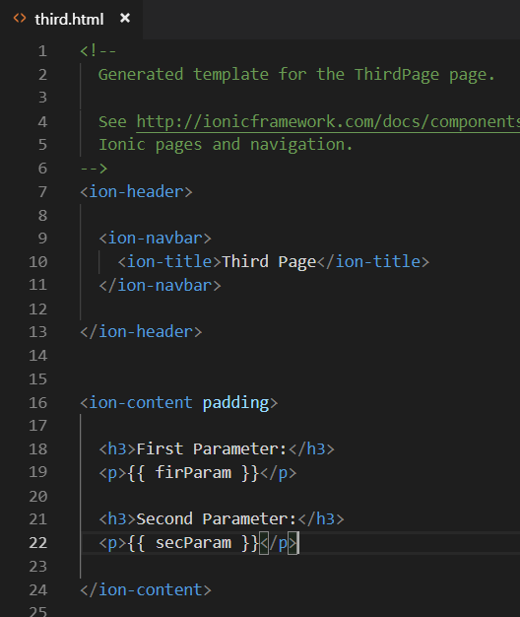
Redirect to New Page with data
Edit third.html

Slide 48
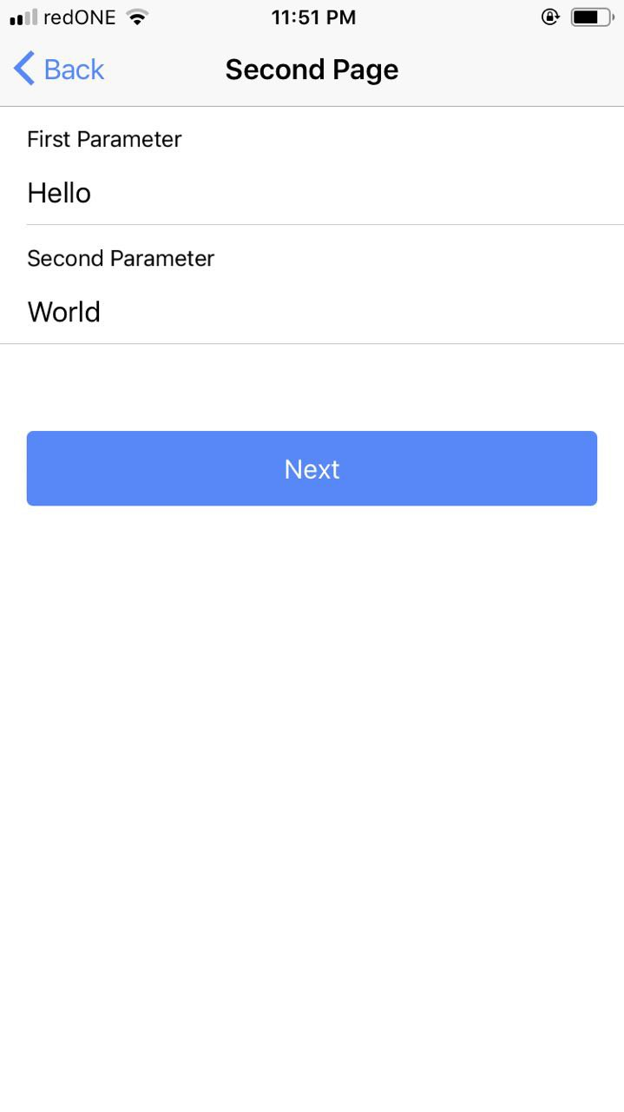
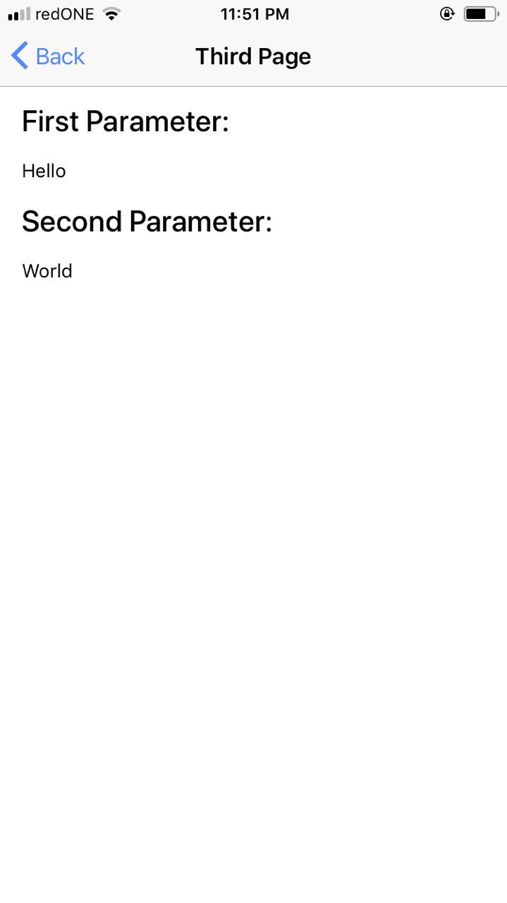
Redirect to New Page with data

Slide 49
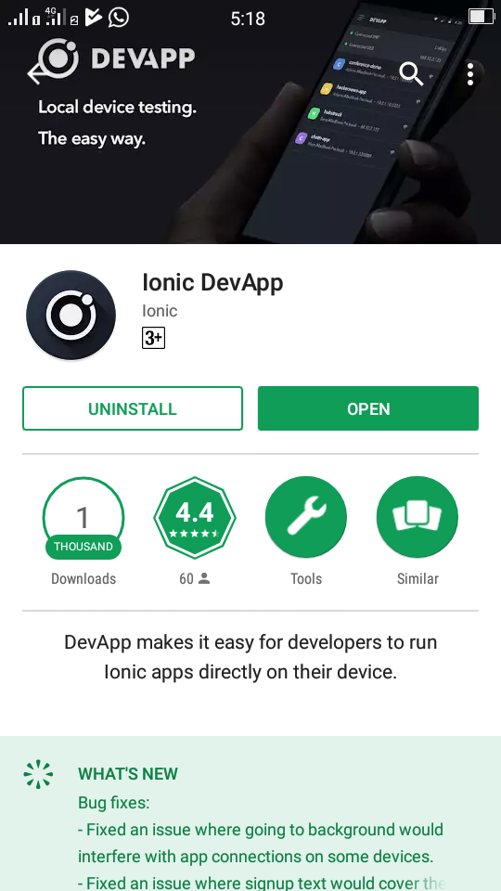
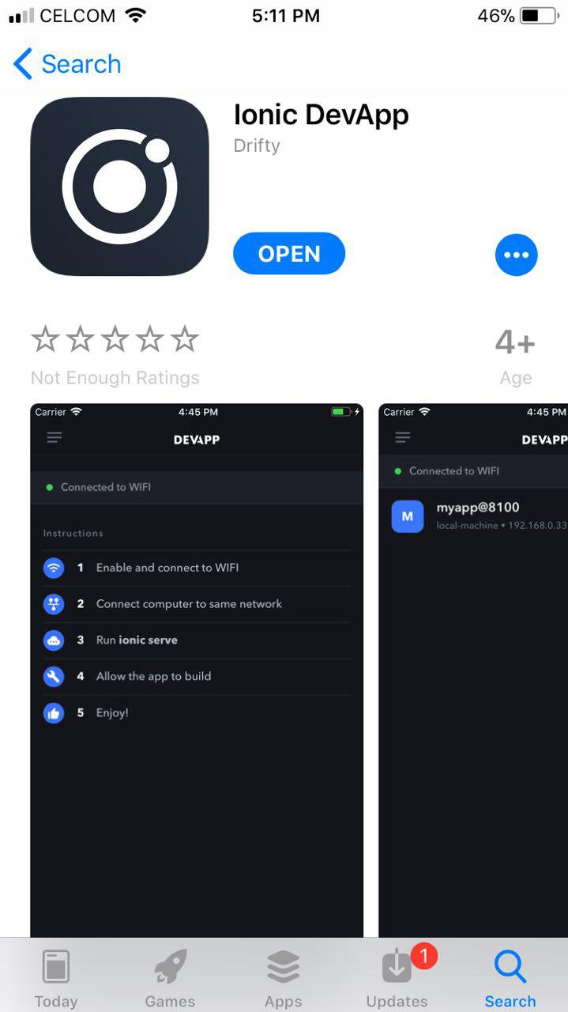
View App using ionic DevApp

Slide 50
Ionic DevApp
Start DevApp
Connect with the same network
Run command: ionic serve -c

Slide 51
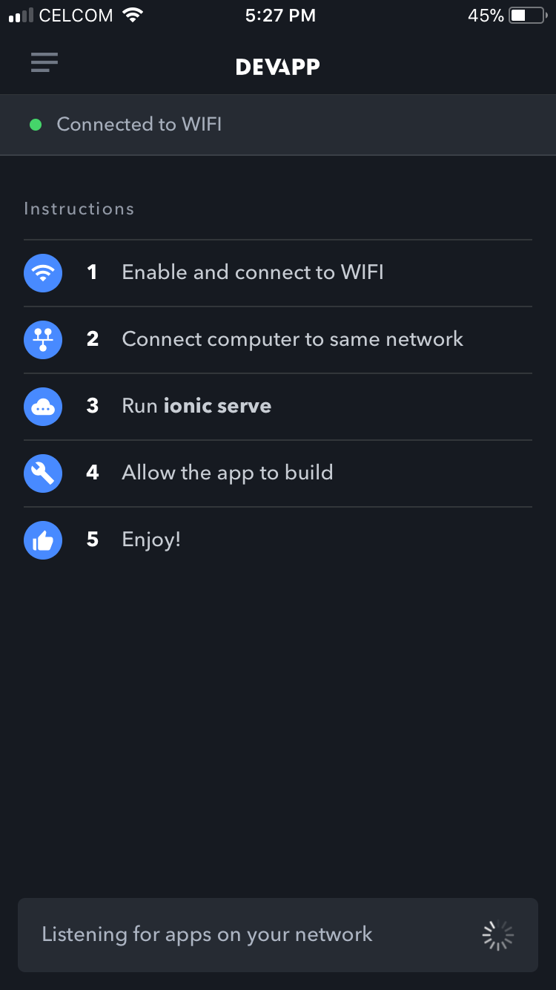

Ionic DevApp

Slide 52


Ionic DevApp

Slide 53
Exercise 1
Design static page for your cv / resume profile
Template: blank page
Information
Bio: name, email, contact number, social link
Education
Career Profile
Experiences
Skills

