Slide 1
CUDA-based PRISM REFRACTION SEARCH
A novel physics-based metaheuristic optimization algorithm
U22CS060
Shashank Thakur

Slide 2
Introduction

Slide 3
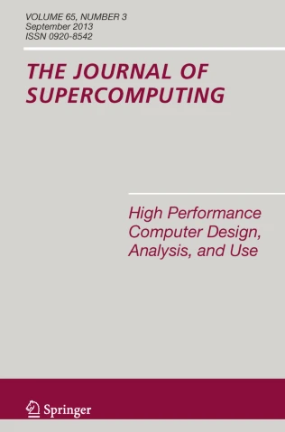

https://doi.org/10.1007/s11227-023-05790-3

Slide 4
Brief Description
Physics-based metaheuristic single-solution optimization algorithm
Models how light interacts with prisms
Solutions in search space are mapped to light ray angles
Calculate divergence of those angles as they pass through the prism
Minimizing the divergence minimizes the function to be optimized

Slide 5
Preliminaries

Slide 6
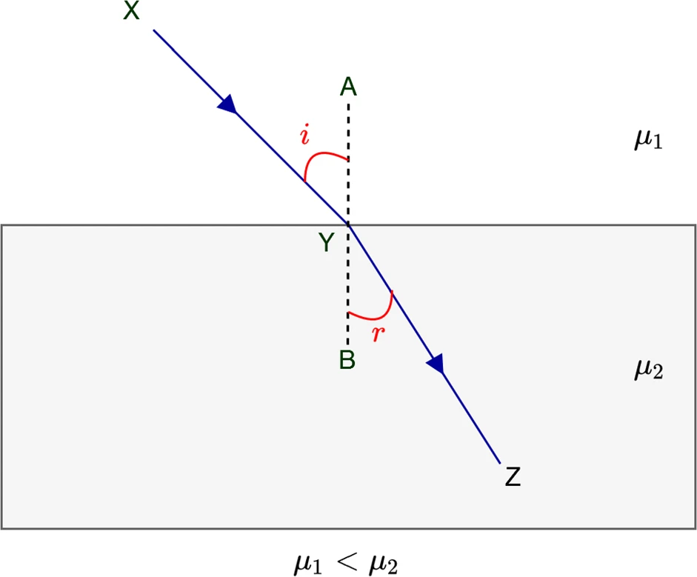


Slide 7
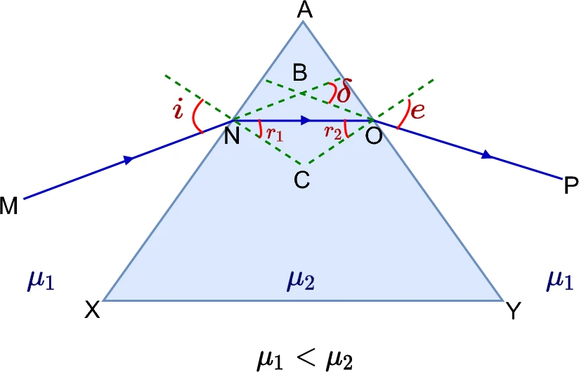



Slide 8
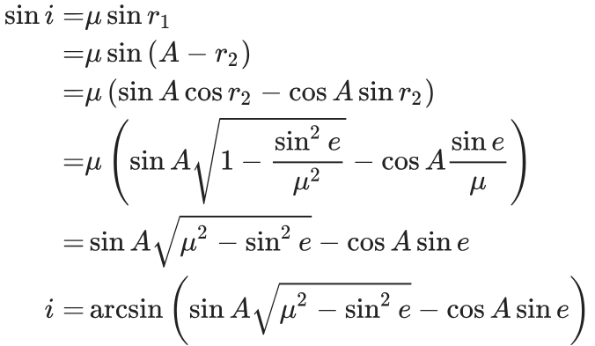

Slide 9
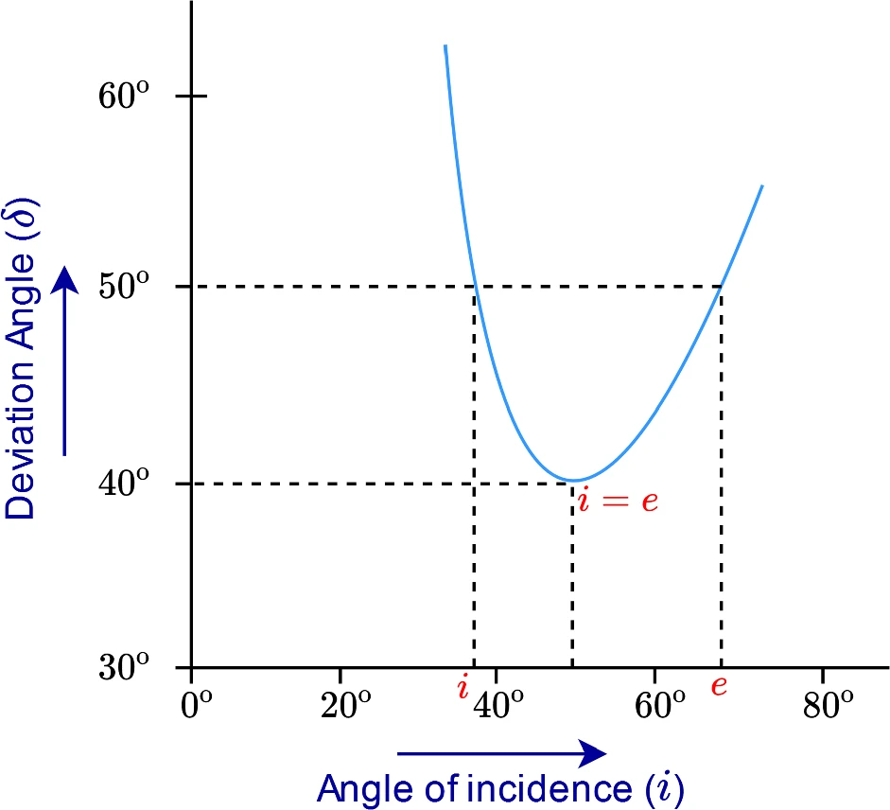

Slide 10
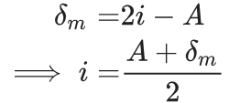
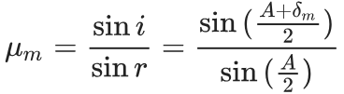

Slide 11
Proposed Algorithm

Slide 12
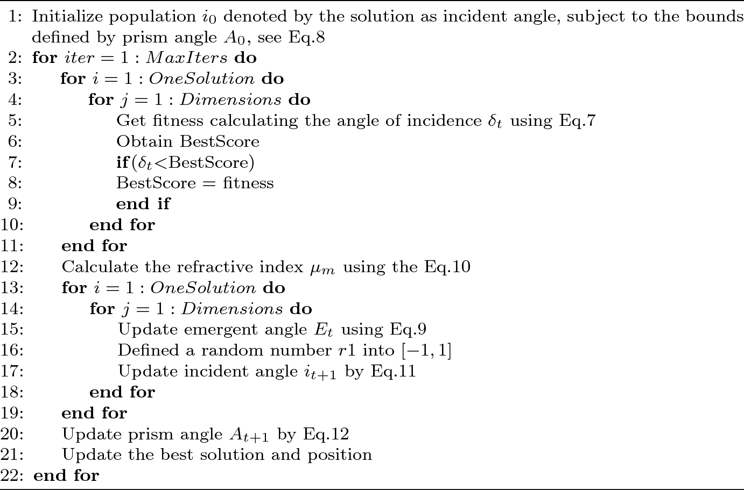

Slide 13

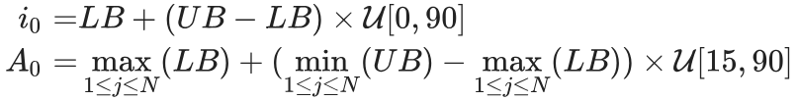

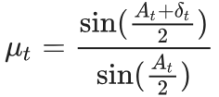
(7)
(8)
(9)
(10)

Slide 14

(11)
(12)

Slide 15
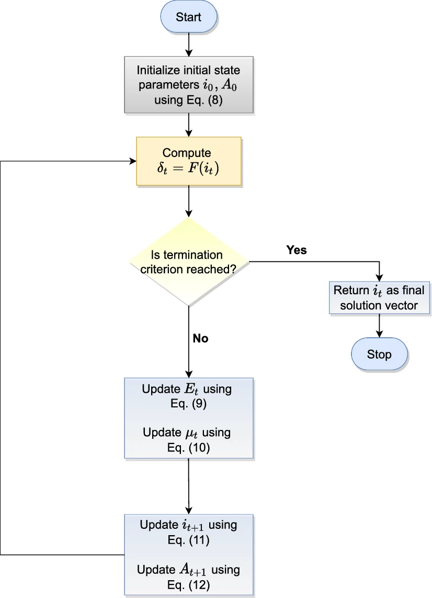

Slide 16
Time Complexity O(n x Population x MaxIter)
Space Complexity O(n x Population)

Slide 17
Benchmark Function

Slide 18

Rastrigin Function

Slide 19
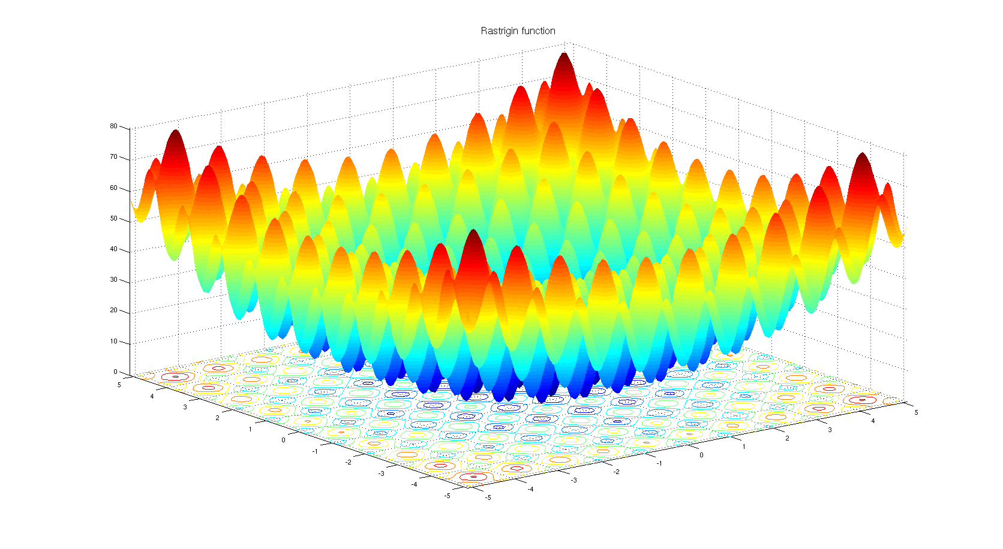

Slide 20
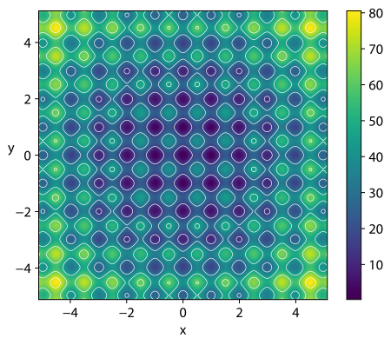

Slide 21
Performance of CPU-based PRS

Slide 22
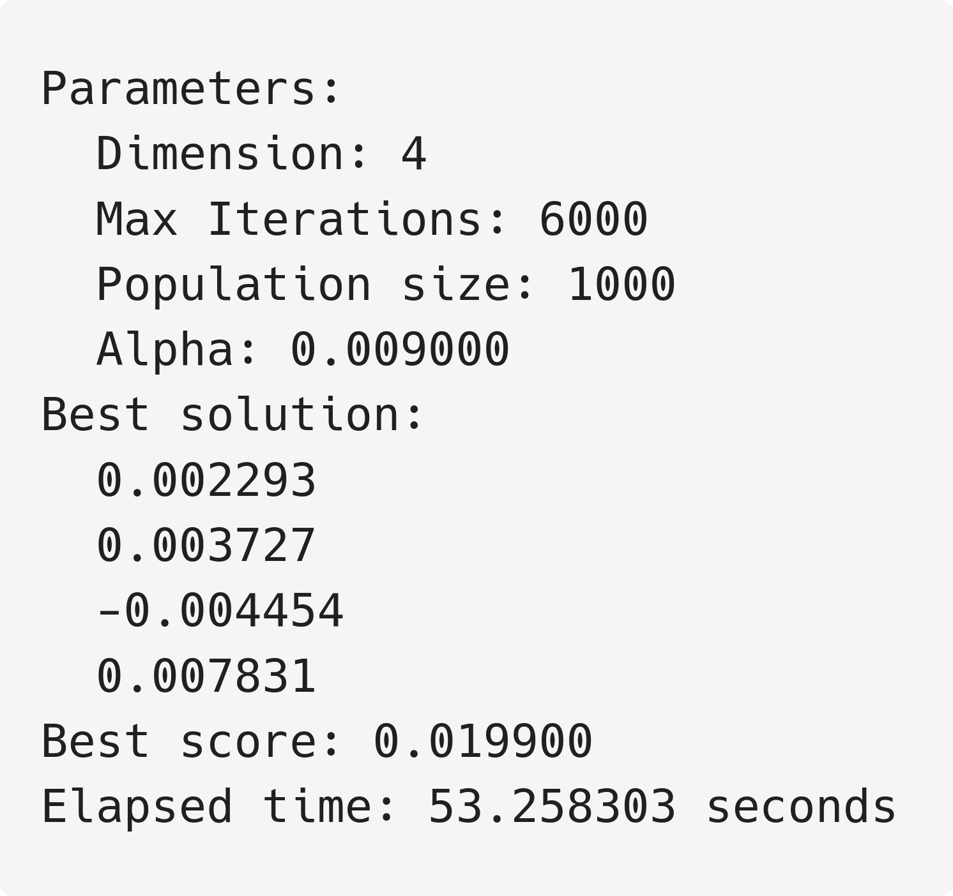

Slide 23
Accelerating with CUDA

Slide 28
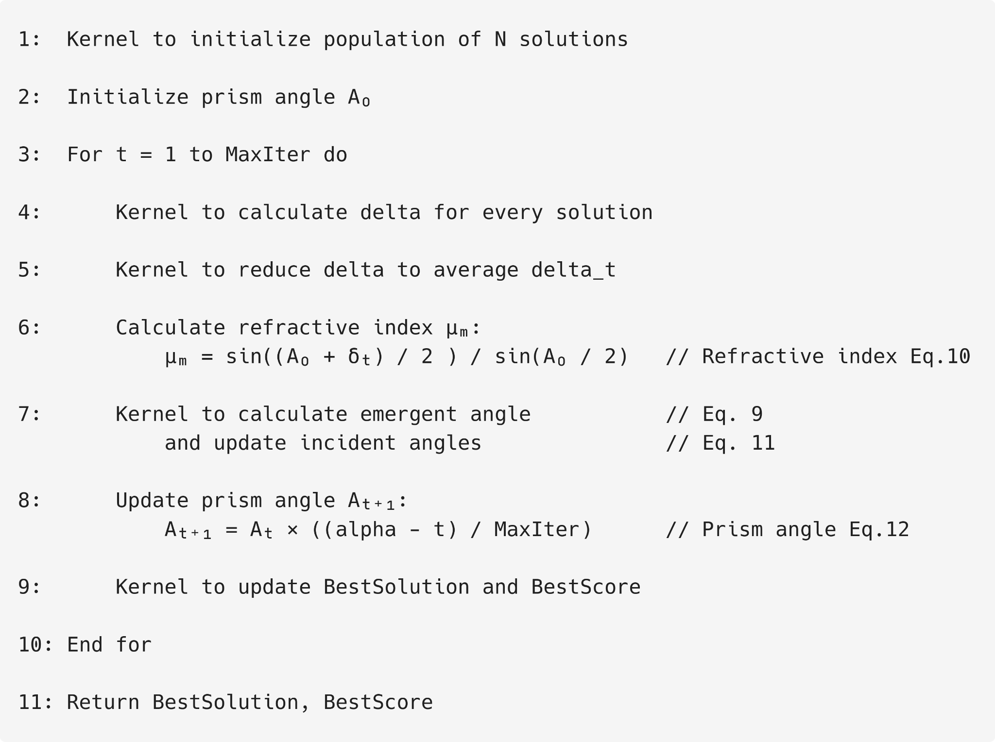

Slide 29
Performance of CUDA-based PRS

Slide 30
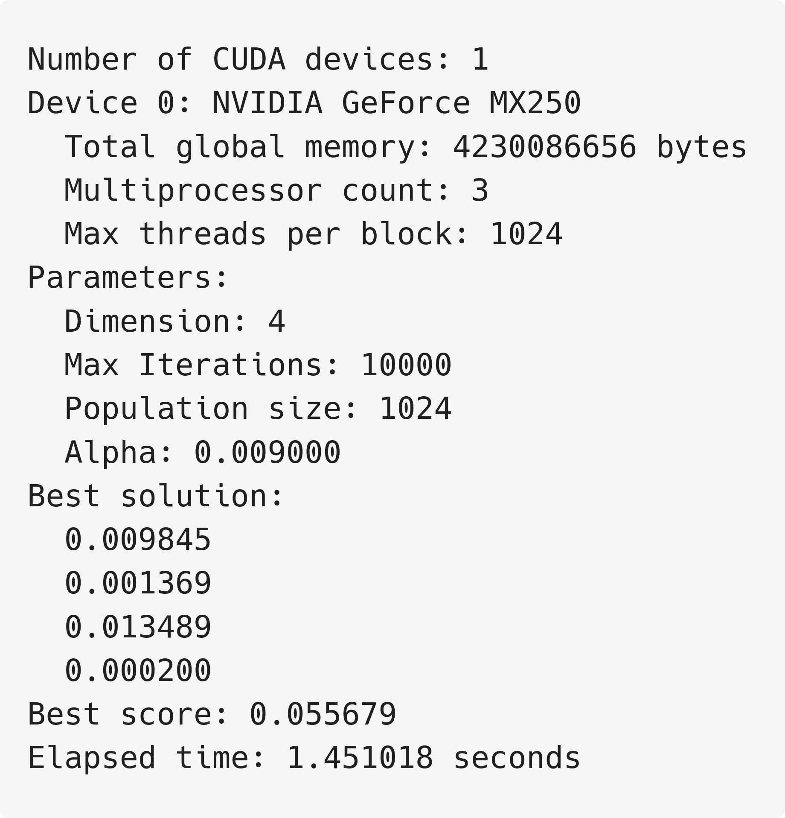

Slide 31
Comparison

Slide 32
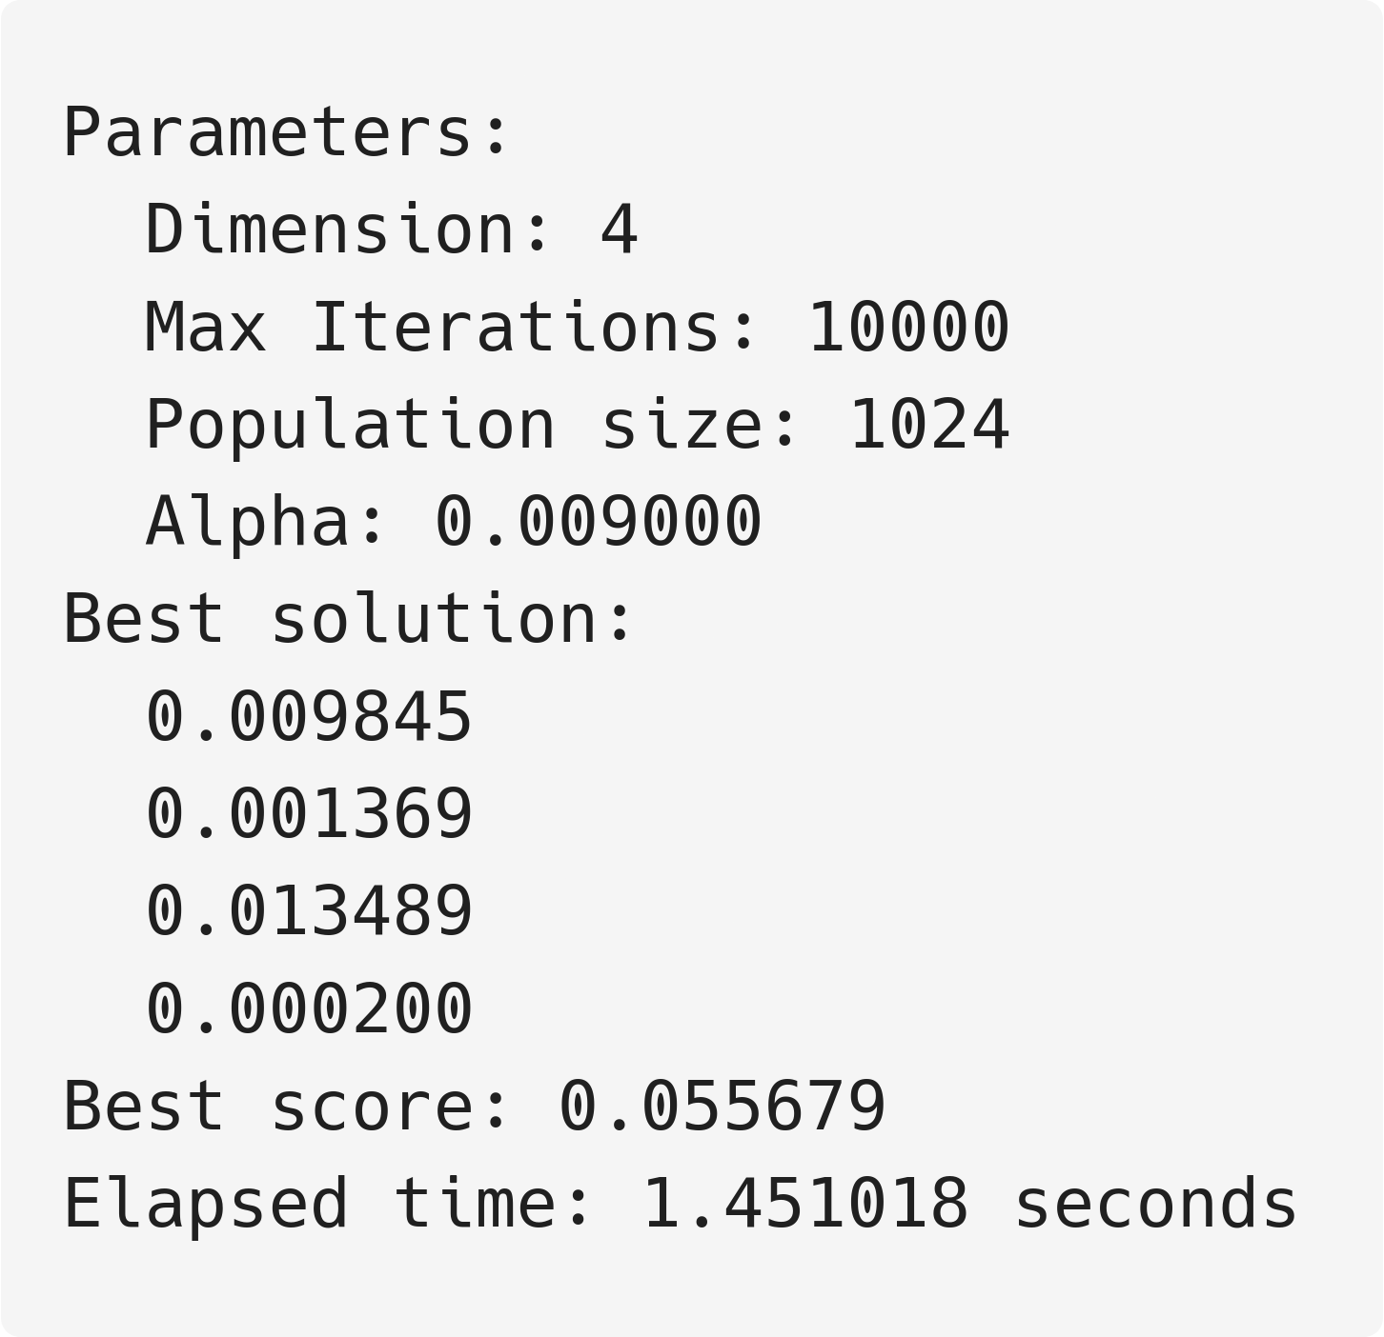
CPU CUDA

Slide 33
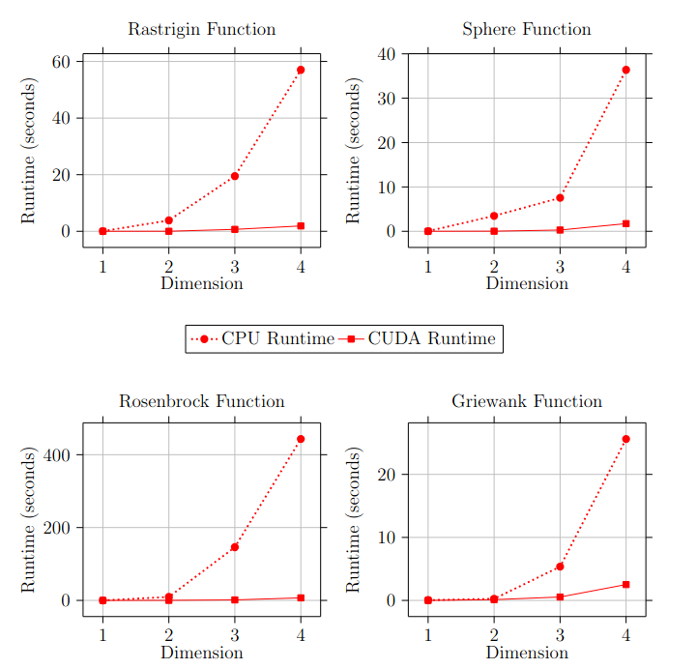

Slide 34
Conclusion

Slide 35
Comparison
CUDA PRS performed significantly faster while processing a higher number of iterations (~40 x speedup)
CUDA processed every solution and (solution, component) pair independently

Slide 36
Algorithm
The algorithm is mainly an exploitative algorithm
Most of the exploration is being done by generating uniformly generated random angles, spread out evenly in the search space
This algorithm should be used in combination with other algorithms that are good at exploring the search to narrow down a possible solution region
PRS exploits the region to find optima

Slide 37
Limitations of my Implementation
CUDA cuRAND random number generator
Some random numbers are generated in a very small neighborhood, creating a pattern of similarity
Exploration aspect of this algorithm is hurt
XORWOW and Philox states for generating random numbers
Flattening a 2D array to a 1D array to allocate memory on the GPU
Memory coalescence for faster memory access

Slide 38
END

