Slide 1
Shooting in the NBA
An exploration and analysis of the various shot-types in modern basketball
Xhoi Shyti – DSC 530

Slide 2
Context
The evolution of shooting in the NBA is a journey that mirrors the sport’s growth from its early days to the dynamic and high-scoring spectacle we watch on TV. From the cautious set-shots in the early days, to the breathtaking displays of long-range marksmanship, the art of shooting has undergone a remarkable transformation that reflects advancements in technique, athleticism, and strategic prowess. For better or worse (depending on who you ask), the three-pointer has revolutionized strategies, player roles, and the overall dynamics of the sport.
The purpose of this research analysis is to quantify the relationship between a team’s shooting success and their chances of winning. If we consider the target to be the probability of winning, we can then use shooting metrics around 3-pointers, 2-pointers, and free throws as predictors to evaluate this probability. We can quantify this by creating a logistic regression model. The target would be winning vs losing, and the predictors would be the various shooting metrics. Once we have created this model, we could then evaluate its accuracy by comparing its predictions against actual data. The coefficients of the predictors would emphasize which shots increase chances of winning over other kinds of shots.
The results of this study would be most useful to owners, managers, and coaching staff. If the model proves to be accurate, then they could gain insight as to what kinds of strategies to employ in-game, what drills to focus on during practice, or what kinds of players to acquire.

Slide 3
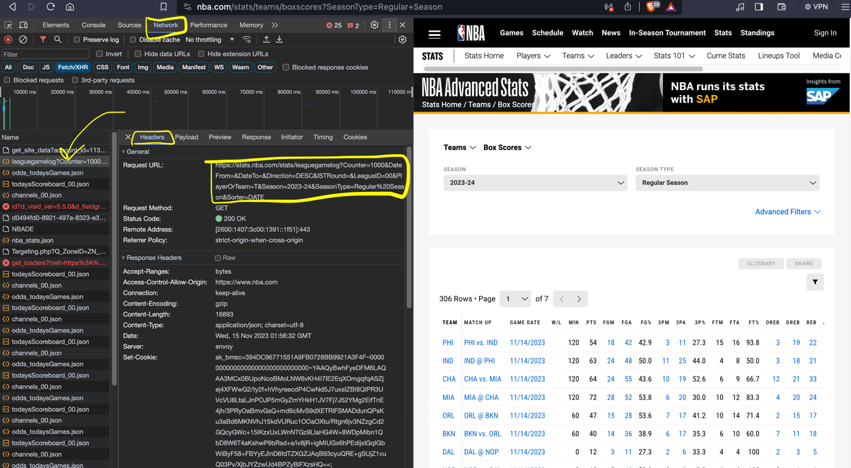
Data Collection
Data sourced from: https://www.nba.com/stats/teams/boxscores?SeasonType=Regular+Season
Unable to export the data directly from nba.com, so the approach that I devised was to programmatically get the JSON data from the nba endpoint, then write that data to a csv.

Slide 4
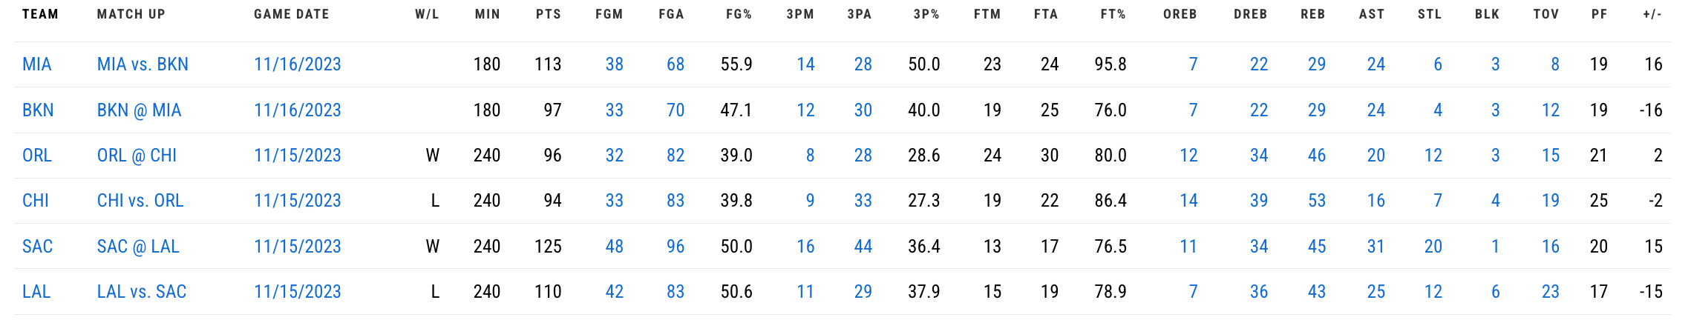
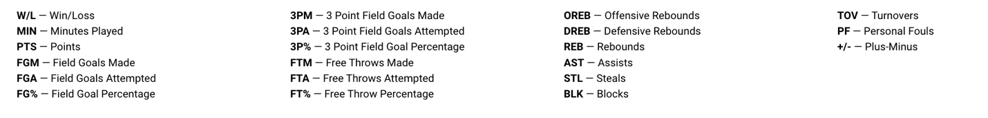
Data Collection cont.
Sample of source data
Each row or observation represents a single game played
Binary variable (W/L) is the outcome of the game, and it corresponds to the TEAM
Attached is a glossary for each variable considered

Slide 5
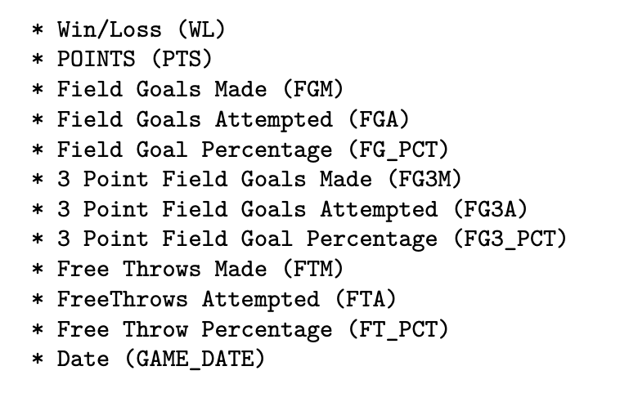
Variables to consider
This list contains variables which are necessary for the exploratory data analysis.
(DISCLAIMER) these variables are as they appear in the CSV, not as they appear in the previous screenshots
There might be some naming differences between the CSV and the website view

Slide 6
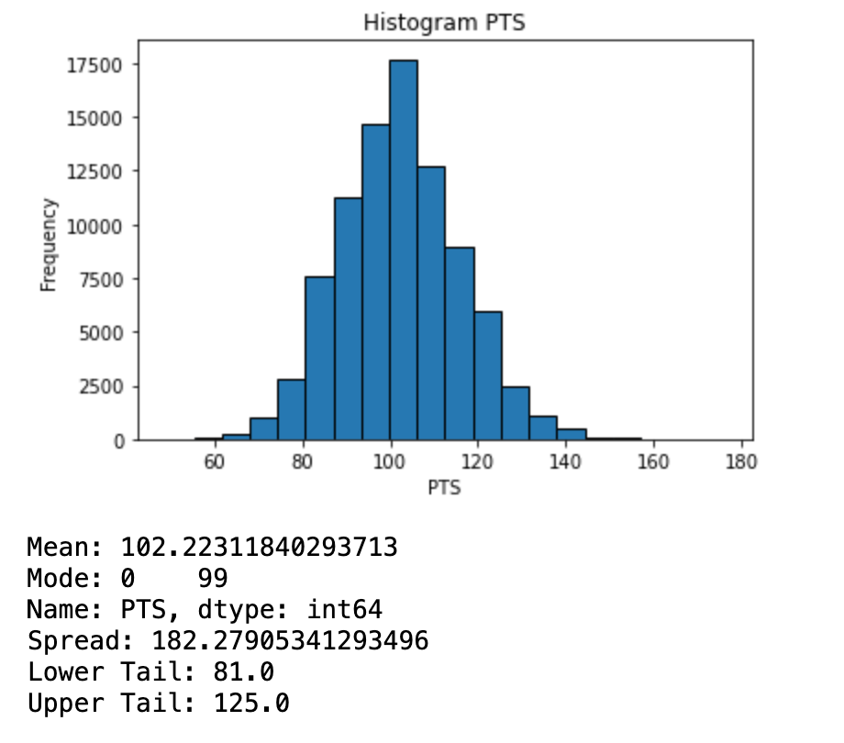
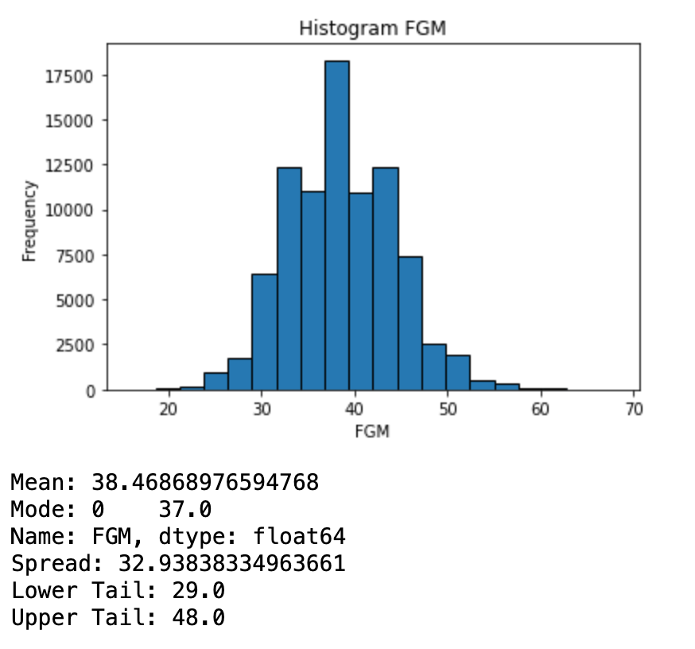
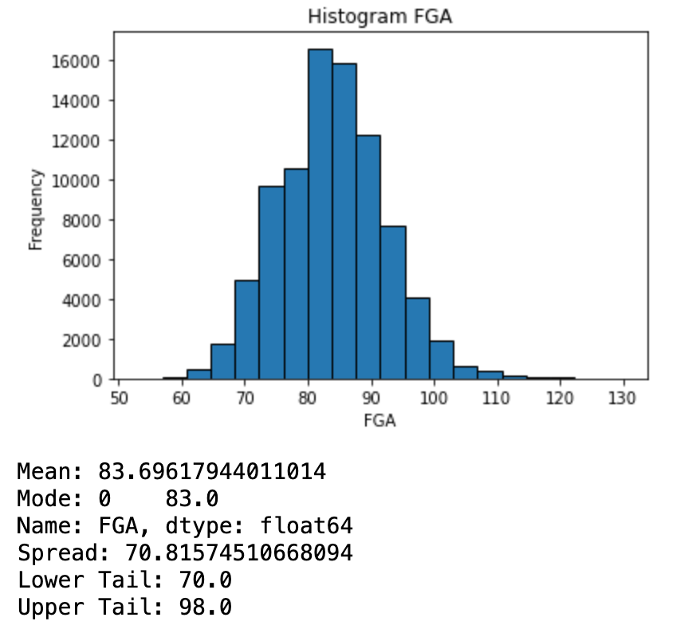
Histograms

Slide 7
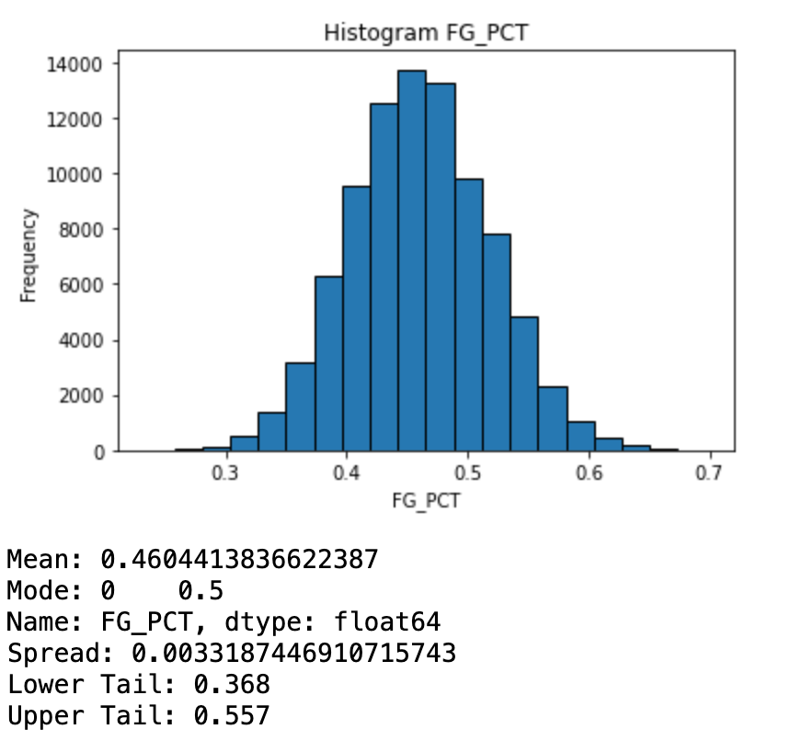
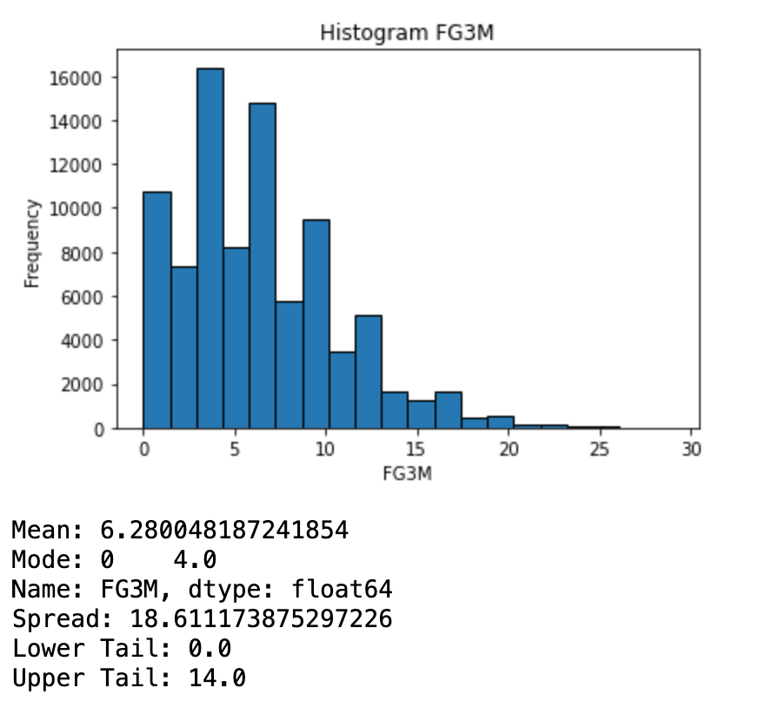
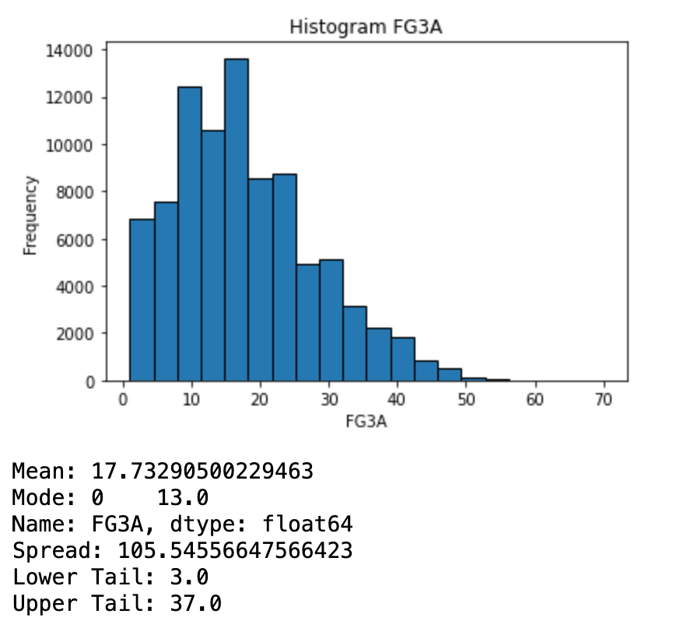
Histograms

Slide 8
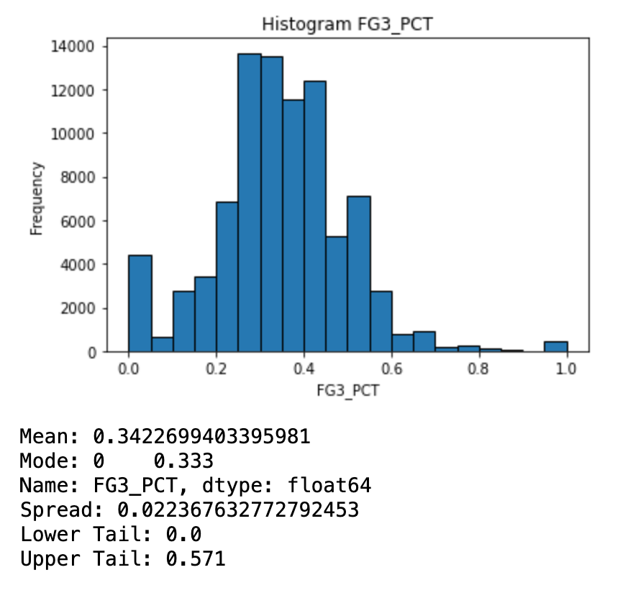
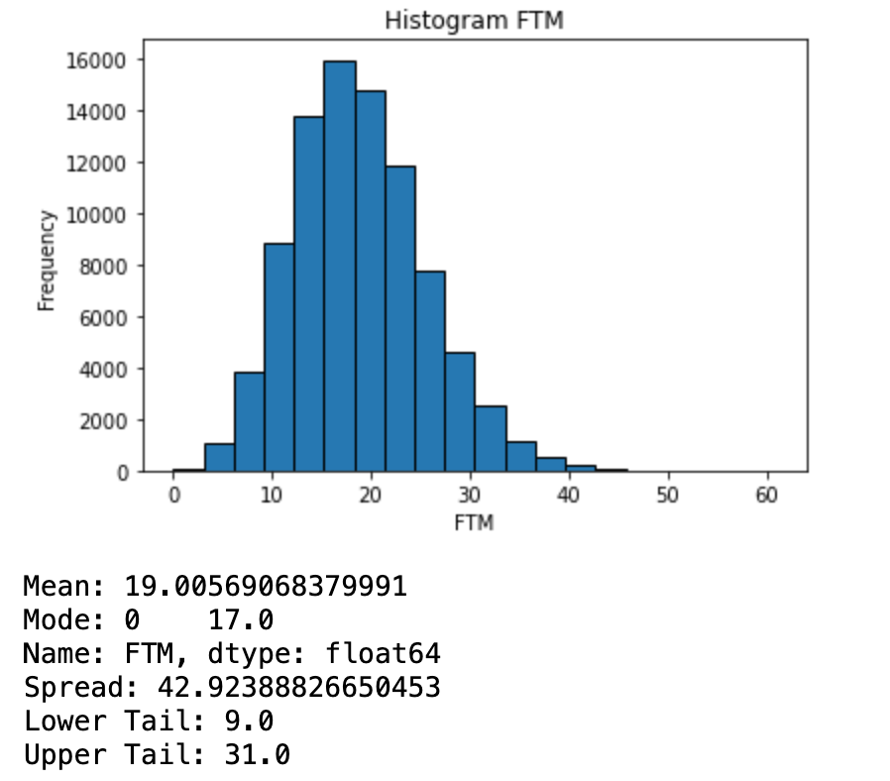
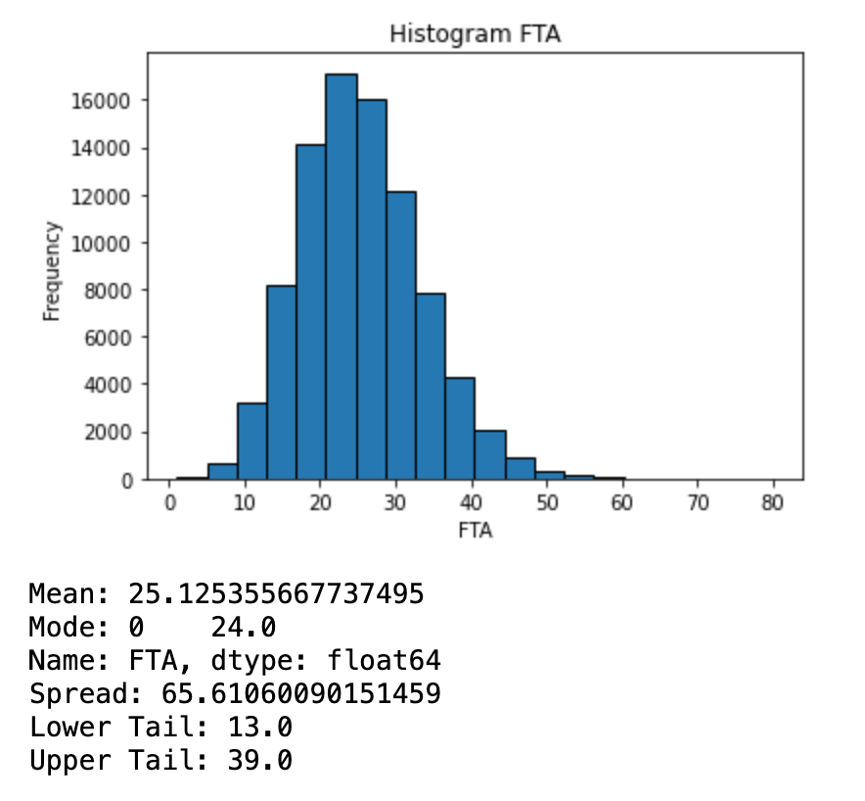
Histograms

Slide 9
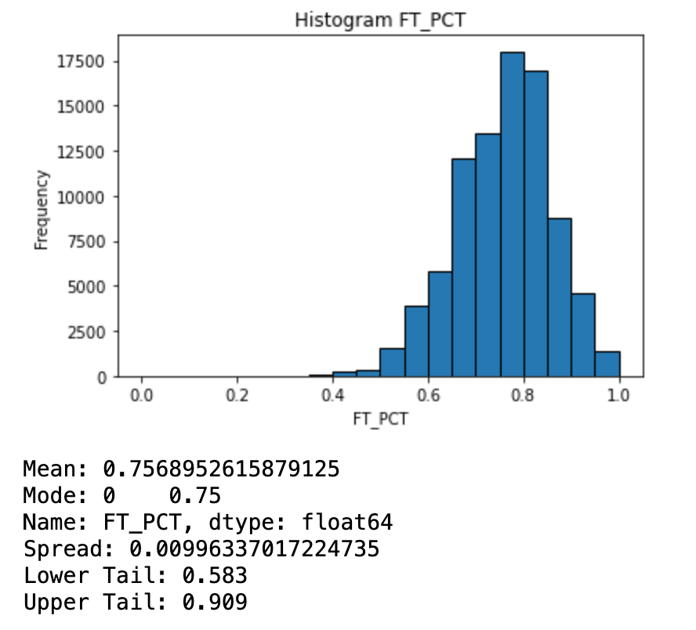
Histograms

Slide 10
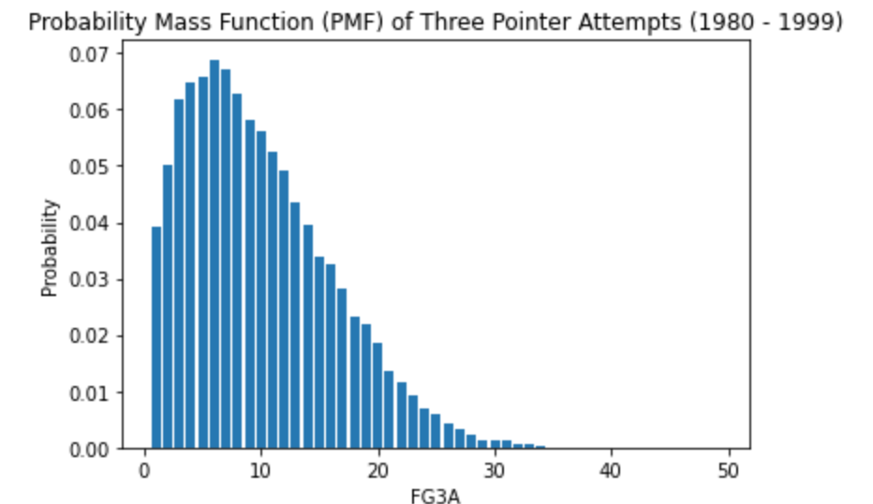
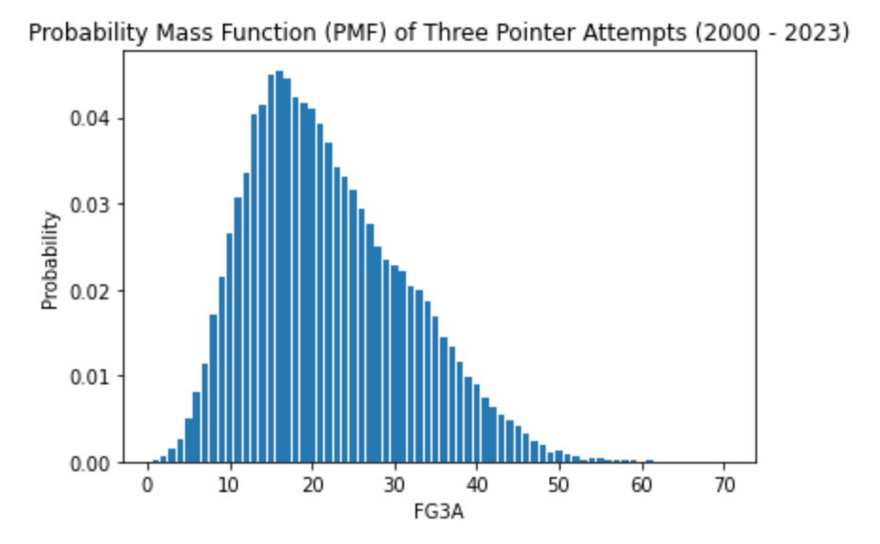
PMF Analysis of FG3A by year
1980 - 1999
2000 - 2023

Slide 11
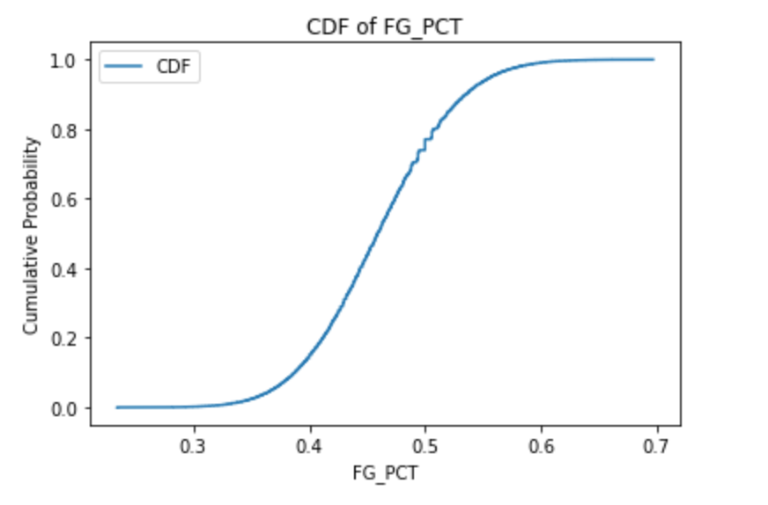
CDF Analysis of FG_PCT
Notes
The 50th percentile is between 45% and 50% field goal percentage
The curve is steeper between 40% and around 50%, and this tells us that most teams fall within this performance range of field goal percentage

Slide 12
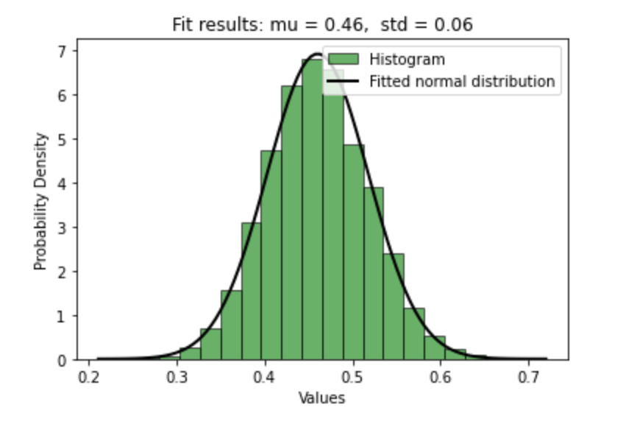
Fitting a curve – Normal distribution
Notes
We can see that the fitted normal distribution overlays quite nicely with the generic histogram.
This tells us that the data distribution is that of a normal distribution for FG_PCT

Slide 13
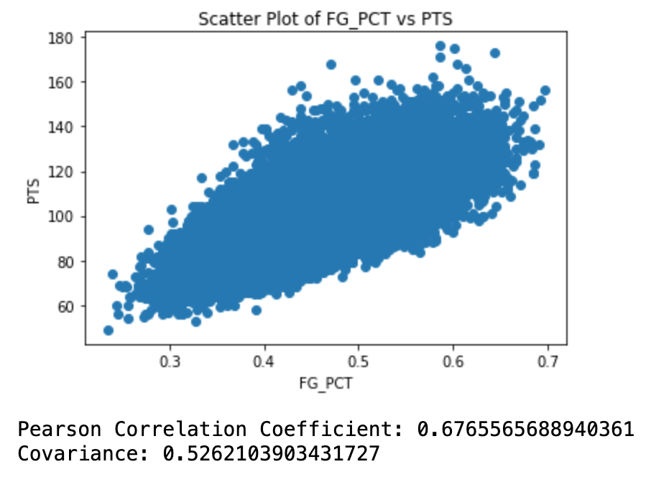
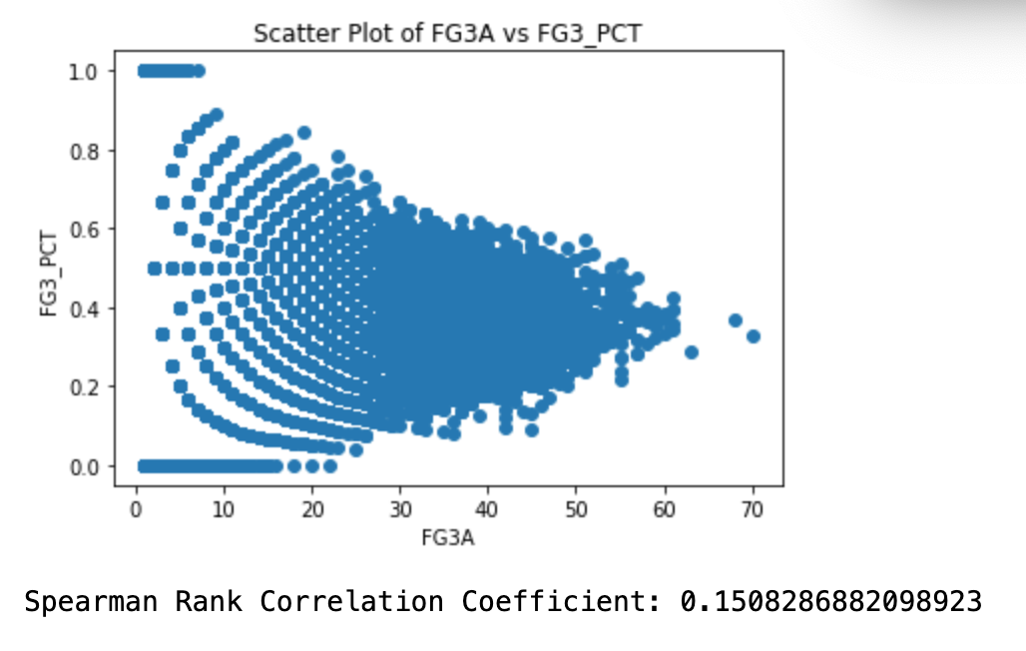
Correlation analysis
FG_PCT vs. PTS
FG3A Vs. FG3_PCT

Slide 14
Correlation analysis cont.
We see an upward trend in the first plot, and Pearson's correlation coefficient provides evidence to that with a value of almost 0.67. We also see a positive covariance value, which indicates a positive relationship. We must keep in mind, however, that covariance is sensitive to the scale of the variables. For that reason, we put more emphasis on the correlation coefficient.
For the second plot, although the coefficient is close to zero, I'm still skeptical and think that there is an underlying correlation. I am not sure, however, as to which approach can best quantifies relationships such as this: where the y-values tend to converge as x-values increase.

Slide 15
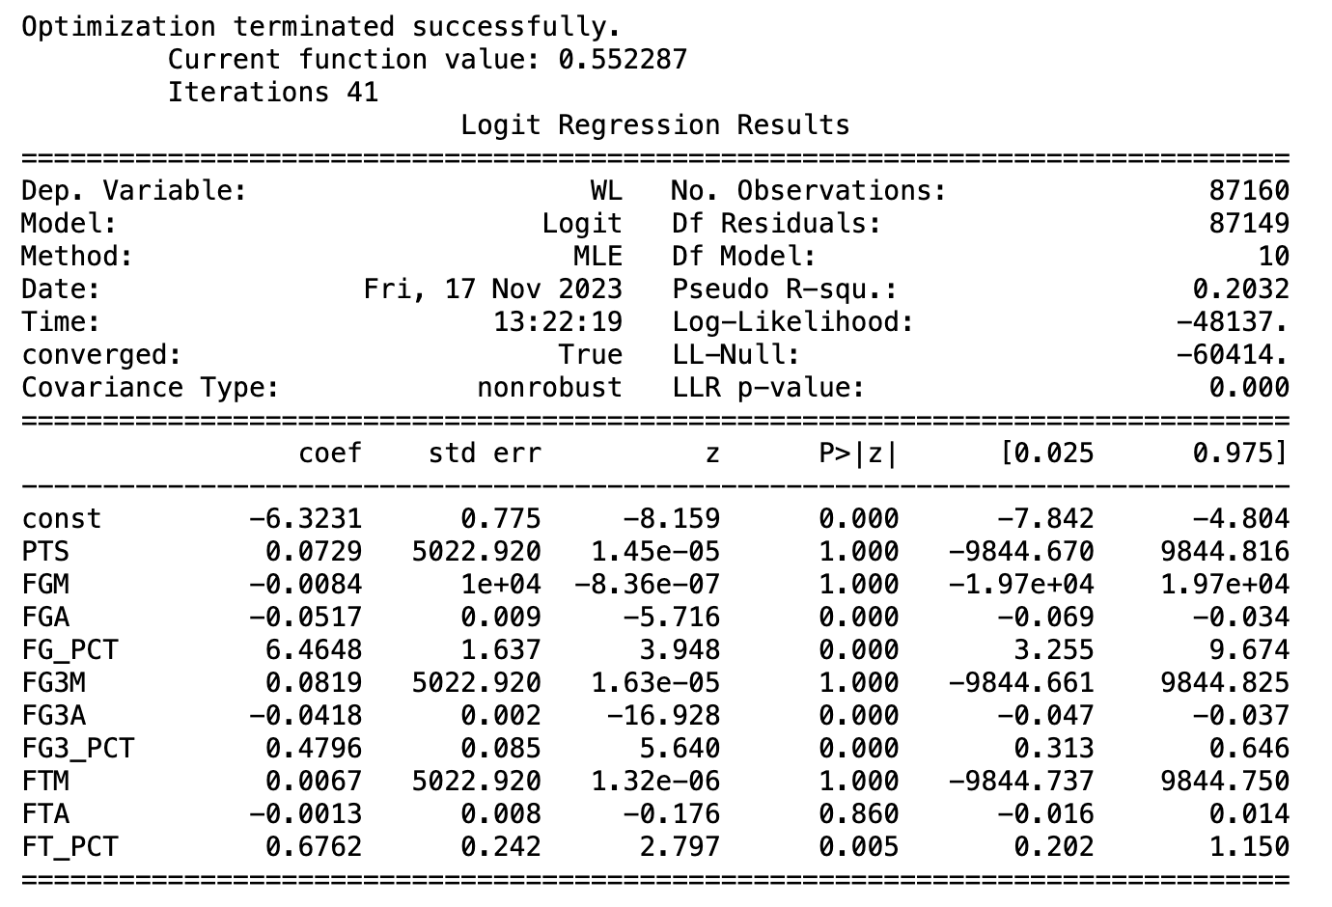
Regression analysis

