Slide 1

Estimating earnings based on demographic and job-related data
DSC 680 – Project 2, Milestone 3
Xhoi Shyti
Bellevue University

Slide 2
Business problem
Gaining insight into the factors that contribute to income disparity is essential for:
Government decision-makers
Business leaders
Academic proffessionals
Goal: Leverage machine learning techniques to classify income levels
Contributes to the development of evidence-based policies and strategic workforce planning

Slide 3
Background
Income analysis is traditionally grounded in economic and social science frameworks
Machine learning adds a layer of predictive capability
Data Source: 1994 Current Population Survey by the U.S. Census Bureau
Objective: Pinpoint key socio-economic variables that influence income levels

Slide 4
Data explanation
32,561 instances with 15 features
Key variables: age, education, workclass, hours/week, etc.
Data Preparation Workflow:
Address incomplete or missing data
Convert categorical fields using label encoding
Scale numerical attributes for consistency
Divide data into training and testing sets using an 80/20 ratio

Slide 5
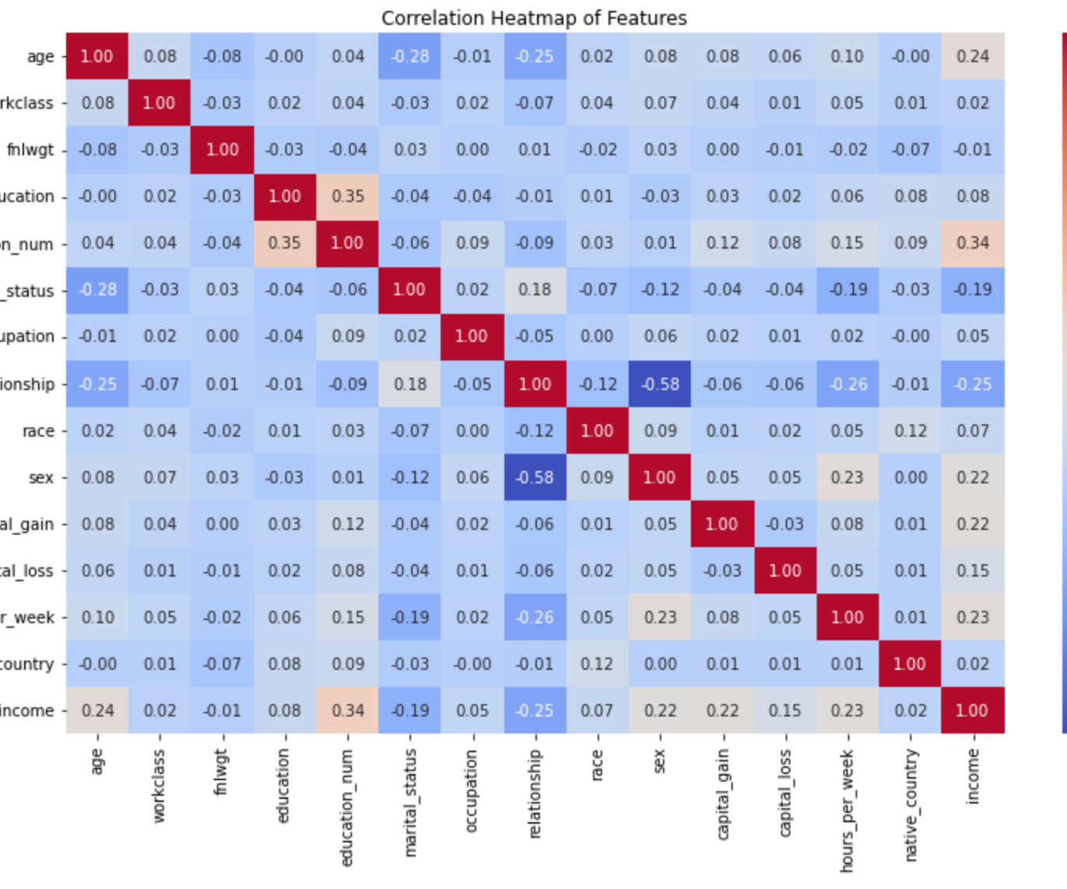
EDA Overview
Understanding the relationship between various attributes and income levels Notable associations:
Advanced education and capital gains tend to align with higher earnings
Age and weekly working hours also show a positive link with income

Slide 6
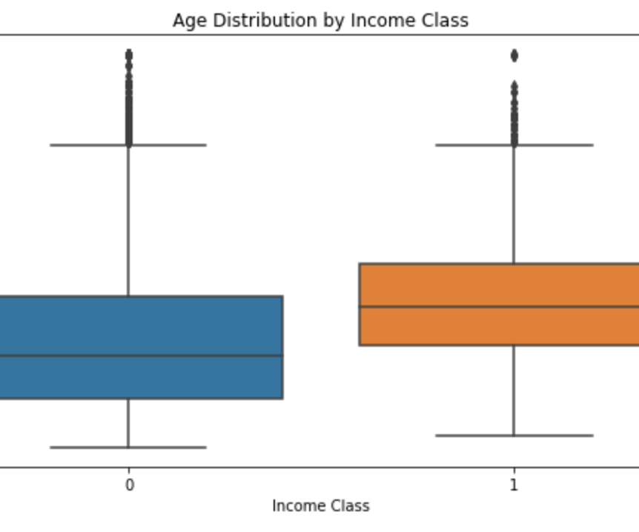
Age distribution by income
Individuals with incomes above $50K tend to be older on average.
Income Class 0: Represents earnings ≤ $50K
Income Class 1: Represents earnings > $50K

Slide 7
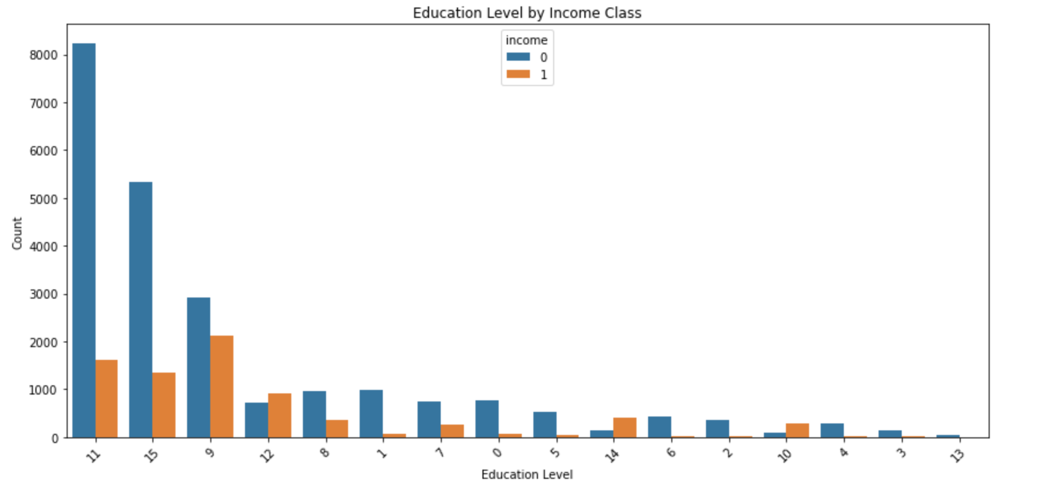
Education and income
Countplot analysis
Income levels appear to be significantly influenced by educational attainment
Original Value | Encoded Value
10th | 0
11th | 1
12th | 2
1st – 4th | 3
5th – 6th | 4
7th – 8th | 5
9th | 6
Assoc-acdm | 7
Assoc-voc | 8
Bachelors | 9
Doctorate | 10
HS-Grad | 11
Masters | 12
Pre-School | 13
Prof-School | 14
Some college | 15

Slide 8
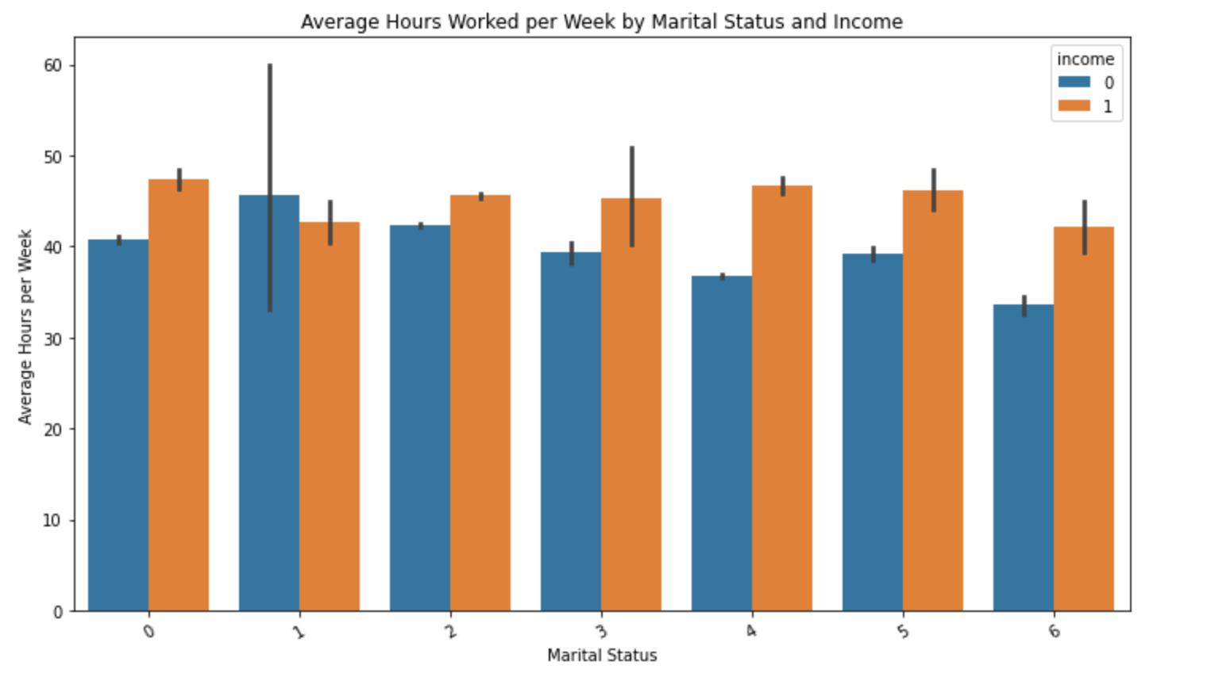
Hours worked vs marital status
Married people who put in longer working hours generally have higher earnings
Original Value | Encoded Value
Divorced | 0
Married-AF-Spouse | 1
Married-civ-spouse | 2
Married-spouce-absent | 3
Never-married | 4
Separated | 5
Widowed | 6

Slide 9
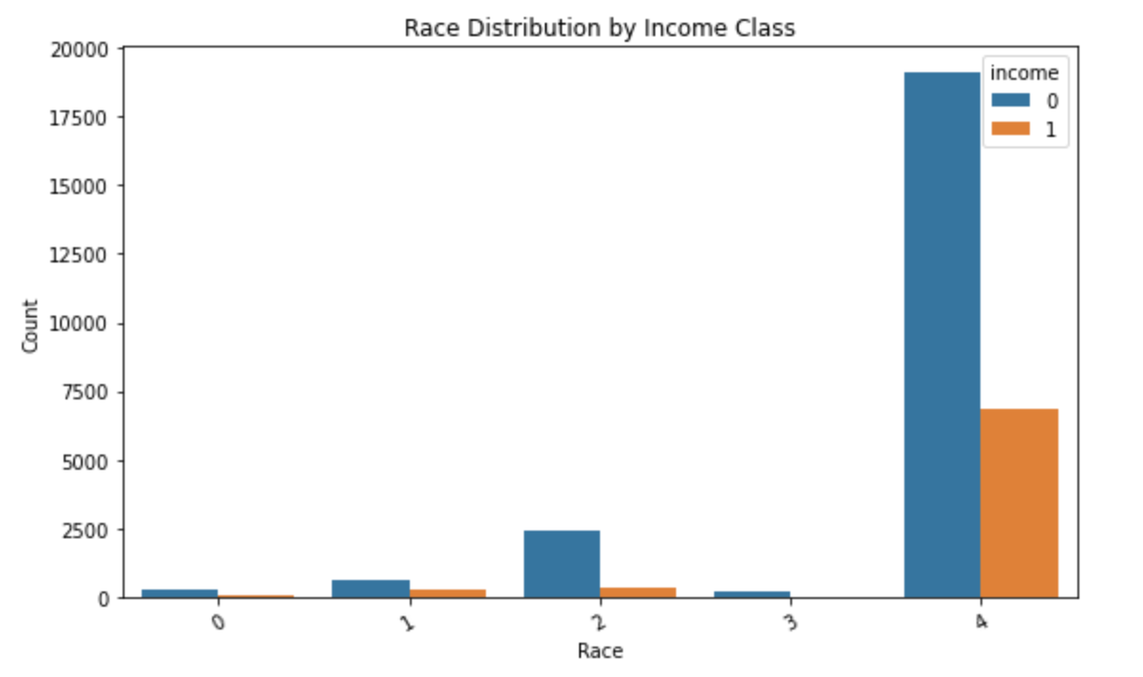
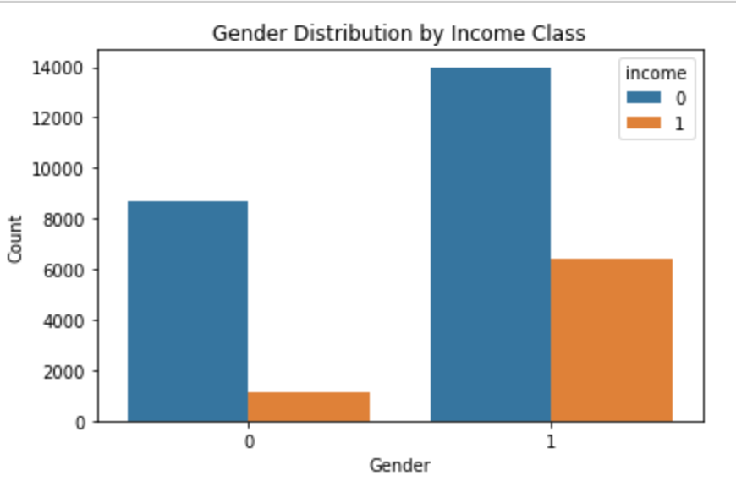
Race and gender by Income
Differences in income are clearly observable among various racial and gender groups
Original Value | Encoded Value
Amer-Indian-Eskimo | 0
Asian-Pac-Islander | 1
Black | 2
Other | 3
White | 4
Original Value | Encoded
Female | 0
Male | 1

Slide 10
methods
Modeling Strategy:
Started with Logistic Regression as a benchmark model
Applied Random Forest to capture complex relationships and assess feature relevance
Assessed performance using accuracy, precision, recall, F1 score, and ROC-AUC
Selected features based on Gini importance derived from the Random Forest model

Slide 11
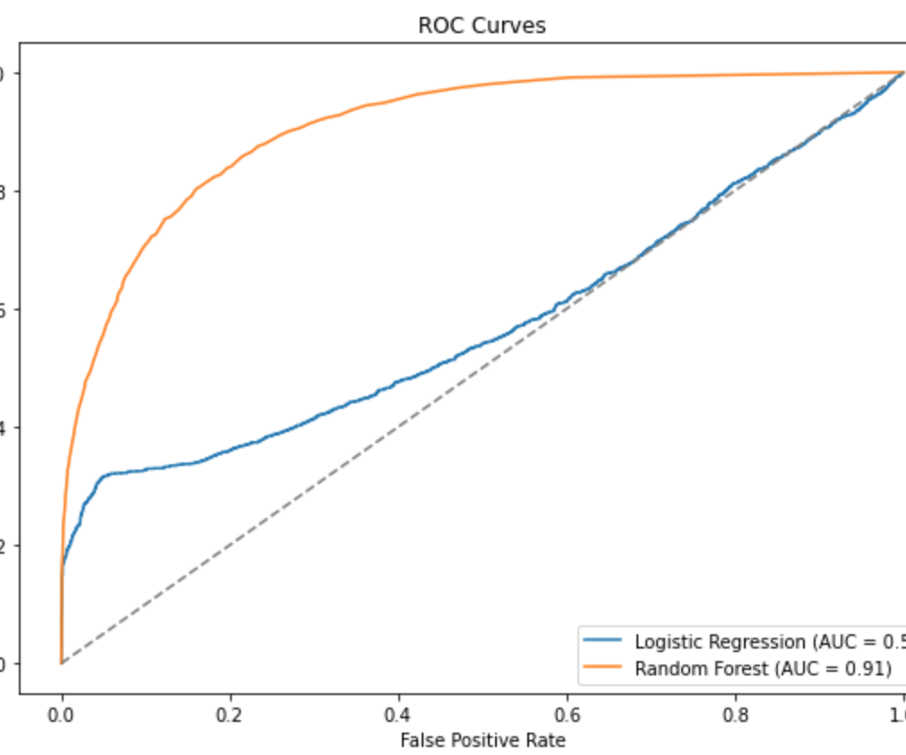
Model performance
Logistic Regression:
Accuracy: 78.6%
ROC-AUC: 0.81
Random Forest:
Accuracy: 85.8%
ROC-AUC: 0.90

Slide 12
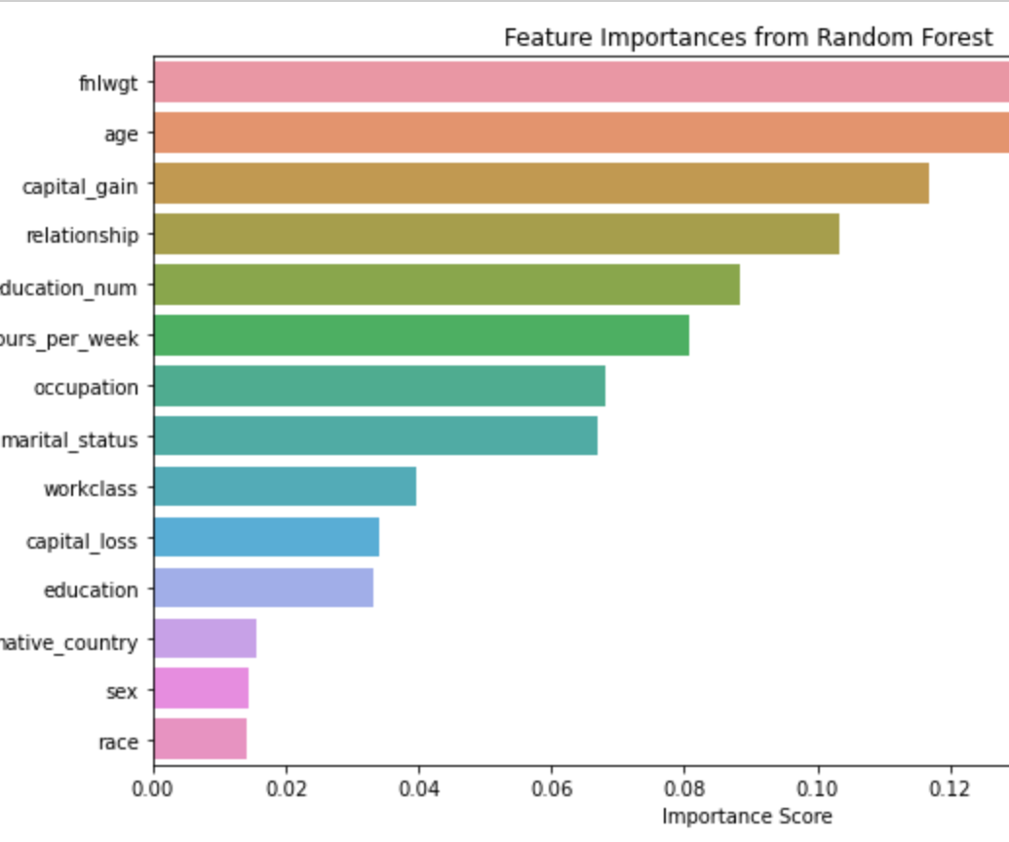
Feature importance
Top features:
Education (education_num)
Capital gain
Hours per week
Age
Marital status

Slide 13
Conclusion
Machine learning algorithms effectively classify income groups
Ensemble approaches show superior performance compared to the baseline
These findings have real-world relevance for shaping public policy, recruitment strategies, and educational planning

Slide 14
Assumptions and limitations
Assumptions: The data offers a representative snapshot of the population, and the socioeconomic patterns identified remain applicable in the present context.
Limitations:
The dataset originates from 1994
Lacks detailed insights at the regional and industry-specific levels
Potential for bias due to the historical nature of the data

Slide 15
Challenges and future work
Challenges:
Uneven class distribution
Numerous categorical attributes to manage
Future Enhancements:
Leverage up-to-date datasets
Integrate geographic, economic, and sector-specific variables
Investigate advanced models like XGBoost and implement interactive dashboards

Slide 16
ethical considerations
Potential Risks:
Reinforcement of existing biases
Issues related to data privacy
Proposed Solutions:
Conduct periodic evaluations and reviews
Maintain openness about model development choices
Engage stakeholders throughout the process

