Slide 1

Modeling Home Run Probability Through Statcast Analytics
Analytics-Based Insights for Batting Strategy
Xhoi Shyti – DSC 680

Slide 2
Business Problem
Home runs play a pivotal role in the outcome of MLB games
Forecasting the likelihood of a home run supports strategic decision-making for coaches and enriches the fan experience.
Facilitates data-driven insights for fantasy leagues, live broadcasts, and player performance assessment.

Slide 3
Rise of Statcast and Advanced Metrics
Introduced in 2015, Statcast tracks metrics such as launch angle, exit velocity, and distance
Traditionally applied for descriptive statistical analysis
This project applies predictive modeling techniques to estimate the probability of a home run

Slide 4

Statcast Dataset (2023–2024)
A dataset of 10,000 pitching events from the 2023–2024 MLB season.
More than 9,600 recorded batted ball events.
Important variables include launch_speed, launch_angle, extra_distance_2025, and events.
Target variable is is_home_run, represented as a binary outcome

Slide 5
Feature Selection & Cleaning
Filtered for in-play batted balls
Removed missing values
Final predictors:
Launch Speed (mph)
Launch Angle (degrees)
Park Factor (extra_distance_2025)

Slide 6
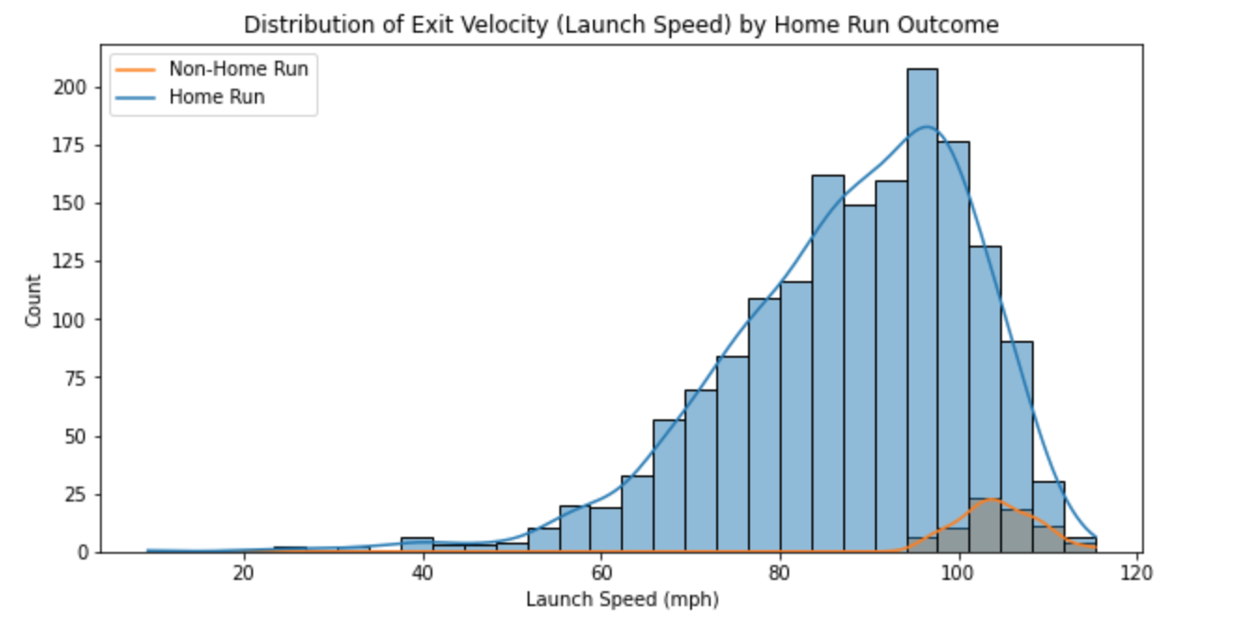
Launch Speed vs Home Run Likelihood

Slide 7
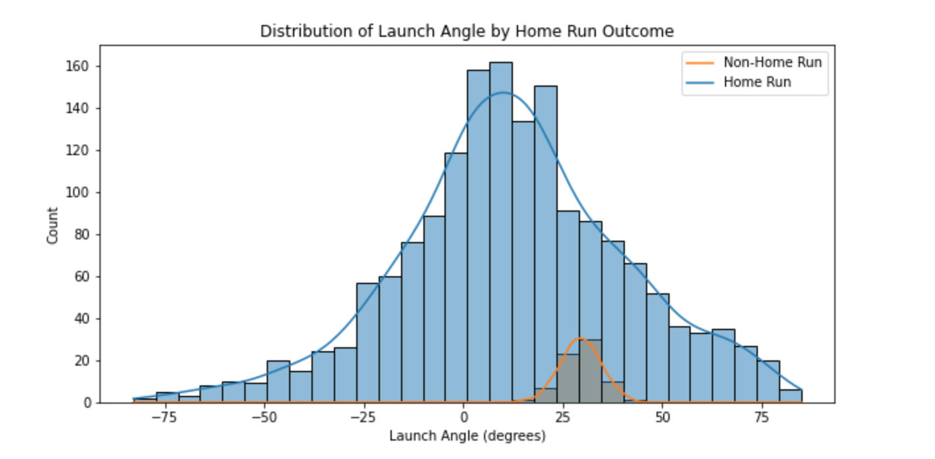
Launch Angle Analysis
Most HRs occur between 20–40 degrees

Slide 8
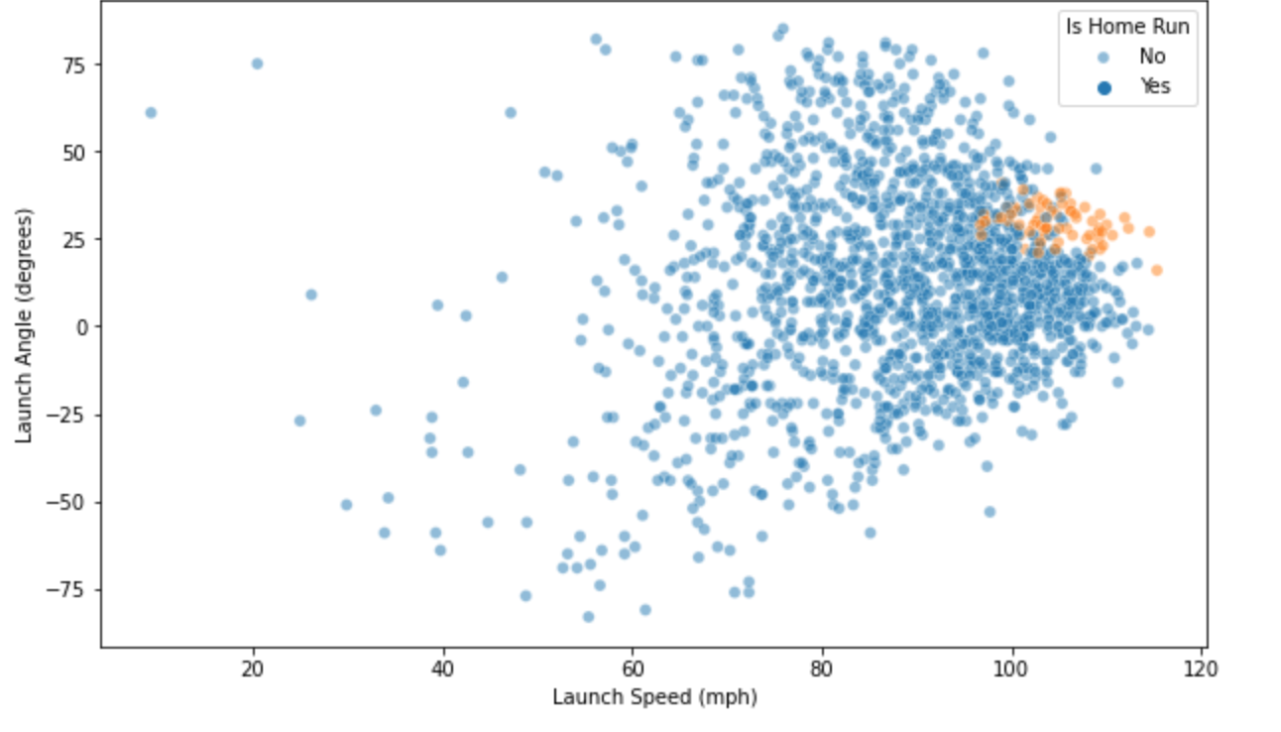
Sweet Spot in Bated-Ball Profiles
High launch_speed + mid-range launch_angle = higher HR chance

Slide 9
Accounting for Stadium Context
Used extra_distance_2025 as a proxy for park-adjusted flight distance
Improves model's ability to generalize across ballparks

Slide 10
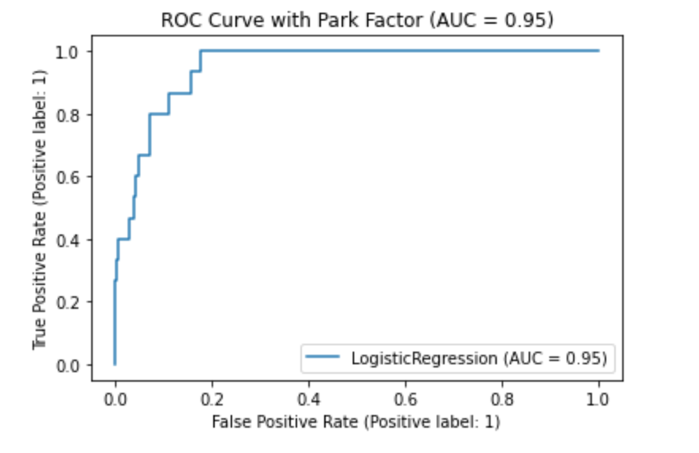
Logistic Regression Results
Accuracy: 96.8%
Precision (HR): 75%
Recall (HR): 40%
ROC-AUC: 0.95

Slide 11
Conclusion
Launch speed and launch angle serve as strong indicators of home run probability
Incorporating park factor notably improves the model’s recall
Straightforward and easy-to-interpret models can still provide meaningful insights

Slide 12
What’s Next?
Evaluate higher-capacity models
Incorporate weather variables and defensive context
Deploy live predictions via an on-screen broadcast overlay
Continuously monitor drift and retrain on a regular cadence

Slide 13
Responsible Model Use
Refrain from summarizing a player’s value with just one statistic
Ensure models are used to assist rather than replace human judgment
Be clear and open about the model’s assumptions and limitations

