Slide 1
Core metrics that influence NBA outcomes during the regular season
Forecasting Results Through Data-Informed Analysis
Xhoi Shyti – DSC 680

Slide 2
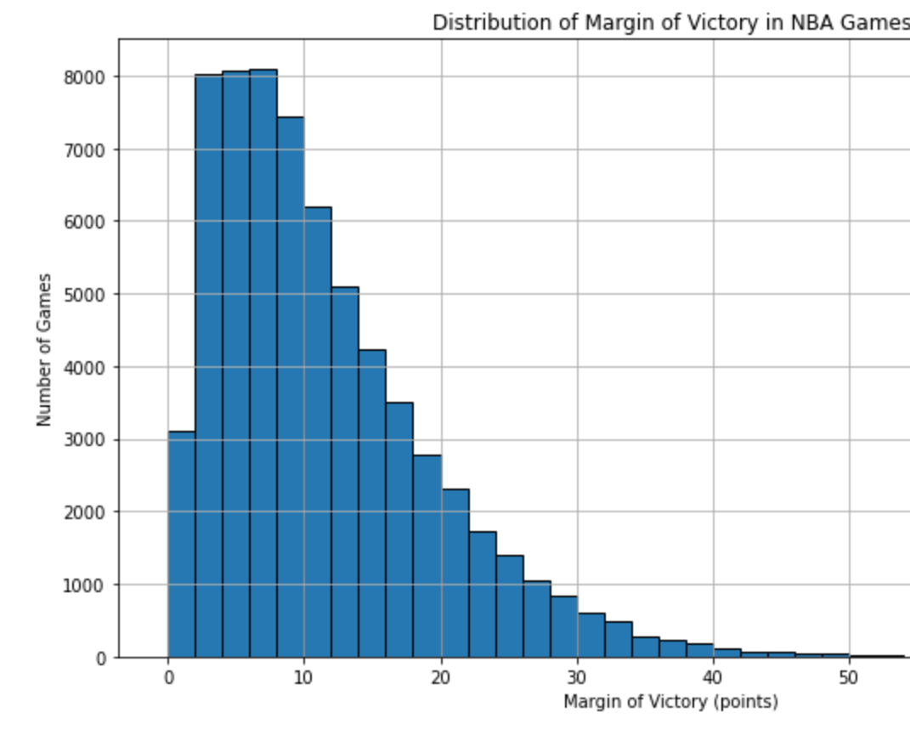
Introduction and Objective
NBA games are often decided by narrow margins, where small advantages can make a big difference.
Data science enables teams to convert statistical data into strategic insights.
Objective: Determine which performance metrics most effectively predict game outcomes.

Slide 3
The Challenge
Which statistical measures are the most reliable indicators of victory?
Guide coaching decisions, player growth, and data-driven planning.
Develop an accurate prediction model using historical performance data.

Slide 4
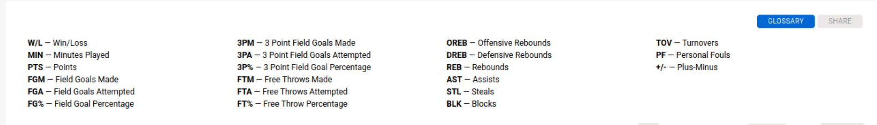
Data and methods
Data Origin: NBA box score records from 1946 to 2023
Primary variables: shooting performance, win/loss results, and efficiency indicators
Analytical method: Exploratory Data Analysis → Selection of Relevant Features → Logistic Regression Modeling

Slide 5
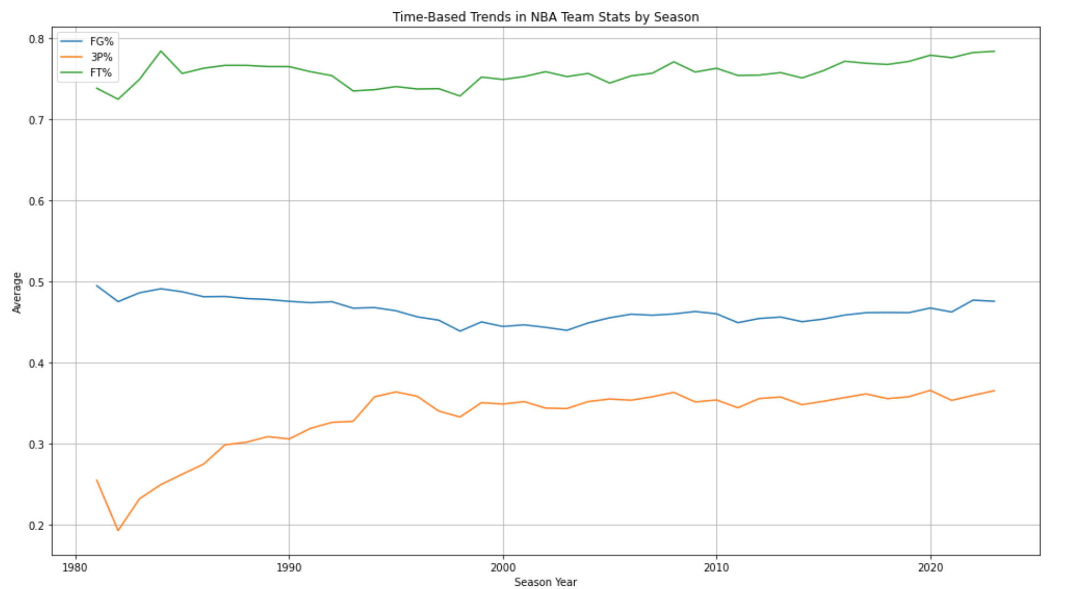
EDA – Trends and correlations
Analyzed long-term trends in shooting performance
Identified significant shifts in three-point and free throw percentages across eras
Used correlation analysis to pinpoint metrics with strong predictive value

Slide 6
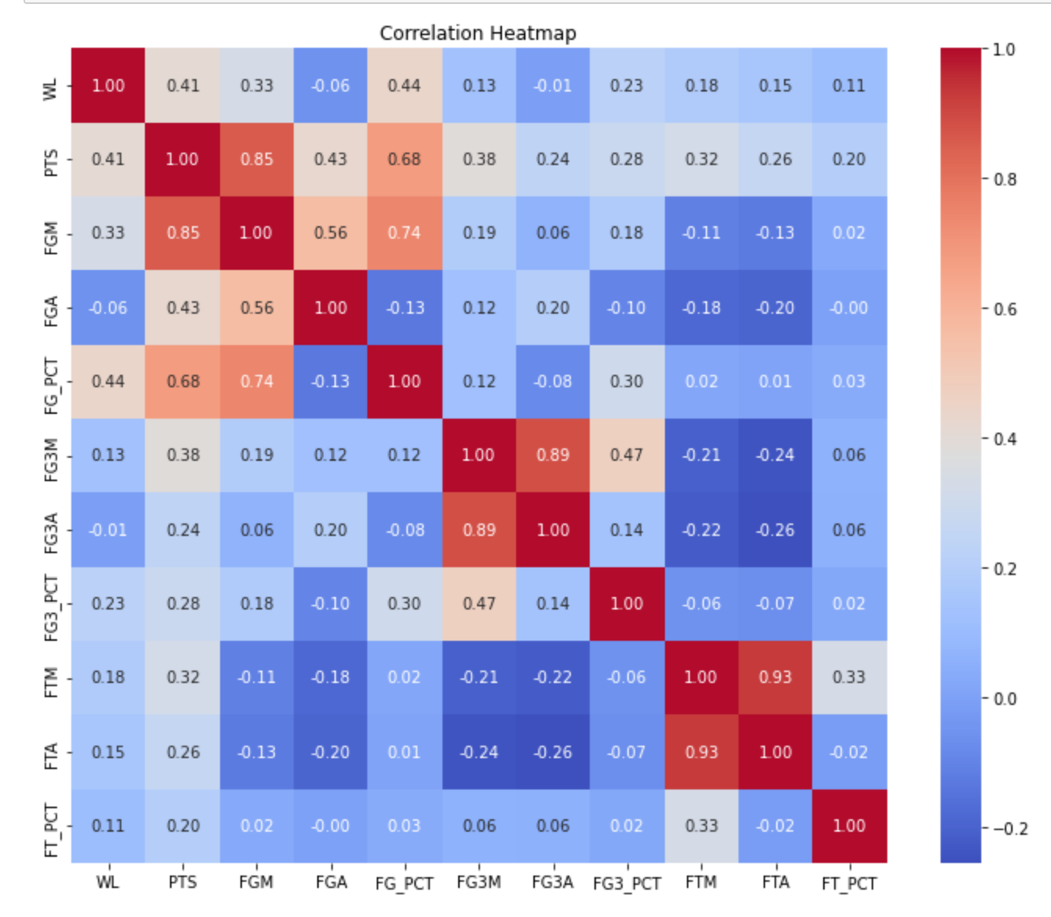
EDA – Trends and correlations CONT.

Slide 7
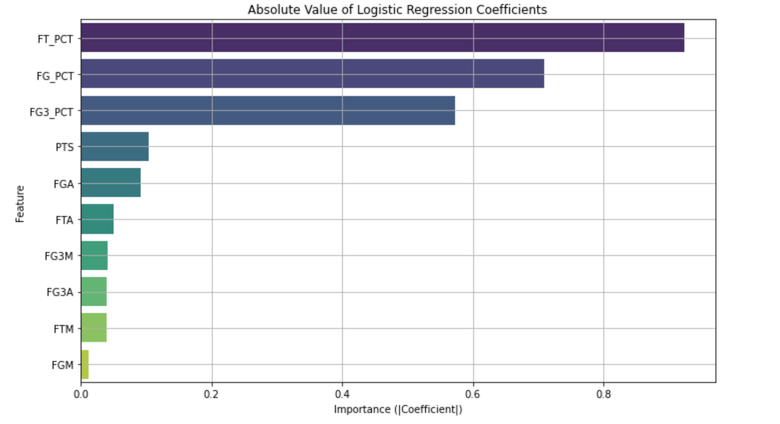
Predictive modeling
Used binary classification to label outcomes as Win (1) or Loss (0)
Key input variables included free throw percentage, field goal percentage, three-point percentage, total points, field goal attempts, and others
Objective: Achieve high prediction accuracy while managing multicollinearity among features

Slide 8
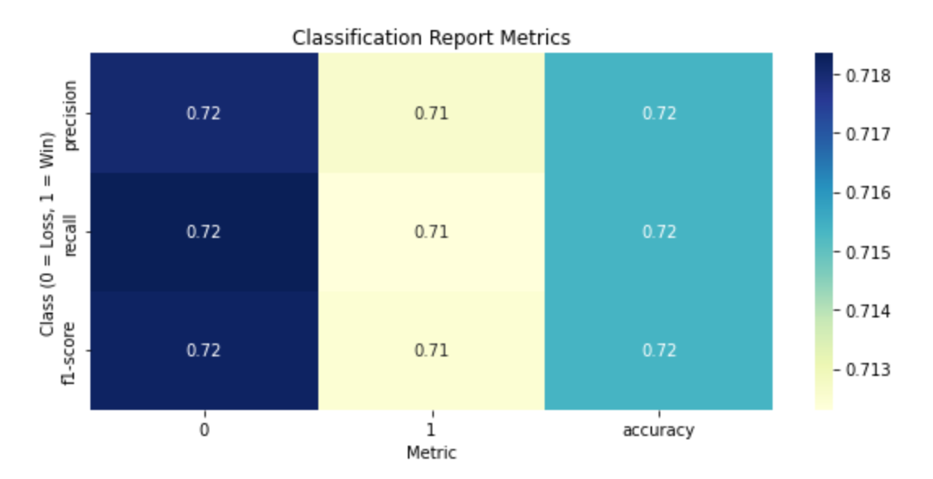
Model accuracy & Metrics
Achieved approximately 72% accuracy
Maintained a balance between precision and recall
Findings remain consistent across different game result scenarios

Slide 9
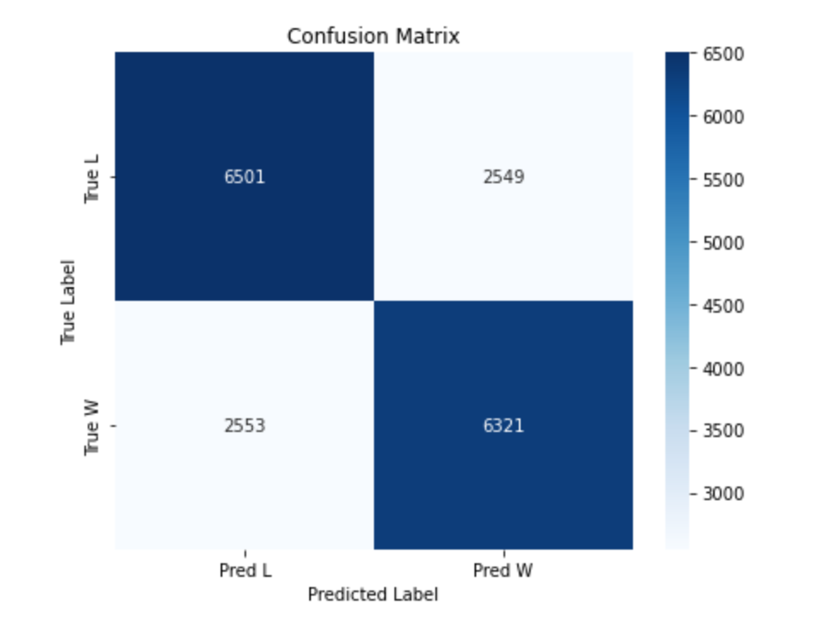
Model accuracy & Metrics CONT.
Correctly predicted 6,501 losses and 6,321 wins
Approximately 2,550 misclassifications in each category
Confusion matrix confirms balanced model performance across outcomes

Slide 10
Key findings
FT% most influential predictor, followed closely by FG% and 3P%
Efficiency outweighs volume: effectiveness of shot selection has greater impact vs number of attempts
Consistent performance at the free-throw line → reliable contributor to winning outcomes

Slide 11
Limitations and ethics
The model does not incorporate situational factors such as the strength of the opposing team
Shifts in league rules over time may introduce bias into long-term trend analysis
Advanced metrics such as player tracking data and measures like PER were not included in the analysis.
Ethical approach: Avoids biased evaluations of individual players or teams.

Slide 12
Implications for teams
Emphasize shooting accuracy as a key component of training sessions
1
Prioritize FT% in scouting and development
2
Place strong emphasis on free throw accuracy in both scouting and player development
3

Slide 13
Future work
Integrate
Incorporate detailed performance metrics such as PER, usage rate, and SportVU data.
Add
Include contextual game factors such as location (home or away), player fatigue, and performance in high-pressure situations.
Explore
Investigate the use of ensemble machine learning algorithms, such as Random Forest and XGBoost.
Build
Develop customized models tailored to individual players or specific teams.

