Slide 1
Key Metrics for Regular-Season NBA Games
Predicting Outcomes with Data-Driven Insights
Xhoi Shyti – DSC 680

Slide 2
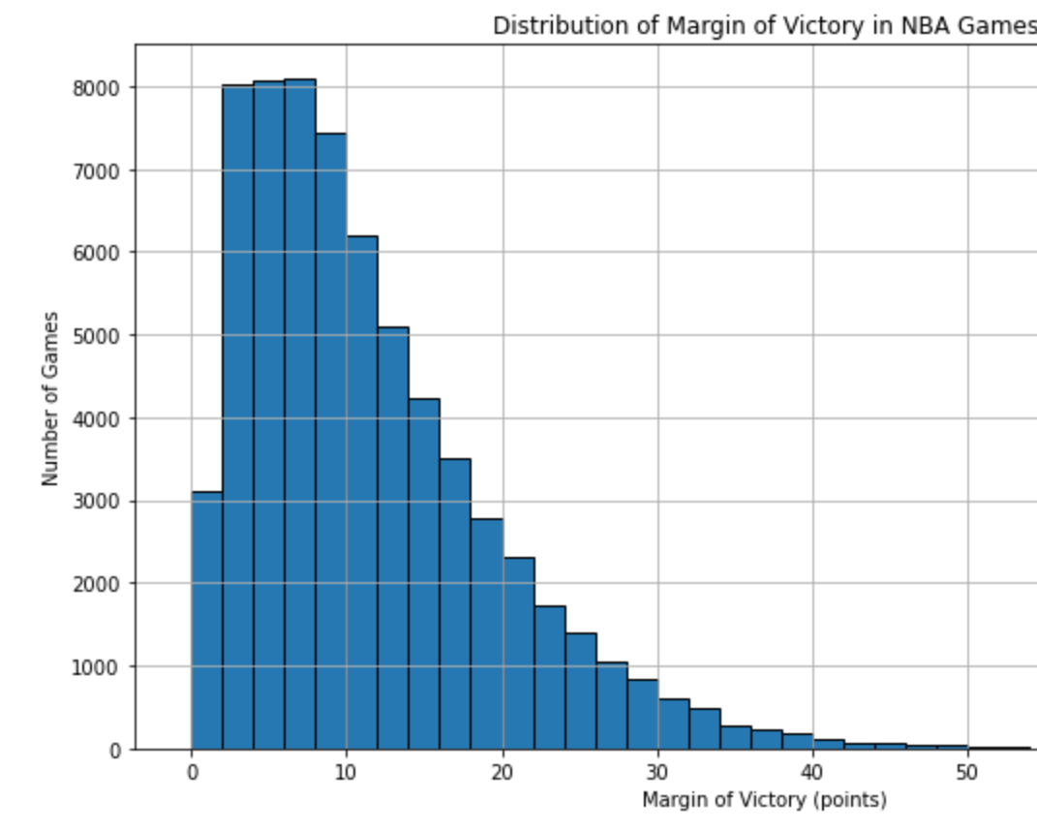
Introduction and Objective
Winning in the NBA is often decided by slim margins.
Data science helps teams translate stats into strategy.
Goal: Identify metrics that best predict game outcomes.

Slide 3
The Challenge
Which performance metrics predict wins most accurately?
Inform coaching, player development, and analytics strategy.
Build a reliable predictive model based on historic data.

Slide 4
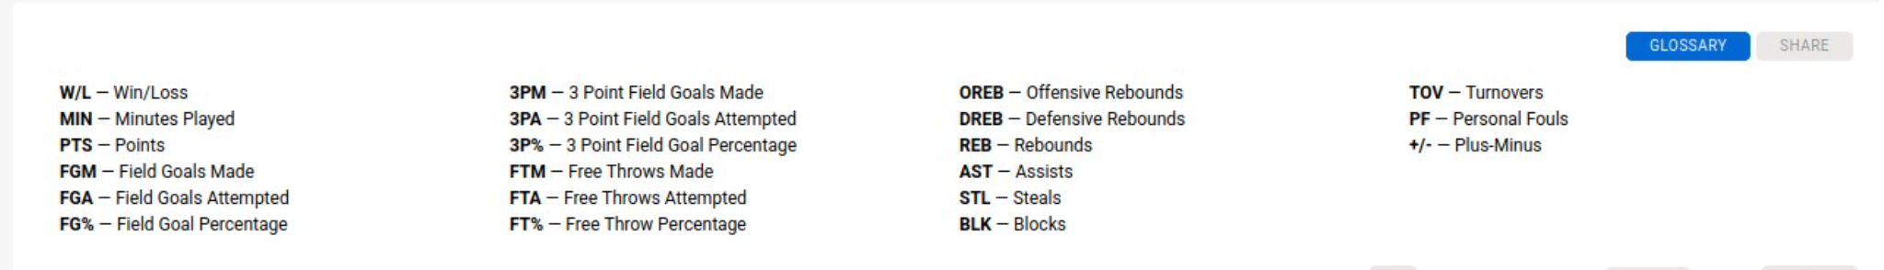
Data and methods
Data Source: NBA box scores (1946–2023)
Key variables: shooting stats, game outcomes, efficiency metrics
Modeling approach: EDA → Feature Selection → Logistic Regression

Slide 5
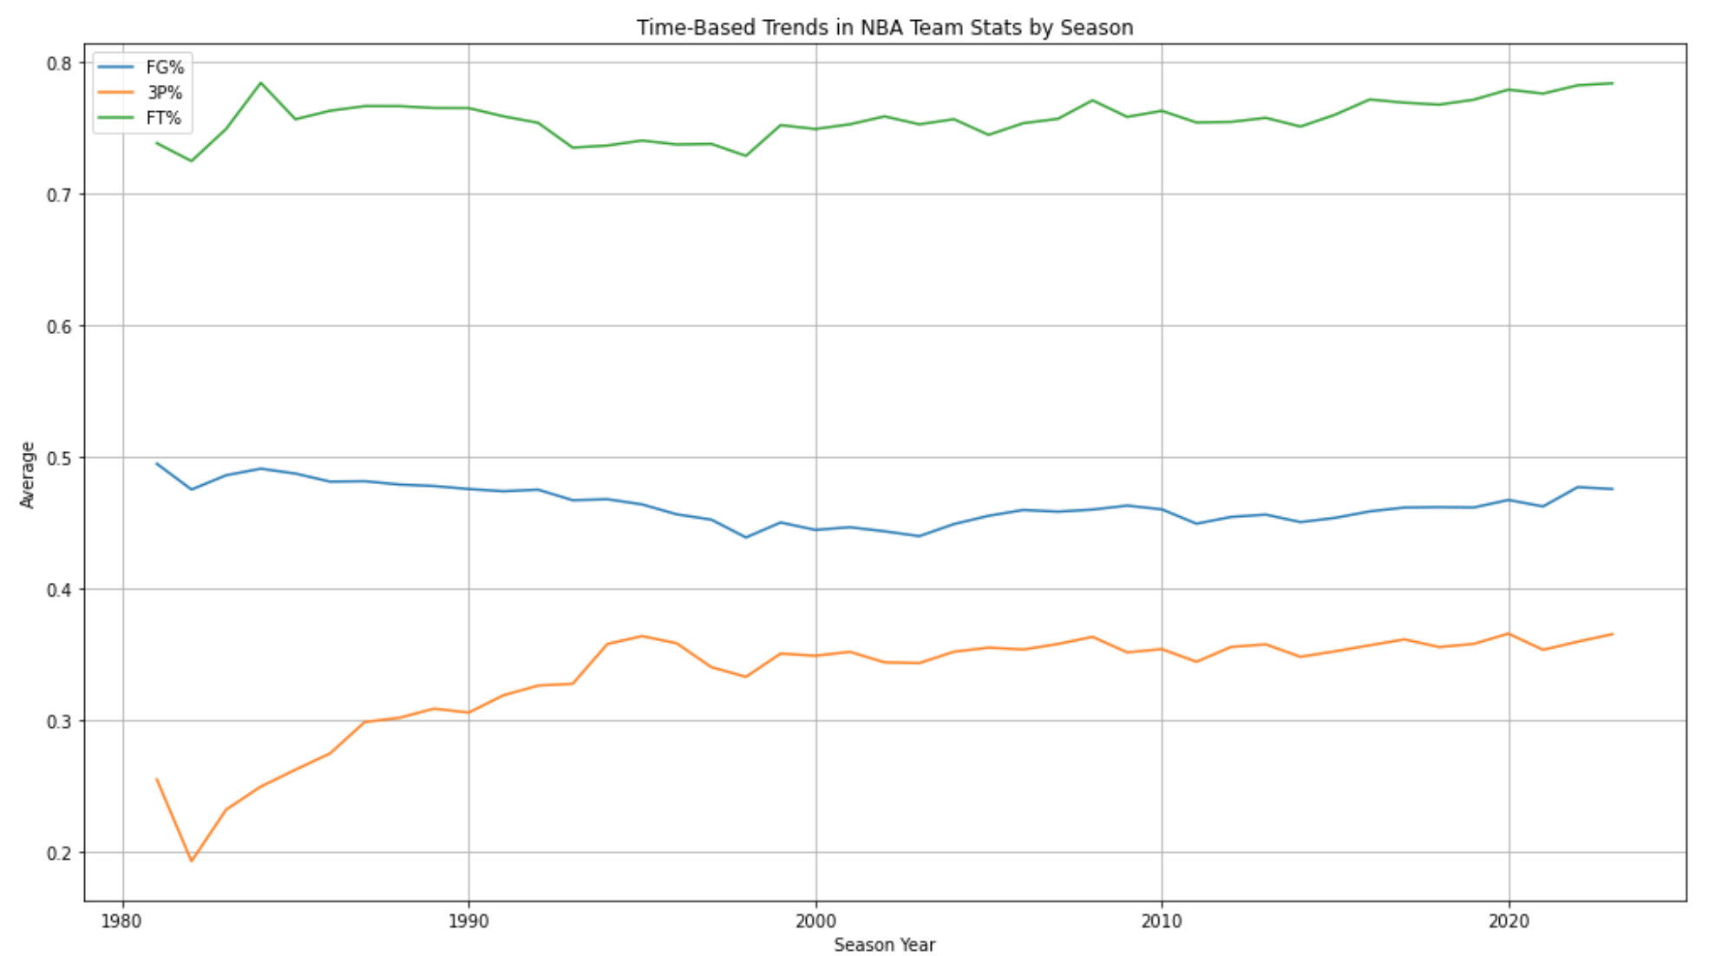
EDA – Trends and correlations
Examined historical patterns in shooting stats
Found meaningful changes in 3P% and FT% over time
Correlations helped isolate predictive metrics

Slide 6
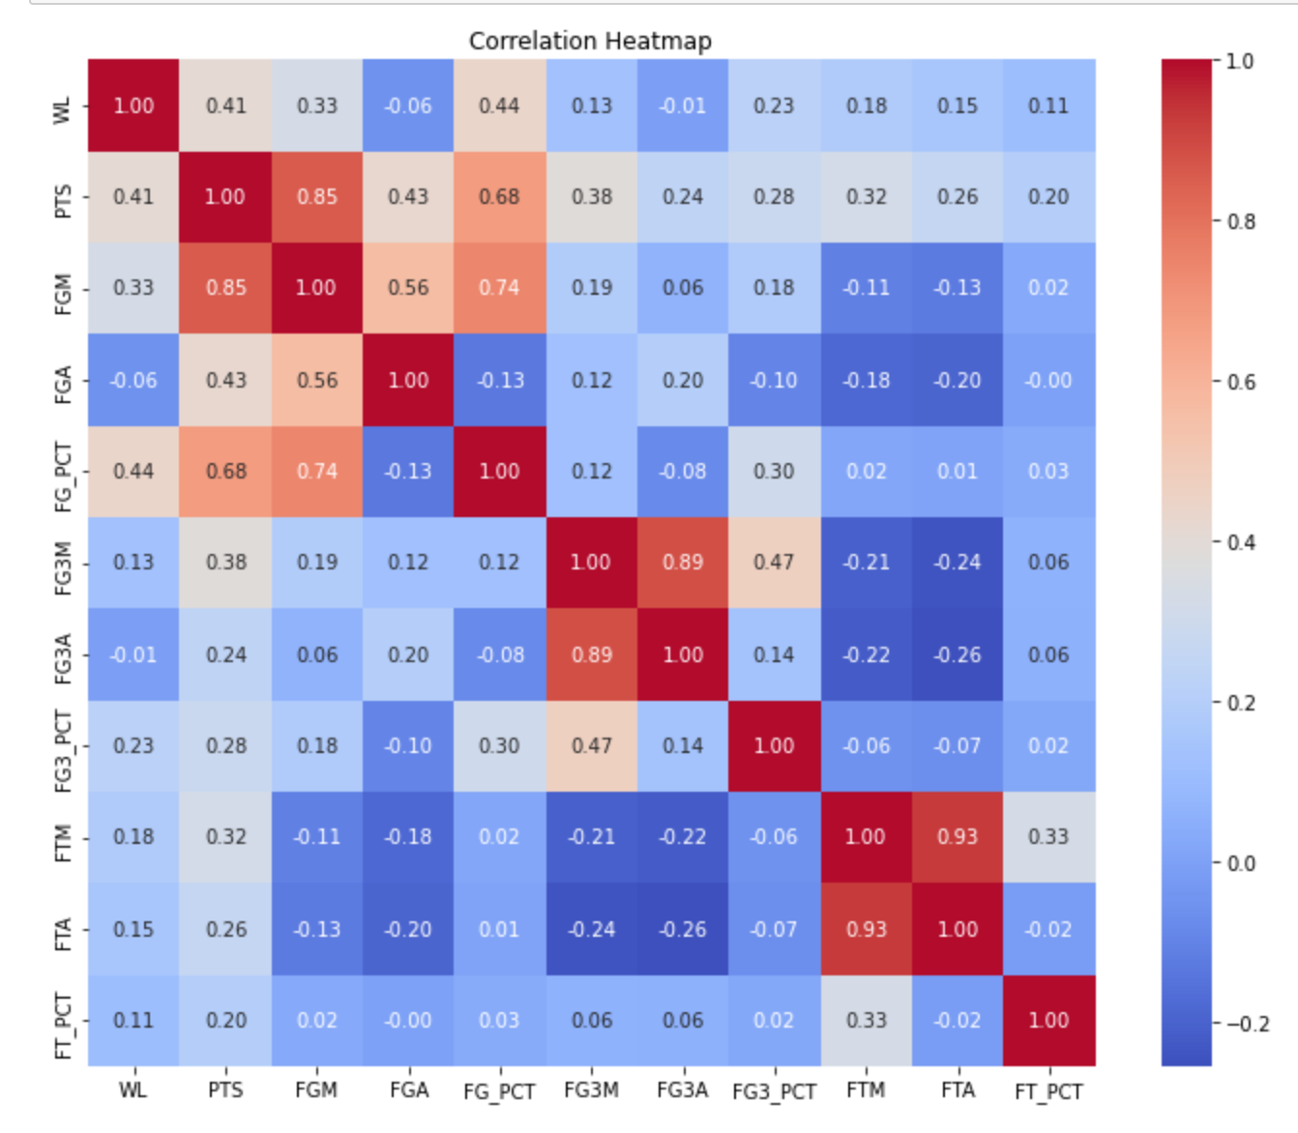
EDA – Trends and correlations CONT.

Slide 7
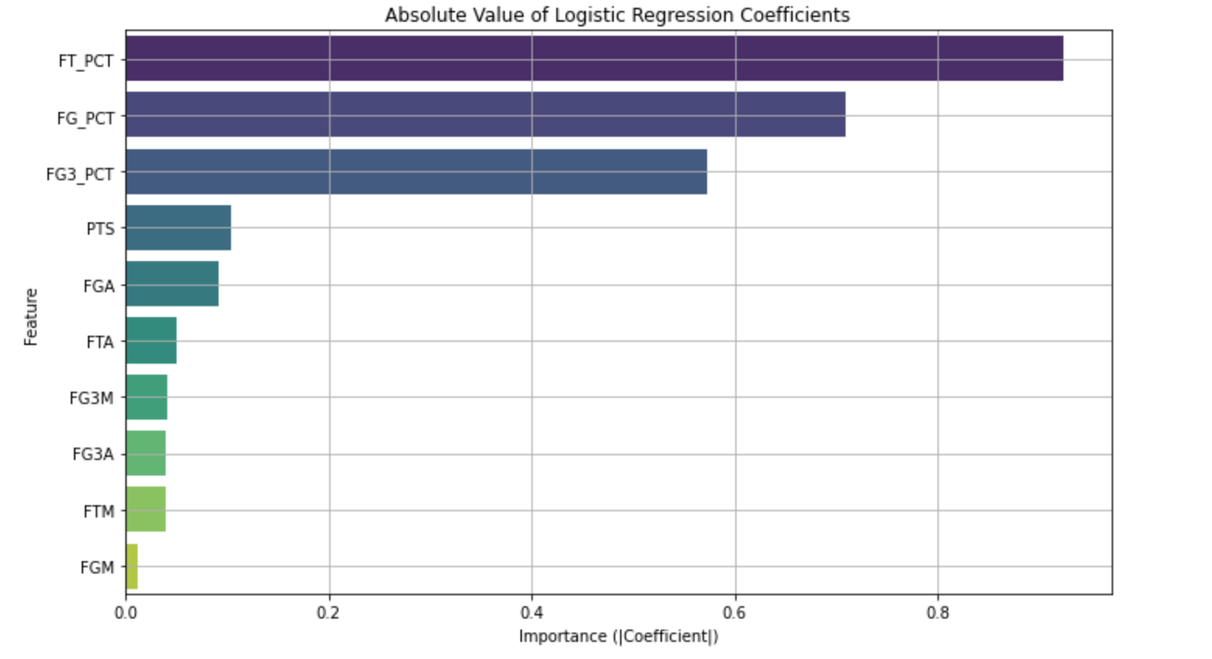
Predictive modeling
Binary classification: Win (1) or Loss (0)
Input features: FT%, FG%, 3P%, PTS, FGA, etc.
Target: Maximize accuracy while controlling for multicollinearity

Slide 8
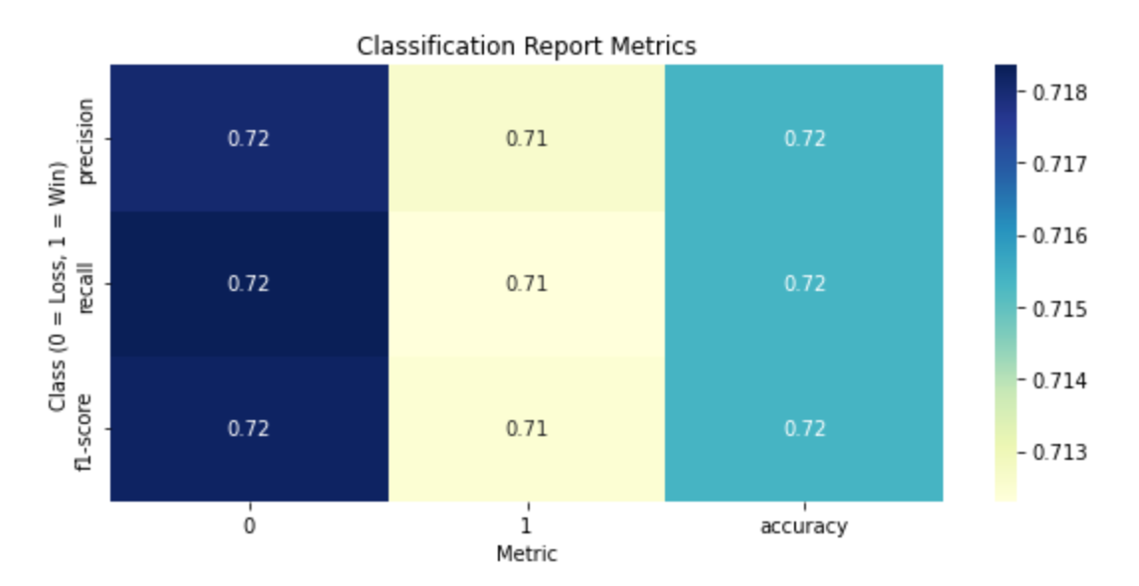
Model accuracy & Metrics
Accuracy: ~72%
Balanced precision and recall
Insights are robust across game outcomes

Slide 9
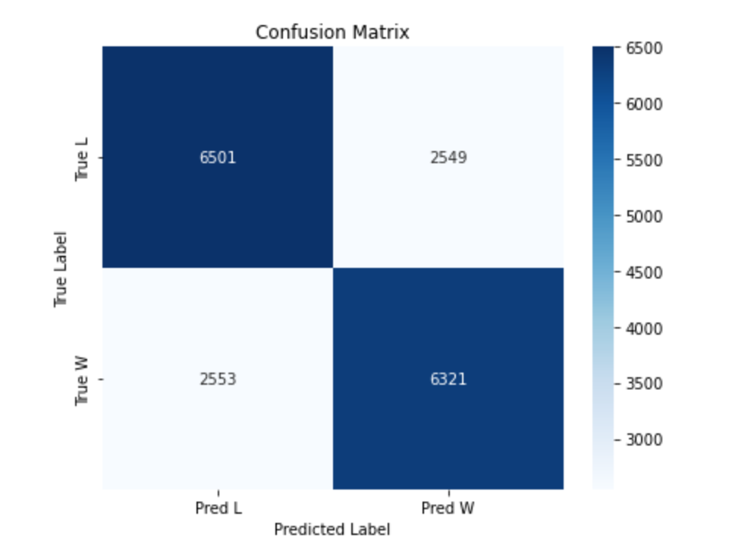
Model accuracy & Metrics CONT.

Slide 10
Key findings
FT% was the strongest predictor, followed by FG% and 3P%
Efficiency > Volume: Quality of shots matters more than quantity
Free throw reliability is a consistent winning factor

Slide 11
Limitations and ethics
Model doesn't account for context (e.g., opponent strength)
Historical changes in rules may skew long-term analysis
No advanced player tracking or PER-type metrics used
Ethical modeling: No unfair player/team judgments

Slide 12
Implications for teams
Focus on efficient shooting during training
1
Prioritize FT% in scouting and development
2
Use predictive modeling to inform coaching and roster moves
3

Slide 13
Future work
Integrate
Integrate advanced stats (PER, usage rate, SportVU)
Add
Add game context (home/away, fatigue, clutch stats)
Explore
Explore ensemble ML models (Random Forest, XGBoost)
Build
Build player- or team-specific models

