Slide 1

Predicting Income Levels from Demographic and Employment Data
DSC 680 – Project 2, Milestone 3
Xhoi Shyti
Bellevue University

Slide 2
Business problem
Understanding the drivers of income inequality is critical for:
Policymakers
Employers
Educators
Objective: Use ML to predict income class (> $50K vs. ≤ $50K)
Helps shape data-informed policies and workforce strategies

Slide 3
Background
Income modeling rooted in economics and social science
Machine learning introduces predictive power
Dataset: U.S. Census Bureau's 1994 Current Population Survey
Goal: Identify key socio-economic indicators of income

Slide 4
Data explanation
32,561 instances with 15 features
Key variables: age, education, workclass, hours/week, etc.
Preprocessing steps:
Handle missing values
Label encode categorical variables
Normalize numeric features
Train-test split (80/20)

Slide 5
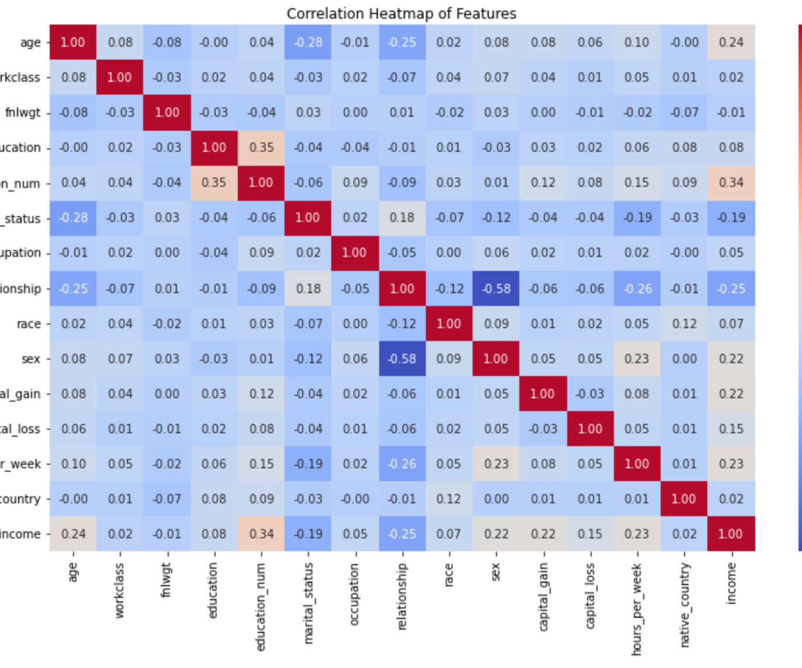
EDA Overview
Insights into how features relate to income
Key correlations:
Higher education and capital gain → higher income
Age and hours/week also positively correlated

Slide 6
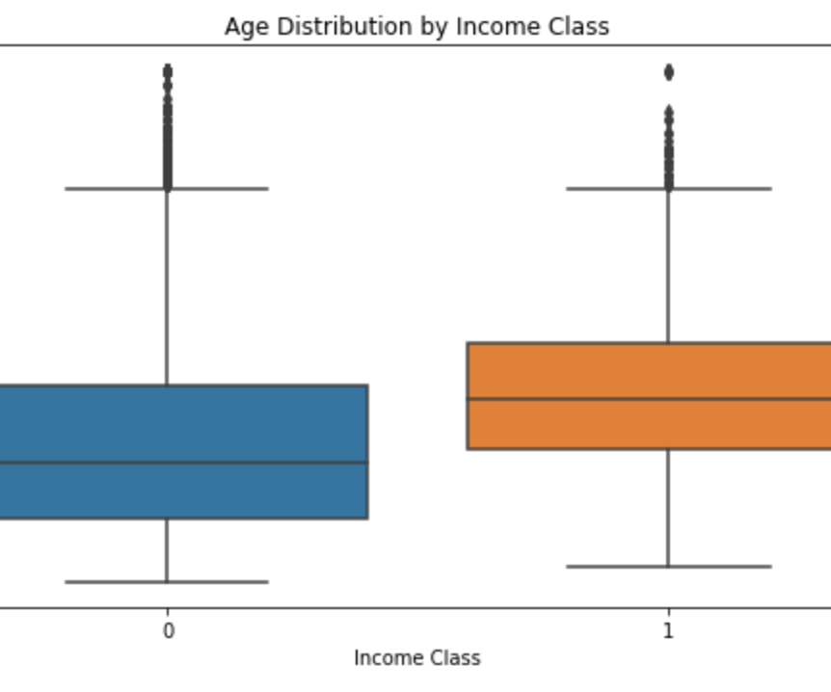
Age distribution by income
Boxplot interpretation
Individuals earning > $50K are typically older
Income class 0 → <= $50k
Income class 1 → > $50k

Slide 7
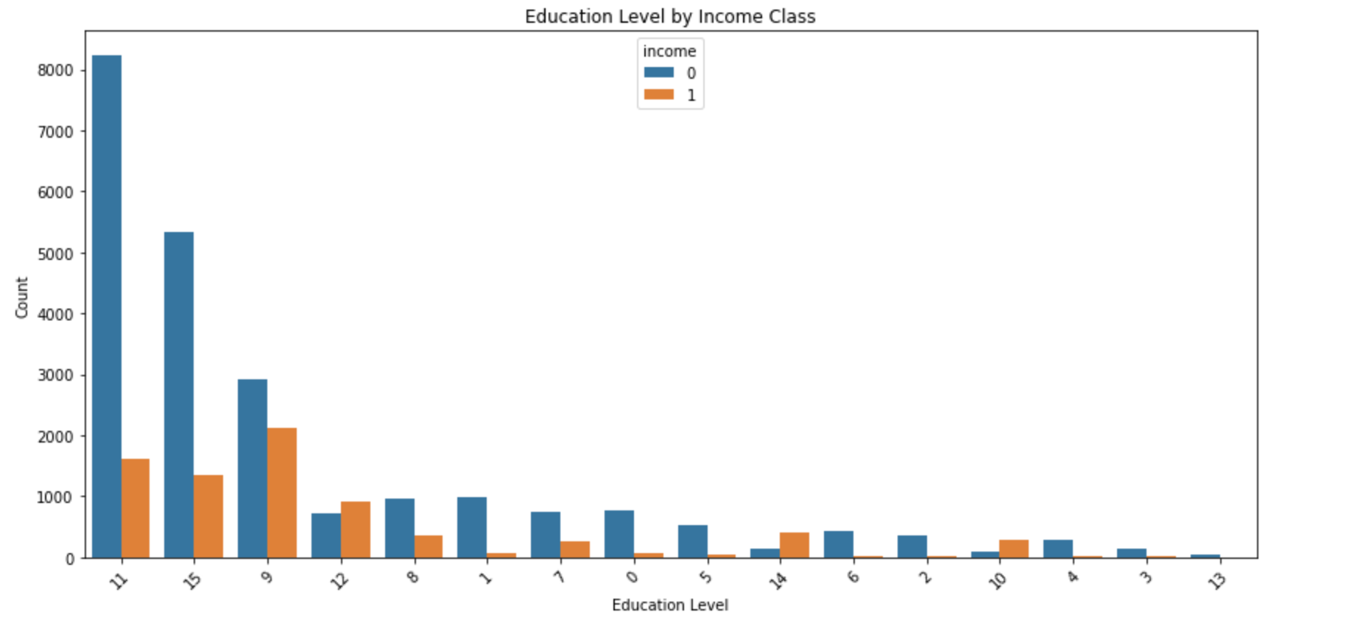
Education and income
Countplot interpretation
Education level shows strong impact on income
Original Value | Encoded Value
10th | 0
11th | 1
12th | 2
1st – 4th | 3
5th – 6th | 4
7th – 8th | 5
9th | 6
Assoc-acdm | 7
Assoc-voc | 8
Bachelors | 9
Doctorate | 10
HS-Grad | 11
Masters | 12
Pre-School | 13
Prof-School | 14
Some college | 15

Slide 8
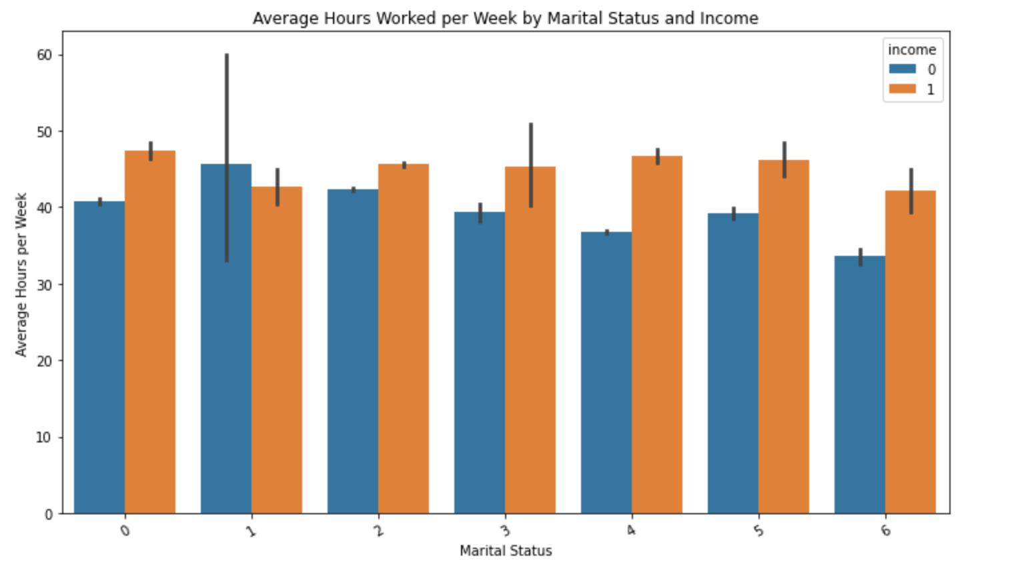
Hours worked vs marital status
Married individuals who work more tend to earn more
Original Value | Encoded Value
Divorced | 0
Married-AF-Spouse | 1
Married-civ-spouse | 2
Married-spouce-absent | 3
Never-married | 4
Separated | 5
Widowed | 6

Slide 9
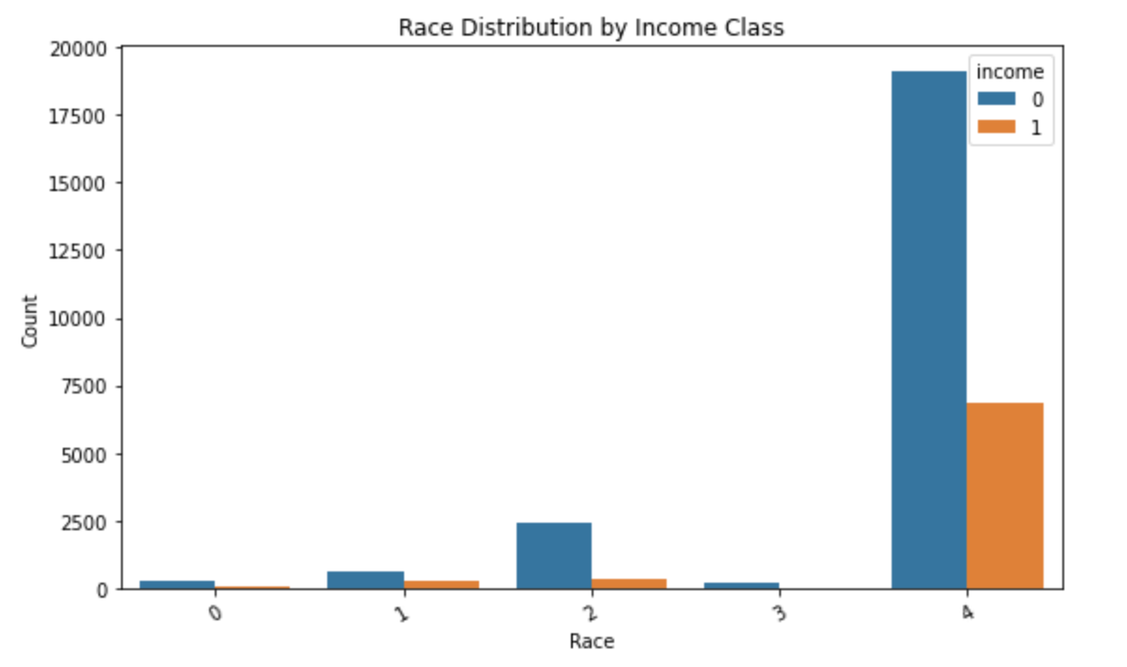
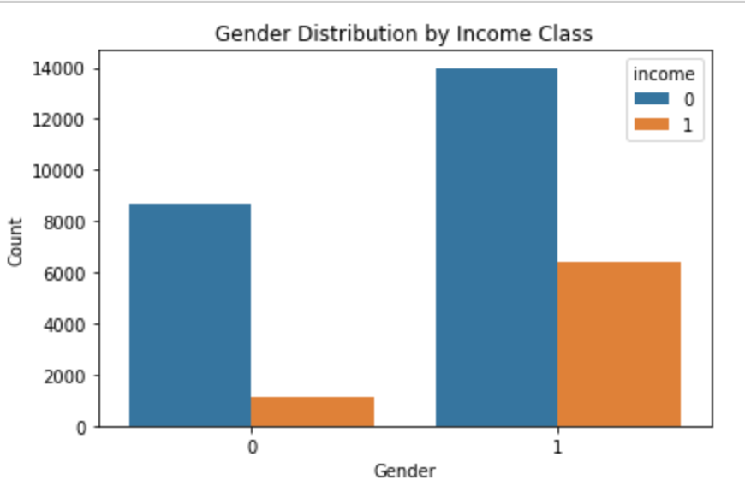
Race and gender by Income
Income disparities evident across race and gender
Original Value | Encoded Value
Amer-Indian-Eskimo | 0
Asian-Pac-Islander | 1
Black | 2
Other | 3
White | 4
Original Value | Encoded
Female | 0
Male | 1

Slide 10
methods
Modeling approach:
Logistic Regression as baseline
Random Forest for nonlinear patterns and feature importances
Evaluation metrics: accuracy, precision, recall, F1, ROC-AUC
Feature selection via Random Forest Gini importance

Slide 11
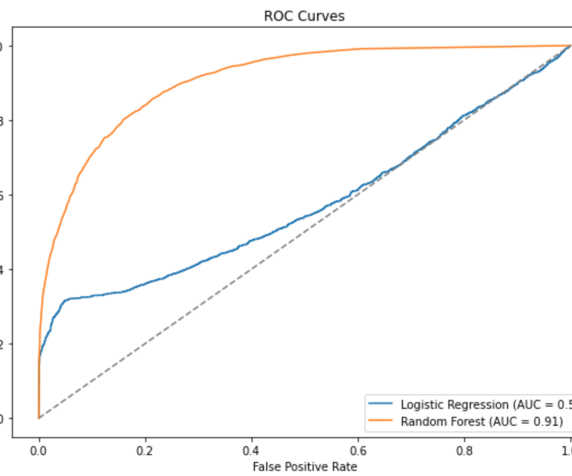
Model performance
Logistic Regression:
Accuracy: 78.6%
ROC-AUC: 0.81
Random Forest:
Accuracy: 85.8%
ROC-AUC: 0.90

Slide 12
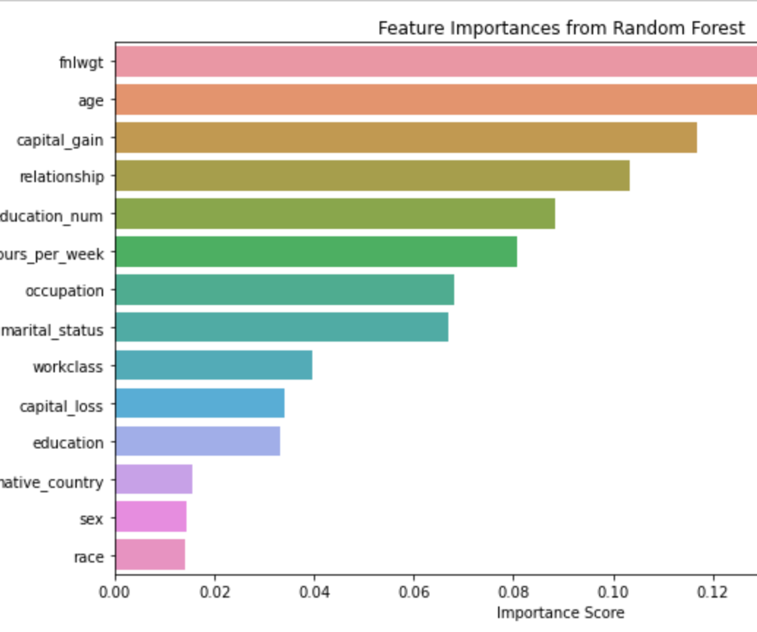
Feature importance
Top features:
Education (education_num)
Capital gain
Hours per week
Age
Marital status

Slide 13
Conclusion
ML models successfully predict income classification
Ensemble methods outperform baseline
Practical implications for policy, hiring, and education planning

Slide 14
Assumptions and limitations
Assumptions:
Dataset is representative
Socioeconomic patterns remain relevant
Limitations:
Data is from 1994
Missing regional & industry-level granularity
Risk of bias in historical data

Slide 15
Challenges and future work
Challenges:
Class imbalance
High number of categorical variables
Future Directions:
Use modern datasets
Include geographic, economic, and industry features
Explore XGBoost, dashboard deployment

Slide 16
ethical considerations
Risks:
Bias propagation
Privacy concerns
Solutions:
Regular audits
Transparency in modeling decisions
Stakeholder collaboration

