Slide 1

Predicting Home Run Probability Using Statcast Data
Data-driven Insights for Hitting Strategy
Xhoi Shyti – DSC 680

Slide 2
Business Problem
Home runs are high-impact events in MLB games
Predicting home run probability enables strategic coaching and enhanced fan experiences
Supports analytics for fantasy sports, broadcasts, and player evaluation

Slide 3
Rise of Statcast and Advanced Metrics
Statcast launched in 2015: measures launch angle, exit velocity, distanc
Historically used for descriptive analysis
This project uses predictive modeling to quantify home run likelihood

Slide 4

Statcast Dataset (2023–2024)
Sample of 10,000 pitching events from the 2023-2024 MLB season
Over 9,600 batted ball events
Key fields: launch_speed, launch_angle, extra_distance_2025, events
Target variable: is_home_run (binary)

Slide 5
Feature Selection & Cleaning
Filtered for in-play batted balls
Removed missing values
Final predictors:
Launch Speed (mph)
Launch Angle (degrees)
Park Factor (extra_distance_2025)

Slide 6
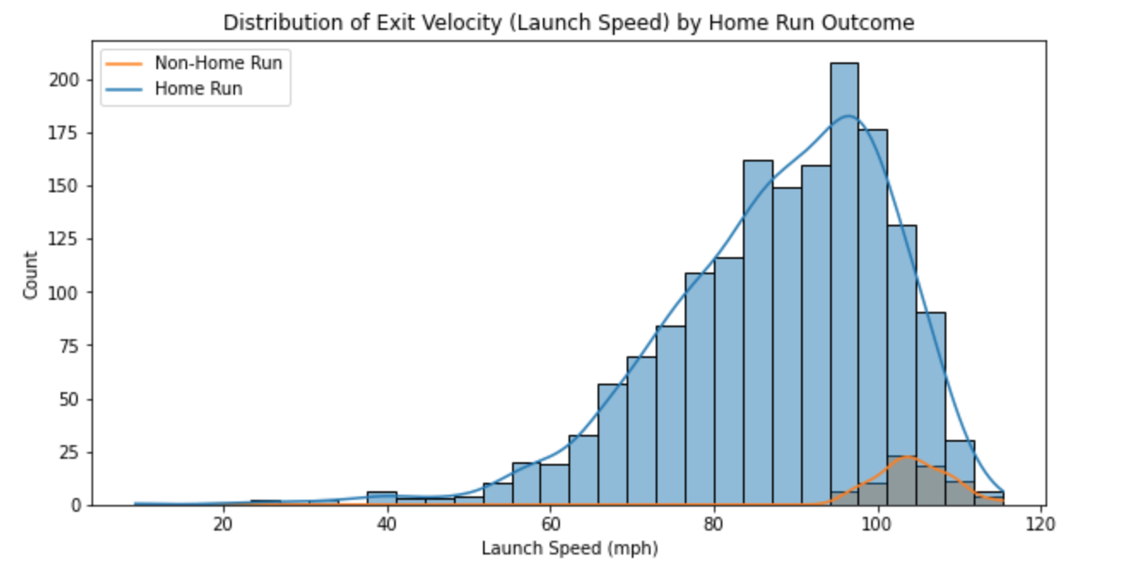
Launch Speed vs Home Run Likelihood

Slide 7
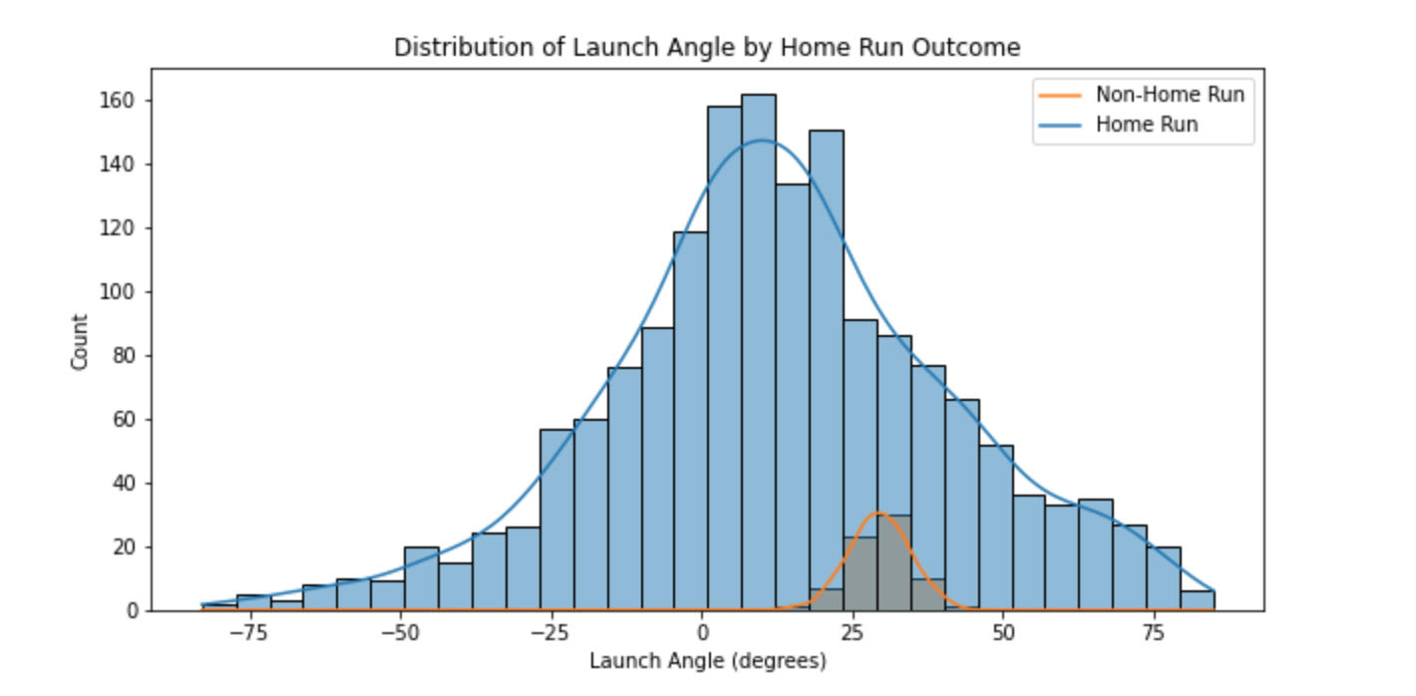
Launch Angle Analysis
Most HRs occur between 20–40 degrees

Slide 8
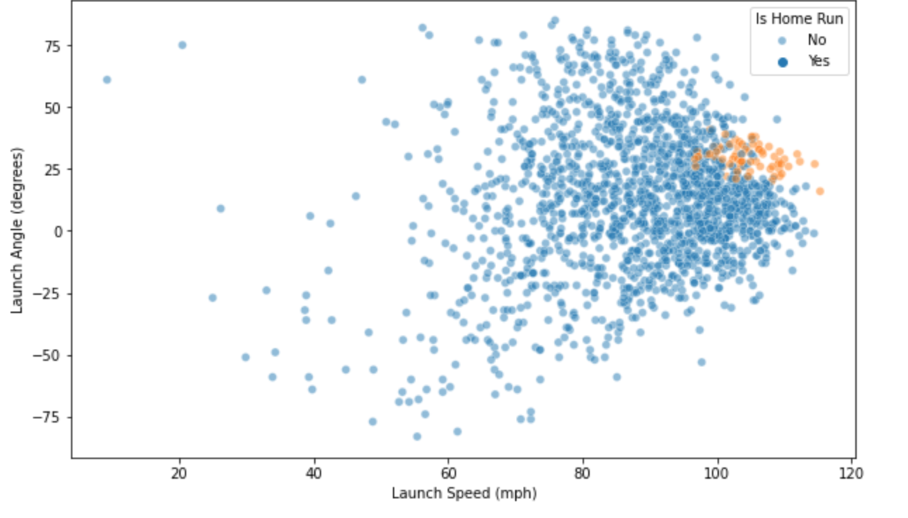
Sweet Spot in Bated-Ball Profiles
High launch_speed + mid-range launch_angle = higher HR chance

Slide 9
Accounting for Stadium Context
Used extra_distance_2025 as a proxy for park-adjusted flight distance
Improves model's ability to generalize across ballparks

Slide 10
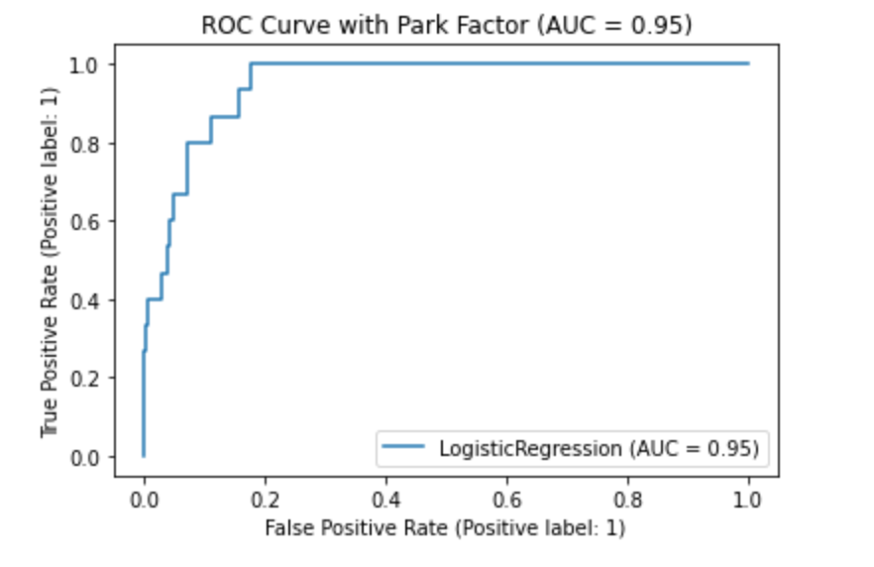
Logistic Regression Results
Accuracy: 96.8%
Precision (HR): 75%
Recall (HR): 40%
ROC-AUC: 0.95

Slide 11
Conclusion
Launch speed and angle are strong HR predictors
Park factor significantly boosts model recall
Simple, interpretable models can offer valuable insights

Slide 12
What’s Next?
Test advanced models (e.g., XGBoost)
Add weather and defense context
Real-time deployment via broadcast overlay
Monitor model drift and retrain periodically

Slide 13
Responsible Model Use
Avoid reducing players to a single metric
Ensure models support—not replace—human judgment
Maintain transparency in assumptions and limitations

