Slide 1
XSpec
Unit testing for XSLT, Schematron, and XQuery
Vincent Lizzi
JATS-Con, 18 April 2018
Notes:
I'm going to talk about unit testing and a tool that can help with unit testing XSLT, Schematron and XQuery. That tool is called XSpec.

Slide 2
Creating XSLT, Schematron or XQuery involves using sample XML to test
Hang on to those sample files, they will be useful again!
XSpec automatically runs sample XML
through XSLT, Schematron or XQuery
and compares the output to the expected output
Notes:
When writing XSLT or XQuery or Schematron it is very common to have a set of sample XML that is used to test whether the code that you have just written does what you expect it to do. It is a very good idea to keep these sample XML files because they might be useful in the future. You can run your XSLT or Schematron or XQuery on each sample XML and inspect the output manually, one at a time. That can be a long process, and it is a process that you might have to do several times. Fortunately there are tools that can help, and XSpec is such a tool.

Slide 3
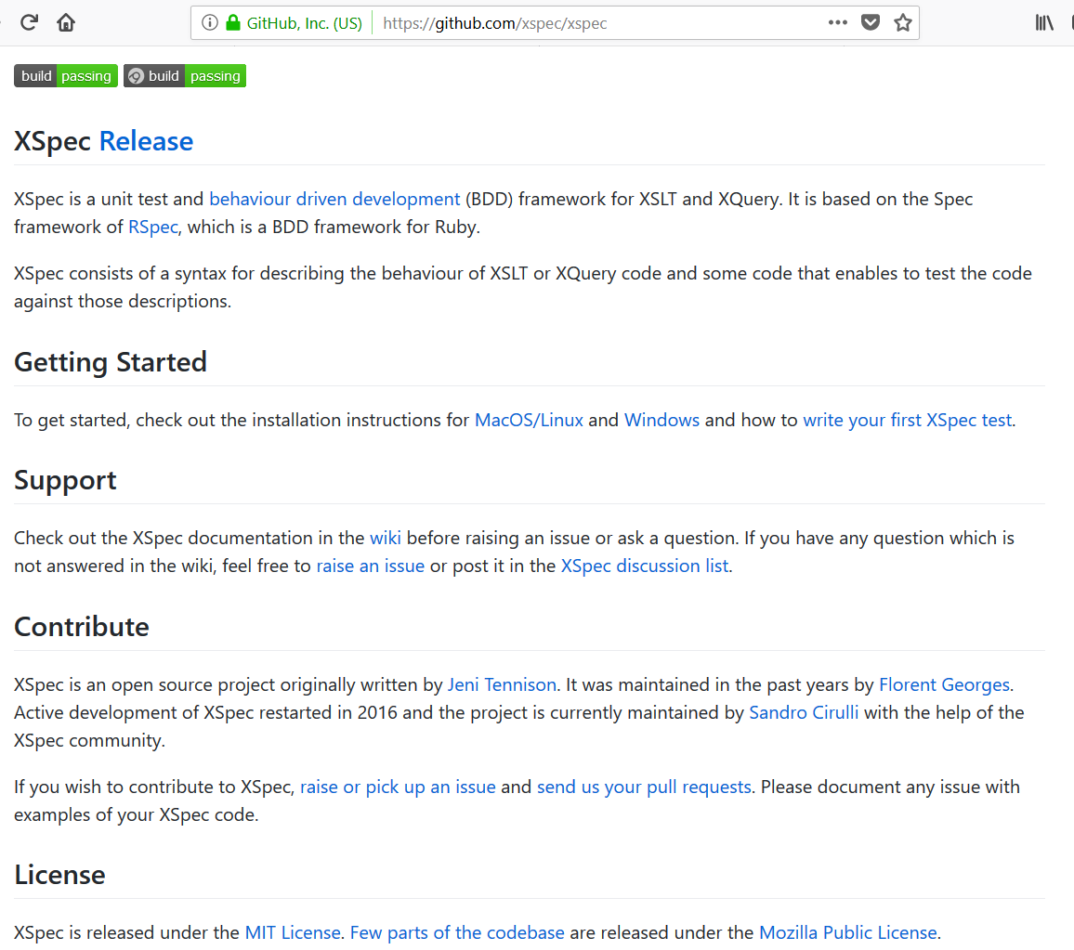







XSpec is available on GitHub
… and integrates with favorite tools
and more!
Notes:
XSpec is an open source project available on GitHub. It is also built into oXygen XML Editor. XSpec is also pretty easy to integrate into automated test suites and continuous integration tools. So if you want to use XSpec there are a lot of options for how to use it.
I am going to show a few examples.

Slide 4
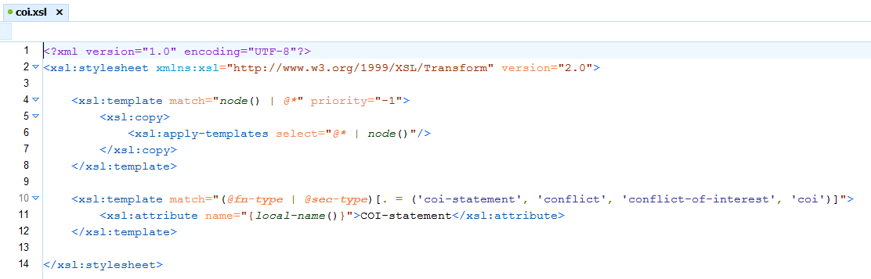
Example 1: XSLT
Notes:
First, an XSLT example. This XSLT has just a few templates. This XSLT specifically processes attributes. A lot of people write XSLT in a way that focuses on elements, but XSLT can give equal treatment to elements and attributes. Here we have a template that matches a few different variations of attribute values that indicate a conflict of interest statement and produces a normalized output.

Slide 5
Sample XML is added to XSpec test
XML fragments:
Sample input: <x:context><sample-in/></x:context>
Expected output: <x:expect label=""><sample-out/></x:expect>
XML files:
Sample input: <x:context href="sample-in.xml"/>
Expected output: <x:expect label="" href="sample-out.xml"/>
Notes:
To test that this XSLT actually does what is intended we have a set of sample XML. This sample XML can be entered into an XSpec test description, along with the expected output. XSpec can then automate the process of running the XSLT and produce a convenient report to show what worked and what failed. One of the nice things about XSpec is that it allows you to use XML fragments or complete XML documents referenced by an href. If you just need a small piece of XML in order to test something you can just use that piece, so you do not have to mock out a whole XML file. If you do want to test a transformation using an XML file for the input and another XML file for the expected output, you can simply reference the two XML files using href attributes.

Slide 6
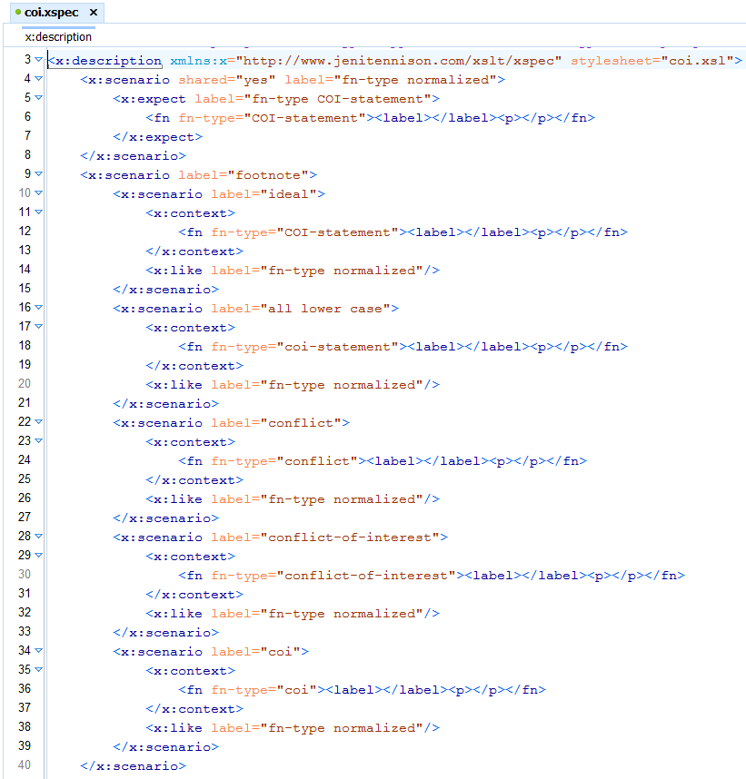
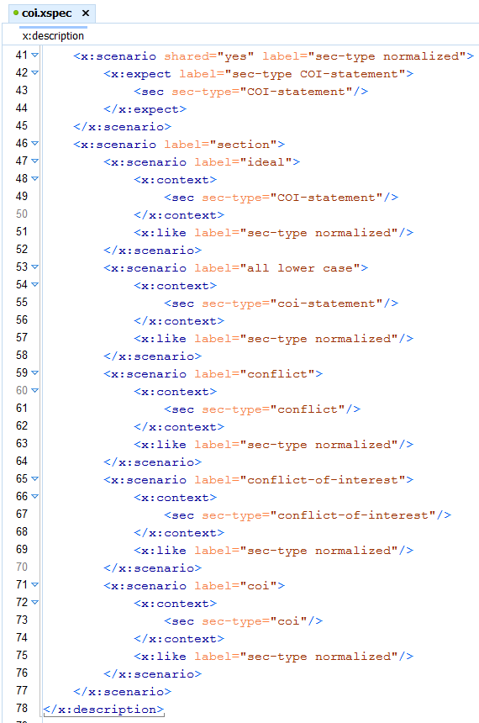
Example 1: XSpec test description
Notes:
Here is the XSpec test description for the XSLT that we just saw. This test description has several scenarios that each contain sample XML and expected output. You can also see at the top of the file that it references the XSLT.

Slide 7
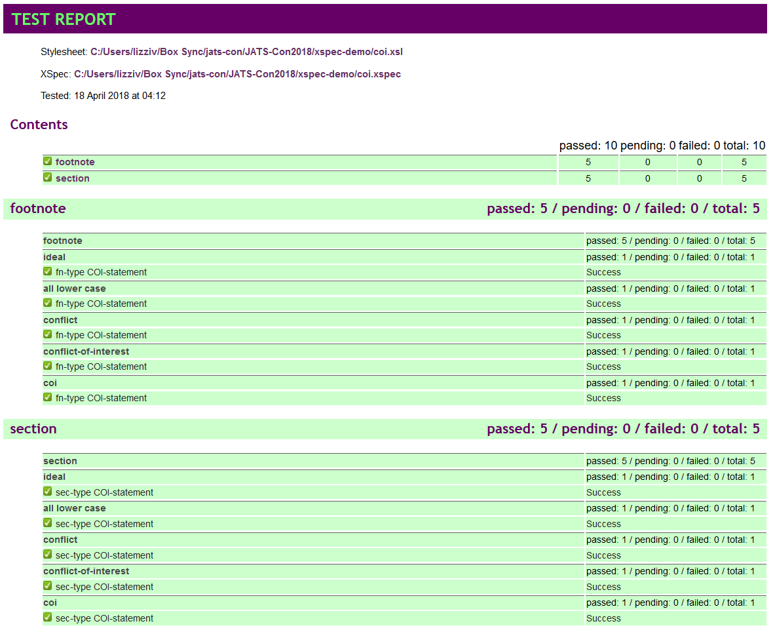
Example 1: XSpec Report
Notes:
When this XSpec is run, it produces a report showing that the XSLT worked, meaning that all scenarios passed using the sample XML to produce the expected output.

Slide 8
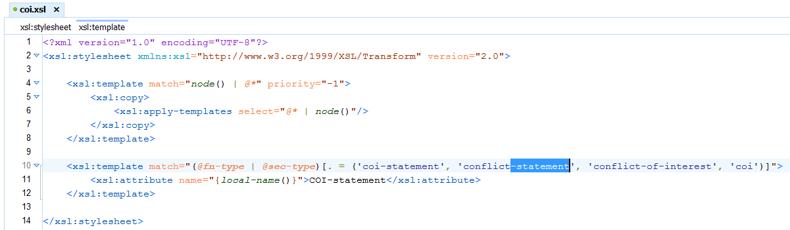
Example 1: A change in the XSLT
Notes:
What happens when we make a change to the XSLT? Here we make a seemingly small change.

Slide 9
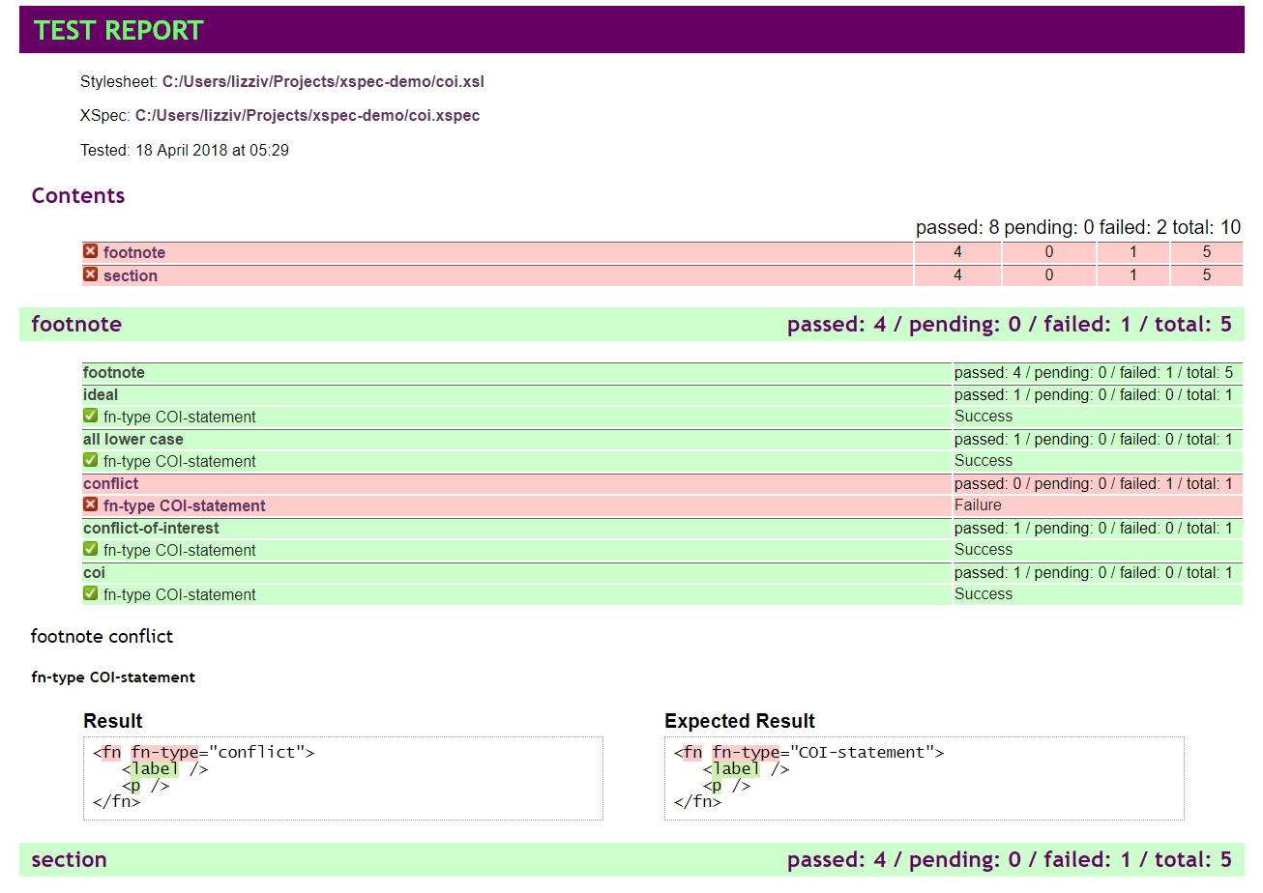
Example 1: XSpec report shows there is a problem
Notes:
Then we run the XSpec. The XSpec report tells us that this change actually broke something! In the real world, if we were adding new templates to this XSLT we would probably also create a few new sample XMLs and add new scenarios to the XSpec test file.

Slide 10
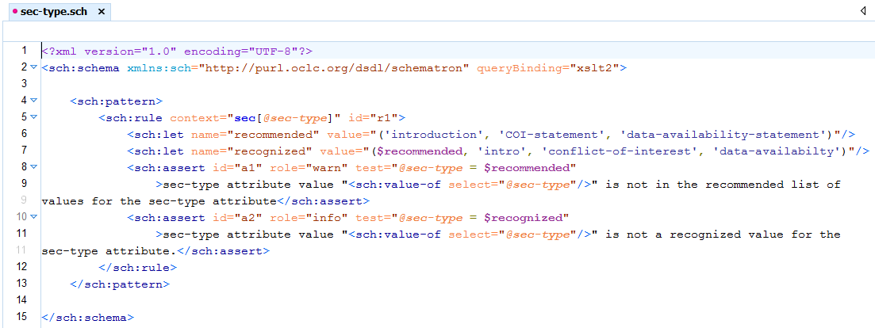
Example 2: Schematron
Notes:
Now, this second example is for Schematron. This Schematron has two lists of values for a sec-type attribute: a recommended list and a recognized list. In this hypothetical scenario, you have a list of sec-type attribute values that you want the people coding your XML to use. You also have a slightly longer list of values that your system understands and knows how to process, and you want to know if a new sec-type attribute value that you have not seen before comes along. There are two assertions in this schematron. One produces a warning if the sec-type value is not in the recommended list. One produces an information message if the sec-type value is not in the recognized list.

Slide 11
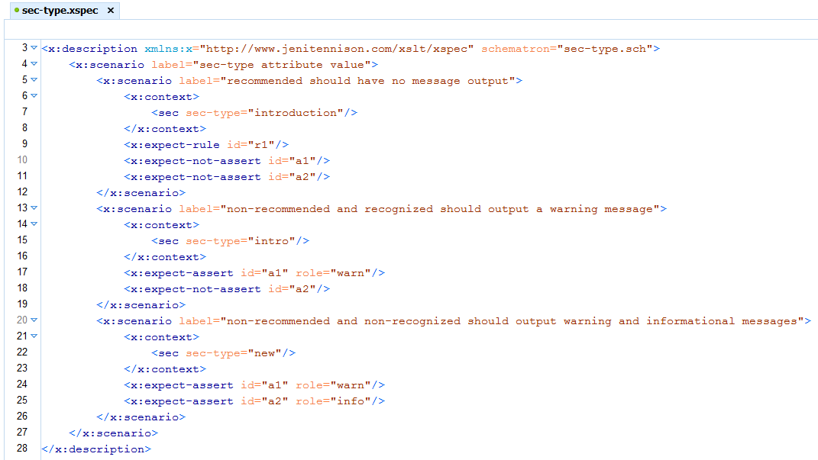
Example 2: XSpec test description
Notes:
Here is an XSpec test description for this schematron. As you can see the schematron is referenced at the top of the file. There are several scenarios to test each of the different outcomes that we expect to happen. Given a recommended sec-type value, there should be no message output. XSpec can verify that the rule is fired and that none of the two assertions are thrown. Given a non-recommended sec-type value that is recognized, the warning message should be output. XSpec can verify that the warning assertion is thrown. Given a non-recommended sec-type value that is not recognized, both the warning message and the informational message should be output. XSpec can verify that both assertions are thrown.

Slide 12
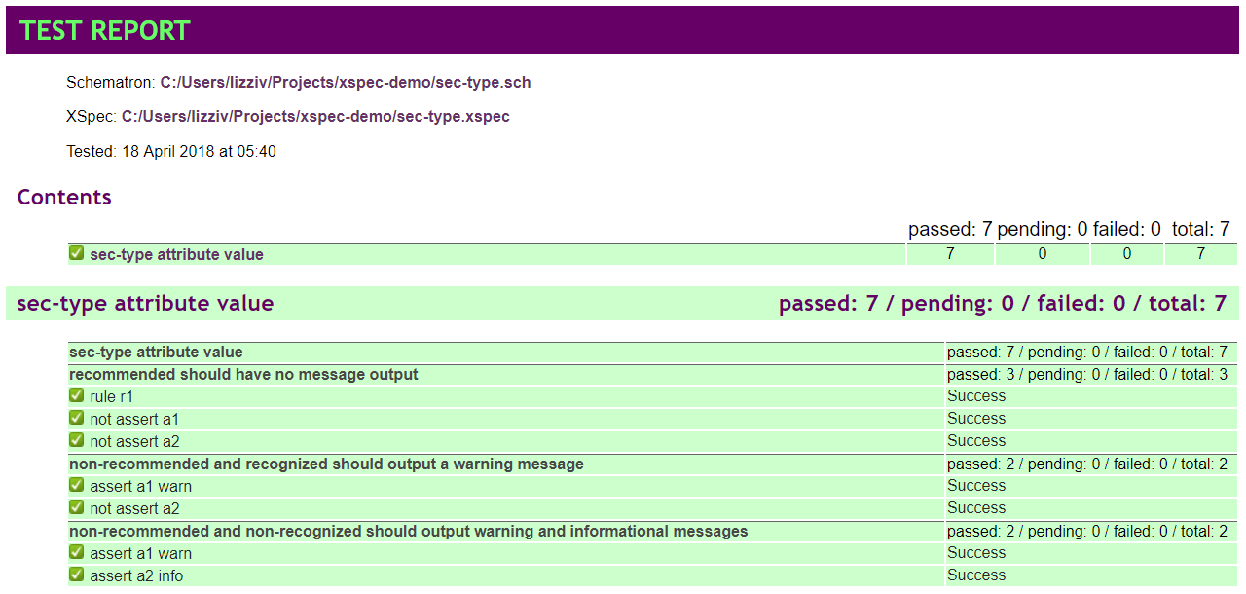
Example 2: XSpec Report
Notes:
Here is the report that is produced when XSpec is run to test this schematron.

Slide 13
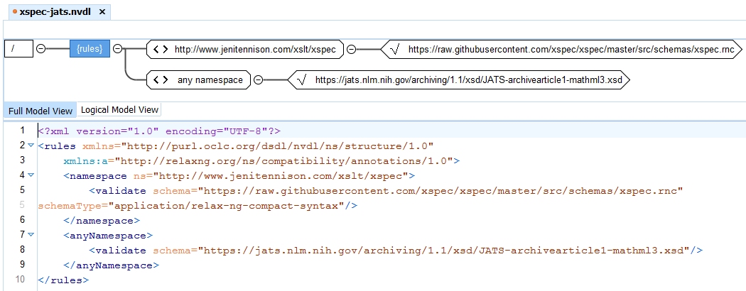
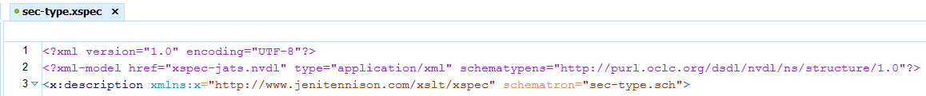
Tip: NVDL to validate JATS fragments in XSpec
Notes:
Here is an extra tip: oXygen can combine multiple schemas using NVDL, namespace based validation dispatching language. You can create an NVDL schema like this that includes the schemas for both XSpec and JATS, then reference the NVDL at the top of your XSpec test definition using an xml-model processing instruction. oXygen will then validate that your XSpec test description contains valid JATS tags.

Slide 14
XSpec
Can also test XQuery
Modular tests
Shared scenarios <x:like>
Import other XSpec files <x:import>
Known (soft) limitations:
Can’t test <xsl:result-document>
Can’t always run end-to-end tests on transformation pipelines
Can test micro pipelines within an XSLT
Notes:
I do not have time to show an XQuery example. I also don't have time to show examples of modular tests. It is worth mentioning that XSpec has several mechanisms to allow tests to be created in modular ways. There are a few known limitations: XSpec cannot test <xsl:result-document> and it is not able to test most pipeline XSLT conversions. Although there might be solutions to these problems.

Slide 15
XSpec Unit testing for XSLT, Schematron, and XQuery
Available on GitHub
https://github.com/xspec/xspec
Included in oXygen version 20
Balisage paper contains more information about Schematron testing: http://www.balisage.net/Proceedings/vol19/html/Lizzi01/BalisageVol19-Lizzi01.html
Thanks to Sandro Cirulli and AirQuick
Notes:
Here is the link where you can get XSpec from GitHub. As I mentioned XSpec is included in oXygen. Specifically, oXygen version 20 or above is what you ideally want if you are interested in testing Schematron. Also there is the link to my paper from Balisage last year which goes into more detail about testing Schematron using XSpec. I also want to say thanks to a few people. Thanks to Sandro Cirulli who leads the project and to AirQuick who reviews many of the pull requests and has done tremendous work to create automated tests for XSpec itself. I'm not sure if there is time for any questions, but feel free to catch me in the hallways if you have questions.

