Slide 1
Angular
Introduction

Slide 2
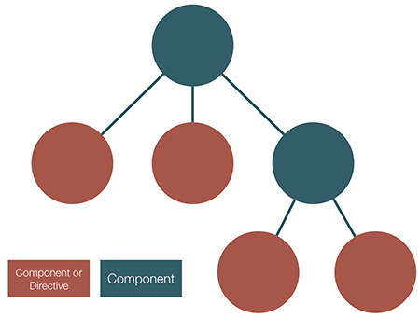
Why Angular 2??
Web Component
Performance
Simplified mental model
Notes:
Web component:
Component is a building block consisting of a controller class, a view and a selector.
Instead of binding to properties on the scope, we bind directly to properties on the component (which in turn can be bound directly to object properties on the DOM).
Performance:
- there is a uni-directional, top-down flow of data, from parent to child. Angular no longer needs to keep constantly checking state.
No more $digest cycle (it’s now a once-off phase). Again, this means no longer having constantly to watch elements
Simplified :
- Angular 2 app is a tree of UI components with one parent/many children (same as DOM tree).

Slide 3
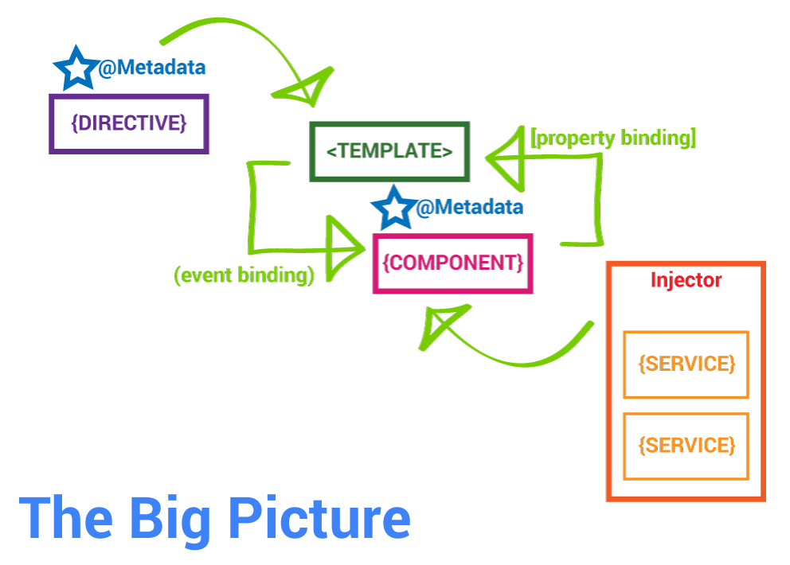

Slide 4
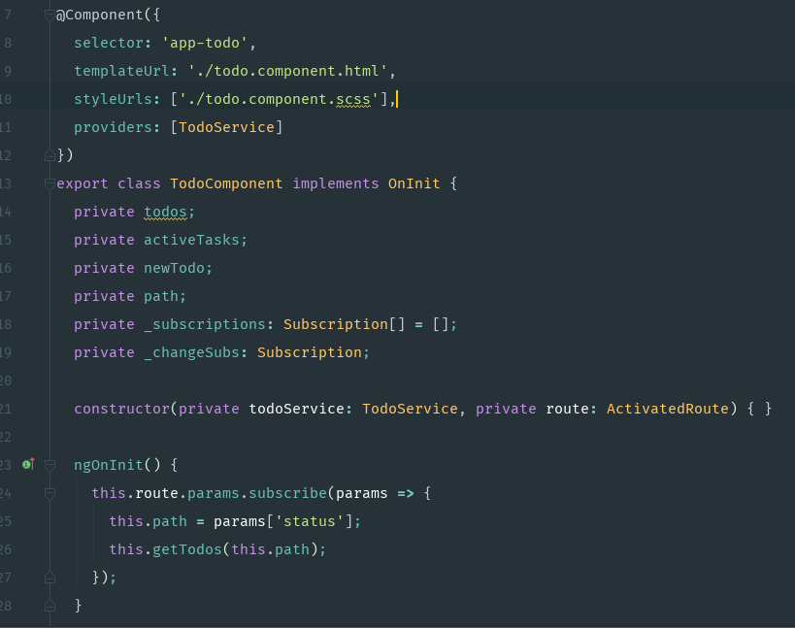
Component
Components are just ES6 classes
Providers (Services) are injected in the constructor
Need to explicitly define providers and directives within the component decoration
Hook into the component lifecycle with hooks
Properties and methods of the component class are available to the template
Notes:
Most common is the @Component() decorator • Takes a config option with the selector, template(Url), providers, directives, pipes and styles

Slide 5
Data binding
Enables data to flow from the component to template and vice-versa
Includes interpolation, property binding, event binding, and two-way binding (property binding and event binding combined)
The binding syntax has expanded but the result is a much smaller framework footprint

Slide 6
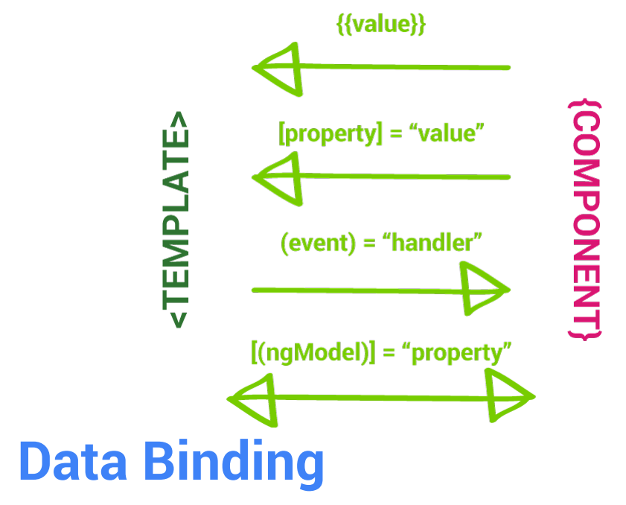

Slide 7
Dependency Injection
Supplies instance of a class with fully-formed dependencies
Maintains a container of previously created service instances
To use DI for a service, we register it as a provider in one of two ways: when bootstrapping the application, or in the component metadata

Slide 8
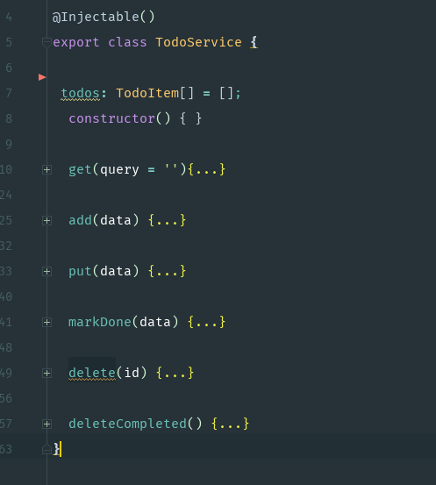
Service
A service is just a class
Should only do one specific thing
Take the burden of business logic out of components
Decorate with @Injectable when we need to inject dependencies into our service

Slide 9
Lifecycle Hooks
ngOnChanges - called when an input or output binding value changes
ngOnInit - after the first ngOnChanges
ngDoCheck - developer's custom change detection
ngAfterContentInit - after component content initialized
ngAfterContentChecked - after every check of component content
ngAfterViewInit - after component's view(s) are initialized
ngAfterViewChecked - after every check of a component's view(s)
ngOnDestroy - just before the directive is destroyed.
Notes:
Allow us to perform custom logic at various stages of a component's life

Slide 10
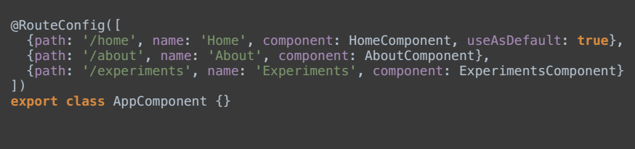
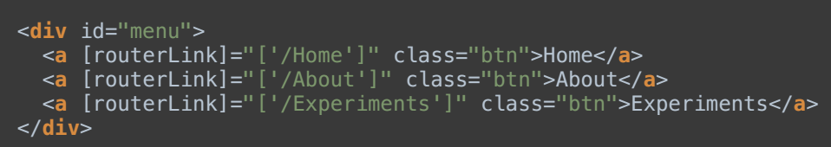
Component Router
Import ROUTE_PROVIDERS, ROUTE_DIRECTIVES, and the RouteConfig decorator
Configuration is handled via a decorator function (generally placed next to a component) by passing in an array of route definition objects
Use the router-outlet directive to tell Angular where you want a route to put its template <router-outlet></router-outlet>

Slide 11
Pipes
A pipe takes in data as input and transforms it to a desired output We use them in our templates with interpolation: User created on {{ created_at | date }}
Include parameters to a pipe by separating them with a colon: User created on {{ created_at | date:"MM/dd/yy" }}
Pipes are chain-able: User created on {{ created_at | date | uppercase }}

Slide 12
Built-in Pipes
DatePipe User created on {{ user.created_at | date }}
UpperCasePipe Middle Initial: {{ user.middle | uppercase }}
LowerCasePipe Username: {{ user.username | lowercase }}
CurrencyPipe Price Plan: {{ user.plan.price | currency }}
PercentPipe Data Usage: {{ user.usage | percent }}

Slide 13
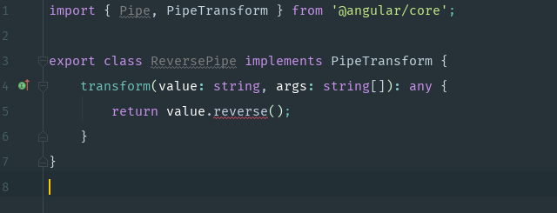
Custom Pipes
Import the pipe decorator and PipeTransform interface
Create a class that implements the PipeTransform interface and includes a transform method

Slide 14
Show Time!!!
Notes:
https://github.com/xstars1505/todo-app

Slide 15
Thank you!!!

