Slide 1

MicroProfile
microservices made easy

Slide 2

# whoami
Martin Štefanko
Software engineer 3+ years, Red Hat
MicroProfile contributor
@xstefank
#devconfcz
#microprofile
@xstefank
@RedHat

Slide 3
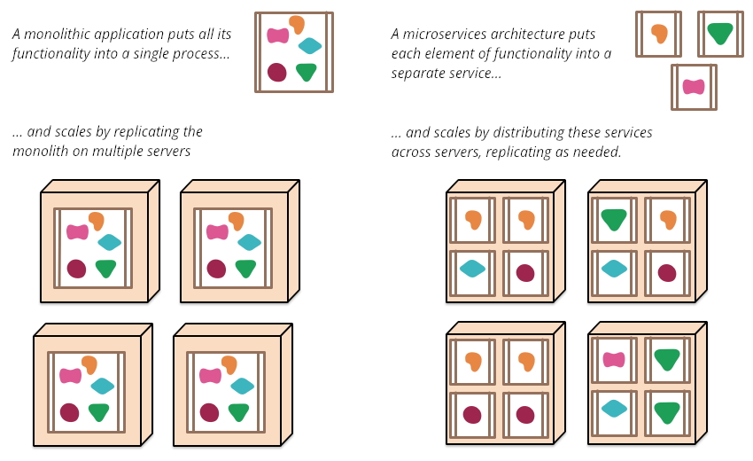
https://martinfowler.com/articles/microservices.html
#devconfcz
#microprofile
@xstefank
@RedHat
Notes:
- developed, tested, scaled and deployed independently
- public API / interface
- faster and more stable releases

Slide 4


Enterprise Java in past 20 years
Java EE (currently Jakarta EE)
  Java EE 5 - May 11, 2006
  Java EE 6 - December 10, 2009
  Java EE 7 - June 12, 2013
  Java EE 8 - August 31, 2017
#devconfcz
#microprofile
@xstefank
@RedHat

Slide 5
MicroProfile
Eclipse MicroProfile is an open-source community specification for Enterprise Java microservices
A community of individuals, organizations, and vendors collaborating within an open source (Eclipse) project to bring microservices to the Enterprise Java community
#devconfcz
#microprofile
@xstefank
@RedHat
Notes:
- eclipse - over 350 projects

Slide 6
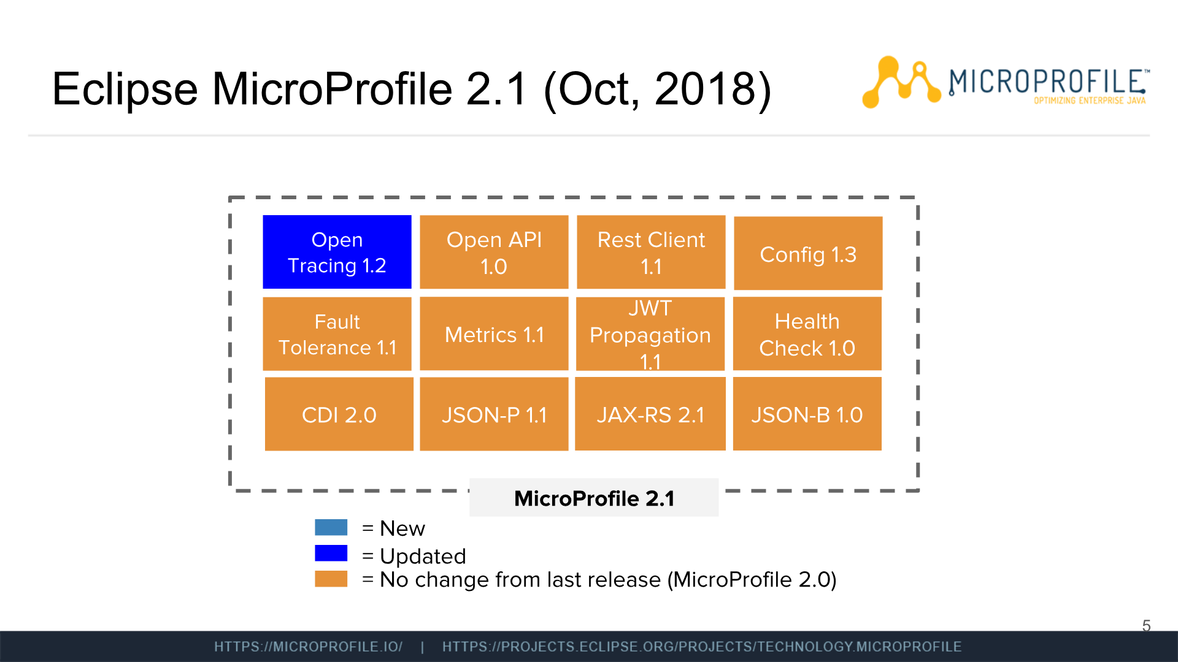

Slide 7
+Under discussion
Long Running Actions (LRA)
Reactive Streams Operators
Reactive messaging
Service mesh
Concurrency
GraphQL
...

Slide 8
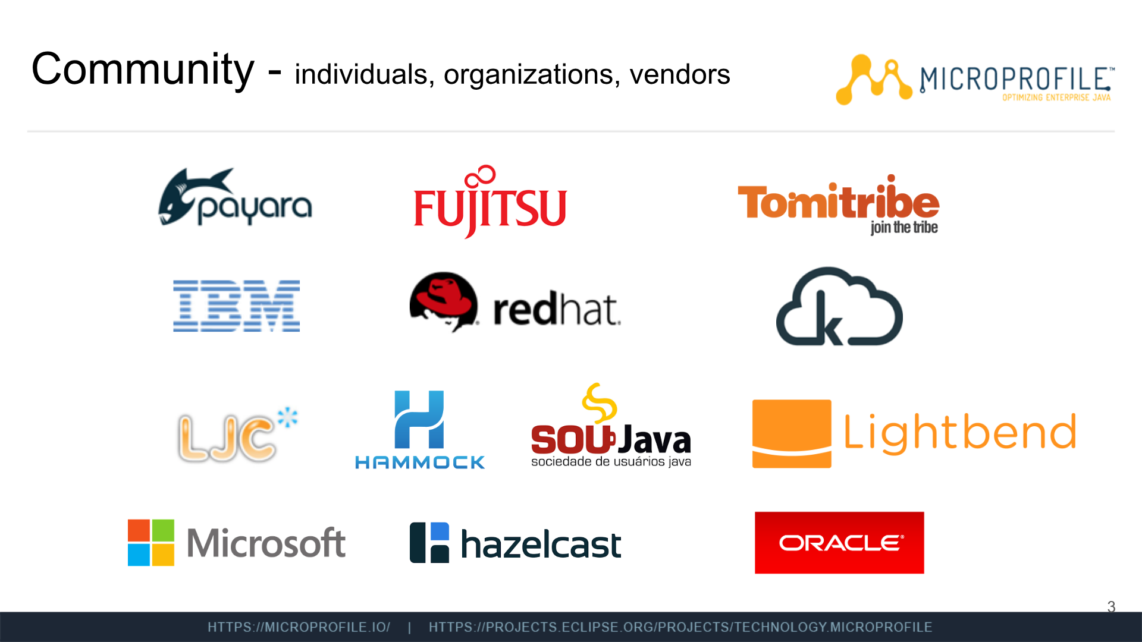

Slide 9
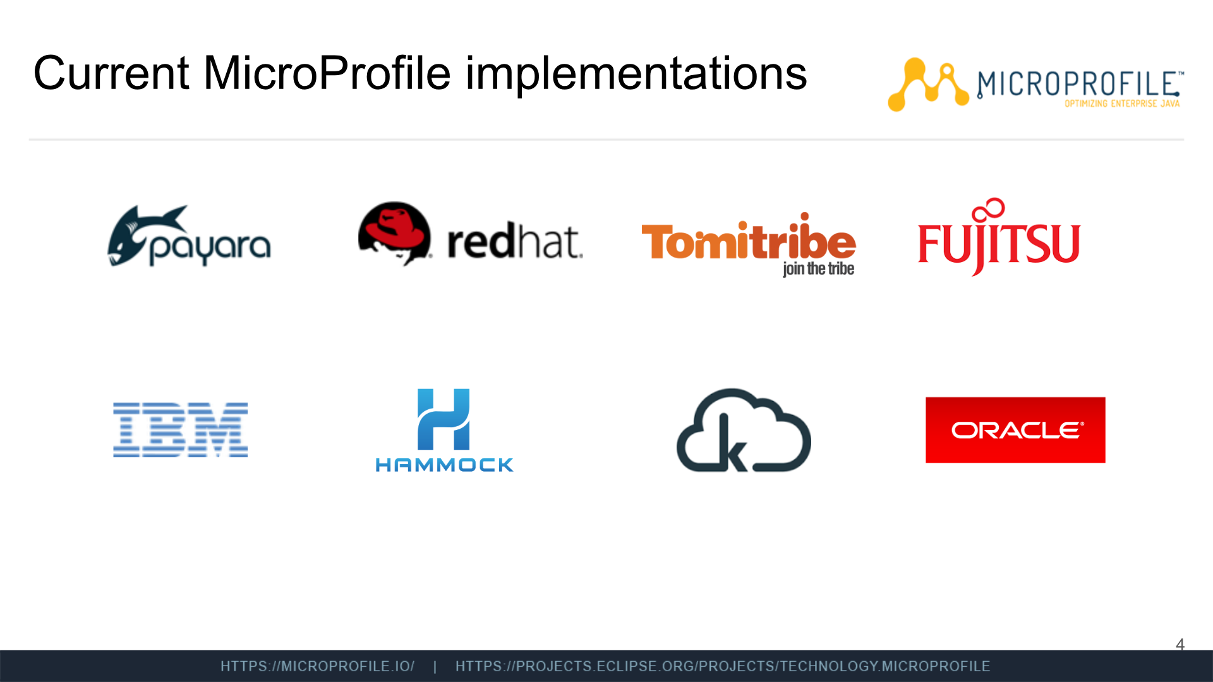

Slide 10
Differences from Java EE
open source and open community
code first approach
3 releases per year (Feb, Jun, Oct)
  MP 1.0 - Sep 2016
  MP 1.1 - Aug 2017
  MP 1.2 - Sep 2017
  MP 1.3 - Jan 2018
  MP 1.4 / MP 2.0 - Jun 2018
  MP 2.1 - Oct 2018

Slide 11
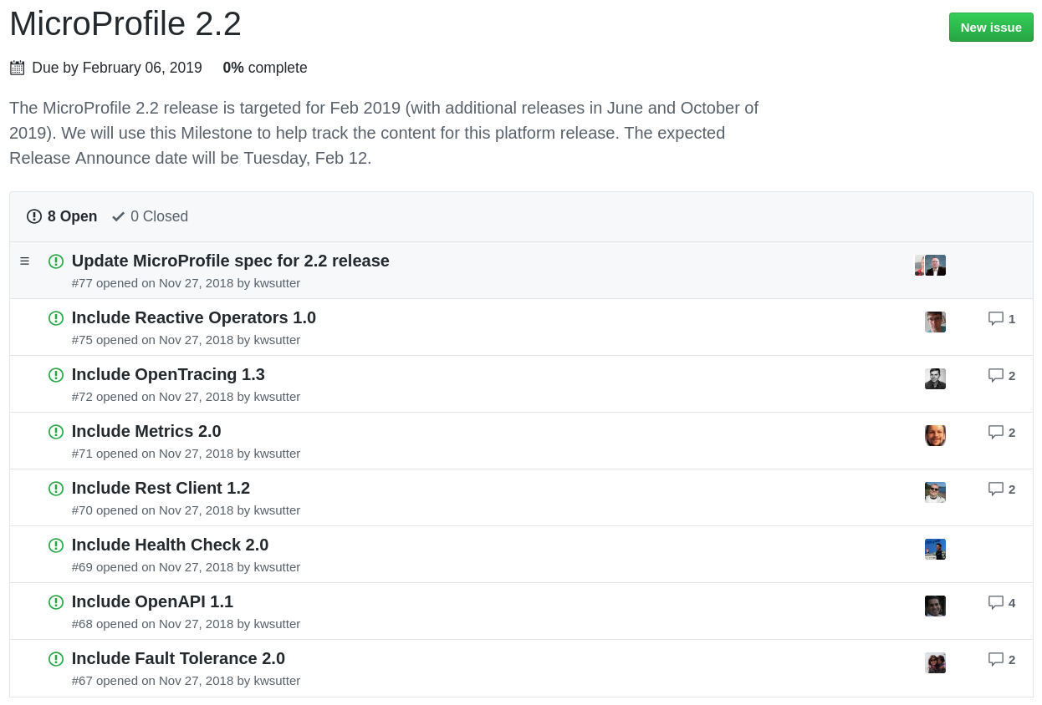

Slide 12
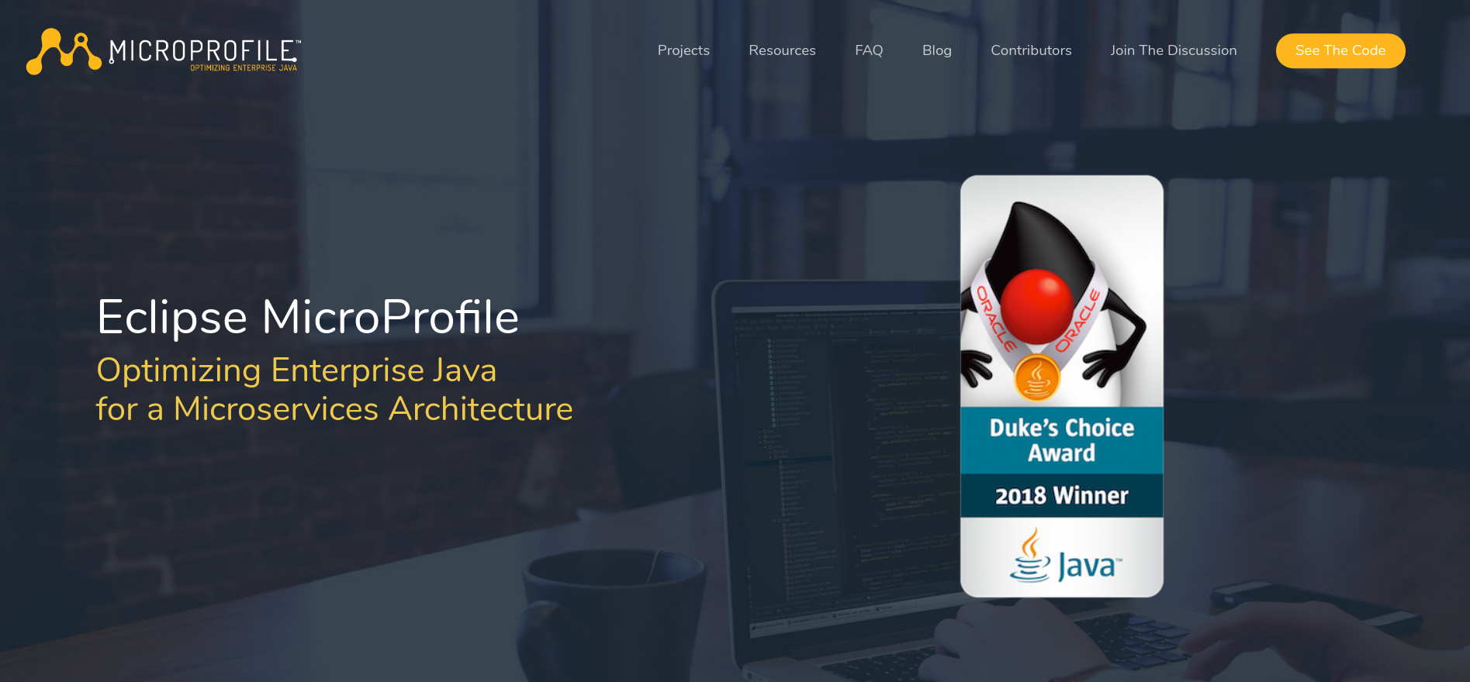
microprofile.io

Slide 14
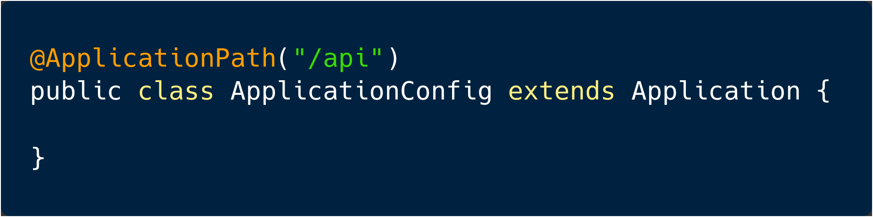
JAX-RS
host:port/api/path1/path2/…

Slide 15
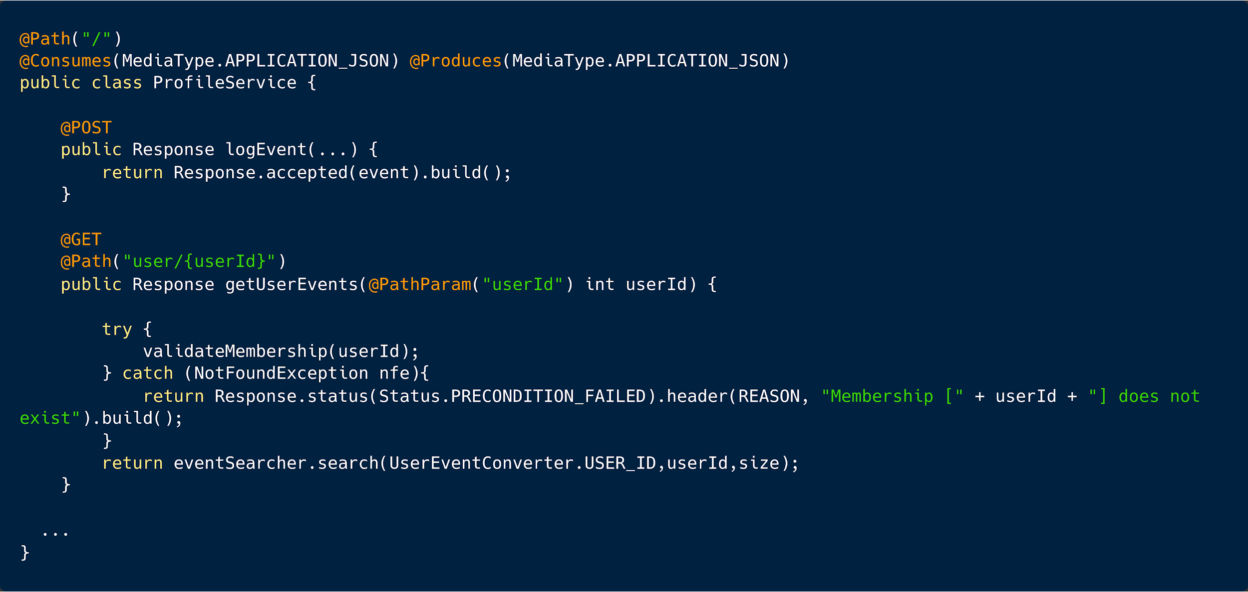

Slide 16
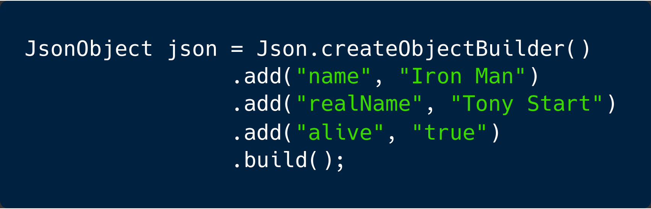
JSON-P

Slide 17
JSON-P
Creating, reading and writing JSON
Parsing JSON
Stream support
JSON pointers
JSON patching

Slide 18
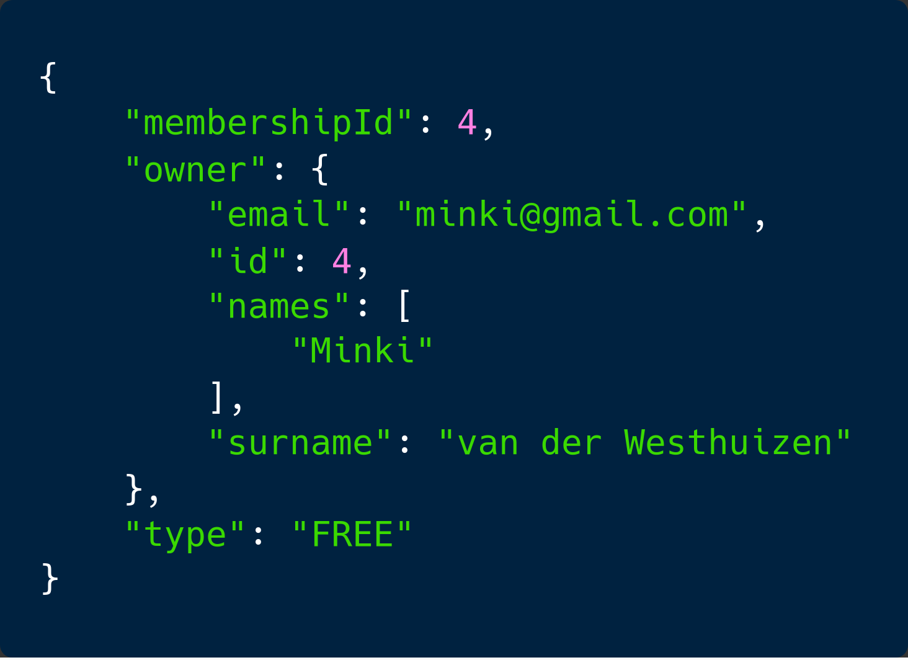
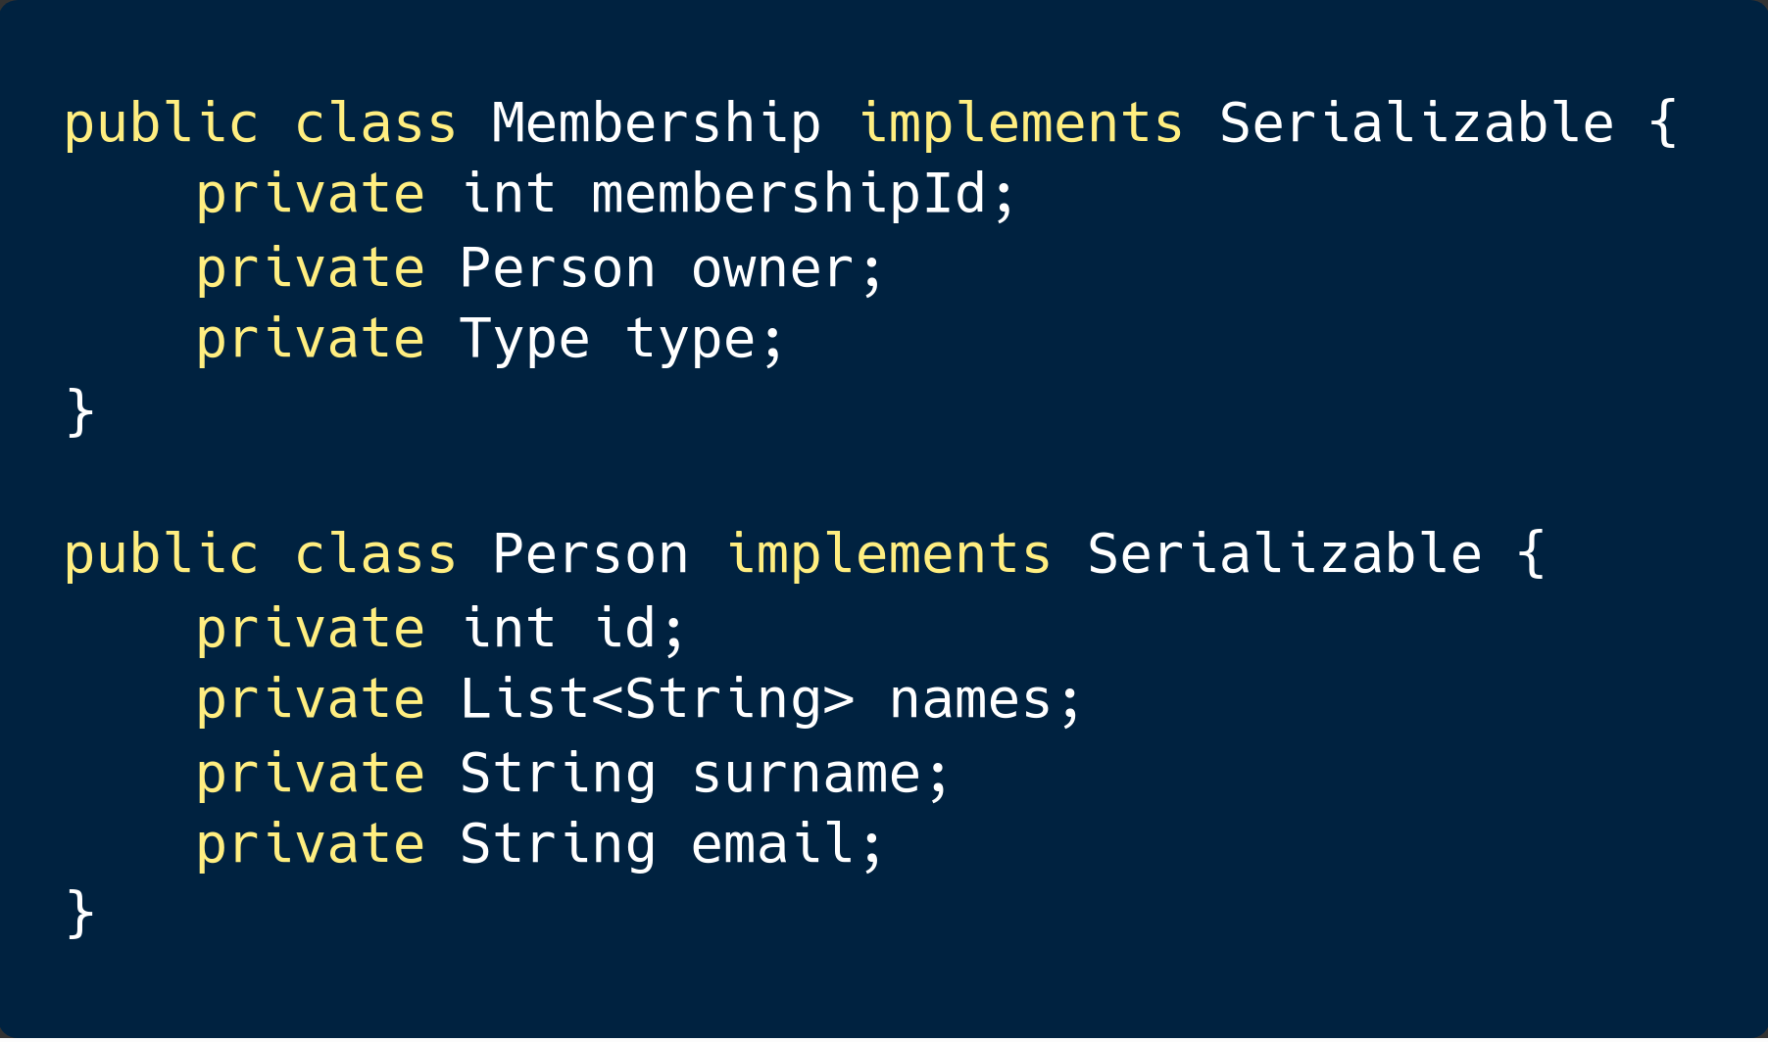
JSON-B

Slide 19
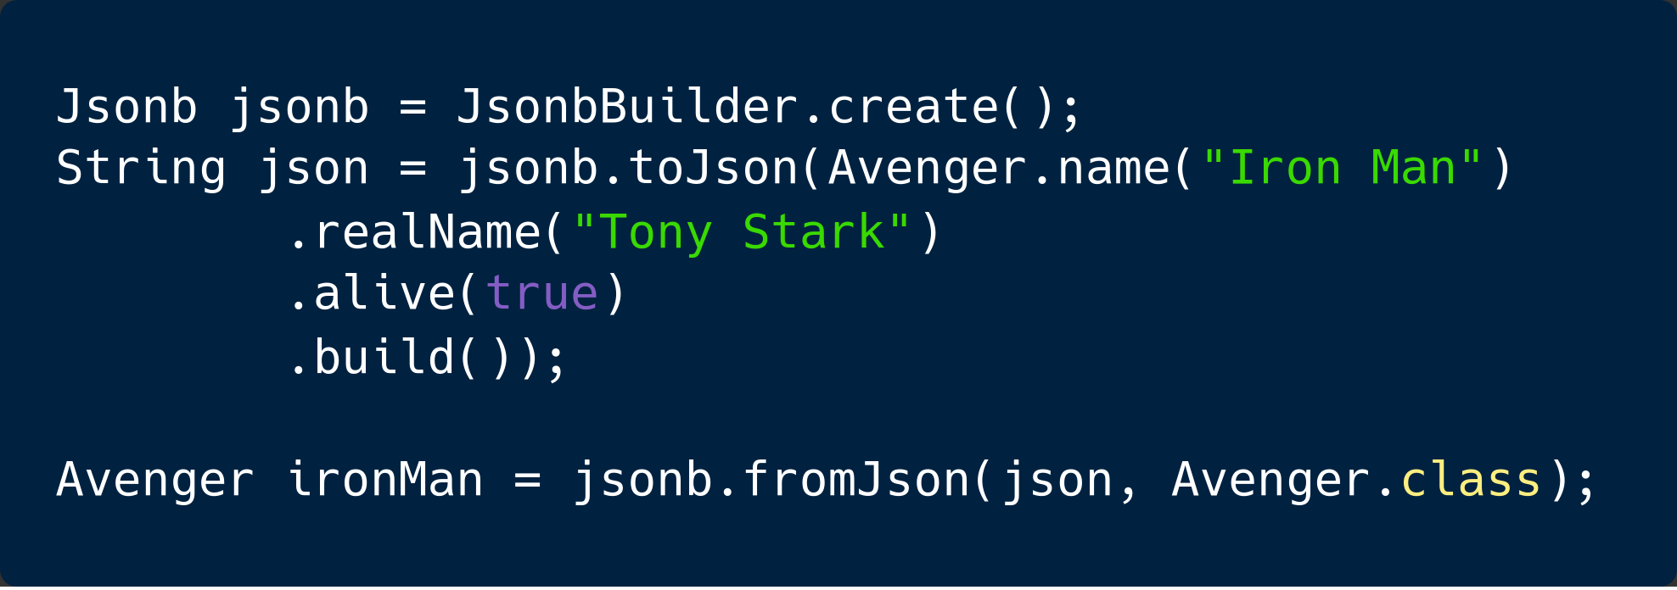
JSON-B

Slide 20
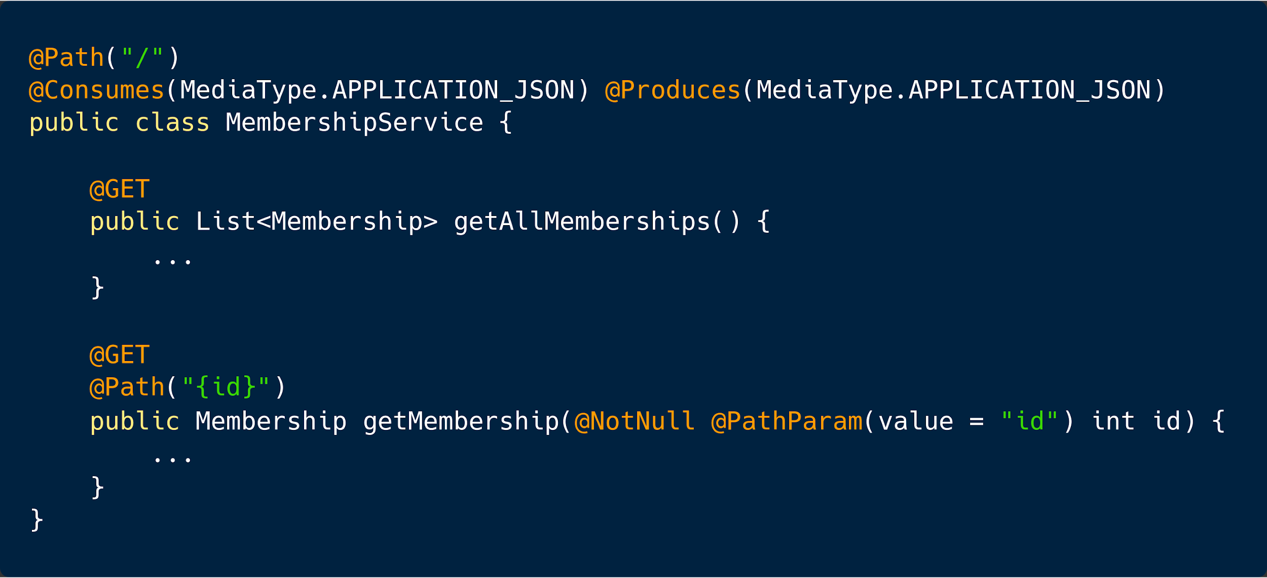

Slide 21
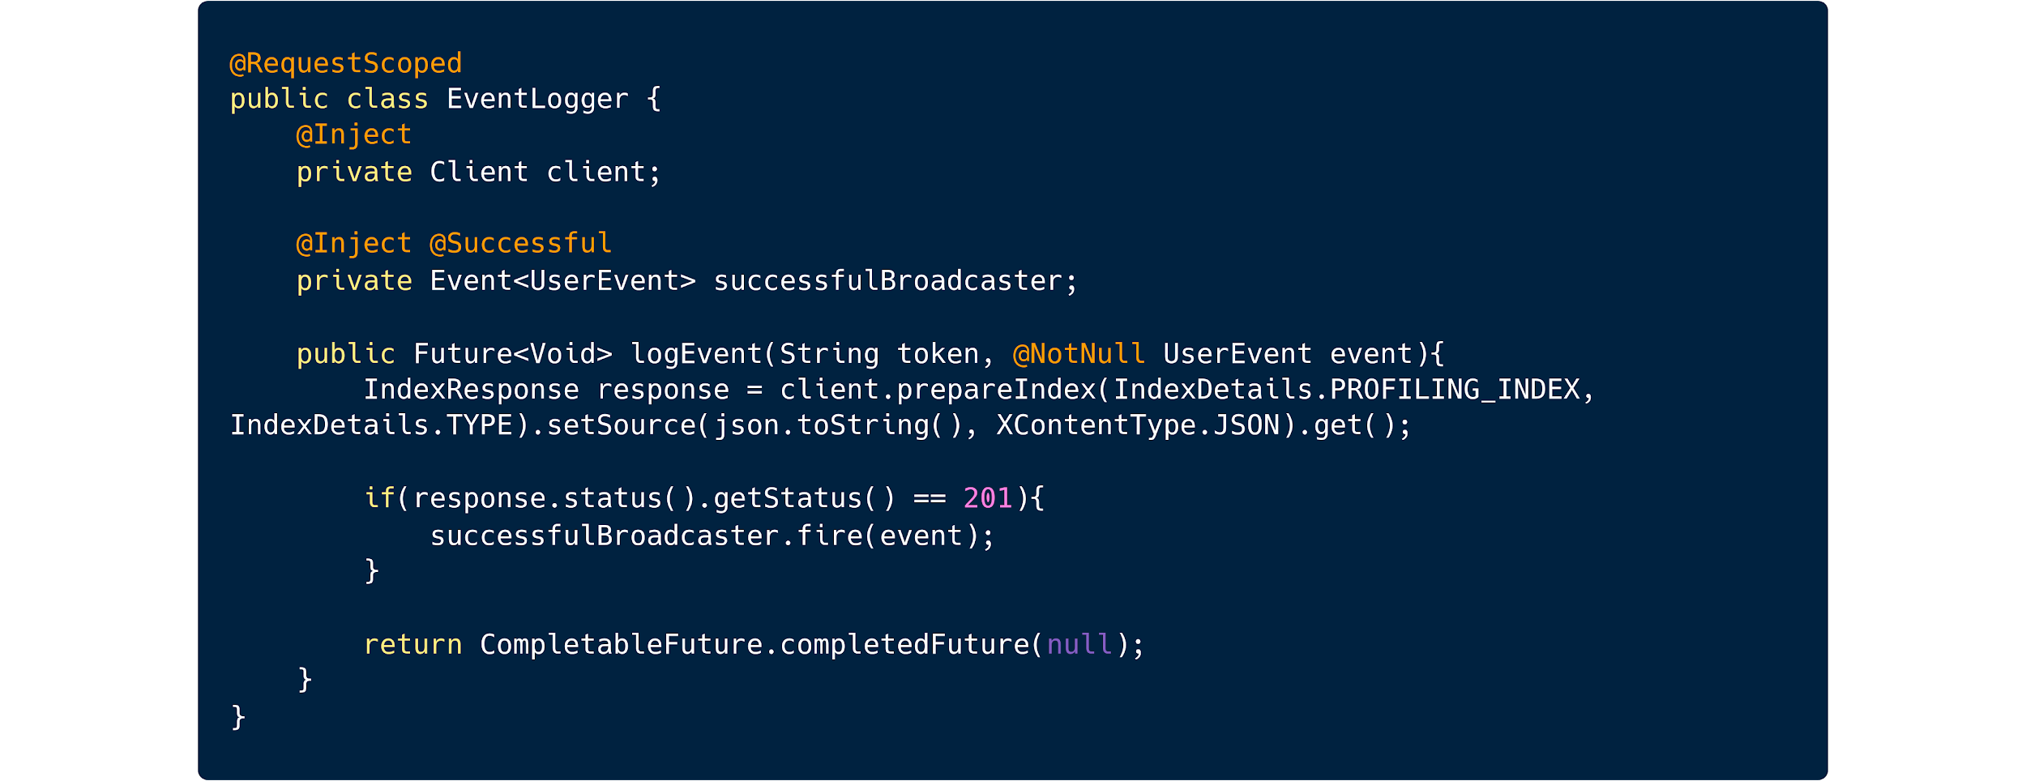
CDI

Slide 22
CDI
@RequestScoped
@ApplicationScoped
@SessionScoped
@Dependent
@ConversationScoped

Slide 23
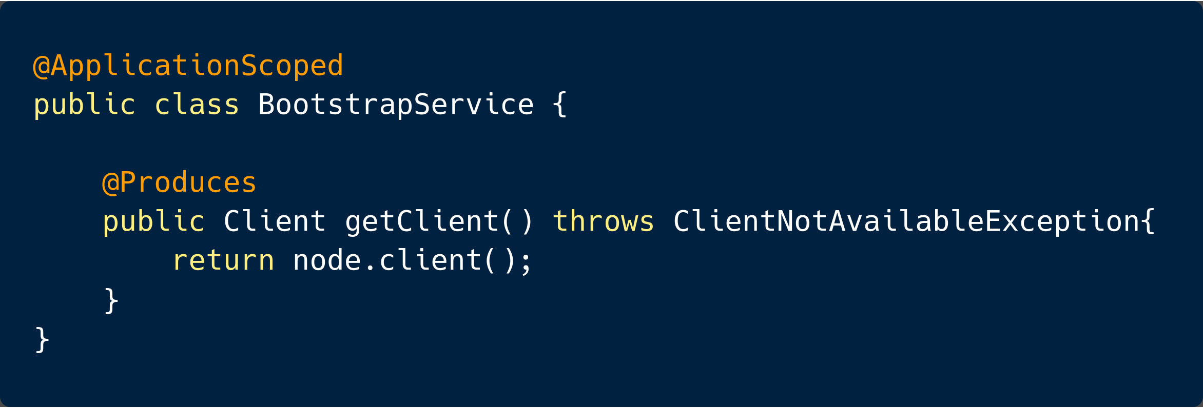

Slide 24


Slide 25
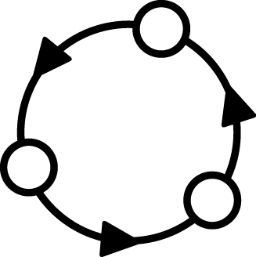
Configuration
Applications need to be configured based on a running environment. It must be possible to modify configuration data from outside an application so that the application itself does not need to be repackaged
Prod
Dev
Test
https://github.com/eclipse/microprofile-config

Slide 26
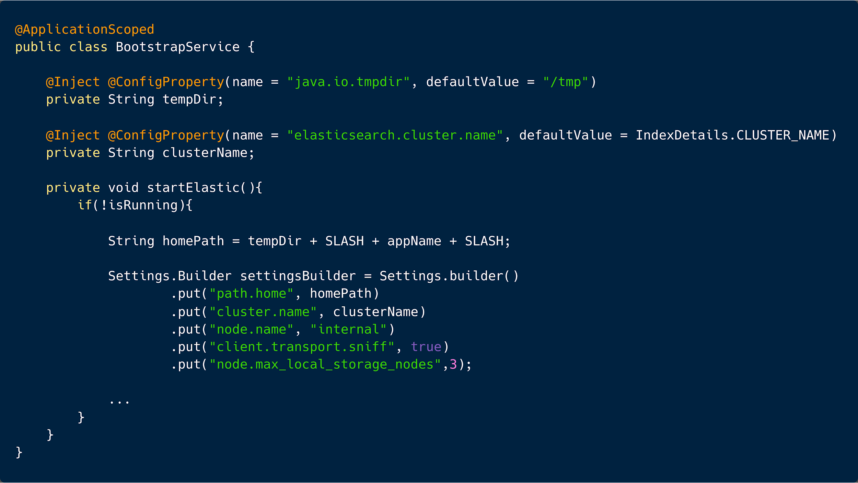

Slide 27
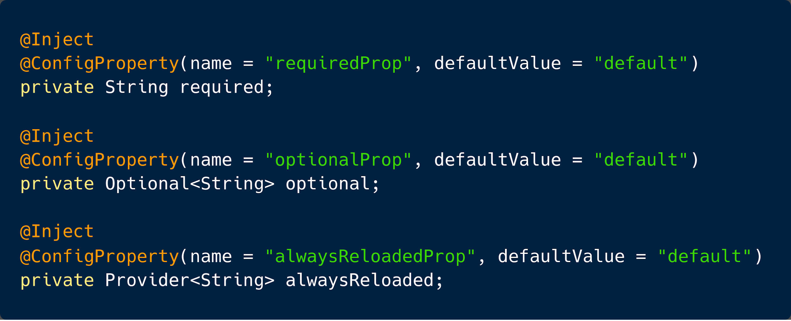

Slide 28
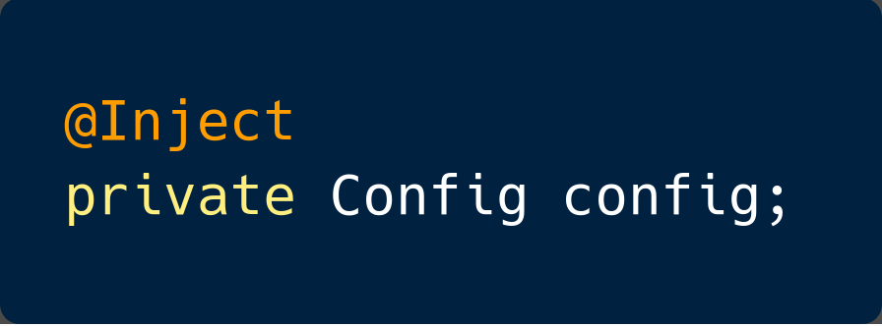
Configuration
getValue(...)
getPropertyNames()
getConfigSources()

Slide 29
Configuration
By default there are 3 default config sources
Your own source...
Your own source...
System.getProperties()
System.getenv()
META-INF/microprofile-config.properties

Slide 30
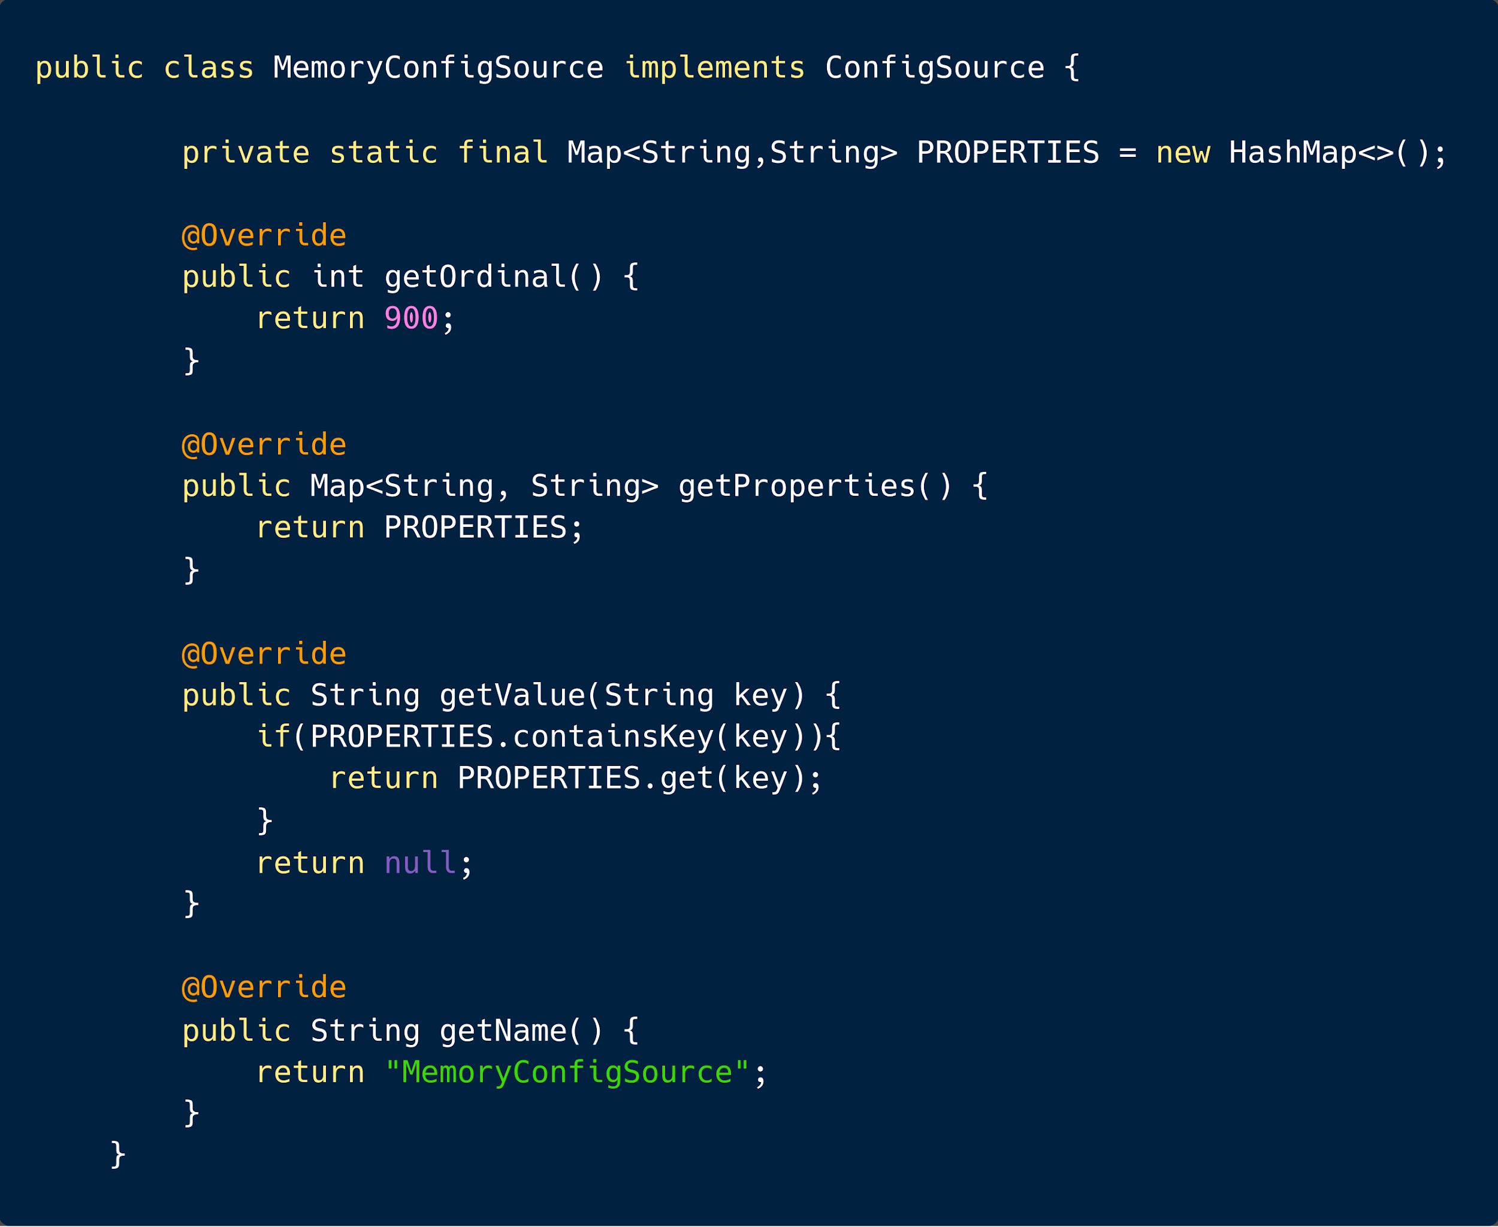

Slide 31

Configuration
META-INF/services/org.eclipse.microprofile.config.spi.ConfigSource

Slide 32
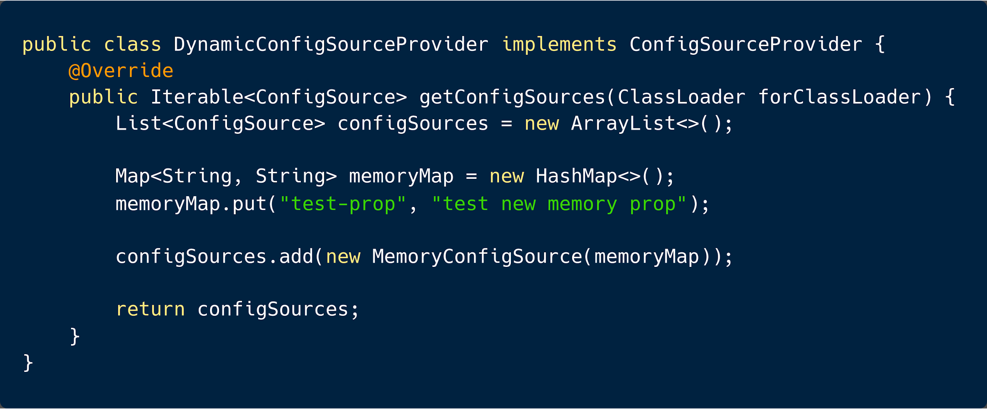

Slide 33
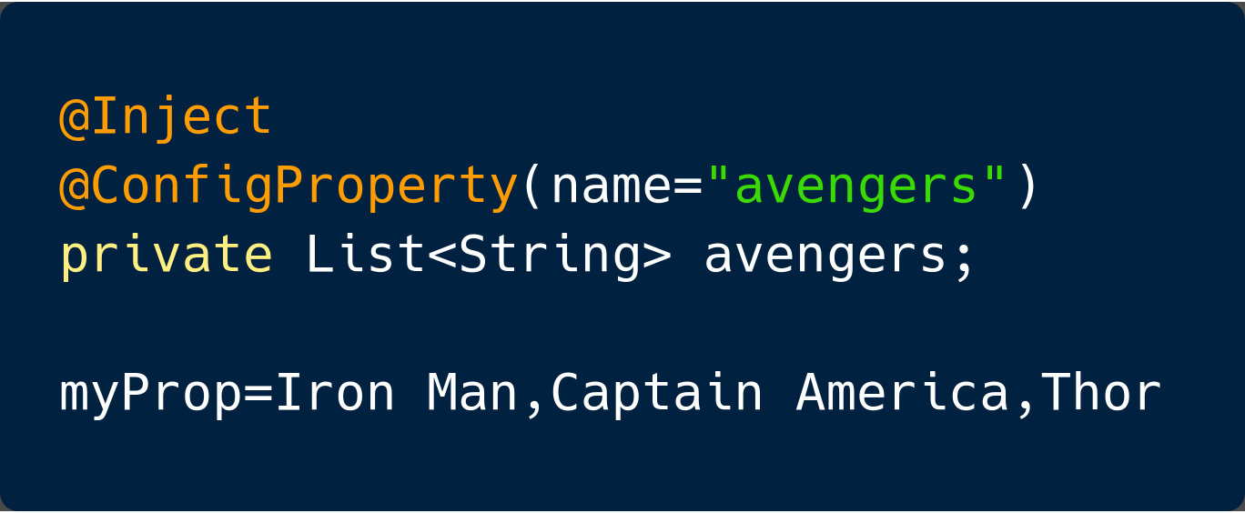
Configuration - converters
Boolean
Byte
Short
Int
Long
Float
Double
Character
Class
Array
List
Set

Slide 34
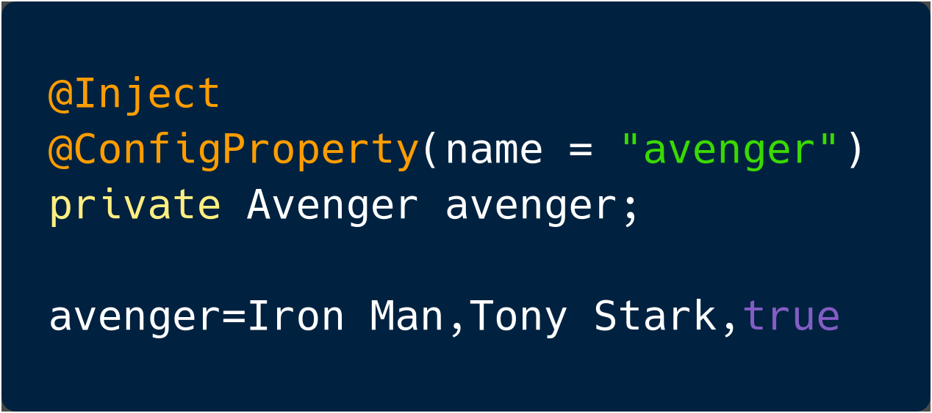
Configuration - converters

Slide 35
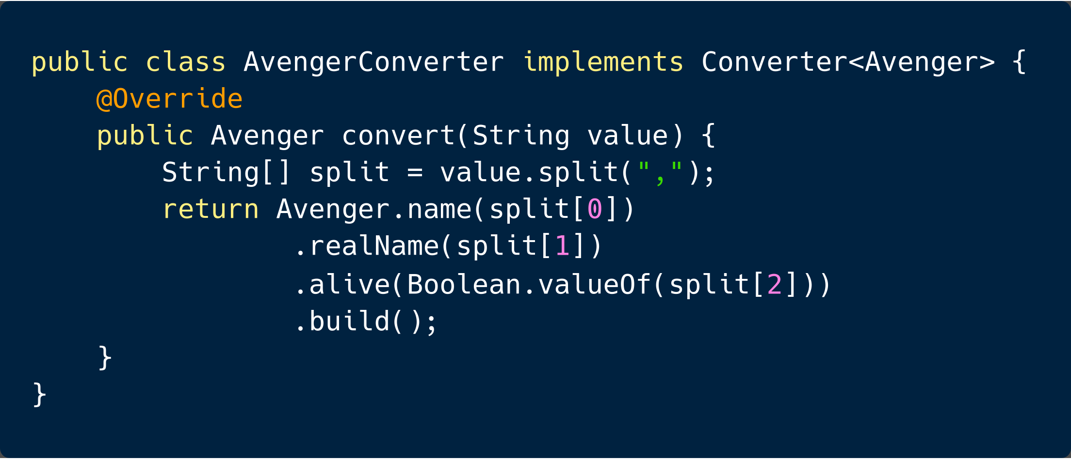

Slide 37

Health
Health checks are used to probe the state of a computing node from another machine (i.e. kubernetes service controller) with the primary target being cloud infrastructure environments where automated processes maintain the state of computing nodes

Slide 38
Health
MUST be compatibility with well known cloud platforms (i.e. http://kubernetes.io/docs/user-guide/liveness/)
MUST be appropriate for machine-to-machine communication
SHOULD give enough information for a human administrator

Slide 39
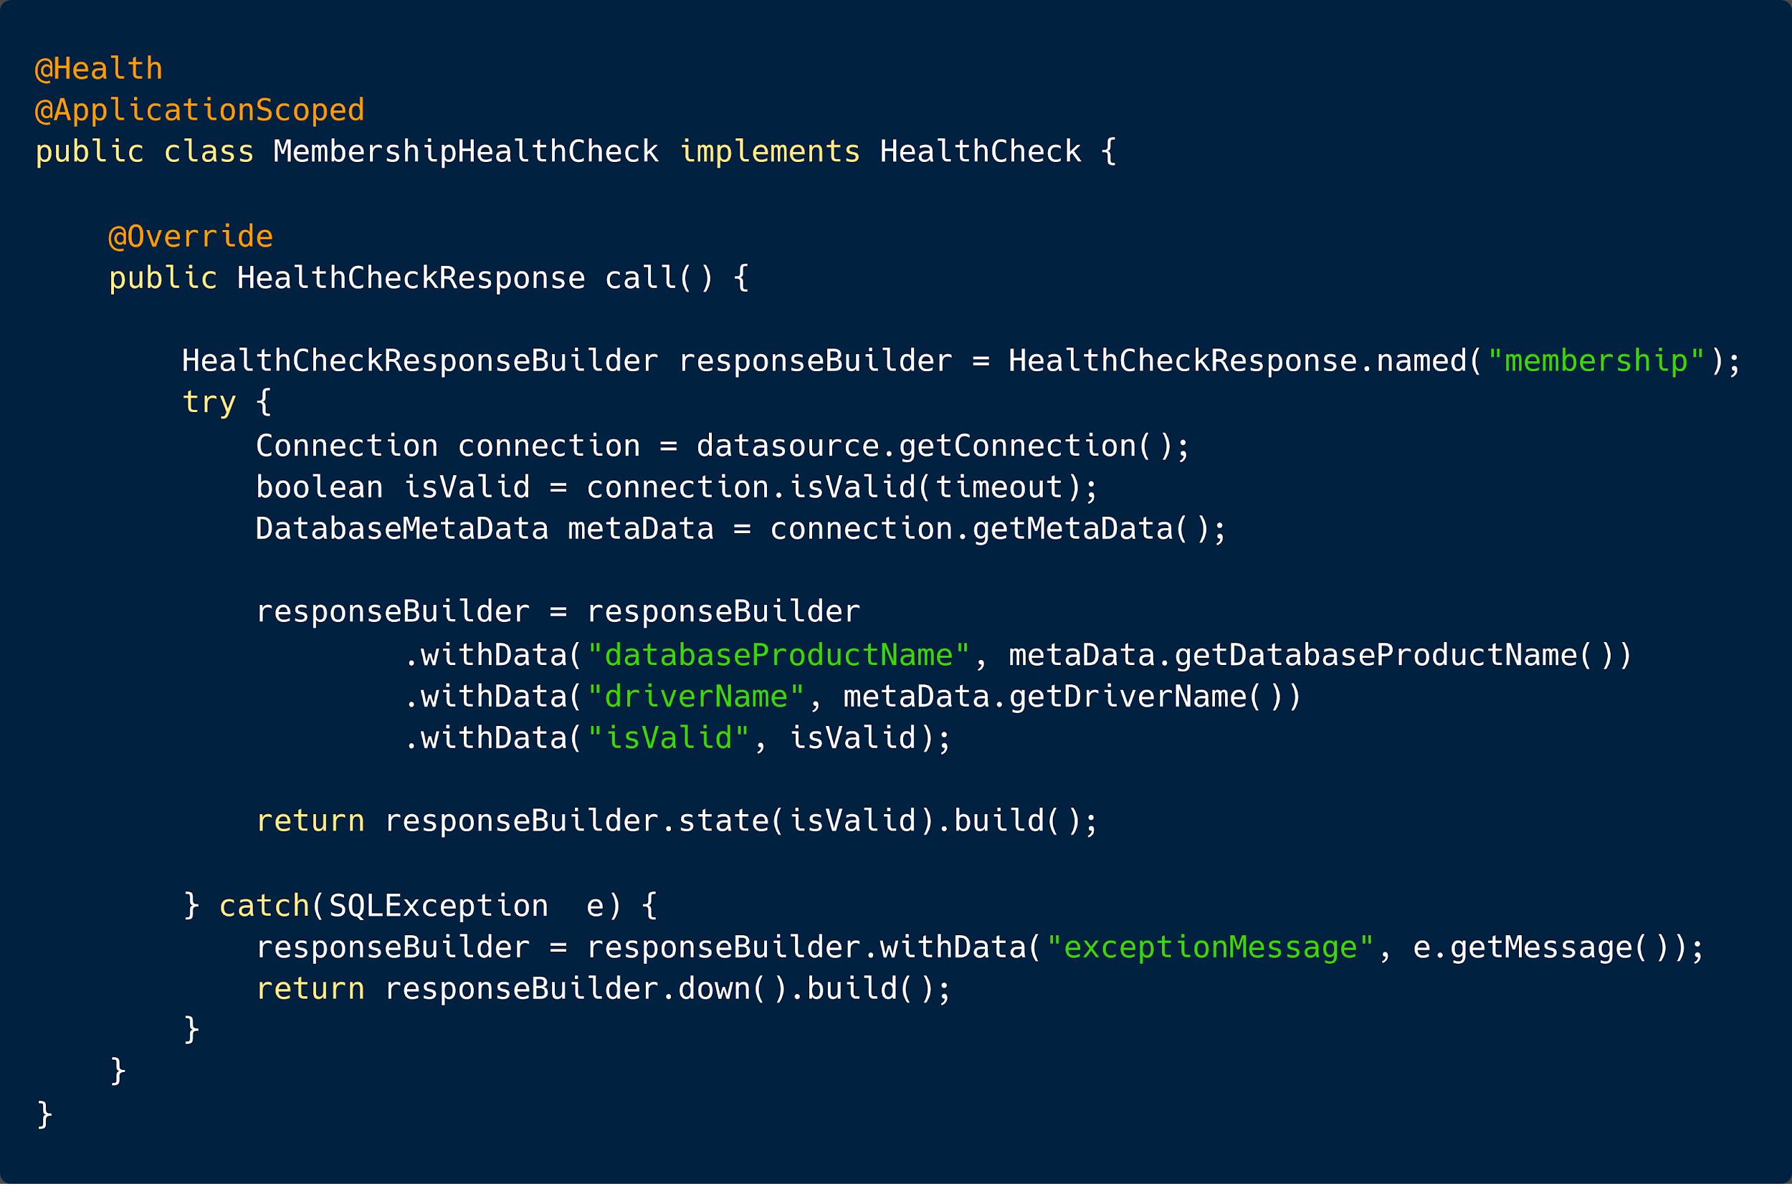

Slide 40
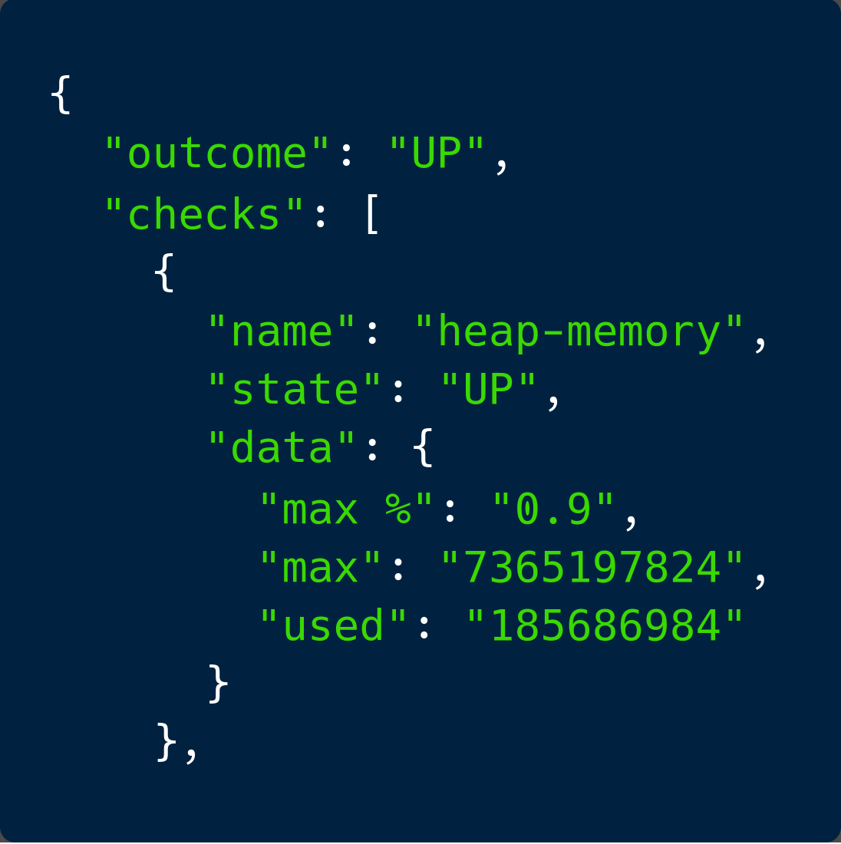
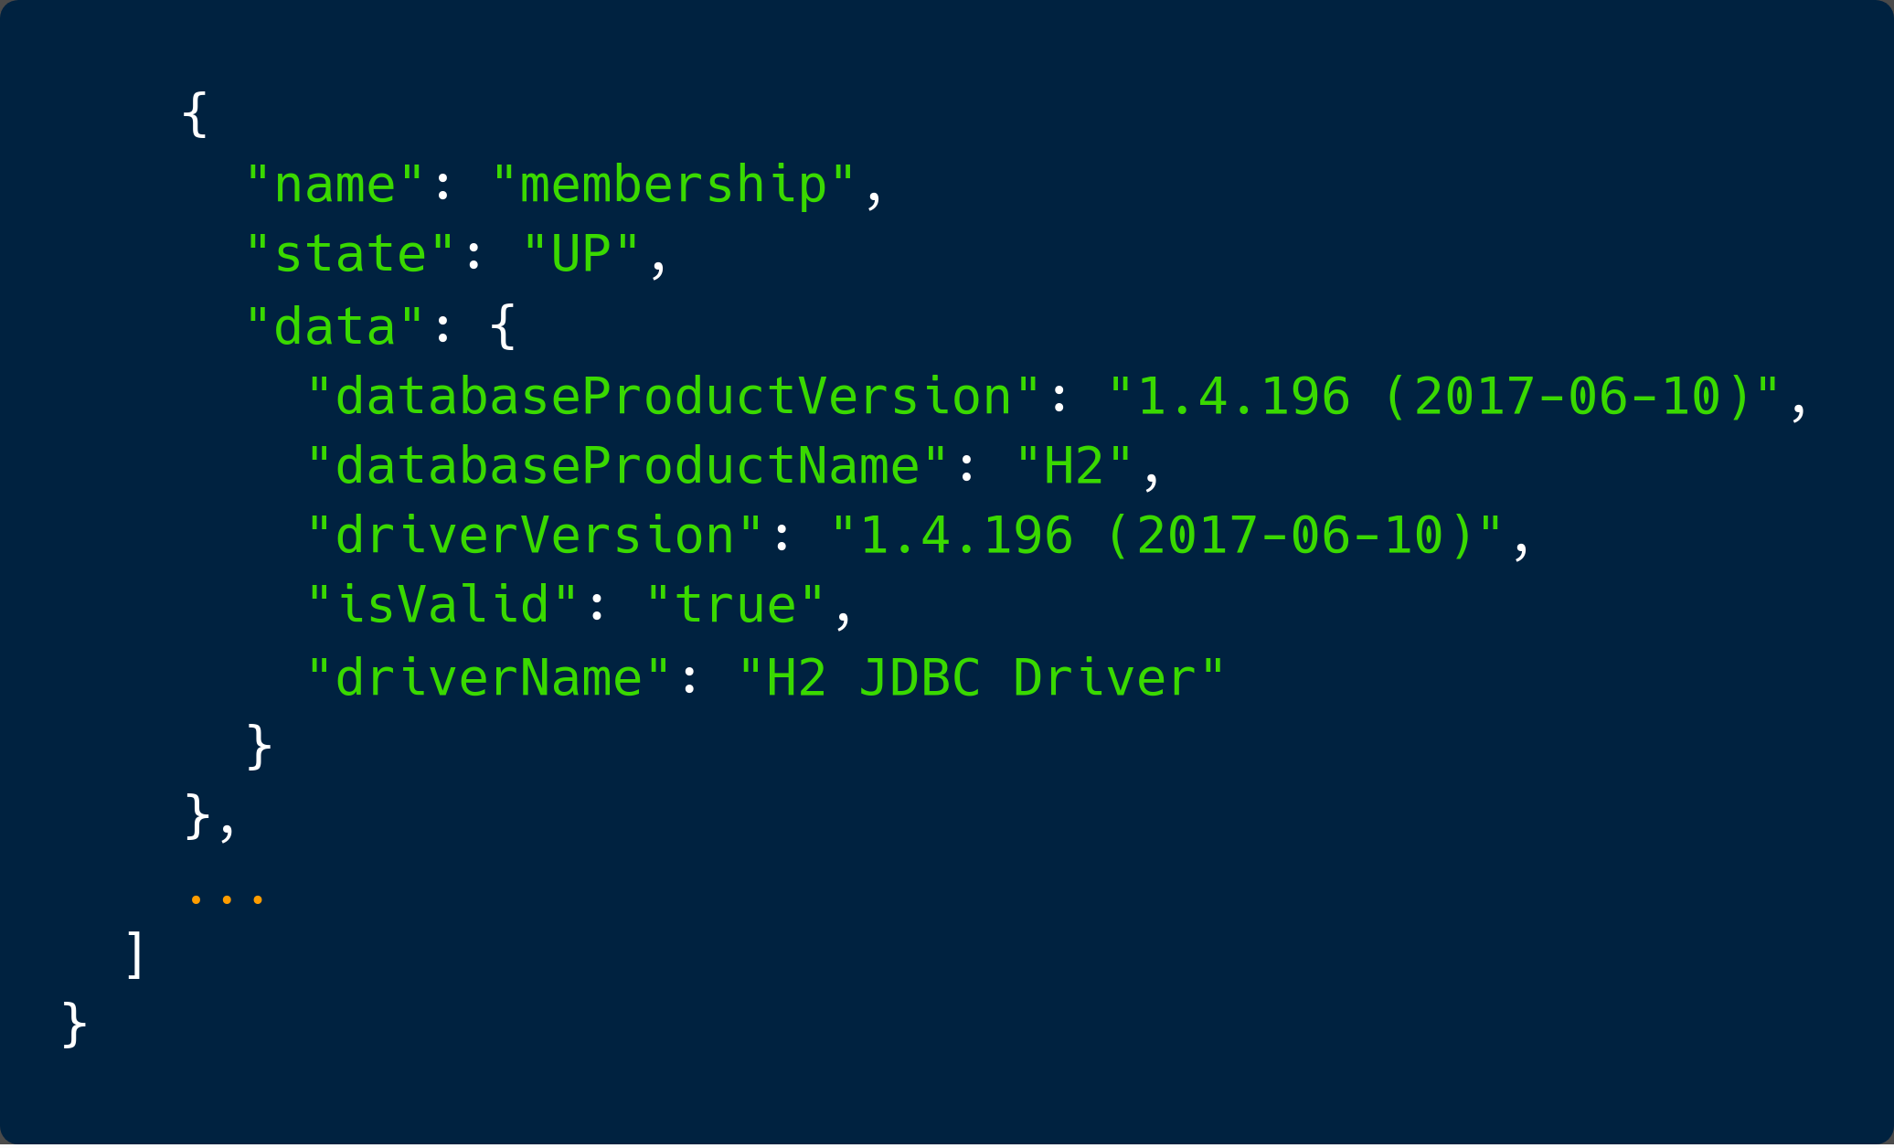
Health - output

