Slide 1

Airline Passenger Satisfaction CSIS 3360-002 Final Project - Group 8
Ianna Iaichikina 300234152
Hazel Ibasco 300366644
Samira Mehdizadeh 300369611
Sergio Torres 300366657

Slide 2

Agenda
Context
Business Case
Objectives
Exploratory Data Analysis
Classification - Naïve Bayes
Classification - Decision Tree
Clustering
Conclusion and Insights

Slide 3
Context

Slide 4
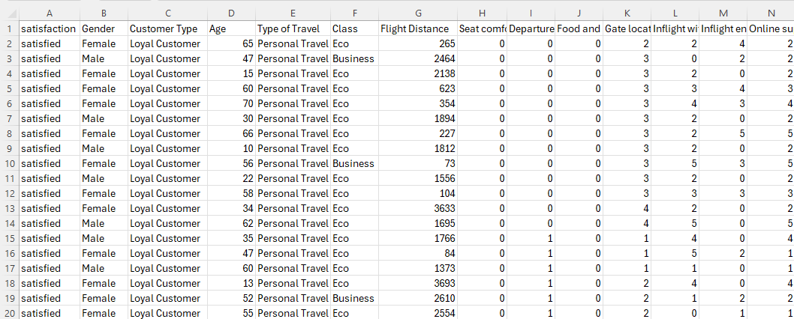
Context
This analysis is based on the 'Airline Passenger Satisfaction' dataset from Kaggle, which covers various aspects of the air travel experience.
Main Variables:
Customer satisfaction
Gender
Customer type (loyal or disloyal)
Age
Type of travel class (e.g., Business, Economy)
Flight distance
Departure delay in minutes
Arrival delay in minutes
The dataset also encompasses a range of onboard services variables.

Slide 5

Business Case
Airline Passenger Satisfaction dataset provides a comprehensive collection of variables that offer valuable insights into the factors influencing passenger satisfaction with airline services.
This dataset includes a wide range of information, such as passenger demographics (e.g., gender and age), travel details (e.g., flight distance and travel class), and satisfaction ratings for various aspects of the travel experience (e.g., inflight entertainment, seat comfort, and cleanliness).
Additionally, the dataset includes departure and arrival delay times data and an overall satisfaction rating.

Slide 6
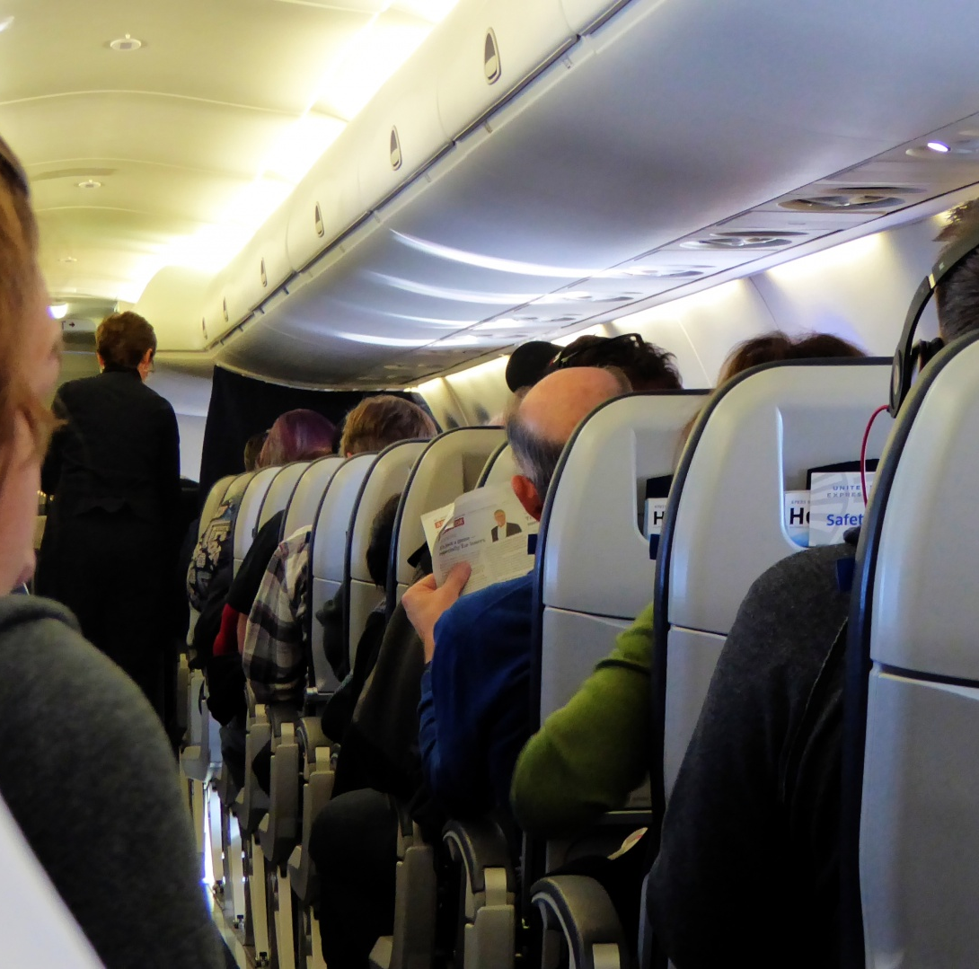
Objectives
By analyzing this dataset, we aim to:
Uncover key drivers of passenger satisfaction
Identify areas for improvement in airline services
Make data-driven decisions to enhance the overall passenger experience, increase customer satisfaction, and improve loyalty to the airline.

Slide 7
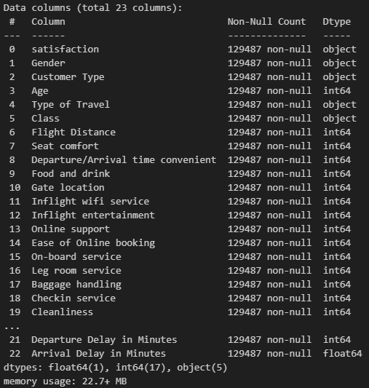
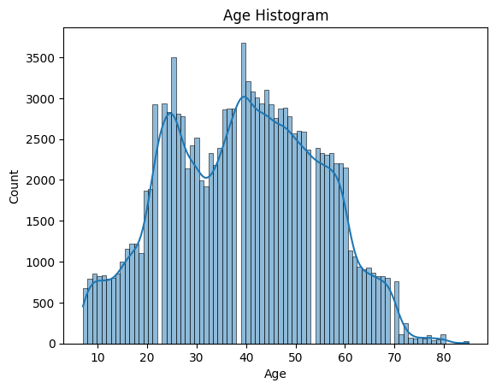
Exploratory Data Analysis

Slide 8
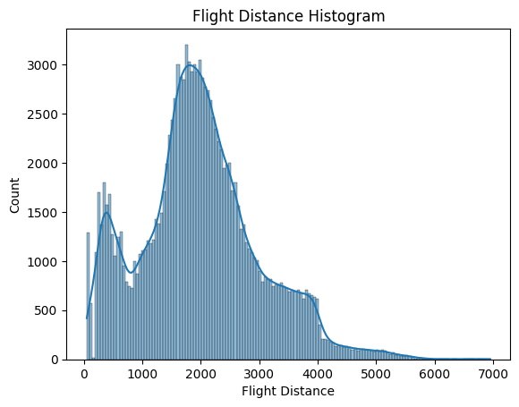
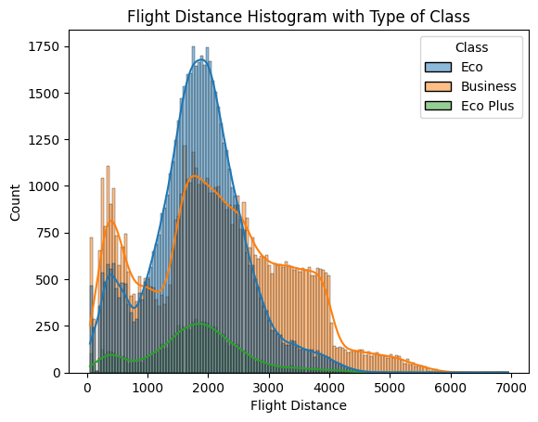
Exploratory Data Analysis

Slide 9
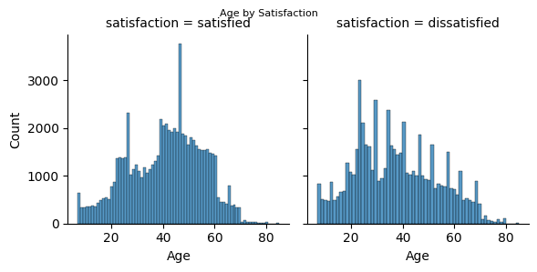
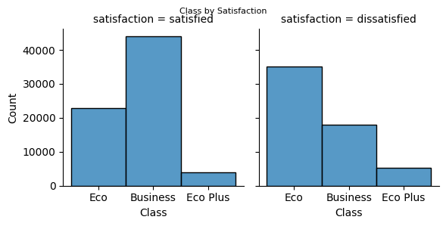
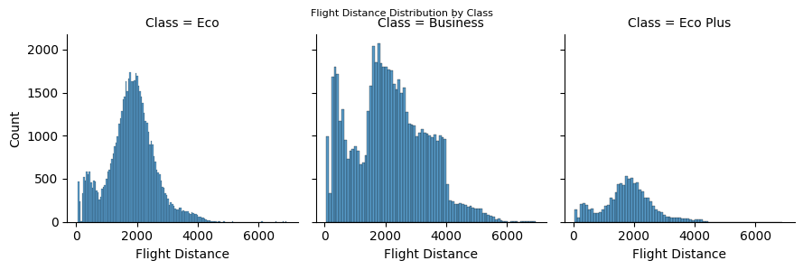
Exploratory Data Analysis

Slide 10
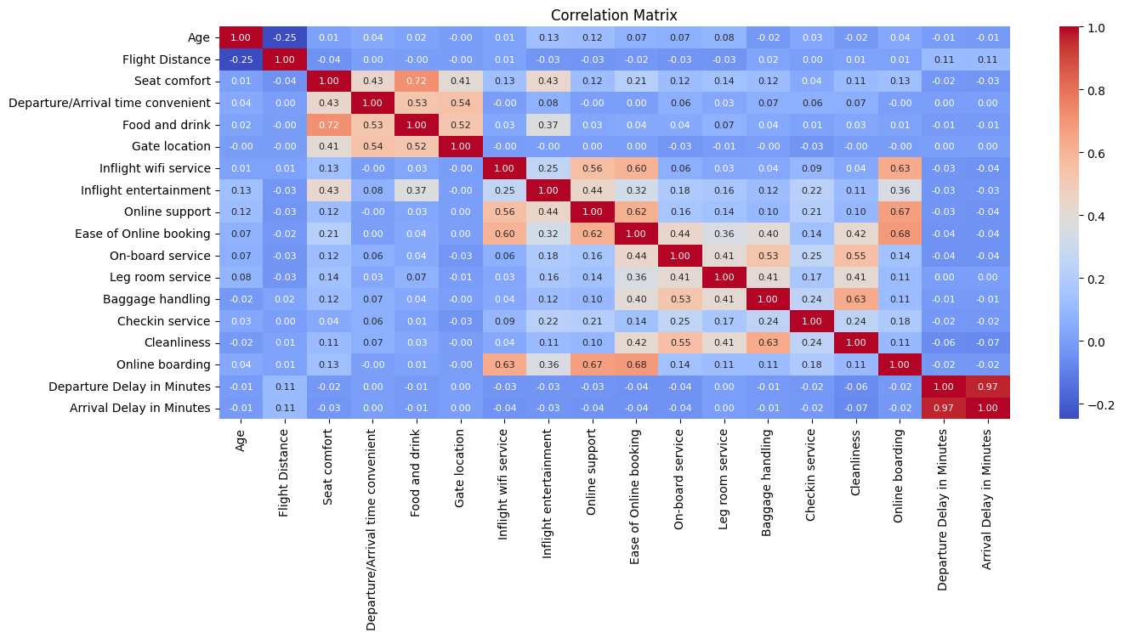
Exploratory Data Analysis

Slide 11
Classification – Naïve Bayes

Slide 12
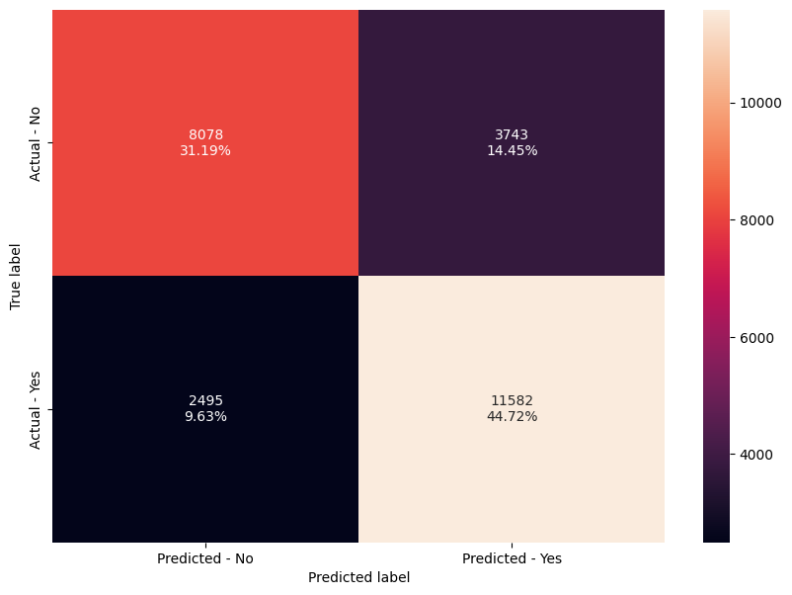
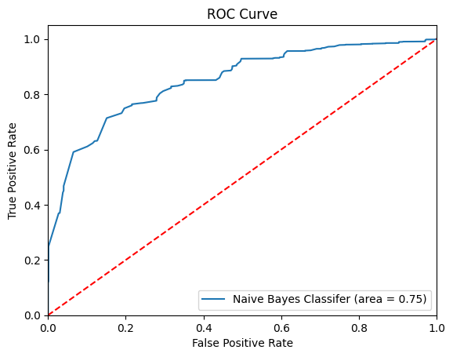
Classification – Naïve Bayes
Loading Data
Cleaning Data
Exploratory Data Analysis
Transformation Categorical Data
Mean Score
Accuracy
Recall
Select dependent feature
Features selection
Split training and test data
Scaling
Applying Naïve Bayes - GaussianNB

Slide 13
Classification – Naïve Bayes
Each cell in the confusion matrix represents a specific outcome of the classification process:
8078 represents the number of True Negatives (TN) cases in which the model correctly predicted the negative class.
3743 represents the number of False Positives (FP). These are the cases where the model incorrectly predicted the positive class when the actual class was negative.
2495 represents the number of False Negatives (FN). These are the cases where the model incorrectly predicted the negative class when the actual class was positive.
11582 represents the number of True Positives (TP) cases where the model correctly predicted the positive class.

Slide 14
Classification – Naïve Bayes
Accuracy:
The accuracy of the training set is approximately 75.71%. The classifier correctly predicts the class of about 75.71% of the instances in the training dataset.
The accuracy on the test set is approximately 75.91%. The classifier correctly predicts the class of about 75.91% of the instances in the test dataset.
Recall:
The recall on the training set is approximately 82.39%. The classifier correctly identifies about 82.39% of the positive instances in the training dataset.
The recall on the test set is approximately 82.28%. The classifier correctly identifies about 82.28% of the positive instances in the test dataset.
Mean Score Naïve Bayes: 75.76%.
The ROC curve value of 0.75 can be considered acceptable because it indicates that it can distinguish between the positive and negative classes.

Slide 15
Classification – Decision Tree

Slide 16
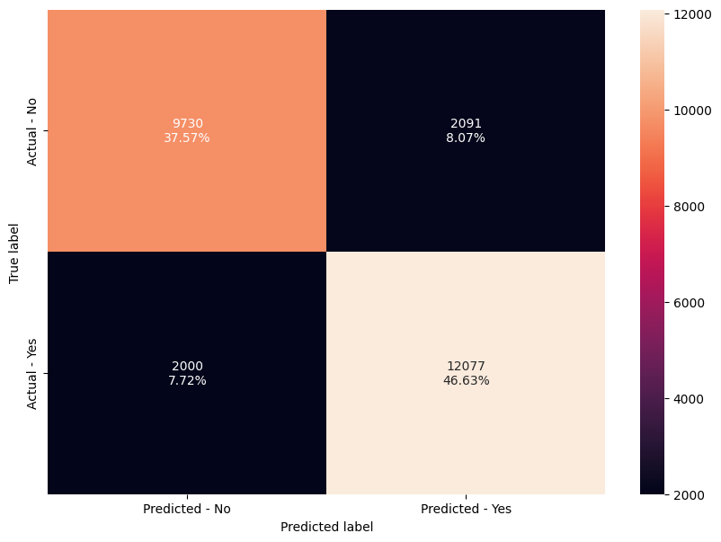
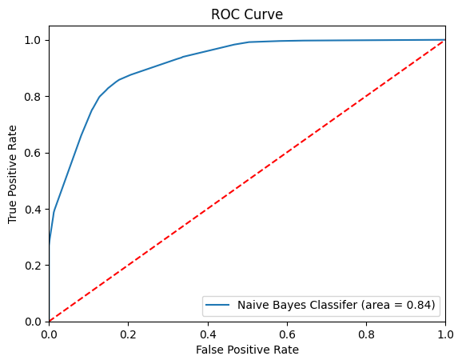
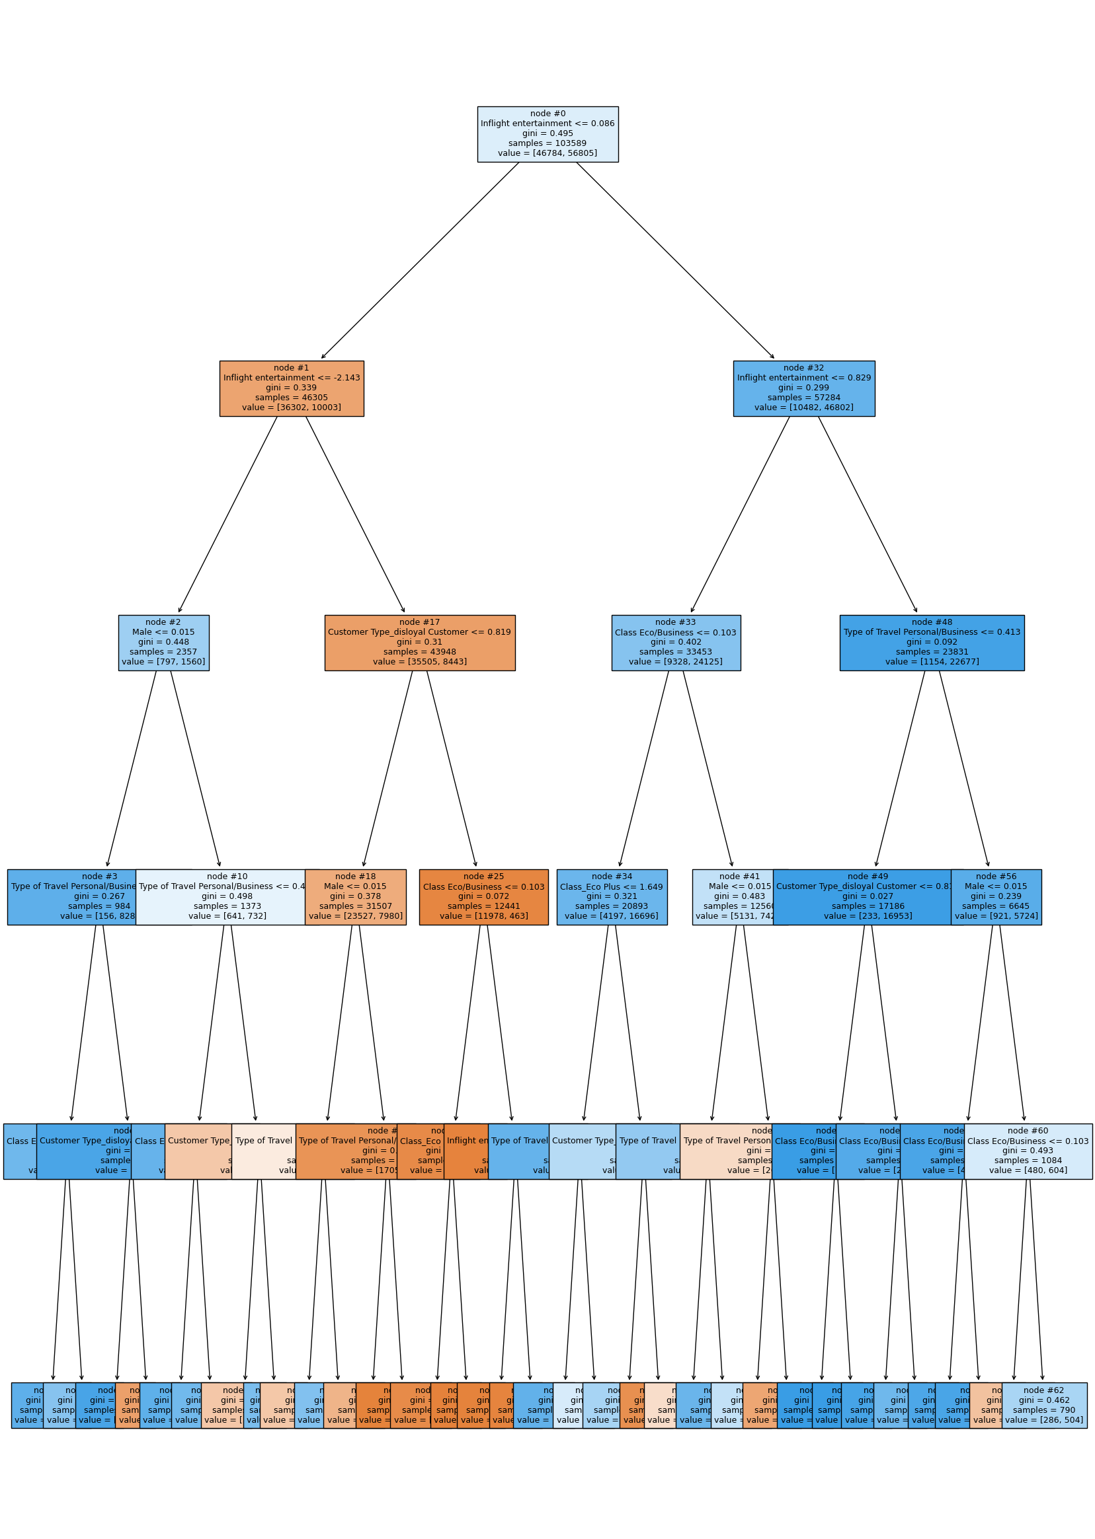
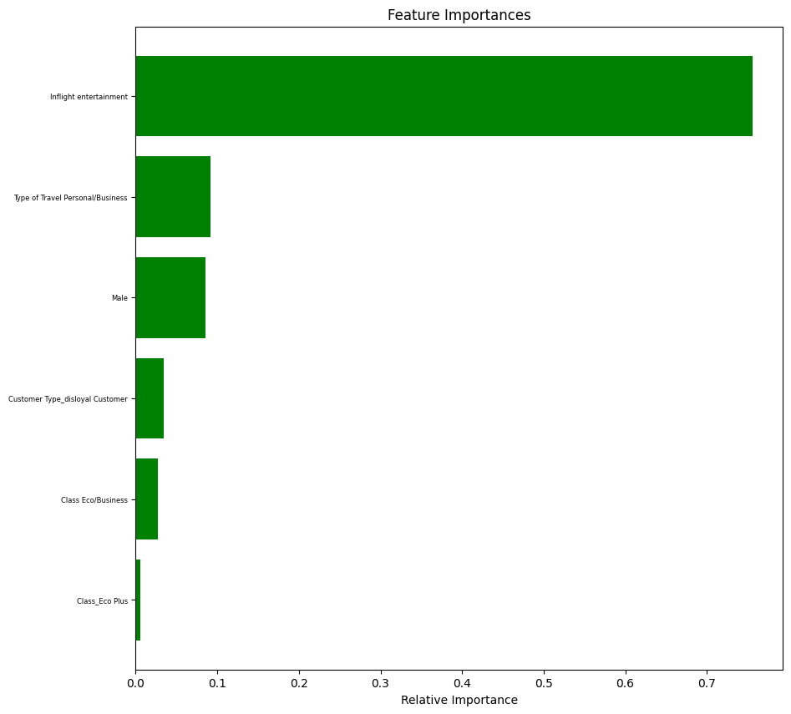
Classification – Decision Tree
Loading Data
Cleaning Data
Exploratory Data Analysis
Transformation Categorical Data
Select dependent feature
Mean Score
Accuracy
Recall
Features selection
Scaling
Split training and test data
Applying Decision Tree - DecisionTreeClassifier
Features Importance
Plot Decision Tree

Slide 17
Classification – Decision Tree
Each cell in the confusion matrix represents a specific outcome of the classification process:
9730 represents the number of True Negatives (TN). These are the cases where the model correctly predicted the negative class.
2091 represents the number of False Positives (FP). These are the cases where the model incorrectly predicted the positive class when the actual class was negative.
2000 represents the number of False Negatives (FN). These are the cases where the model incorrectly predicted the negative class when the actual class was positive.
12077 represents the number of True Positives (TP). These are the cases where the model correctly predicted the positive class.

Slide 18
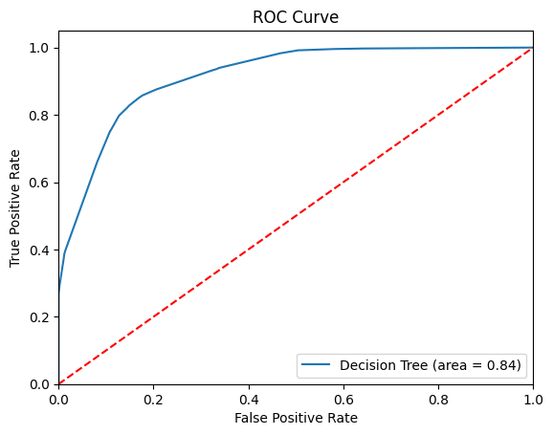
Classification – Decision Tree
Accuracy:
The accuracy on the training set is approximately 84.27%. The classifier correctly predicts the class of about 84.27% of the instances in the training dataset.
The accuracy on the test set is approximately 84.20%. The classifier correctly predicts the class of about 84.20% of the instances in the test dataset.
Recall:
The recall on the training set is approximately 85.75%. The classifier correctly identifies about 85.75% of the positive instances in the training dataset.
The recall on the test set is approximately 85.79%. The classifier correctly identifies about 85.79% of the positive instances in the test dataset.
Mean Score Decision Tree: 84.27%.
The ROC curve value of 0.84 can be considered a good range because it indicates a strong ability to distinguish between the positive and negative classes.

Slide 19
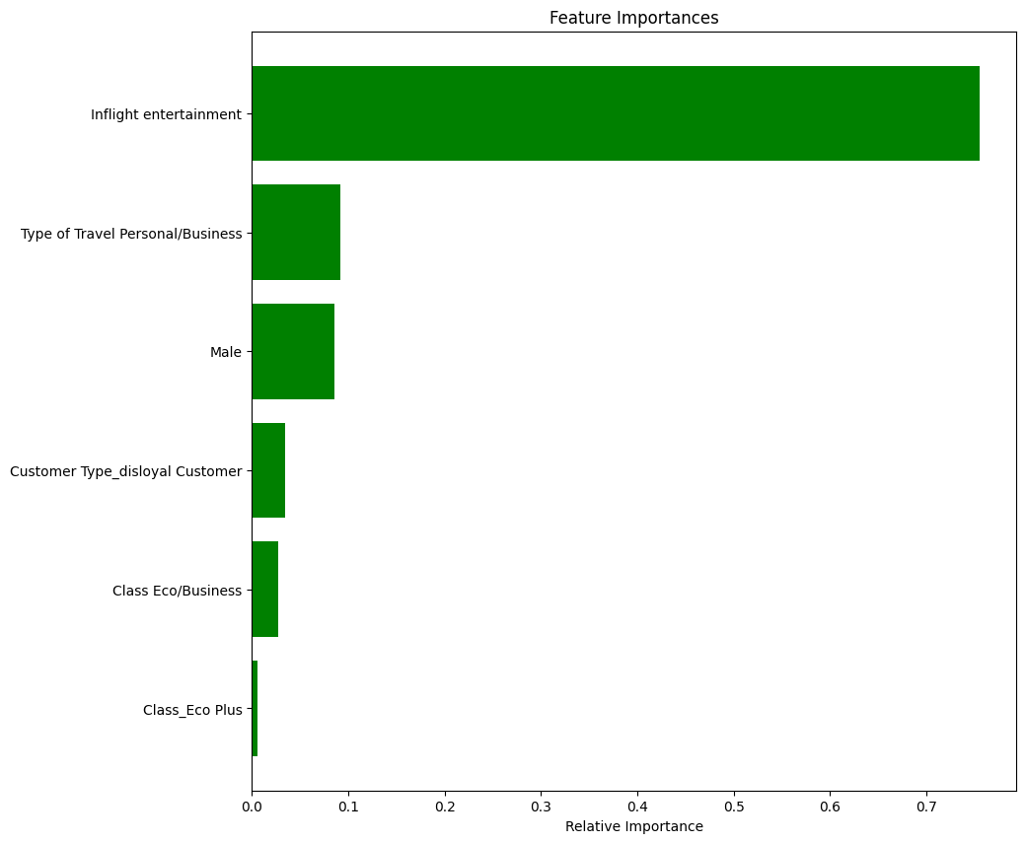
Classification – Decision Tree
Features Importances
Inflight entertainment 0.755
Type of Travel Personal/Business 0.091
Male 0.085
Customer Type_disloyal Customer 0.034
Class Eco/Business 0.027
Class_Eco Plus 0.005

Slide 20
Clustering

Slide 21
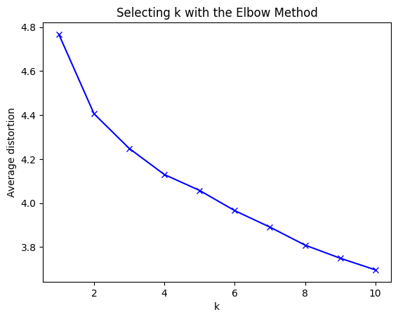
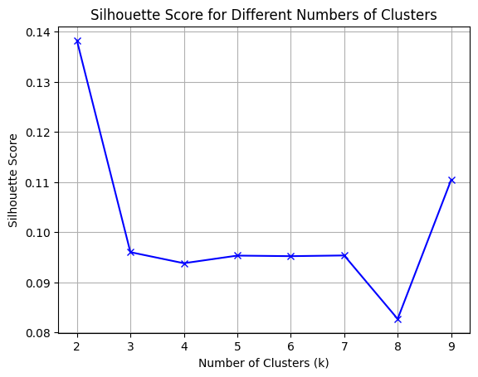
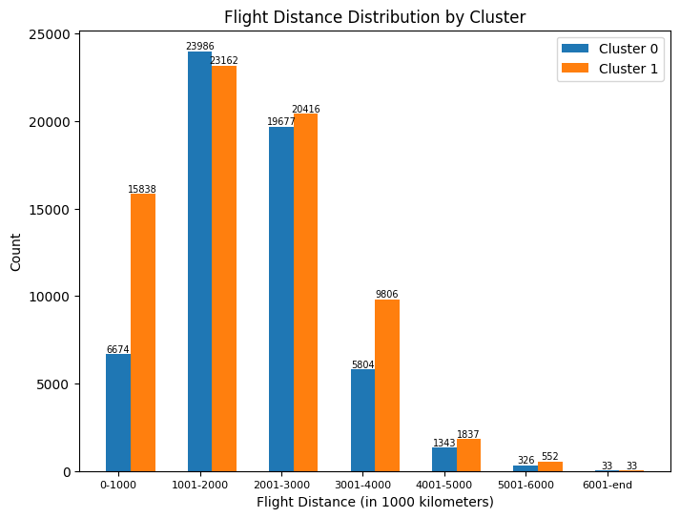
Clustering – K-means
Loading Data
Cleaning Data
Exploratory Data Analysis
Transformation Categorical Data
Scaling
Elbow Method
Silhouette Score
Applying Clustering - KMeans
Generate Clusters

Slide 22
Clustering – K-means

Slide 23
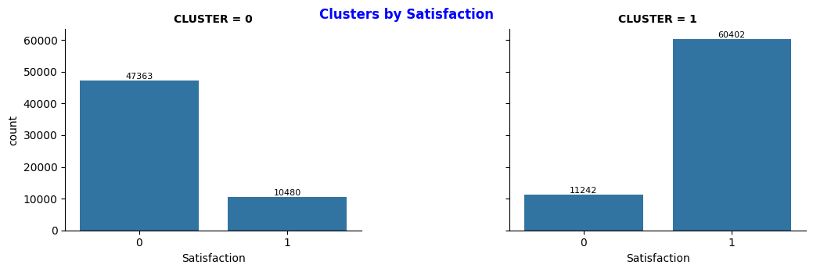
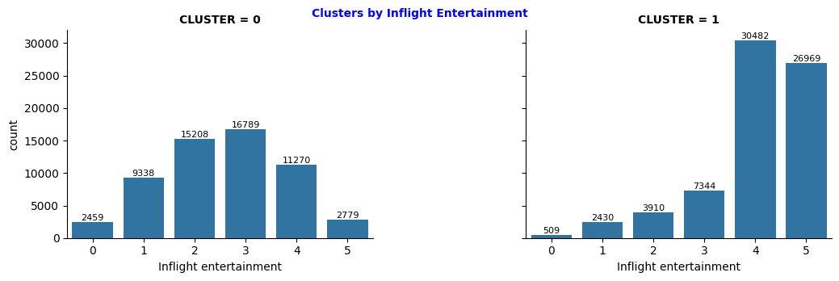
Clustering – K-means

Slide 24
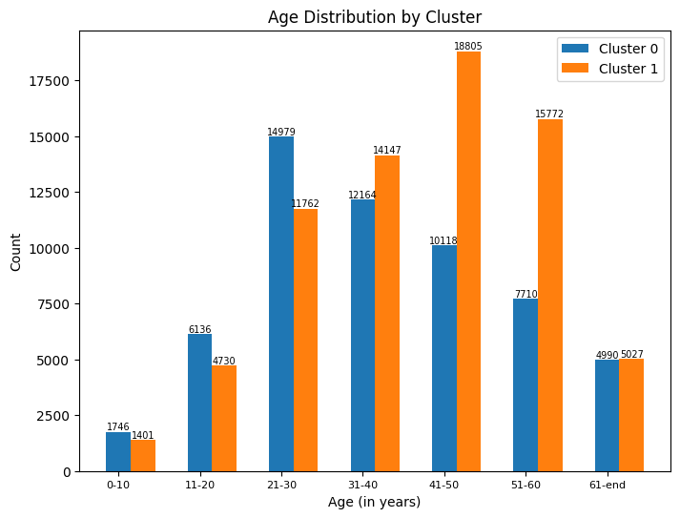
Clustering – K-means

Slide 25
Conclusion and Insight

Slide 26
Conclusion and Insights
Insights
Naïve Bayes
Decision Tree
Insights
Clustering
Mean Score 75.76% 84.27%
Accuracy Training Set 75.71% 84.27%
Accuracy Test Set 75.91% 84.20%
True Negative (TN) 8.078 9.730
True Positive(TP) 11.582 12.077
False Negative(FN) 2.495 2.000
False Positive(FP) 3.743 2.091
ROC 0.75 0.84
Features Importances 6
Inflight entertainment
Clusters K-Means 2
- Elbow Method
- Silhouette Score
Cluster 1 Satisfied
- Inflight entertainment 4 – 5
- Flight distance < 1.000 km
- Age 41 – 50
51 – 60
The most optimal to use Decision Tree because it has better performance and greater prediction probability than Naive Bayes (84.20% vs 75.91%) and generates important features for decision-making that are related to “satisfied” cluster.

Slide 27
Airline Passenger Satisfaction CSIS 3360-002 Final Project- Group 8
Ianna Iaichikina 300234152
Hazel Ibasco 300366644
Sergio Torres 300366657
Samira Mehdizadeh 300369611

