Slide 1

Airline Passenger Satisfaction CSIS 3360-002 Final Project - Group 8
Ianna Iaichikina 300234152
Hazel Ibasco 300366644
Samira Mehdizadeh 300369611
Sergio Torres 300366657

Slide 2

Agenda
Context
Business Case
Objectives
Exploratory Data Analysis
Classification - Naïve Bayes
Classification - Decision Tree
Clustering
Conclusion and Insights

Slide 3
Context

Slide 4
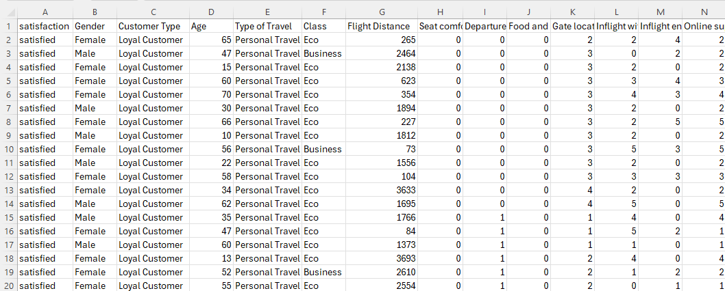
Context
This analysis is based on the 'Airline Passenger Satisfaction' dataset from Kaggle, which covers various aspects of the air travel experience.
Main Variables:
Customer satisfaction
Gender
Customer type (loyal or disloyal)
Age
Type of travel class (e.g., Business, Economy)
Flight distance
Departure delay in minutes
Arrival delay in minutes
The dataset also encompasses a range of onboard services variables.

Slide 5

Business Case
Airline Passenger Satisfaction dataset provides a comprehensive collection of variables that offer valuable insights into the factors influencing passenger satisfaction with airline services.
This dataset includes a wide range of information, such as passenger demographics (e.g., gender and age), travel details (e.g., flight distance and travel class), and satisfaction ratings for various aspects of the travel experience (e.g., inflight entertainment, seat comfort, and cleanliness).
Additionally, the dataset includes departure and arrival delay times data and an overall satisfaction rating.

Slide 6
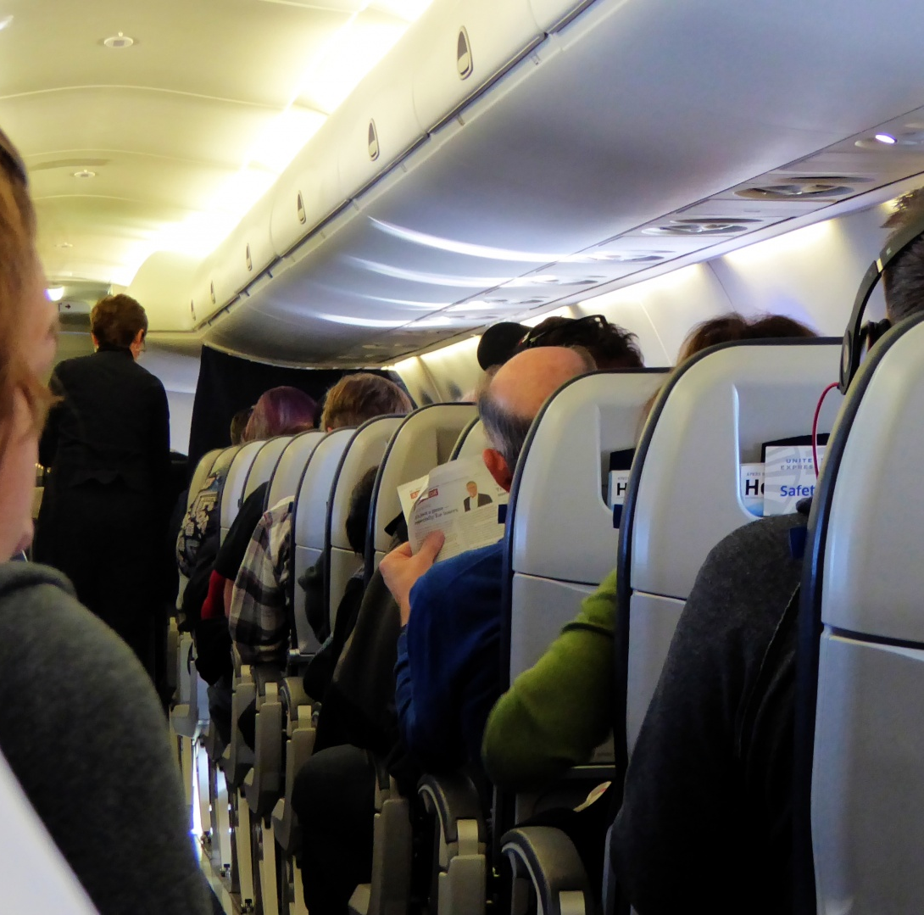
Objectives
By analyzing this dataset, we aim to:
Uncover key drivers of passenger satisfaction
Identify areas for improvement in airline services
Make data-driven decisions to enhance the overall passenger experience, increase customer satisfaction, and improve loyalty to the airline.

Slide 7
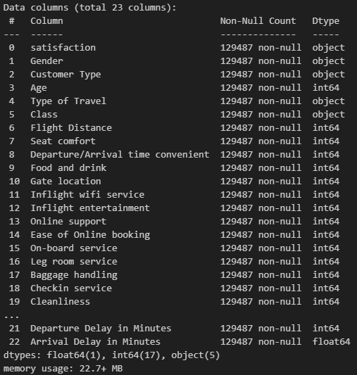
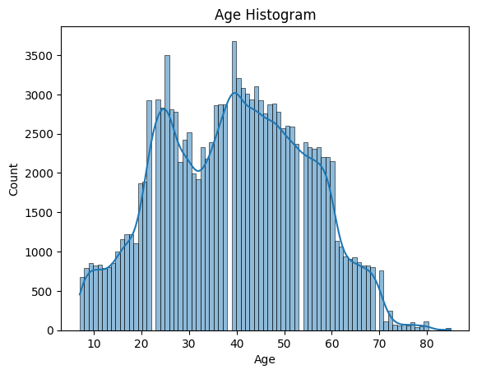
Exploratory Data Analysis

Slide 8
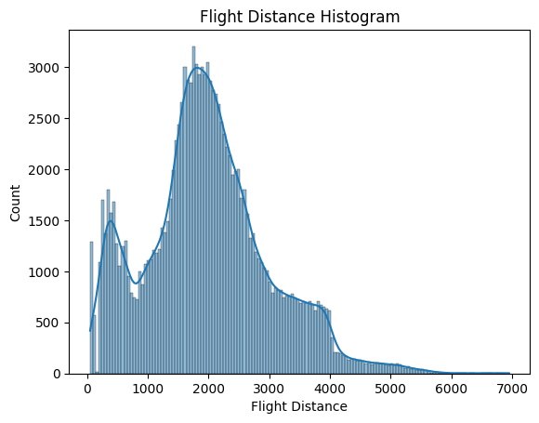
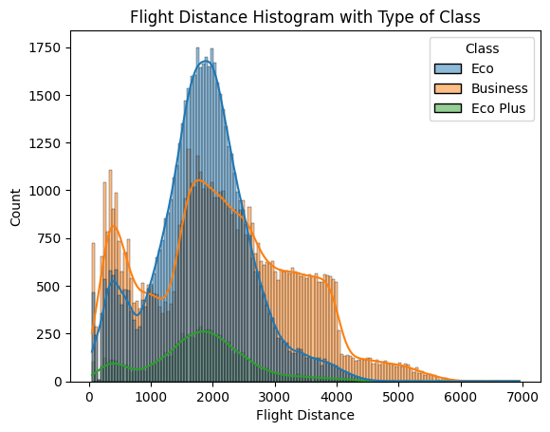
Exploratory Data Analysis

Slide 9
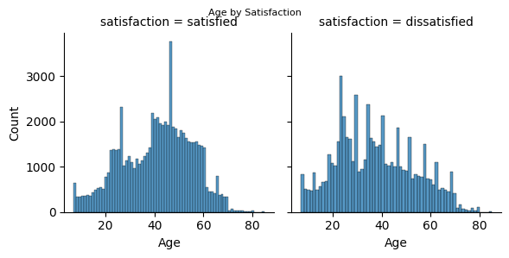
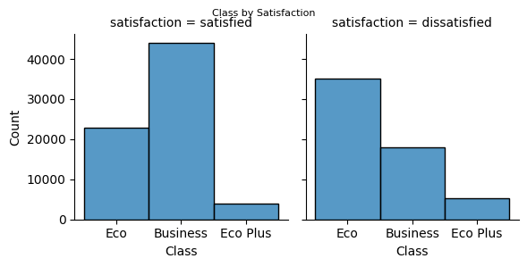
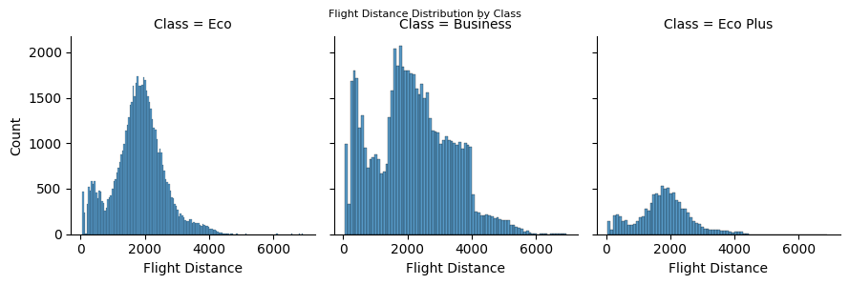
Exploratory Data Analysis

Slide 10
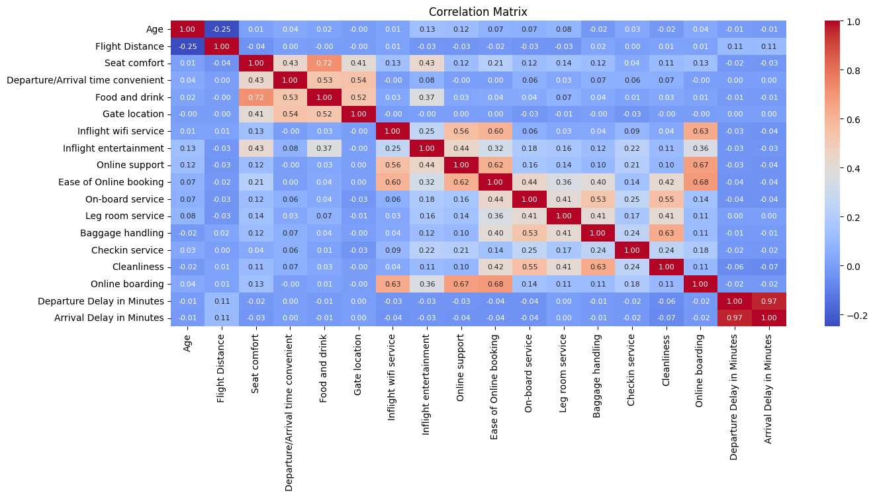
Exploratory Data Analysis

Slide 11
Classification – Naïve Bayes

Slide 12
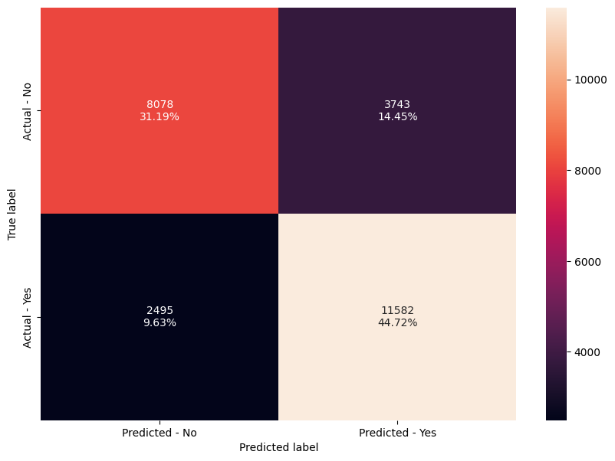
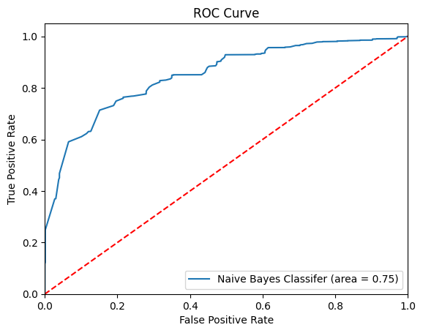
Classification – Naïve Bayes
Loading Data
Cleaning Data
Exploratory Data Analysis
Transformation Categorical Data
Mean Score
Accuracy
Recall
Select dependent feature
Features selection
Split training and test data
Scaling
Applying Naïve Bayes - GaussianNB

Slide 13
Classification – Naïve Bayes
Each cell in the confusion matrix represents a specific outcome of the classification process:
8078 represents the number of True Negatives (TN) cases in which the model correctly predicted the negative class.
3743 represents the number of False Positives (FP). These are the cases where the model incorrectly predicted the positive class when the actual class was negative.
2495 represents the number of False Negatives (FN). These are the cases where the model incorrectly predicted the negative class when the actual class was positive.
11582 represents the number of True Positives (TP) cases where the model correctly predicted the positive class.

Slide 14
Classification – Naïve Bayes
Accuracy:
The accuracy of the training set is approximately 75.71%. The classifier correctly predicts the class of about 75.71% of the instances in the training dataset.
The accuracy on the test set is approximately 75.91%. The classifier correctly predicts the class of about 75.91% of the instances in the test dataset.
Recall:
The recall on the training set is approximately 82.39%. The classifier correctly identifies about 82.39% of the positive instances in the training dataset.
The recall on the test set is approximately 82.28%. The classifier correctly identifies about 82.28% of the positive instances in the test dataset.
The ROC curve value of 0.75 can be considered acceptable because it indicates that it can distinguish between the positive and negative classes.

Slide 15
Classification – Decision Tree

Slide 16
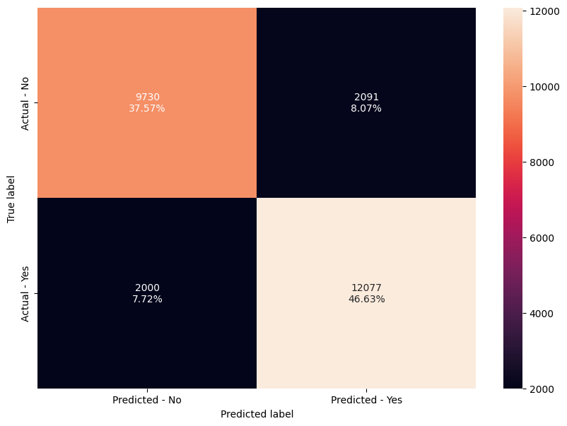
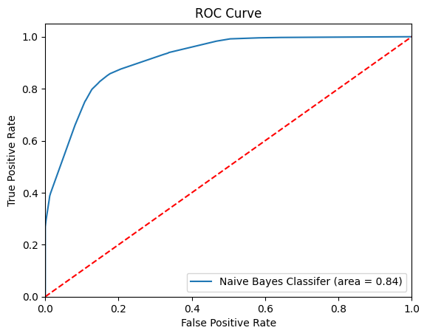
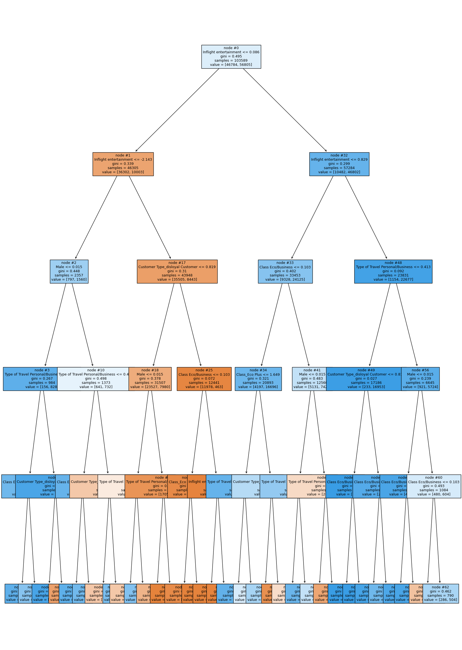
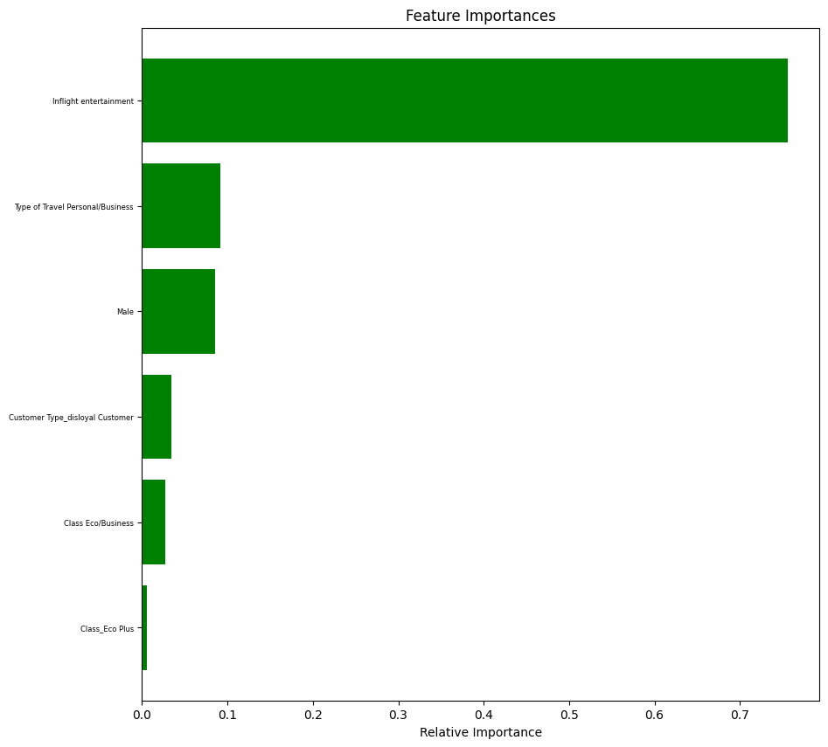
Classification – Decision Tree
Loading Data
Cleaning Data
Exploratory Data Analysis
Transformation Categorical Data
Select dependent feature
Mean Score
Accuracy
Recall
Features selection
Scaling
Split training and test data
Applying Naïve Bayes - GaussianNB
Features Importance
Plot Decision Tree

Slide 17
Classification – Decision Tree
Each cell in the confusion matrix represents a specific outcome of the classification process:
9730 represents the number of True Negatives (TN). These are the cases where the model correctly predicted the negative class.
2091 represents the number of False Positives (FP). These are the cases where the model incorrectly predicted the positive class when the actual class was negative.
2000 represents the number of False Negatives (FN). These are the cases where the model incorrectly predicted the negative class when the actual class was positive.
12077 represents the number of True Positives (TP). These are the cases where the model correctly predicted the positive class.

Slide 18
Classification – Decision Tree
Accuracy:
The accuracy on the training set is approximately 84.27%. The classifier correctly predicts the class of about 84.27% of the instances in the training dataset.
The accuracy on the test set is approximately 84.20%. The classifier correctly predicts the class of about 84.20% of the instances in the test dataset.
Recall:
The recall on the training set is approximately 85.75%. The classifier correctly identifies about 85.75% of the positive instances in the training dataset.
The recall on the test set is approximately 85.79%. The classifier correctly identifies about 85.79% of the positive instances in the test dataset.
The ROC curve value of 0.84 can be considered good range because indicating that it has a strong ability to distinguish between the positive and negative classes.

Slide 19
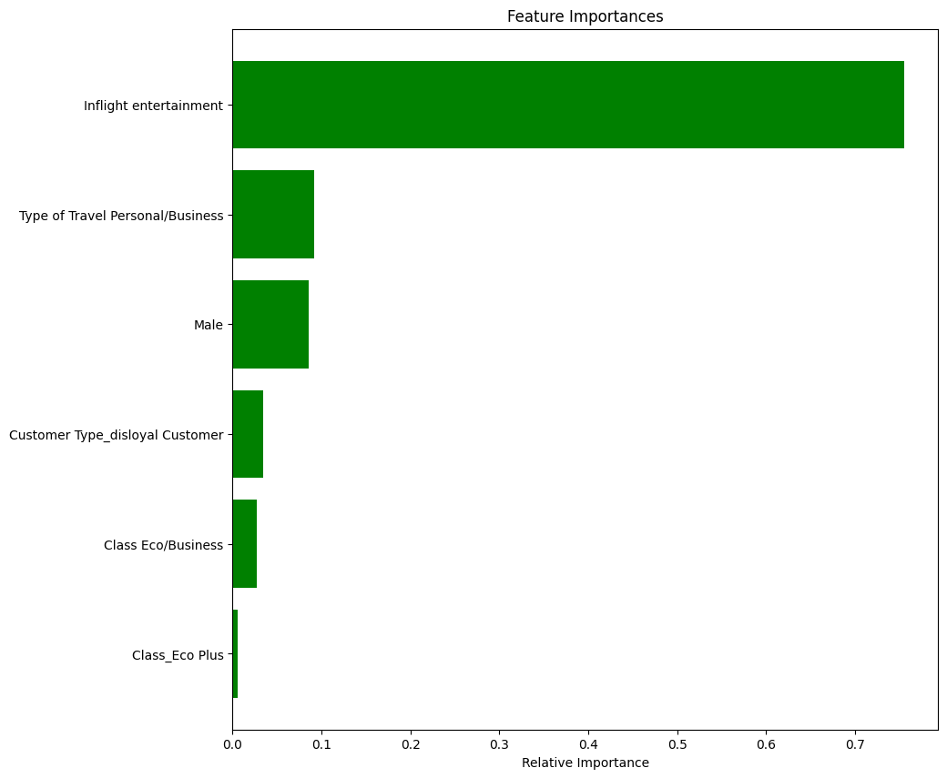
Classification – Decision Tree
Features Importances
Inflight entertainment 0.755
Type of Travel Personal/Business 0.091
Male 0.085
Customer Type_disloyal Customer 0.034
Class Eco/Business 0.027
Class_Eco Plus 0.005

Slide 20
Clustering

Slide 21
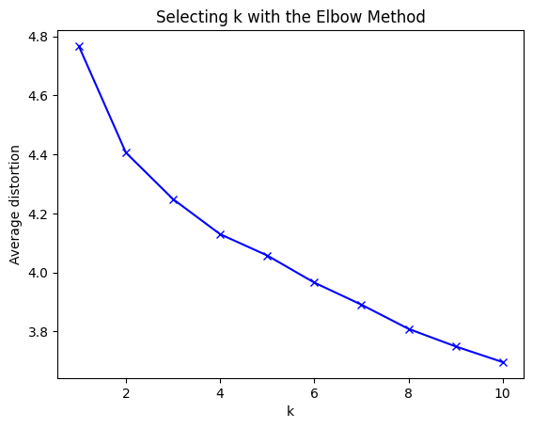
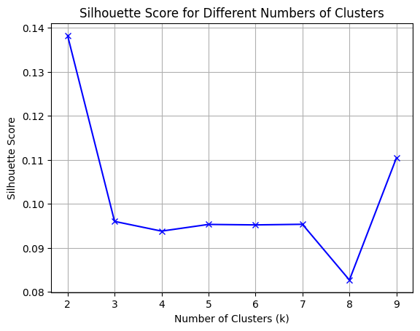
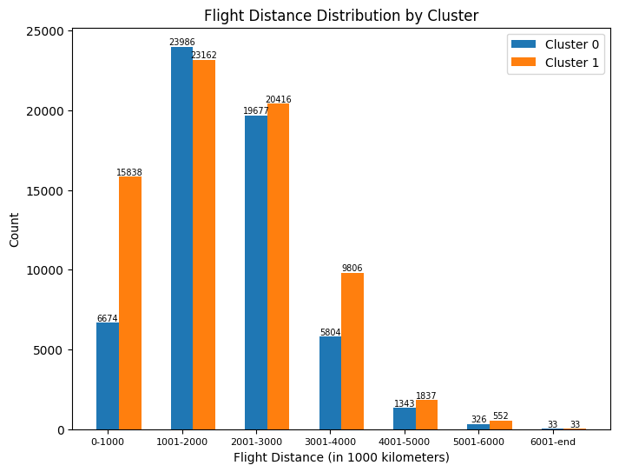
Clustering – K-means
Loading Data
Cleaning Data
Exploratory Data Analysis
Transformation Categorical Data
Scaling
Elbow Method
Silhouette Score
Applying Clustering - KMeans
Generate Clusters

Slide 22
Clustering – K-means

Slide 23
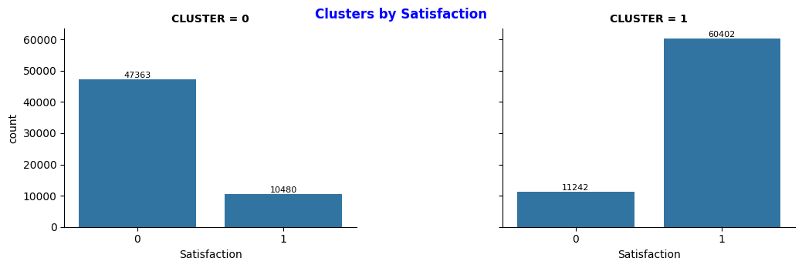
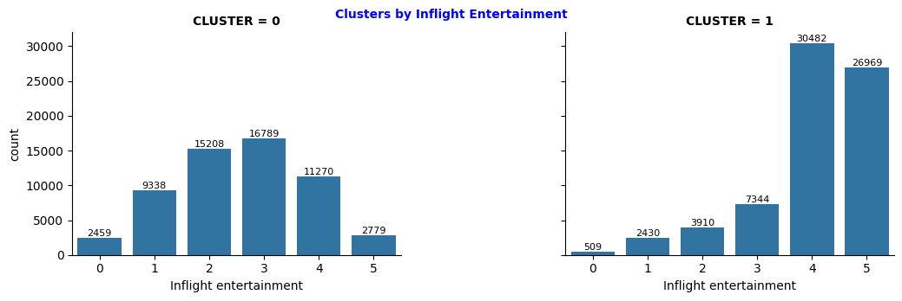
Clustering – K-means

Slide 24
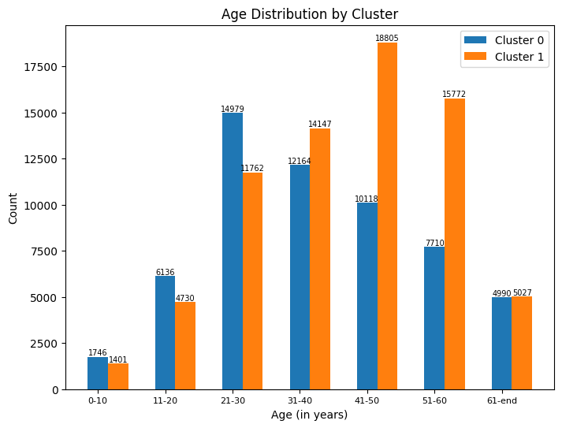
Clustering – K-means

Slide 25
Conclusion and Insight

Slide 26
Conclusion and Insights
Naive Bayes:
In this first classification model, Naive Bayes is applied, precisely the GaussianNB algorithm. Where feature selection is carried out with Logistic Regression and scaling with Standard Scaler.
The mean score was 75.76%, the accuracy on the training set was 75.71%, and the accuracy on the test set was 75.91%, which results in a model with no overfitting or underfitting.
These values provide insights into how the Naive Bayes model performs well in terms of accuracy, recall, and ROC (0.75) curve analysis.
Decision Tree:
In the second classification model, a Decision Tree is applied, using a parameter of max_depth=5.
The mean score was 84.27%, the accuracy on the training set was 84.20%, and the accuracy on the test set was 84.20%.
These values provide insights into how the Decision Tree model performs well in terms of accuracy, recall, and ROC (0.84) curve analysis. It also has better prediction probability than the Naive Bayes model.
In addition, it manages to identify six features that are the most relevant in decision-making. Still, the positive evaluation of Inflight entertainment is essential in determining passenger satisfaction.
Clustering:
Calculating the Elbow method, and then to achieve better precision, the Silhouette Score is applied, generating 2 clusters as a result.
The most significant differences between the clusters are observed in that Cluster 1 has more passengers with positive satisfaction than Cluster 0. Concerning the ages between 41 and 50 and 51 and 60, and those who fly long distances, less than 1000 kilometers, are mostly passengers with positive satisfaction.
Regarding the most crucial feature in the Decision Tree model, which is Inflight entertainment, a correlation is observed because passengers with positive satisfaction mainly evaluate the service with scores 4 and 5, corresponding to the highest scores.

Slide 27
Airline Passenger Satisfaction CSIS 3360-002 Final Project- Group 8
Ianna Iaichikina 300234152
Hazel Ibasco 300366644
Sergio Torres 300366657
Samira Mehdizadeh 300369611

