Slide 1
CS 557 Water Alert and Tracking System by Using Jawbone UP
Xin Su
Hanye Wei

Slide 2
Background - UP
Launched in November 2011, UP by Jawbone is an activity tracker.
Consists of a flexible rubber-coated wristband and accompanying iPhone and Android app
Allows users to track their sleep, eating habits, and daily activity including steps taken and calories burned.
Features a vibration motor that can be programmed as an alarm to wake users in the best phase of their natural sleep cycle, or act as a reminder when users have been sedentary too long.

Slide 3
Outlook
http://www.tekshanghai.com/product/jawbone-up-2nd-gen/
http://axbom.se/fitbit-flex-jawbone-up
http://www.whatmobile.net/2014/06/02/review-fitness-
wearables-round-nikefuelband-se-vs-jawbone-up24-vs-misfit-shine/
http://www.slashgear.com/jawbone-up24-adds-pink-navy-and-
lemon-lime-color-choices-23326256/

Slide 4
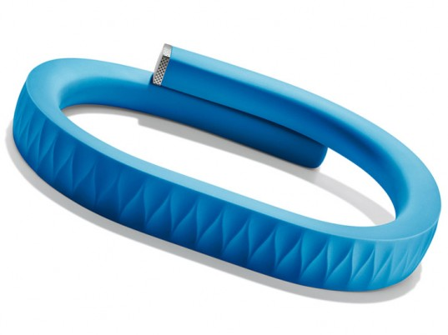

Slide 5
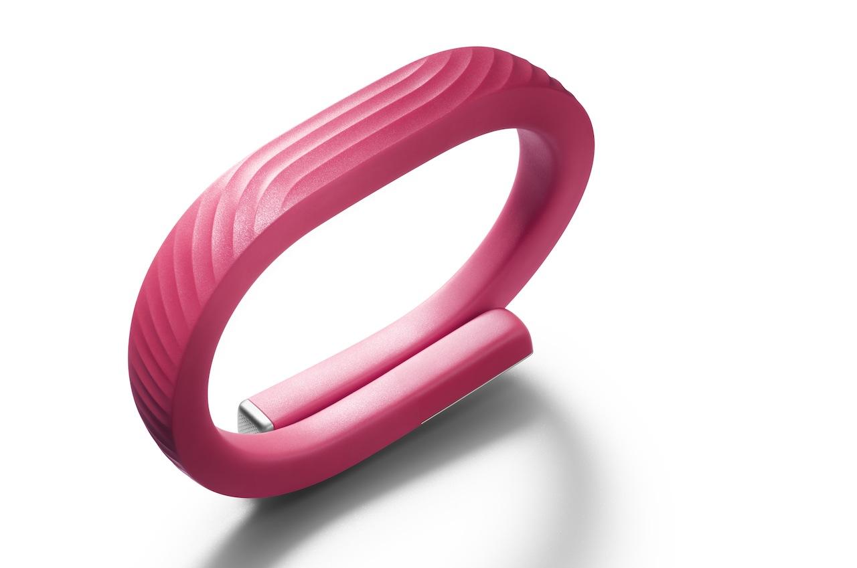

Slide 6
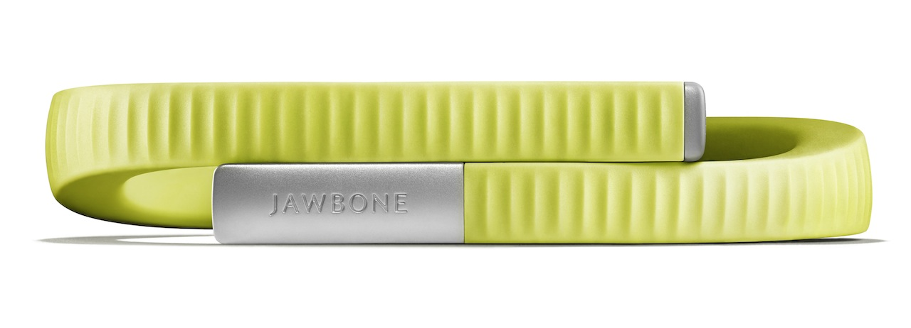
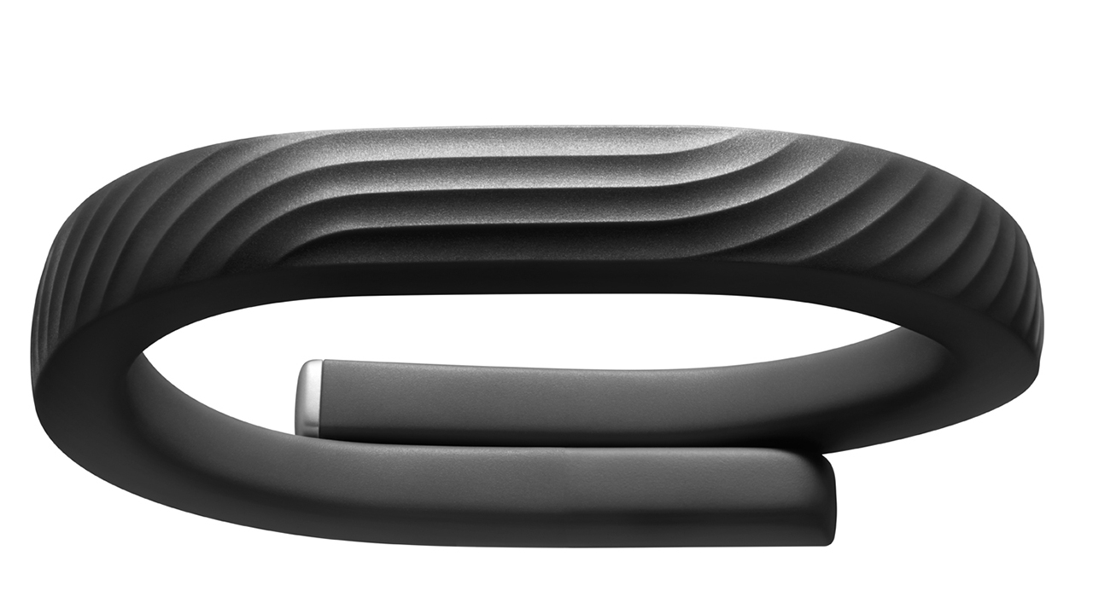

Slide 7
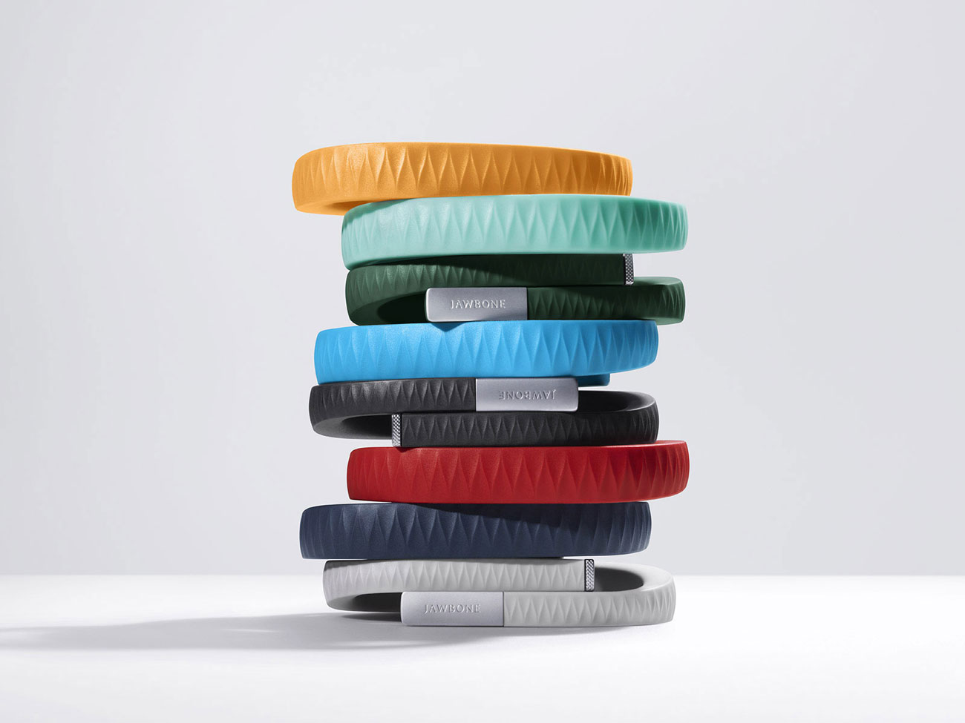

Slide 8
UP App (iOS)
http://www.techradar.com/reviews/gadgets/jawbone-up24-
review-1230596/review
http://www.gizmodo.com.au/2013/03/new-android-apps-jawbone-
up-a-world-of-fire-and-ice-and-more/

Slide 9
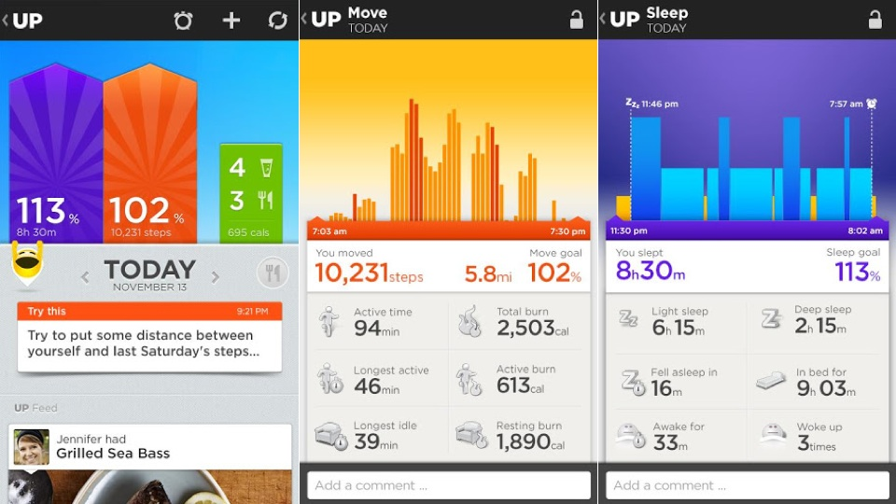

Slide 10
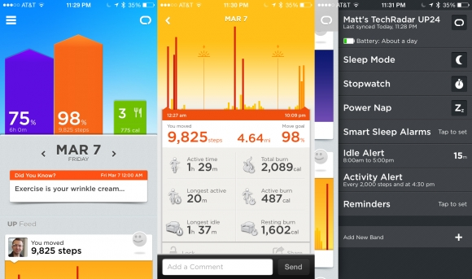

Slide 11
Motivation
Drink better, feel better. The human body needs enough water to maintain hydrate. Also accelerating metabolism lets people get fit and help to lose weight. We design this water alert and tracking system to assist people to drink water regularly and nurture the good habit and gathering information to know themselves better.

Slide 12
Project Goals
Using the Idle Alert system in the UP to create a Water Alert to allow user to set reminders to make sure you're staying healthy with ample water in the body and promote metabolism throughout the day. Customize the Water Alert from the app in the smartphone and the wristband will vibrate to let the user know when it's time to get some water.
Using the advanced sensors in the UP to capture the user’s drinking movement and monitor the water quantity the use has. User also can set goals and the app can sync the UP to expand and personalize your experience by giving out the graph of the comparison of the goal and real data.

Slide 13
App General Process Design
General
Login
Synchronize user data from the UP
Water Drink pattern learning
Set the UP to monitor Water Drink motion
Water Tracking
Display Water Tracking data Graph based on the tracking data
Water Alert
Set Water Alert time

Slide 14
References
[1] http://en.wikipedia.org/wiki/Wearable_technologys
[2] http://en.wikipedia.org/wiki/Jawbone_(company)
[3] https://jawbone.com/
[4] Bobick, Aaron F., and James W. Davis. "The recognition of human movement using temporal templates." Pattern Analysis and Machine Intelligence, IEEE Transactions on 23.3 (2001): 257-267.
[5] Weinland, Daniel, Remi Ronfard, and Edmond Boyer. "Free viewpoint action recognition using motion history volumes." Computer Vision and Image Understanding 104.2 (2006): 249-257.

