Slide 1
Introduction to the Laboratory ARMKit with MCXC143VFT
Juraj Sýkora
Brno University of Technology, Faculty of Information Technology
Božetěchova 1/2, 612 66 Brno, Czech republic
xsykorj00@fit.vutbr.cz
20.05.2026

Slide 2
Content
32-bit ARM MCU laboratory kit
Schematic: debug interface and power supply
Schematic: target MCU MCXC143VFT and peripherals
MCUXpresso IDE– project creation
MCUXpresso IDE– build, flash and debug

Slide 3
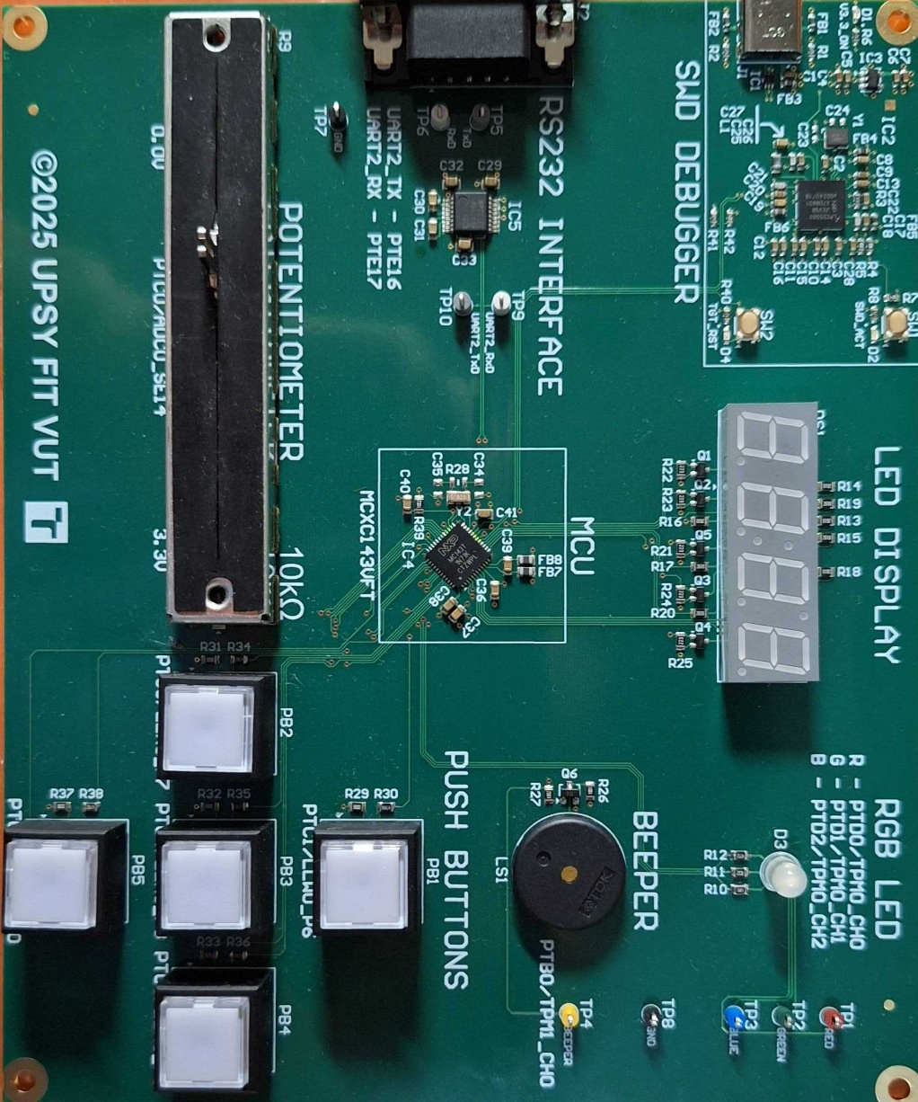
32-bit ARM MCU Laboratory Kit
Kits are located in laboratory L306
Target MCU: NXP MCXC143VFT
ARM Cortex-M0+ core, up to 48MHz
256kB Flash, 32kB SRAM
48-pin LQFP package
On-board debugger: MCU-Link v3 (NXP LPC55S69JEV98)
USB-C connector– power + CMSIS-DAP/SWD debug
3.3V main supply via RT9080-33 LDO

Slide 4
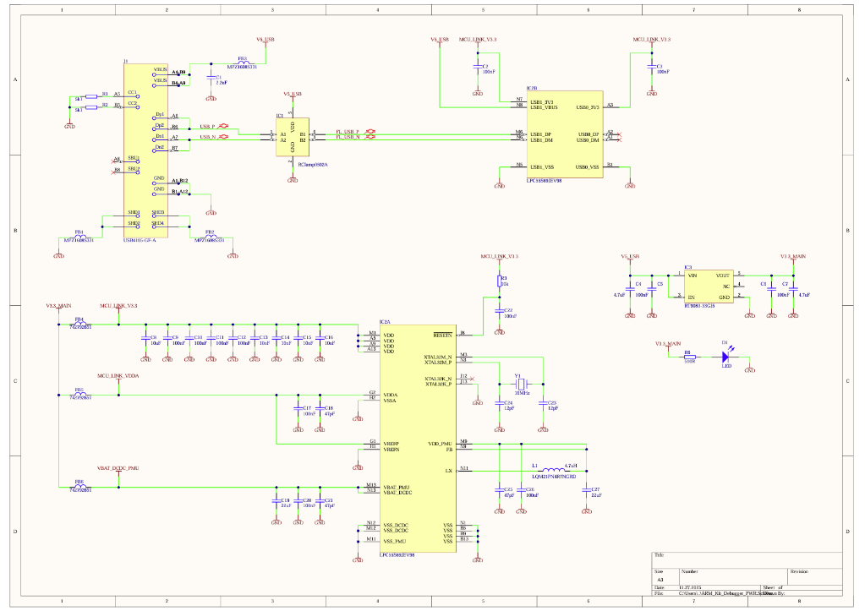
Schematic– Debug Interface
Key components:
USB4105-GF-A – USB-C receptacle
LPC55S69JEV98 – MCU-Link v3 chip
RT9080-33GJ5 – 3.3V LDO regulator
MPZ1608S331 – ferrite bead EMI filters
Y1 –16MHzcrystal for MCU-Link

Slide 5
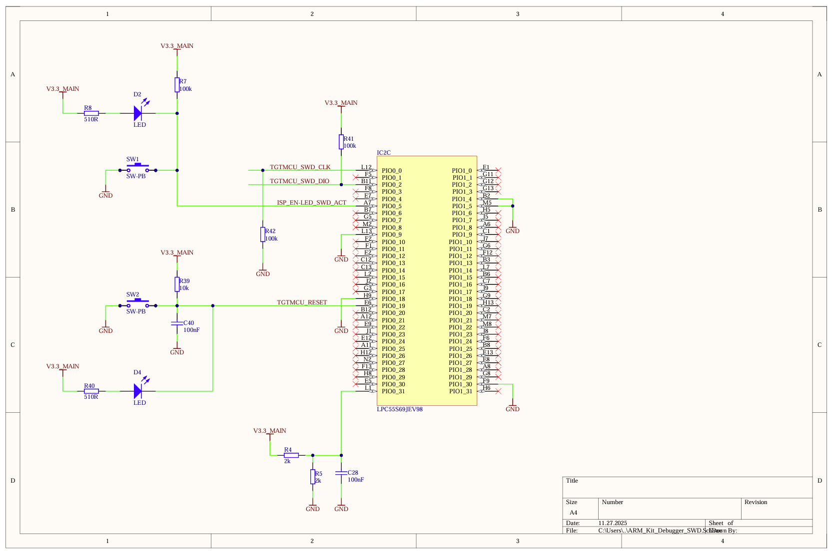
Schematic – SWD Debug Interface

Slide 6
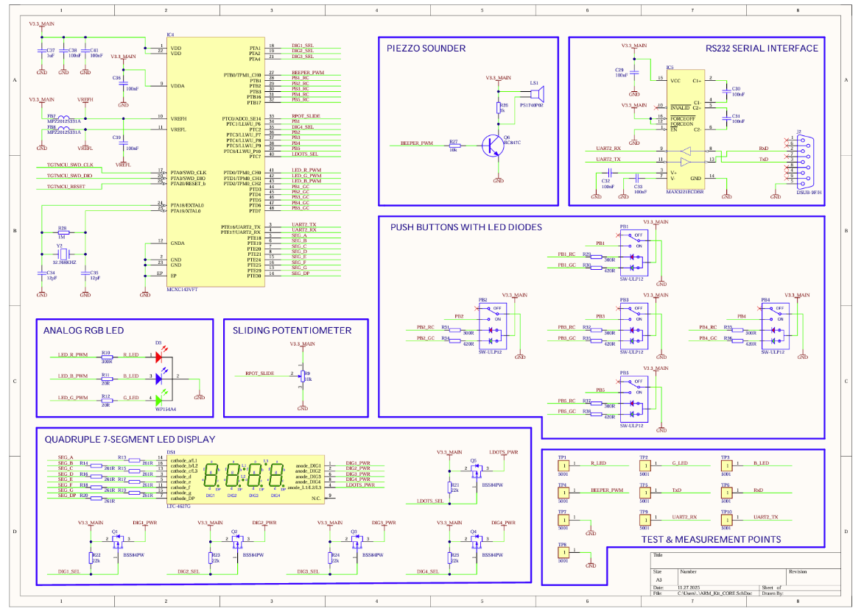
Schematic – Target MCU MCXC143VFT
Key pin assignments:
PTA0/SWD CLK, PTA3/SWD DIO, PTA20/RESET b – SWD debug interface
PTE16/UART2 TX, PTE17/UART2 RX – RS-232 via MAX3221E
PTD0-2/TPM0 CH0-2 – RGB LED PWM
PTB0/TPM1 CH0 – buzzer PWM
PTC0/ADC0 SE14 – sliding potentiometer
VDDA/VREFH/VREFL – analog supply and reference

Slide 7
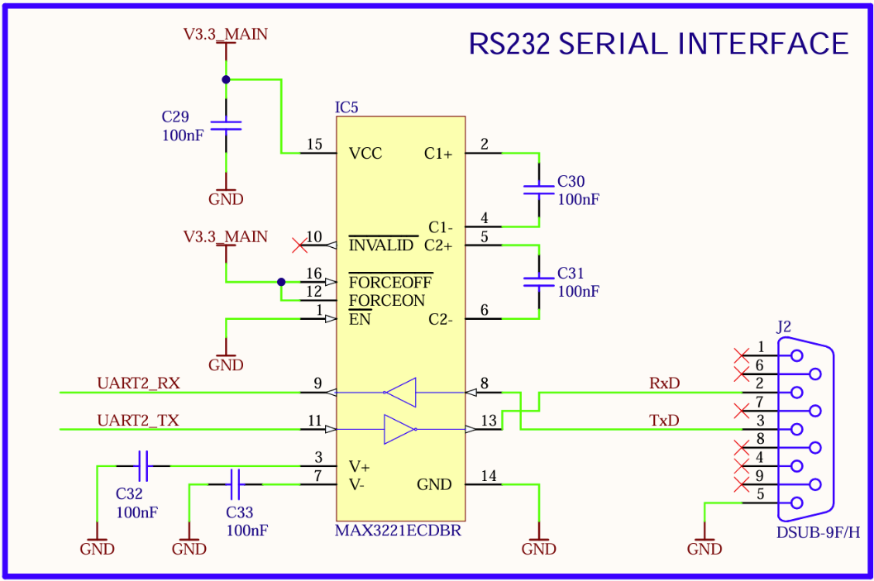
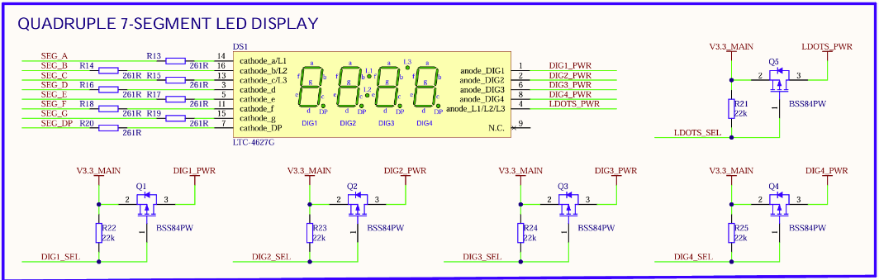
Schematic– RS-232 and 7-Segment Display
RS-232 serial interface:
Transceiver MAX3221ECDBR
Connector DSUB-9F/H
UART2 TX/RX ↔ TxD/RxD
4-digit 7-segment display
(DS1– LTC-4627G):
Common-anode; digit drive: Q1–Q4 (BSS84PW P-FETs), Q5 drives colon dots (LDOTS)
Segment signals: SEG A–G, SEG DP

Slide 8
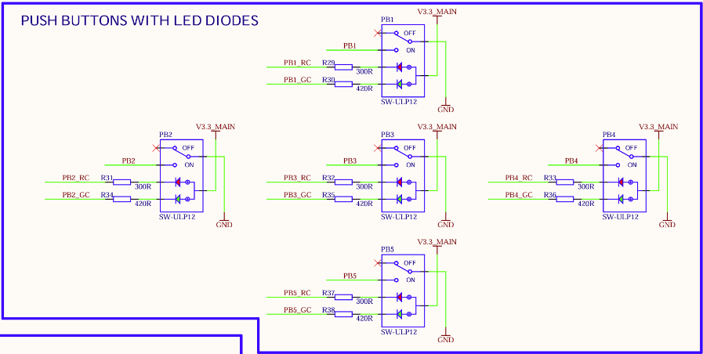
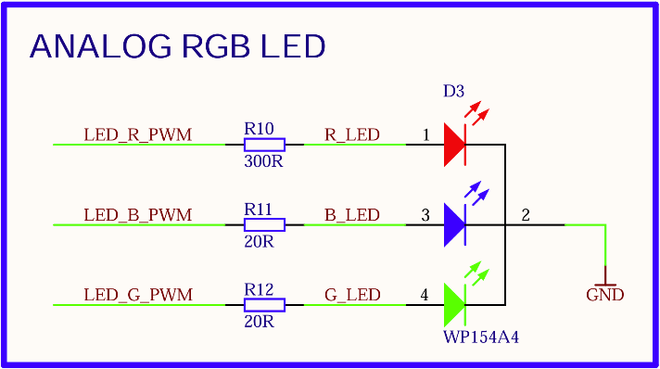
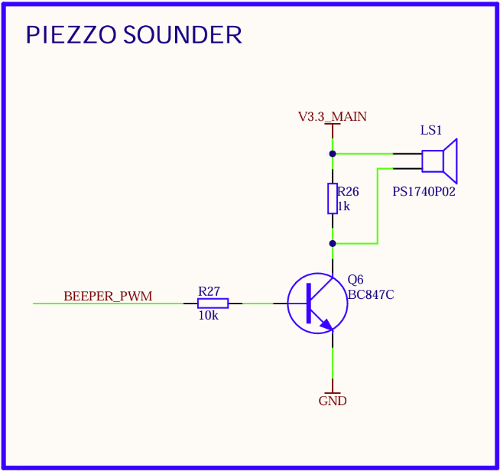
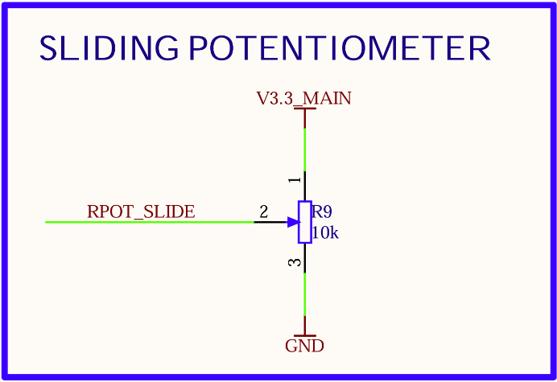
Schematic – Buttons, RGB LED, Buzzer, Potentiometer
Push buttons PB1 – PB5
(SW-ULP12):
PBx_RC/PBx_GC – GPIO
and LED anode
Analog RGB LED (D3
WP154A4):
LED R/G/B PWM
driven by TPM0_CH0–2
R10=300Ω, R11/R12=20Ω
Piezo buzzer (LS1):
NPNdriver Q6 (BC847C)
Signal: BEEPER_PWM on PTB0
Sliding potentiometer:
RPOT SLIDE → ADC0 SE14

Slide 9
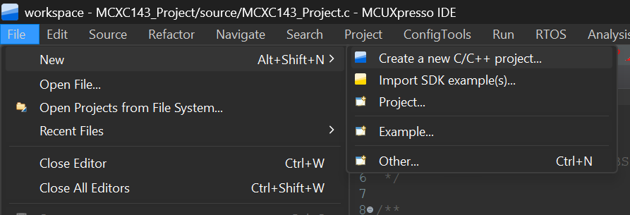
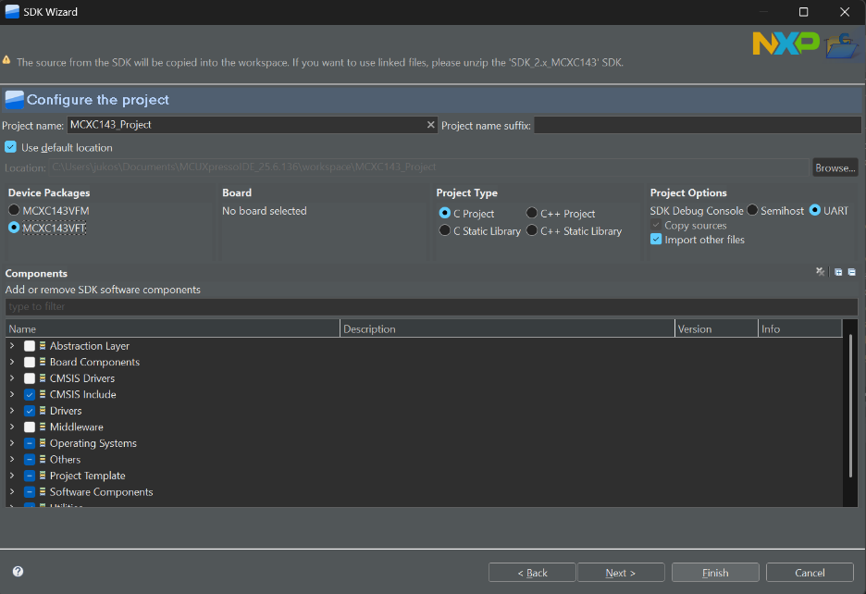
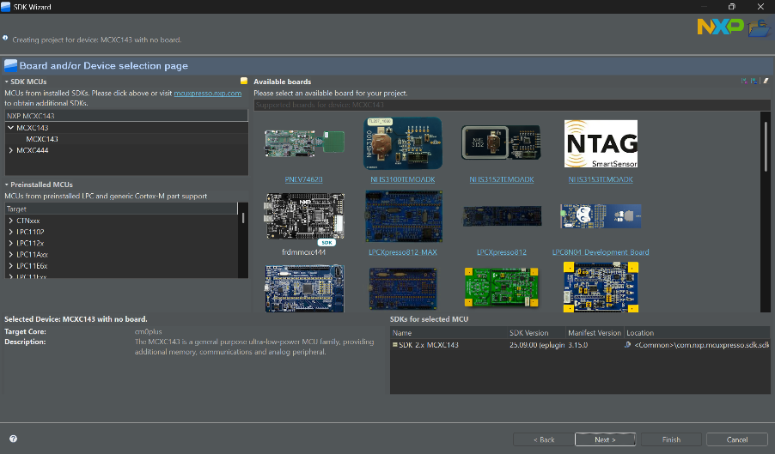
MCUXpresso IDE – Creating a New Project
File → New →Create a new C/C++ project; Select NXP MCUXpresso SDK Project; Choose SDK for MCXC143VFT (download from mcuxpresso.nxp.com if not yet installed)
Enter a project name; set the workspace, e.g. D:/IMP/ or P:/IMP Labs/
Select language C; leave the default linker script and click Finish

Slide 10
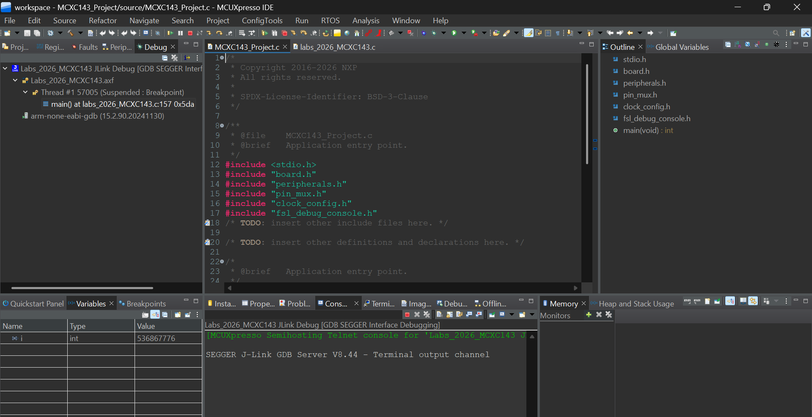
MCUXpresso IDE – Build and Flash
Build (hammer icon) – compiles sources and links the binary
Debug (bug icon) – starts an interactive debug session
Perspective switcher – toggle between C/C++ (edit) and Debug views
Console panel – build output; check here for errors
Variables/Registers/ Memory – inspect MCU state at runtime next to console panel

Slide 11
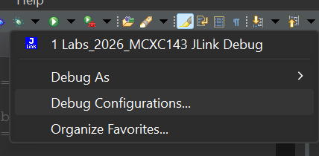
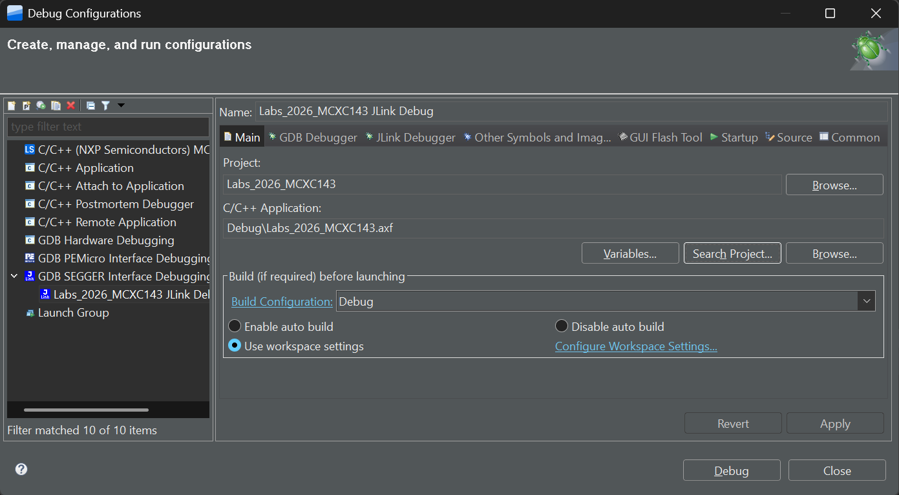
MCUXpresso IDE – Debug Configuration 1
Arrow next to Debug → Debug Configurations
Expand GDB SEGGER Interface Debugging; select or create the project entry
Main tab – verify:
Project – your project name
C/C++ Application path
JLink Debugger tab verify:
Device: MCXC143
Target Interface: SWD
JLink Interface: USB
Click Debug and resume execution: F8 or green Resume button

Slide 12
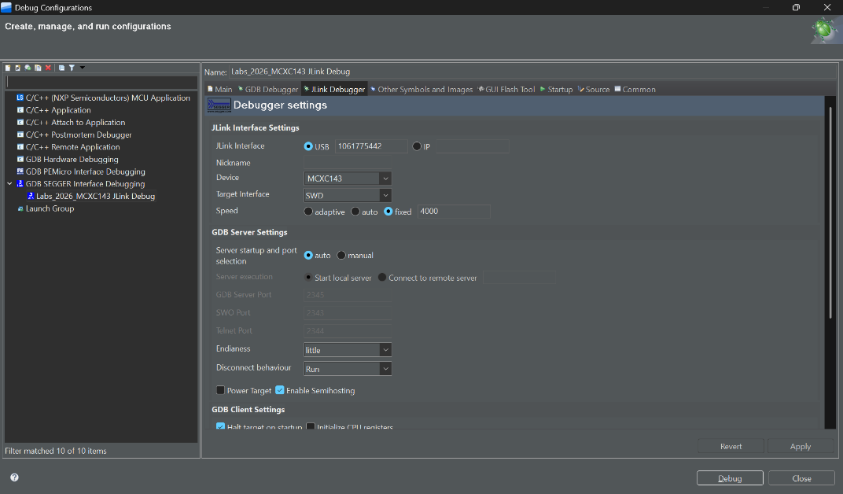
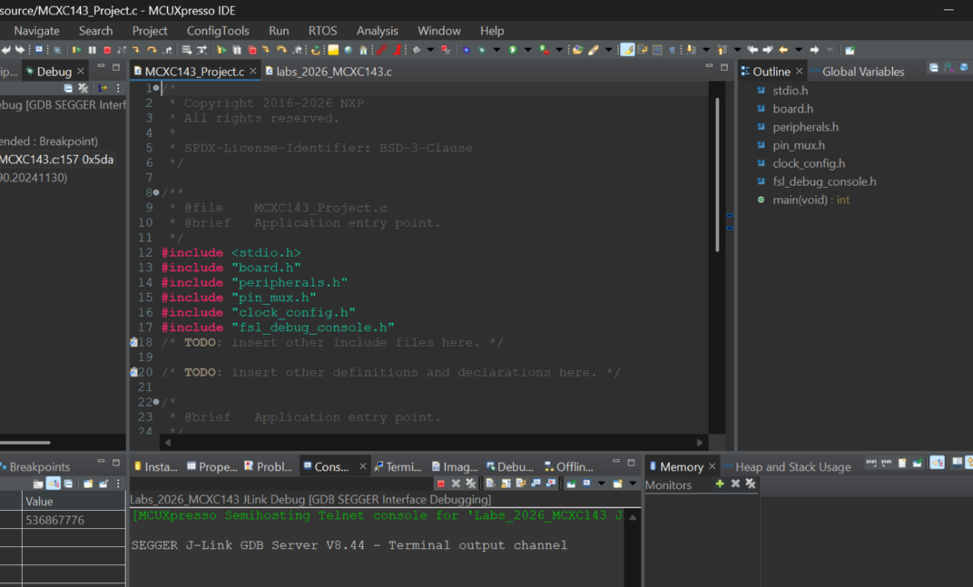
MCUXpresso IDE – Debug Configuration 2
Arrow next to Debug → Debug Configurations
Expand GDB SEGGER Interface Debugging; select or create the project entry
Main tab – verify:
Project – your project name
C/C++ Application path
JLink Debugger tab verify:
Device: MCXC143
Target Interface: SWD
JLink Interface: USB
Click Debug and resume execution: F8 or green Resume button

Slide 13
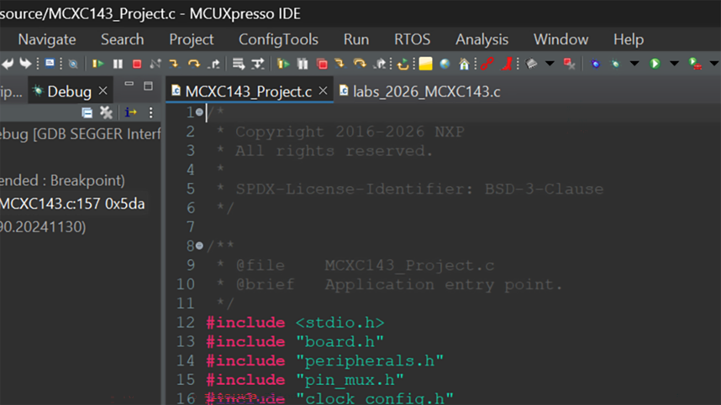
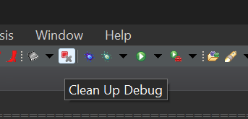
MCUXpresso IDE – Running and Stopping Code
Resume (F8) – starts or continues execution on the MCU
Suspend – pauses execution; inspect variables, registers, memory
Terminate (Ctrl+F2) – ends the debug session. Confirm the entry in the Debug view turns grey. A red entry means the session is still active – cannot be restarted!
After terminating, click the C/C++ perspective to return to the editor
Stuck debug session
If the debug thread hangs, right-click <terminated> in the Debug view and choose Terminate and Remove or click Clean Up Debug.

Slide 14
CodeExample – Piezo Buzzer
#include "MCXC143.h“
static void delay(volatile uint32_t n) {
while (n--);
}
int main(void) {
/* Disable watchdog explicitly */
SIM->COPC = SIM_COPC_COPT(0);
/* Enable clock gate for Port B */
SIM->SCGC5 |= SIM_SCGC5_PORTB_MASK;
/* PTB0 -> GPIO output (MUX = 1) */
PORTB->PCR[0] = PORT_PCR_MUX(1);
GPIOB->PDDR |= (1u << 0);
GPIOB->PCOR = (1u << 0); /* start LOW */
for (;;) {
GPIOB->PSOR = (1u << 0); /* PTB0 high */
delay(50000u);
GPIOB->PCOR = (1u << 0); /* PTB0 low */
delay(50000u);
}
return 0;
}
Notes:
Header MCXC143.h selected for MCXC143
Use atomic PSOR/PCOR instead of read-modify write on PDOR
Watchdog disabled explicitly via SIM->COPC
BEEPER PWM is wired to PTB0 on the kit (see schematic ARM Kit CORE

Slide 15
MCUXpresso SDK – Interrupt Handler Names
Override in your application code:
void DMA0_IRQHandler(void);
void DMA1_IRQHandler(void);
void DMA2_IRQHandler(void);
void DMA3_IRQHandler(void);
void FTFE_IRQHandler(void); /* Flash done */
void LVD_LVW_IRQHandler(void);
void LLWU_IRQHandler(void);
void I2C0_IRQHandler(void);
void SPI0_IRQHandler(void);
void UART2_IRQHandler(void); /* RS-232 */
void ADC0_IRQHandler(void);
void CMP0_IRQHandler(void);
void TPM0_IRQHandler(void); /* RGB PWM */
void TPM1_IRQHandler(void); /* Buzzer PWM */
void RTC_IRQHandler(void);
void PIT_IRQHandler(void);
void LPTMR0_IRQHandler(void);
void PORTA_IRQHandler(void);
void PORTB_IRQHandler(void);
void PORTC_PORTD_IRQHandler(void); /* C and D */
void PORTE_IRQHandler(void);

Slide 16
Thank You For Your Attention!

