Slide 1
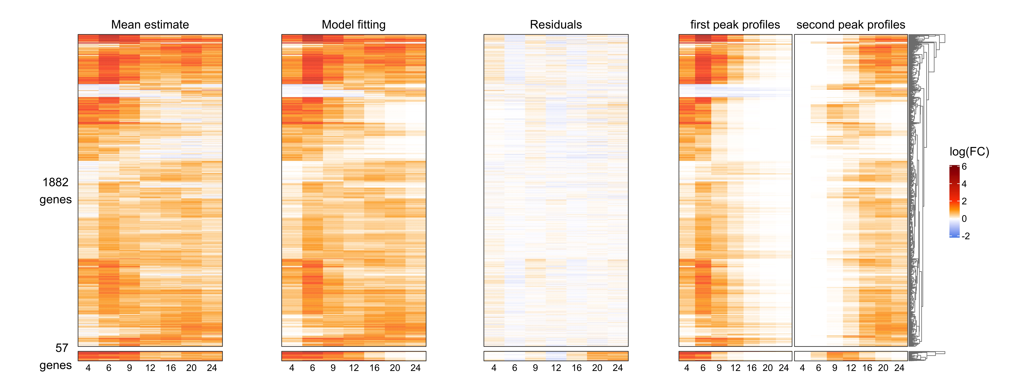














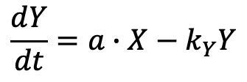





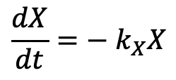


A
B
$$X$$
$$a$$
$$Y$$
$$S^{(0)}$$
$$S^{(1)}$$
$$S^{(2)}$$
… …
$$S^{(6)}$$
Signaling transduction (S)
$$k^{(0)}$$
$$k^{(1)}$$
$$k^{(2)}$$
$$k^{(6)}$$
$$k_{X}$$
$$k_{Y}$$
$$a_{A,g}$$
$$a_{N,g}$$
Autonomous
Cell Population
(ACP)
Non-autonomous
Cell Population
(NCP)
$$\frac{dX}{dt}=− k_{X}X$$
$$R_{A, g}$$
mixed by sample preparation
$$R_{N,g}$$
$$k_{g}$$
$R_{A,g}+R_{N,g}$
$$k_{g}$$
gene-specific (g) Response (R)
$$\frac{dY}{dt}=a∙X−k_{Y}Y$$
$$k_{g}$$
negative binomial
maximum likelihood estimation
mRNA level of a gene
C
D

