Slide 1
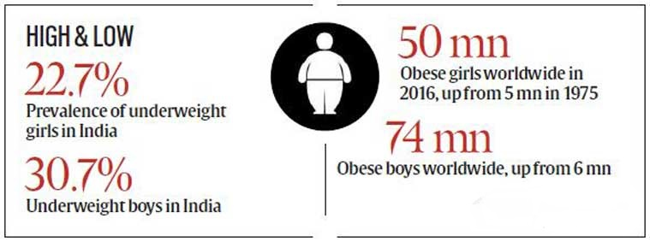


FOOD RECOGNITION AND CLASSIFICATION ALONG WITH CALORIE COUNT USING MACHINE LEARNING
INTRODUCTION
OBJECTIVE
MOTIVATION
OUTLINE
An unbalanced diet may cause many problems like weight gain, obesity, diabetes so it is necessary to manage our daily food intake.
Every age group may differ calorie requirements from that of a child to an adult.
The dietary assessment system gives an efficient way for a person’s food intake.
The users who lack knowledge about nutrition might be unable to know the number of calories in each meal then and there.
The system detects the type of food using a Support Vector Machine classifier and recommends the fitness diet from the calorie dataset.
1 IN 8 adults in the world is obese.
Rise in Overweightness and Obesity.
Increase in Diseases especially heart-related Diseases.
Increased death rate.
No recognition of food at tourist destinations.
No accurate way of estimating calorie intake.
Acquisition and pre-processing of the food images.
To select the best features for extraction.
To select methods for feature extraction of images.
To select a classifier depending on the type of dataset.
To detect the food type and providing calorie count of the food recognized.
Recommend diet for different body profiles based on calorie count.
Integrating the trained model with web application as well as android application.
PROBLEM STATEMENT
Introduction
Literature Work
Proposed System
Project Requirements
System Architecture
Results
Advantages
Disadvantages
Conclusion
Future Scope
E
Presenting
N
DEPARTMENT OF ELECTRONICS AND TELECOMMUNICATION ENGINEERING
SINHGAD ACADEMY OF ENGINEERING, PUNE-411048
2019-2020
LITERATURE SURVEY
My
To create a food recognition system which helps to keep track of everyday calorie intake based on food recognition and classification to maintain a healthy lifestyle.
I
LEARNING
Submitted By:
Bhumika Agarwal PRN No: 71716343B
Sheetal Dekate PRN No. 71716833G
Vaishali Gupta PRN No. 71716936H
Sumit Kumar PRN No. 71716882E
Guided By:
Mrs. M. M. Patil
Dietitian
H
C
A
M

Slide 2
PAPER NAME | DESCRIPTION | RESULTS
FCTH: FUZZY COLOR AND TEXTURE HISTOGRAM A LOW-LEVEL FEATURE FOR ACCURATE IMAGE RETRIEVAL JOURNAL: IEEE AUTHOR & YEAR: Savvas A. Chatzichristofis 2008 | This paper proposes a new low-level descriptor that includes in one quantized histogram color and texture information. This feature (FCTH) results from the combination of 3 fuzzy units. It is compared with other color and texture descriptors. | Experimental results showed the ANMRR value of FCTH to 0.27 which was the lowest as compared to other CDDs proving it to be a better quality match for image retrieval.
COLOR AND EDGE DIRECTIVITY DESCRIPTOR ON GPGPU JOURNAL: IEEE AUTHOR & YEAR: C. Iakovidou 2015 | This paper deals with the extraction of a new low level feature that combines in one histogram, color and texture information and its length does not exceed 54 bytes. | We found by comparison that the ANMRR value of CEDD is 0.2431 for Wang’s database and Rummager database respectively which is the lowest of all others.
PAPER NAME | DESCRIPTION | RESULTS
A FOOD RECOGNITION SYSTEM FOR CALORIE MEASUREMENT JOURNAL: IJARCCE AUTHOR & YEAR: Ankita A. Podutwar 2017 | Users just take a picture of the food image then recognize the image to detect the type of food portion and classify using a support vector machine. Segmentation, food portion recognition using skull stripping and classification using support vector machine are used to calculate the calorie along with the type of energy in an accurate way. | Based on our simulation results, the proposed algorithm recognizes food categories with an absolute accuracy of 89%.
FOOD IMAGE CLASSIFICATION USING SPHERE SHAPED- SUPPORT VECTOR MACHINE JOURNAL: IEEE AUTHOR & YEAR: S. Jasmine Minija 2017 | In this paper the Fuzzy C-Means method is used to segment the image which is given as input. The significant feature of food items is taken out by the global and local feature extraction method. After that the classification phase is performed by the Sphere – Shaped SVM classifier. | Thus, the proposed method achieved 95% of accuracy value which provided the better classification Performance.
PAPER NAME | DESCRIPTION | RESULTS
MEASURING CALORIE AND NUTRITION FROM FOOD IMAGE Journal: IEEE AUTHOR AND YEAR: Parisa Pouladzadeh 2014 | In this paper, to improve the accuracy of the current state of the art technologies, we have engaged color k-mean clustering along with color mean shift and texture segmentation schemes to get more accurate results in segmentation phase. In this application we have two important stages, segmentation and recognition. | In this paper they applied our method to 3 different categories of food: single food, non-mixed food, and mixed food, and from the results, we saw that the SVM’s accuracy is approximately 92.21%, 85%, and 35% to 65%, respectively.
YOUR CONTENT
YOUR CONTENT
YOUR CONTENT

Slide 3
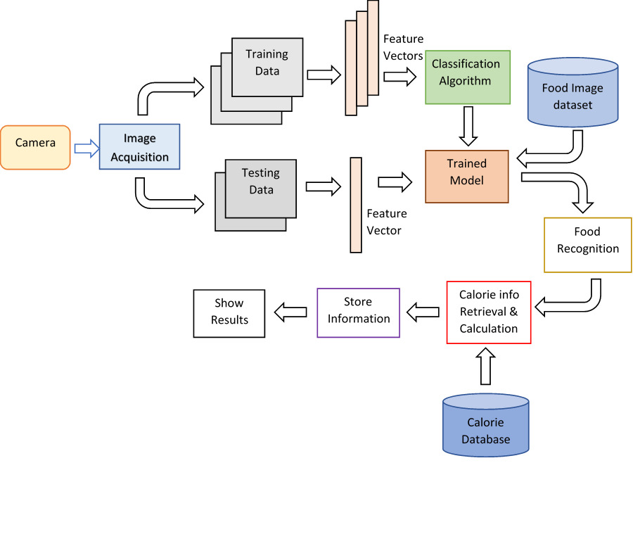
Stages
SVM
Capture Food Image
Preprocessing
Feature Extraction
Classification
Result
PROPOSED SYSTEM
FCTH
CEDD
SVM

Slide 4
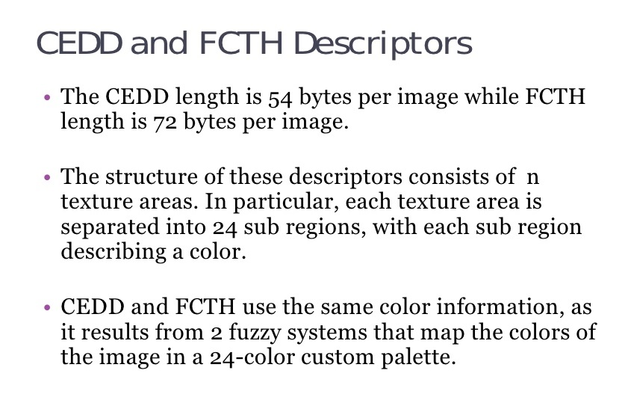
FCTH and CEDD Descriptor

Slide 5
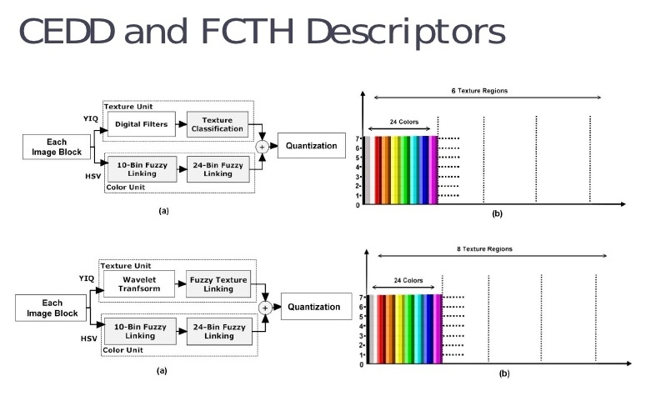

Slide 6
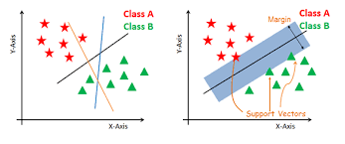
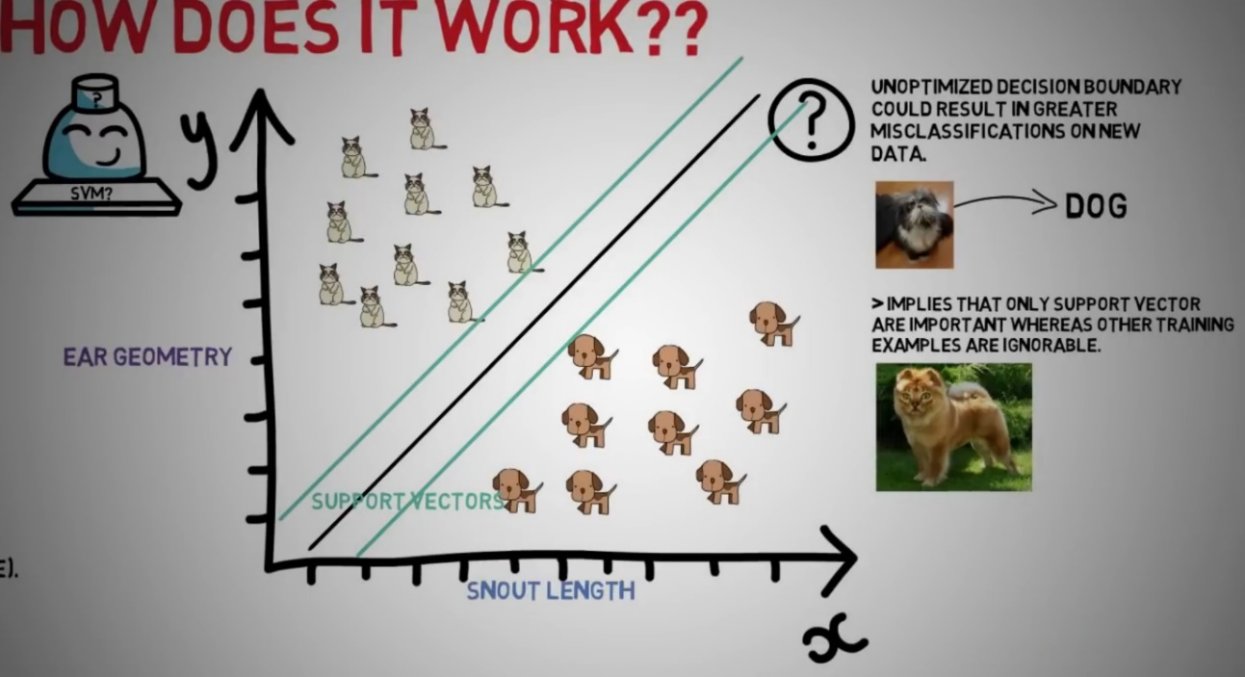
Support Vector Machine
What is SVM?
- Supervised machine learning algorithm
- predict the class in the best
possible way.
- Support Vectors
- Hyperplane separation
Why SVM?
- More accurate
- More robust
- Linear vectors
- Uses kernel trick
- Non-linear vector separation using
kernel trick

Slide 7

System Requirements
Developer’s end
User’s end
HARDWARE REQUIREMENTS :
PROCESSOR : 1 gigahertz (GHz) or faster processor or SoC
RAM : 1 gigabyte (GB) for 32-bit or 2 GB for 64-bit.
HARD DISK SPACE : 16 GB for 32-bit OS 20 GB for 64-bit OS.
HARDWARE REQUIREMENTS :
PROCESSOR : Android
RAM : 512 or above
HARD DISK SPACE : 2gb or above
SOFTWARE REQUIREMENTS :
PLATFORM: Microsoft Windows 7 Professional or greater.
IDE: Eclipse Luna
DATABASE: MySQL
LANGUAGE: Java/ Python for food Matching

Slide 8
SYSTEM
Architecture
And Flowcharts

Slide 9
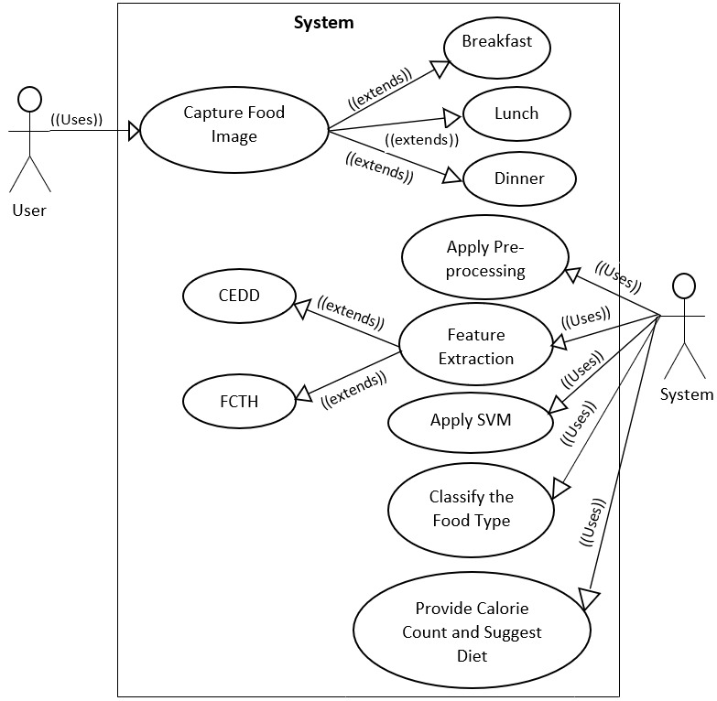
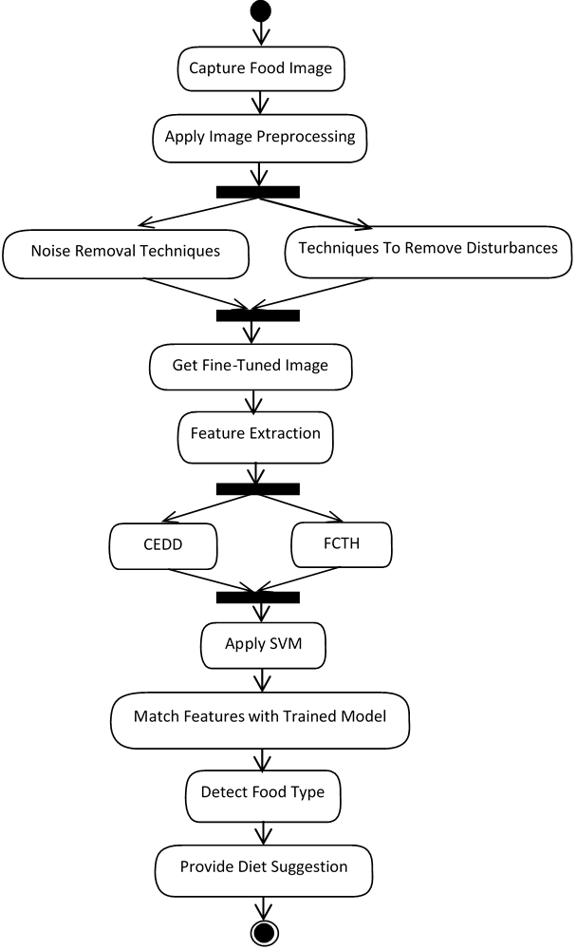
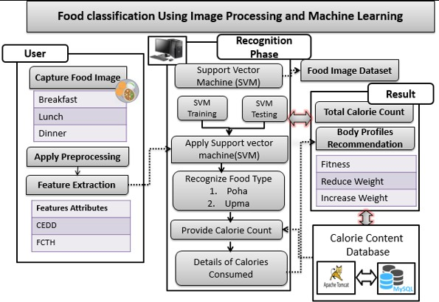
A
USE
CASE
Diagram
ACTIVITY
Diagram
DATASET

Slide 10
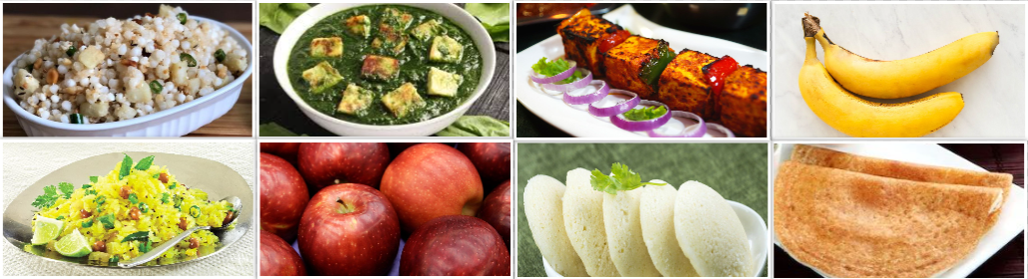
CATEGORIES :
Total images – 600
Training – 420 images (70%)
Test – 180 images (30%)
Apple
Banana
Poha
Dosa
Idli
Palak Paneer
Paneer Tikka
Sabudana Khichdi

Slide 11
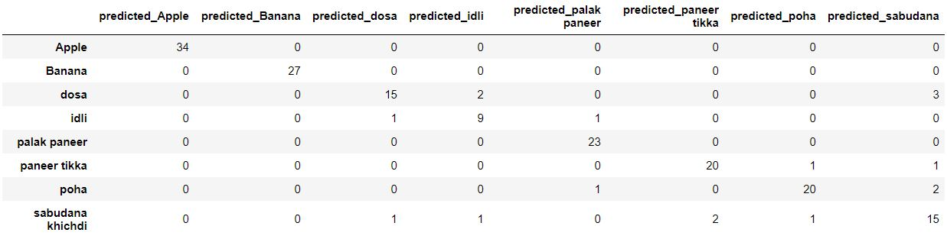

Results

Slide 12
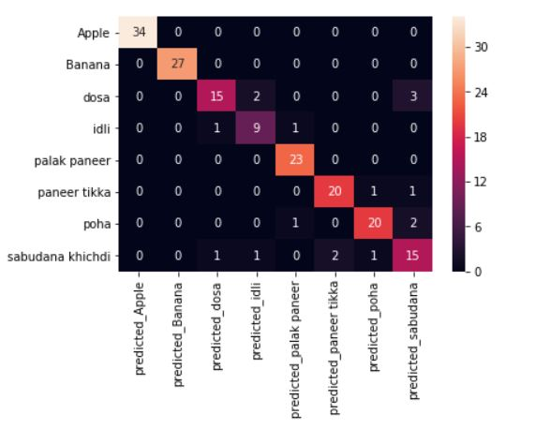
Confusion Matrix

Slide 13
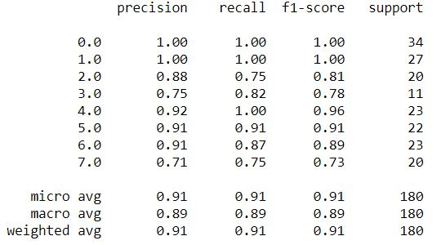

Slide 14
HTML
JAVA SCRIPT
Web-app
Styling
Establishing connection
Front-end
. . .
Design
Responsive
Webpages
CSS

Slide 15



MySQL
Back-end
SVM
JAVA
. . .
Database
PYTHON
Platform

Slide 16

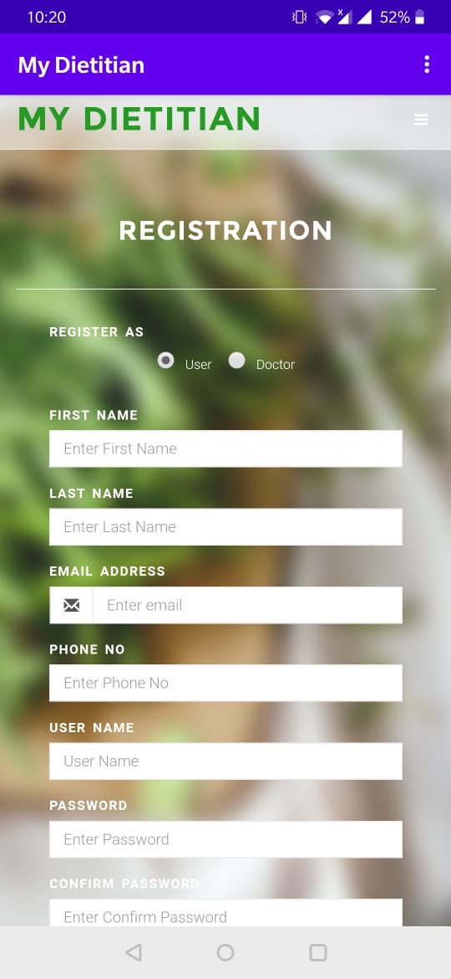
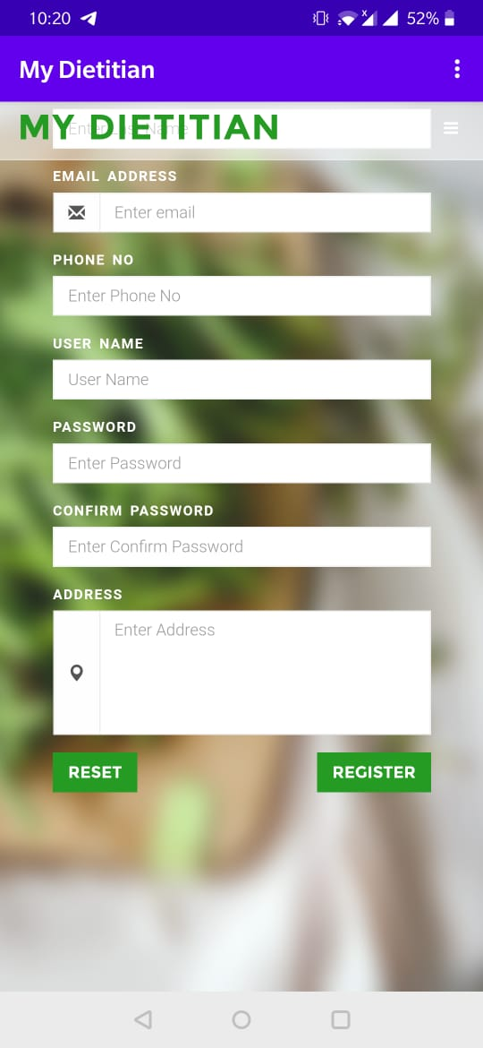
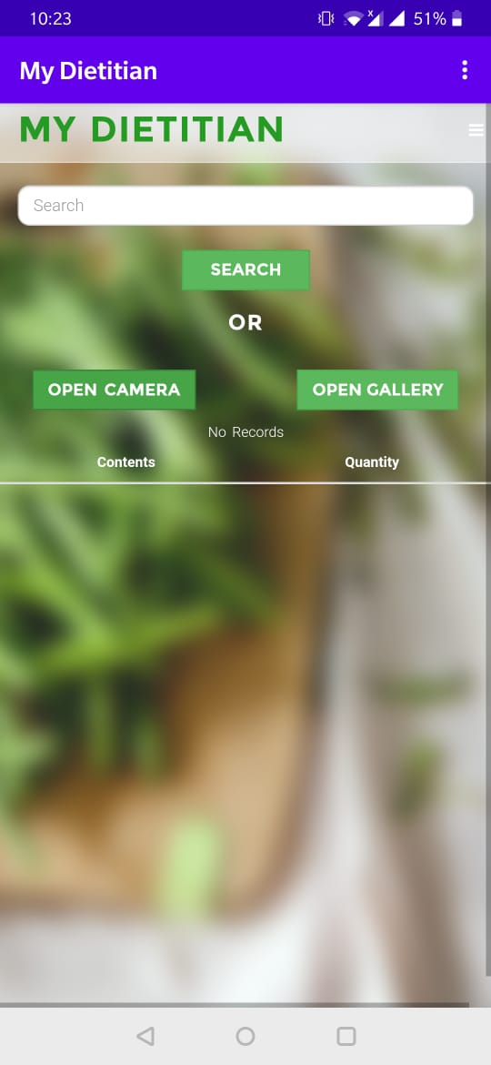
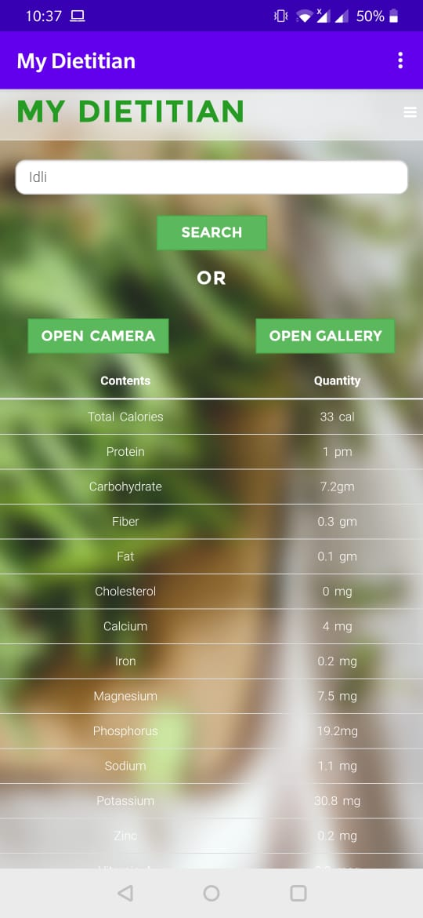
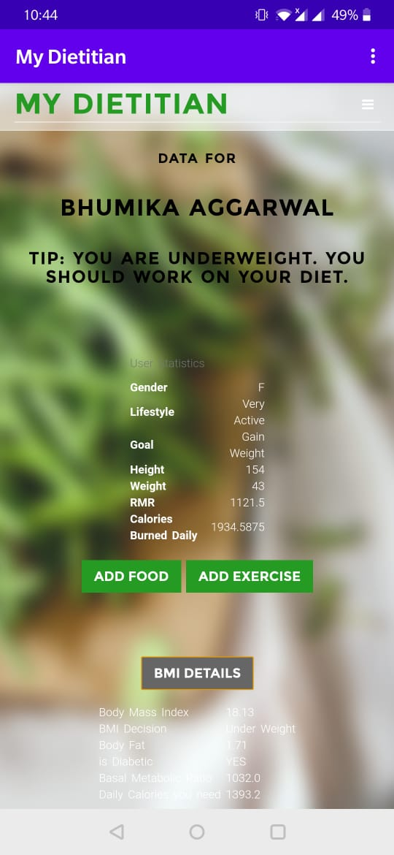
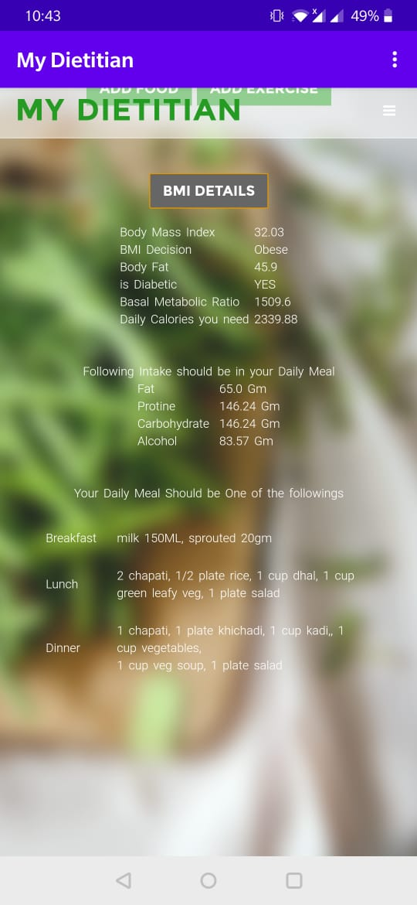
USER STATISTICS AND DIET SUGGESTION
Registration Page
FOOD RECOGNITION AND CALORIE COUNT
Homepage
Our WebApp

Slide 17
Conclusion
The proposed system outputs an accuracy of 90.55 % i.e. SVM classifier efficiently recognize 163 images correctly out of 180 images.
The system uses a smartphone camera as measurement reference. It also maintains a food journal to keep track of daily consumed meals.
We believe that the proposed method could be used as a helping tool for use in treatment of obesity, overweight and diet-related issues.

Slide 18
Future Scope
Recommendation of meal and workout routine to different age groups.
Expand dataset
Multi-food recognition.

Slide 19
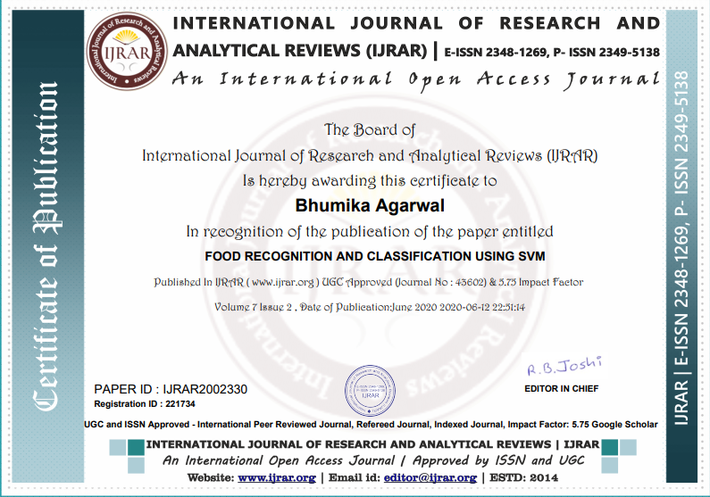
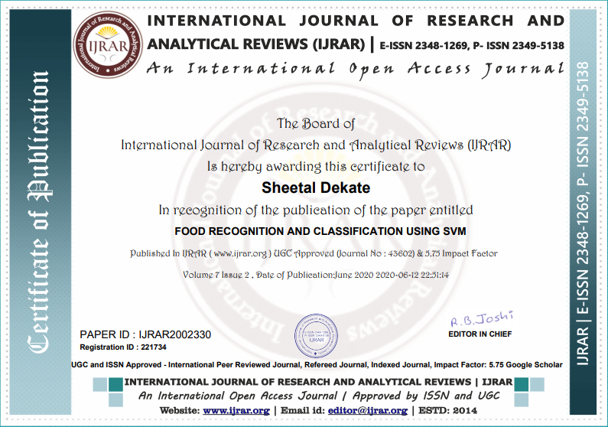


Research Paper Published at the International Journal of Research and Analytical Reviews.

Slide 20
H
O
P
E

Slide 21
Y
O
U

Slide 22
I
D
L
K
E

Slide 23
I
T

Slide 24


Thank You
My Dietitian
Sumit
Sheetal
Sheetal
Your Name
As Our Sponsor
Your Name
As Our Sponsor
Bhumika
Vaishali

