Slide 1
A genome graph paradigm for cancer genome structure
Xiaotong Yao
In partial fulfillment of the requirements for the degree of
Doctor of Philosophy
08/12/2021

Slide 2
Genome instability is a hallmark of cancer

Slide 3
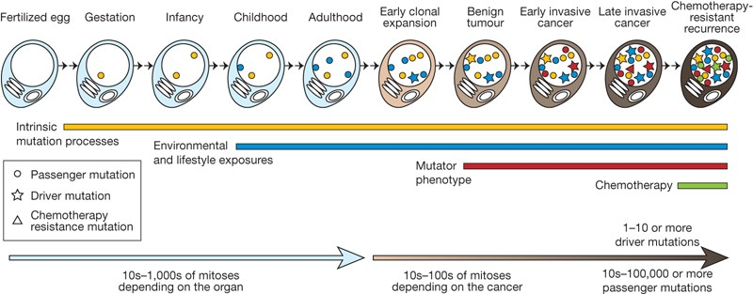
Repertoire of variants in a cancer genome is the result of mutagenesis, repair, and evolution
MR Stratton et al. Nature 458, 719-724 (2009) doi:10.1038/nature07943

Slide 4
Genomic sequencing enabled holistic profiling of variants

Slide 5
Structurally rearranged chromosomes is a hallmark of cancer
Notes:
To know the origin/etiology of cancer we must know what genetic variations are in their genomes and subsequently find out how they acquired them.

Slide 6
Whole genome sequencing characterizes SVs at base level resolution…
Junction
Copy Number (Aberration)
Notes:
Thanks to the emergence of sequencing…

Slide 7
…and on massive scale
Notes:
And because of the decreasing cost…

Slide 8
Many patterns of SVs are discovered, and mechanisms proposed
Notes:
As a result…

Slide 9
SV complexity complicates discovery
Notes:
Yet…

Slide 10
SVs in germline genomes are simpler
Simple event ~ 1 or 2 junctions
Complex events are rare
Notes:
Most SV studies are first done in germline genomes, where events are relatively simple: composed of only 1 or 2 junctions and straightforward to categorize

