Slide 1
CBM Journal Club
A spectral approach integrating functional genomic annotations for coding and noncoding variants
Xiaotong Yao
PhD student
Tri-I Computational Biology and Medicine
04.25.16
Github.com/

Slide 2
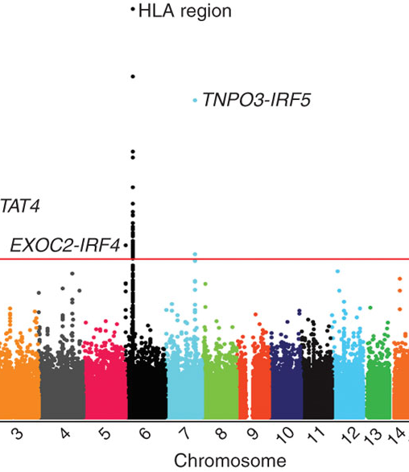
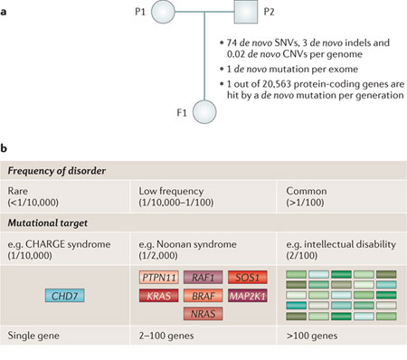
Needle in a haystack: computational annotation to guide validation
Inherited variants in association with phenotypes found in GWAS
Radstake, Timothy RDJ, et al. "Genome-wide association study of systemic sclerosis identifies CD247 as a new susceptibility locus." Nature genetics42.5 (2010): 426-429.
De novo mutations identified from exome-sequencing or whole-genome sequencing
Veltman, Joris A., and Han G. Brunner. "De novo mutations in human genetic disease." Nature Reviews Genetics 13.8 (2012): 565-575.
Somatic mutations from sequencing particular tissue (e.g. tumor) and germline samples
Alexandrov, Ludmil B., et al. "Signatures of mutational processes in human cancer." Nature 500.7463 (2013): 415-421.

Slide 3
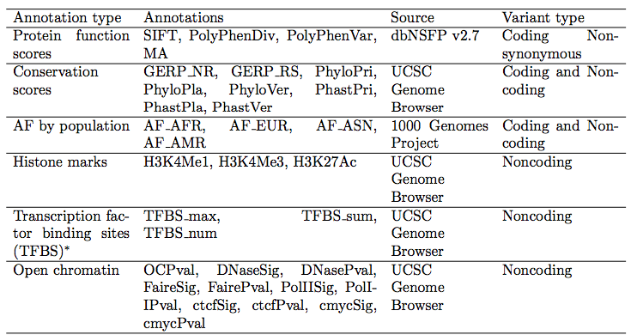
Functional impact of genomic variants: inferred from various sources of evidence
Combine scores: majority vote, weighted sum, supervised learning
Combined Annotation-Dependent Depletion (CADD), Genome-Wide Annotation of Variants (GWAVA)
Limitation: dependence on training labels!

Slide 4
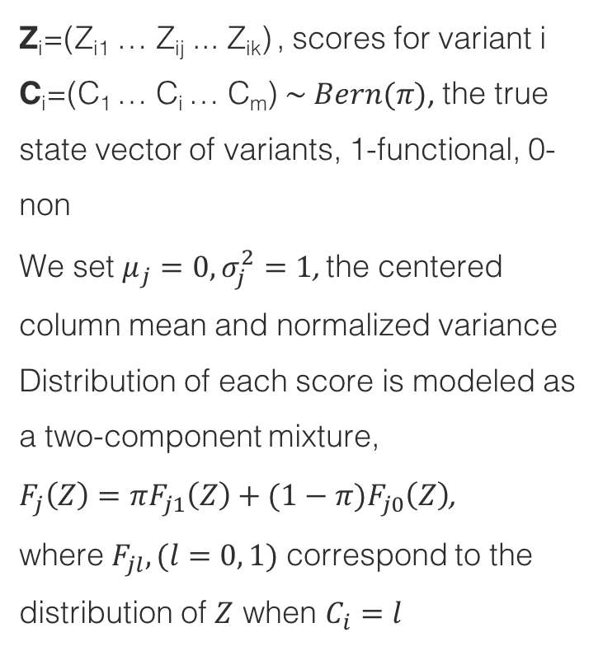
Spectral Meta-Learner (SML): notations and constraints
Z_{i}=(Z_{i1} … Z_{ij} ... Z_{ik}) , scores for variant i
C_{i}=(C₁ … C_{i} … C_{m}) $\sim Bern(π)$, the true state vector of variants, 1-functional, 0-non
We set $μ_{j}=0, σ_{j}^{2}=1$, the centered column mean and normalized variance
Distribution of each score is modeled as a two-component mixture,
$F_{j}\left(Z\right)=πF_{j1}\left(Z\right)+(1−π)F_{j0}\left(Z\right)$,
where $F_{jl}, (l=0, 1)$ correspond to the distribution of $Z$ when $C_{i}=l$
k individual scores
Z₁₁ | … | Z_{1j} | … | Z_{1k}
…
Z_{i1}
…
Z_{m1}
C₁
…
C_{i}
…
C_{m}
m variants

Slide 5
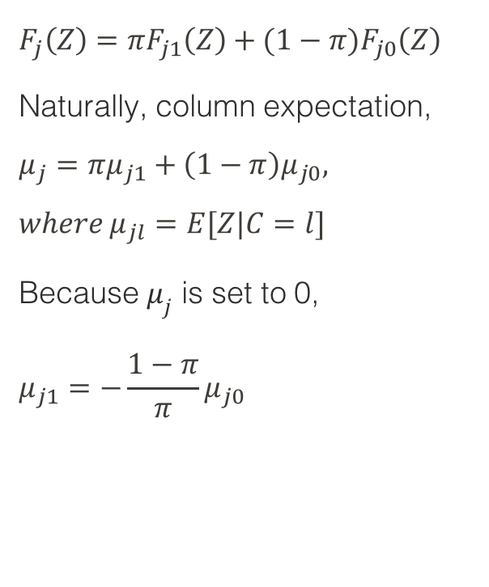
SML: decompose covariance matrix
$$F_{j}\left(Z\right)=πF_{j1}\left(Z\right)+(1−π)F_{j0}\left(Z\right)$$
Naturally, column expectation,
$$μ_{j}=πμ_{j1}+\left(1−π\right)μ_{j0},$$
$$where{ μ}_{jl}=E[Z|C=l]$$
Because $μ_{j}$ is set to 0,
$$μ_{j1}=−\frac{1−π}{π}μ_{j0}$$

Slide 6
SML (cont.): individual scores weighted by first eigenvector of (partial) column covariance matrix

