Slide 1
Mindfulness for Entrepreneurs: Success & Survival
Xin Tang

Slide 2
Does being happy, mindful, or enlightened help entrepreneurs reach success in their career paths??

Slide 3

Entrepreneurs are a fascinating breed of people
Most passionate and most driven
Often most obsessive and out of balance individuals
Can lead to new innovations but at the same time lead to self destruction

Slide 4
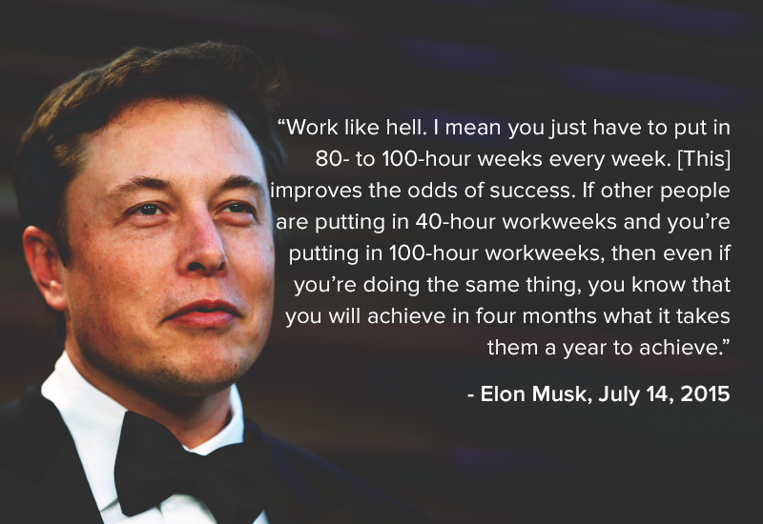

Slide 5

Interview with Li Rong Tang
“It worked in the beginning but as you become more successful, you are given more opportunity and you don’t have enough time in the day to continue Elon’s approach.”

Slide 6
The Science of Mindfulness to be a better leader
- Amishi Jha (Professor at UMaimi)
Meditation improves creativity
According to American Psychometric Society
  Decrease stress and anxiety
  Increase positive emotions
According to American Psychometric Society
  Increase productivity
    Focus, attention, and ability to think outside the box

Slide 7
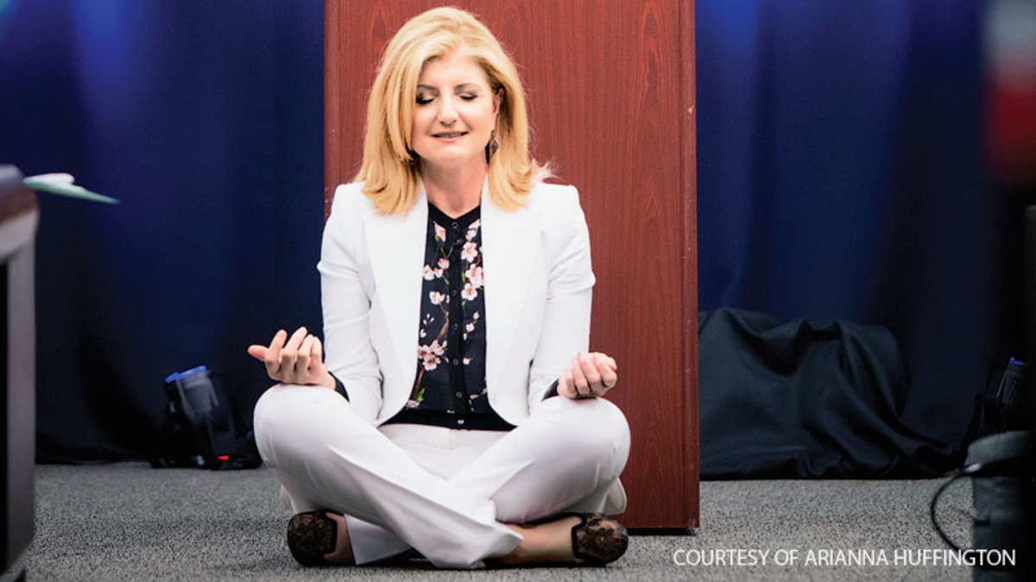
Arianne Huffington
“That mediation is a reminder underneath all of comings and goings, successes and failures, there is a deeper dimension in our lives and we can tap into which makes more successful and compassionate and more of things we want in our lives”.

Slide 8
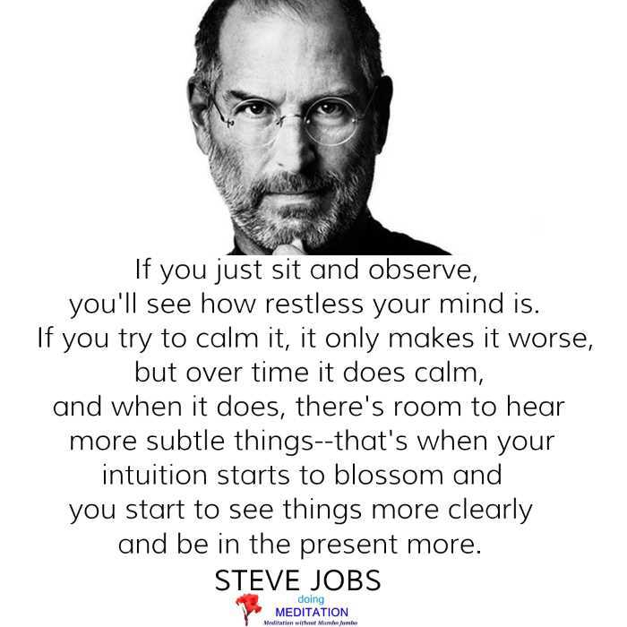
Steve Jobs

Slide 9
Does being happy, mindful, or enlightened help entrepreneurs reach success in their career paths??

Slide 10
References
Huffington, A. S. (2017). The Sleep Revolution: Transforming Your Life, One Night at a Time. London: WH Allen.
Isaacson, W. (2017). Leonardo Da Vinci. New York: Simon & Schuster.
Melby, C. (2012). The Zen of Steve Jobs. Hoboken, NJ: Wiley.
Tang, L., personal communication, April 12, 2018
Vance, A. (2017). Elon Musk: Tesla, SpaceX, and the Quest for a Fantastic Future. New York, NY: Ecco, an imprint of HarperCollins.

