Slide 1

Football Manager AI Assistant
Data-Driven Player Scouting & Tactical Recommendation System
School of Computer Science and Engineering
Department of Computer Science and Engineering
Submitted By:
Tanmay Singh
2427030035
Supervised By:
Dr. Akshay Jadhav

Slide 2
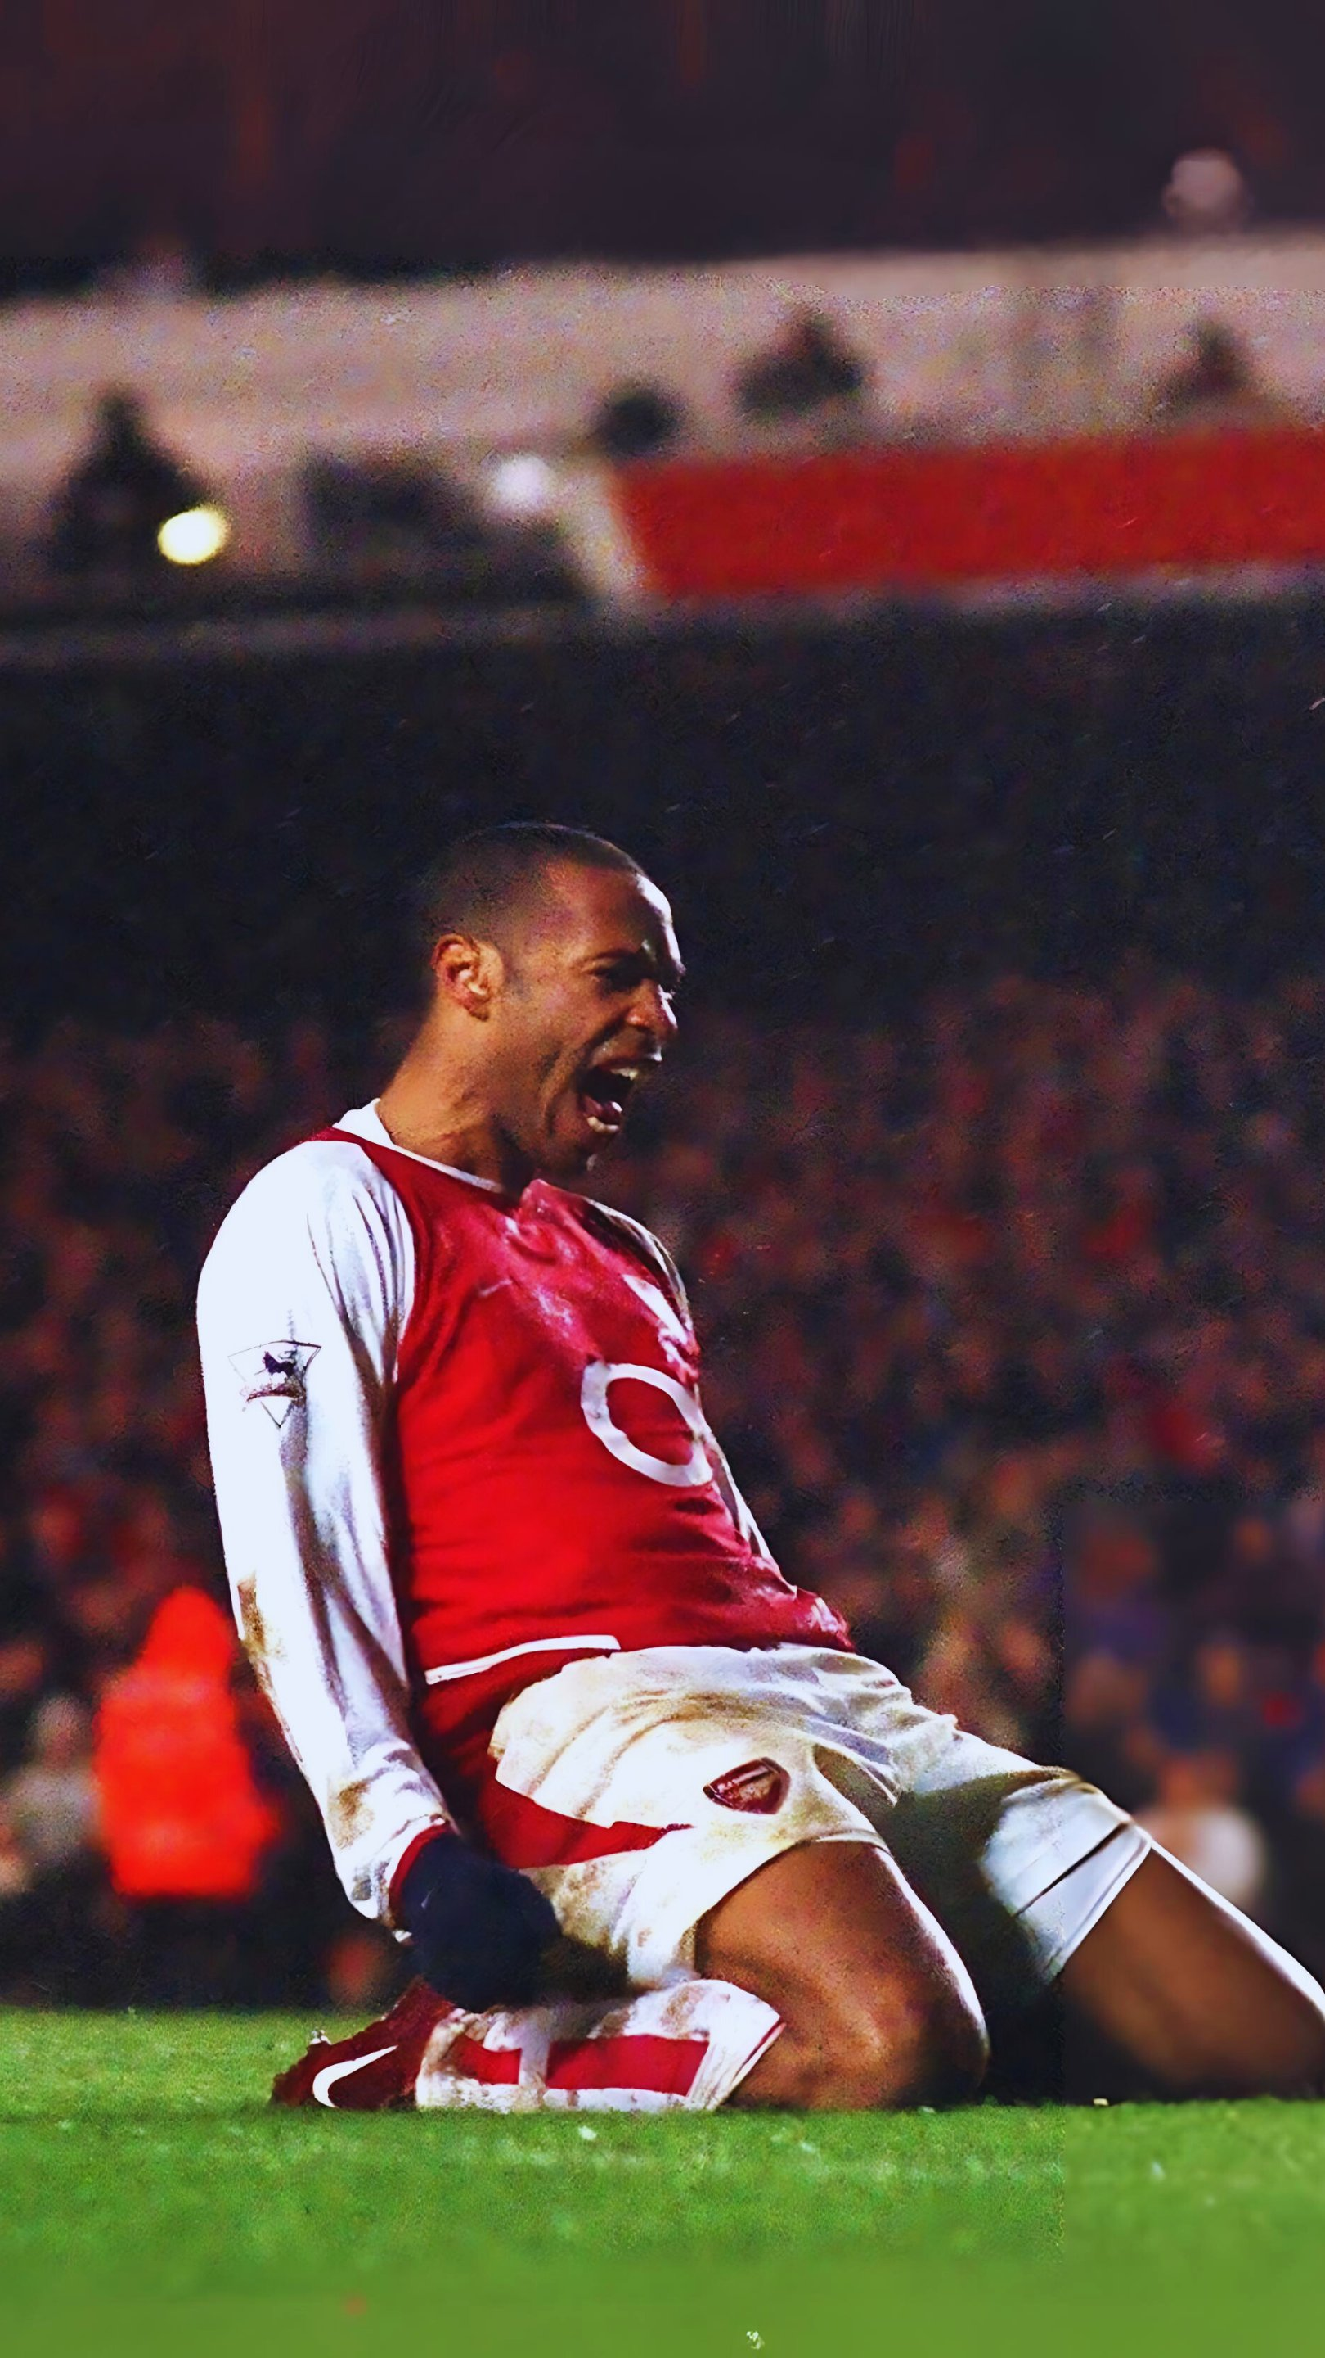
Football Manager AI Assistant
Data-Driven Player Scouting & Tactical Recommendation System

Slide 3
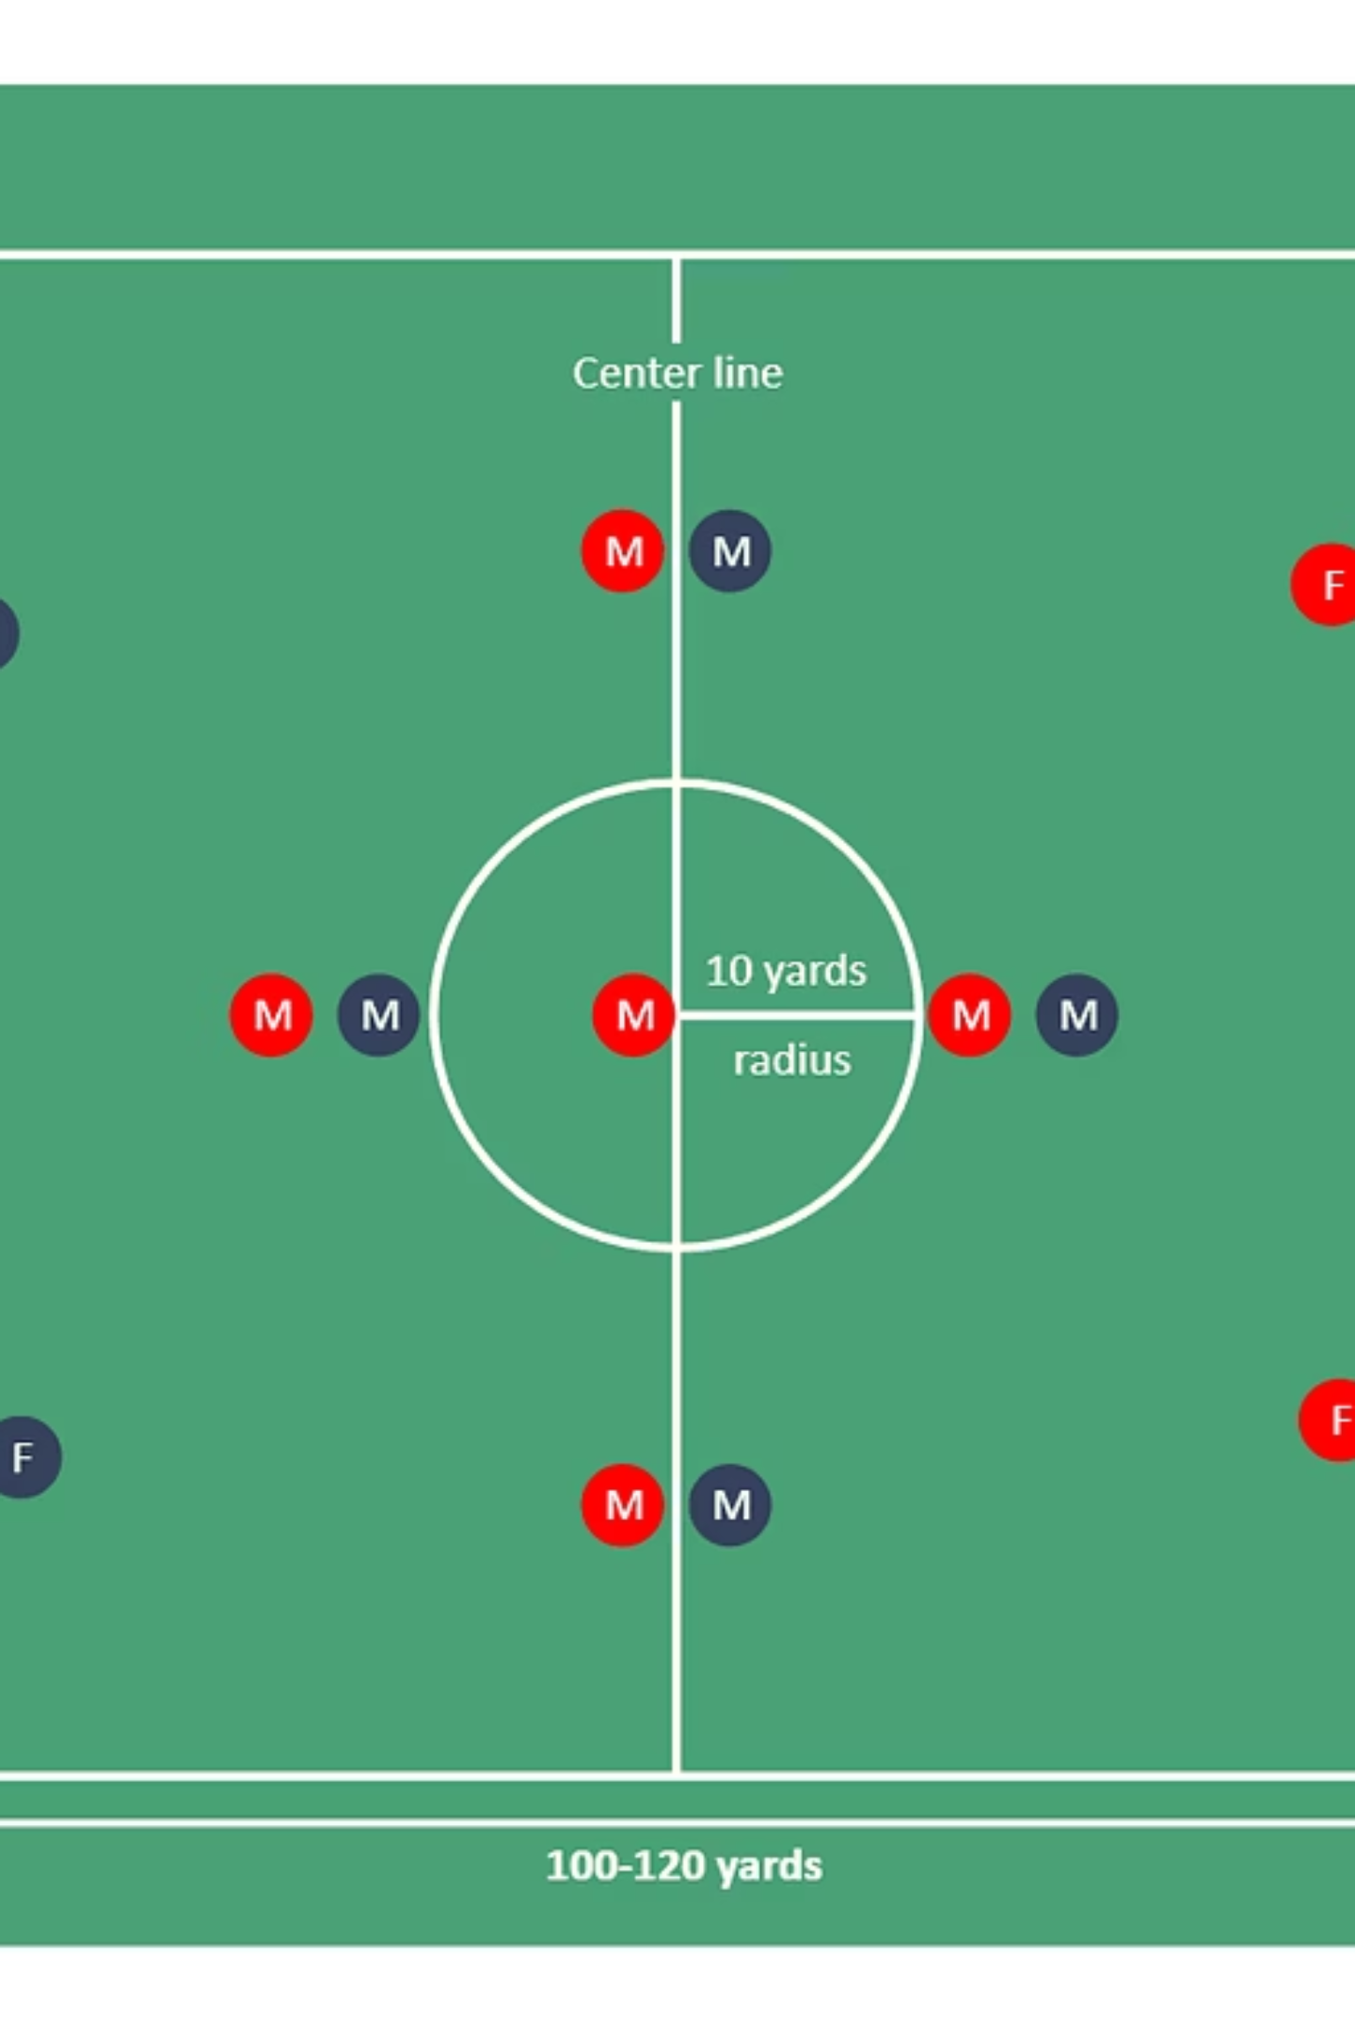
Introduction: Project Scope
What We Built:
Key Components:
A Python-based desktop application with two integrated phases.
Phase 1: Search and rank 3,000+ players using intelligent metrics.
Phase 2: Analyze squad composition, detect weaknesses, recommend formations.
Data: 3,000 player dataset
Models: Random Forest + Neural Network ensemble.
GUI: Tkinter-based user interface for Phase-1 and Phase-2.
Features: 7 engineered metrics capturing tactical attributes.
Scope Limitations:
Keyword-based search (not full NLP/BERT models).
Rule-based formation recommendations (not game simulation).
Offline analysis (no real-time market data integration).

Slide 4
Research Papers Overview: ML in Football Analytics
S.No
Title
Description
Model Used
Parameters
Results
Limitations
1
Predicting Football Player Performance Using Machine Learning (2023)
ML models predict player performance using match stats
RF, XGBoost
Goals, assists, passes, tackles
RF performs best
Limited dataset
2
Market Value Prediction of Football Players (2023)
Estimates player value with regression
Random Forest
Age, goals, assists
R² ≈ 0.90
Excludes off-field factors
3
ML Applications in Soccer (2022)
Review of ML uses in soccer
SVM, RF, ANN
All match data
ML enhances scouting
Inconsistent datasets
4
Bayesian Player Value Model (2022)
Predicts value using Bayesian approach
Bayesian Ensemble
Goals, age, matches
Low error
Needs clean data
5
ML Modeling for Player Value (2022)
Player value ranking using ML
RF
Shots, passes, duels
Strong accuracy
No real-time input
6
PlayeRank (2018)
Data-driven ranking system
ML + scoring model
Passes, dribbles, shots
Accurate rankings
Requires tracking data
7
Football Performance Prediction (2021)
Predicts match performance
ANN
Possession, shots
High accuracy
Heavy training time
8
NN Player Performance Prediction (2020)
Uses ANN to predict performance
ANN
xG, passing, tackles
High performance
Overfitting possible
9
Forecasting Player Development (2025)
Predicts future player growth
Regression + ML
Trends, age, form
Good future prediction
Early data unstable
10
Soccer Match Prediction (2021)
Predicts match outcomes
SVM, RF
Goals, cards, home
75–80% accuracy
Unpredictable events

Slide 5
Real-World Applications in Football AI
S.No
Application
Description
Model Used
Parameters
Output
Limitations
1
Opta Sports
Provides xG, xA, tracking data
ML + Stats
Shots, passes, movement
Performance analytics
Paid access
2
Transfermarkt
Estimates player market value
Algorithm + ML
Age, performance
Player value
Not transparent
3
SciSports BallJames
AI-based video tracking
Deep Learning
Speed, movement
Tactical insights
Needs HD cameras
4
Man City Fan Labs
AI for fan analytics & insights
Predictive analytics
Behavior data
Decision support
Limited to fan data
5
Barça Innovation Hub
AI for tactics & performance
ML + CV
Heatmaps, passes
Evaluation support
Not public

Slide 6

Problem Statement
Small football clubs lack an integrated, data-driven system that combines player scouting and tactical
Analysis into a single decision-support platform
Current Scenario
Manual scouting and data review are time consuming.
Tactical analysis depends on human judgement and intuition
Need for solution
A real-time , data-driven system for decision support
Integration of AI for predictive and analytical insights

Slide 7
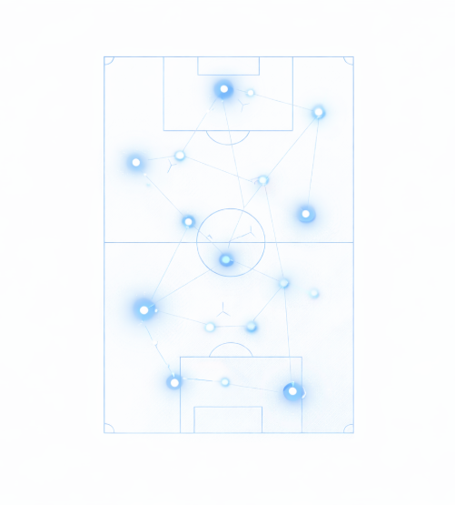




Objectives
Intelligent Search
Develop keyword-based system for tactical player matching.
Engineer Domain Features
Extract 7 meaningful metrics (Finishing, Creativity, Defense, etc.).
Build Predictive Models
Train Random Forest + Neural Network ensemble for evaluation.
Create Squad Analysis
Quantify team strength across 4 dimensions (Attack, Creativity, Defense, Discipline).

Slide 8
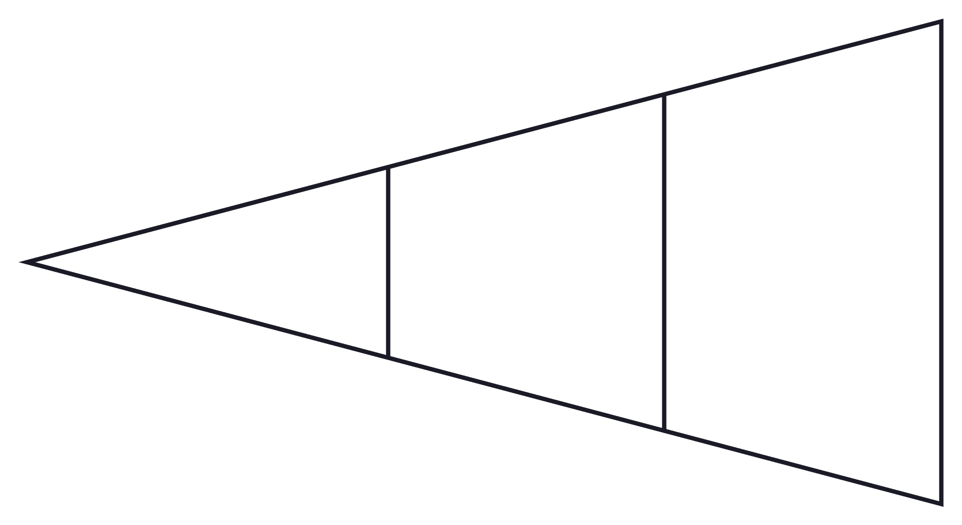
Methodology: Data Pipeline
Data Sources
Preprocess & Split
Train-Test Split
Data Sources:
Input: 3000+ real football players with 165 attributes.
Process: Structure and refine dataset for machine learning training.
Output: Clean, normalized dataset for ML training.
Data Preprocessing:
Train-Test Split:
Fill missing values with 0.
Parse position strings into categories (GK, DF, MF, FW).
Normalize numeric columns to 0-100 range using MinMax scaling.
Remove outliers (age bounds: 16-38 years).
80% training data for model fitting.
20% validation data for performance evaluation.

Slide 9
Methodology: Feature Engineering
Seven meticulously engineered metrics, scaled from 0-100, provide a comprehensive evaluation of player capabilities beyond raw statistics.
1. Finishing Quality
2. Creativity
3. Goal Threat
(Goal Efficiency vs xG × 50%) + (Shot Accuracy × 50%)
(Assists × 0.6) + (Expected Assists
× 0.4)
Expected Goals (xG) normalized to
0-100
Measures clinical finishing ability; high scores indicate strikers who convert chances effectively.
Normalized and scaled to 0-100, identifying key playmaking midfielders.
Quantifies offensive danger and presence in attacking positions.
4. Defensive Actions
5. Discipline
6. Involvement
(Tackles × 0.5) + (Interceptions × 0.3) + (Blocks × 0.2)
100 − ((Yellow Cards × 5) + (Red Cards × 25)) / 10
Mean of (Touches, Passes , Interceptions ) normalized to 0-100
Combines defensive contributions, weighted by tactical importance.
A fair play metric where lower card counts result in higher discipline scores.
Indicates player participation and intensity in game actions.
7. Pace
Shots per 90 minutes normalized to
0-100
A proxy for speed and directness, reflecting offensive urgency.

Slide 10
Methodology: Machine Learning & Deep Learning Models
Our system employs a robust ensemble of Random Forest and Neural Network models to generate accurate player predictions.
Random Forest Regressor:
Neural Network (Keras/TensorFlow):
Configuration: 200 decision trees, max_depth=15, min_samples_split=5
Purpose: Learns intricate feature patterns and provides reliable baseline predictions.
Advantages: Robust to outliers, effectively handles non-linear relationships, and offers valuable feature importance ranking.
Performance: Achieves an R² score of approximately 0.76-0.82.
Architecture: Dense layers with ReLU activations, Batch Normalization, and Dropout for regularization.
Training: 50 epochs, batch_size=32, validation_split=0.2.
Optimizer: Adam (learning_rate=0.001).
Loss: Mean Squared Error.
Ensemble Combination:
We combine the strengths of both models: Random Forest (60% weight) for its reliability on this dataset, and Neural Network (40% weight) for capturing complex patterns.
Final Score: (RF Score × 0.6) + (NN Score × 0.4). This approach mitigates individual model blind spots, achieving an overall R² of 0.85 and capturing more variance.

Slide 11
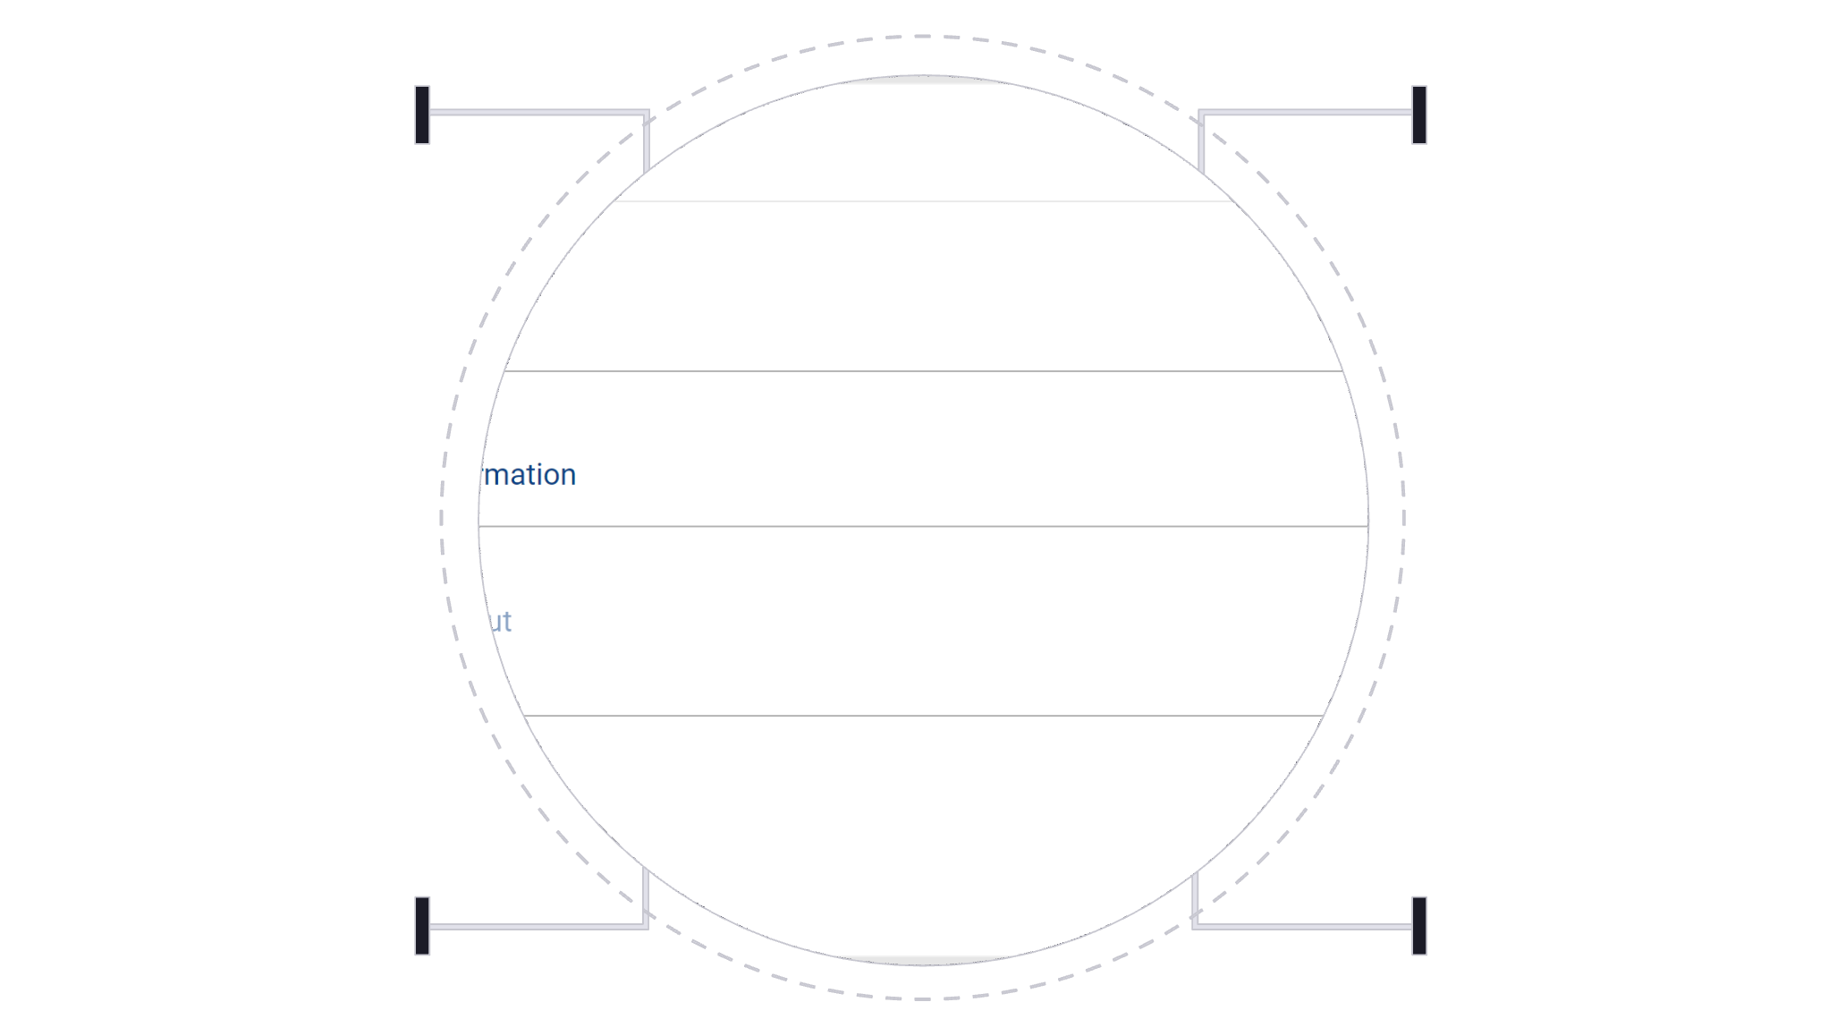
Methodology: System Architecture
Our system is designed in two distinct phases, ensuring a seamless and efficient workflow from scouting to tactical analysis.
Scouting
Modeling
Load 3000 players CSV
Train RF (15s) and NN (20s)
Search
Team Analysis
Keyword match, score, show top 50
Load squad, metrics, recommend formation
Key Classes:
DataProcessor
AIModels
IntelligentSearchEngine
Handles loading, expansion, and feature engineering of player data.
Manages training of RF + NN models and ensemble predictions.
Facilitates keyword detection and player ranking for efficient searches.
TeamTacticsAnalyzer
ScoutingAssistantGUI
Performs squad analysis, identifies weaknesses, and recommends formations.
Provides the Tkinter interface for both phases, ensuring user interaction.
Data Transfer Between Phases:
Selected players from Phase-1 are stored in memory via the SquadBuilder class. Phase-2 then retrieves this squad as a DataFrame for immediate analysis, eliminating the need for file I/O for fast, seamless transfer.

Slide 12
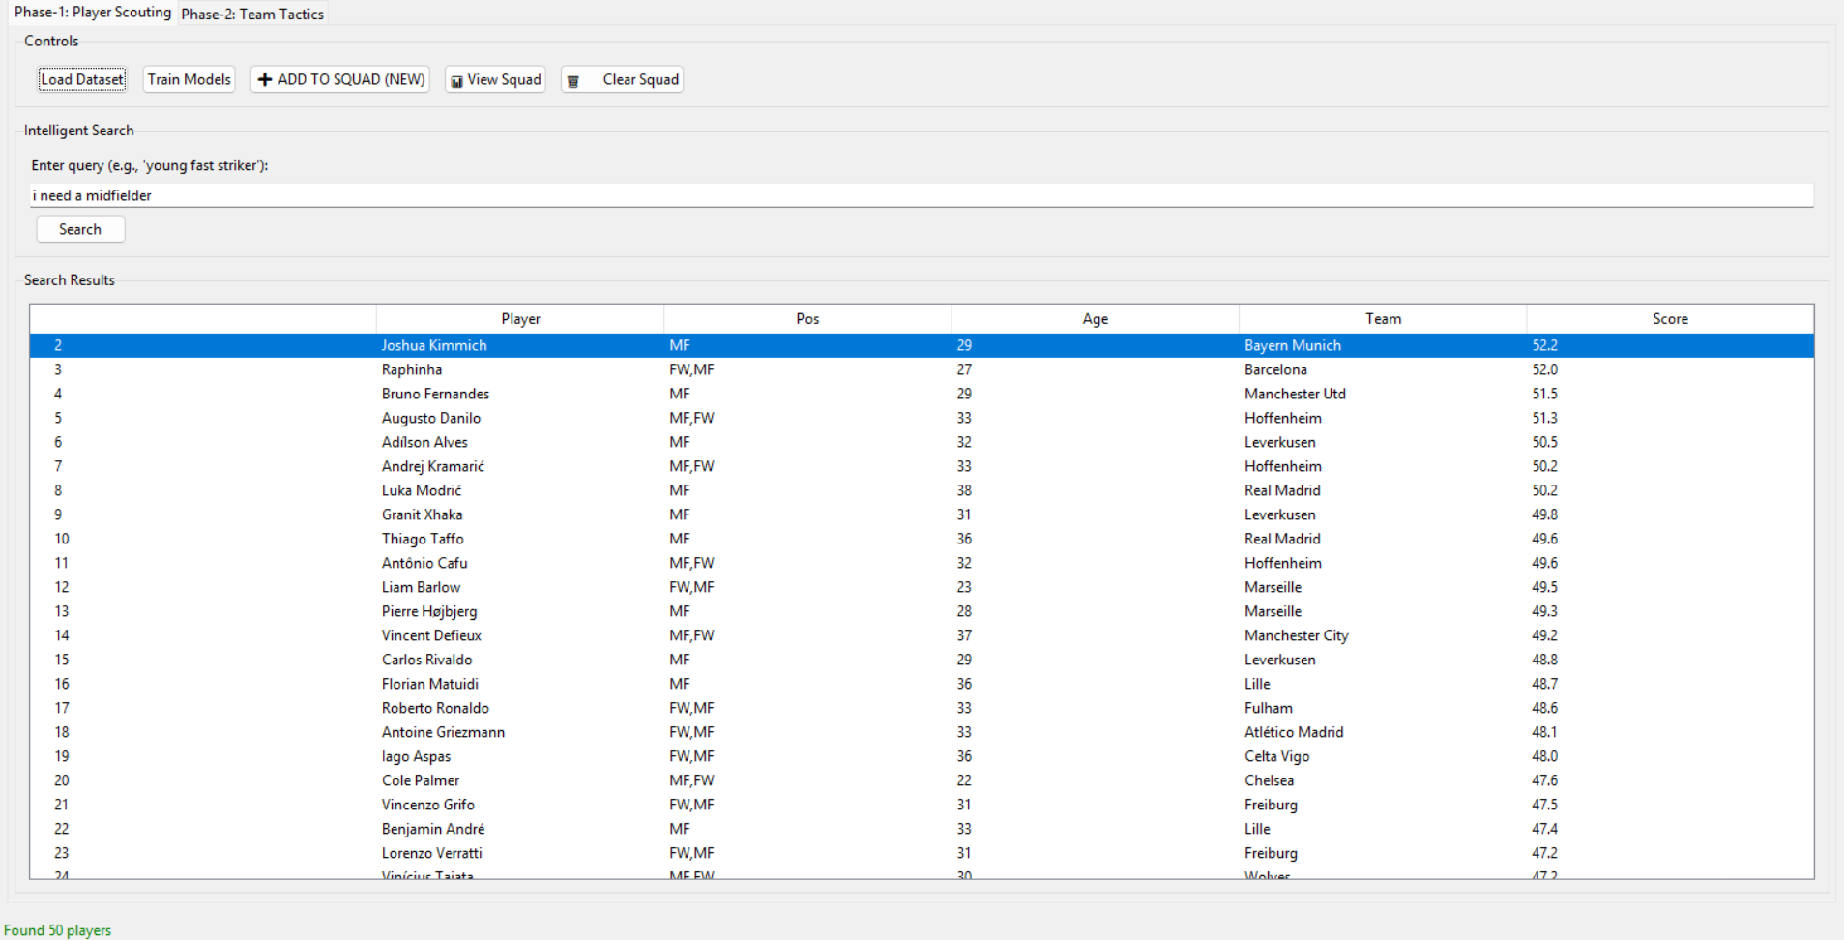
Results: Phase-1 Search Output Example
Our intelligent search engine quickly identifies and ranks players based on natural language queries.
Query: “I need a midfielder"
This query combines age, passing, and position attributes to find highly relevant players.
User Action:
Clicking on a player like Kimmich adds them directly to the
squad.
Action: Click on Kimmich → "Add to Squad"
Result: Player is stored in the squad list, and the squad count updates to "1 player".

Slide 13
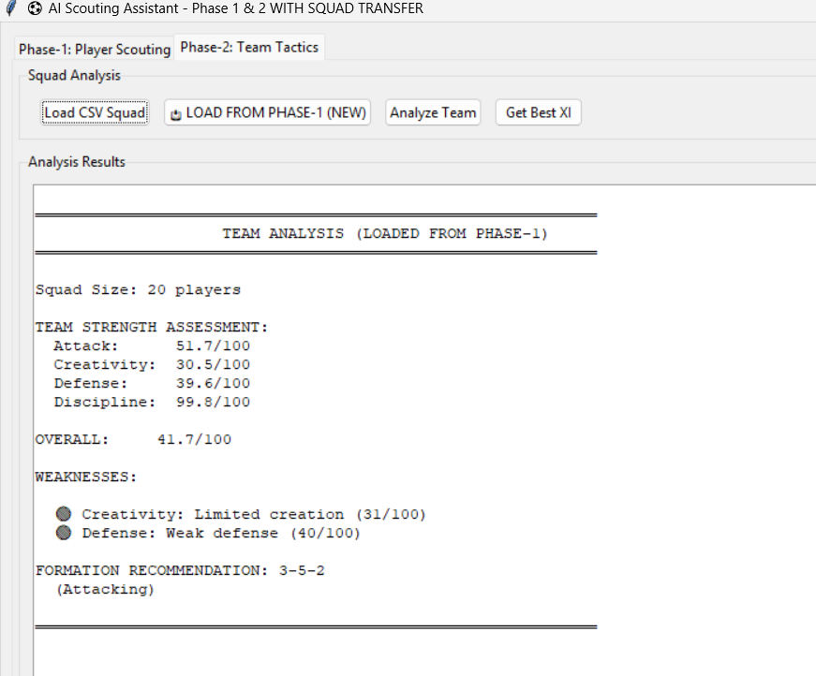
Results: Phase-2 Team Analysis Output
Squad Analysis Example:
Input: A squad of 20 selected players (2 GK, 4 DF, 6 MF, 8 FW)
Output: Team Strength Assessment
Calculations for Team Metrics:
Attack: Mean of Finishing_Quality for all Forward (FW) players.
Creativity: Mean of Creativity for all Midfielder (MF) players.
Defense: Mean of Defensive_Actions for all Defender (DF) players.
Discipline: Mean of Discipline across all positions in the squad.
Overall: Weighted average: (Attack × 0.4) + (Creativity × 0.3) + (Defense × 0.3).

Slide 14
Outcomes & Next Steps
Achieved in Current Semester
Next Phase
Designed and implemented an AI-based football scouting and tactical analysis system
Developed a hybrid ML/DL ensemble scoring model
Built a complete data processing and feature engineering pipeline
Integrated intelligent player search and squad evaluation
Created a functional GUI for end-to-end system demonstration
Draft and submit a research paper based on the system architecture
Perform structured experimental validation using real-world datasets
Improve model evaluation with detailed performance analysis

Slide 15
References
Real-World Applications
Opta Sports (StatsPerform)
Transfermarkt Player Valuation Method
Research Papers
SciSports (AI Scouting & Player Tracking)
Manchester City — City Fan Labs (AI Projects)
Predicting Football Player Performance Using ML (2023)
FC Barcelona — Barça Innovation Hub (AI in Sports)
Market Value Prediction of Football Players Using ML (2023)
Machine Learning in Soccer — Systematic Review (2022)
Prediction of Football Player Value Using Bayesian Ensemble Model (2022)
Machine Learning Modeling to Evaluate Football Player Value (2022)
PlayeRank: Data-Driven Player Ranking in Soccer (2018)
Machine Learning Applied to Professional Football (2023)
Soccer Player Performance Prediction Using Neural Networks (2020)
Forecasting Player Development and Value (2025 preprint)
Soccer Match Outcome Prediction Using ML (2021)

