Slide 1
Credit Card Fraud SPARK STREAMING & SPARK SQL
CS 522 – Big Data
Prof. Mrudula Mukadam
Prof. Meli

Slide 2
Team Members
Thanh Van – 985218
Jeremy – 985515
Bataak – 985307

Slide 3





Brief Project Overview
This project analysis & examine whether the new transaction is “enriched” or “fraud”
This application is developed by JAVA 8 and SPARK API
SPARK STREAMING
SPARK SQL Integrate HIVE
Data Streaming with NetCat
Cloudera & Hadoop

Slide 4
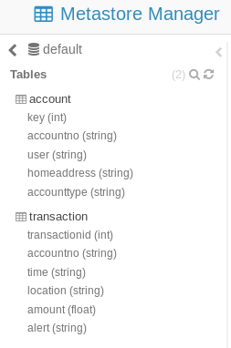
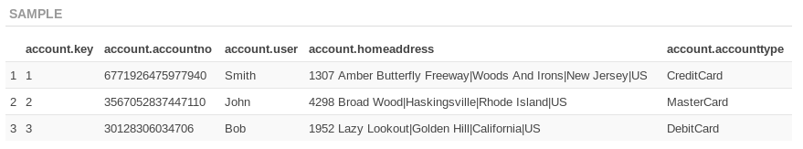
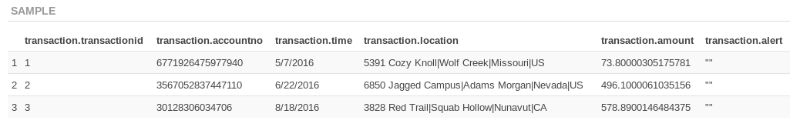
Database Structure
Account: Contains Bank Account information as AccountNo, HomeAddress, UserName, AccountType
Transaction: For keeping track of Bank Transactions as TransactionId, AccountNo, Time, Location, Amount, Alert
Account
Transaction

Slide 5
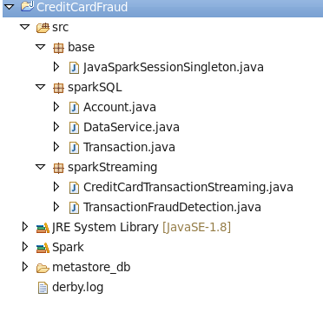
Solution Structure
DataSevice:
SparkSQL implementation which handle to load and Insert data to Hive
Bean Classes: Account & Transaction
CreditCardTransactionStream:
SparkStream implementation which handle to receive/analysis streaming data.
Integrate with DataService and TransactionFraudDectection Engine to analysis data

Slide 6
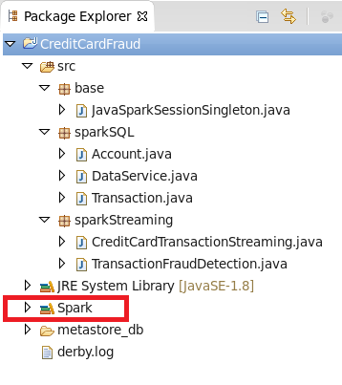
Environment Preparation
Upgrade Spark version:
References ONLY SPARK library

Slide 7
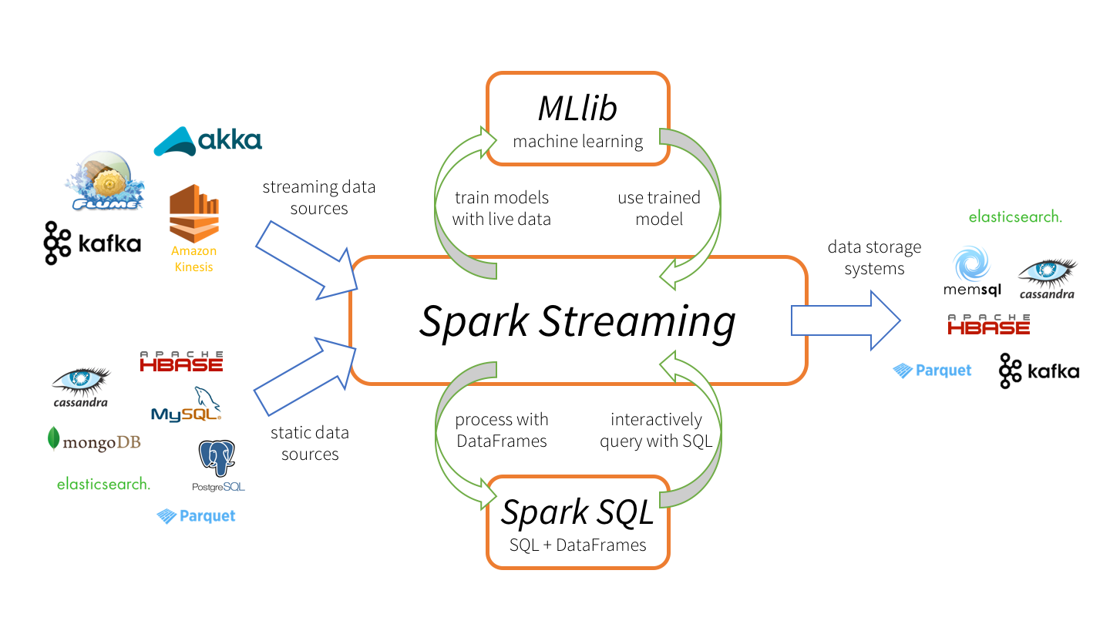
Spark Streaming vs Spark SQL

Slide 8
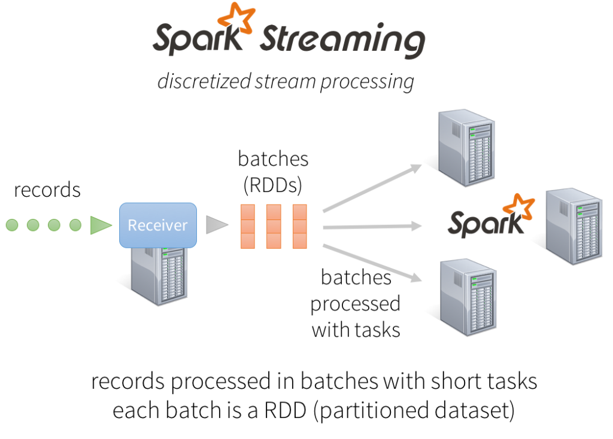

Slide 9
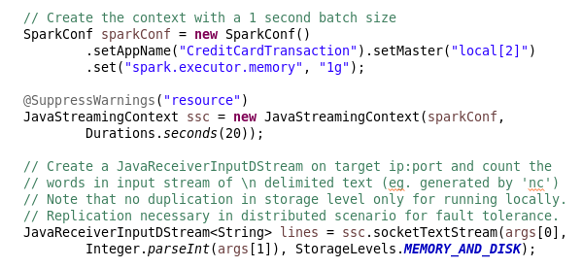
Spark Session and Stream Receiver Configuration

Slide 10
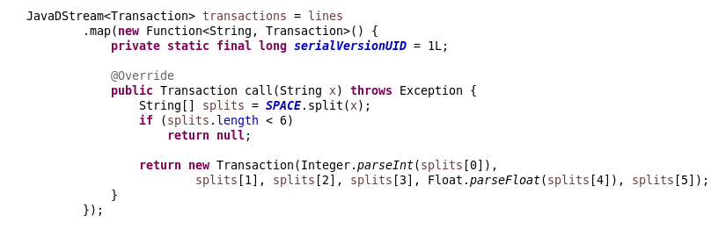
Convert Single Line of Stream Data to Transaction Bean

Slide 11
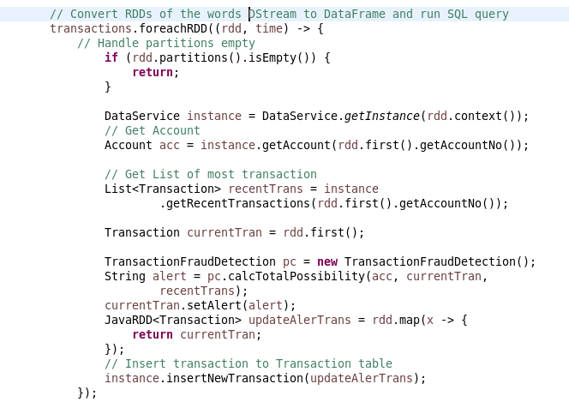
Transform and Analysis RDD Data

Slide 12


Slide 13
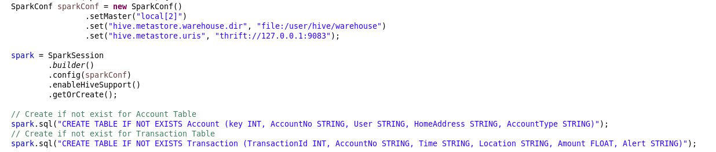
Spark SQL Configuration
Notes:
Thrift is a software framework for scalable cross-language services development.

Slide 14
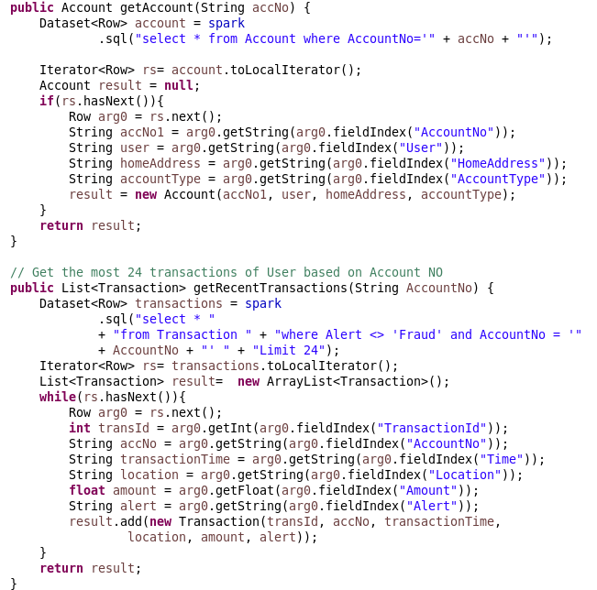
Account & Transaction HQL
Notes:
Thrift is a software framework for scalable cross-language services development.

Slide 15
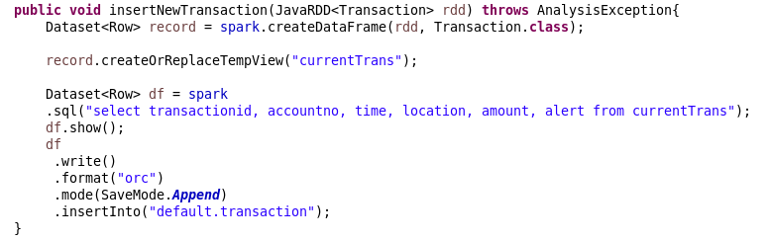
Insert New Transaction HQL
Notes:
Thrift is a software framework for scalable cross-language services development.

Slide 16
Transaction Fraud Detection
Simple algorithm to compute “ Transaction” points – Based on
Location of Transaction
Same City, State, Country -> 0 point
Same State and Country -> 5 points
Different Country - > 11 points
At most 24 of Recent Transactions
Existed Location -> 0 point
New Location
Same Country -> 5 points
Different Country -> 11 points
Average Amount of 24 Recent Transactions
<= (Avg + $500) -> 0 points
> (Avg + $500) -> 5 points
➔ ENRICHED (<=10 points) otherwise FRAUD (>10 points)

Slide 17
Demo

