Slide 1
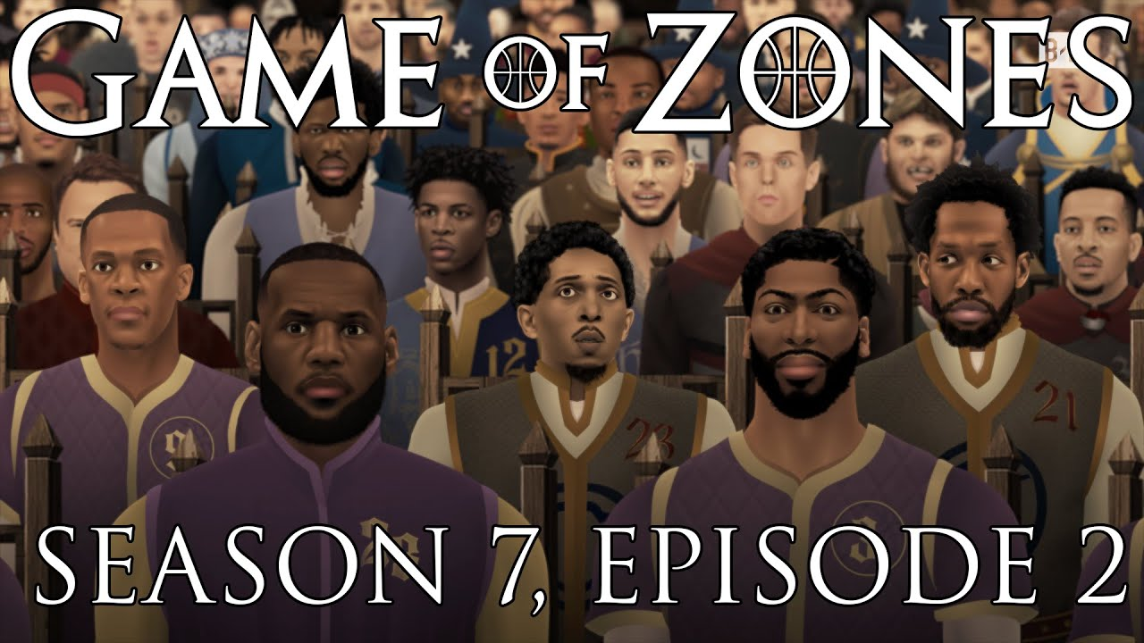
NBA players are taller and heavier than ever

Slide 2
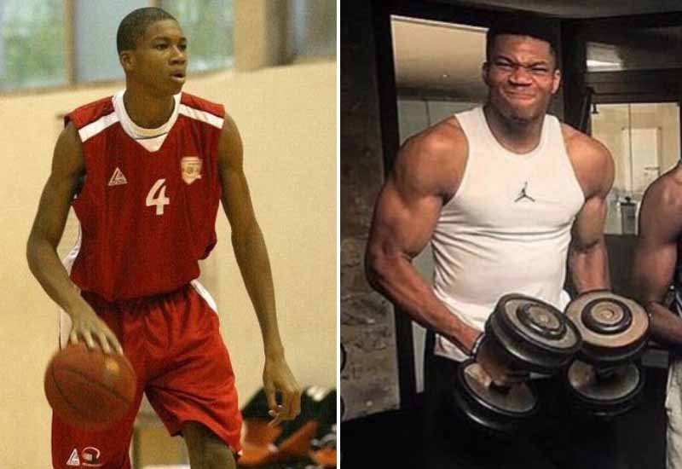
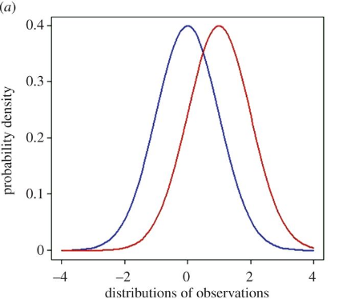
NBA over time?

Slide 3
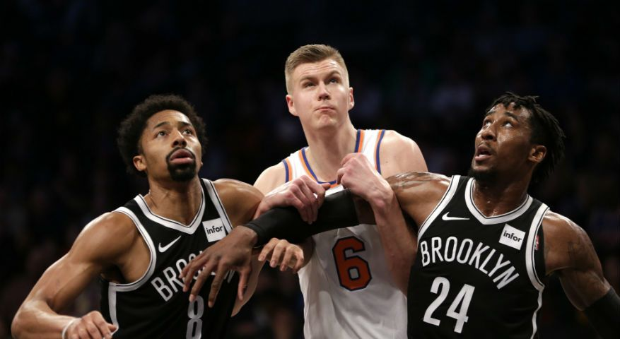
US vs Foreign players?

Slide 4
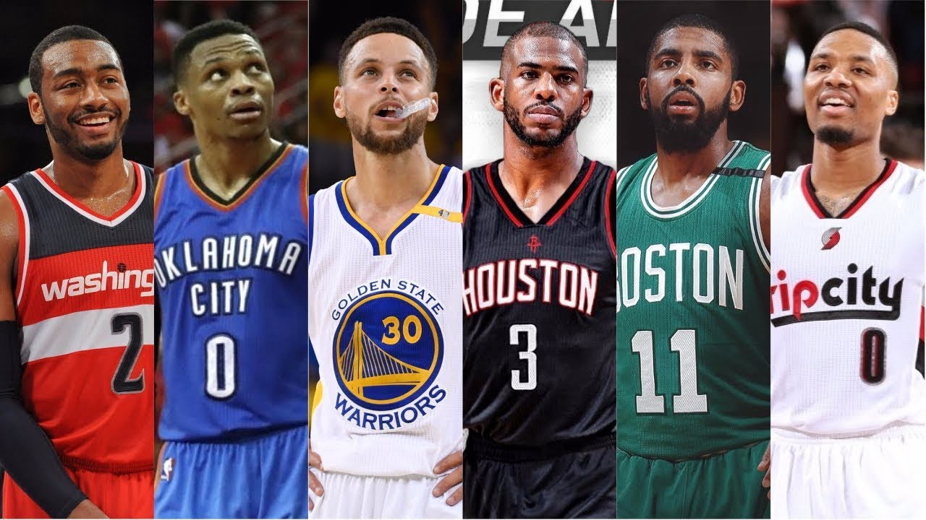
US vs Foreign players?
Is bigger always better?

Slide 5
Design planning process
Audience: Sports lovers
- like:
+ short and direct story telling
+ simple analysis
+ easy to observe data and make comparison
- dislike:
+ complicated maths
+ distracting visual cues
+ irrelevant information

Slide 6
Design planning process
Planned content:
- Visual tools to show distributions of data
- Statistics tool to make comparisons
- Search tool
Backend:
- Run simple queries in R to filter, fetch data
- Embed a t-test for two samples by user’s choice
Options for charts/graphs:
- Simple charts for distribution discovery: boxplot, kernel denstity
- Showing trend: Scatterplot with fitting line.

Slide 7
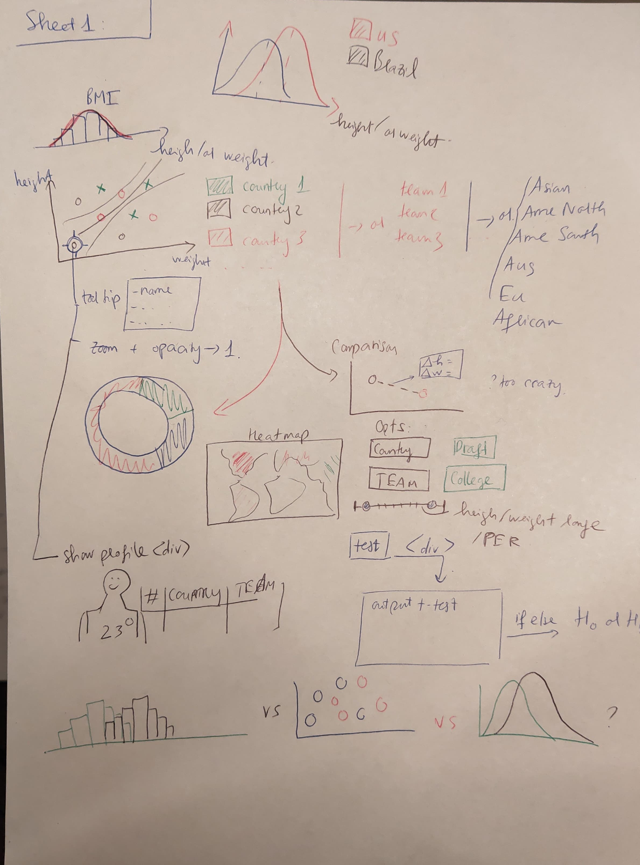

Slide 8
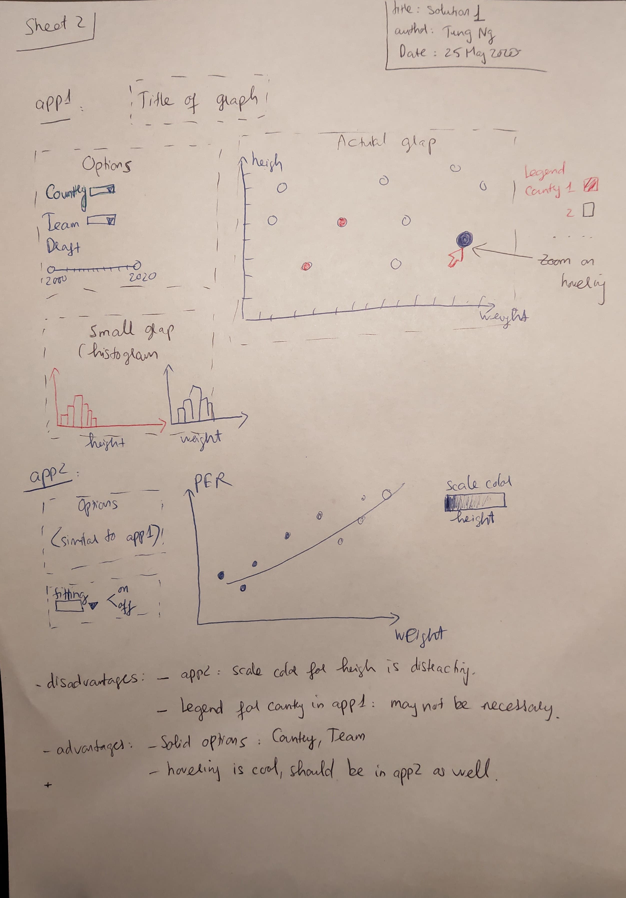

Slide 9
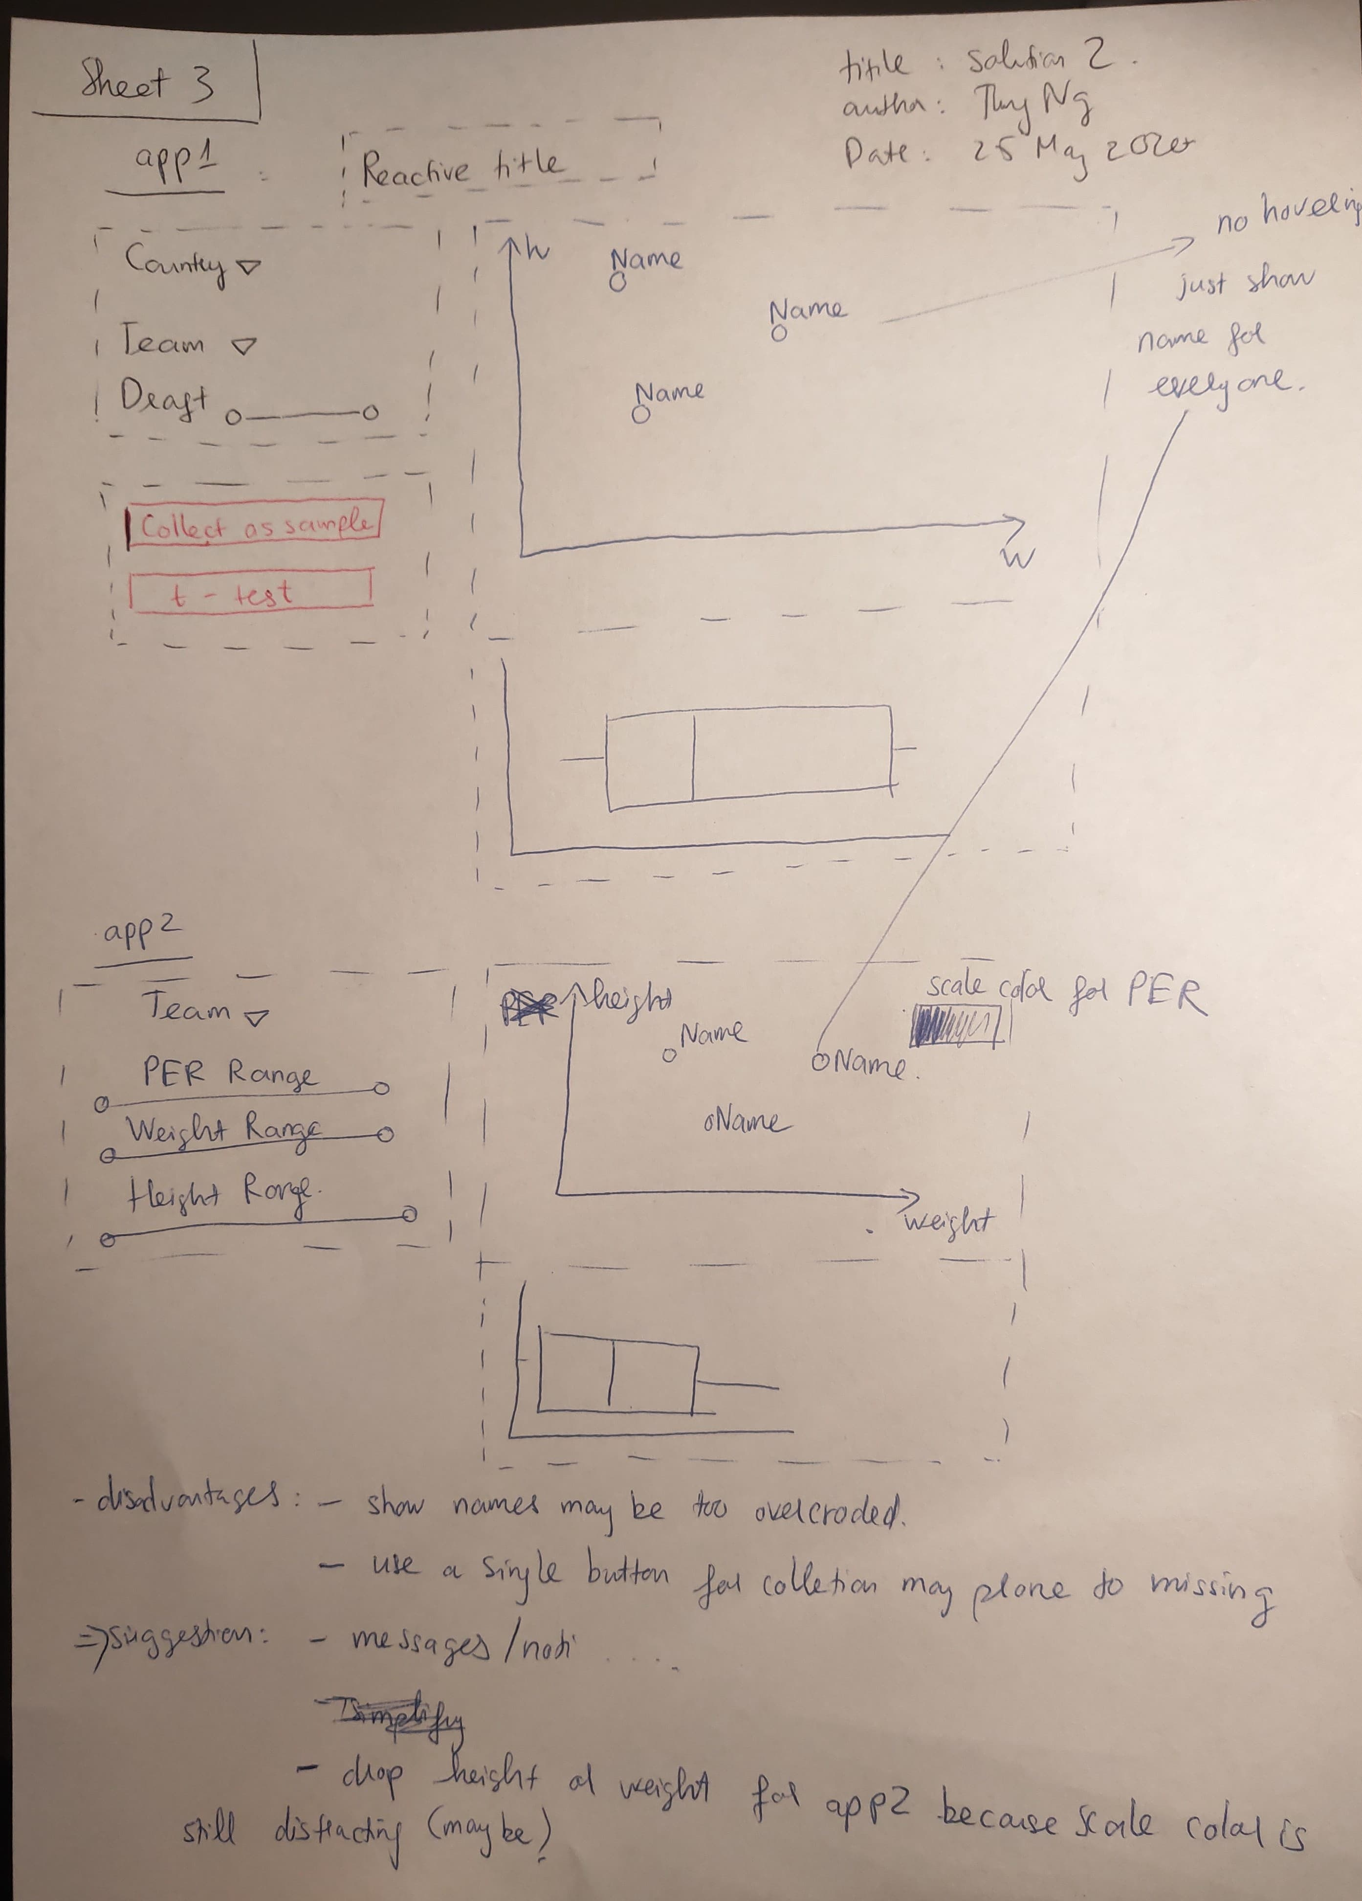

Slide 10
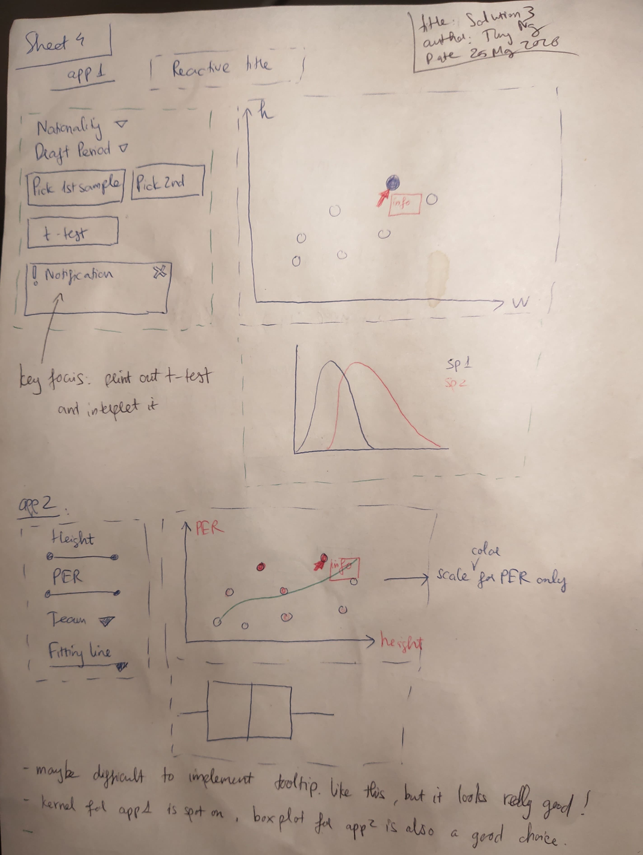

Slide 11
