Slide 1
Windows Program with C/C++
Menu & Resource, MDI
FPT Software
Trainer Name – Trainer Unit

Slide 2
Agenda
Menu and Resource
Dialog box
Multiple Document Interface - MDI

Slide 3
Menu and Resource

Slide 4
Get Started
Icons, cursors, menus, dialog boxes are all related. They are all type of Windows “resources”
Resources are data and they are often stored in a program’s .EXE file, but they do not reside in the executable program’s data area
Windows provides functions that explicitly or implicitly load a program’s resources into memory so that they can be used
List of resources’s style :
  Icons
  Cursors
  Text Strings
  Custom resources
  Menus
  Keyboard accelerators
  Dialog boxes
  Bitmaps

Slide 5
Icons, Cursors, Strings, and Custom Resources
One of benefits of using resources is that many components of a program can be bound into the program’s .EXE file
Without the concept of resource, a binary file such as an icon image would probably have to reside in a separate file that the .EXE would read into memory for using. Or the icon would have to defined in the program as an array of bytes
As an resource, the icon is stored in a separate editable file but is bound into the .EXE file during the build process

Slide 6
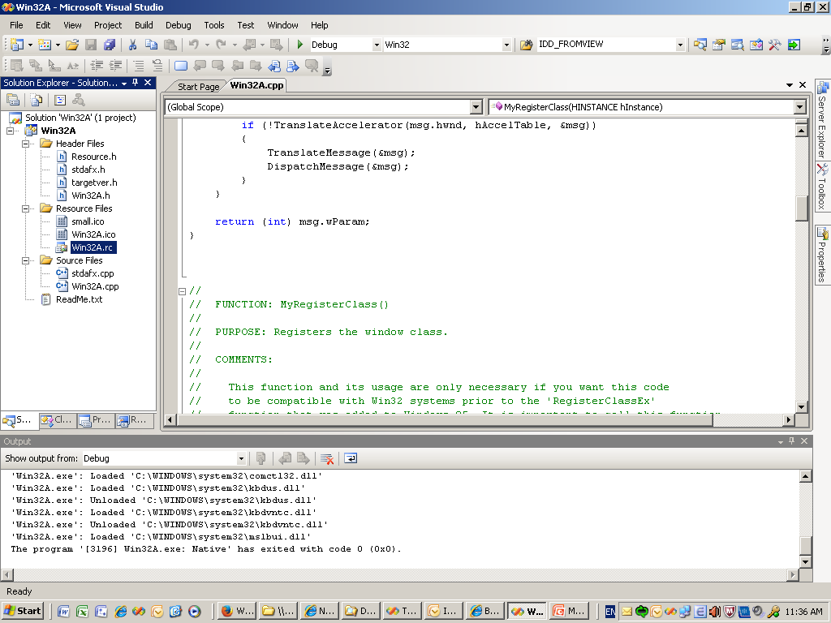
Create icon in a program
1. Create an Win32 Application project name Win32A
2. Open resource in visual studio environment

Slide 7
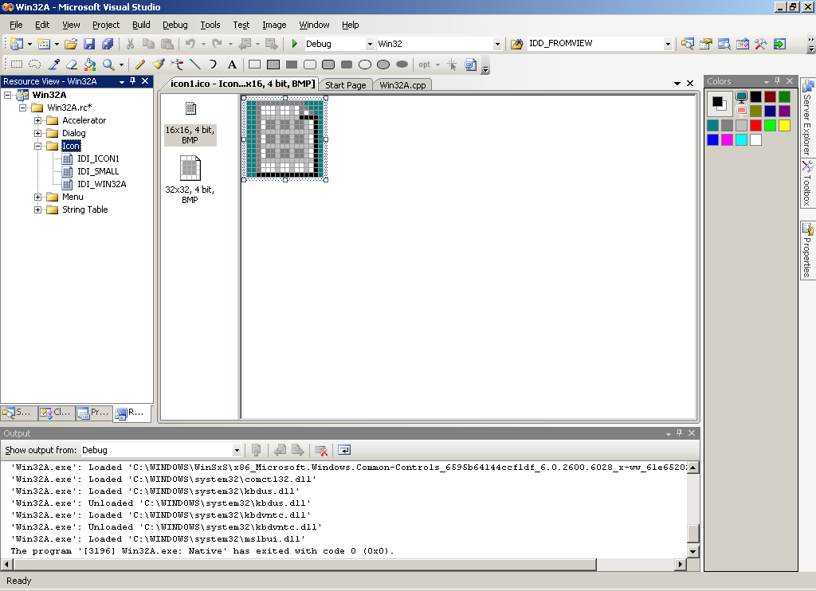
Create icon in a program
3. Insert resource icon to project

Slide 8
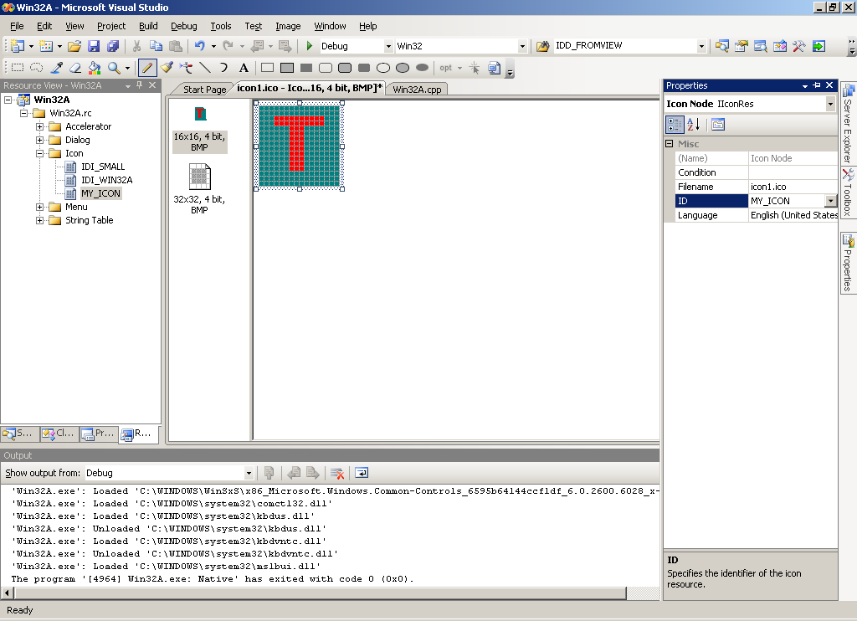
Create icon in a program
4. Edit Icon like below and change ID to MY_ICON in Properties

Slide 9
Create icon in a program
Step 5 : Write code for load icon
  Load icon by calling to LoadIcon function :
    HICON LoadIcon(
      HINSTANCE hInstance, // handle to application instance
      LPCTSTR lpIconName // name string or resource identifier
      );
    - If define icon identifier by identifier number :
    HICON hIcon = LoadIcon (hInstance, MAKEINTRESOURCE (MY_ICON));

Slide 10
Create icon in a program
RESOURCE.H (excerpts) :
  //{{NO_DEPENDENCIES}}
  // Microsoft Developer Studio generated include file.
  // Used by IconDemo.rc
  //
  #define MY_ICON 129
ICONDEMO.RC (excerpts) :
  //Microsoft Developer Studio generated resource script.
  #include "resource.h"
  #define APSTUDIO_READONLY_SYMBOLS
  // Generated from the TEXTINCLUDE 2 resource.
  #include "afxres.h“
  // Icon
  // Icon with lowest ID value placed first to ensure application icon
  // remains consistent on all systems.
  MY_ICON ICON “icon1.ico"

Slide 11
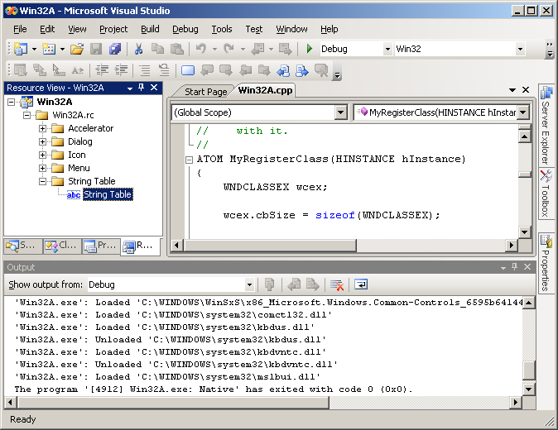
String Table
The character string resources (String table) are primarily for easing the translation of your program to other languages
If the text in resource script file is translated to another language, all you need to do to create a foreign-language version of your program is re-link the program

Slide 12
String table in resource file
In resource script file (.rc)
STRINGTABLE
BEGIN
IDS_APP_TITLE "Win32A"
IDC_WIN32A "WIN32A"
END
Use LoadString function for copy a string resource into a buffer in the program’s data segment :
  LoadString (HINSTANCE, UINT, LPTSTR, int );

Slide 13
Menus
There are two main ways to create menu:
  Create menu in design time
  Create menu in run time (programmatically)

Slide 14
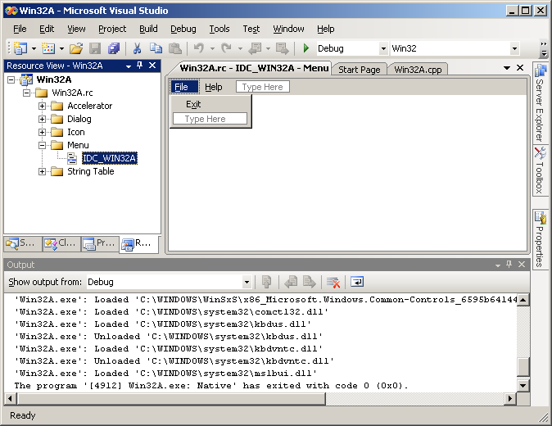
Create menu in design
Double click on menu

Slide 15
Create menu programmatically
Example Code :
  hMenu = CreateMenu () ;
  hMenuPopup = CreateMenu () ;
  AppendMenu (hMenuPopup, MF_STRING, IDM_FILE_NEW, "&New") ;
  AppendMenu (hMenuPopup, MF_STRING, IDM_FILE_OPEN, "&Open...") ;
  AppendMenu (hMenuPopup, MF_STRING, IDM_FILE_SAVE, "&Save") ;
  AppendMenu (hMenuPopup, MF_STRING, IDM_FILE_SAVE_AS, "Save &As...") ;
  AppendMenu (hMenuPopup, MF_SEPARATOR, 0, NULL) ;
  AppendMenu (hMenuPopup, MF_STRING, IDM_APP_EXIT, "E&xit") ;
  AppendMenu (hMenu, MF_POPUP, hMenuPopup, "&File") ;

Slide 16
Other Menu Commands
Redrawing menu by calls to DrawMenuBar function :
  DrawMenuBar (HWND); // Handle of window
Get handle of one popup menu by calls to GetSubMenu function :
  HMENU hMenuPopup = GetSubMenu (hMenu, iPosition);
Get ID of one menu item in a popup menu by calls to GetMenuItemID function :
  Id = GetMenuItemID (hMenuPopup, iPosition);
Get current flags of one menu item :
  iFlags = GetMenuState (hMenu, id, iFlag);
Destroy a menu :
  DestroyMenu (hMenu);

Slide 17
Dialog box

Slide 18
Fundamental Concepts
Dialog boxes are windows that are most often used for obtaining additional input from the user beyond what can be easily managed through a menu
Dialog box contains some controls elements such as: button, list box, combo box, edit box, …
Dialog box is one type of resource
Dialog boxes also have procedures that handling messages sent to them. These procedures are called dialog procedures.

Slide 19
Modal Dialog Boxes
When a modal dialog box is displayed, the user can not switch between the dialog box and another window in program
However, the user can switch to another program while the dialog box is displayed
Insert a dialog box to program is similar to inserting an icon, a menu or other resources
Design dialog box by using dialog box design tools provided by Microsoft Visual C++

Slide 20
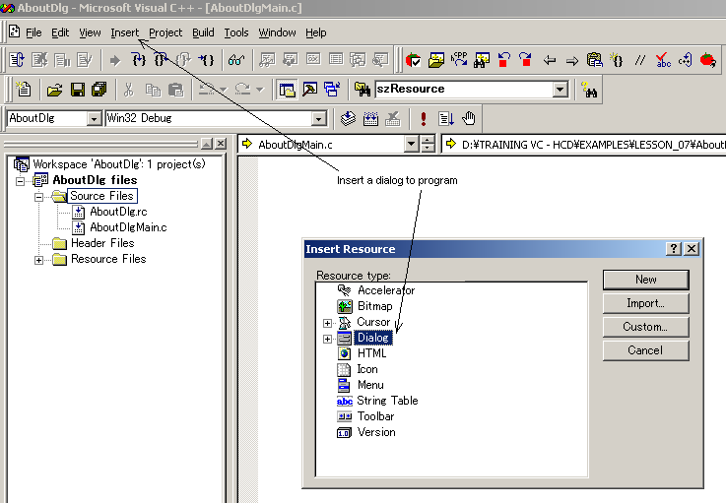
Create Dialog Boxes
Step 1 : Insert dialog box to program

Slide 21
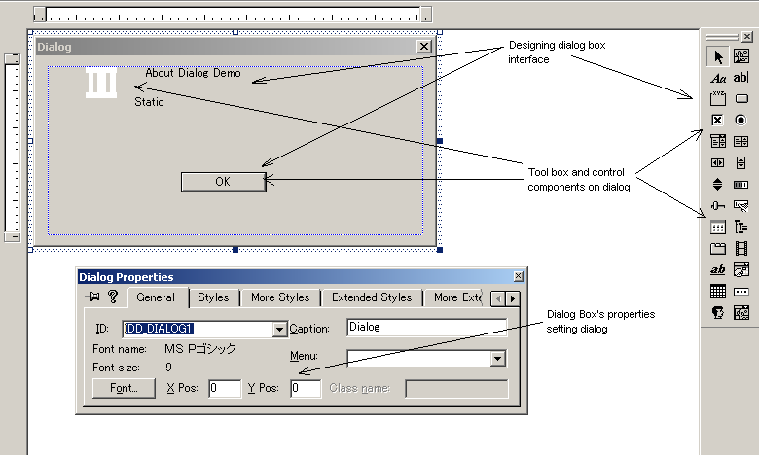
Create Dialog Boxes
Step 2 : Design Dialog Box Interface

Slide 22
The Dialog Box Procedure
The dialog box procedure within program handles messages sent to the dialog box. Although the dialog box procedure looks like a window procedure, it is not a true window procedure
Example of dialog box procedure :
  BOOL CALLBACK AboutDlgProc (HWND hDlg, UINT message, WPARAM wParam, LPARAM lParam) {
  switch (message) {
  case WM_INITDIALOG :
  return TRUE ;
  case WM_COMMAND :
  switch (LOWORD (wParam)) {
  case IDOK :
  case IDCANCEL :
  EndDialog (hDlg, 0) ;
  return TRUE ;
  }
  break ;
  }
  return FALSE ;
  }

Slide 23
The Dialog Box Procedure
Some different things between window procedure and dialog box procedure :
  Window procedure returns an LRESULT; a dialog procedure returns a BOOL value
  Window procedure calls DefWindowProc function if it does not process a particular message; a dialog box procedure returns TRUE if it processes a message and FALSE if it does not
  A dialog box procedure does not need to process WM_PAINT or WM_DESTROY messages ; it also will not receive WM_CREATE message, instead, the dialog box procedure perform initialization during the special WM_INITDIALOG message

Slide 24
The Dialog Box Procedure
The WM_INITDIALOG is the first message the dialog box procedure receives. This message is sent only to dialog box procedure
The WM_COMMAND messages are sent from child window controls on dialog box to dialog box procedure when user interacts with them
The messages for a modal dialog box do not go through program’s message queue

Slide 25
Invoking The Dialog Box
Invoking the dialog box by a calls to DialogBox macro
  INT_PTR DialogBox(
  HINSTANCE hInstance, // handle to module
  LPCTSTR lpTemplate, // dialog box template
  HWND hWndParent, // handle to owner window
  DLGPROC lpDialogFunc // dialog box procedure
  );
Even when the dialog box is displayed, WndProc can continue to receive messages by calling to the SendMesssage function in the dialog box procedure :
  SendMessage (GetParent (hDlg), . . .);
The DialogBox macro does not return control to Windows until the specified callback function terminates the modal dialog box by calling the EndDialog function

Slide 26
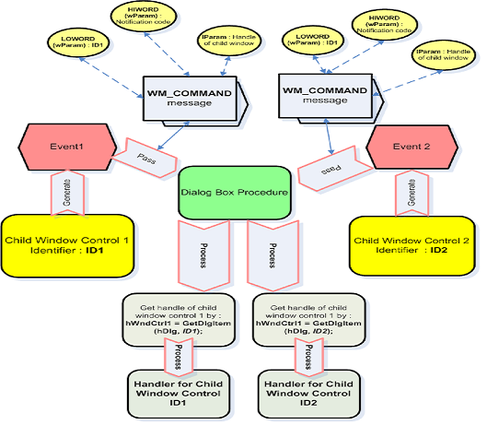
Working with Dialog Box Controls

Slide 27
The Modeless Dialog Boxes
Modeless dialog boxes allow the user to switch between the dialog box and the window that created it as well as between the dialog box and other programs
Modeless dialog boxes are created using CreateDialog :
  HWND CreateDialog(
  HINSTANCE hInstance , // handle to module
  LPCTSTR lpTemplate , // dialog box template name
  HWND hWndParent , // handle to owner window
  DLGPROC lpDialogFunc // dialog box procedure
  );
The difference is that the CreateDialog function returns immediately with the window handle of the dialog box
Unlike messages to modal dialog boxes and message boxes, messages to modeless dialog boxes come through your program's message queue

Slide 28
Message Loop
Altering the modeless dialog box’s messages in message loop of window procedure
  while (GetMessage (&msg, NULL, 0, 0)) {
  if (hDlgModeless == 0 ¦¦ !IsDialogMessage (hDlgModeless, &msg)) {
  TranslateMessage (&msg) ;
  DispatchMessage (&msg) ;
  }
  }
If use keyboard accelerators :
  while (GetMessage (&msg, NULL, 0, 0)) {
  if (hDlgModeless == 0 ¦¦ !IsDialogMessage (hDlgModeless, &msg)) {
  if (!TranslateAccelerator (hwnd, hAccel, &msg)) {
  TranslateMessage (&msg) ;
  DispatchMessage (&msg) ;
  }
  }
  }

Slide 29
Multiple Document Interface

Slide 30
MDI – Fundamental Concepts
The Multiple-Document Interface (MDI) is a specification for applications that handle documents in Microsoft Windows
The Multiple-Document Interface (MDI) describes a window structure and user interface that allow the user to work with multiple documents within a single application

Slide 31
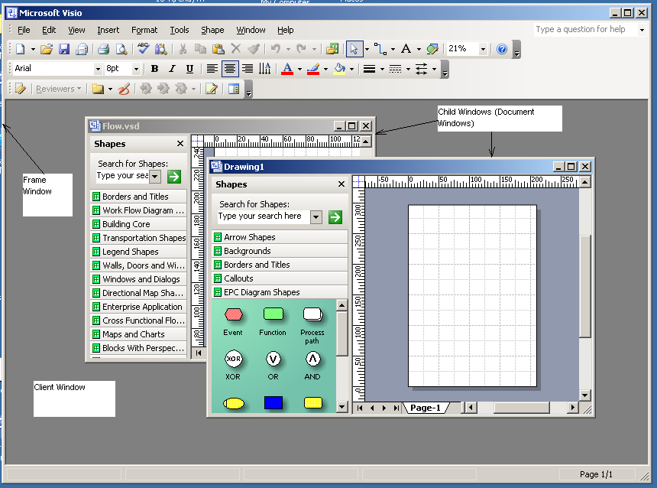
MDI - Elements

Slide 32
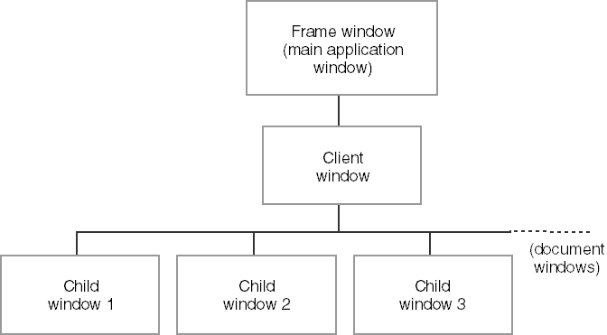
MDI - Elements
The parent-child hierarchy of a Windows MDI application

Slide 33
Create MDI Application
Declare frame window procedure, child windows procedures
  LRESULT CALLBACK FrameWndProc (HWND, UINT, WPARAM, LPARAM);
  LRESULT CALLBACK ChildWnd1Proc (HWND, UINT, WPARAM, LPARAM);
  LRESUTL CALLBACK ChildWnd2Proc (HWND, UINT, WPARAM, LPARAM);
  . . .
Register frame window, client window, child windows classes

Slide 34
Create MDI Application
Load menu for frame window from resource script
Load keyboard accelerator table (if defined)
Create frame window by calls CreateWindow function
Get client window handle by calls GetWindow function
  hwndClient = GetWindow (hwndFrame, GW_CHILD) ;
Change message loop
  while (GetMessage (&msg, NULL, 0, 0)) {
  if (!TranslateMDISysAccel (hwndClient, &msg) &&
  !TranslateAccelerator (hwndFrame, hAccel, &msg)) {
  TranslateMessage (&msg) ;
  DispatchMessage (&msg) ;
  }
  }

Slide 35
Frame Window Procedure
Declare a CLIENTCREATESTRUCT variable :
    CLIENTCREATESTRUCT clientCreate;
    // Definition of CLIENTCREATESTRUCT :
    typedef struct tagCLIENTCREATESTRUCT {
    HANDLE hWindowMenu;
    UINT idFirstChild;
    } CLIENTCREATESTRUCT, *LPCLIENTCREATESTRUCT;
Declare a MDICREATESTRUCT variable :
  MDICREATESTRUCT mdiCreate;
    // Definitiion of MDICREATESTRUCT
    typedef struct tagMDICREATESTRUCT {
    LPCTSTR szClass;
    LPCTSTR szTitle;
    HANDLE hOwner;
    int x;
    int y;
    int cx;
    int cy;
    DWORD style;
    LPARAM lParam;
    } MDICREATESTRUCT, *LPMDICREATESTRUCT;

Slide 36
Frame Window Procedure
Handle the WM_CREATE message :
  Setting data for clientCreate struct
  Create client window by calls to CreateWindow
    hwndClient = CreateWindow (TEXT ("MDICLIENT"), NULL,
    WS_CHILD | WS_CLIPCHILDREN | WS_VISIBLE,
    0, 0, 0, 0, hwnd, (HMENU) 1, hInst,
    (PSTR) &clientcreate) ;
Handle the WM_COMMAND message :
  Setting data for mdiCreate struct
  Create child window control by calls to SendMessage
    hwndChild = (HWND) SendMessage (hwndClient,
    WM_MDICREATE, 0, (LPARAM ) (LPMDICREATESTRUCT) &mdicreate) ;

Slide 37
Frame Window Procedure
Retrieve the handle of the active MDI child window :
  hWndChild = (HWND) SendMessage (hWndClient, WM_MDIGETACTIVE, 0, 0 );
Close the MDI child window :
  SendMessage (hWndChild, WM_QUERYENDSESSION, 0, 0 );
  SendMessage (hWndClient, WM_MDIDESTROY, (WPARAM) hWndChild, 0 );
Pass the messages that no need to process in program to DefFrameProc
  return DefFrameProc (hWnd, hWndClient, message, wParam, lParam);

Slide 38
MDI Child Window Procedure
MDI child window procedure is similar to other window procedures. It processes messages that are generated on child window or messages that are sent to child window from client window, main frame window
With messages that are no need to process, pass to DefMDIChildProc
  return DefMDIChildProc (hWnd, message, wParam, lParam);

Slide 39
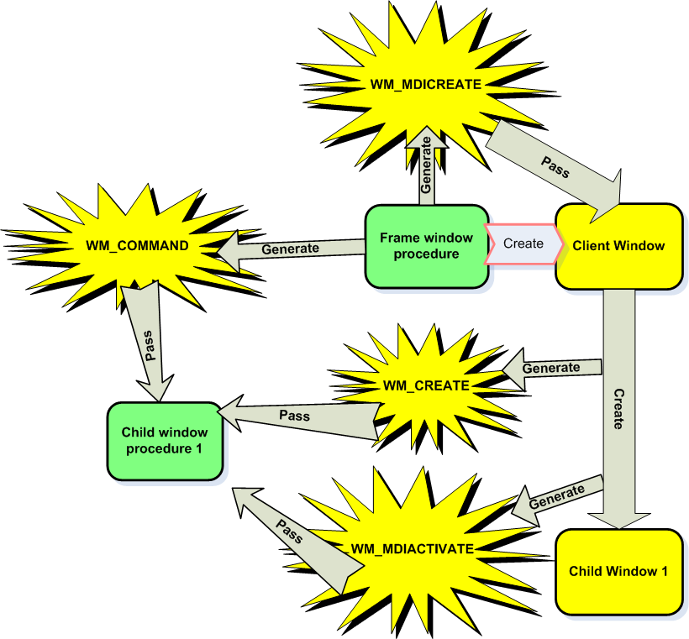
Frame – Client - Child

Slide 40
DISCUSSION

