Slide 1
Classification and Regression Learning on the Wine Quality Dataset
Christian McDaniel, Jeremy Shi

Slide 2
Plan
Background
Dataset
Techniques
Results
Findings/Recommendations

Slide 3

Background
Goal: predict sensory-derived “quality” from physicochemical properties
Data source: red and white vinho verde from Portugal
Researchers (oenologists) try to use the results to get better wine
Notes:
Oenologist ~ sommelier
Vinho verde from Minho (NW) portugal
Portugal = top 10 wine exporter
Vinho verde increased 36% 97-07
Wine certification and quality assessment important step
Taste is one of the least understood human senses → sommelier black box

Slide 4
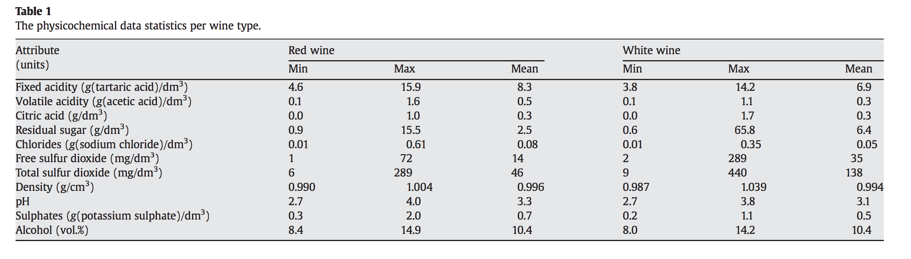
Datasets
Two csv files
1599 red examples
4898 white examples
11 features, 1 target. All numerical
Step further:
Combined datasets: 6497 examples; 12 features
Target = type; Quality

Slide 5
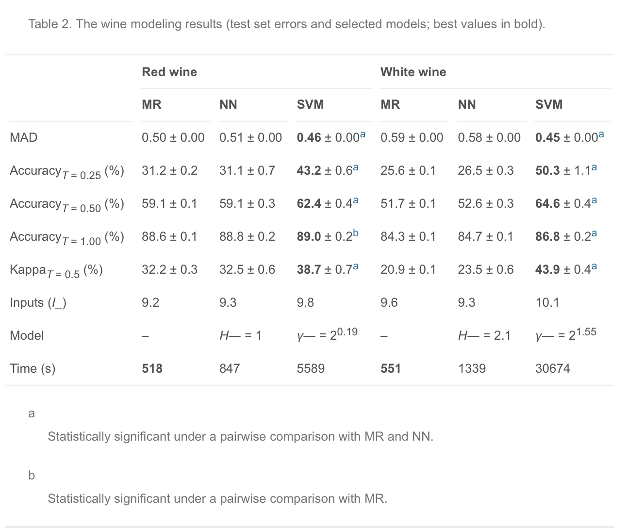
Benchmark results:
regression techniques
Accuracay via Tolerance (T)
Kappa (vs. random)
(I_): avg. num inputs
Model: Hyperparams
Using R
20 x 5-fold CV
SVM: Gaussian kernel

Slide 6
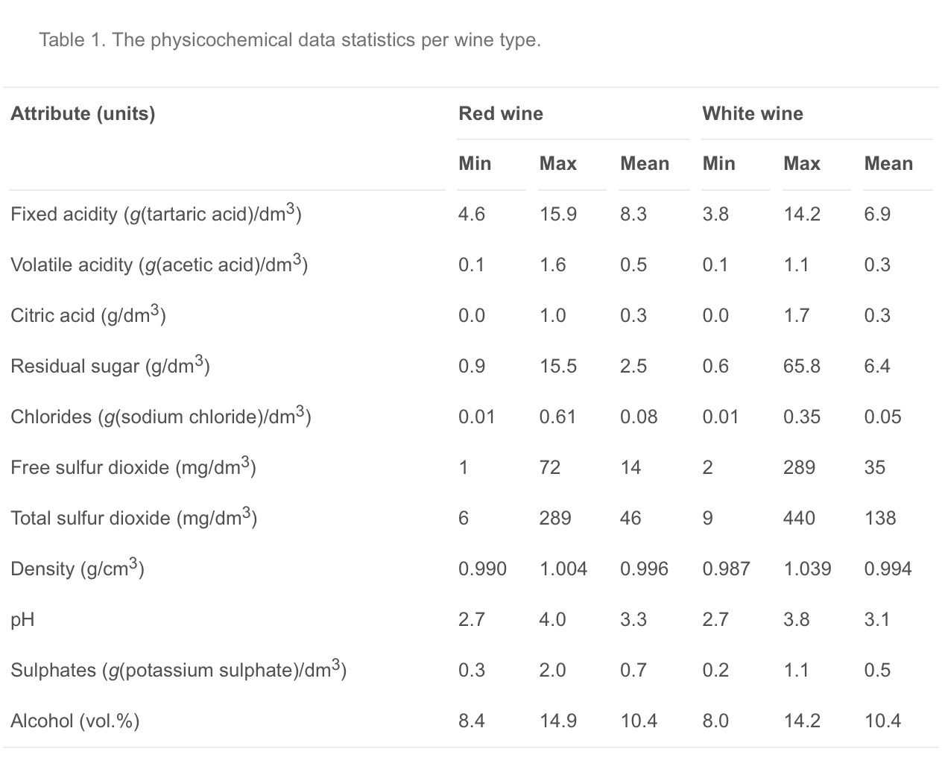
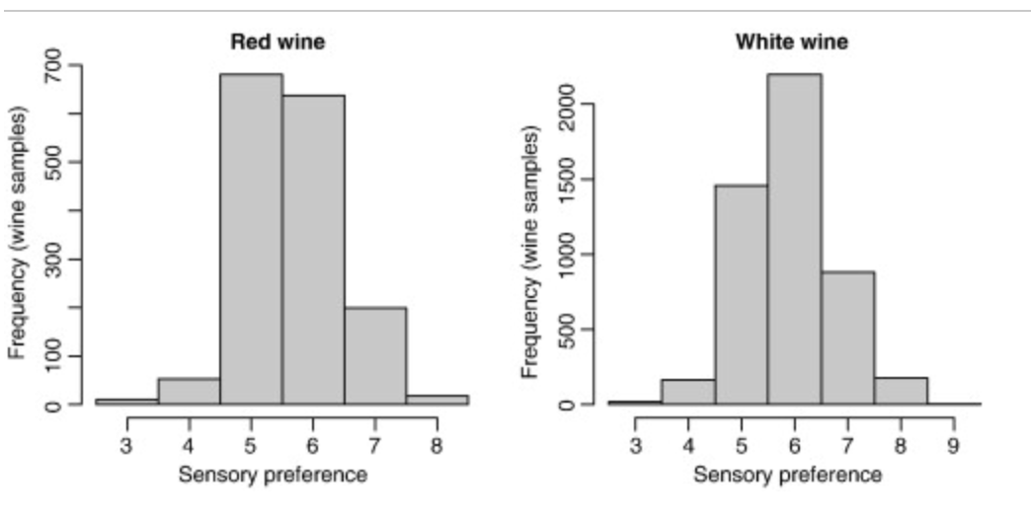
Dataset Exploration
→
→
→
Sommeliers are (boringly) Gaussian!
Feature characteristics:
Most appear to have Gaussian distribution
Few seem skewed to lower values
Ranges larger for Red
→

Slide 7
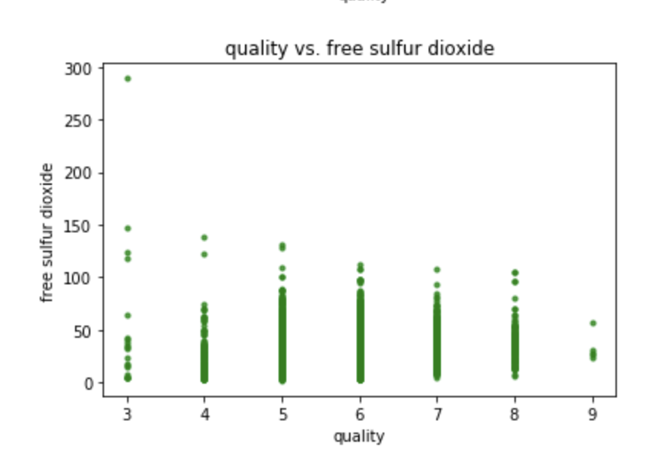
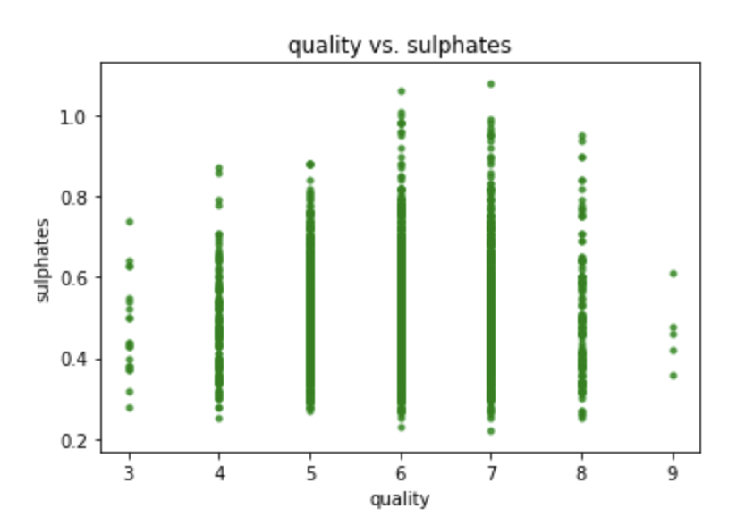
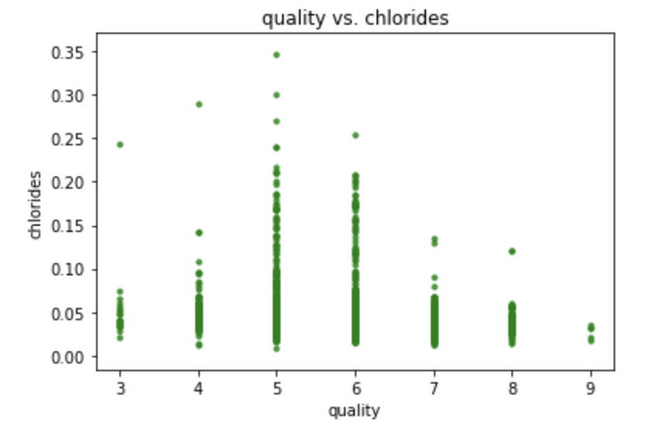
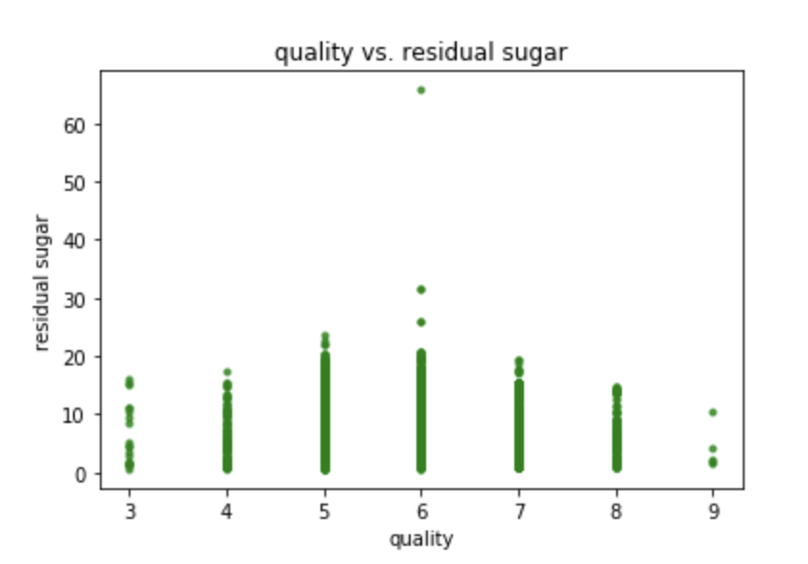
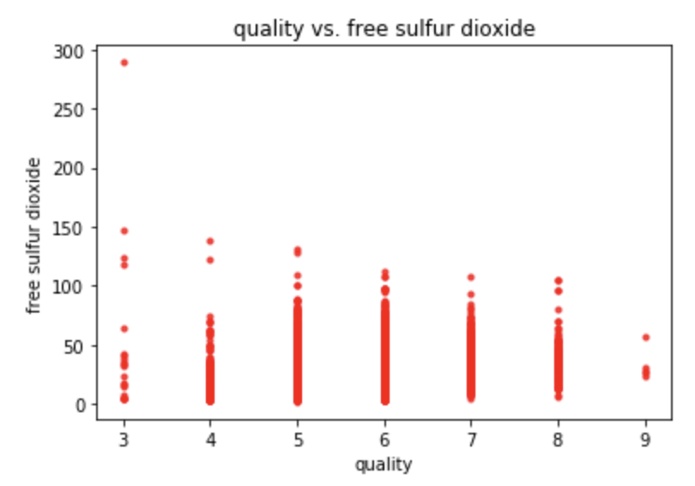
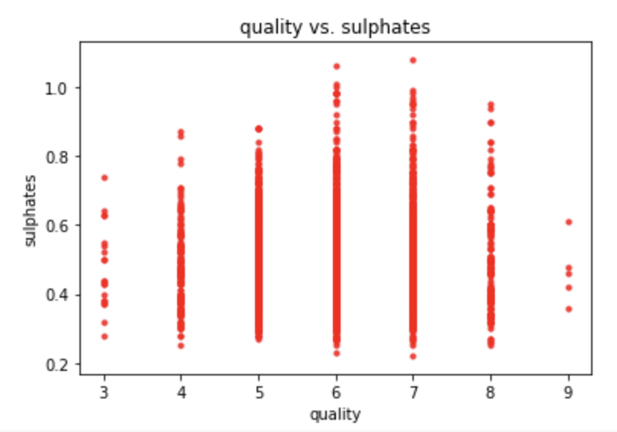
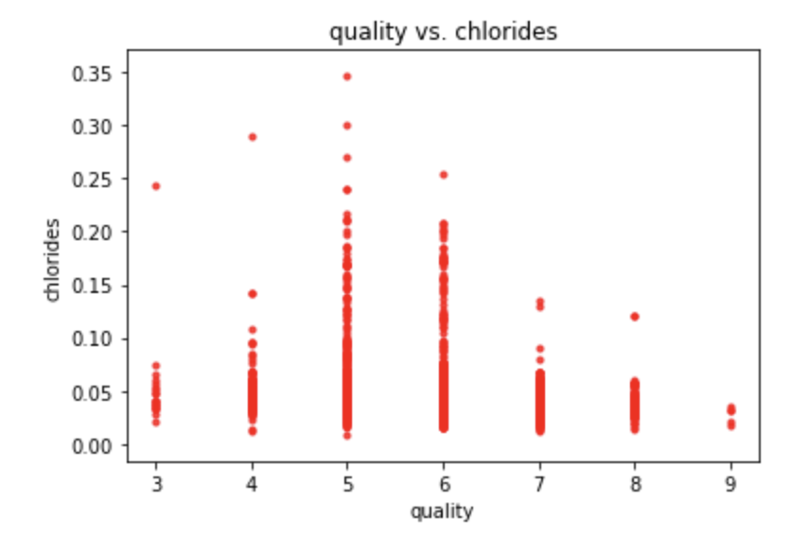
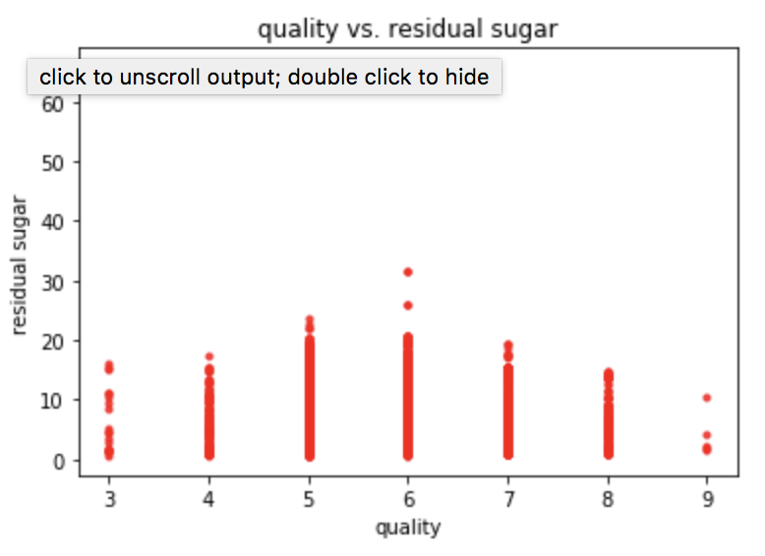
Further look into our features:
Outliers indicate quality?
How to predict the quality? Regression vs. Classification

Slide 8
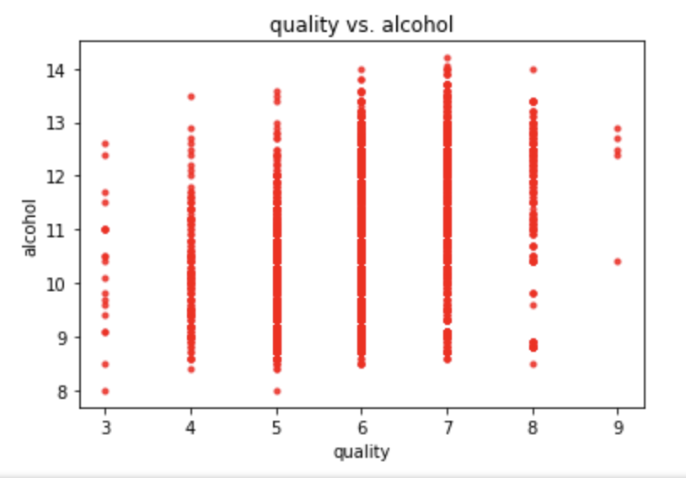
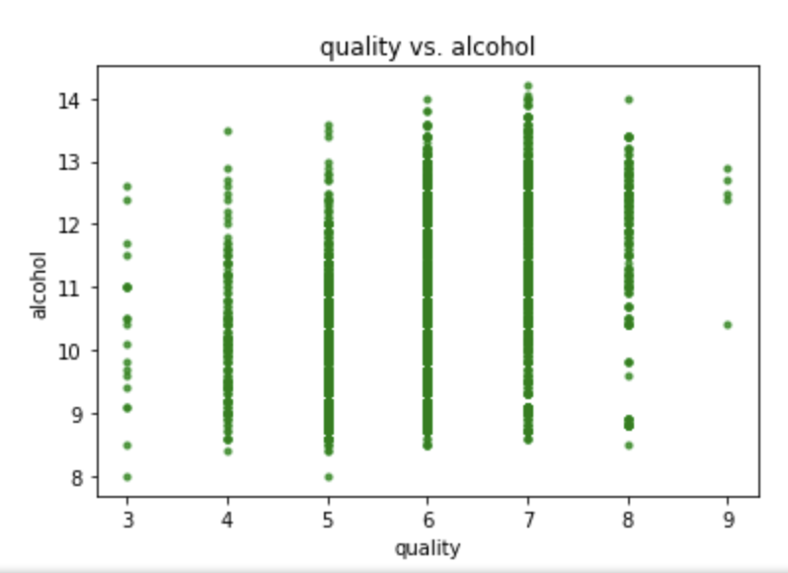
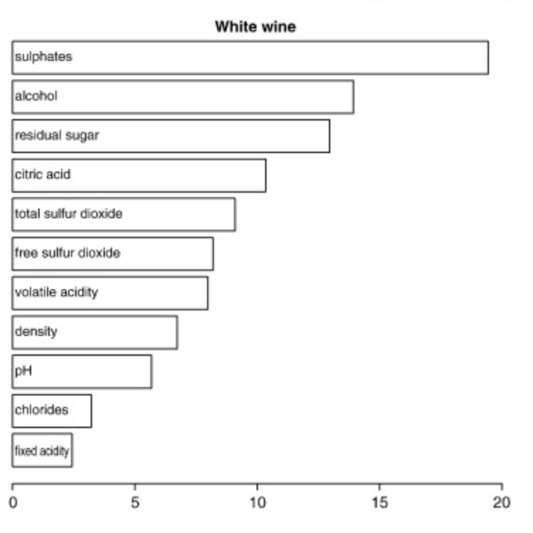
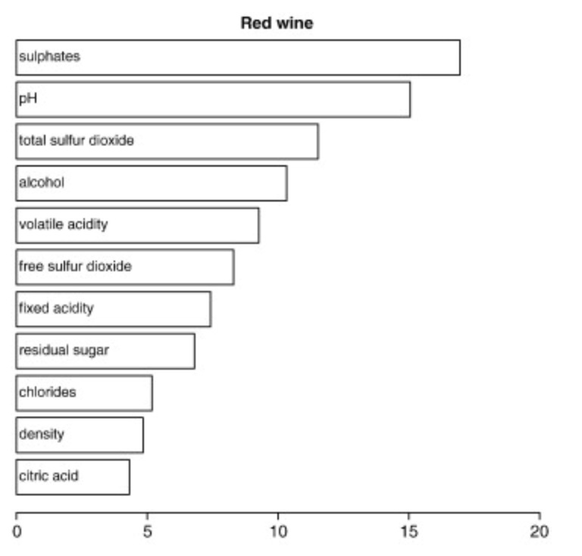
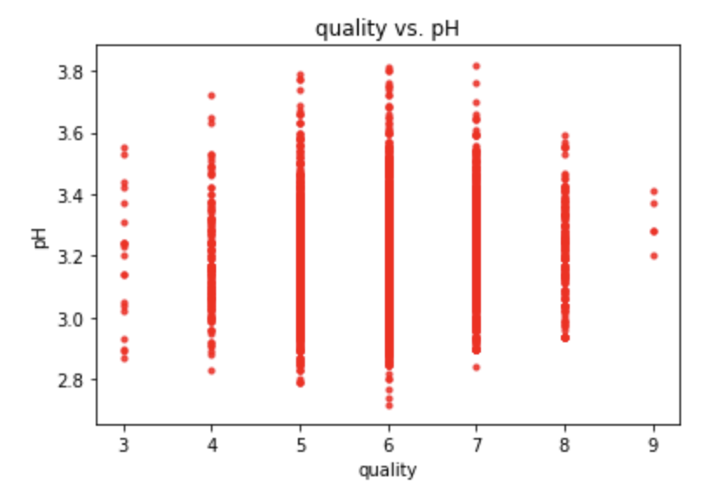
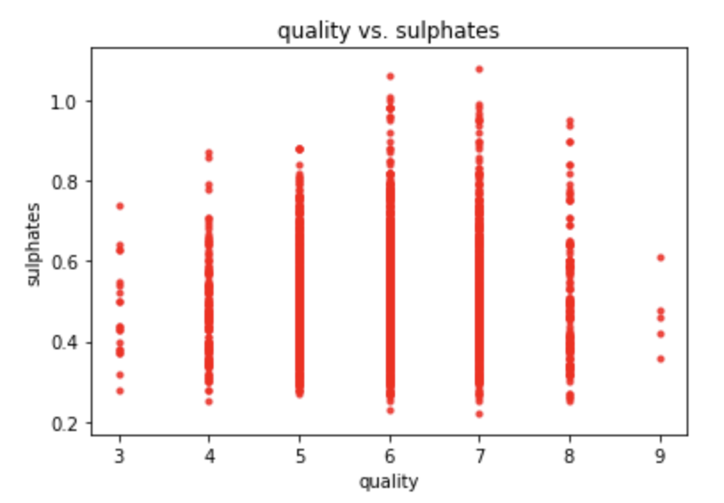
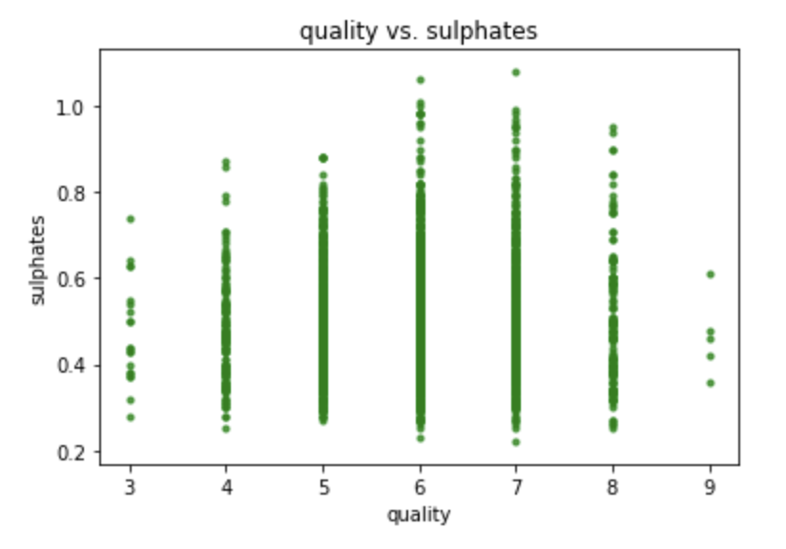
Finally, a peak into the Sommelier Black Box?
Notes:
Bar graphs on right: avg SVM relative importance (Ra values);
Oentological theory alignment:
Alcohol directly correlated with quality
Citric acid and residual sugar more important in white wine (freshnness & sweetness more important)
Volatile acidity indirectly correlated with quality (acetic acid key ingredient in vinegar)
Sulphates…. (?)
Maybe related to fermenting nutrition → wine aroma
Vif values shown later.

Slide 9
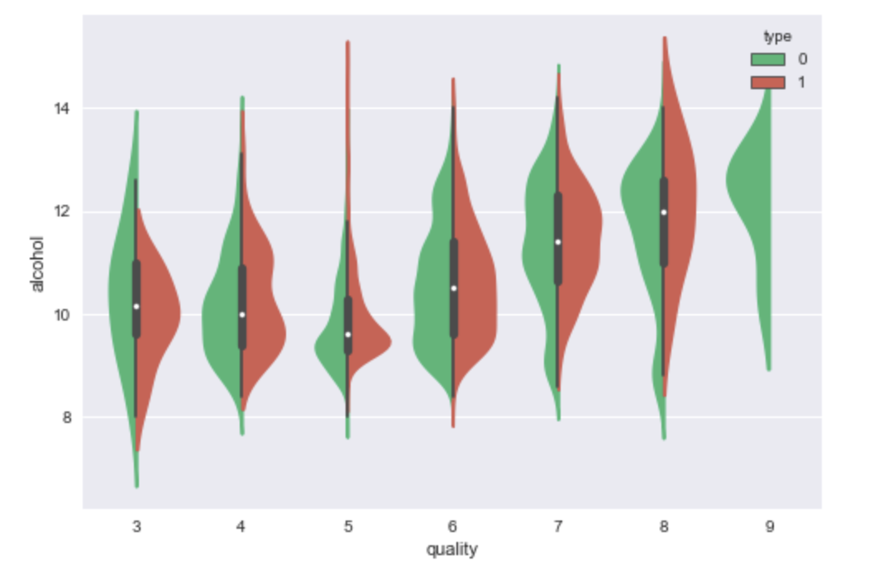
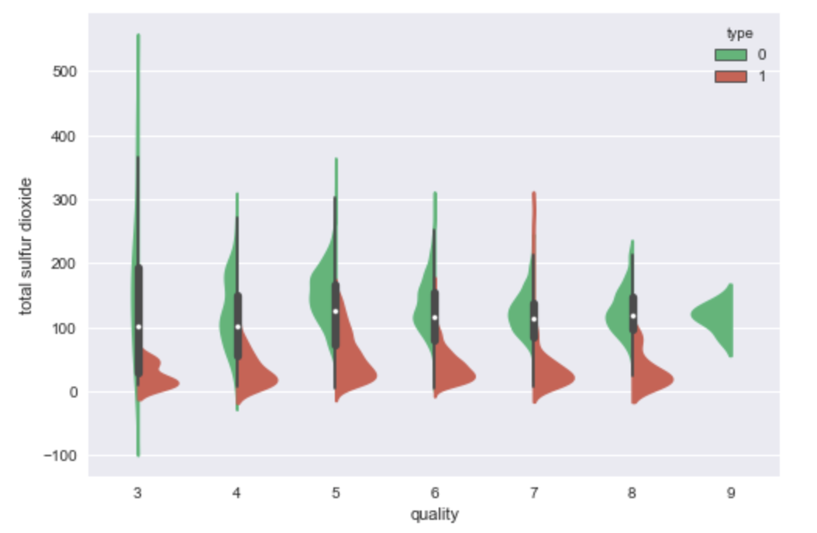
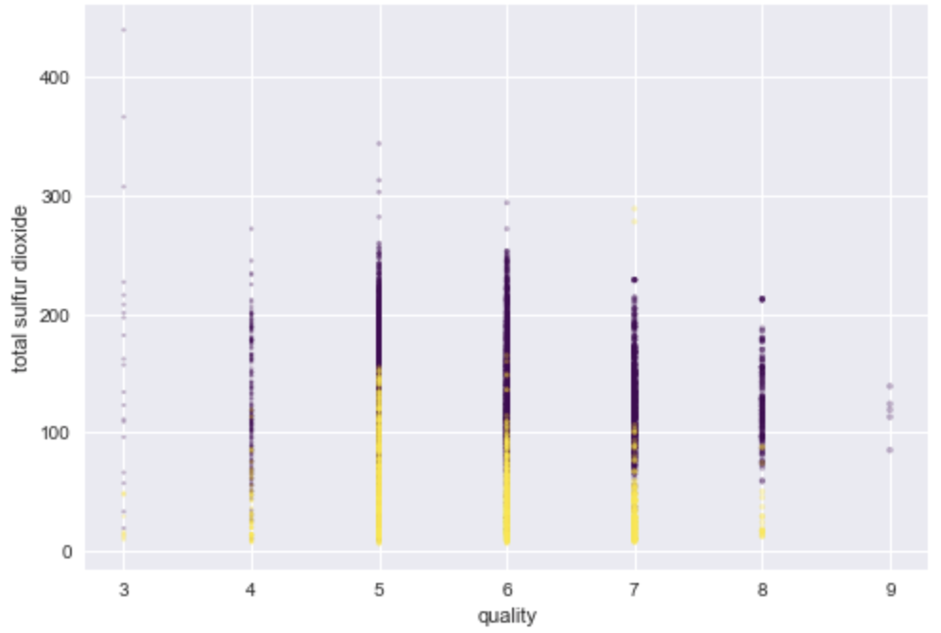
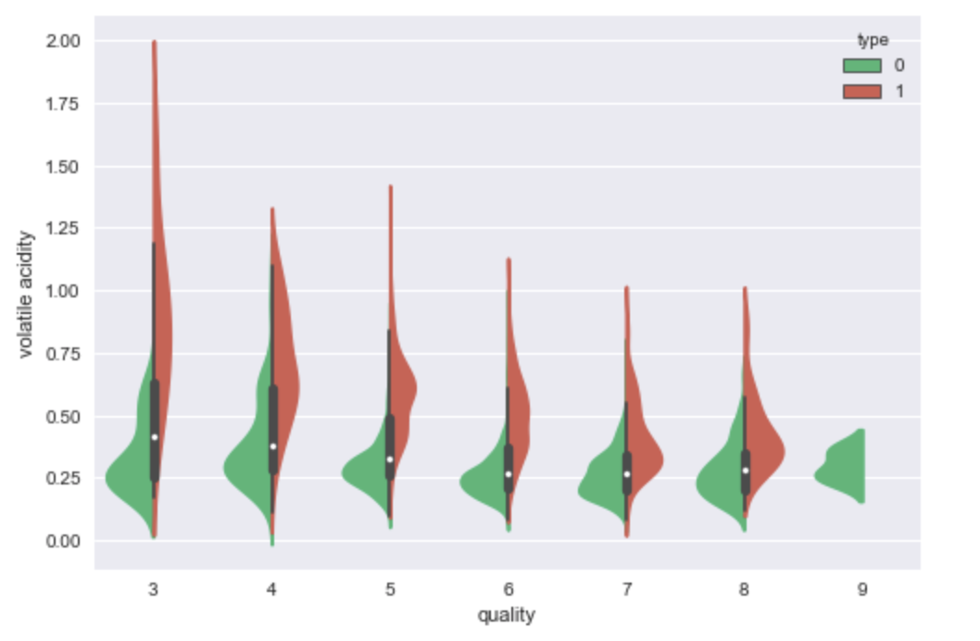
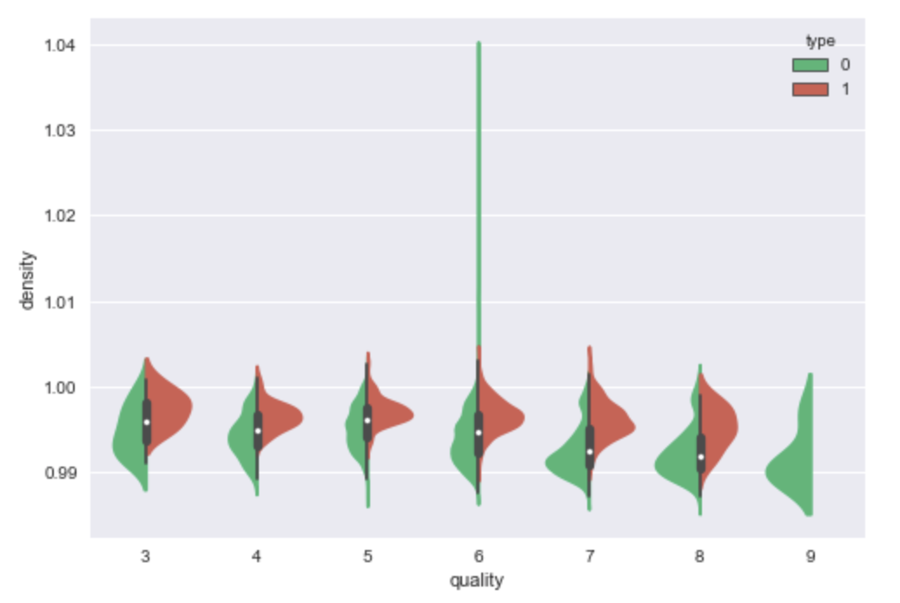
The Amateur Sommelier: White vs. Red
Developing a taste for sulfur dioxides… -_-
Notes:
Vif values shown later.

Slide 10
Something about Scalation...
In the newest version of Scalation 1.4.1, RegressionTest won’t work.
But it does work in an early version of Scalation -- 1.4, which is the one we use for vif and regression in this project.
RandomForestTest4, the test that used the wine dataset, also has bugs. So we did not use RandomForest in Scalation for the datasets.

Slide 11
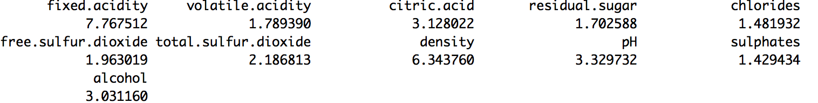
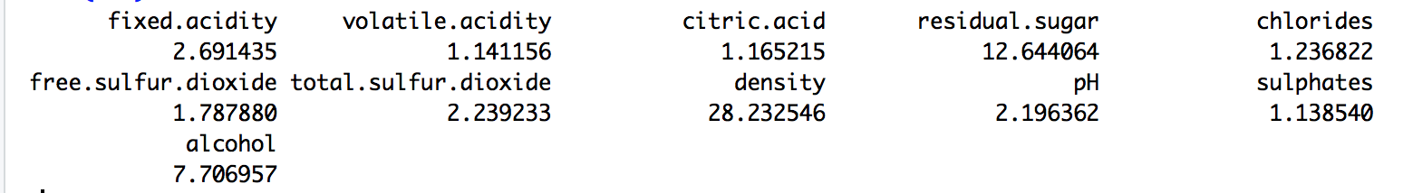
Feature Selection using Scalation/R (results are the same; here using screenshots in R)
Vif values in the red wine dataset (all seem okay):
(7.76751, 1.78939, 3.12802, 1.70259, 1.48193, 1.96302, 2.18681, 6.34376, 3.32973, 1.42943, 3.03116)
Vif values in the white wine dataset (some of them not okay):
Notes:
We can also see the vif values later.

Slide 12
Data Preparation and Training Pipeline
Target values rescaled to start from 0
Cross validation used for training the models
New CV conducted for each parameter combination tried
Stratified folds (re: target values)
Standardization applied via μ, σ from training folds only
Validation hold-out within training folds used for NN’s
Dropout and BatchNormalisation used between layers

Slide 13
Regression in Scalation (Red)
Without removing any features:
SSE: 666.4107
Residual stdErr: 0.6480 on 11 degrees of freedom
R-Squared: 0.3606, Adjusted rSquared: 0.3561
F-Statistic: 81.3479 on 11 and 1587 DF
AIC: -1375.4889
BIC: -1310.9633
After removing the vif values over 5, the results actually got a bit worse:
SSE: 688.8910
Residual stdErr: 0.6584 on 9 degrees of freedom
R-Squared: 0.3390, Adjusted rSquared: 0.3352
F-Statistic: 90.5405 on 9 and 1589 DF
AIC: -1326.4391
BIC: -1272.6677
Exponential Regression:
ListMap(Degrees of Freedom -> 1587, Effective DF -> 1586.0, Residual stdErr -> 0.6478, R-Squared -> 0.3610, Adjusted R-Squared -> 0.3566, F-Statistic -> 81.4990, SSE -> 665.9646, RMSE -> 0.6454, AIC -> -1376.5596, BIC -> -1312.0340)

Slide 14
Regression in Scalation (White)
Without removing any features:
SSE: 2758.3286
Residual stdErr: 0.7514 on 11 degrees of freedom
R-Squared: 0.2819, Adjusted rSquared: 0.2803
F-Statistic: 174.3441 on 11 and 4886 DF
AIC: -2788.4416
BIC: -2710.4826
After removing vif values over 10:
SSE: 2793.4243
Residual stdErr: 0.7560 on 9 degrees of freedom
R-Squared: 0.2727, Adjusted rSquared: 0.2714
F-Statistic: 203.6728 on 9 and 4888 DF
AIC: -2730.5148
BIC: -2665.5490
Exponential Regression:
ListMap(Degrees of Freedom -> 4886, Effective DF -> 4885.0, Residual stdErr -> 5.9515, R-Squared -> -44.0577, Adjusted R-Squared -> -44.1591, F-Statistic -> -434.3237, SSE -> 173066.0000, RMSE -> 5.9442, AIC -> 17484.6160, BIC -> 17562.5750)

Slide 15
Regression Results: white wine dataset (3-fold CV, all from Sklearn)
 | SVM Regressor | Multi-layer Perceptron | Random Forest Regressor | Gradient Boosting Regressor | AdaBoost Regressor | Lasso Regression | Elastic Nets | Ridge Regression | Multiple Linear Regression
Best r2 score | 0.31875 | 0.24768 | 0.28029 | 0.29310 | 0.24253 | 0.18560 | 0.19172 | 0.23485 (0.23683 after scaling) | 0.23934
Params in the best model | {'kernel': 'rbf’, ‘gamma': 0.03125, 'ep': 0.1, 'C': 1} | {'activation': 'relu', 'hidden_layer_sizes': (9000,), 'learning_rate': 'invscaling', 'solver': 'lbfgs'}) | {'max_depth': 5, 'n_estimators': 10} | {'max_depth': 5, 'n_estimators': 22} | {'n_estimators': 1000} | {'alpha': 0.1} | {'alpha': 0.1, 'l1_ratio': 0.3} | {'alpha': 1} {'alpha': 0.2} after scaling | {'normalize': True}

Slide 16
Regression Results: white wine dataset (3-fold CV, all from Sklearn)
 | SVM Regressor | Multi-layer Perceptron | Random Forest Regressor | Gradient Boosting Regressor | AdaBoost Regressor | Lasso Regression | Elastic Nets | Ridge Regression | Multiple Linear Regression
Best MAE | 0.652847901626108 | 0.6007864324512657 | 0.5932960754173086 | 0.5882562805661777 | 0.6095430791908534 | 0.6274679553609409 | 0.62677646148489 | 0.6026447562660786 | 0.6010021790413785
Params in the best model | {'degree': 2, 'kernel': 'linear', 0.03125, 'ep': 0.1, 'C': 1} | {'activation': 'relu', 'hidden_layer_sizes': (9000,), 'learning_rate': ‘adaptive’, 'solver': 'lbfgs'}) | {'max_depth': 5, 'n_estimators': 10} | {'max_depth': 5, 'n_estimators': 40} | {'n_estimators': 10000} | {'alpha': 0.1} | {'alpha': 0.1, 'l1_ratio': 0.5} | {'alpha': 1} | {'normalize': True}
Notes:
370344f2f07f0da1359557d7a5541669be015b0412910d3c

Slide 17
Regression Results: white wine dataset (5-fold CV, all from Sklearn)
 | SVM Regressor | Multi-layer Perceptron | Random Forest Regressor | Gradient Boosting Regressor | AdaBoost Regressor | Lasso Regression | Elastic Nets | Ridge Regression | Multiple Linear Regression
Best MAE | 0.652847901626108 | 0.6007864324512657 | 0.5932960754173086 | 0.5882562805661777 | 0.6095430791908534 | 0.6274679553609409 | 0.62677646148489 | 0.6026447562660786 | 0.6010021790413785
Params in the best model | {'degree': 2, 'kernel': 'linear', 0.03125, 'ep': 0.1, 'C': 1} | {'activation': 'relu', 'hidden_layer_sizes': (9000,), 'learning_rate': ‘adaptive’, 'solver': 'lbfgs'}) | {'max_depth': 5, 'n_estimators': 10} | {'max_depth': 5, 'n_estimators': 40} | {'n_estimators': 10000} | {'alpha': 0.1} | {'alpha': 0.1, 'l1_ratio': 0.5} | {'alpha': 1} | {'normalize': True}

Slide 18
Also tried Neural Network in Keras (for white wine) -- updated Apr 24
Best model has a r2 score of 0.2849443610717076.
{'batch_size': 140, 'epochs': 800}
def new2_advanced_hidden_model():
model = Sequential()
model.add(Dense(12, activation='relu', input_dim=11))
model.add(Dense(19, activation='relu', input_dim=12))
model.add(Dense(13, activation='relu', input_dim=19))
model.add(Dense(10, activation='relu', input_dim=13))
model.add(Dense(7, activation='relu', input_dim=10))
model.add(Dense(1, activation='linear', input_dim=7))
model.compile(loss='mean_squared_error', optimizer='adam')
return model

Slide 19
Regression Results: Red wine dataset (3-fold CV, all from Sklearn)
 | SVM Regressor | Multi-layer Perceptron | Random Forest Regressor | Gradient Boosting | AdaBoost | Lasso Regression | Elastic Nets | Ridge Regression | Multiple Linear Regression
Best r2 score | 0.31064 | 0.33303 | 0.33989 | 0.34064 | 0.30238 | 0.20375 | 0.23086 | 0.31393 | 0.31157
Params in the best model | {'kernel': 'rbf’, ‘gamma': 0.03125, 'ep': 0.1, 'C': 1} | {'activation': 'tanh', 'hidden_layer_sizes': (4000,), 'learning_rate': 'adaptive', 'solver': 'lbfgs'} | {'max_depth': 5, 'n_estimators': 50} | {'max_depth': 4, 'n_estimators': 22} | {'n_estimators': 100} | {'alpha': 0.1} | {'alpha': 0.1, 'l1_ratio': 0.3} | {'alpha': 0.1} | {'normalize': True}
Notes:
(added scaling, the results are even worse…..)

Slide 20
Regression Results: Red wine dataset (3-fold CV, all from Sklearn)
 | SVM Regressor | Multi-layer Perceptron | Random Forest Regressor | Gradient Boosting | AdaBoost | Lasso Regression | Elastic Nets | Ridge Regression | Multiple Linear Regression
Best MAE | 0.5099358249134207 | 0.5081844794133895 | 0.5174080364857803 | 0.5153901215236079 | 0.5320248816345822 | 0.5671013347977876 | 0.552183209070724 | 0.5167036583485715 | 0.517959125464443
Params in the best model | {'degree': 2, 'kernel': 'linear'} | {'activation': 'tanh', 'hidden_layer_sizes': (9000,), 'learning_rate': 'invscaling', 'solver': 'lbfgs'} | {'max_depth': 5, 'n_estimators': 50} | {'max_depth': 3, 'n_estimators': 40} | {'n_estimators': 50000} | {'alpha': 0.1} | {'alpha': 0.1, 'l1_ratio': 0.3} | {'alpha': 0.1} | {'normalize': False}
Notes:
(added scaling, the results are even worse…..)

Slide 21
Regression Results: Red wine dataset (5-fold CV, all from Sklearn)
 | SVM Regressor | Multi-layer Perceptron | Random Forest Regressor | Gradient Boosting | AdaBoost | Lasso Regression | Elastic Nets | Ridge Regression | Multiple Linear Regression
Best MAE | 0.5076109800988632 | 0.505728048884583 | 0.5076235726934847 | 0.49909291520651994 | 0.5288696063774421 | 0.564174577819966 | 0.5475809225117063 | 0.5101122208931989 | 0.5104139778164065
Params in the best model | {'degree': 2, 'kernel': 'linear'} | {'activation': 'tanh', 'hidden_layer_sizes': (9000,), 'learning_rate': 'invscaling', 'solver': 'lbfgs'} | {'max_depth': 5, 'n_estimators': 50} | {'max_depth': 3, 'n_estimators': 100} | {'n_estimators': 50000} | {'alpha': 0.1} | {'alpha': 0.1, 'l1_ratio': 0.3} | {'alpha': 0.1} | {'normalize': False}
Notes:
(added scaling, the results are even worse…..)

Slide 22
Regression Results: Red and white datasets combined and add type as a feature (3-fold CV, all from Sklearn)
 | SVM Regressor | Multi-layer Perceptron | Random Forest Regressor | Gradient Boosting | AdaBoost | Lasso Regression | Elastic Nets | Ridge Regression | Multiple Linear Regression
Best r2 score | < 0 | 0.33303 | 0.19273 | 0.21651 | 0.17258 | 0.17315 | 0.19218 | 0.18569 | 0.05156
Params in the best model | {'kernel': 'rbf’, ‘gamma': 0.03125, 'ep': 0.1, 'C': 1} | {'activation': 'tanh', 'hidden_layer_sizes': (4000,), 'learning_rate': 'adaptive', 'solver': 'lbfgs'} | {'max_depth': 2, 'n_estimators': 50} | {'max_depth': 2, 'n_estimators': 22} | {'n_estimators': 10} | {'alpha': 0.1} | {'alpha': 0.1, 'l1_ratio': 0.3} | {'alpha': 1} | {'normalize':False}

Slide 23
Classification Results: white wine dataset
(5-fold CV, Sklearn)
 | Naive Bayes` | TAN Bayes` | LDA` | Logistic Regression` | Multilayer Perceptron (Dense NN)^ | Linear SVM” | C-SVM”
Accuracy | 95.0% | 10.823% | 89.177% | 89.177% | 53.104% | 52.106% | 53.596%
F1 Score* | 1.0 | 0.0 | 0.94040 | 0.94040 | 0.53104 | 0.12861 | 0.12861
Parameters | default | default | default | default | {n_layers=2, units1=85, units2=45, units3=85, batch_size=1280, use_bias=False, krnl_init=lecun_normal, optimizer=’SGD’, activation=relu} | {'mult_class': 'ovr', 'loss': 'squared_hinge', 'C': 0.25} | {'kernel': 'rbf', 'gamma': 0.03125, 'C': 2}
` = scalation ^ = keras, sklearn “ = sci-kit learn * : if tp, fp, fn = 0 → recall, precis, fscore = 1
If tp = 0, fp or fn != 0 → recall, precis, fscore = 0

Slide 24
Classification Results: red wine dataset
(5-fold CV, Sklearn)
 | TAN Bayes` | LDA` | Logistic Regression` | Multilayer Perceptron (Dense NN)^ | Linear SVM” | C-SVM”
Accuracy | 17.238% | 82.762% | 82.762% | 59.050% | 56.987% | 58.230%
F1 Score | 0.0 | 0.90017 | 0.90017 | 0.59050 | 0.13945 | 0.13945
Parameters | default | default | default | {n_layers=2, units1=45, units2=45, batch_size=50, use_bias=False, kernel_init=’glorot_uniform’, optimizer=’adam’, activationh=’relu’} | {'mult_class': 'ovr', 'loss': 'squared_hinge', 'C': 1} | {'kernel': 'rbf', 'gamma': 0.03125, ''C': 4}
` = scalation ^ = keras, sklearn “ = sci-kit learn * : if tp, fp, fn = 0 → recall, precis, fscore = 1
If tp = 0, fp or fn != 0 → recall, precis, fscore = 0

Slide 25
Wine Type (Red vs. White)
 | Naive Bayes` | TAN Bayes` | LDA` | LR` | KNN` | Multilayer Perceptron (Dense NN)^ | Linear SVM” | SVM Regressor”
Accuracy/R2 | 98.153% | 75.388% | 99.708% | 99.969% | 99.908% | 99.554% | 98.813% | 0.96639
F1 Score | 0.32852 | 0.0 | 0.32840 | 0.32963 | 0.32935 | 0.99084 | 0.13020 | 8.0997(sse)
Parameters | default | default | default | default | default | {n_layers: 1, units1: 45, batch_size: 128, use_bias: True, bias_initializer: ‘lecun_normal’, kernel_initializer: ‘lecun_normal’, optimizer: SGD, activationh: relu} | {mult_class: 'ovr', 'loss': 'sqrd_hinge 'C': 0.25} | {'kernel': 'rbf', 'gamma': 0.03125, 'ep': 0, 'degree': 4, 'C': 4}
` = R ^ = Keras + Sci-Kit Learn “ = Sci-Kit Learn

Slide 26
Class-wise Analysis
-Dense NN-
WHITE
RED
CLASS | Top Accuracy | Noteworthy Parameters | Accuracy, F1 Score | Noteworthy Parameters
0 (quality=3) | 82.857% | 5 layers (85,85,45… units), SGD opt, tanh act, no bias, zeros kernel init | 72.222%, | 2 layers (45 untis), adam opt, linear act
1 (quality=4) | 32.208% | 2 layers(45,45), SGD, linear, batch_size 4898 | 32.500% | 10 layers (10,10.45... units), adam, relu
2 (quality=5) | 80.557% | 3 layers (10,45,85), adam, sigmoid, batch_size 1280, zeros kernel init | 99.393% | 3 layers (85,85,45... ), SGD, sigmoid, zeros kernel init
3 (quality=6) | 99.805% | 5 layers (45,45,10…), SGD, softmax, batch_size 4898, zeros kernel init | 65.021% | 1 layer (45), SGD, sigmoid, 1280 batch_size
4 (quality=7) | 54.318% | 2 layers(45,45), SGD, tanh, no bias, batch_size 4898 | 84.750% | 5 layers (85,45…), SGD, tanh, batch_size=50
5 (quality=8) | 21.508% | 5 layers (10,45,10…), SGD, relu, no bias, batch_size 1280 | 72.667% | 5 layers (10,45,10…), adam, tanh, no bias
6 (quality=9) | 47.143% | 5 layers (45,85,10…), SGD, sigmoid | -- | --

Slide 27
Findings/Recommendations - Models
Able to surpass benchmark (Naive Bayes, LDA, Log. Reg.)
R2 systematically low - high variation in dataset
Distinguishing Red vs. White quite feasible
SVM:
RBF kernel; gamma: 2⁻⁵ ; C = 1⁺
NN:
n_layers: 5 or less; batch_size: 128⁺ ; SGD, adam optimizers (among others); tanh, relu activations (among others)
Quality:
Quality=4 had worst prediction accuracy
Qualitiy=5 and 6 had strong prediction accuracy (highest frequency)
Extremes not so bad overall (despite low frequency)

Slide 28
Findings/Recommendations - General
Physicochemical properties show mild-moderate correlation with quality assessment
Sklearn, Keras very user-friendly. Highly recommended.
Normalizing/scaling data in some situations is very important.
No single best method for every task.
But in general, ensemble models usually won’t perform too bad.
Given the overall poor performances across all different models, maybe wine quality is just magical and hardly predictable.

Slide 29
Limitations & Future Work
Limitations:
Parameter size for NN was too large
Not all possible classes (0-10) were used
“Quality” is a very difficult (subjective) target value to predict
Difficulty comparing results to benchmark due to performance measure
Time complexities
Future Work:
Apply the Tolerance approach used in the paper*
Maybe more preprocessing (normalization, standardization, re-scaling, etc.)?
Explore parallel NN, capsule networks to specify parameters to each class
Further explore parameter space → Continue training!*
Contribute to open source by updating ScalaTion examples with this dataset*
Assess time complexities
Notes:
Taste is one of the least understood human senses!

Slide 30
Thank you!
Questions?

