Slide 1
Big Data or Good Data: Which One Is More Important for AI in Medical Imaging?
Ran Zhang¹, Xin Tie¹, Zhihua Qi³, Nicholas Bevins³, John W. Garrett²
and Guang-Hong Chen^{1,2}
¹ Department of Medical Physics, University of Wisconsin-Madison, Madison, WI, USA
² Department of Radiology, University of Wisconsin-Madison, Madison, WI, USA
³ Department of Radiology, Henry Ford Health
Notes:
Thank you for the introduction.

Slide 2

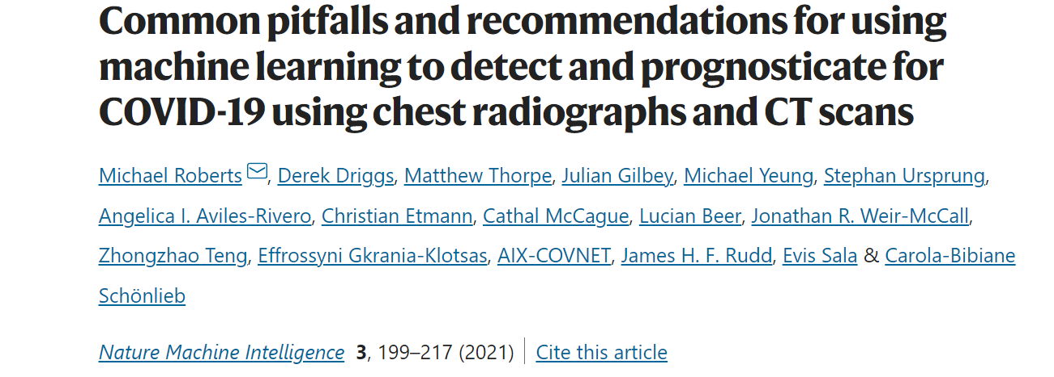
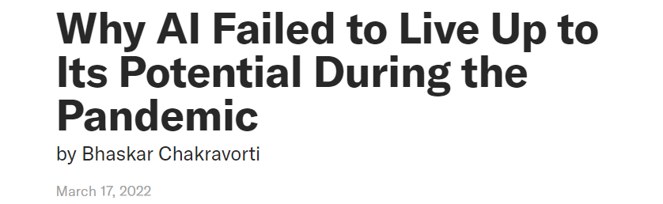
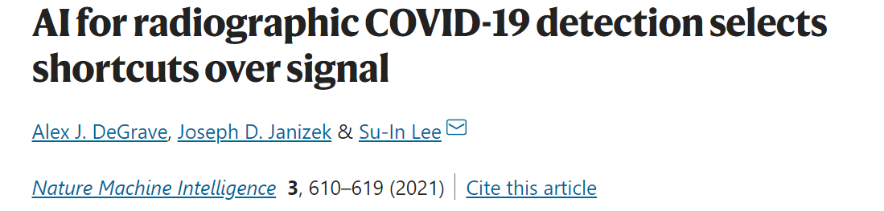
Failures of AI in the COVID Pandemic
Notes:
Over the past decade, we have seen some amazing achievements of AI in many fields. But as we hear the successful stories, we also started to see some failures and challenges, especially during this COVID pandemic. These are some review articles from popular magazines and scientific journals on the failures of AI in the COVID response.
As pointed out by these reviews, a fundamental challenge of AI in medical imaging is generalizability, which is the central topic of this talk.

Slide 3
The Fundamental Challenge: Generalizability
Generalizability in the context of statistical learning
Consistent performance on the i.i.d test set
Pitfalls (bias, shortcuts)
Generalizability in the context of medical AI
Consistent performance on prospective, external clinical cohorts (i.i.d assumption may not be valid)
Learn the desired solution that generalizes to the target cohort
Ways to improve generalizability?
Data size
Data heterogeneity
Notes:
But what is the definition of generalizability? Actually, this is a non-trivial question. In the context of machine learning and statistical learning, a model is generalizable if it performs consistently on the independent test set that follows the same distribution as the training data, the so-called i.i.d test set. But there is a problem with this definition: what if the training data is biased, or has shortcuts? A model can simply learn these features and perform well on the i.i.d test set, but it won’t be a useful model.
In the context of medical AI, we care about whether the model has consistent performance on prospective, external clinical cohorts where the i.i.d assumption may be violated. What we hope for the model is to learn the desired solution from the data, which, should generalize across different patient populations and clinical sites.
It is a common belief that adding more data, especially from diverse sources, is the key to improve generalizability. But this big data concept is not very compatible in the pandemic setting, where we only have a small amount of data in the early stage of the pandemic, and we want to develop solutions quickly.

Slide 4
Background: COVID Classification from CXR
Can a model trained using a small, high-quality dataset from a single clinical site be generalizable?
How do the model’s performance and generalization depend on the data size?
Notes:
So, the purpose of this work is to use COVID classification from chest x-rays as the example, to answer the following questions:
First, can we develop a generalizable model using a small, but high-quality dataset from a single clinical site?
Then, how do the model’s performance and generalizability change with the data size?

Slide 5
Data curation with quality assurance
All data are collected in the native DICOM format
Metadata such as patient sex, patient age, viewpoint, modality, imaging system vendor, and model are collected to check for potential biases
A short time window (-3 to 3 days) between the imaging study and RT-PCR test was used to ensure the accuracy of the diagnosis (label)
Both COVID+/COVID- cohorts were collected from the same hospitals and within the same time range to mitigate shortcut learning
Notes:
As I emphasized in the previous slide, we want to make sure the quality of the dataset is assured. Here I listed a few quality assurance considerations in our data curation.
First, all data are collected in their native DICOM format.
For each image, we also keep its metadata, including the patient sex, age, viewpoint of the image, modality, vendor, and model. So we can check if there are potential shortcuts or biases.
To make sure the label is trustworthy, we define delta as the days between the imaging study and the RT-PCR test. We only include chest x-rays within a narrow delta window.
Finally, we make sure both COVID+ and COVID- cases came from the same hospitals and same patient cohorts.

Slide 6




Datasets for model training and evaluation
 | Model development | External test sets
 | HF-train | HF-internal | BIMCV | UW Health | MIDRC
Type |  | Internal, temporal | external | external | external
Time | Feb-Sep, 2020 | Oct, 2020 | Feb-Apr, 2020 | 2020-2021 | 2020-
No. images (+/-) | 6689/10848 | 466/5224 | 3144/3335 | 694/5435 | 1022/7313
No. patients (+/-) | 3264/4802 | 334/3120 | 2004/2365 | 425/3574 | 514/2761
Age (+/-) | 63±17/69±15 | 66±16/67±18 | 67±17/69±20 | 60±17/64±18 | 59±17/62±16
Imaging system vendors | Carestream (53%), Konica Minolta (20%), GE (19%), Agfa (6%), others (2%) | Carestream (54%), Konica Minolta (16%), Agfa (16%), GE (10%), others (4%) | Agfa (37%), Carestream (13%), Konica Minolta (12%), Philips (8%), Siemens (6%), Canon (6%), others (18%) | Philips (85%), FUJIFILM (8%), others (7%) | Unknown
https://bimcv.cipf.es/bimcv-projects/bimcv-covid19/
25,000 CXRs from 15,000 patients
https://www.midrc.org/
Notes:
With these data quality assurance procedures, here is an overview of the curated datasets. For model training, we collected and curated data from Henry Ford Health in 2020. This training dataset has roughly 17,000 CXRs from over 8,000 patients.
As I just explained, our focus is on the generalizability of the model. To evaluate that, we need more than just the internal test set from the same institution. Here we curated another dataset from UW Health; we also used two public COVID chest x-ray dataset: the BIMCV dataset collected in Spain; and the MIDRC dataset curated by Medical Imaging & Data Resource Center.
Overall, the model was evaluated using over 25,000 images from 15,000 patients in different regions, and different countries.
Also, note that the distribution of imaging system vendors in these external datasets is quite different from that of the training dataset.

Slide 7
Sampled training datasets with different sizes
Data size from 100 patients to 6000 patients
50/50 class ratio
10 different random samples for each data size
For each data size, 10 different models are trained. The mean and the standard deviation of AUC are calculated
Evaluation of generalizability
AUC gap between internal test and external tests
Notes:
To systematically study the impact of training data size. We sampled datasets of different sizes, from a small dataset with 100 patients to 6000 patients, from the full training data. For each data size, we randomly sampled 10 times, and each time we sampled a different subset of the data. We then train a model and evaluate its performance. So for each size, we will have 10 AUC numbers, and we will evaluate the mean and standard deviation of the AUC.
To evaluate the generalizability, we will focus on the AUC gap between the internal test and external tests.

Slide 8
Model description
Model architecture: DenseNet-121¹
Three-stage transfer learning
ImageNet dataset
NIH chest x-ray dataset²
COVID CXR dataset
Model ensemble
Five models trained with different Train/Val splits
1. Huang G, Liu Z, van der Maaten L, Weinberger KQ. Densely connected convolution-al networks. In: 2017 IEEE Conference on Computer Vision and Pattern Recognition (CVPR), Honolulu, HI, July 21–26, 2017.
2. Wang, X., Peng, Y., Lu, L., Lu, Z., Bagheri, M., & Summers, R. M. (2017). Chestx-ray8: Hospital-scale chest x-ray database and benchmarks on weakly-supervised classification and localization of common thorax diseases. In Proceedings of the IEEE conference on computer vision and pattern recognition (pp. 2097-2106).
Notes:
We used the densenet model architecture and applied three-stage transfer learning: where the model was trained first using imagenet dataset, then pre-COVID public chest x-ray dataset with 14 common disease labels, but no COVID label; and finally on our COVID dataset.
For each training dataset, five models were trained with different train/validation splits, and the final prediction is an ensemble average of the 5 scores to reduce the variability of the model’s prediction.

Slide 9
AUC vs training data size
 | Internal | BIMCV | UW Health | MIDRC
100 | 0.732 ±0.016 | 0.725 ±0.023 | 0.729 ±0.024 | 0.700 ±0.025
200 | 0.766 ±0.026 | 0.749 ±0.028 | 0.764 ±0.018 | 0.731 ±0.019
400 | 0.786 ±0.009 | 0.772 ±0.015 | 0.779 ±0.009 | 0.747 ±0.010
800 | 0.794 ±0.007 | 0.781 ±0.009 | 0.785 ±0.006 | 0.757 ±0.009
1200 | 0.799 ±0.008 | 0.787 ±0.007 | 0.791 ±0.005 | 0.764 ±0.009
1600 | 0.802 ±0.003 | 0.792 ±0.005 | 0.797 ±0.006 | 0.766 ±0.005
2000 | 0.808 ±0.004 | 0.796 ±0.005 | 0.800 ±0.005 | 0.771 ±0.006
AUC $=aN^{k}+b$
Notes:
Here are the results. As we can see, as the training data size increases, the performance on each of the test sets is also increasing. But also note that even with a small dataset of 100 cases, the AUC gap between the internal test and the external tests is already quite small, indicating good generalizability.
We can fit the so-called learning curve of the model using the following function.

Slide 10
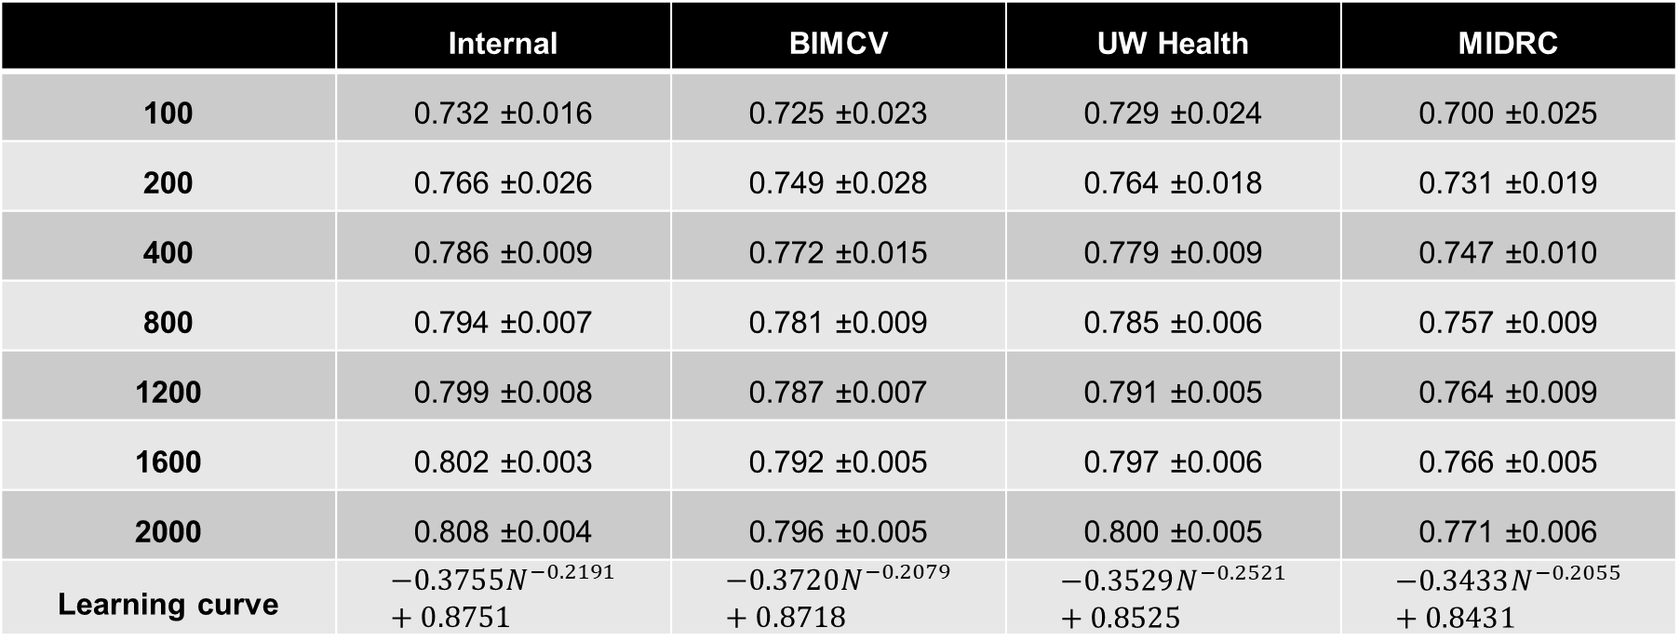
AUC vs training data size
 | Internal | BIMCV | UW Health | MIDRC
100 | 0.732 ±0.016 | 0.725 ±0.023 | 0.729 ±0.024 | 0.700 ±0.025
200 | 0.766 ±0.026 | 0.749 ±0.028 | 0.764 ±0.018 | 0.731 ±0.019
400 | 0.786 ±0.009 | 0.772 ±0.015 | 0.779 ±0.009 | 0.747 ±0.010
800 | 0.794 ±0.007 | 0.781 ±0.009 | 0.785 ±0.006 | 0.757 ±0.009
1200 | 0.799 ±0.008 | 0.787 ±0.007 | 0.791 ±0.005 | 0.764 ±0.009
1600 | 0.802 ±0.003 | 0.792 ±0.005 | 0.797 ±0.006 | 0.766 ±0.005
2000 | 0.808 ±0.004 | 0.796 ±0.005 | 0.800 ±0.005 | 0.771 ±0.006
Learning curve | $$−0.3755N^{−0.2191}+0.8751$$ | $$−0.3720N^{−0.2079}+0.8718$$ | $$−0.3529N^{−0.2521}+0.8525$$ | $$−0.3433N^{−0.2055}+0.8431$$
Notes:
Here are the fitting results.

Slide 11
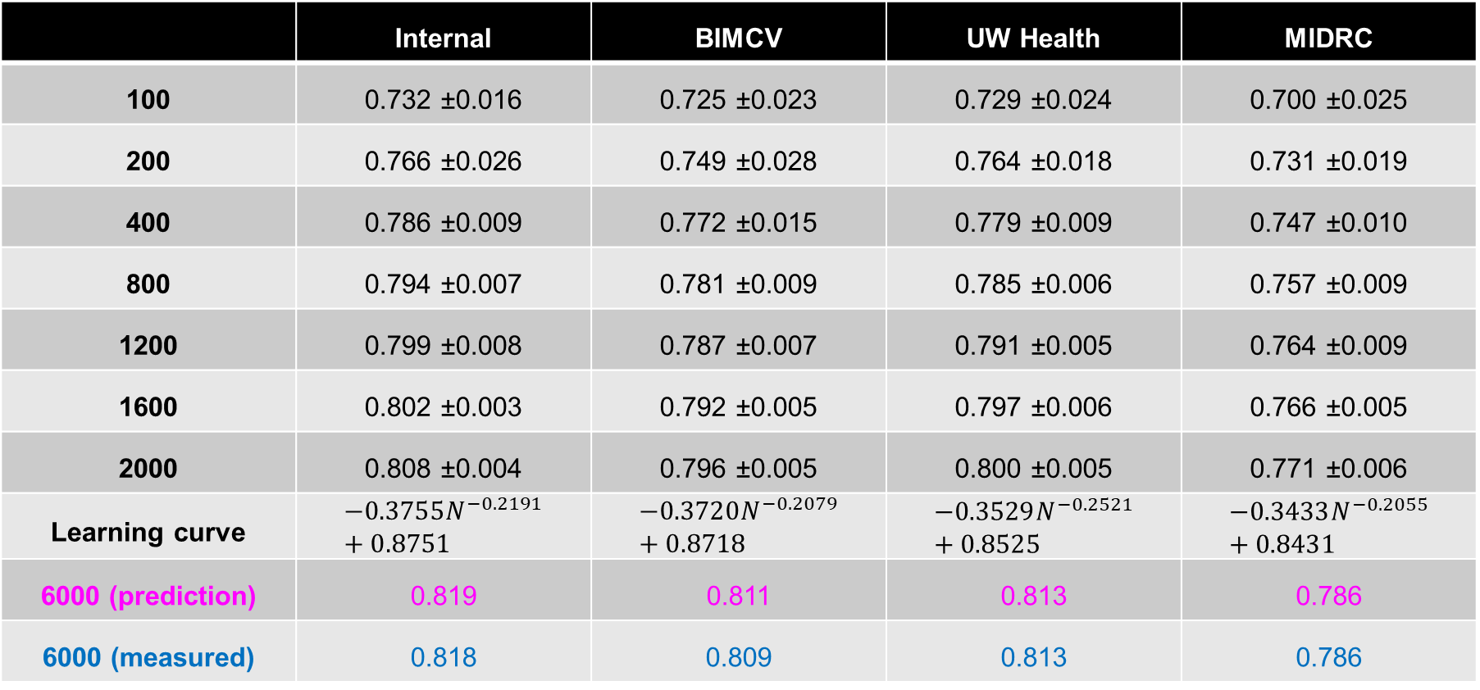
AUC vs training data size
 | Internal | BIMCV | UW Health | MIDRC
100 | 0.732 ±0.016 | 0.725 ±0.023 | 0.729 ±0.024 | 0.700 ±0.025
200 | 0.766 ±0.026 | 0.749 ±0.028 | 0.764 ±0.018 | 0.731 ±0.019
400 | 0.786 ±0.009 | 0.772 ±0.015 | 0.779 ±0.009 | 0.747 ±0.010
800 | 0.794 ±0.007 | 0.781 ±0.009 | 0.785 ±0.006 | 0.757 ±0.009
1200 | 0.799 ±0.008 | 0.787 ±0.007 | 0.791 ±0.005 | 0.764 ±0.009
1600 | 0.802 ±0.003 | 0.792 ±0.005 | 0.797 ±0.006 | 0.766 ±0.005
2000 | 0.808 ±0.004 | 0.796 ±0.005 | 0.800 ±0.005 | 0.771 ±0.006
Learning curve | $$−0.3755N^{−0.2191}+0.8751$$ | $$−0.3720N^{−0.2079}+0.8718$$ | $$−0.3529N^{−0.2521}+0.8525$$ | $$−0.3433N^{−0.2055}+0.8431$$
6000 (prediction) | 0.819 | 0.811 | 0.813 | 0.786
6000 (measured) | 0.818 | 0.809 | 0.813 | 0.786
Notes:
Based on this learning curve, we can get the predicted AUC when data size is increased to 6000. We can see that they match well with the measured values.

Slide 12
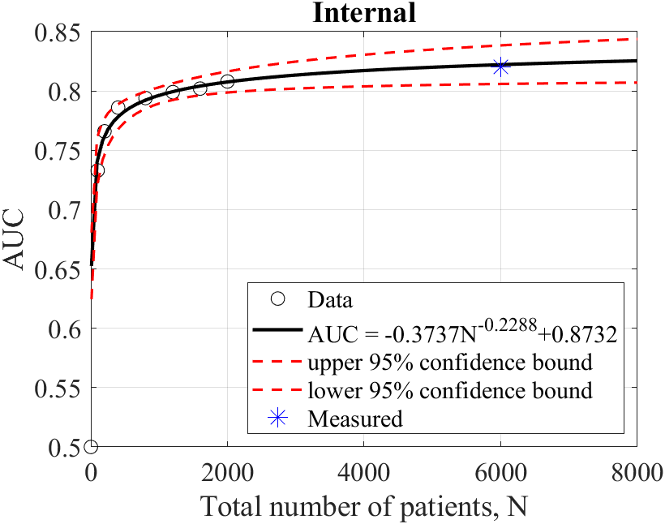
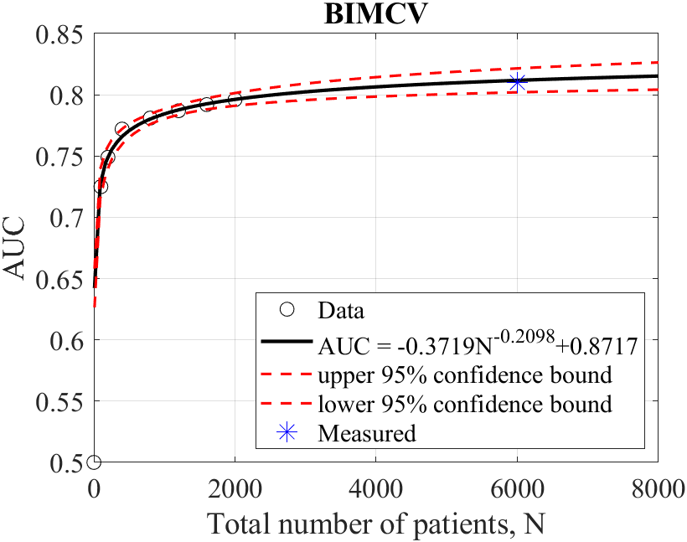
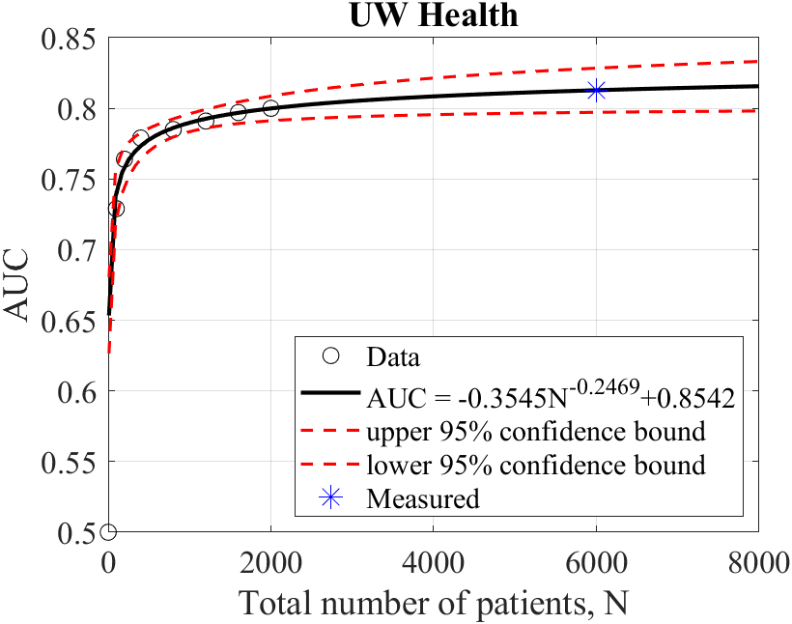
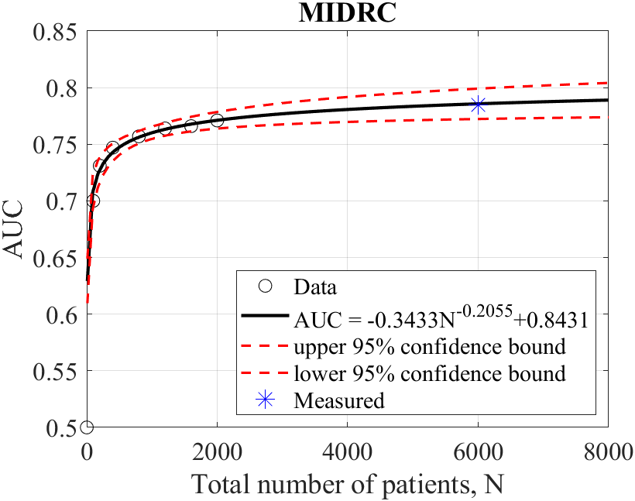
AUC vs training data size
To boost AUC from 0.81 to 0.83 on the UW dataset requires an increase of N from 6,000 to 100,000
Small training datasets (~100 patients) can be used to develop a baseline model with good initial performance
Notes:
So if we look at these learning curves. While the performance may be increasing as we get more and more data, the benefit of adding more data to your training is actually diminishing.
On the other hand, we see that even with a small dataset of 100 patients, as long as the data quality is good, the model can already have a pretty good baseline performance, and this performance is also generalizable across different external test datasets.
In this sense, the generalization performance of a model is not dependent on the data size, but rather on the data quality.

Slide 13
Important lessons learned
Data quality >> data size
Model trained using well-curated data from a single clinical site can generalize to other sites
A small, high-quality training dataset can provide a decent baseline
Notes:
To summarize, data quality is more important than data size.
Models trained using well-curated data from a single clinical site can generalize to other sites.
Even with a small training dataset, we can already generate a decent baseline model with good generalization performance.

Slide 14

Thank You
e
University of Wisconsin-Madison

