Slide 1
POMODORO APP
BY XTINA PARK
REACT JS, styled-components, react-hook-form, react-confetti, use-sound

Slide 2

timeLeft $≥0$
POMODORO APP
Minutes: ____________
BEGIN
:
01
minutes
25
seconds
RESET
Green = App; owns timeLeft and isPaused.
Gold = Form; modifies timeLeft and isPaused.
Pink = Timer; composed of Blocks; uses timeLeft, isPaused and modifies both.
Blue = Block; uses minutes or seconds, whichever is passed in as a prop from Timer.
XTINA PARK
Notes:
isLive will be set by the clock, which keeps track of the difference between the current time and the campaign start date. The campaign will be between September 21 and November 30!
Weeks, days, hours, minutes, and seconds also included in state and passed into the blocks as params.

Slide 3

timeLeft $<0$
POMODORO APP
Minutes: ____________
BEGIN
*CONFETTI ANIMATION USING 'react-confetti'
RESET
You have finished your Pomodoro! You can choose to keep working, or to take a short break!
Green = App; owns timeLeft.
Gold = Form; modifies timeLeft
Purple = Finished; displays when timeLeft <0, uses setTimeLeft to reset timeLeft to zero when the reset button is used.
XTINA PARK
Notes:
isLive will be set by the clock, which keeps track of the difference between the current time and the campaign start date. The campaign will be between September 21 and November 30!
Weeks, days, hours, minutes, and seconds also included in state and passed into the blocks as params.

Slide 4

useRef & useEffect
Friends forever, like Patrick and SpongeBob.
XTINA PARK

Slide 5
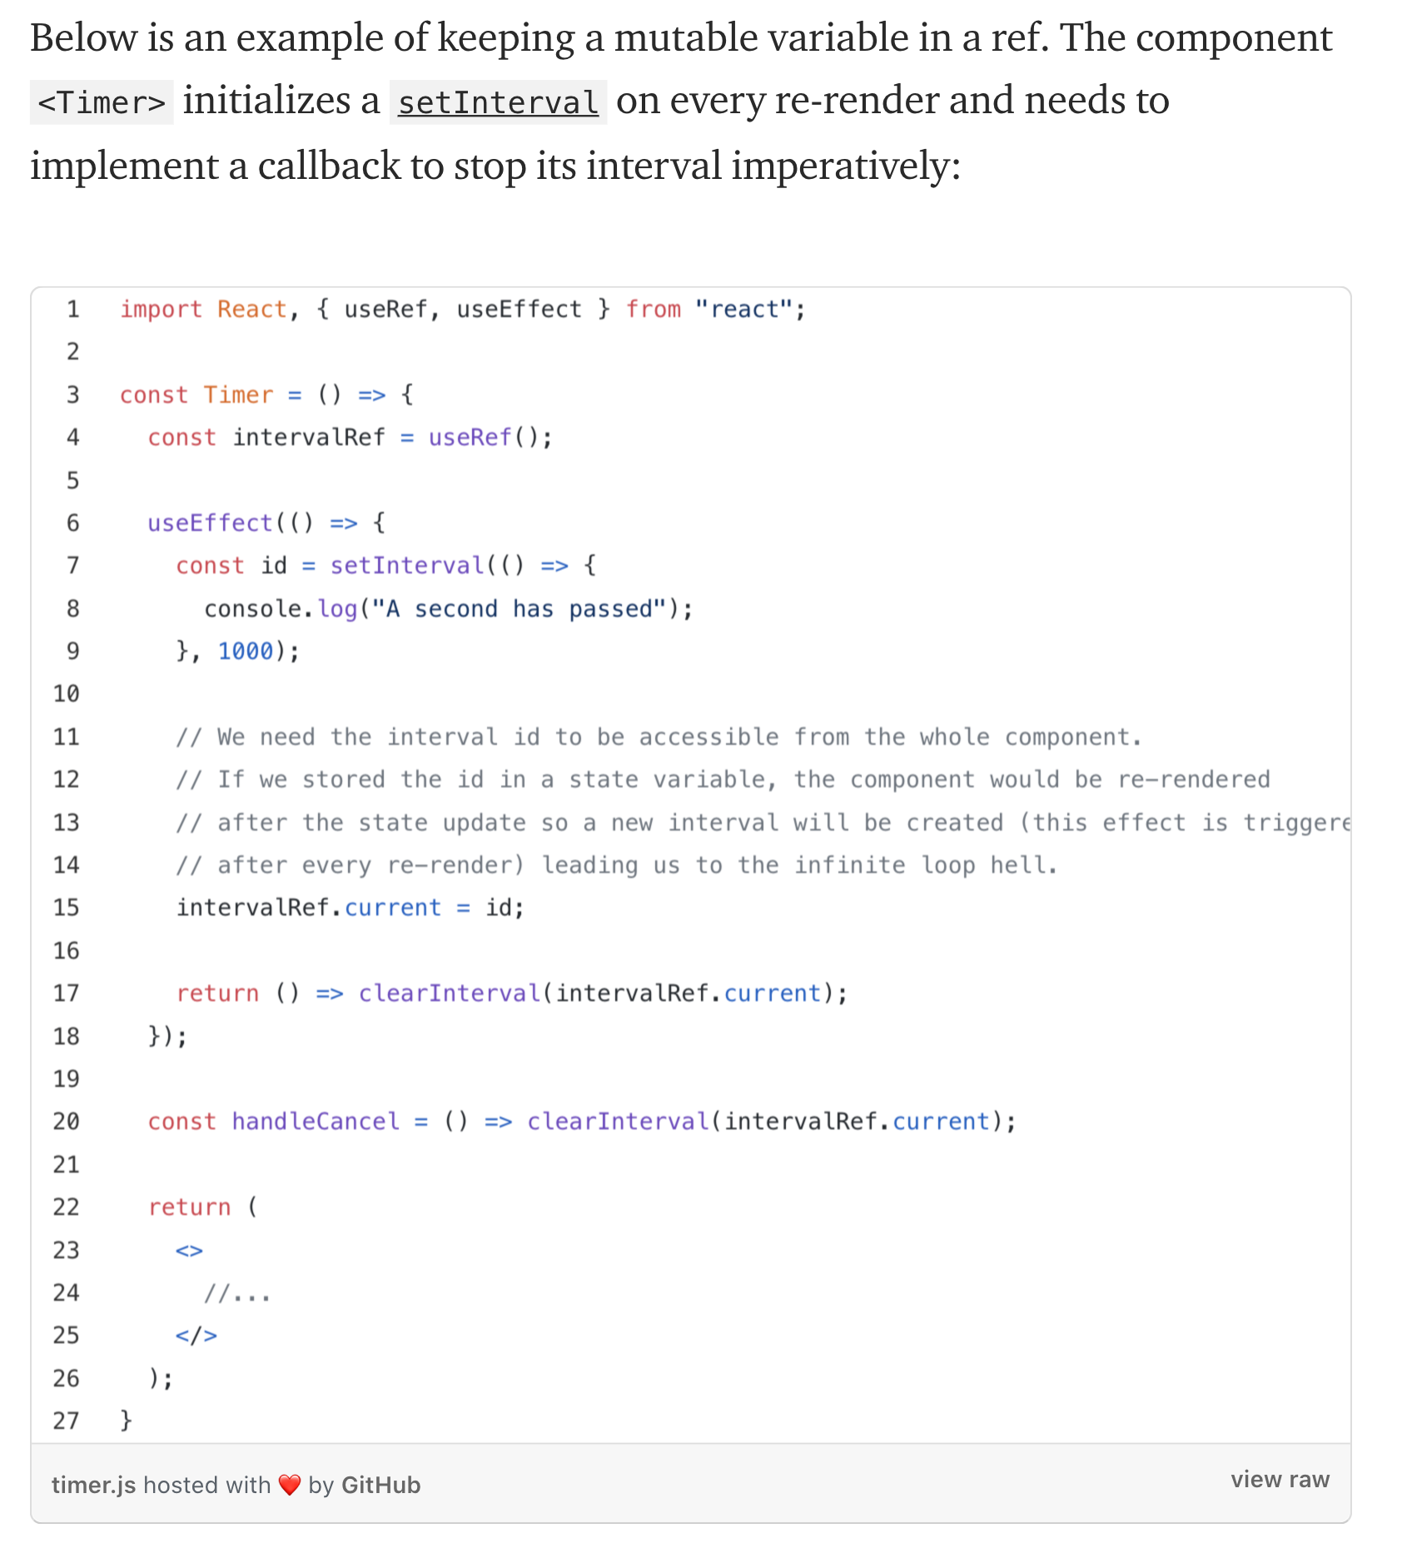
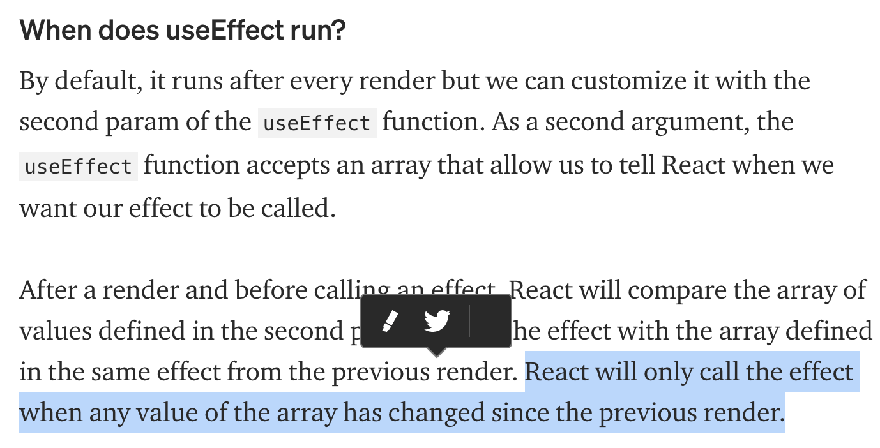
Example of useRef, useEffect, and setInterval
Source: https://medium.com/trabe/react-useref-hook-b6c9d39e2022
XTINA PARK
Author: Ceci García García

Slide 6
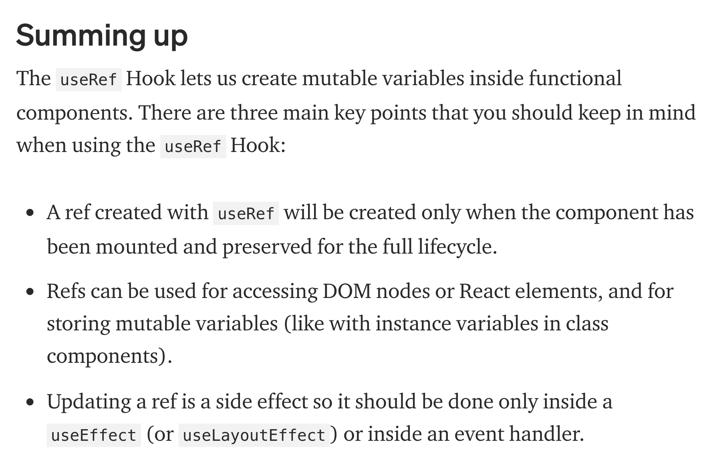
UseRef notes cont’d
Source: https://medium.com/trabe/react-useref-hook-b6c9d39e2022
XTINA PARK
Author: Ceci García García

Slide 7

useForm
AKA React Hook Form, the easiest way to handle user input!
XTINA PARK

Slide 8
UseForm (1/2)
import { useForm } from "react-hook-form";
function Form({submitForm}) {
const { register, handleSubmit, errors } = useForm();
const onSubmit = data => {
console.log(data); submitForm();
};
[…]
XTINA PARK

Slide 9
UseForm (2/2)
return (<div align=’center’>
<form onSubmit={handleSubmit(onSubmit)} noValidate id=“pomodoro-form"> …
<input
type=”number" name=”minutes” id=”minutes-input”
ref={register({
required: {value: true, message: ”Please enter the number of minutes …"},
min: {value: .01, message: "Please enter a number between .01 and 100."},
max: {value: 100, message: "Please enter number between .01 and 100."},
})}
/>
<input type="submit"/>
{errors.minutes && <p>{errors.minutes.message}</p>}
</form>
</div>)
}
XTINA PARK

Slide 10

Random Snippets I Know I Will Forget
“Pride is not the opposite of shame, but its source. True humility is the only antidote to shame.” — Uncle Iroh
XTINA PARK

Slide 11
IMPORTS
import { useForm } from "react-hook-form";
import * as $ from 'jquery’;
import Confetti from 'react-confetti’;
import useSound from 'use-sound’;
XTINA PARK

Slide 12
STYLING:
display:flex;
justify-content: center;
margin/padding: top-bottom left-right; ^Four inputs = clockwise from top
text-shadow: 2px 2px grey;
XTINA PARK

Slide 13
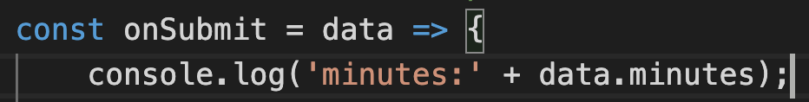
OTHER:
Math.floor()
$('#pomodoro-form').trigger("reset");
Remember to pass data to onSubmit:
let width=window.innerWidth;
<Confetti width={width}/>
const [play] = useSound(ObjectName, { volume: .25 });
XTINA PARK

