Slide 1

AI CREATOR TOOLS · KAJABI
Creator Studio
Turning one piece of creator content into an editable marketing funnel —
Kajabi’s first monetized AI-generation product.
Christine Noh · Lead Product Designer · Feb 2023 – Apr 2024
CPO interview walkthrough
Notes:
Open: walk Creator Studio — first monetized AI product. Focus on problem, three bets, outcomes.

Slide 2

OVERVIEW
Agenda
01
Problem & opportunity
Why earn = stay, and why marketing was the wedge
02
My role
Lead designer 0→1 through GA; strategy + DS ownership
03
Three product bets
Prove clips → expand to funnel → rebuild for scale
04
Outcome & honesty
What we measured — and what we didn’t claim
05
Reflection
What I’d change, and how I partner beyond pixels
Creator Studio · Christine Noh
2 / 11
Notes:
~12–15 min speaking + discussion.

Slide 3
ROLE & COLLABORATION
What I owned vs. what I co-led
Lead Product Designer · 0→1 through GA · team of 11
OWNED
CO-LED
CONSTRAINT
• End-to-end UX, pre-beta → GA
• Assistive AI principle — creators edit every output
• Kajabi’s first AI Design System patterns
• Product strategy with PM & PMM
• Research direction and the funnel pivot
• Pricing — first AI-generation NRR line
• No DS or code precedent
• Vendor-capped video stack (Pictory)
• Mid-flight re-scope without stalling the team
Creator Studio · Christine Noh
03 / 12
Notes:
Seniority story: owned craft + AI principle + DS; co-led strategy/pricing; constraints explain the three bets.

Slide 4
ROLE & COLLABORATION
Lead Product Designer
End-to-end on a net-new product line — pre-beta through GA
Owned
Co-led
Team of 11
• End-to-end UX across phases
• Assistive AI principle — editable, never autonomous
• Kajabi’s first AI Design System patterns
• Creator sessions alongside Research
• Strategy with PM & PMM
• Roadmap + mid-flight scope pivot
• 4 research studies
• Pricing / first AI-generation NRR line
• 1 designer (me)
• 1 PM · 1 PMM
• 2 researchers
• 5 eng · 1 QA
Creator Studio · Christine Noh
3 / 11
Notes:
Strategy, pricing, research, reusable AI patterns — not only screens.

Slide 5
BUSINESS CONTEXT
Earn = stay
Non-earners drove churn. Marketing confidence — not ambition — was the gap.
70%
~60%
8+ hrs
65%
of churned creators never earned
not highly confident in marketing
to build a funnel even with templates
lower churn with 1 contact / 30 days
User — can’t convert audience → contacts/revenue; too many tools (Canva, ChatGPT, Descript…)
Business — shrink unprofitable churn; new NRR line; keep marketing spend inside Kajabi
Demand — 10.5k waitlist before we charged for anything
Creator Studio · Christine Noh
4 / 11
Notes:
CPO hook: retention + NRR. Unlock rich content they already had.

Slide 6
THESIS
The product bet
Turn one existing asset into an editable marketing funnel —
AI as a tool creators tweak, never the final author.
• Assistive, not autonomous — every AI output can be edited, removed, or rebuilt
• Context beats prompting — start from their footage and voice, not a blank prompt
• Validate → expand → harden — clips first, then funnel, then economics for GA
Creator Studio · Christine Noh
5 / 11
Notes:
North star for the three bets that follow.

Slide 7
DECISIONS
How we sequenced the bets
01 · Pre-beta
02 · Beta
03 · GA
Prove repurposing
Become the funnel
Scale the stack
Video → social clips
Build-vs-buy: Pictory + GPT
Narrow scope, fast learning
37+ media types
YouTube import
First paid AI add-on
Pictory → Picsart
Adobe Express editing
Status for long AI jobs
Creator Studio · Christine Noh
6 / 11
Notes:
Learning loops. Each phase responded to findings.

Slide 8
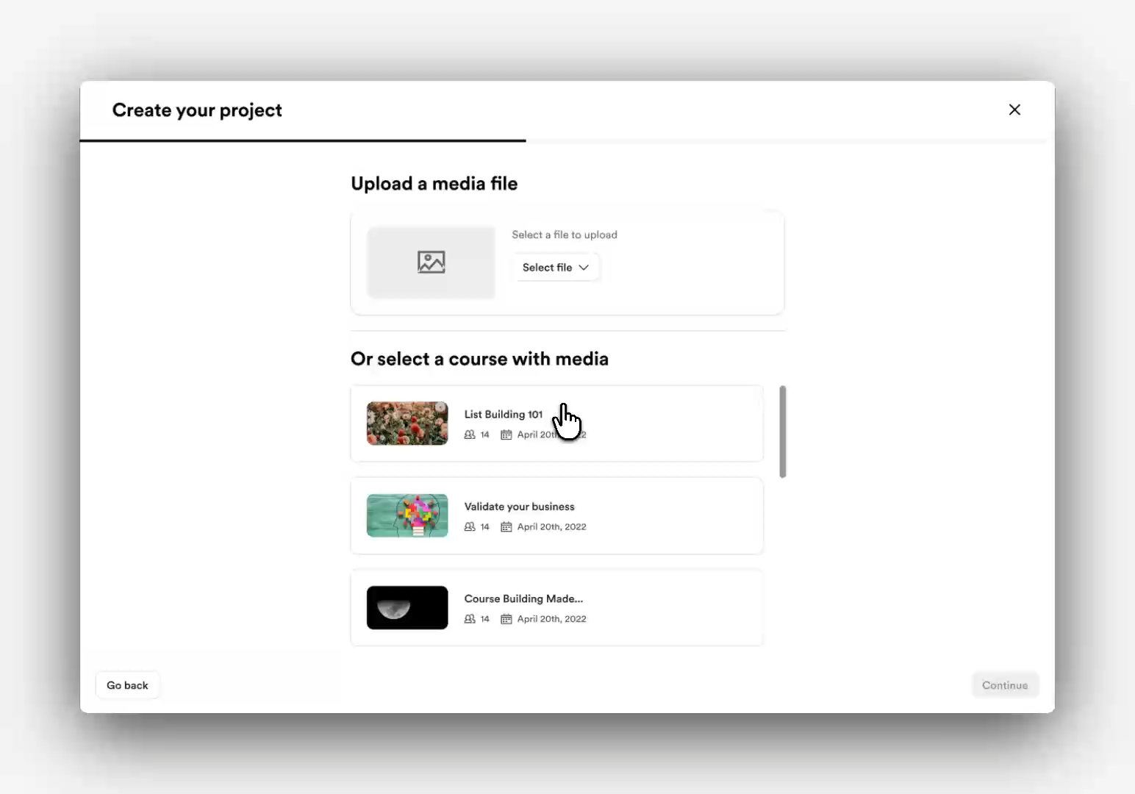
01 · PRE-BETA
Start narrow
Prove creators will repurpose what they already have — clips only.
• Call — Pictory + ChatGPT for platform-sized clips
• Tradeoff — less engine control; weeks, not quarters
• Findings — repurposing worked; a clip was too small
Creators asked for the whole funnel, YouTube import, fast course search — and to move the business, not just the workflow.
Creator Studio · Christine Noh
7 / 11
Notes:
Build-vs-buy. Findings forced the pivot.

Slide 9
02 · BETA
Expand to the funnel
Marketing is a funnel, not a format.
REJECTED
SHIPPED
Deepen the clip tool
Become the marketing product
Richer editor · more crops · stay in “repurpose for social.”
Why not: a better clip still left creators with nothing to send.
37+ funnel media types · YouTube import · pricing/add-on.
Why: matched how creators earn — and what Kajabi needed for NRR.
Disagreement: eng/product could deepen clips. I argued the empty funnel was the business problem.
Pricing as design: 1 free project/mo → Basic $9 / Premium $29 — prove willingness to pay before GA.
Creator Studio · Christine Noh
8 / 11
Notes:
Strongest product-sense + conflict story.

Slide 10
03 · GA
Rebuild underneath for scale
Demand was proven. Editing depth, status, and vendor cost weren’t ready.
01
Pictory → Picsart + GPT-4 highlights
Unit economics + better clip intelligence
02
Adobe Express in-product
Creators asked for real editing — partner, don’t underbuild
03
Async status for 37+ jobs
Long AI work is a design problem: progress, error, retry
Creator Studio · Christine Noh
9 / 11
Notes:
Heavier migration vs patching — patching capped GA.

Slide 11
OUTCOME
GA · Mar 13, 2024
Kajabi’s first monetized AI-generation product
131
17.2k
43%
paid add-on users in ~2 weeks
109% of March goal
marketing assets from
3.3k users · 3.8k projects
of beta replaced tools like
Descript, Canva, CastMagic
Impact closure
Measured: paid adoption, assets, tool replacement · Aimed at ~$650k annualized NRR
Not claimed: churn / contacts / GMV lift only from Creator Studio
Next: prove generation → contact → purchase; judge revenue by usage, not just purchase
Creator Studio · Christine Noh
10 / 11
Notes:
Honesty on non-claims builds CPO trust.

Slide 12
REFLECTION
What I’d carry forward
What worked
What I’d change
• Trusted rich inputs over blank prompts
• Listened after pre-beta — clip → funnel
• Treated pricing & vendor cost as design
• Buy/partner to validate fast (Pictory → Adobe)
• Shipped reusable AI DS patterns
• Validate the funnel bet earlier
• Test editing-control needs sooner
• Instrument activation from week one
Happy to go deeper on decisions, craft, AI principles, or how this maps to your product.
Creator Studio · Christine Noh
11 / 11
Notes:
Invite questions.

