Slide 1

AI CREATOR TOOLS · KAJABI
Creator Studio
Breaking the marketing barrier for creators by turning content they already have into full marketing funnels.
Kajabi’s first monetized AI-generation product.
Christine Noh · Lead Product Designer · Feb 2023 – Apr 2024
Notes:
I’ll walk Creator Studio from problem to three bets, then outcome. Interrupt anytime. Lead designer, 0→1 through GA, team of 11.

Slide 2

WHY IT MATTERED
Earn = stay
70%
~60%
8+ hrs
65%
of churned creators
never earned
not highly confident
in marketing
to build a funnel
even with templates
lower churn with
1 contact / 30 days
Creator Studio · Christine Noh · Case study
2 / 12
Notes:
Non-earners drove churn. They knew their craft; marketing stalled them. Contacts are a retention lever. Business problem, not a nice AI feature.

Slide 3
THE BET
One existing asset → an editable marketing funnel
AI they tweak. Never the final author.
Source
AI assist
Funnel out
Course video, YouTube,
PDF, blog…
→
Highlights & drafts
creators can edit
→
Clips, email, social,
landing page…
• Assistive, not autonomous
• Their content in, not a blank prompt
• Prove small → expand → harden for GA
Creator Studio · Christine Noh · Case study
3 / 12
Notes:
Prior Kajabi AI used short prompts. An hour of course video ≈ 12k words in their voice. 10.5k waitlist before we charged.

Slide 4
ROLE & CONSTRAINTS
Lead PD · 0→1 through GA · team of 11
OWNED
CO-LED
CONSTRAINT
• End-to-end UX
• Assistive AI principle
• First AI DS patterns
• Strategy + funnel pivot
• Research direction
• First AI NRR pricing
• No DS / code precedent
• Pictory capped depth
• Mid-flight re-scope
Creator Studio · Christine Noh · Case study
4 / 12
Notes:
Sole designer with PM, PMM, research, eng. AI DS later reused. Constraints forced build-vs-buy (D01) and vendor swap (D03).

Slide 5
WHAT WE KNEW
Research that set the opening bet
01
Marketing is the barrier
Not content creation
02
Start from assets they have
Not blank-page AI
03
They’re paying this stack outside
Descript, Canva, CastMagic…
Creator Studio · Christine Noh · Case study
5 / 12
Notes:
Only ~2 in 5 highly confident marketers. 61% wanted funnel help later. ~9 tools outside. Start with video clips first.

Slide 6
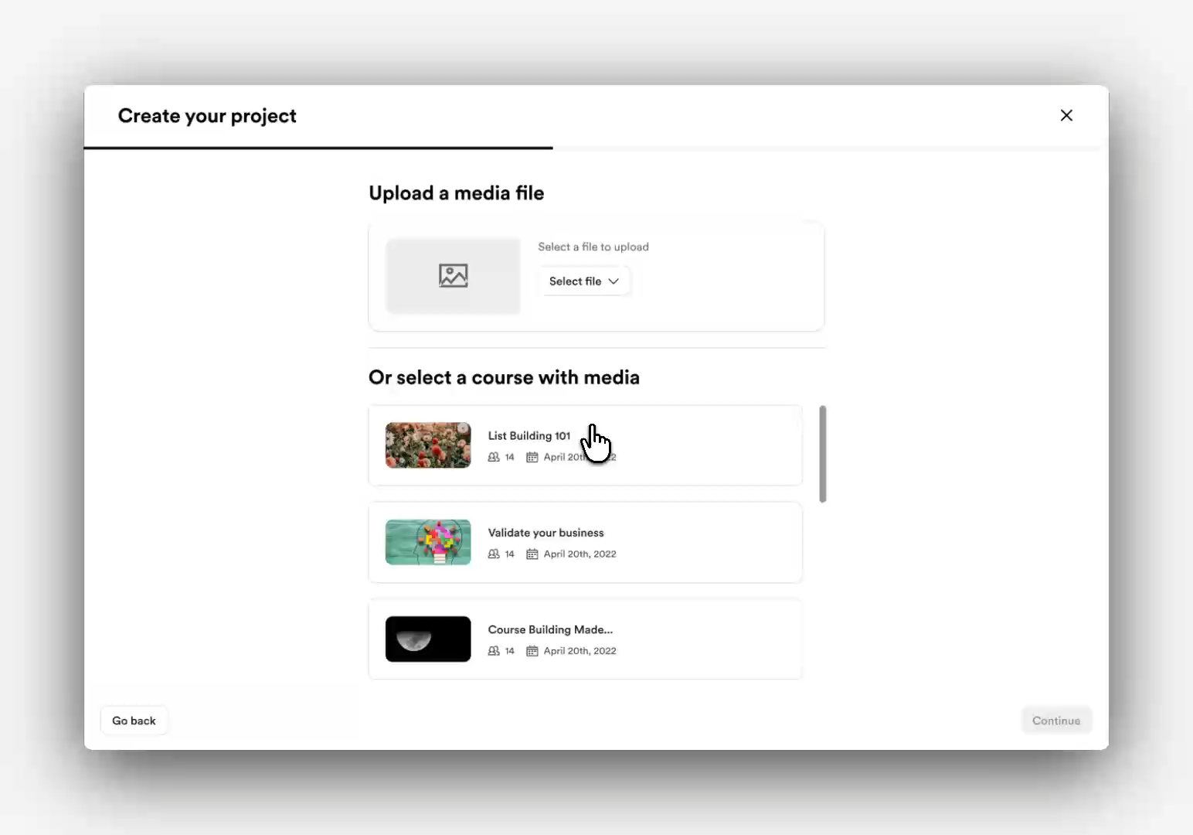
DECISION 01 · PRE-BETA
Prove repurposing on video
Clips only. No funnel yet.
• Call: Pictory + GPT → social-sized clips
• Tradeoff: less engine control, weeks not quarters
• Goal: Will they repurpose what they filmed?
VIDEO · cs-alpha-flow.mp4
Creator Studio · Christine Noh · Case study
6 / 12
Notes:
IG, FB, TikTok, LI, YT. Build-vs-buy. Upload, highlights, edit, syndication.

Slide 7

THE TURN
Repurposing worked.
A clip wasn’t the job.
Creators asked for the whole funnel · YouTube import · a path to the business,
not a nicer editor.
Notes:
Post–pre-beta sessions. 61% funnel demand. Best footage on YouTube. Empty funnel = real problem. I pushed to change the product job.

Slide 8
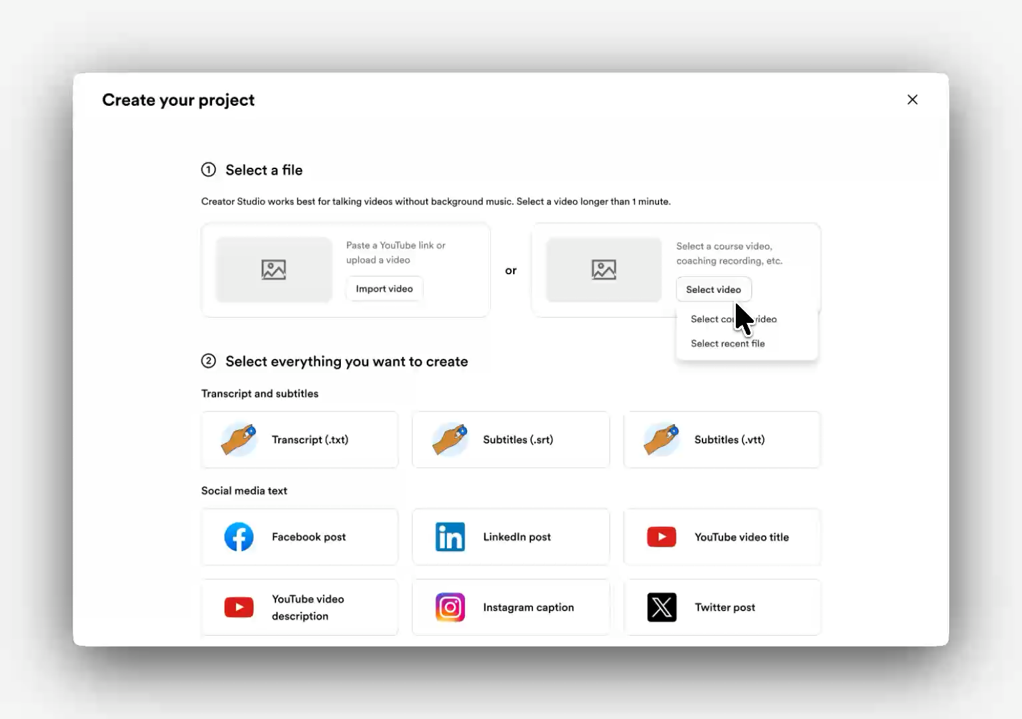
DECISION 02 · BETA
Marketing is a funnel, not a format
REJECTED
SHIPPED
Deepen the clip tool
37+ types · YouTube · paid add-on
A better clip still left an empty funnel.
I argued: empty funnel = the business problem.
VIDEO
cs-beta-flow.mp4
MEDIA PLACEHOLDER
STILL: cs-d2-media-types
+ cs-d2-youtube
37+ types · YouTube import
Creator Studio · Christine Noh · Case study
8 / 12
Notes:
Pricing: 1 free/mo, $9 / $29. Framed vs tools they bought. YouTube from sessions.

Slide 9
DECISION 03 · GA
Demand proven. Stack couldn’t scale.
01
Pictory → Picsart + GPT-4
MEDIA PLACEHOLDER
Cost + clip intelligence
IMAGE: cs-ga-picsart
02
Adobe Express in-product
MEDIA PLACEHOLDER
Real editing control
IMAGE: cs-ga-adobe-edit
03
Status for long AI jobs
MEDIA PLACEHOLDER
Progress, error, retry
IMAGE: cs-ga-status
Creator Studio · Christine Noh · Case study
9 / 12
Notes:
Beta asked for editing, status, lower cost. Migration vs capped GA.

Slide 10
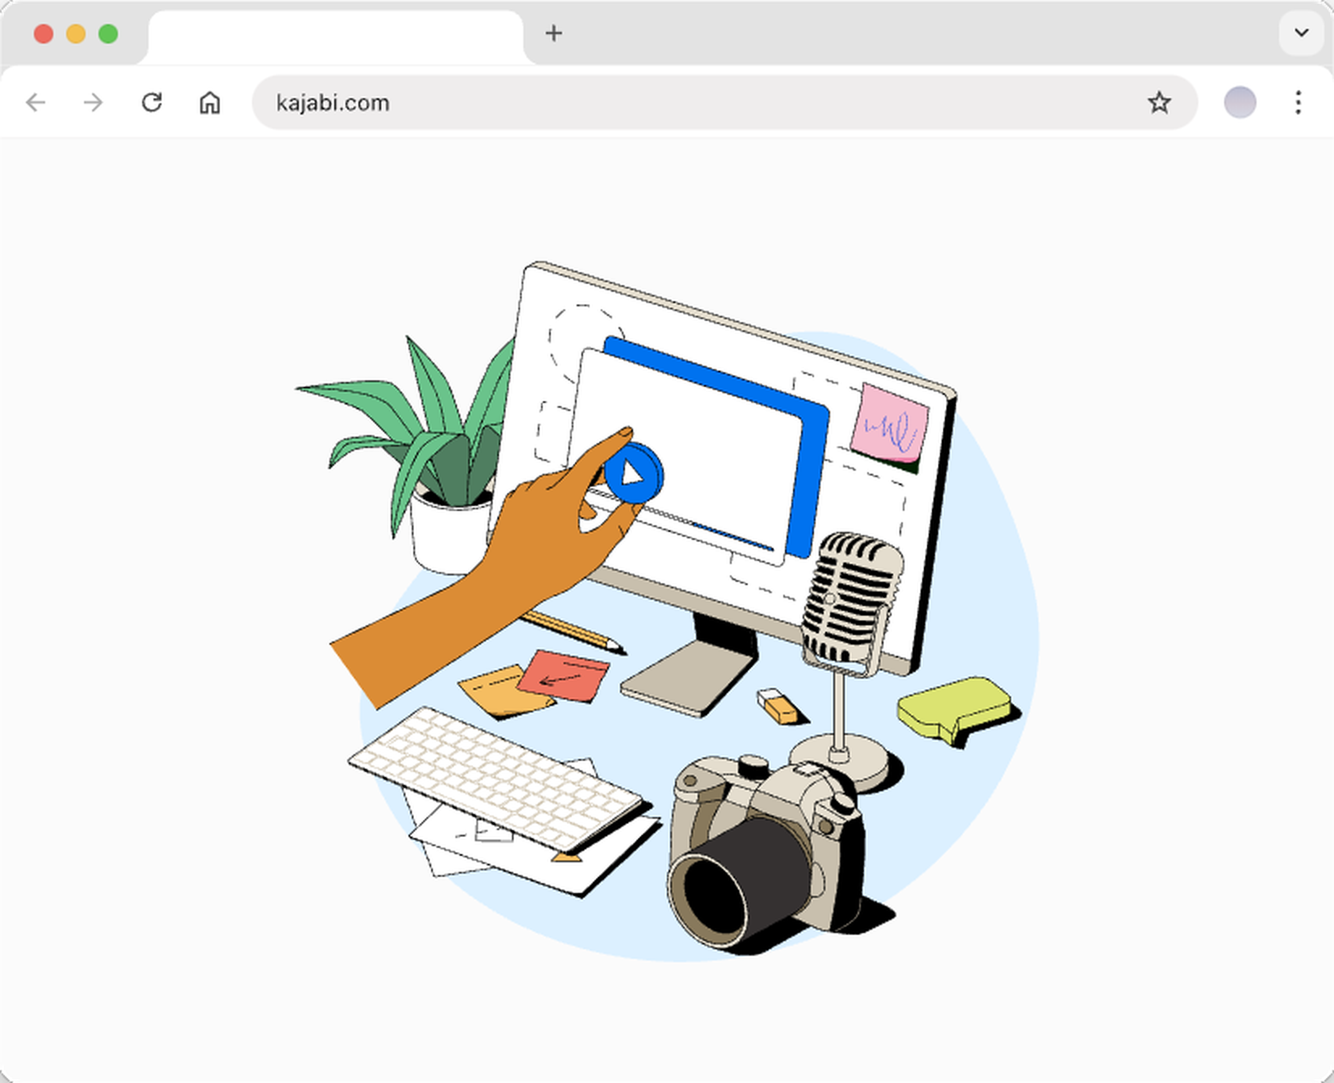
WHAT SHIPPED
One source in. Editable funnel out.
Their video or writing → clips, social, email, landing page, newsletter.
MEDIA PLACEHOLDER
DEMO MOMENT
1. Edit highlight
2. Pick media type
3. Generation status
Talk over — don’t restate thesis
IMAGE · Hero: one source → full funnel chips
Creator Studio · Christine Noh · Case study
10 / 12
Notes:
Walk one path: intake → edit highlight → 37+ → status → Adobe at GA. Patterns reused across Kajabi AI.

Slide 11
OUTCOME
GA · Mar 13, 2024
131
17.2k
43%
paid in ~2 weeks
109% of goal
assets from
3.3k users
of beta replaced
outside tools
Impact closure
Measured: adoption, assets, replacement · ~$650k NRR aim
Not claimed: churn / contacts / GMV from this alone
Next: prove generation → contact → purchase
Creator Studio · Christine Noh · Case study
11 / 12
Notes:
First monetized AI add-on. Honest attribution. Roadmap if asked: syndication, analytics, multi-lang.

Slide 12
REFLECTION
What I’d carry forward
WHAT WORKED
WHAT I’D CHANGE
• Trusted their content
• Pivoted after pre-beta
• Pricing and vendors as design
• Validate the funnel earlier
• Test editing needs sooner
• Measure from week one
Happy to go deeper or map this to your product.
Creator Studio · Christine Noh · Case study
12 / 12
Notes:
If Popl: messy real-world input → enrich/assist → CRM-ready, with human control and clear status. End on their questions.

