Slide 1


IPS/IDS Evasion Techniques
Miroslav Todorović

Slide 2
Agenda
Network Intrusion
IDS/IPS
Network Attacks
IDS/IPS Evasion Techniques
Prototype
Testing

Slide 3
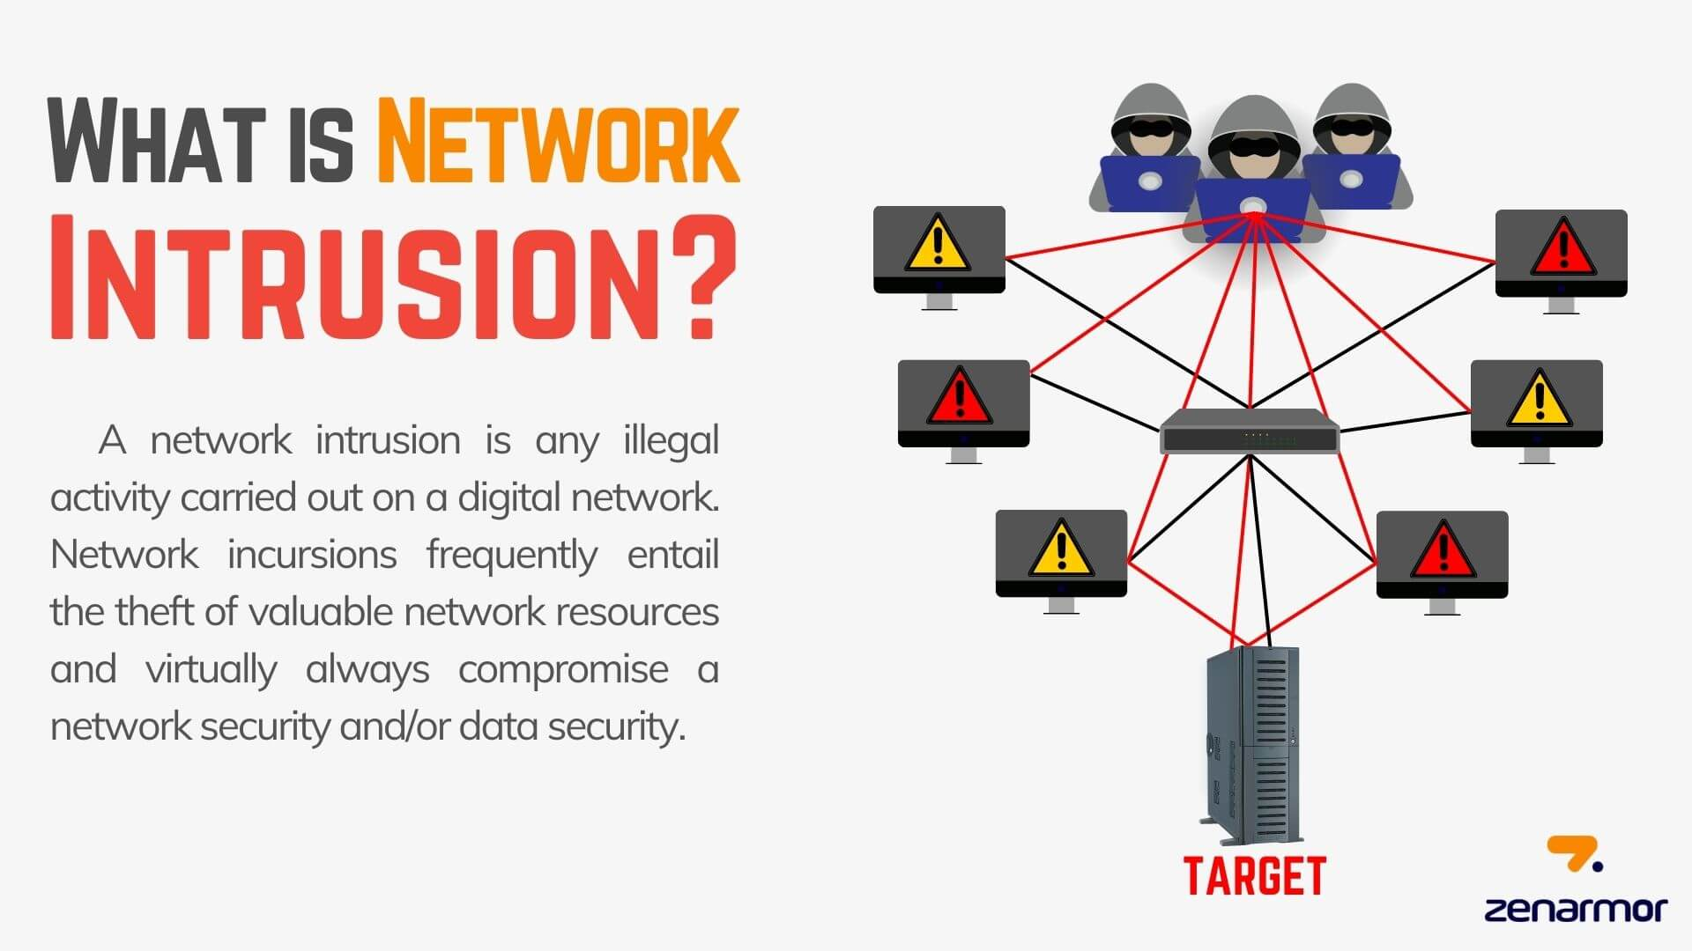

Slide 4
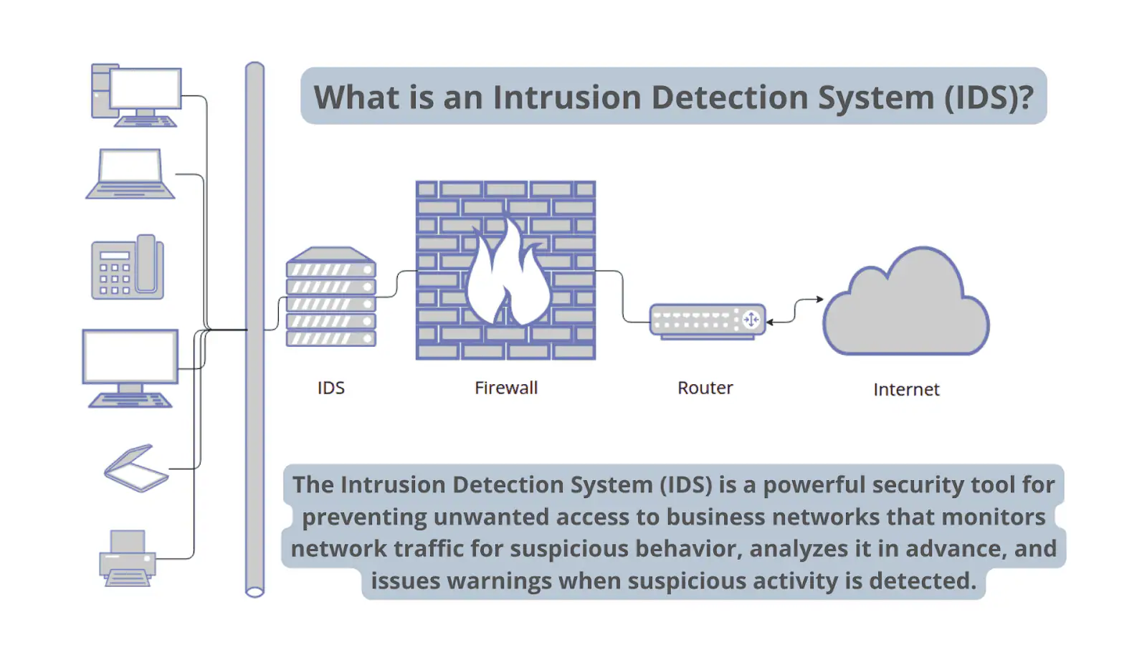

Slide 5
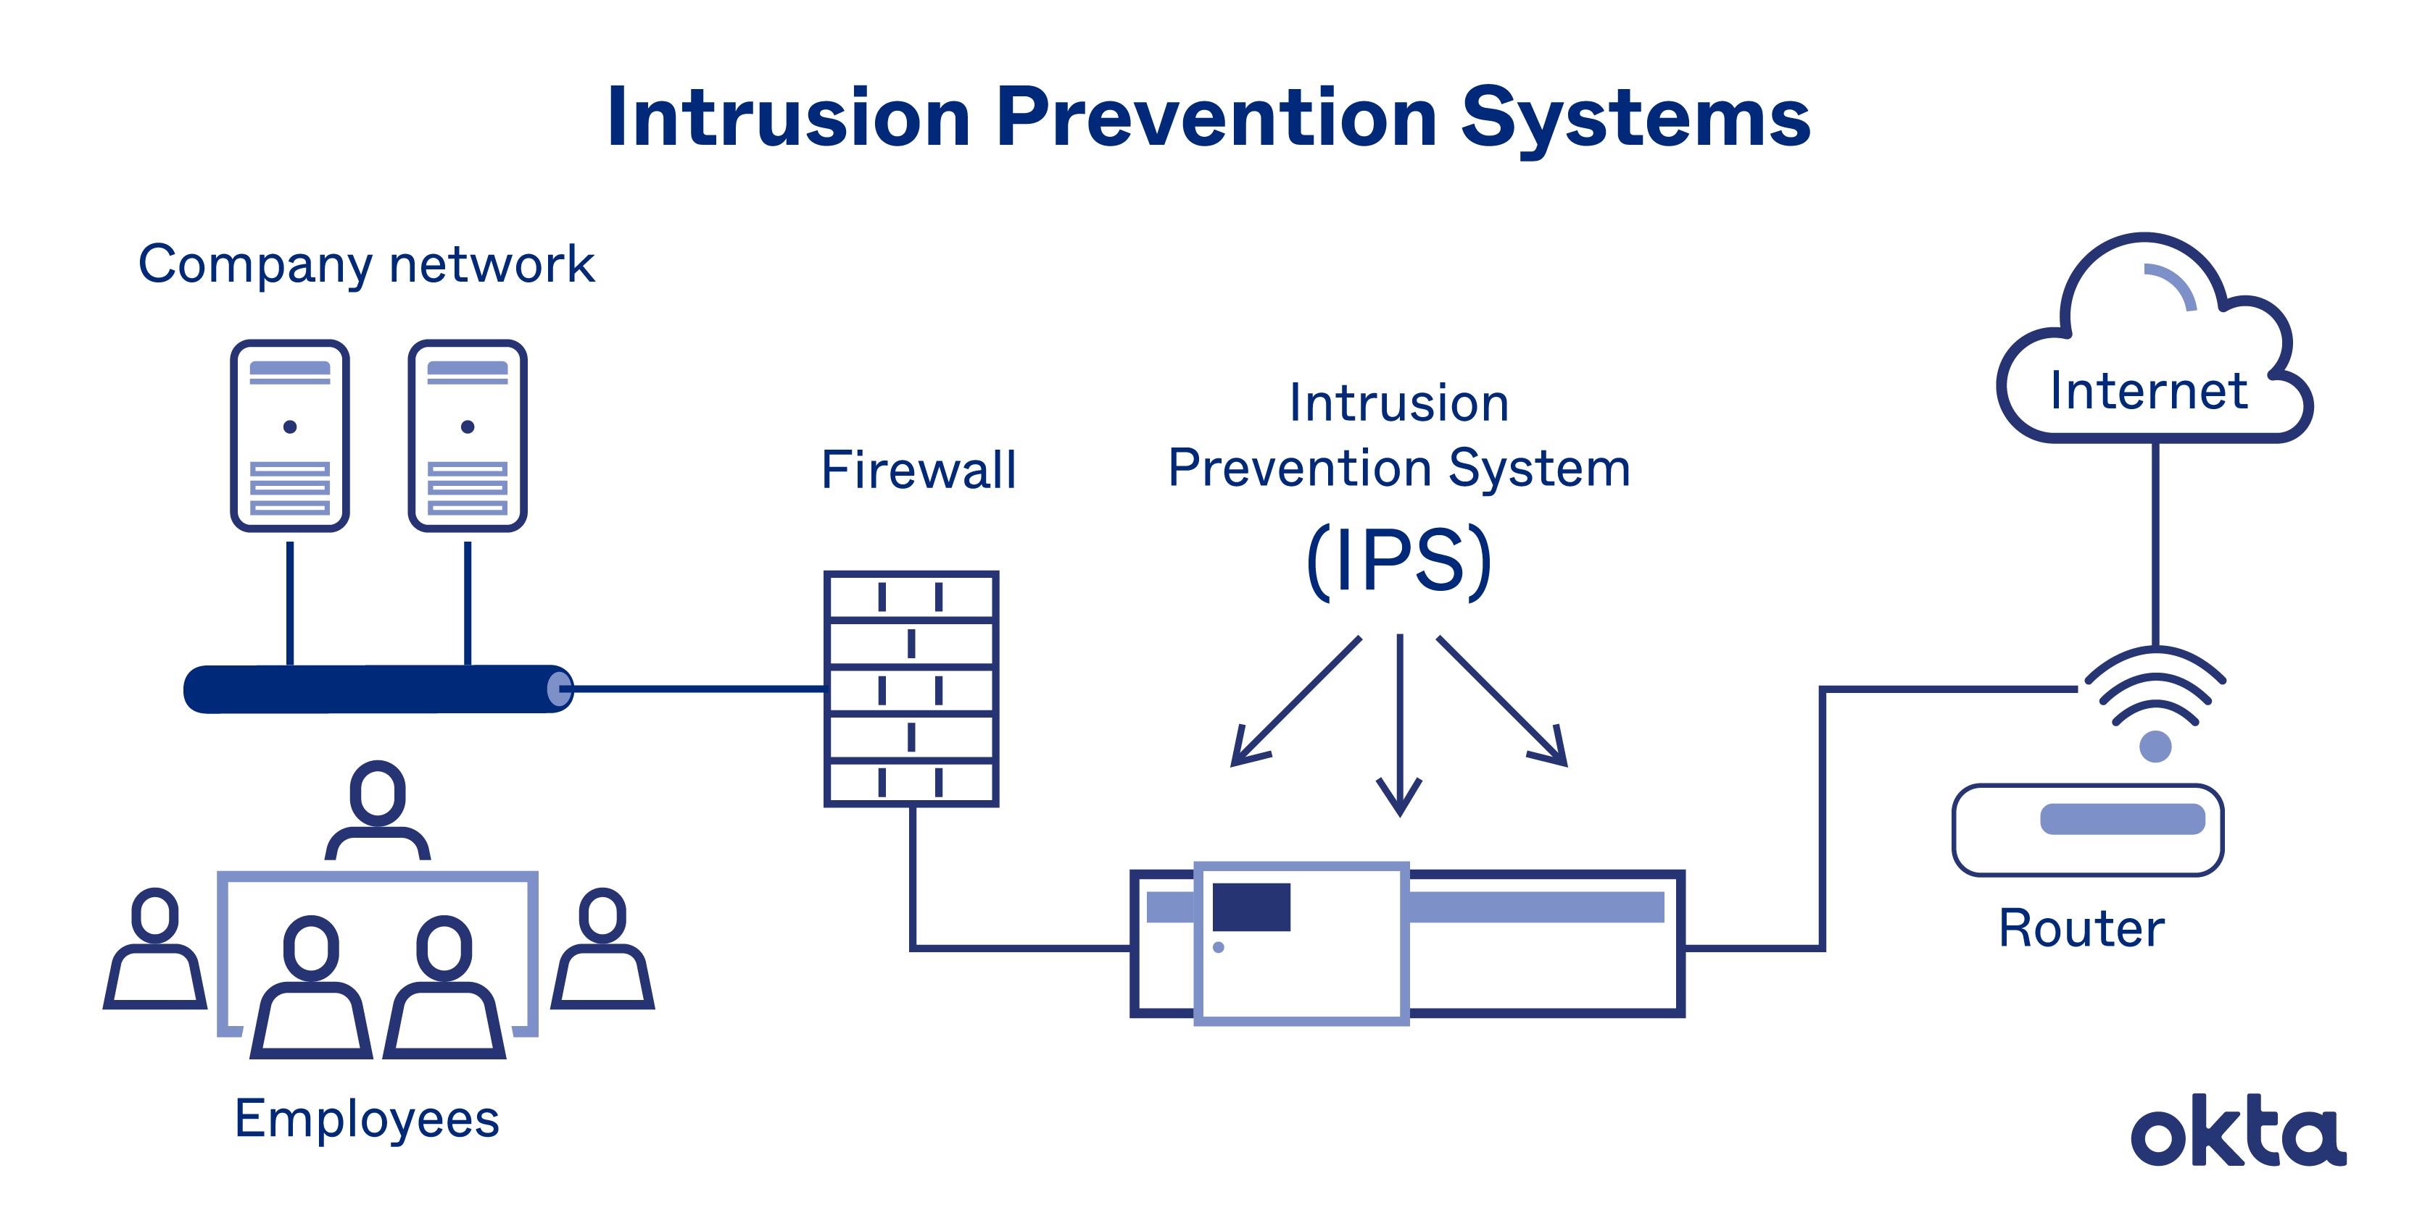

Slide 6
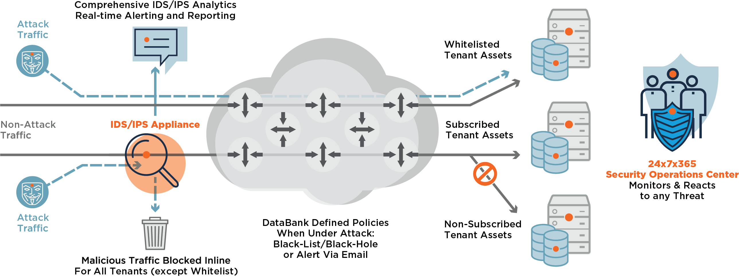

Slide 7
IDS/IPS Evasion Techniques
Packet Fragmentation
SYN/FIN Scanning using IP Fragments
Source Port Manipulation
IP Address Decoy
Spoofing the IP Address
Sending the Bad Checksums

Slide 8
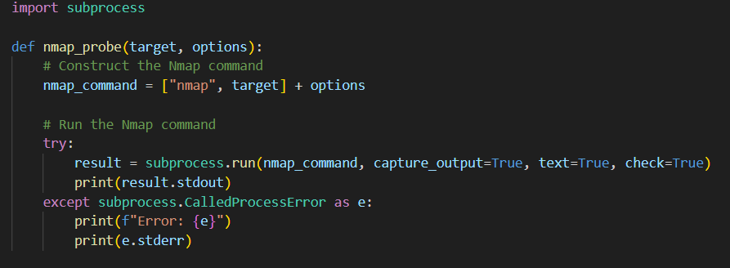
Prototype
Nmap 7.94 + Python

Slide 9
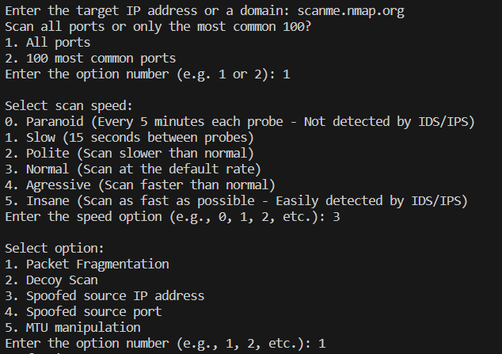

Slide 10
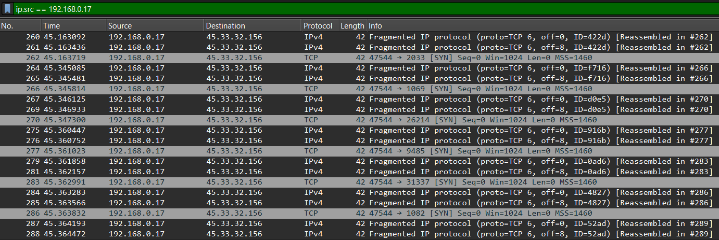
Fragmentation

Slide 11
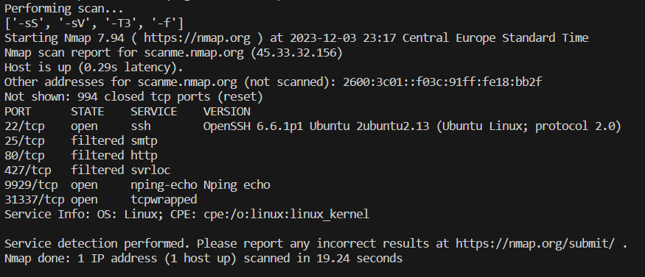

Slide 12
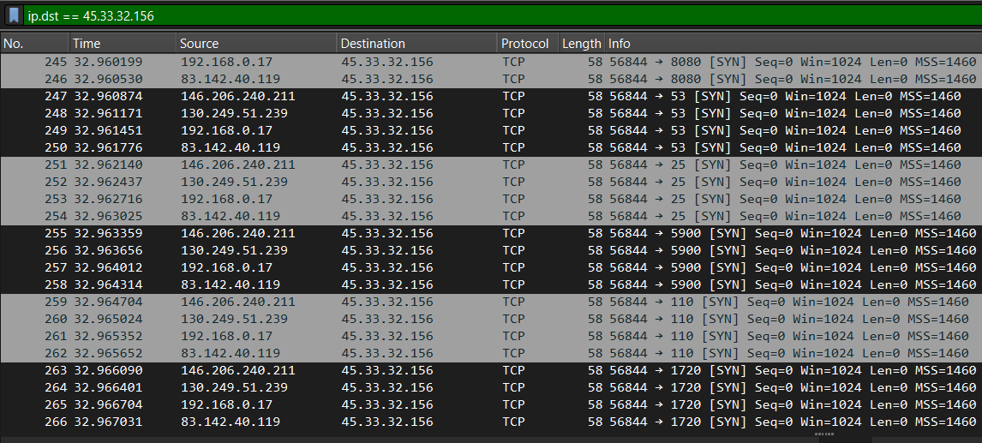
IP Decoy

Slide 13
Conclusion
Intrusion Detection System (IDS)
Intrusion Prevention System (IPS)
IPS/IDS Evasion Techniques
Prototype

