Slide 1

Laser pointer drawing
Let’s speak together 2010
Tomáš Pokorný, Vojtěch Přikryl

Slide 2
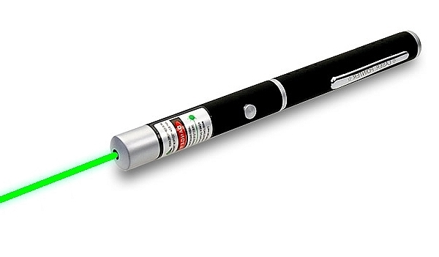
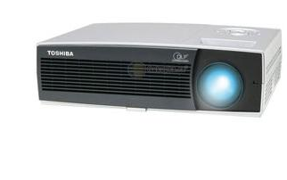
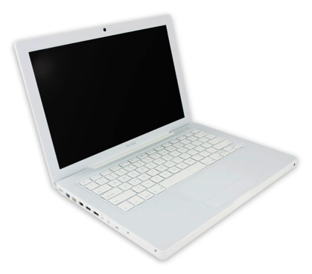
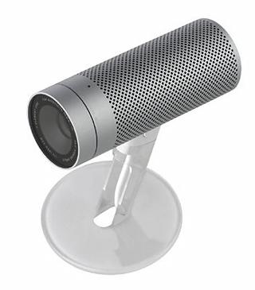
Equipment
camera
projector
computer
laser pointer

Slide 3
Image processing
using framework CocoaSequenceGrabber
finding lightness 5x5 pixels square
  goes pixel by pixel
  throws away pixels of bad color

Slide 4
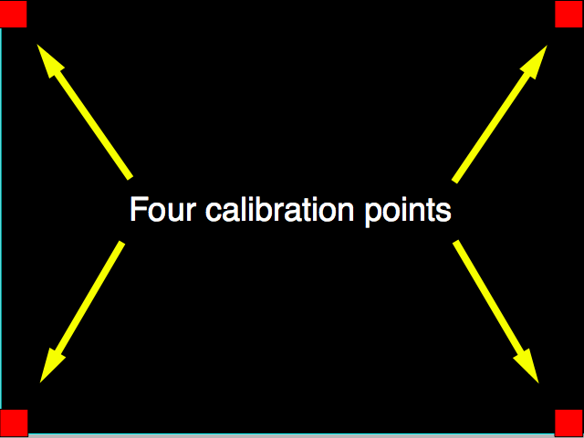
Calibration
determining where in image are corners of screen
sequential showing little square in corners
same finding algorithm
like in image processing

Slide 5
Transformation
the original image is distorted
we need to make rectangle from quadrilateral
various methods with various results

Slide 6
Ratio transformation
ratios of lengths stays kept
generalised in 2 dimensions we get transformation
not so accurate

Slide 7
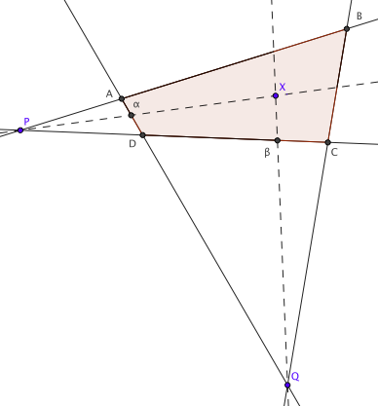
Two point transformation
the best our programmed transformation
opposite sides of the quadrilateral intersects
drawing lines through these points and found points
intersection with sides defines ratios

Slide 8
Graphic transformation
used in first version of project
function in Python image library
very accurate
can’t port it in Objective C

Slide 9
Other transformations
trapezoidal transformation
  easy
  not very accurate
angle transformation
  bad pricipe

Slide 10
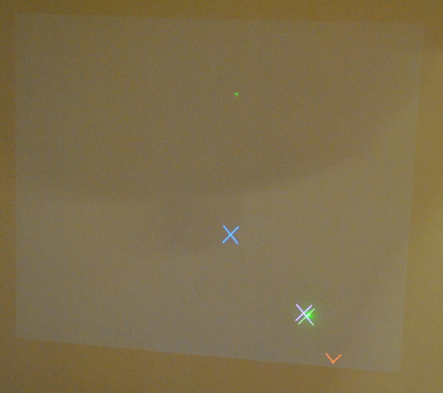
Viewing
using computed ratios
need to use right color
  good visibility
  can’t be determined as laser pointer

