Slide 1

SYSTEM AND NETWORK ENGINEERING MSc
Research Project I
PROTECTING AGAINST RELAY ATTACKS
FORGING INCREASED DISTANCE REPORTS
Xavier Torrent Gorjón
xavier.torrentgorjon@os3.nl
Supervisors:
Paul van Iterson Jordi van den Breekel
vanIterson.Paul@kpmg.nl vandenBreekel.Jordi@kpmg.nl

Slide 2
Summary
Distance-bounding protocols
Feasibility of the attack: study cases
  Autonomous Cars
  Drone MANETs (Mobile Ad-Hoc NETworks)
Limitations of other systems
Preventing increased distance reports
  Behavior verification
  Multiple distance-bounding signals
  Distributed knowledge
Conclusions

Slide 3
Summary
Distance-bounding protocols
Feasibility of the attack: study cases
  Autonomous Cars
  Drone MANETs (Mobile Ad-Hoc NETworks)
Limitations of other systems
Preventing increased distance reports
  Behavior verification
  Multiple distance-bounding signals
  Distributed knowledge
Conclusions

Slide 4


Distance-bounding protocols
With the current implementations, closer distances cannot be faked.
  Proof through physical limitations: cannot go faster than speed of light.
  Need for a shared nonce and fast processing time.
Challenge channel: 1 bit
Response channel 1: 1 bit
Response channel 2: 1 bit
Figure 1: Distance-bounding protocol. Each challenge bit is answered with two bits: one in the communication and another one in the form of channel selection.

Slide 5
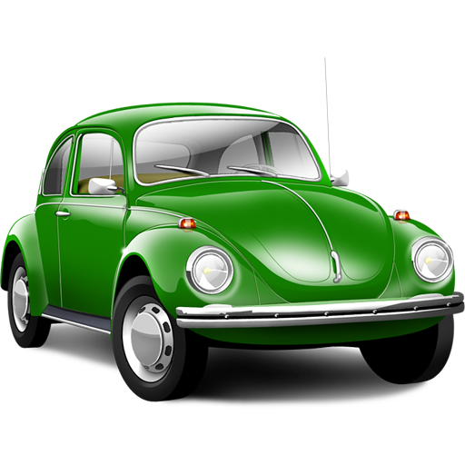

Distance-bounding protocols
Current implementations can be used to prevent a wide range of attacks that attempt to fake decreased distance reports, generally on Access Control Systems.
Figure 2: Distance-bounding protocols can be used to protect Passive Key Entry Systems (PKES).

Slide 6
Distance-bounding protocols
However, current distance-bounding protocols do not prevent increased distance reports.
  Physical limitations cannot be used.
  This leads to our research questions:
    Study the feasibility of relay attacks forging increased distance reports.
    How can these relay attacks be prevented.

Slide 7
Summary
Distance-bounding protocols
Feasibility of the attack: study cases
  Autonomous Cars
  Drone MANETs (Mobile Ad-Hoc NETworks)
Limitations of other systems
Preventing increased distance reports
  Behavior verification
  Multiple distance-bounding signals
  Distributed knowledge
Conclusions

Slide 8
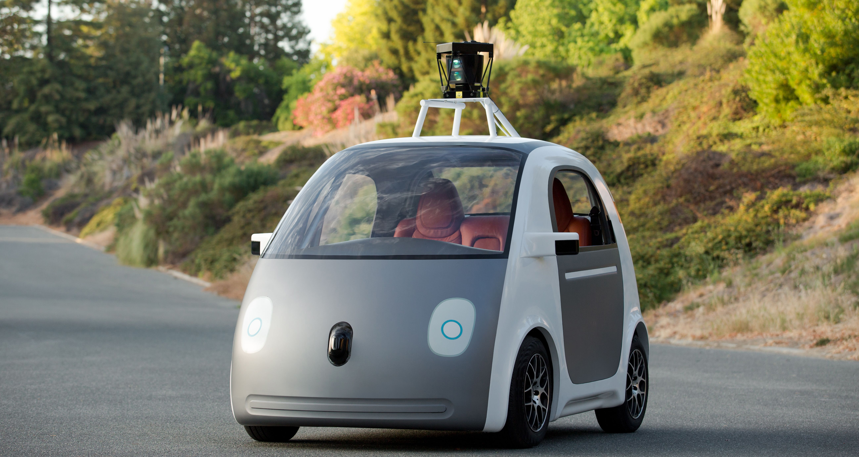
Feasibility of the attack: study cases
Autonomous Cars
  If two cars believe they are further away than they really are, they might crash.
  Other systems might prevent this, but distance-bounding protocols could be an additional safety measure.
Figure 3: An early design of a fully autonomous car by Google.

Slide 9
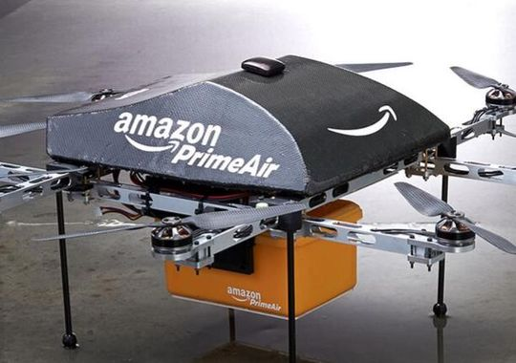
Feasibility of the attack: study cases
Drone MANETs I: Autonomous delivery service
  To save costs, multiple drones could be used to carry large packages.
  Tempering the distance awareness of these drones might cause them to lose equilibrium and fall.
Figure 4: A delivery drone by Amazon.

Slide 10
Feasibility of the attack: study cases
Drone MANETs II: Area surveillance
  Drones can be used to check areas for multiple purposes: military operations, updating maps, searching for lost people...
  Erroneous distance reports can lead to leave areas unexplored.

Slide 11
Summary
Distance-bounding protocols
Feasibility of the attack: study cases
  Autonomous Cars
  Drone MANETs (Mobile Ad-Hoc NETworks)
Limitations of other systems
Preventing increased distance reports
  Behavior verification
  Multiple distance-bounding signals
  Distributed knowledge
Conclusions

Slide 12
Limitations of other systems
It could be argued that distance-bounding protocols were not made for this purpose.
However, other location systems present difficulties as well.

Slide 13
Limitations of other systems
GPS location
Radar detection
Inertial Navigation System

Slide 14
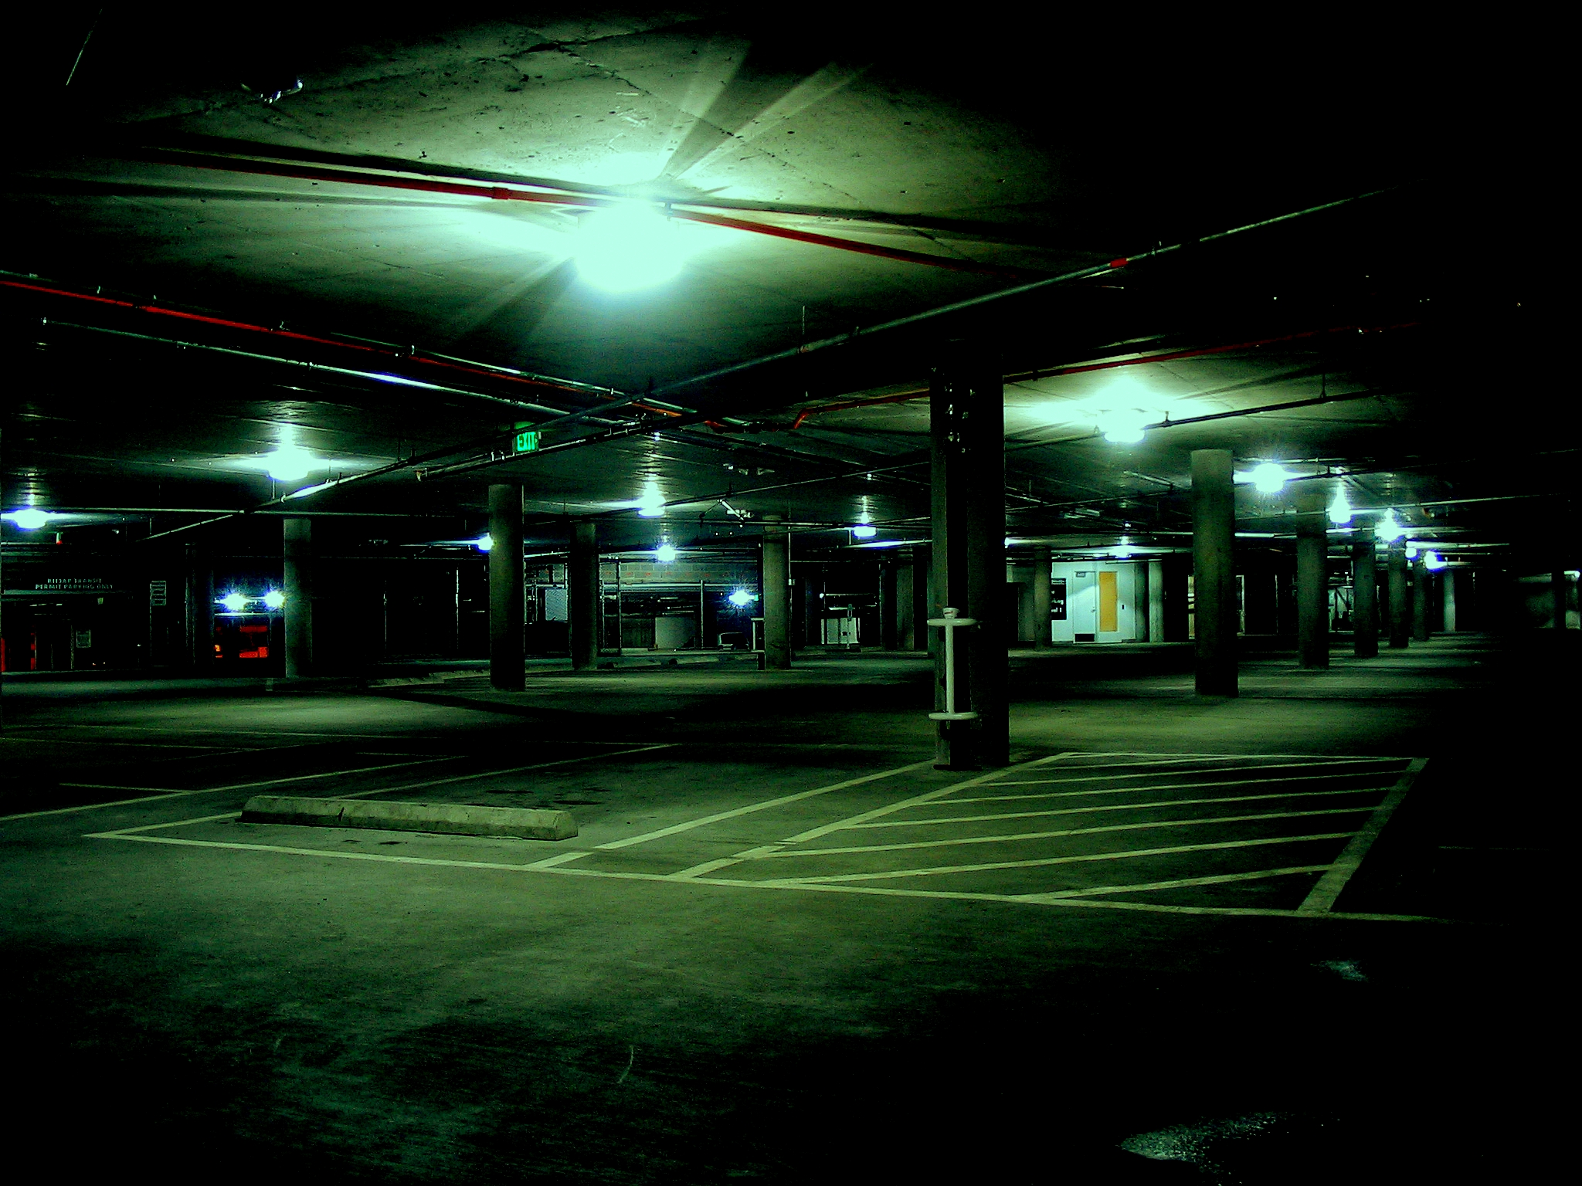
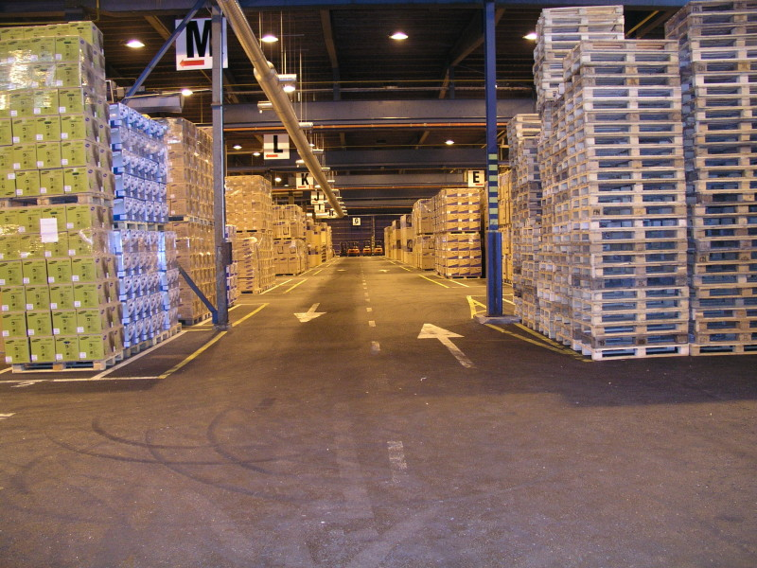
Why other systems can't be used?
GPS location
  Can be disrupted
  Sometimes not reliable even in non-dangerous environments.
Figure 5: GPS requires unobstructed line of sight with satellites to work. This limits its usability inside buildings or underground.

Slide 15
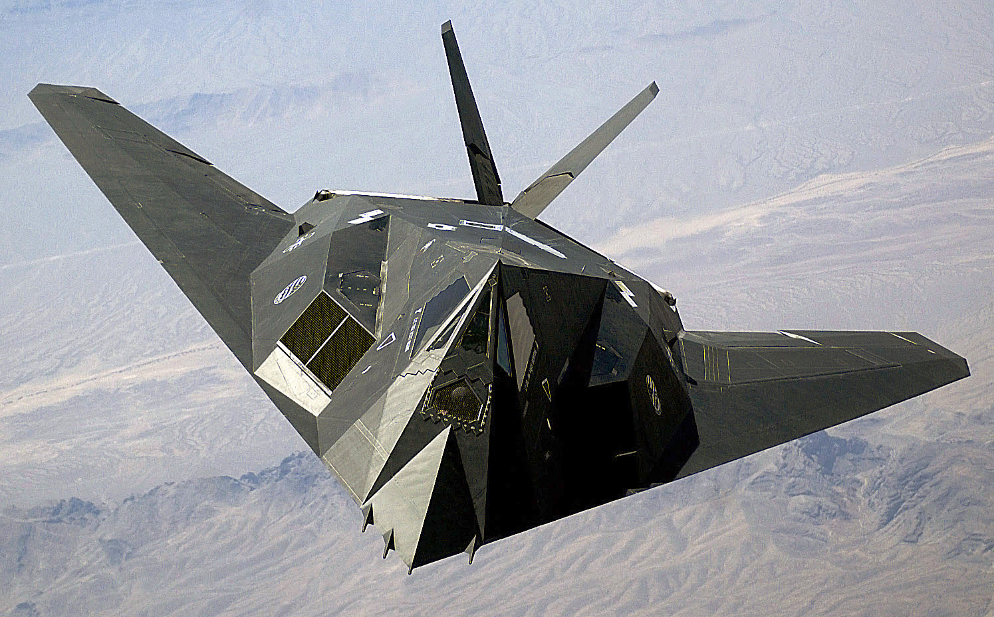
Why other systems can't be used?
Radar detection
  Systems could attempt to physically detect attackers
  Problem: stealth technology surpasses anti-stealth technology in the current state of the art
Figure 5: The US F117 is a 13m wide airplane, but under the radar it appears to have the same size as a bird.

Slide 16
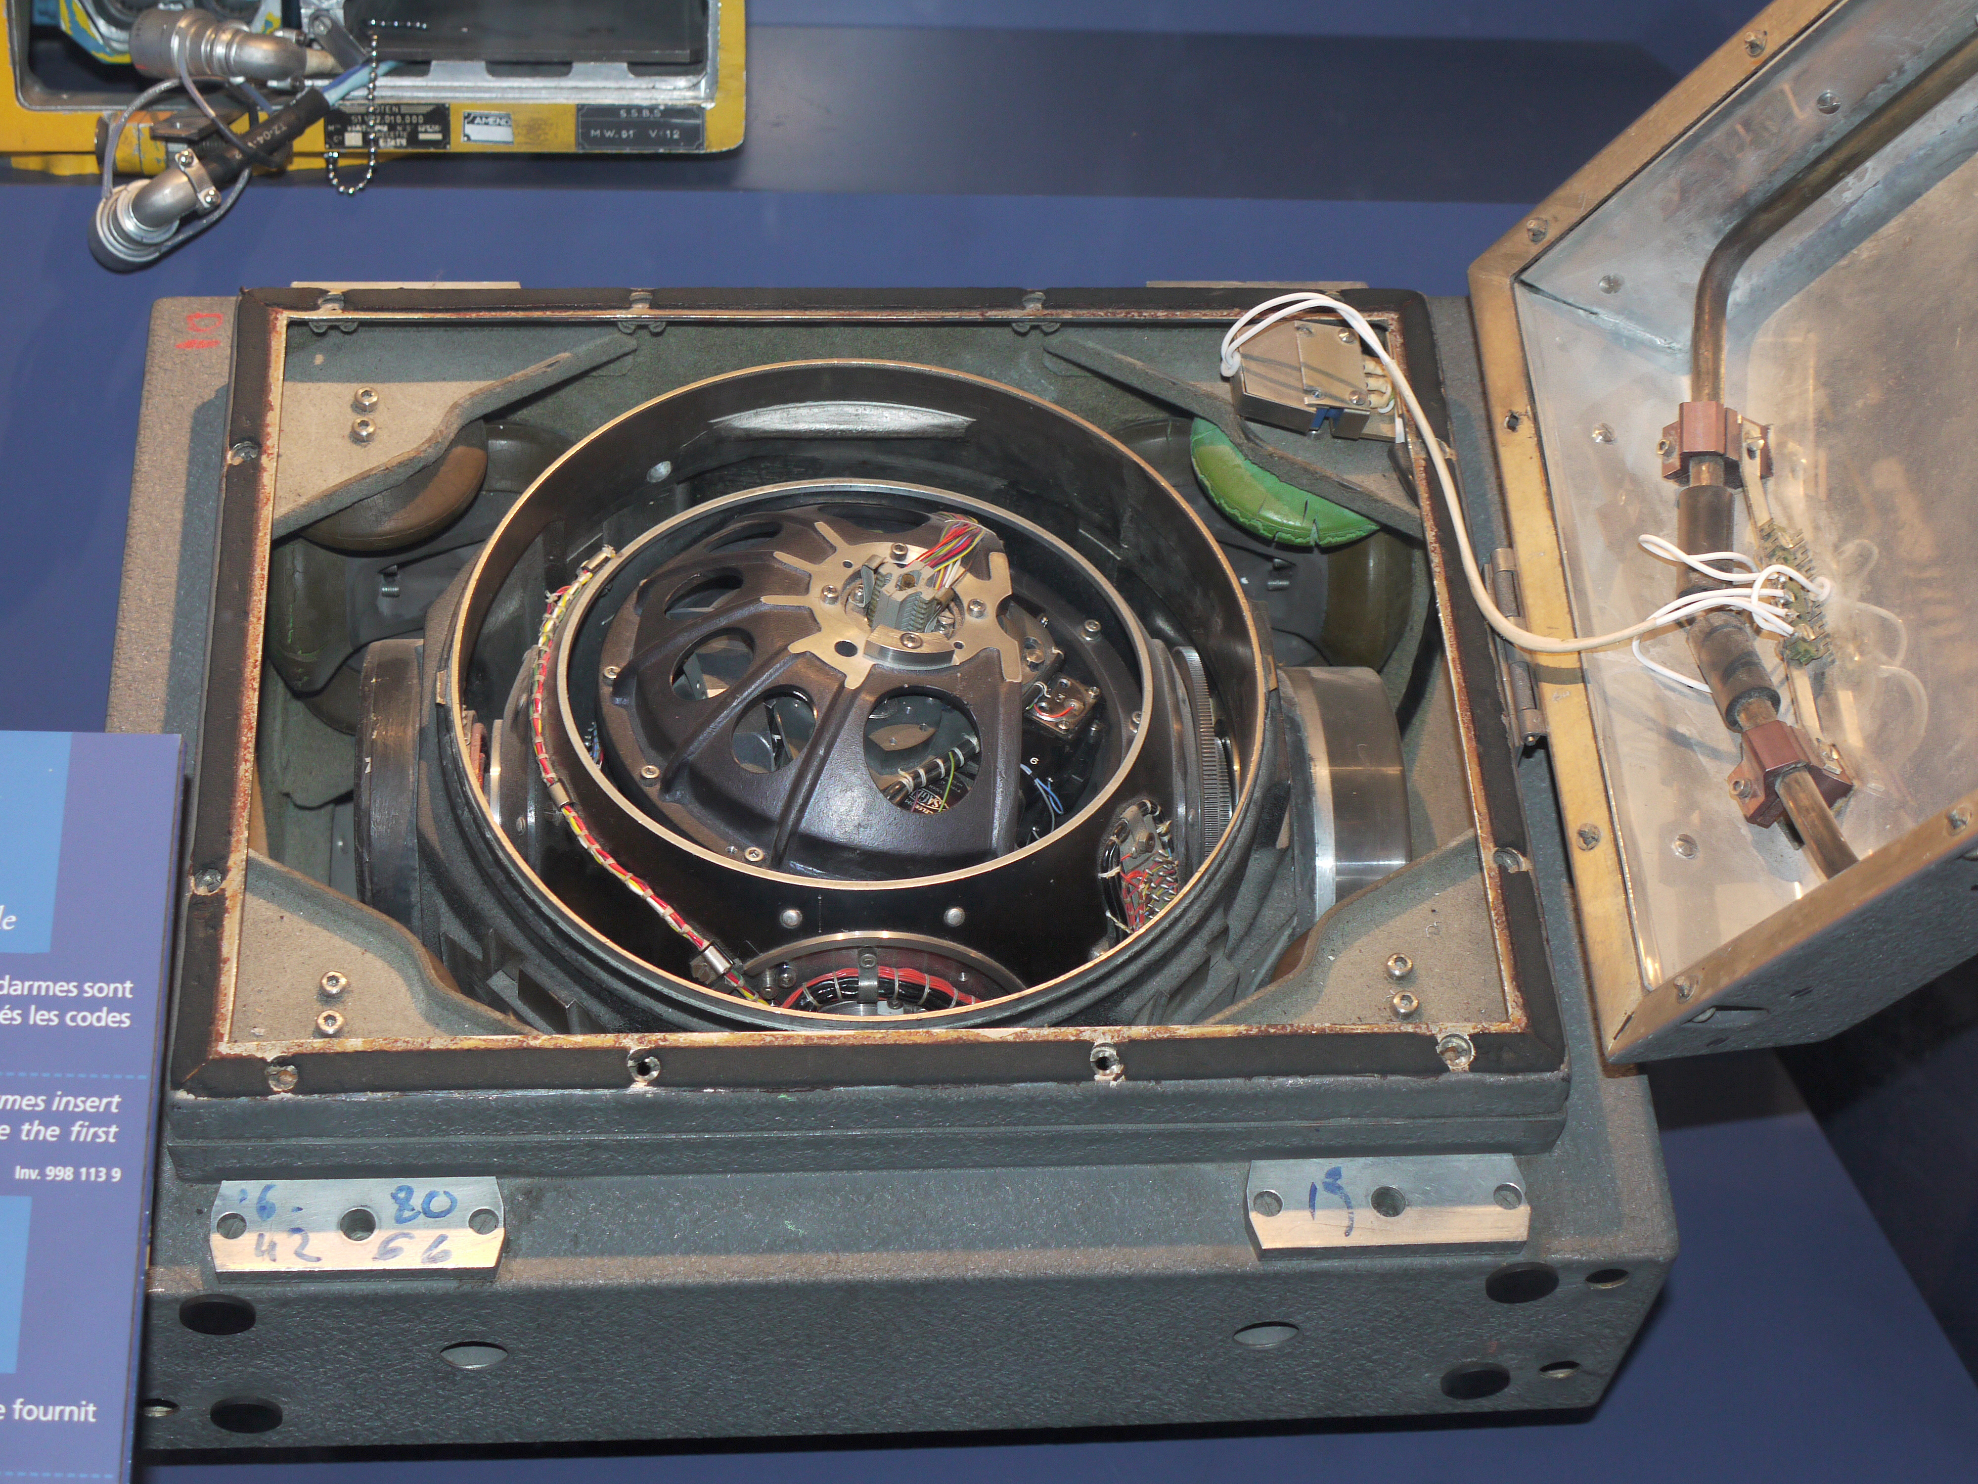
Why other systems can't be used?
Inertial navigation system
  Fits perfectly our purpose, but it cannot be reliably used as a stand-alone positioning system due its accuracy. This may change in the future.
Figure 6: An Inertial Navigation System used by the French army.

Slide 17
Summary
Distance-bounding protocols
Feasibility of the attack: study cases
  Autonomous Cars
  Drone MANETs (Mobile Ad-Hoc NETworks)
Limitations of other systems
Preventing increased distance reports
  Behavior verification
  Multiple distance-bounding signals
  Distributed knowledge
Conclusions

Slide 18
Preventing increased distance reports
Behavior verification
  Similar idea to Intruder Detection System on networking environments.
  Attempt to detect sudden changes in the received data, such as signal strength or large variations on the reported locations.

Slide 19
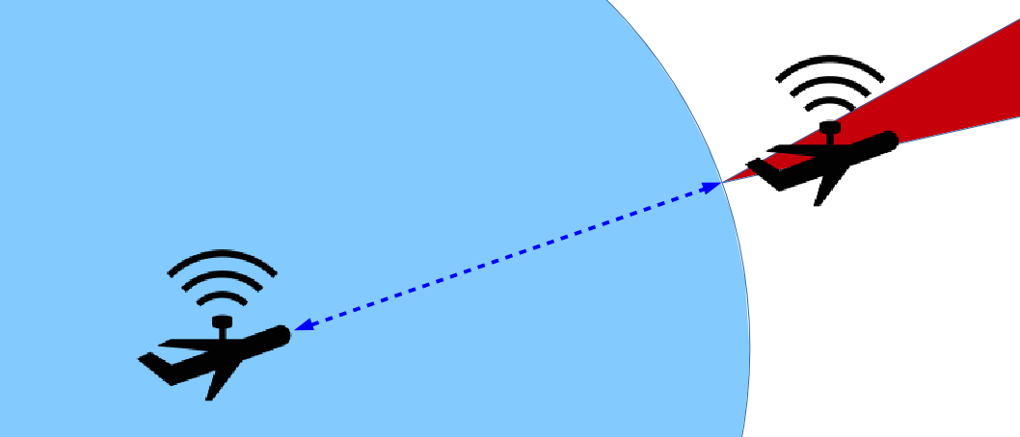
Preventing increased distance reports
Multiple distance-bounding signals
  Original distance-bounding only attempts to check if a reporter is inside or outside a certain range.
  Use multiple distance-bounding signals to obtain approximate location, not only distance.
Figure 7: Multiple signals difficult attacks on the system, as attackers need to coherently fake multiple distances. However, distance in a straight line is still easy to fake.

Slide 20
Preventing increased distance reports
Distributed knowledge
  Instead of relying only on its own measurement, a node could also ask for the measurements of other nodes.
  It would be extremely difficult for an attacker to fake multiple different distances at the same time.

Slide 21
Summary
Distance-bounding protocols
Feasibility of the attack: study cases
  Autonomous Cars
  Drone MANETs (Mobile Ad-Hoc NETworks)
Limitations of other systems
Preventing increased distance reports
  Behavior verification
  Multiple distance-bounding signals
  Distributed knowledge
Conclusions

Slide 22
Conclusions
Most of the systems discussed are not employed nowadays but they are a latent problem.
Lower-distance bound cannot rely on physical limitations for its security: difficult to achieve perfect security.
Proposed solutions -specially a combination of them- reduce the changes of performing an attack without the system noticing it.

Slide 23
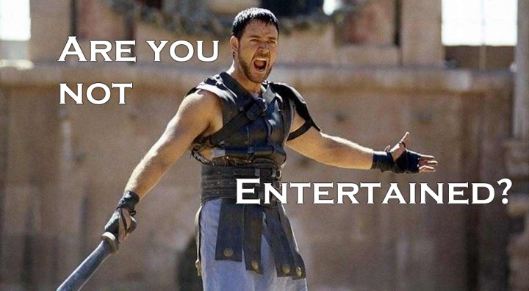
Questions?

