Slide 1
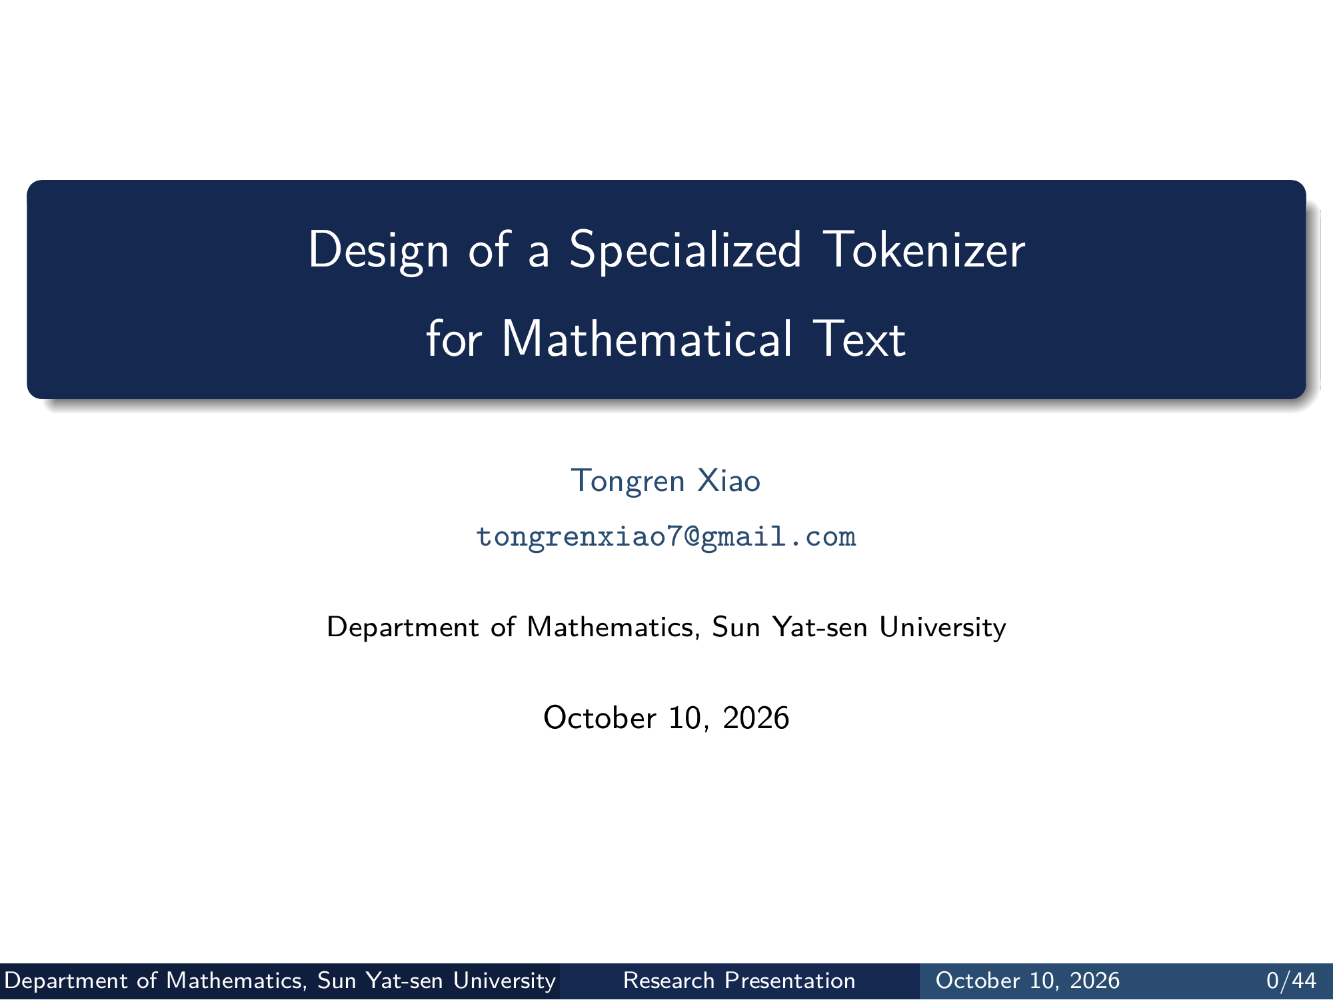
Notes:
Design of a Specialized Tokenizer
for Mathematical Text
Tongren Xiao
tongrenxiao7@gmail.com
Department of Mathematics, Sun Yat-sen University
October 10, 2026
Department of Mathematics, Sun Yat-sen University Research Presentation October 10, 2026 0/44
Editable master: mathematical_tokenizer.tex in companion source bundle; this page preserves the Beamer rendering.

Slide 2
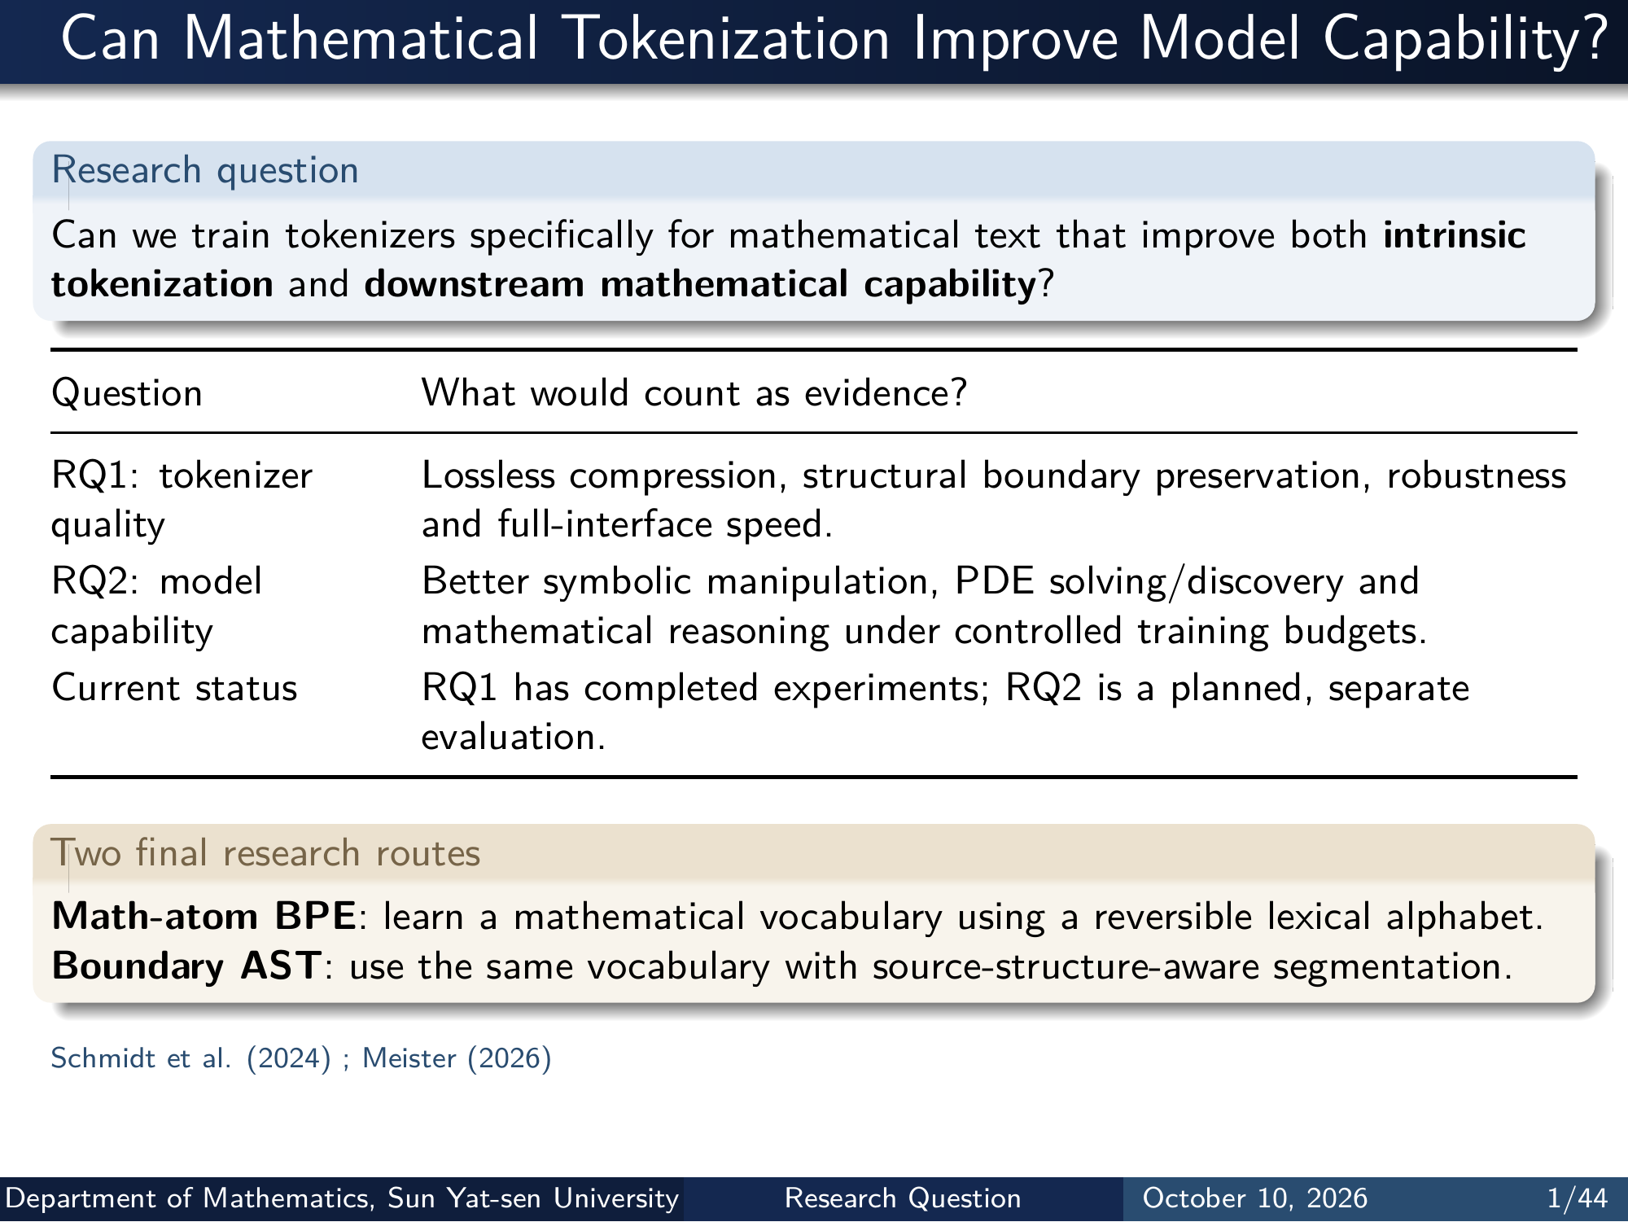
Notes:
Can Mathematical Tokenization Improve Model Capability?
Research question
Can we train tokenizers specifically for mathematical text that improve both intrinsic
tokenization and downstream mathematical capability ?
Question What would count as evidence?
RQ1: tokenizer
quality
Lossless compression, structural boundary preservation, robustness
and full-interface speed.
RQ2: model
capability
Better symbolic manipulation, PDE solving/discovery and
mathematical reasoning under controlled training budgets.
Current status RQ1 has completed experiments; RQ2 is a planned, separate
evaluation.
Two final research routes
Math-atom BPE : learn a mathematical vocabulary using a reversible lexical alphabet.
Boundary AST : use the same vocabulary with source-structure-aware segmentation.
Schmidt et al. (2024) ; Meister (2026)
Department of Mathematics, Sun Yat-sen University Research Question October 10, 2026 1/44
Editable master: mathematical_tokenizer.tex in companion source bundle; this page preserves the Beamer rendering.

Slide 3
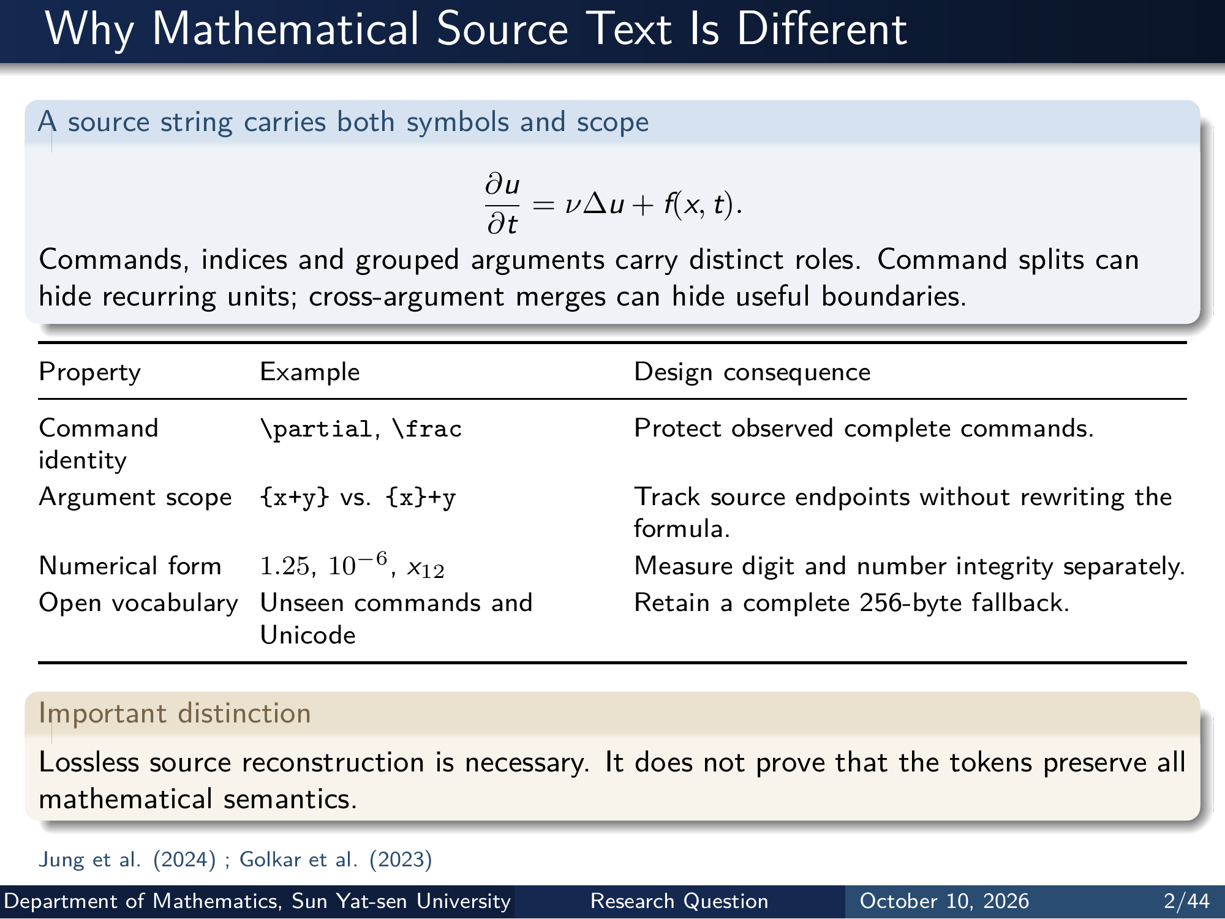
Notes:
Why Mathematical Source Text Is Different
A source string carries both symbols and scope
∂u
∂t = ν∆u + f(x, t).
Commands, indices and grouped arguments carry distinct roles. Command splits can
hide recurring units; cross-argument merges can hide useful boundaries.
Property Example Design consequence
Command
identity
\partial, \frac Protect observed complete commands.
Argument scope {x+y} vs. {x}+y Track source endpoints without rewriting the
formula.
Numerical form 1.25, 10−6, x12 Measure digit and number integrity separately.
Open vocabulary Unseen commands and
Unicode
Retain a complete 256-byte fallback.
Important distinction
Lossless source reconstruction is necessary. It does not prove that the tokens preserve all
mathematical semantics.
Jung et al. (2024) ; Golkar et al. (2023)
Department of Mathematics, Sun Yat-sen University Research Question October 10, 2026 2/44
Editable master: mathematical_tokenizer.tex in companion source bundle; this page preserves the Beamer rendering.

Slide 4
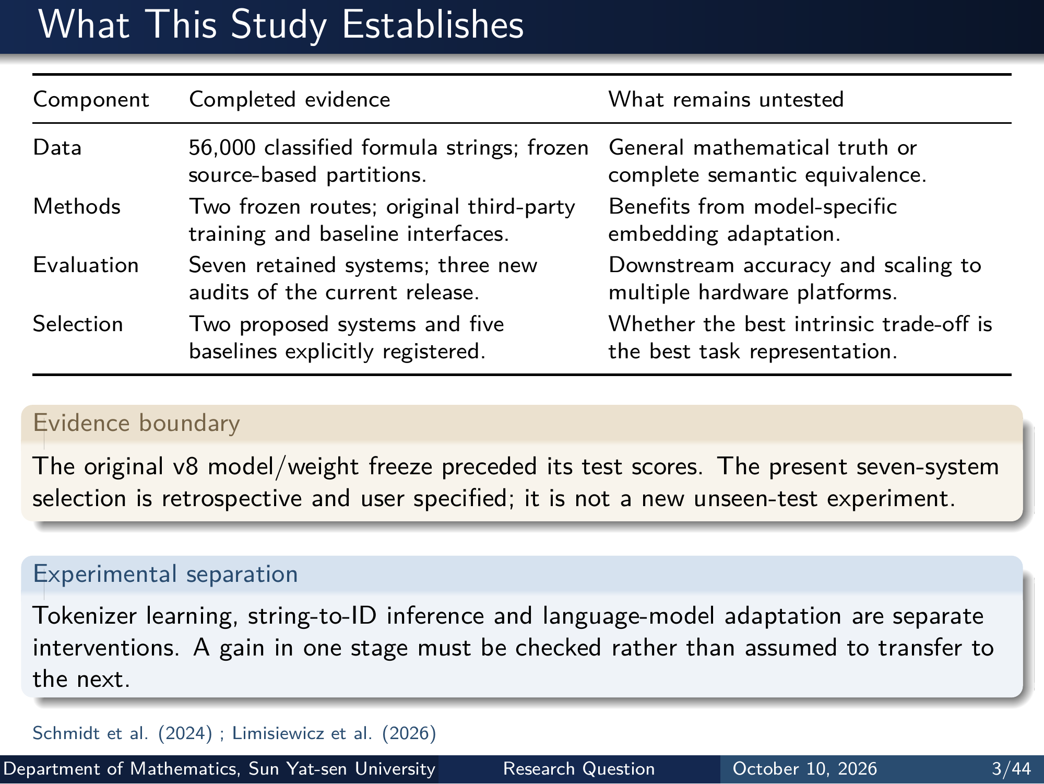
Notes:
What This Study Establishes
Component Completed evidence What remains untested
Data 56,000 classified formula strings; frozen
source-based partitions.
General mathematical truth or
complete semantic equivalence.
Methods Two frozen routes; original third-party
training and baseline interfaces.
Benefits from model-specific
embedding adaptation.
Evaluation Seven retained systems; three new
audits of the current release.
Downstream accuracy and scaling to
multiple hardware platforms.
Selection Two proposed systems and five
baselines explicitly registered.
Whether the best intrinsic trade-off is
the best task representation.
Evidence boundary
The original v8 model/weight freeze preceded its test scores. The present seven-system
selection is retrospective and user specified; it is not a new unseen-test experiment.
Experimental separation
Tokenizer learning, string-to-ID inference and language-model adaptation are separate
interventions. A gain in one stage must be checked rather than assumed to transfer to
the next.
Schmidt et al. (2024) ; Limisiewicz et al. (2026)
Department of Mathematics, Sun Yat-sen University Research Question October 10, 2026 3/44
Editable master: mathematical_tokenizer.tex in companion source bundle; this page preserves the Beamer rendering.

Slide 5
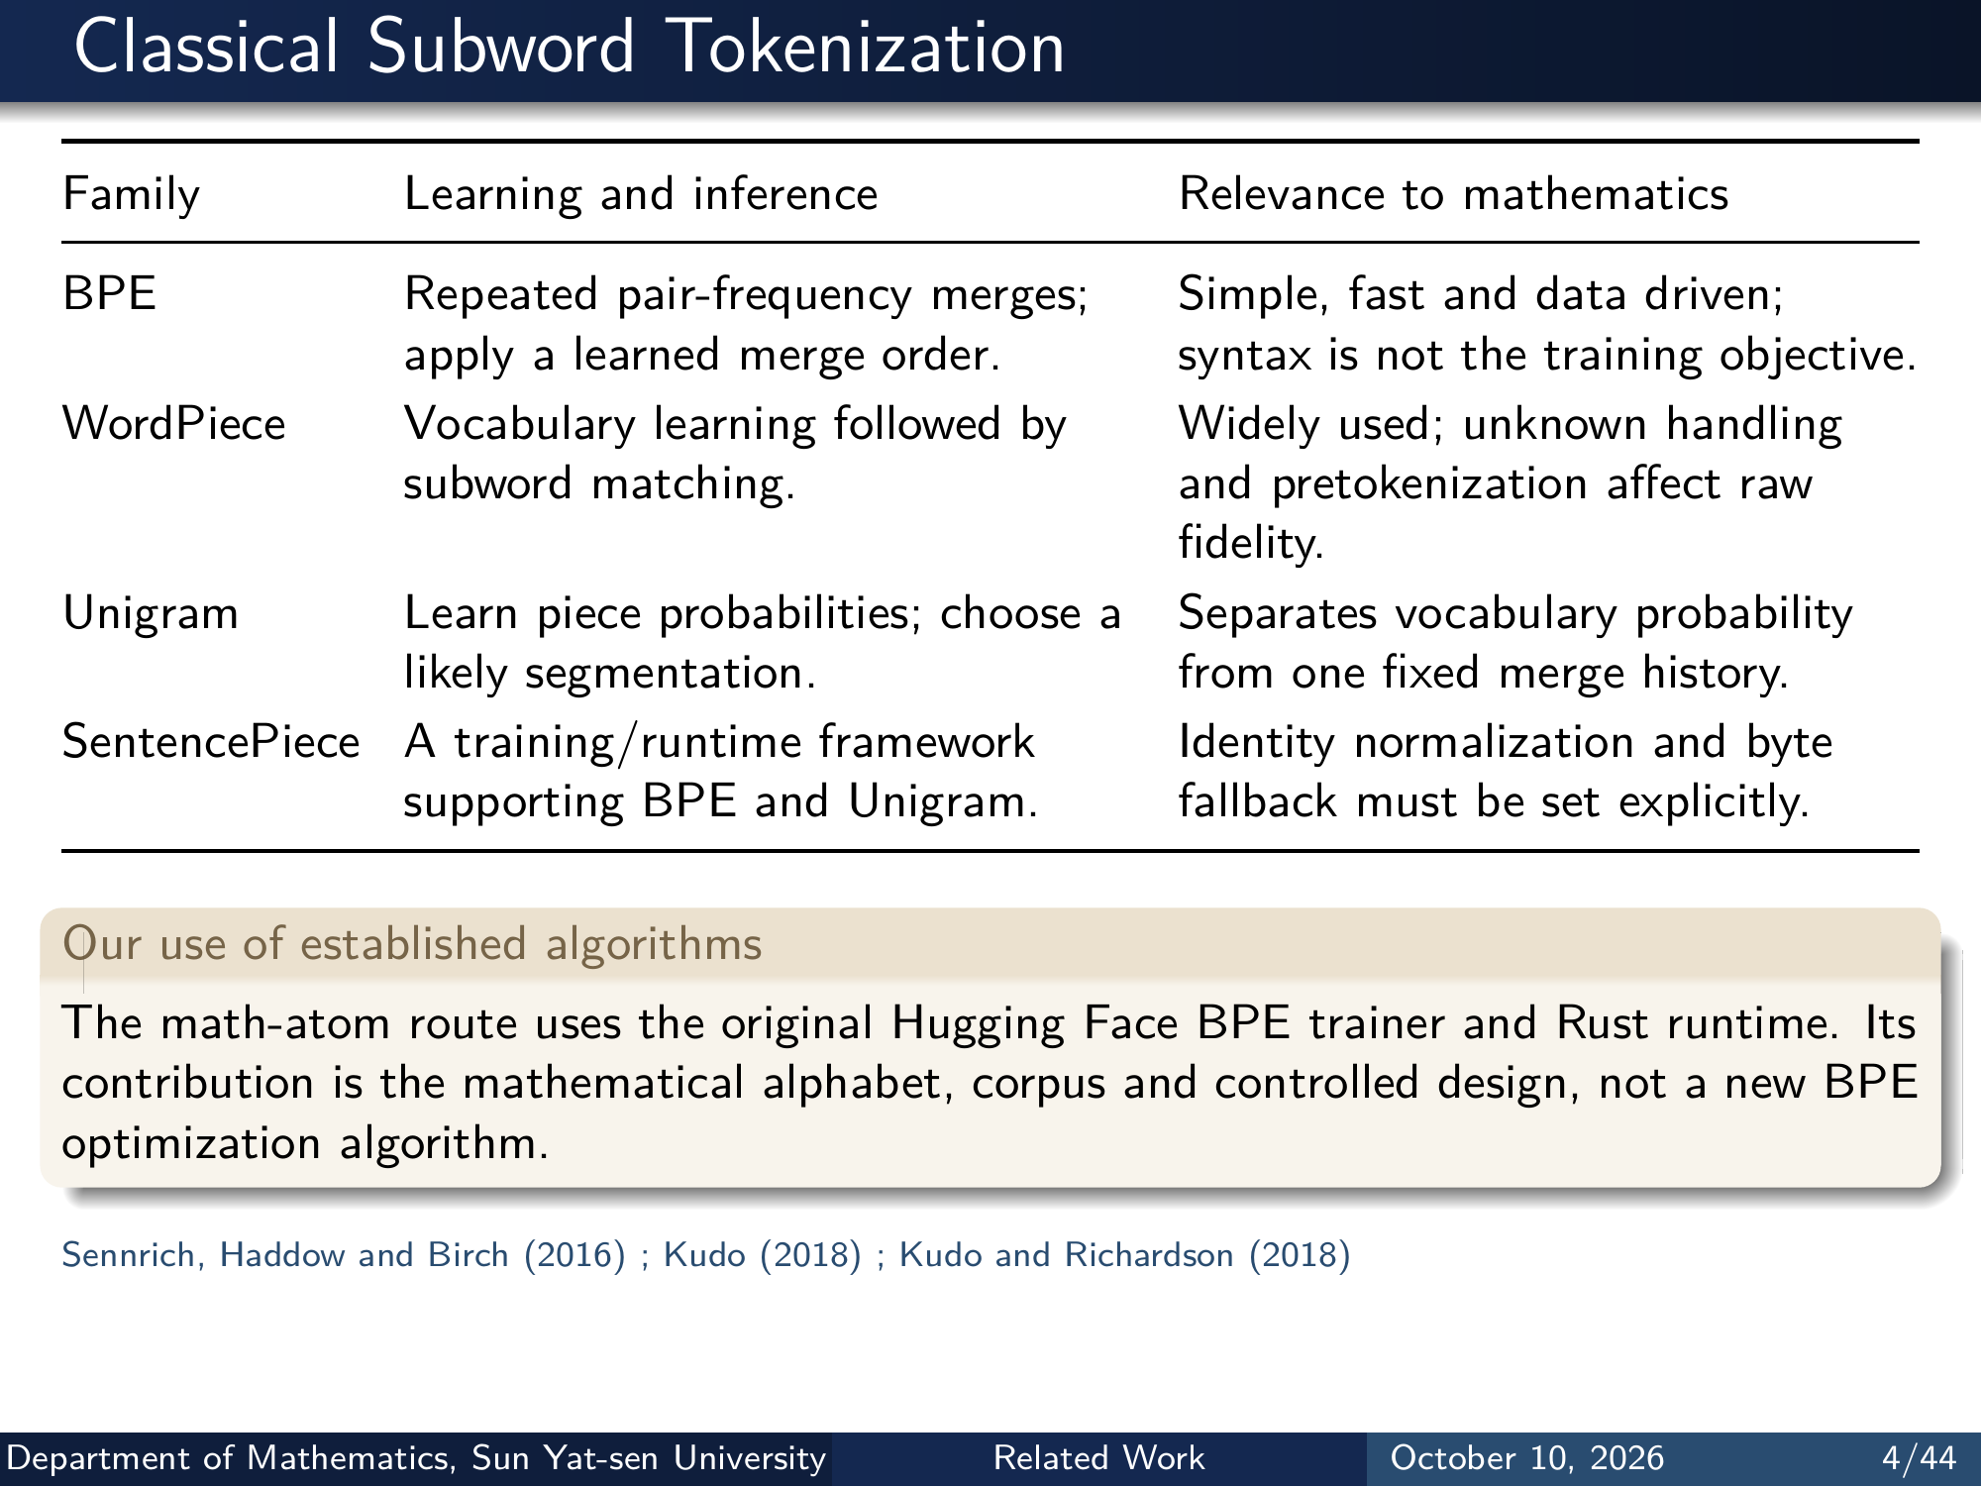
Notes:
Classical Subword Tokenization
Family Learning and inference Relevance to mathematics
BPE Repeated pair-frequency merges;
apply a learned merge order.
Simple, fast and data driven;
syntax is not the training objective.
WordPiece Vocabulary learning followed by
subword matching.
Widely used; unknown handling
and pretokenization affect raw
fidelity.
Unigram Learn piece probabilities; choose a
likely segmentation.
Separates vocabulary probability
from one fixed merge history.
SentencePiece A training/runtime framework
supporting BPE and Unigram.
Identity normalization and byte
fallback must be set explicitly.
Our use of established algorithms
The math-atom route uses the original Hugging Face BPE trainer and Rust runtime. Its
contribution is the mathematical alphabet, corpus and controlled design, not a new BPE
optimization algorithm.
Sennrich, Haddow and Birch (2016) ; Kudo (2018) ; Kudo and Richardson (2018)
Department of Mathematics, Sun Yat-sen University Related Work October 10, 2026 4/44
Editable master: mathematical_tokenizer.tex in companion source bundle; this page preserves the Beamer rendering.

Slide 6
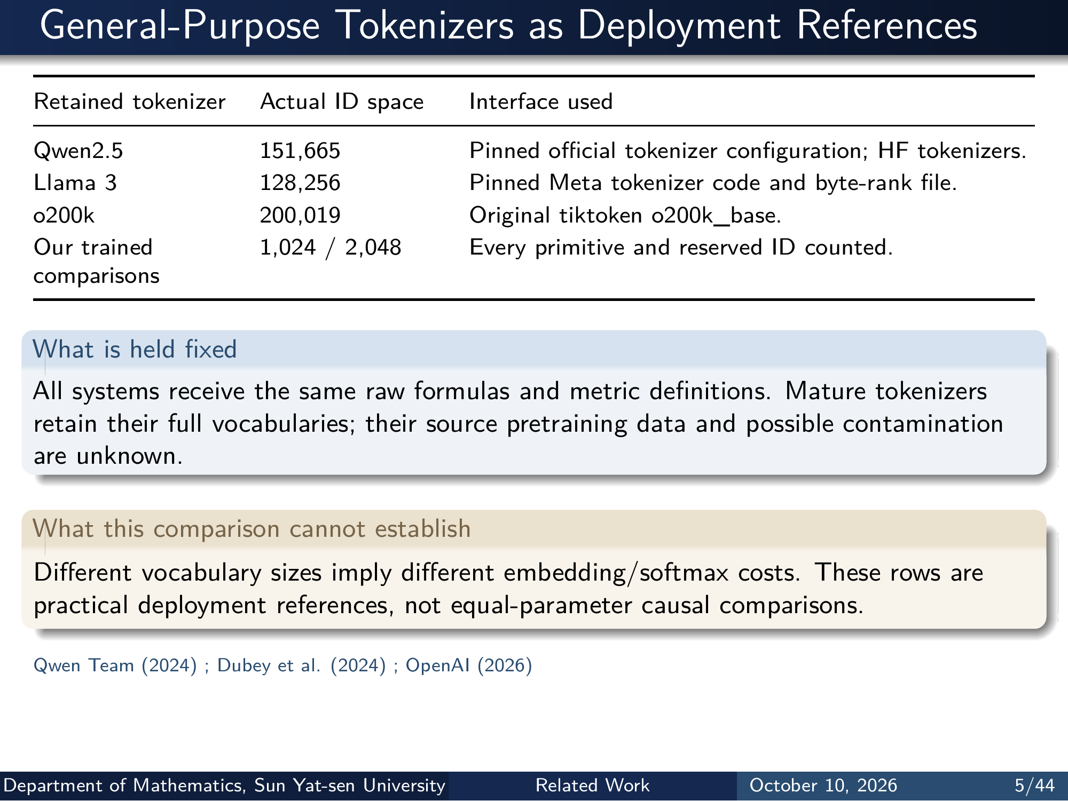
Notes:
General-Purpose Tokenizers as Deployment References
Retained tokenizer Actual ID space Interface used
Qwen2.5 151,665 Pinned oﬀicial tokenizer configuration; HF tokenizers.
Llama 3 128,256 Pinned Meta tokenizer code and byte-rank file.
o200k 200,019 Original tiktoken o200k_base.
Our trained
comparisons
1,024 / 2,048 Every primitive and reserved ID counted.
What is held fixed
All systems receive the same raw formulas and metric definitions. Mature tokenizers
retain their full vocabularies; their source pretraining data and possible contamination
are unknown.
What this comparison cannot establish
Different vocabulary sizes imply different embedding/softmax costs. These rows are
practical deployment references, not equal-parameter causal comparisons.
Qwen Team (2024) ; Dubey et al. (2024) ; OpenAI (2026)
Department of Mathematics, Sun Yat-sen University Related Work October 10, 2026 5/44
Editable master: mathematical_tokenizer.tex in companion source bundle; this page preserves the Beamer rendering.

Slide 7
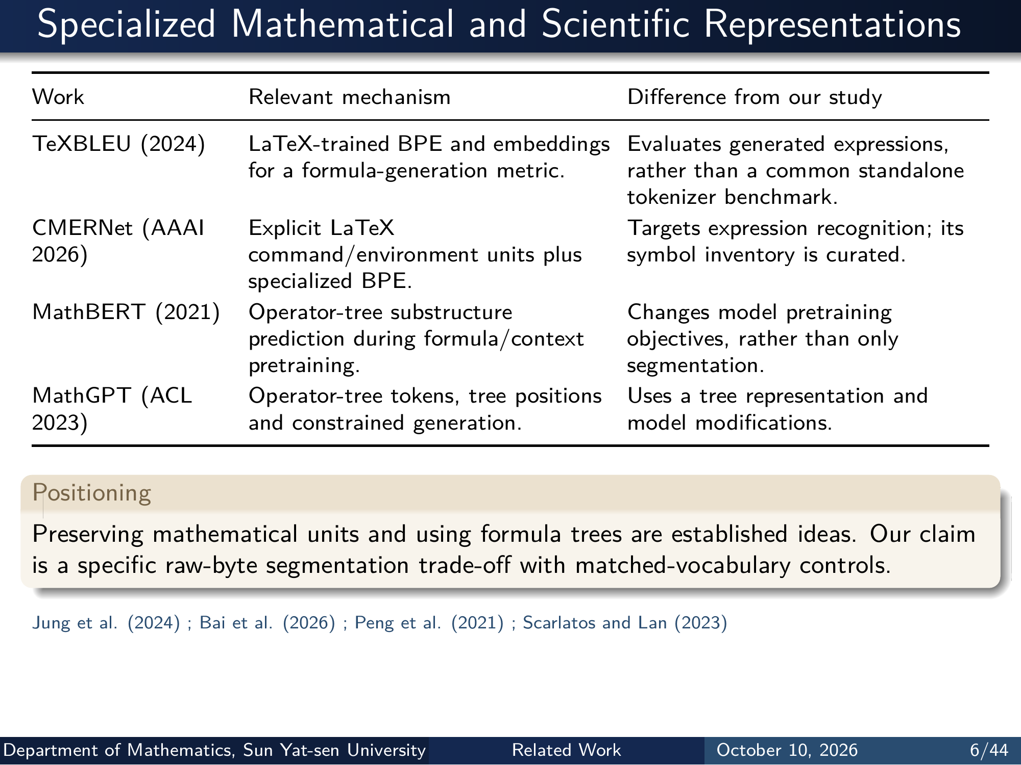
Notes:
Specialized Mathematical and Scientific Representations
Work Relevant mechanism Difference from our study
TeXBLEU (2024) LaTeX-trained BPE and embeddings
for a formula-generation metric.
Evaluates generated expressions,
rather than a common standalone
tokenizer benchmark.
CMERNet (AAAI
2026)
Explicit LaTeX
command/environment units plus
specialized BPE.
Targets expression recognition; its
symbol inventory is curated.
MathBERT (2021) Operator-tree substructure
prediction during formula/context
pretraining.
Changes model pretraining
objectives, rather than only
segmentation.
MathGPT (ACL
2023)
Operator-tree tokens, tree positions
and constrained generation.
Uses a tree representation and
model modifications.
Positioning
Preserving mathematical units and using formula trees are established ideas. Our claim
is a specific raw-byte segmentation trade-off with matched-vocabulary controls.
Jung et al. (2024) ; Bai et al. (2026) ; Peng et al. (2021) ; Scarlatos and Lan (2023)
Department of Mathematics, Sun Yat-sen University Related Work October 10, 2026 6/44
Editable master: mathematical_tokenizer.tex in companion source bundle; this page preserves the Beamer rendering.

Slide 8
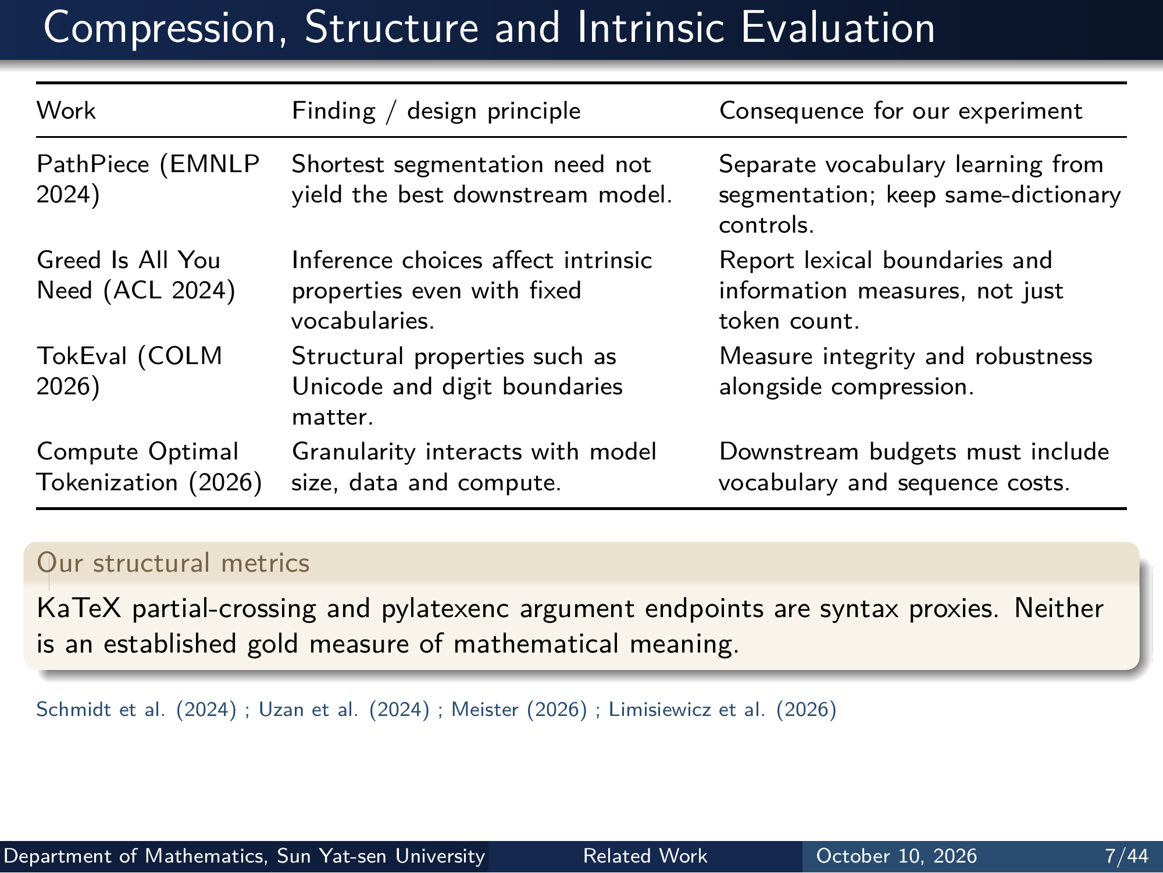
Notes:
Compression, Structure and Intrinsic Evaluation
Work Finding / design principle Consequence for our experiment
PathPiece (EMNLP
2024)
Shortest segmentation need not
yield the best downstream model.
Separate vocabulary learning from
segmentation; keep same-dictionary
controls.
Greed Is All You
Need (ACL 2024)
Inference choices affect intrinsic
properties even with fixed
vocabularies.
Report lexical boundaries and
information measures, not just
token count.
TokEval (COLM
2026)
Structural properties such as
Unicode and digit boundaries
matter.
Measure integrity and robustness
alongside compression.
Compute Optimal
Tokenization (2026)
Granularity interacts with model
size, data and compute.
Downstream budgets must include
vocabulary and sequence costs.
Our structural metrics
KaTeX partial-crossing and pylatexenc argument endpoints are syntax proxies. Neither
is an established gold measure of mathematical meaning.
Schmidt et al. (2024) ; Uzan et al. (2024) ; Meister (2026) ; Limisiewicz et al. (2026)
Department of Mathematics, Sun Yat-sen University Related Work October 10, 2026 7/44
Editable master: mathematical_tokenizer.tex in companion source bundle; this page preserves the Beamer rendering.

Slide 9
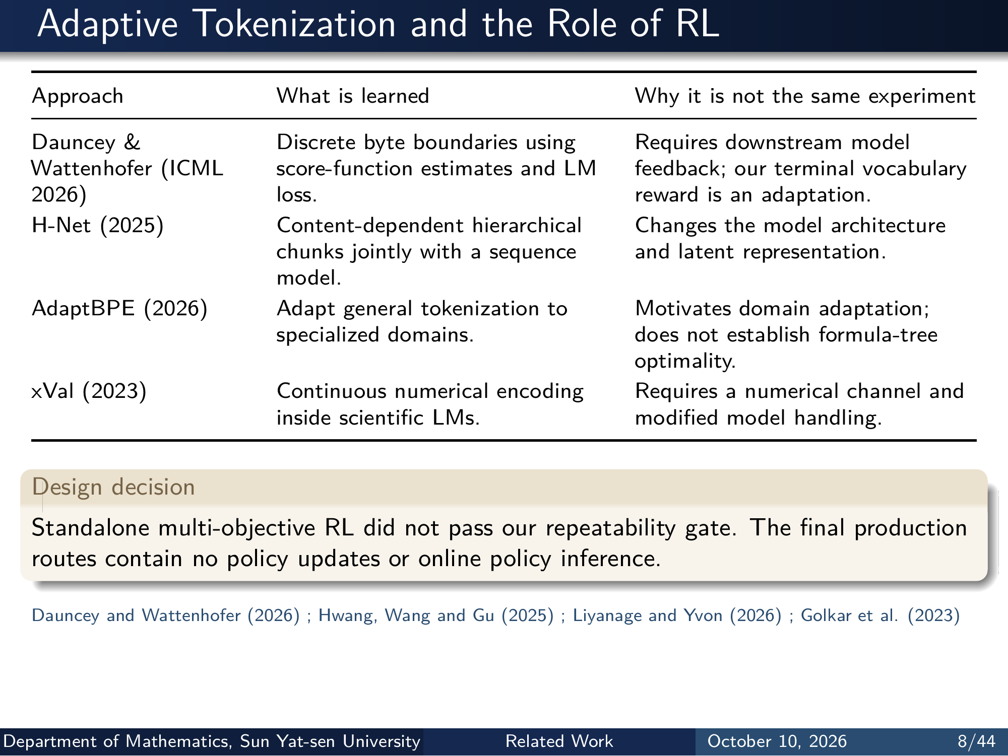
Notes:
Adaptive Tokenization and the Role of RL
Approach What is learned Why it is not the same experiment
Dauncey &
Wattenhofer (ICML
2026)
Discrete byte boundaries using
score-function estimates and LM
loss.
Requires downstream model
feedback; our terminal vocabulary
reward is an adaptation.
H-Net (2025) Content-dependent hierarchical
chunks jointly with a sequence
model.
Changes the model architecture
and latent representation.
AdaptBPE (2026) Adapt general tokenization to
specialized domains.
Motivates domain adaptation;
does not establish formula-tree
optimality.
xVal (2023) Continuous numerical encoding
inside scientific LMs.
Requires a numerical channel and
modified model handling.
Design decision
Standalone multi-objective RL did not pass our repeatability gate. The final production
routes contain no policy updates or online policy inference.
Dauncey and Wattenhofer (2026) ; Hwang, Wang and Gu (2025) ; Liyanage and Yvon (2026) ; Golkar et al. (2023)
Department of Mathematics, Sun Yat-sen University Related Work October 10, 2026 8/44
Editable master: mathematical_tokenizer.tex in companion source bundle; this page preserves the Beamer rendering.

Slide 10
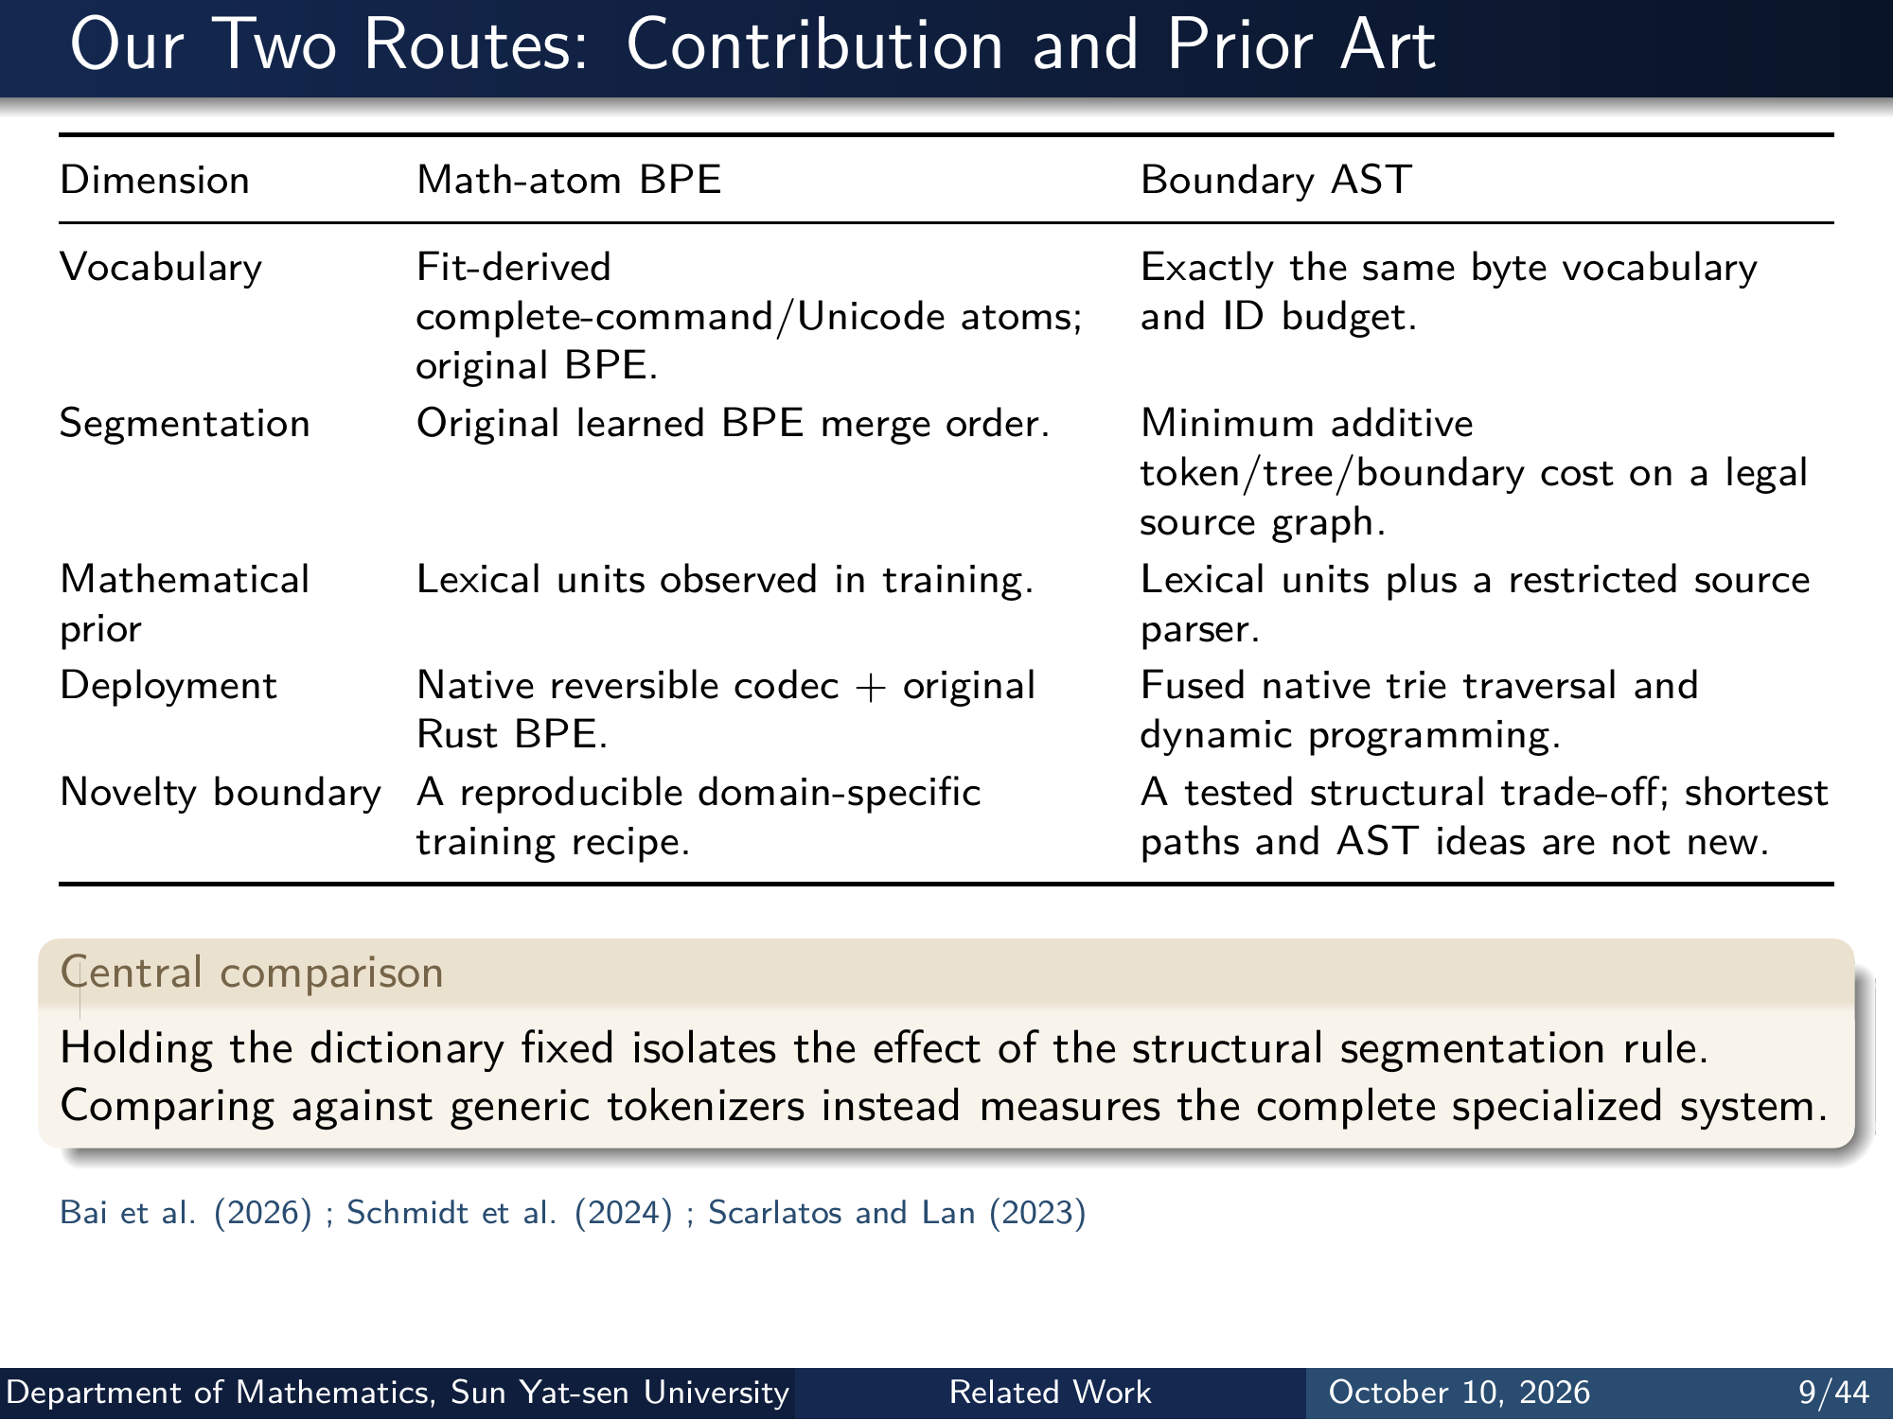
Notes:
Our Two Routes: Contribution and Prior Art
Dimension Math-atom BPE Boundary AST
Vocabulary Fit-derived
complete-command/Unicode atoms;
original BPE.
Exactly the same byte vocabulary
and ID budget.
Segmentation Original learned BPE merge order. Minimum additive
token/tree/boundary cost on a legal
source graph.
Mathematical
prior
Lexical units observed in training. Lexical units plus a restricted source
parser.
Deployment Native reversible codec + original
Rust BPE.
Fused native trie traversal and
dynamic programming.
Novelty boundary A reproducible domain-specific
training recipe.
A tested structural trade-off; shortest
paths and AST ideas are not new.
Central comparison
Holding the dictionary fixed isolates the effect of the structural segmentation rule.
Comparing against generic tokenizers instead measures the complete specialized system.
Bai et al. (2026) ; Schmidt et al. (2024) ; Scarlatos and Lan (2023)
Department of Mathematics, Sun Yat-sen University Related Work October 10, 2026 9/44
Editable master: mathematical_tokenizer.tex in companion source bundle; this page preserves the Beamer rendering.

Slide 11
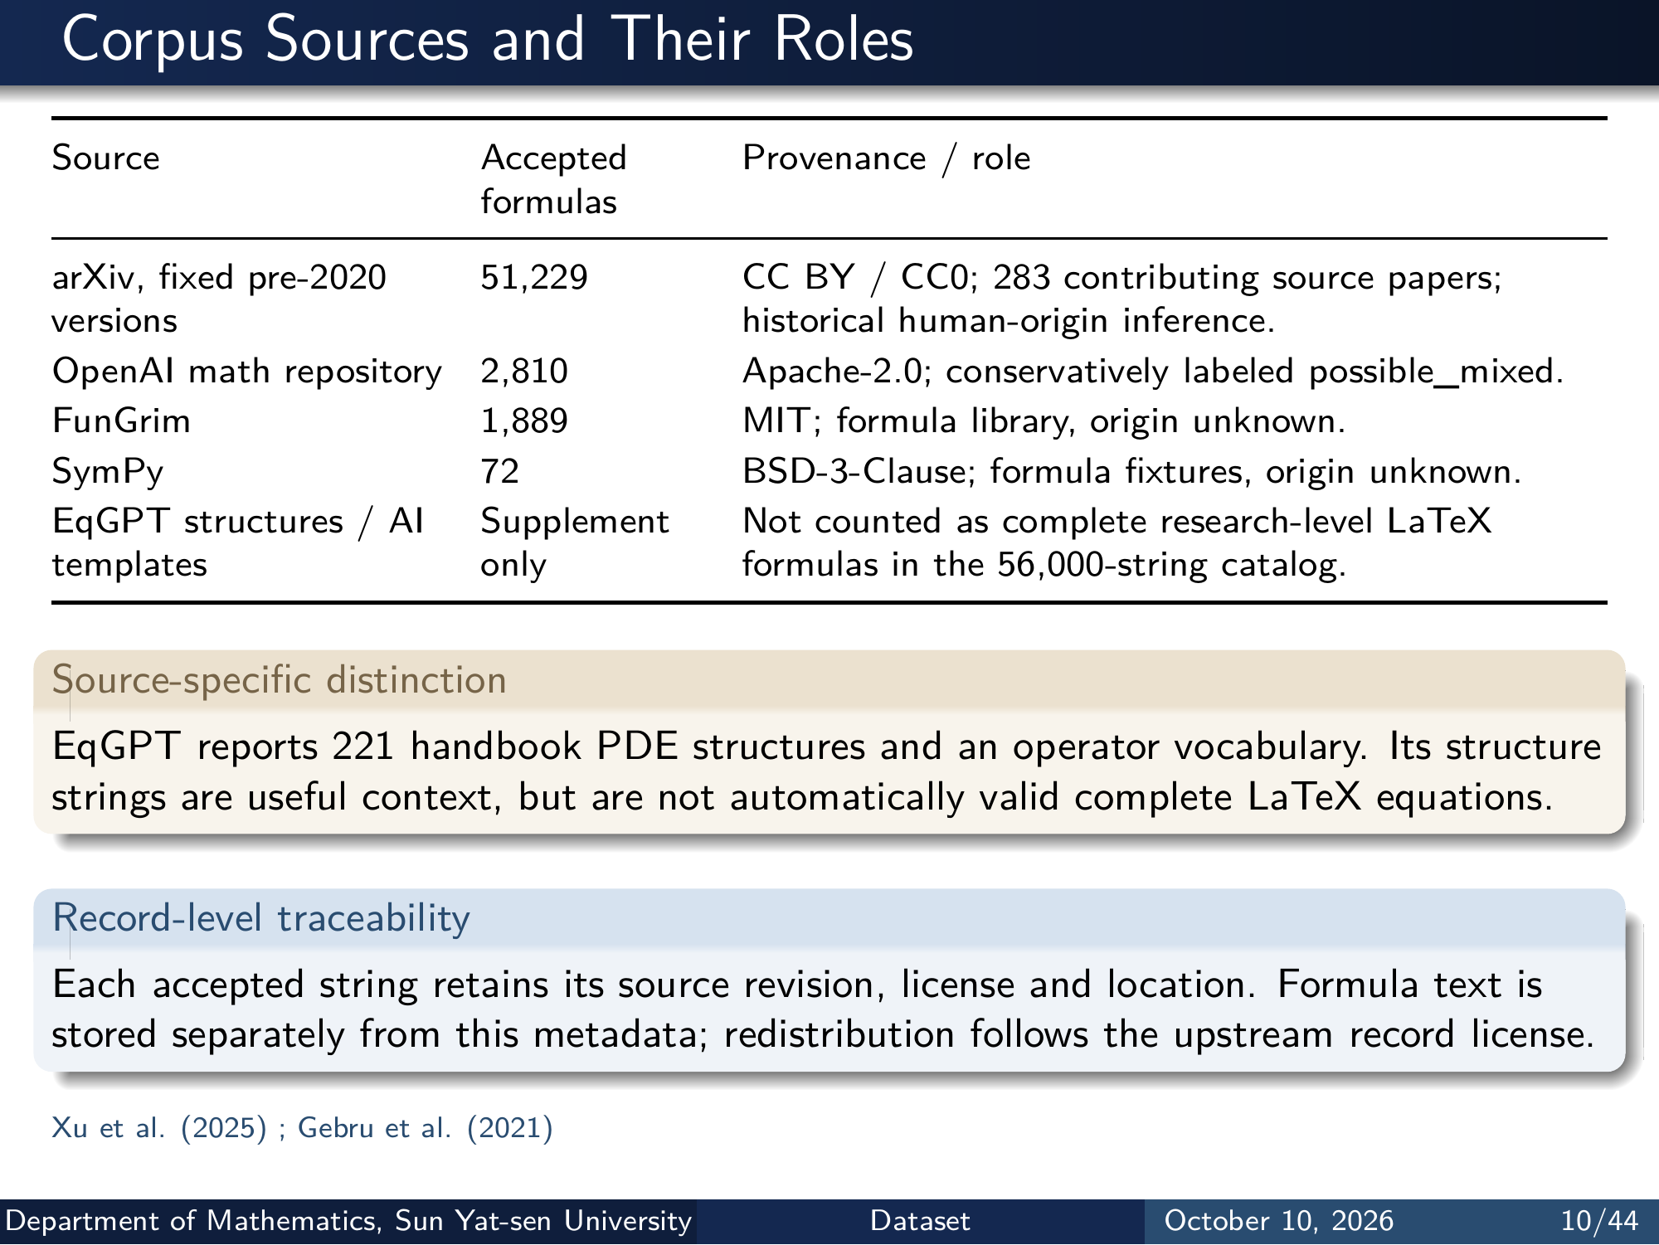
Notes:
Corpus Sources and Their Roles
Source Accepted
formulas
Provenance / role
arXiv, fixed pre-2020
versions
51,229 CC BY / CC0; 283 contributing source papers;
historical human-origin inference.
OpenAI math repository 2,810 Apache-2.0; conservatively labeled possible_mixed.
FunGrim 1,889 MIT; formula library, origin unknown.
SymPy 72 BSD-3-Clause; formula fixtures, origin unknown.
EqGPT structures / AI
templates
Supplement
only
Not counted as complete research-level LaTeX
formulas in the 56,000-string catalog.
Source-specific distinction
EqGPT reports 221 handbook PDE structures and an operator vocabulary. Its structure
strings are useful context, but are not automatically valid complete LaTeX equations.
Record-level traceability
Each accepted string retains its source revision, license and location. Formula text is
stored separately from this metadata; redistribution follows the upstream record license.
Xu et al. (2025) ; Gebru et al. (2021)
Department of Mathematics, Sun Yat-sen University Dataset October 10, 2026 10/44
Editable master: mathematical_tokenizer.tex in companion source bundle; this page preserves the Beamer rendering.

Slide 12
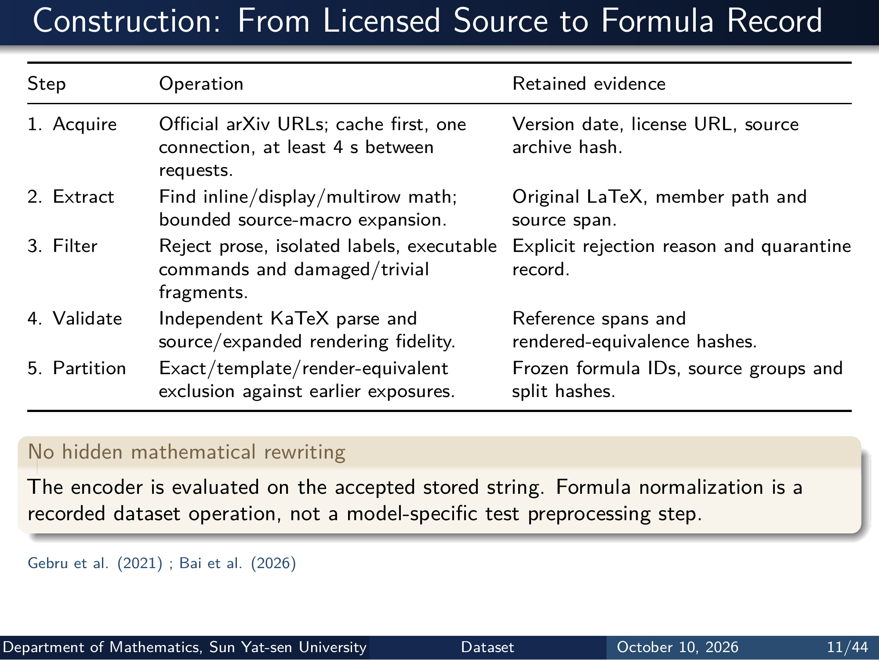
Notes:
Construction: From Licensed Source to Formula Record
Step Operation Retained evidence
1. Acquire Oﬀicial arXiv URLs; cache first, one
connection, at least 4 s between
requests.
Version date, license URL, source
archive hash.
2. Extract Find inline/display/multirow math;
bounded source-macro expansion.
Original LaTeX, member path and
source span.
3. Filter Reject prose, isolated labels, executable
commands and damaged/trivial
fragments.
Explicit rejection reason and quarantine
record.
4. Validate Independent KaTeX parse and
source/expanded rendering fidelity.
Reference spans and
rendered-equivalence hashes.
5. Partition Exact/template/render-equivalent
exclusion against earlier exposures.
Frozen formula IDs, source groups and
split hashes.
No hidden mathematical rewriting
The encoder is evaluated on the accepted stored string. Formula normalization is a
recorded dataset operation, not a model-specific test preprocessing step.
Gebru et al. (2021) ; Bai et al. (2026)
Department of Mathematics, Sun Yat-sen University Dataset October 10, 2026 11/44
Editable master: mathematical_tokenizer.tex in companion source bundle; this page preserves the Beamer rendering.

Slide 13
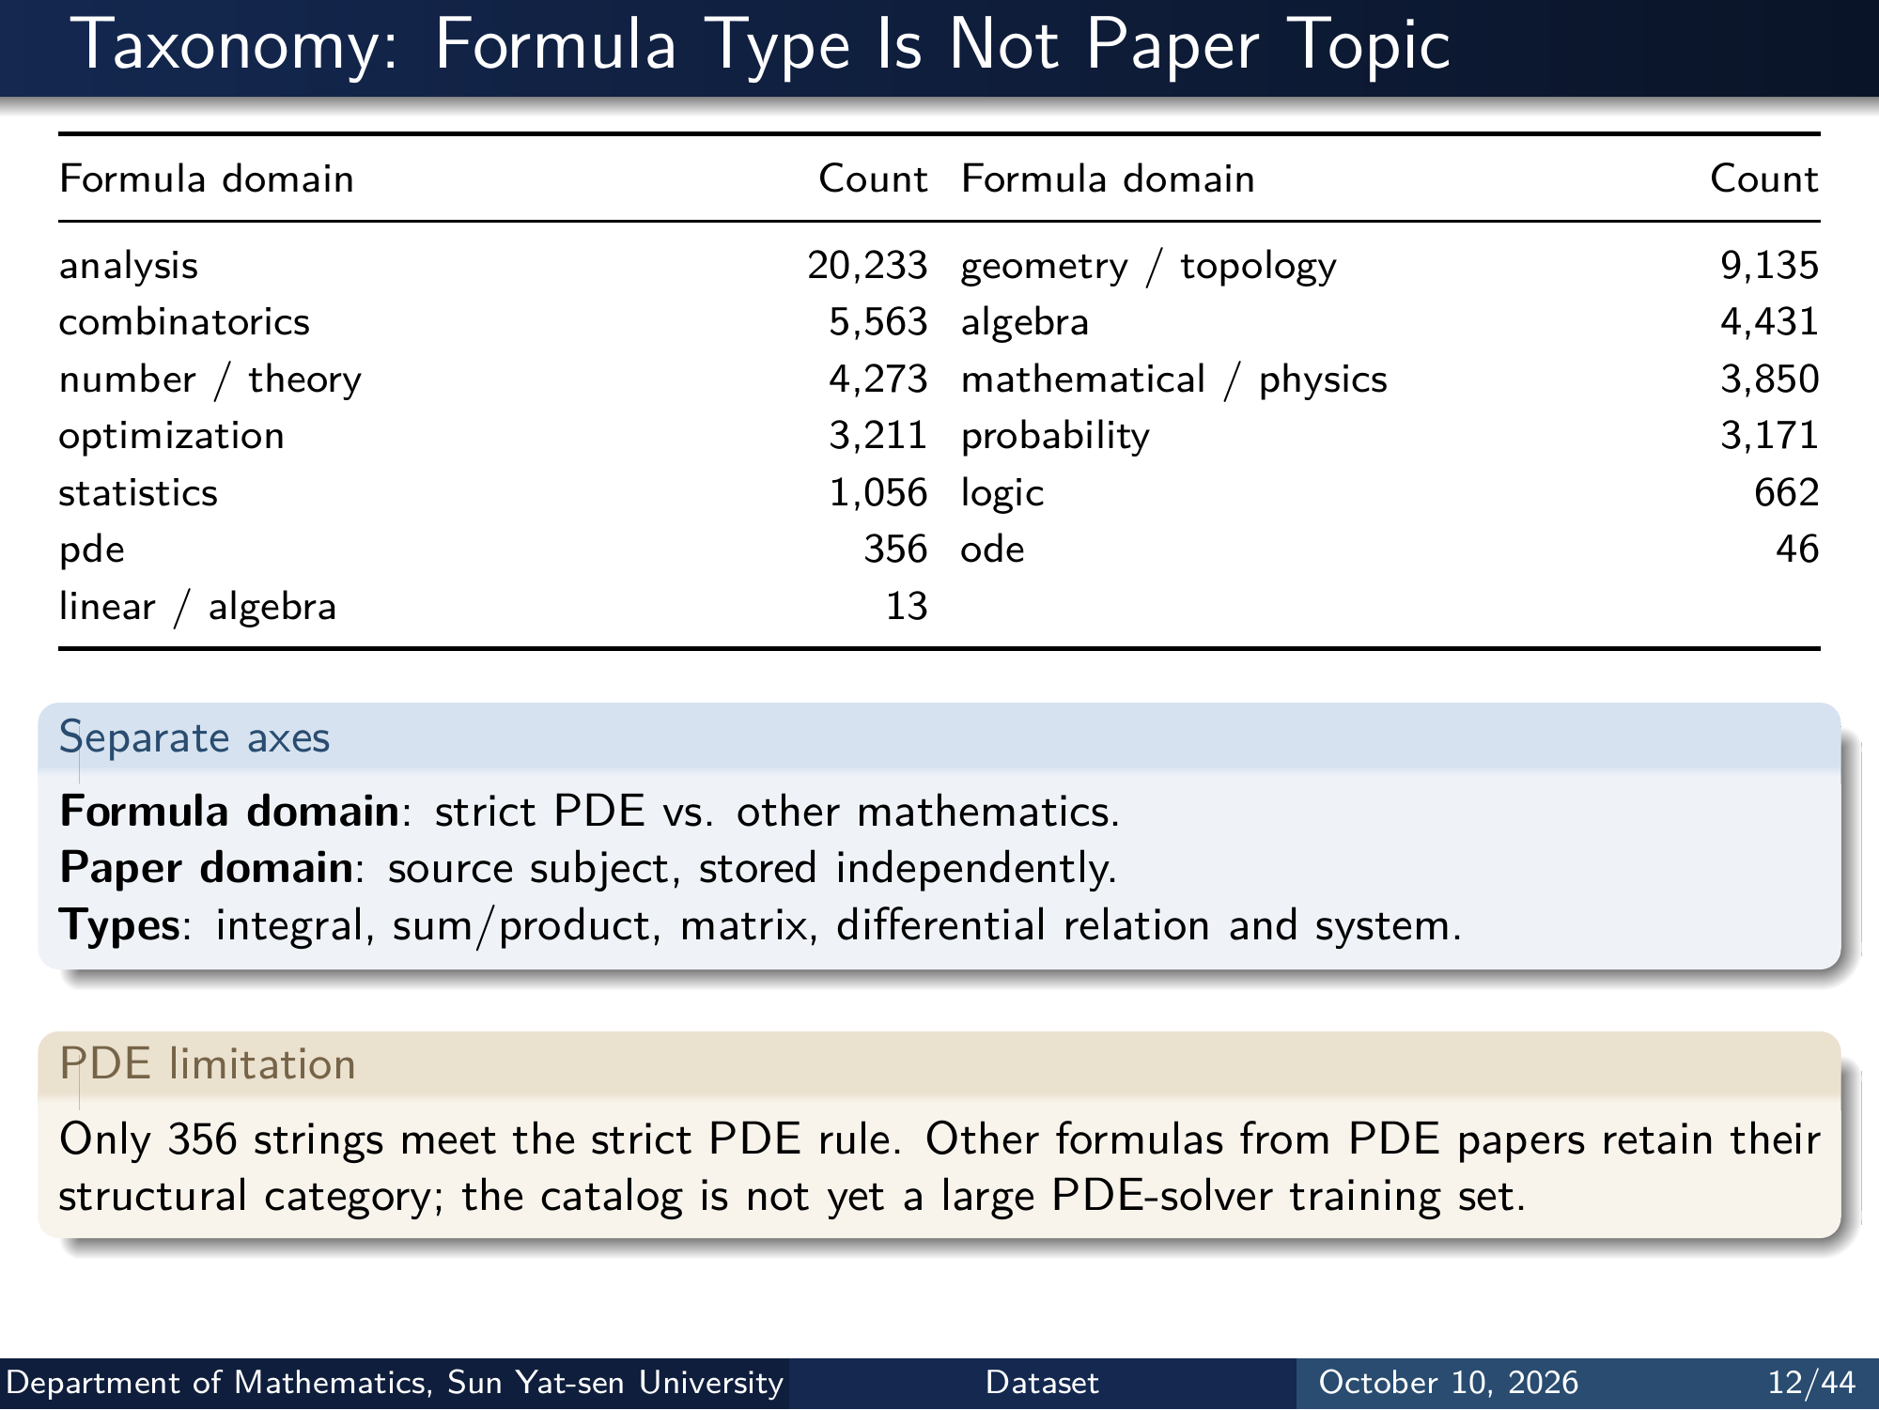
Notes:
Taxonomy: Formula Type Is Not Paper Topic
Formula domain Count Formula domain Count
analysis 20,233 geometry / topology 9,135
combinatorics 5,563 algebra 4,431
number / theory 4,273 mathematical / physics 3,850
optimization 3,211 probability 3,171
statistics 1,056 logic 662
pde 356 ode 46
linear / algebra 13
Separate axes
Formula domain : strict PDE vs. other mathematics.
Paper domain : source subject, stored independently.
Types: integral, sum/product, matrix, differential relation and system.
PDE limitation
Only 356 strings meet the strict PDE rule. Other formulas from PDE papers retain their
structural category; the catalog is not yet a large PDE-solver training set.
Department of Mathematics, Sun Yat-sen University Dataset October 10, 2026 12/44
Editable master: mathematical_tokenizer.tex in companion source bundle; this page preserves the Beamer rendering.

Slide 14
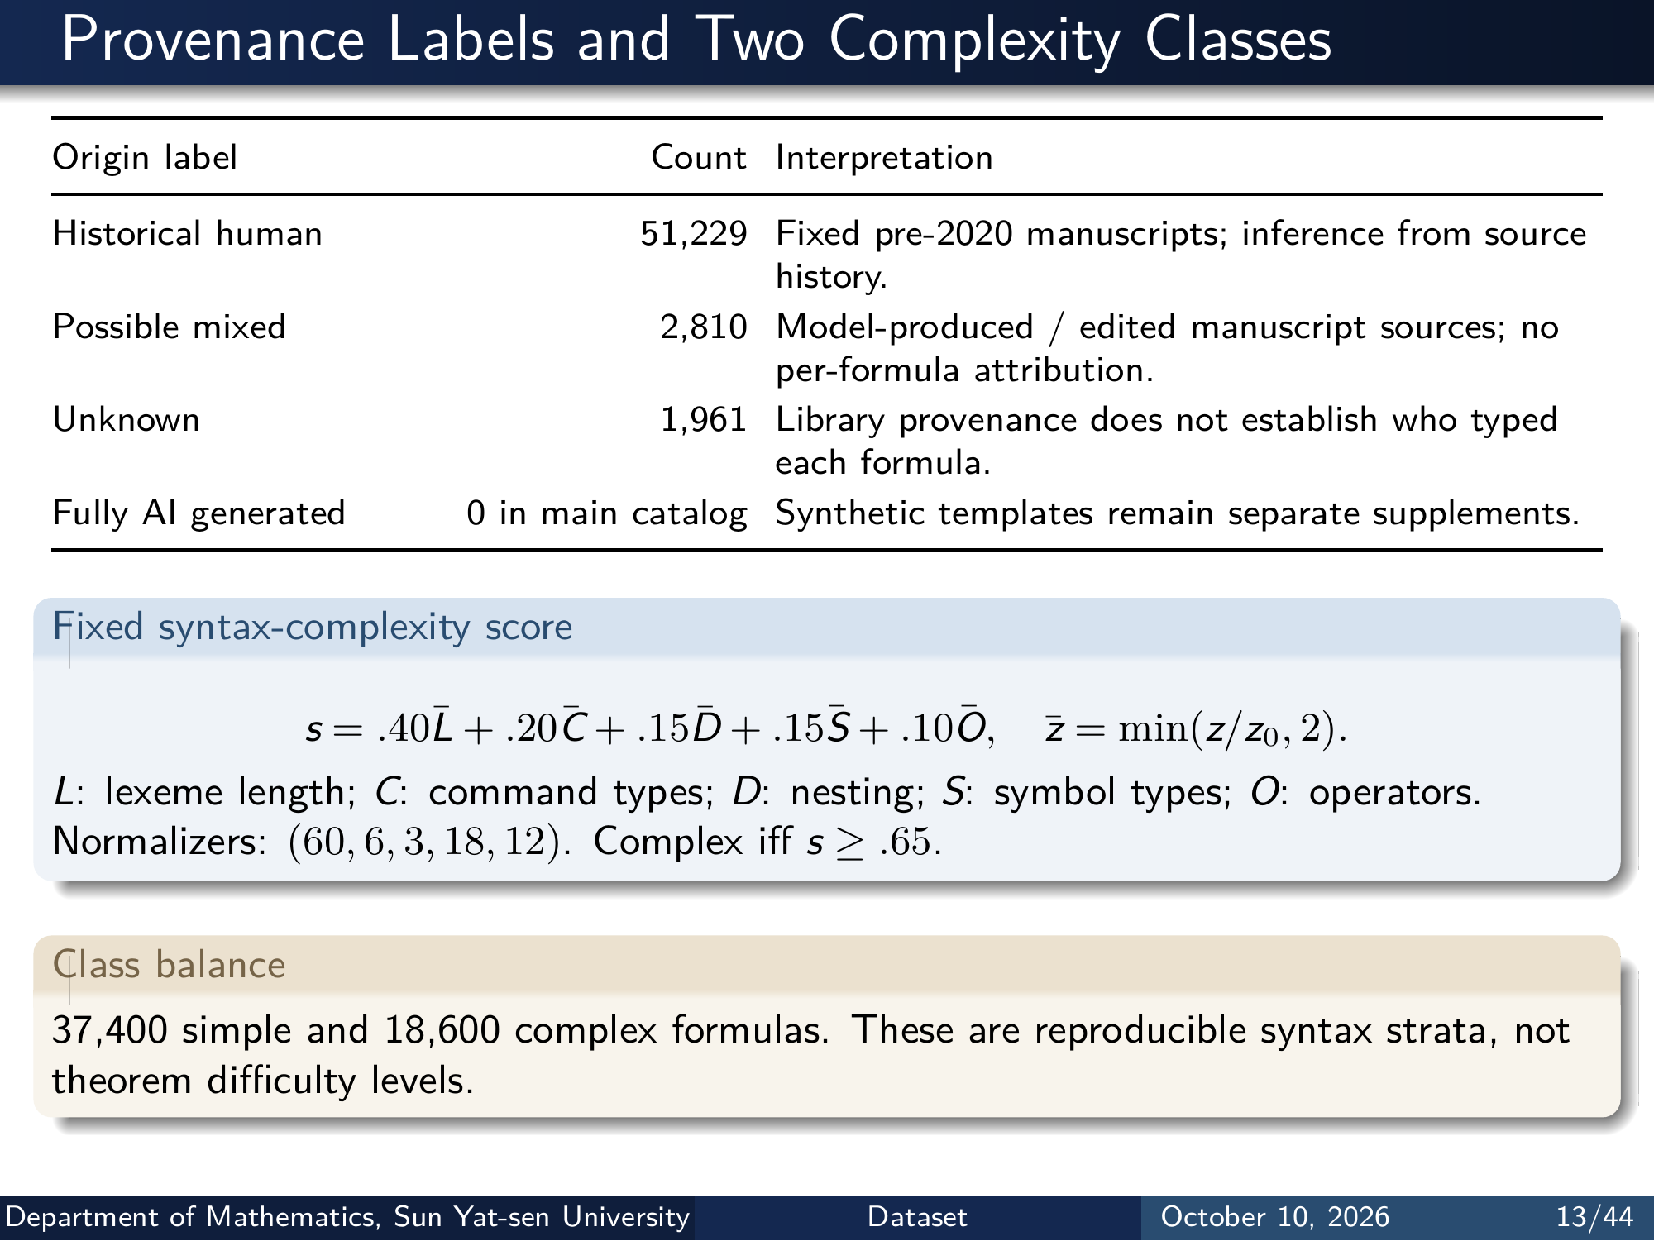
Notes:
Provenance Labels and Two Complexity Classes
Origin label Count Interpretation
Historical human 51,229 Fixed pre-2020 manuscripts; inference from source
history.
Possible mixed 2,810 Model-produced / edited manuscript sources; no
per-formula attribution.
Unknown 1,961 Library provenance does not establish who typed
each formula.
Fully AI generated 0 in main catalog Synthetic templates remain separate supplements.
Fixed syntax-complexity score
s = .40¯L + .20¯C + .15 ¯D + .15¯S + .10 ¯O, ¯z = min(z/z0, 2).
L: lexeme length; C: command types; D: nesting; S: symbol types; O: operators.
Normalizers: (60, 6, 3, 18, 12). Complex iff s ≥ .65.
Class balance
37,400 simple and 18,600 complex formulas. These are reproducible syntax strata, not
theorem diﬀiculty levels.
Department of Mathematics, Sun Yat-sen University Dataset October 10, 2026 13/44
Editable master: mathematical_tokenizer.tex in companion source bundle; this page preserves the Beamer rendering.

Slide 15
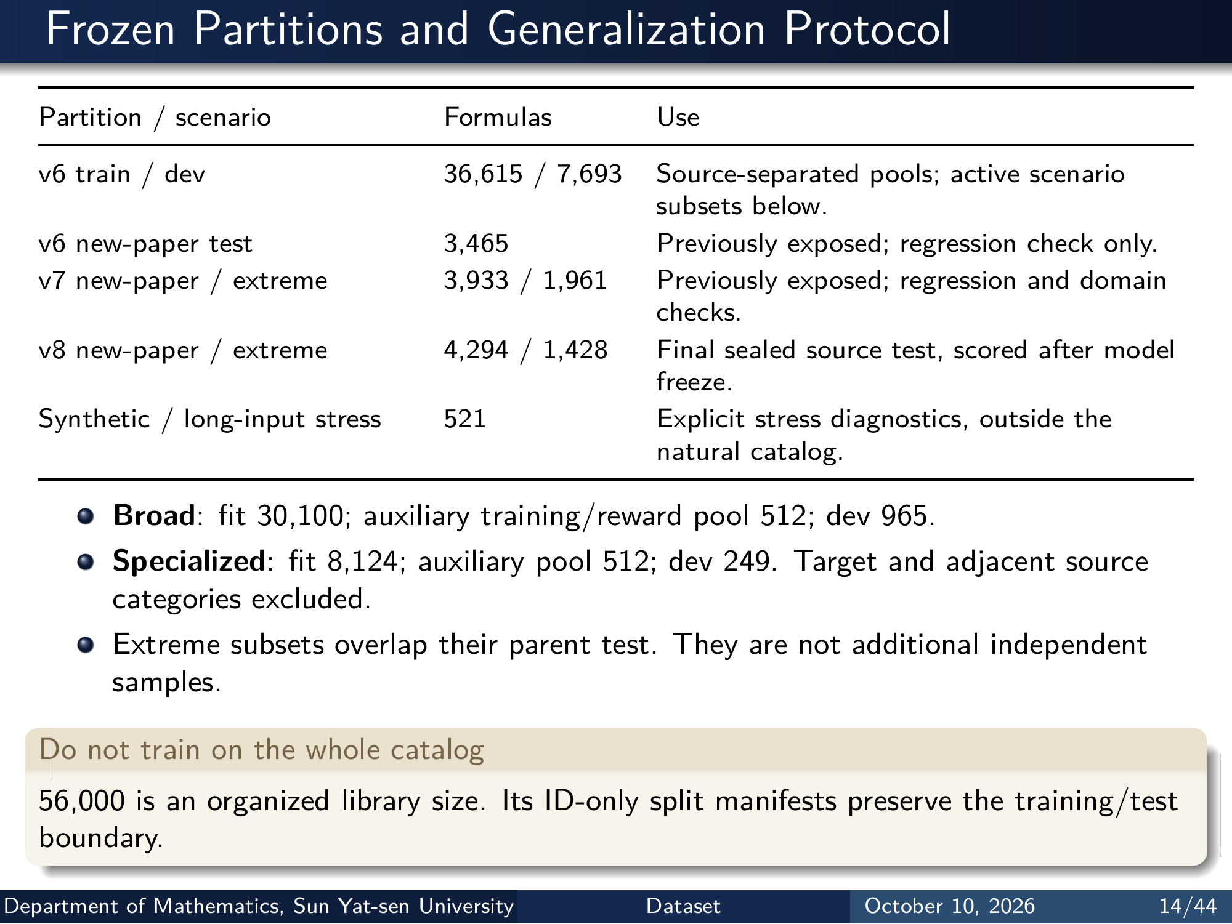
Notes:
Frozen Partitions and Generalization Protocol
Partition / scenario Formulas Use
v6 train / dev 36,615 / 7,693 Source-separated pools; active scenario
subsets below.
v6 new-paper test 3,465 Previously exposed; regression check only.
v7 new-paper / extreme 3,933 / 1,961 Previously exposed; regression and domain
checks.
v8 new-paper / extreme 4,294 / 1,428 Final sealed source test, scored after model
freeze.
Synthetic / long-input stress 521 Explicit stress diagnostics, outside the
natural catalog.
Broad: fit 30,100; auxiliary training/reward pool 512; dev 965.
Specialized: fit 8,124; auxiliary pool 512; dev 249. Target and adjacent source
categories excluded.
Extreme subsets overlap their parent test. They are not additional independent
samples.
Do not train on the whole catalog
56,000 is an organized library size. Its ID-only split manifests preserve the training/test
boundary.
Department of Mathematics, Sun Yat-sen University Dataset October 10, 2026 14/44
Editable master: mathematical_tokenizer.tex in companion source bundle; this page preserves the Beamer rendering.

Slide 16
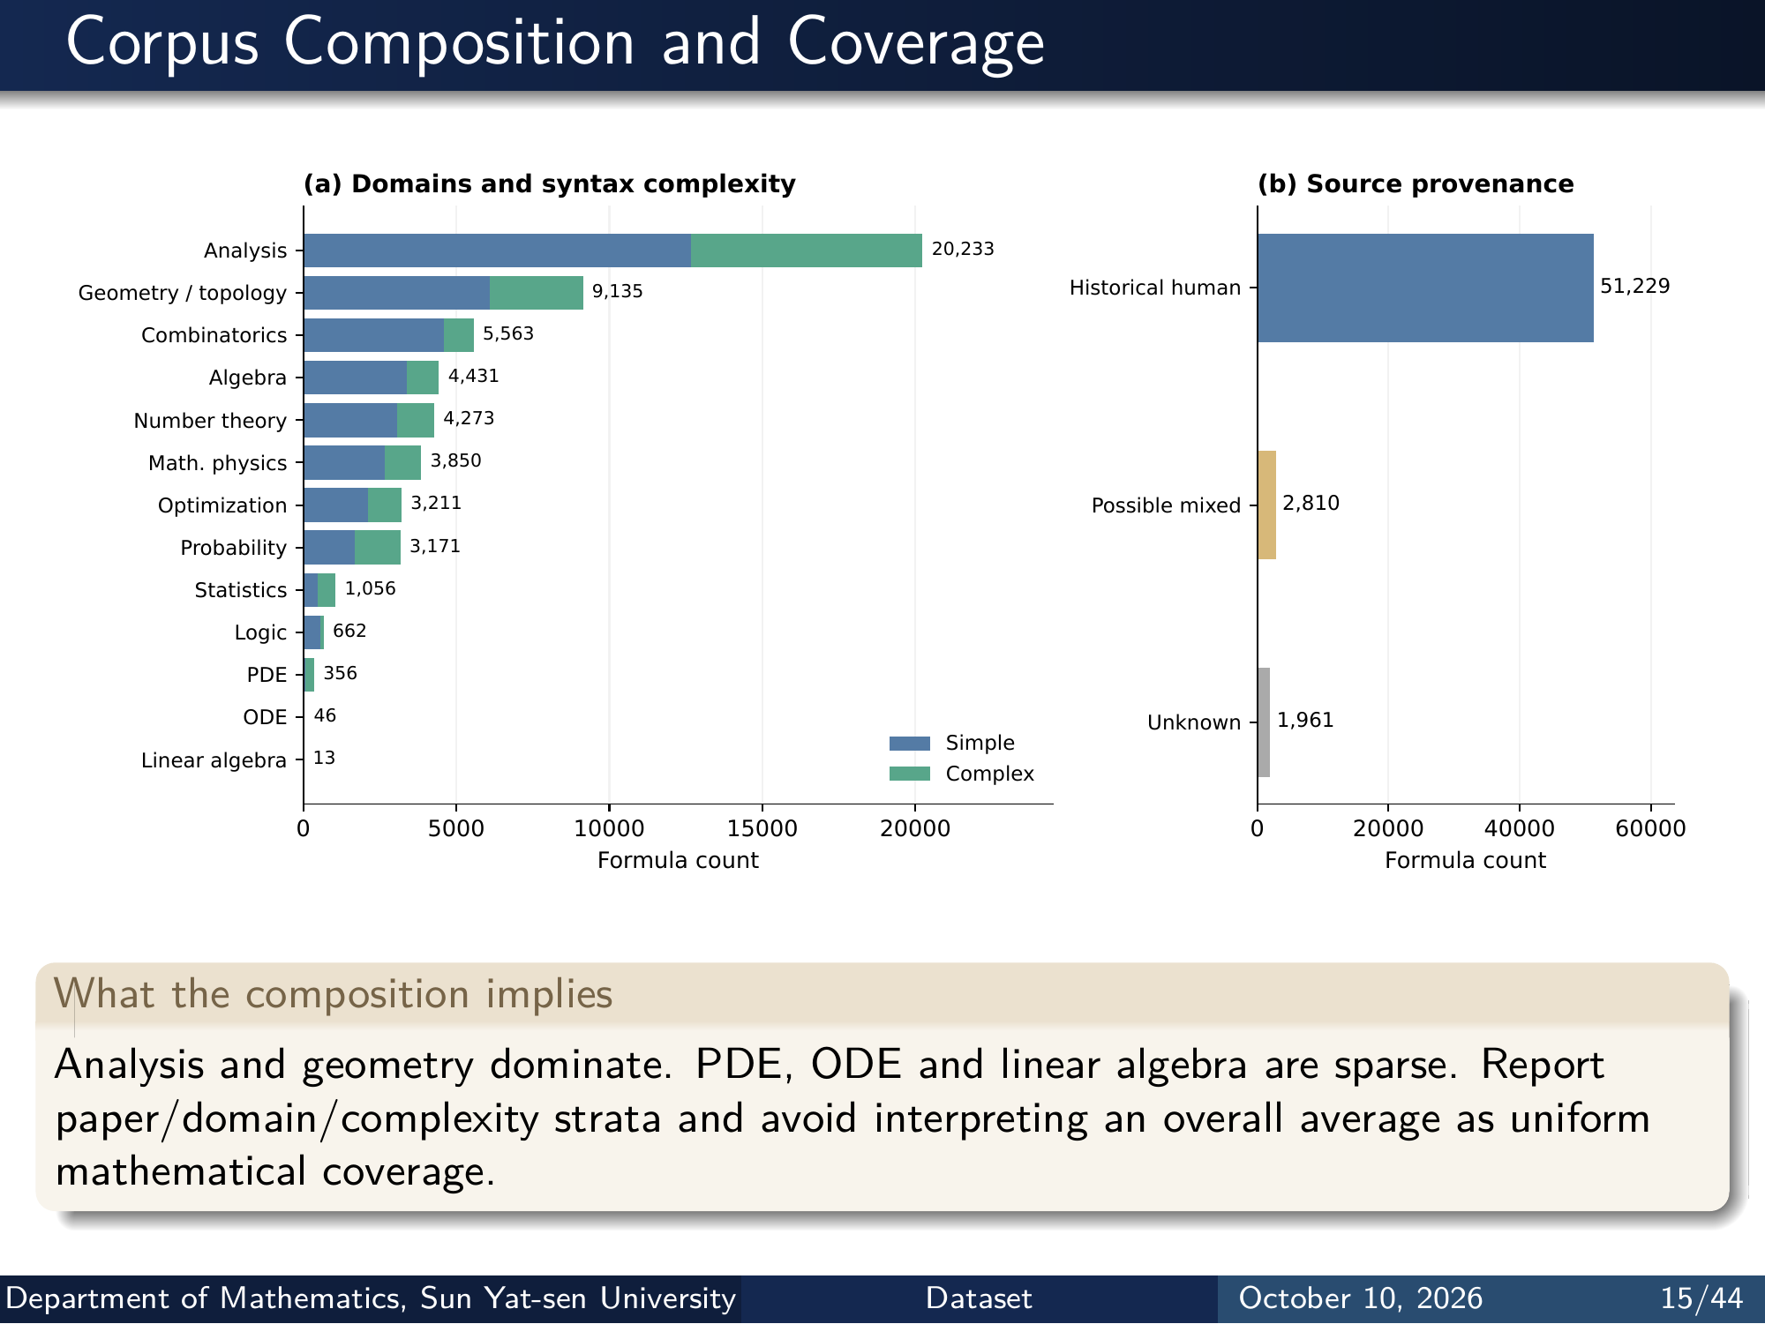
Notes:
Corpus Composition and Coverage
0 5000 10000 15000 20000
Formula count
Analysis
Geometry / topology
Combinatorics
Algebra
Number theory
Math. physics
Optimization
Probability
Statistics
Logic
PDE
ODE
Linear algebra
20,233
9,135
5,563
4,431
4,273
3,850
3,211
3,171
1,056
662
356
46
13
(a) Domains and syntax complexity
Simple
Complex
0 20000 40000 60000
Formula count
Historical human
Possible mixed
Unknown
51,229
2,810
1,961
(b) Source provenance
What the composition implies
Analysis and geometry dominate. PDE, ODE and linear algebra are sparse. Report
paper/domain/complexity strata and avoid interpreting an overall average as uniform
mathematical coverage.
Department of Mathematics, Sun Yat-sen University Dataset October 10, 2026 15/44
Editable master: mathematical_tokenizer.tex in companion source bundle; this page preserves the Beamer rendering.

Slide 17
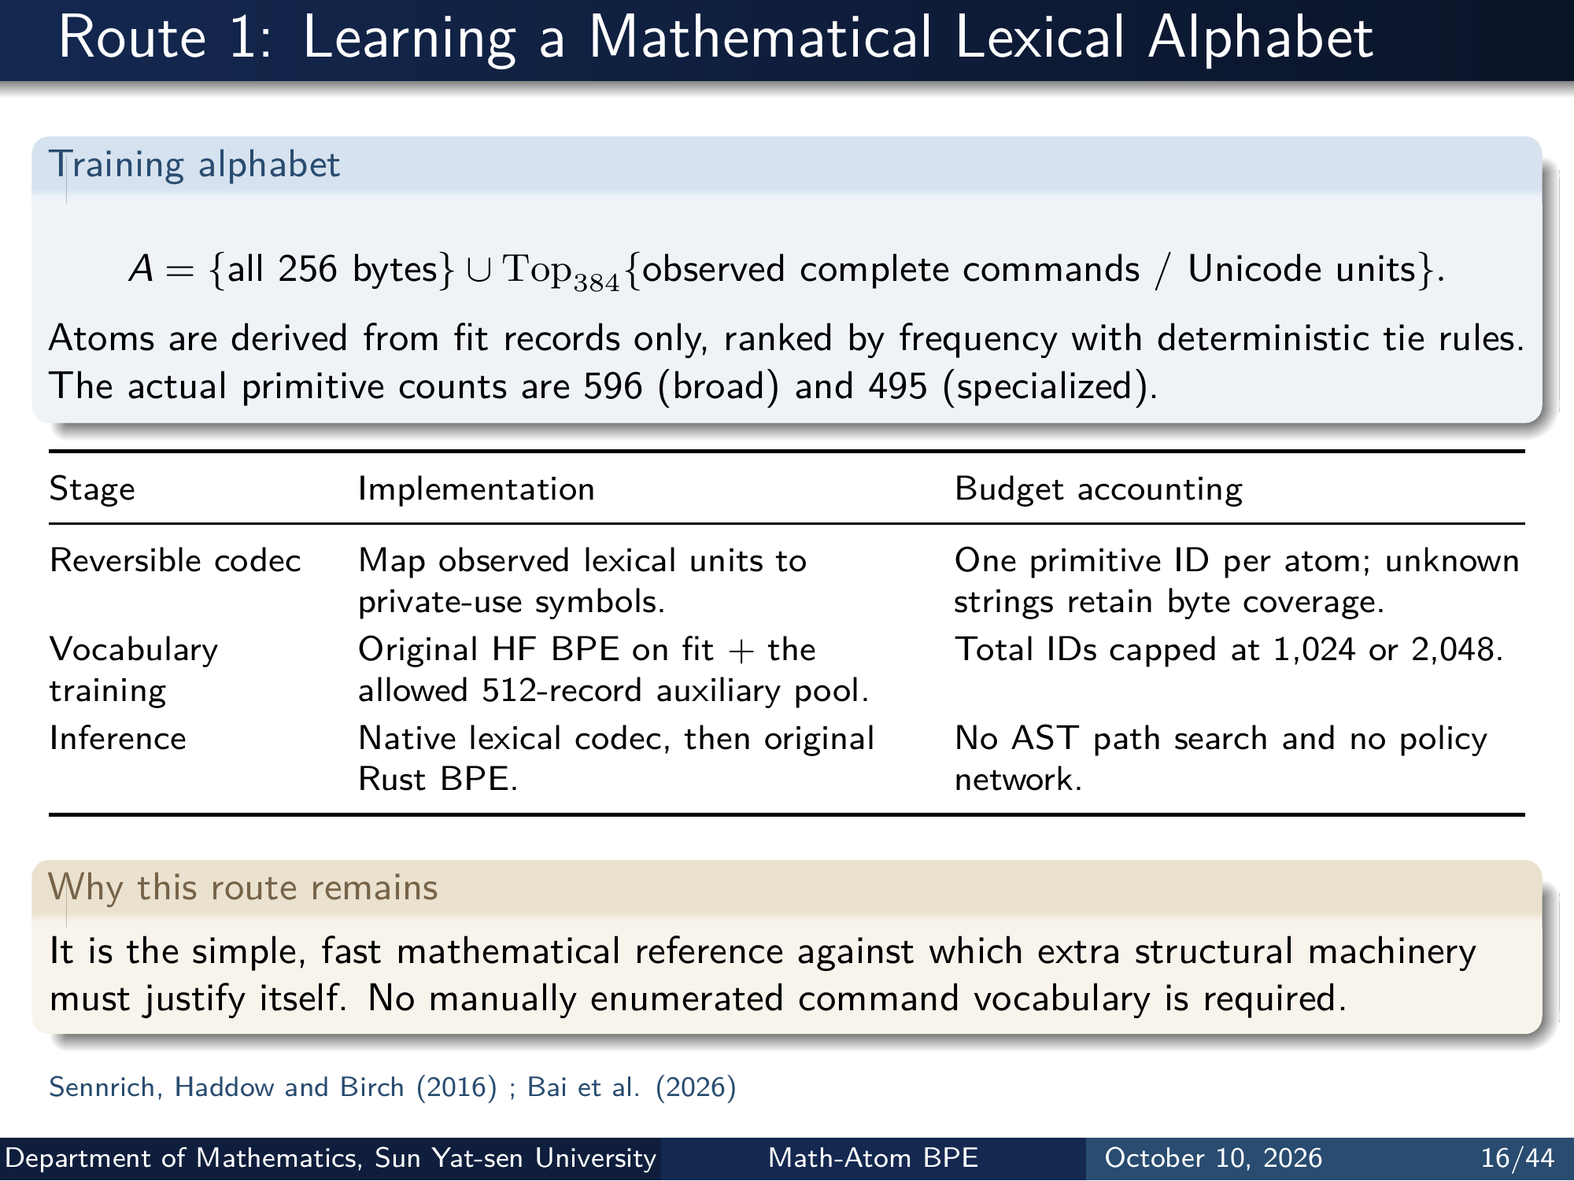
Notes:
Route 1: Learning a Mathematical Lexical Alphabet
Training alphabet
A = {all 256 bytes } ∪ Top384{observed complete commands / Unicode units }.
Atoms are derived from fit records only, ranked by frequency with deterministic tie rules.
The actual primitive counts are 596 (broad) and 495 (specialized).
Stage Implementation Budget accounting
Reversible codec Map observed lexical units to
private-use symbols.
One primitive ID per atom; unknown
strings retain byte coverage.
Vocabulary
training
Original HF BPE on fit + the
allowed 512-record auxiliary pool.
Total IDs capped at 1,024 or 2,048.
Inference Native lexical codec, then original
Rust BPE.
No AST path search and no policy
network.
Why this route remains
It is the simple, fast mathematical reference against which extra structural machinery
must justify itself. No manually enumerated command vocabulary is required.
Sennrich, Haddow and Birch (2016) ; Bai et al. (2026)
Department of Mathematics, Sun Yat-sen University Math-Atom BPE October 10, 2026 16/44
Editable master: mathematical_tokenizer.tex in companion source bundle; this page preserves the Beamer rendering.

Slide 18
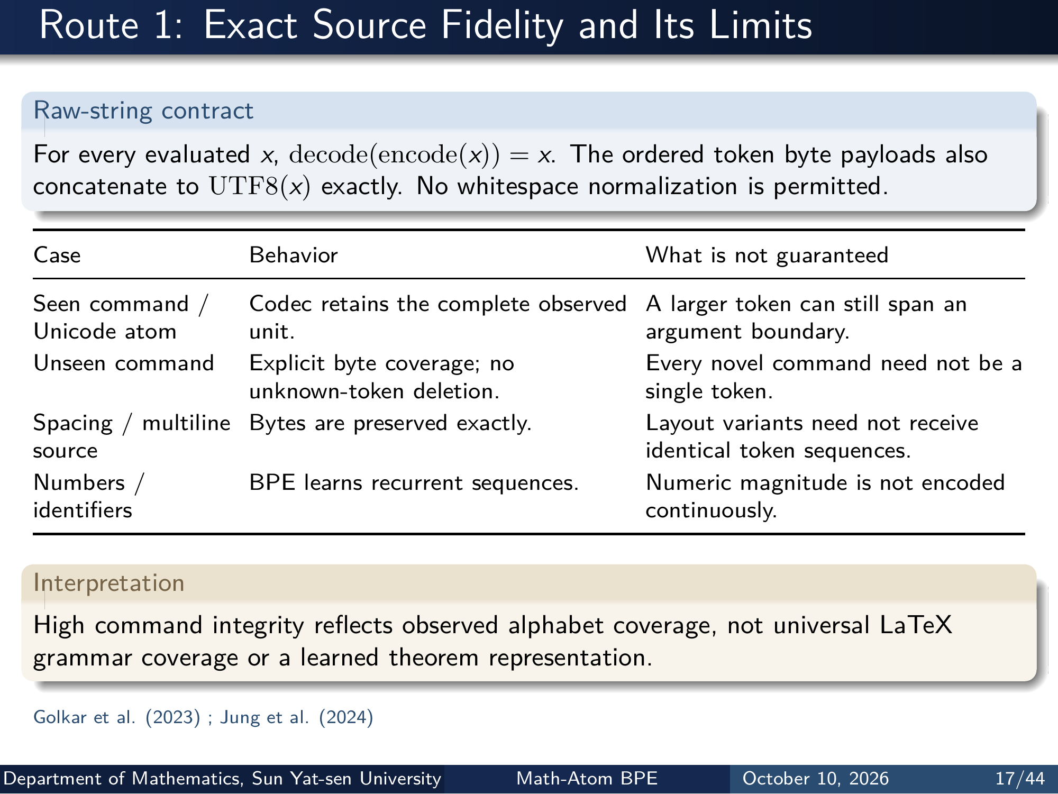
Notes:
Route 1: Exact Source Fidelity and Its Limits
Raw-string contract
For every evaluated x, decode(encode(x)) = x. The ordered token byte payloads also
concatenate to UTF8(x) exactly. No whitespace normalization is permitted.
Case Behavior What is not guaranteed
Seen command /
Unicode atom
Codec retains the complete observed
unit.
A larger token can still span an
argument boundary.
Unseen command Explicit byte coverage; no
unknown-token deletion.
Every novel command need not be a
single token.
Spacing / multiline
source
Bytes are preserved exactly. Layout variants need not receive
identical token sequences.
Numbers /
identifiers
BPE learns recurrent sequences. Numeric magnitude is not encoded
continuously.
Interpretation
High command integrity reflects observed alphabet coverage, not universal LaTeX
grammar coverage or a learned theorem representation.
Golkar et al. (2023) ; Jung et al. (2024)
Department of Mathematics, Sun Yat-sen University Math-Atom BPE October 10, 2026 17/44
Editable master: mathematical_tokenizer.tex in companion source bundle; this page preserves the Beamer rendering.

Slide 19
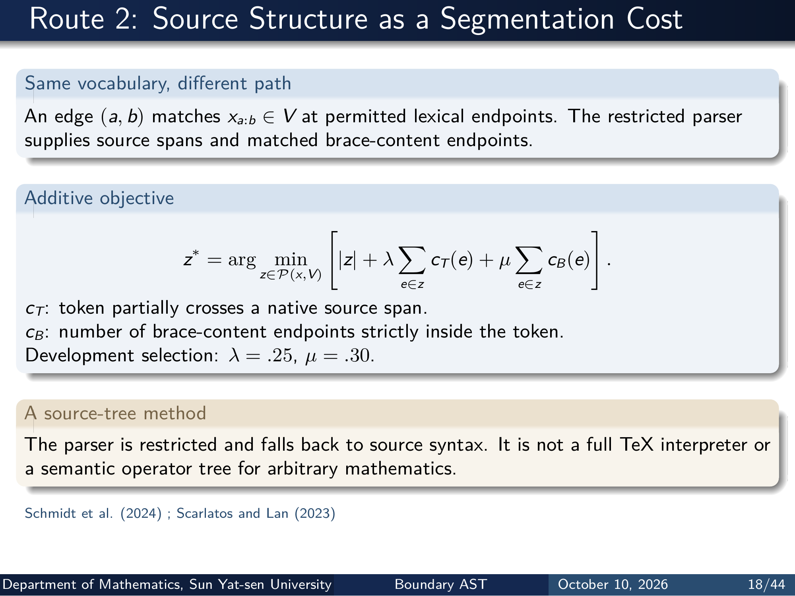
Notes:
Route 2: Source Structure as a Segmentation Cost
Same vocabulary, different path
An edge (a, b) matches xa:b ∈ V at permitted lexical endpoints. The restricted parser
supplies source spans and matched brace-content endpoints.
Additive objective
z∗ = arg min
z∈P(x,V)
[
|z| + λ
∑
e∈z
cT(e) + µ
∑
e∈z
cB(e)
]
.
cT: token partially crosses a native source span.
cB: number of brace-content endpoints strictly inside the token.
Development selection: λ = .25, µ = .30.
A source-tree method
The parser is restricted and falls back to source syntax. It is not a full TeX interpreter or
a semantic operator tree for arbitrary mathematics.
Schmidt et al. (2024) ; Scarlatos and Lan (2023)
Department of Mathematics, Sun Yat-sen University Boundary AST October 10, 2026 18/44
Editable master: mathematical_tokenizer.tex in companion source bundle; this page preserves the Beamer rendering.

Slide 20
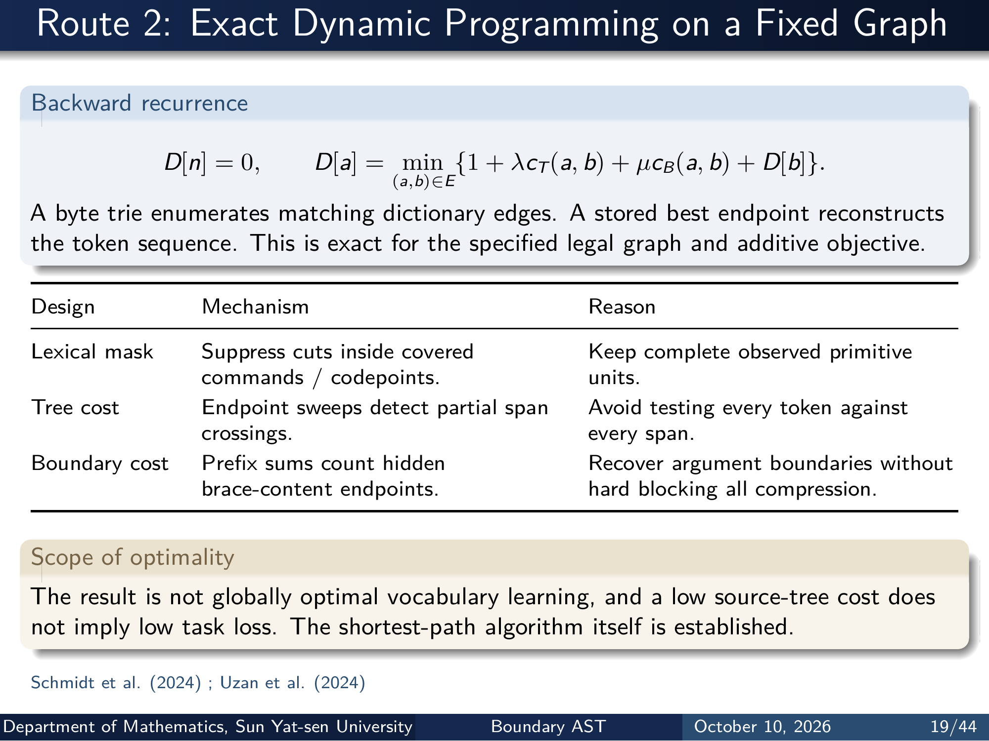
Notes:
Route 2: Exact Dynamic Programming on a Fixed Graph
Backward recurrence
D[n] = 0 , D[a] = min
(a,b)∈E
{1 + λcT(a, b) + µcB(a, b) + D[b]}.
A byte trie enumerates matching dictionary edges. A stored best endpoint reconstructs
the token sequence. This is exact for the specified legal graph and additive objective.
Design Mechanism Reason
Lexical mask Suppress cuts inside covered
commands / codepoints.
Keep complete observed primitive
units.
Tree cost Endpoint sweeps detect partial span
crossings.
Avoid testing every token against
every span.
Boundary cost Prefix sums count hidden
brace-content endpoints.
Recover argument boundaries without
hard blocking all compression.
Scope of optimality
The result is not globally optimal vocabulary learning, and a low source-tree cost does
not imply low task loss. The shortest-path algorithm itself is established.
Schmidt et al. (2024) ; Uzan et al. (2024)
Department of Mathematics, Sun Yat-sen University Boundary AST October 10, 2026 19/44
Editable master: mathematical_tokenizer.tex in companion source bundle; this page preserves the Beamer rendering.

Slide 21
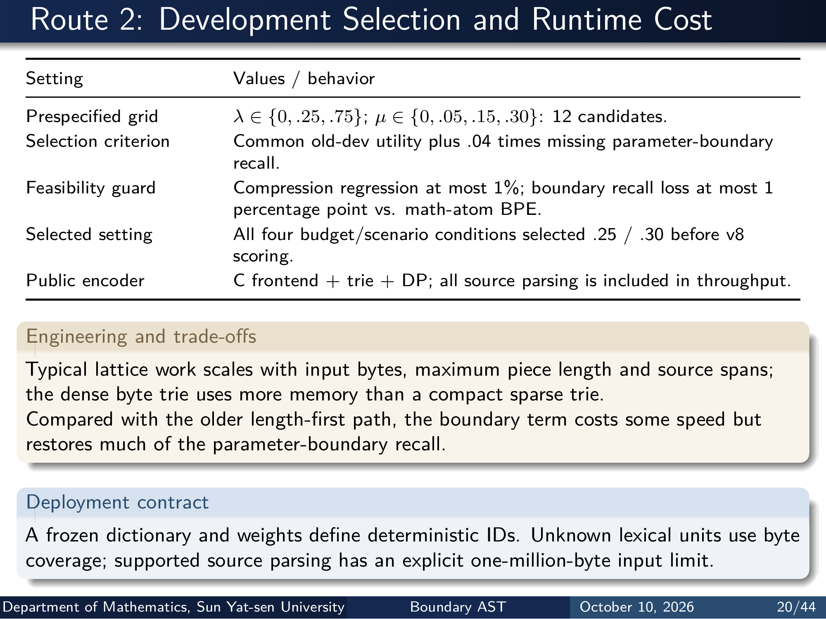
Notes:
Route 2: Development Selection and Runtime Cost
Setting Values / behavior
Prespecified grid λ ∈ {0, .25, .75}; µ ∈ {0, .05, .15, .30}: 12 candidates.
Selection criterion Common old-dev utility plus .04 times missing parameter-boundary
recall.
Feasibility guard Compression regression at most 1%; boundary recall loss at most 1
percentage point vs. math-atom BPE.
Selected setting All four budget/scenario conditions selected .25 / .30 before v8
scoring.
Public encoder C frontend + trie + DP; all source parsing is included in throughput.
Engineering and trade-offs
Typical lattice work scales with input bytes, maximum piece length and source spans;
the dense byte trie uses more memory than a compact sparse trie.
Compared with the older length-first path, the boundary term costs some speed but
restores much of the parameter-boundary recall.
Deployment contract
A frozen dictionary and weights define deterministic IDs. Unknown lexical units use byte
coverage; supported source parsing has an explicit one-million-byte input limit.
Department of Mathematics, Sun Yat-sen University Boundary AST October 10, 2026 20/44
Editable master: mathematical_tokenizer.tex in companion source bundle; this page preserves the Beamer rendering.

Slide 22
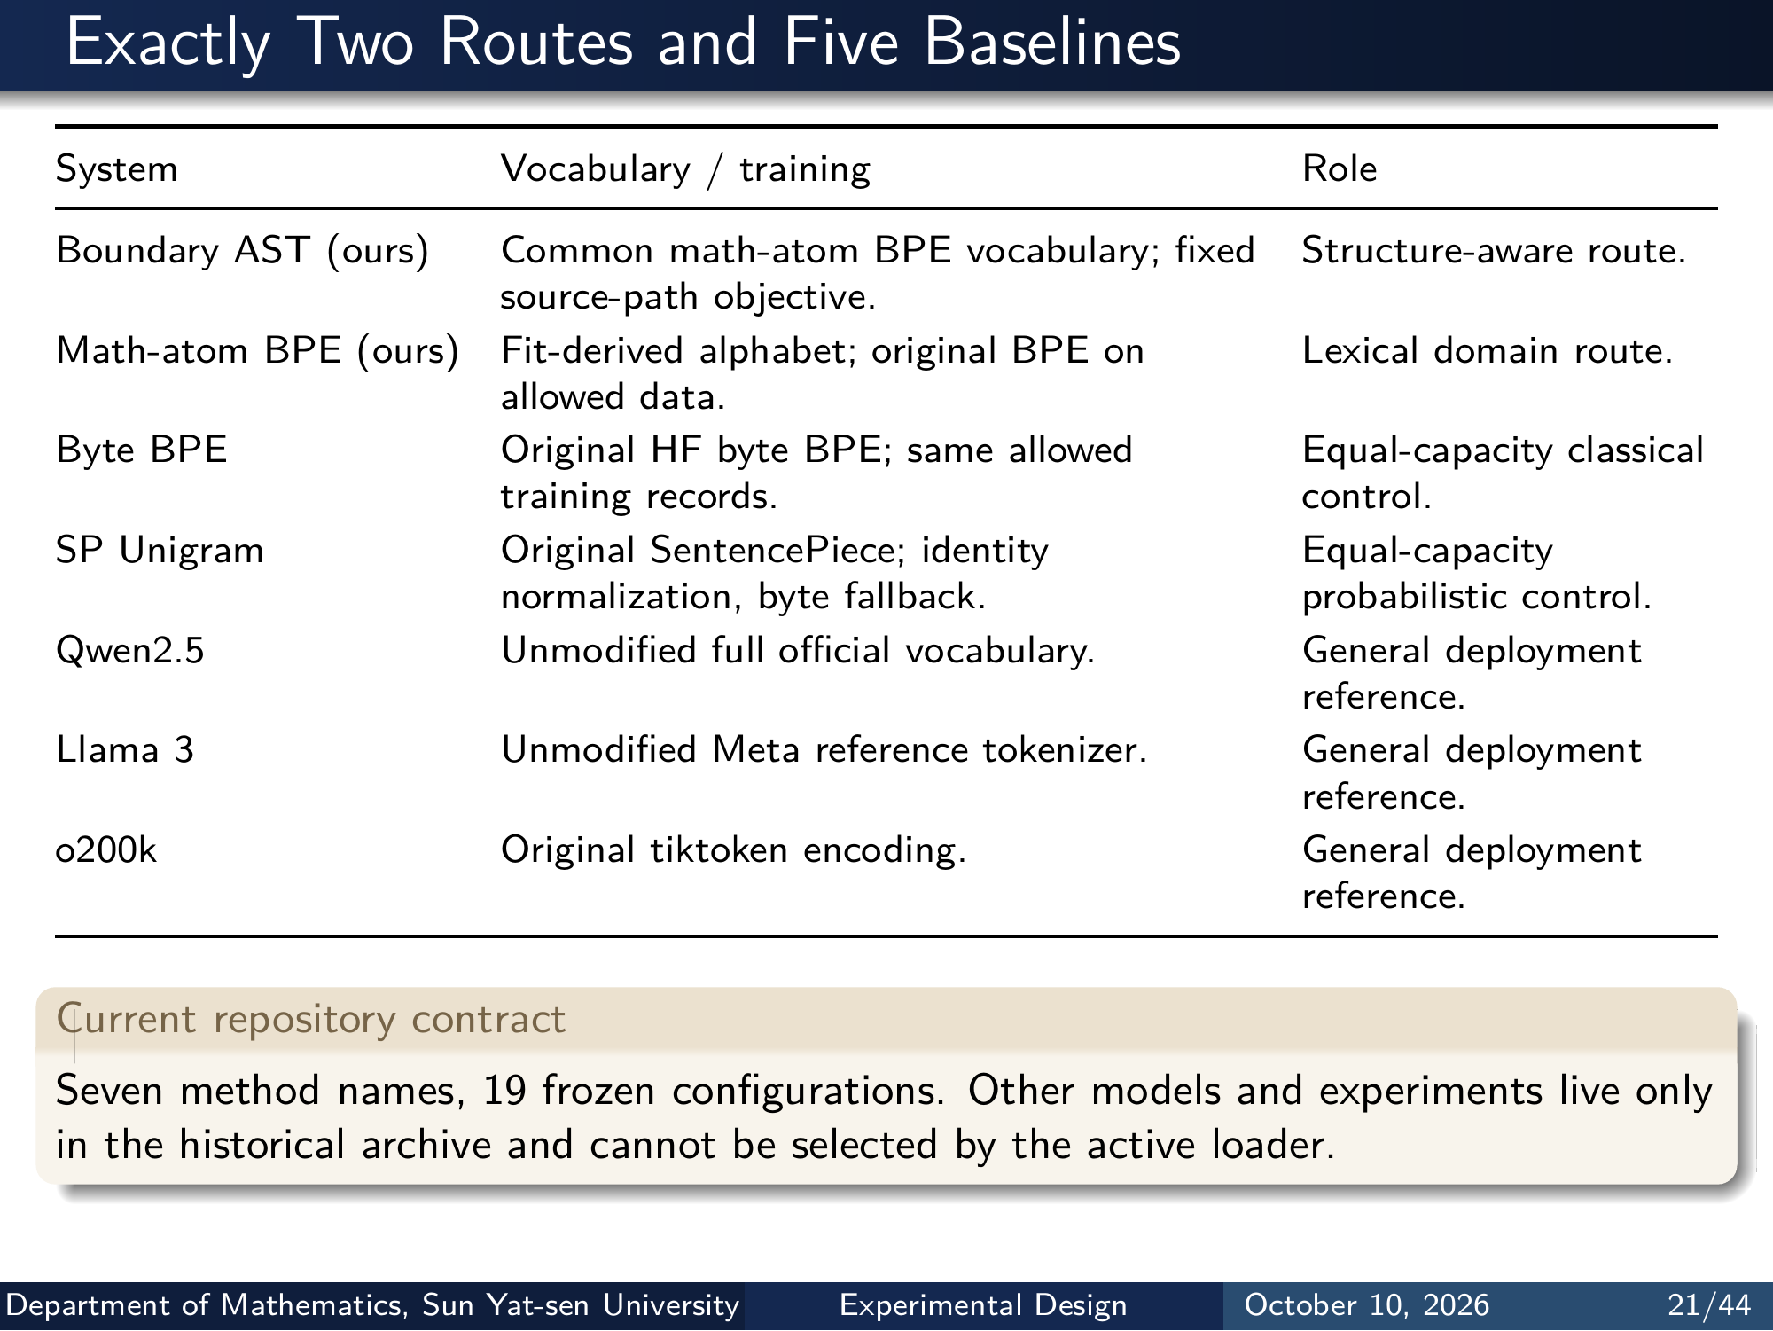
Notes:
Exactly Two Routes and Five Baselines
System Vocabulary / training Role
Boundary AST (ours) Common math-atom BPE vocabulary; fixed
source-path objective.
Structure-aware route.
Math-atom BPE (ours) Fit-derived alphabet; original BPE on
allowed data.
Lexical domain route.
Byte BPE Original HF byte BPE; same allowed
training records.
Equal-capacity classical
control.
SP Unigram Original SentencePiece; identity
normalization, byte fallback.
Equal-capacity
probabilistic control.
Qwen2.5 Unmodified full oﬀicial vocabulary. General deployment
reference.
Llama 3 Unmodified Meta reference tokenizer. General deployment
reference.
o200k Original tiktoken encoding. General deployment
reference.
Current repository contract
Seven method names, 19 frozen configurations. Other models and experiments live only
in the historical archive and cannot be selected by the active loader.
Department of Mathematics, Sun Yat-sen University Experimental Design October 10, 2026 21/44
Editable master: mathematical_tokenizer.tex in companion source bundle; this page preserves the Beamer rendering.

Slide 23
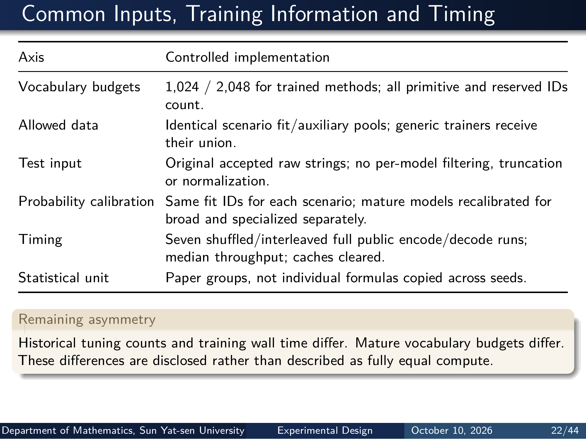
Notes:
Common Inputs, Training Information and Timing
Axis Controlled implementation
Vocabulary budgets 1,024 / 2,048 for trained methods; all primitive and reserved IDs
count.
Allowed data Identical scenario fit/auxiliary pools; generic trainers receive
their union.
Test input Original accepted raw strings; no per-model filtering, truncation
or normalization.
Probability calibration Same fit IDs for each scenario; mature models recalibrated for
broad and specialized separately.
Timing Seven shuffled/interleaved full public encode/decode runs;
median throughput; caches cleared.
Statistical unit Paper groups, not individual formulas copied across seeds.
Remaining asymmetry
Historical tuning counts and training wall time differ. Mature vocabulary budgets differ.
These differences are disclosed rather than described as fully equal compute.
Department of Mathematics, Sun Yat-sen University Experimental Design October 10, 2026 22/44
Editable master: mathematical_tokenizer.tex in companion source bundle; this page preserves the Beamer rendering.

Slide 24
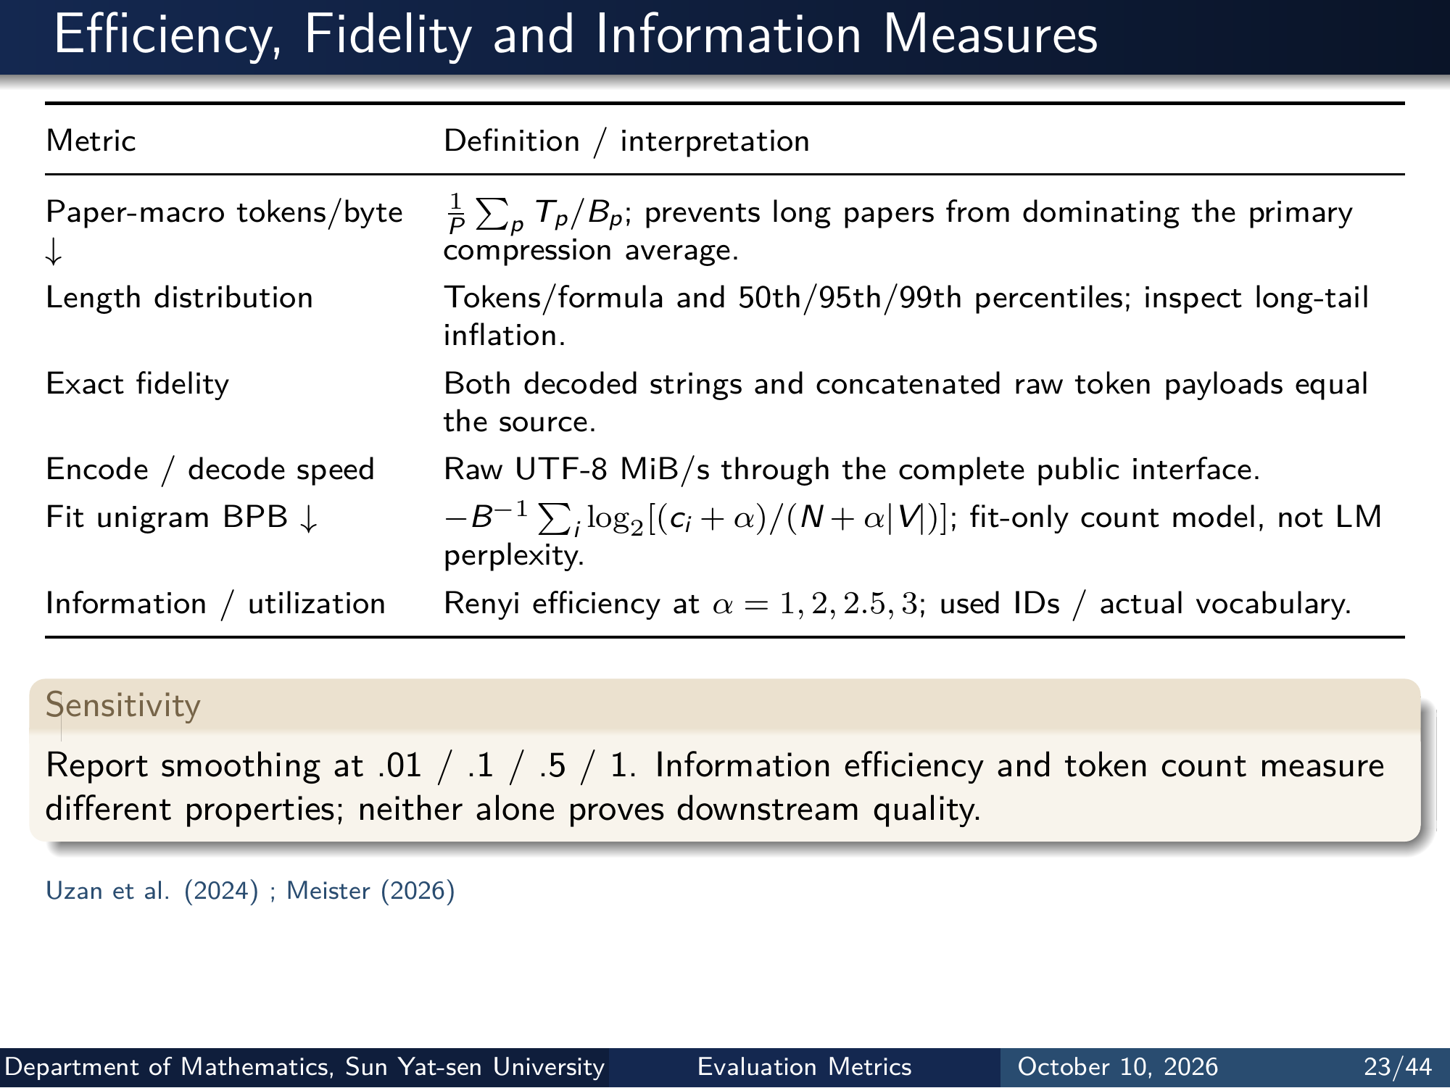
Notes:
Eﬀiciency, Fidelity and Information Measures
Metric Definition / interpretation
Paper-macro tokens/byte
↓
1
P
∑
p Tp/Bp; prevents long papers from dominating the primary
compression average.
Length distribution Tokens/formula and 50th/95th/99th percentiles; inspect long-tail
inflation.
Exact fidelity Both decoded strings and concatenated raw token payloads equal
the source.
Encode / decode speed Raw UTF-8 MiB/s through the complete public interface.
Fit unigram BPB ↓ −B−1 ∑
i log2[(ci + α)/(N + α|V|)]; fit-only count model, not LM
perplexity.
Information / utilization Renyi eﬀiciency at α = 1, 2, 2.5, 3; used IDs / actual vocabulary.
Sensitivity
Report smoothing at .01 / .1 / .5 / 1. Information eﬀiciency and token count measure
different properties; neither alone proves downstream quality.
Uzan et al. (2024) ; Meister (2026)
Department of Mathematics, Sun Yat-sen University Evaluation Metrics October 10, 2026 23/44
Editable master: mathematical_tokenizer.tex in companion source bundle; this page preserves the Beamer rendering.

Slide 25
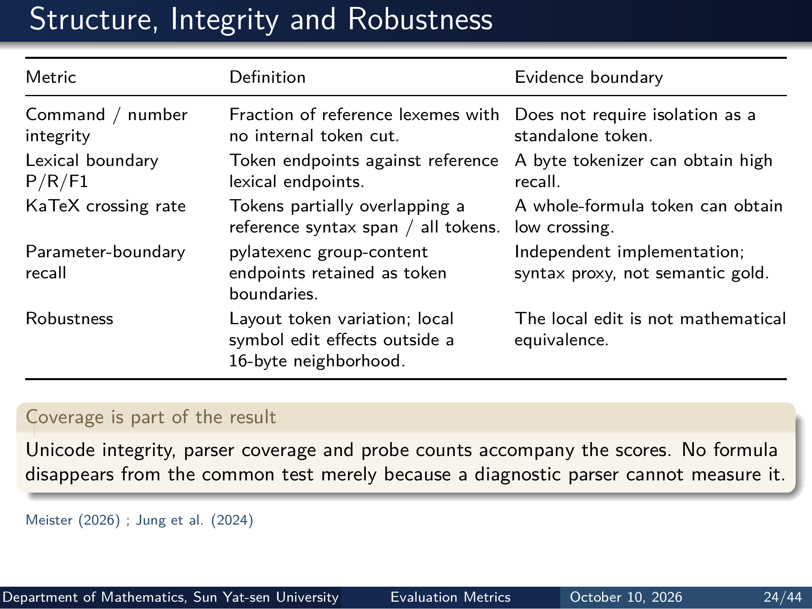
Notes:
Structure, Integrity and Robustness
Metric Definition Evidence boundary
Command / number
integrity
Fraction of reference lexemes with
no internal token cut.
Does not require isolation as a
standalone token.
Lexical boundary
P/R/F1
Token endpoints against reference
lexical endpoints.
A byte tokenizer can obtain high
recall.
KaTeX crossing rate Tokens partially overlapping a
reference syntax span / all tokens.
A whole-formula token can obtain
low crossing.
Parameter-boundary
recall
pylatexenc group-content
endpoints retained as token
boundaries.
Independent implementation;
syntax proxy, not semantic gold.
Robustness Layout token variation; local
symbol edit effects outside a
16-byte neighborhood.
The local edit is not mathematical
equivalence.
Coverage is part of the result
Unicode integrity, parser coverage and probe counts accompany the scores. No formula
disappears from the common test merely because a diagnostic parser cannot measure it.
Meister (2026) ; Jung et al. (2024)
Department of Mathematics, Sun Yat-sen University Evaluation Metrics October 10, 2026 24/44
Editable master: mathematical_tokenizer.tex in companion source bundle; this page preserves the Beamer rendering.

Slide 26
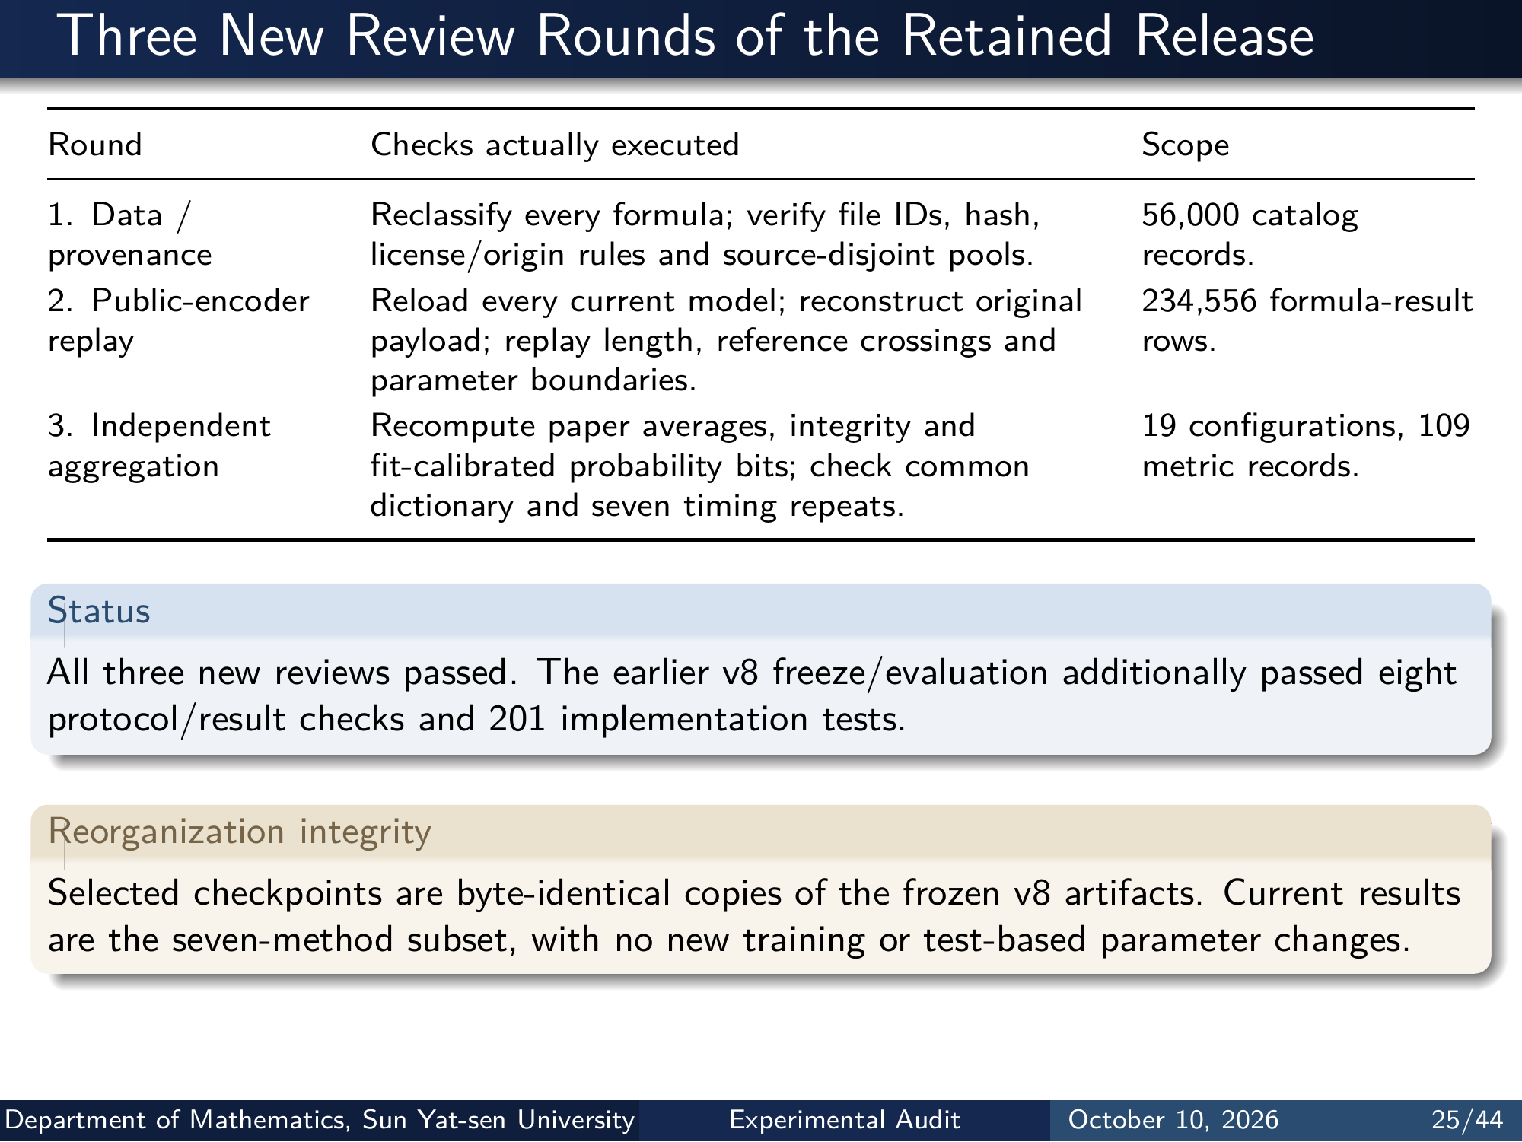
Notes:
Three New Review Rounds of the Retained Release
Round Checks actually executed Scope
1. Data /
provenance
Reclassify every formula; verify file IDs, hash,
license/origin rules and source-disjoint pools.
56,000 catalog
records.
2. Public-encoder
replay
Reload every current model; reconstruct original
payload; replay length, reference crossings and
parameter boundaries.
234,556 formula-result
rows.
3. Independent
aggregation
Recompute paper averages, integrity and
fit-calibrated probability bits; check common
dictionary and seven timing repeats.
19 configurations, 109
metric records.
Status
All three new reviews passed. The earlier v8 freeze/evaluation additionally passed eight
protocol/result checks and 201 implementation tests.
Reorganization integrity
Selected checkpoints are byte-identical copies of the frozen v8 artifacts. Current results
are the seven-method subset, with no new training or test-based parameter changes.
Department of Mathematics, Sun Yat-sen University Experimental Audit October 10, 2026 25/44
Editable master: mathematical_tokenizer.tex in companion source bundle; this page preserves the Beamer rendering.

Slide 27
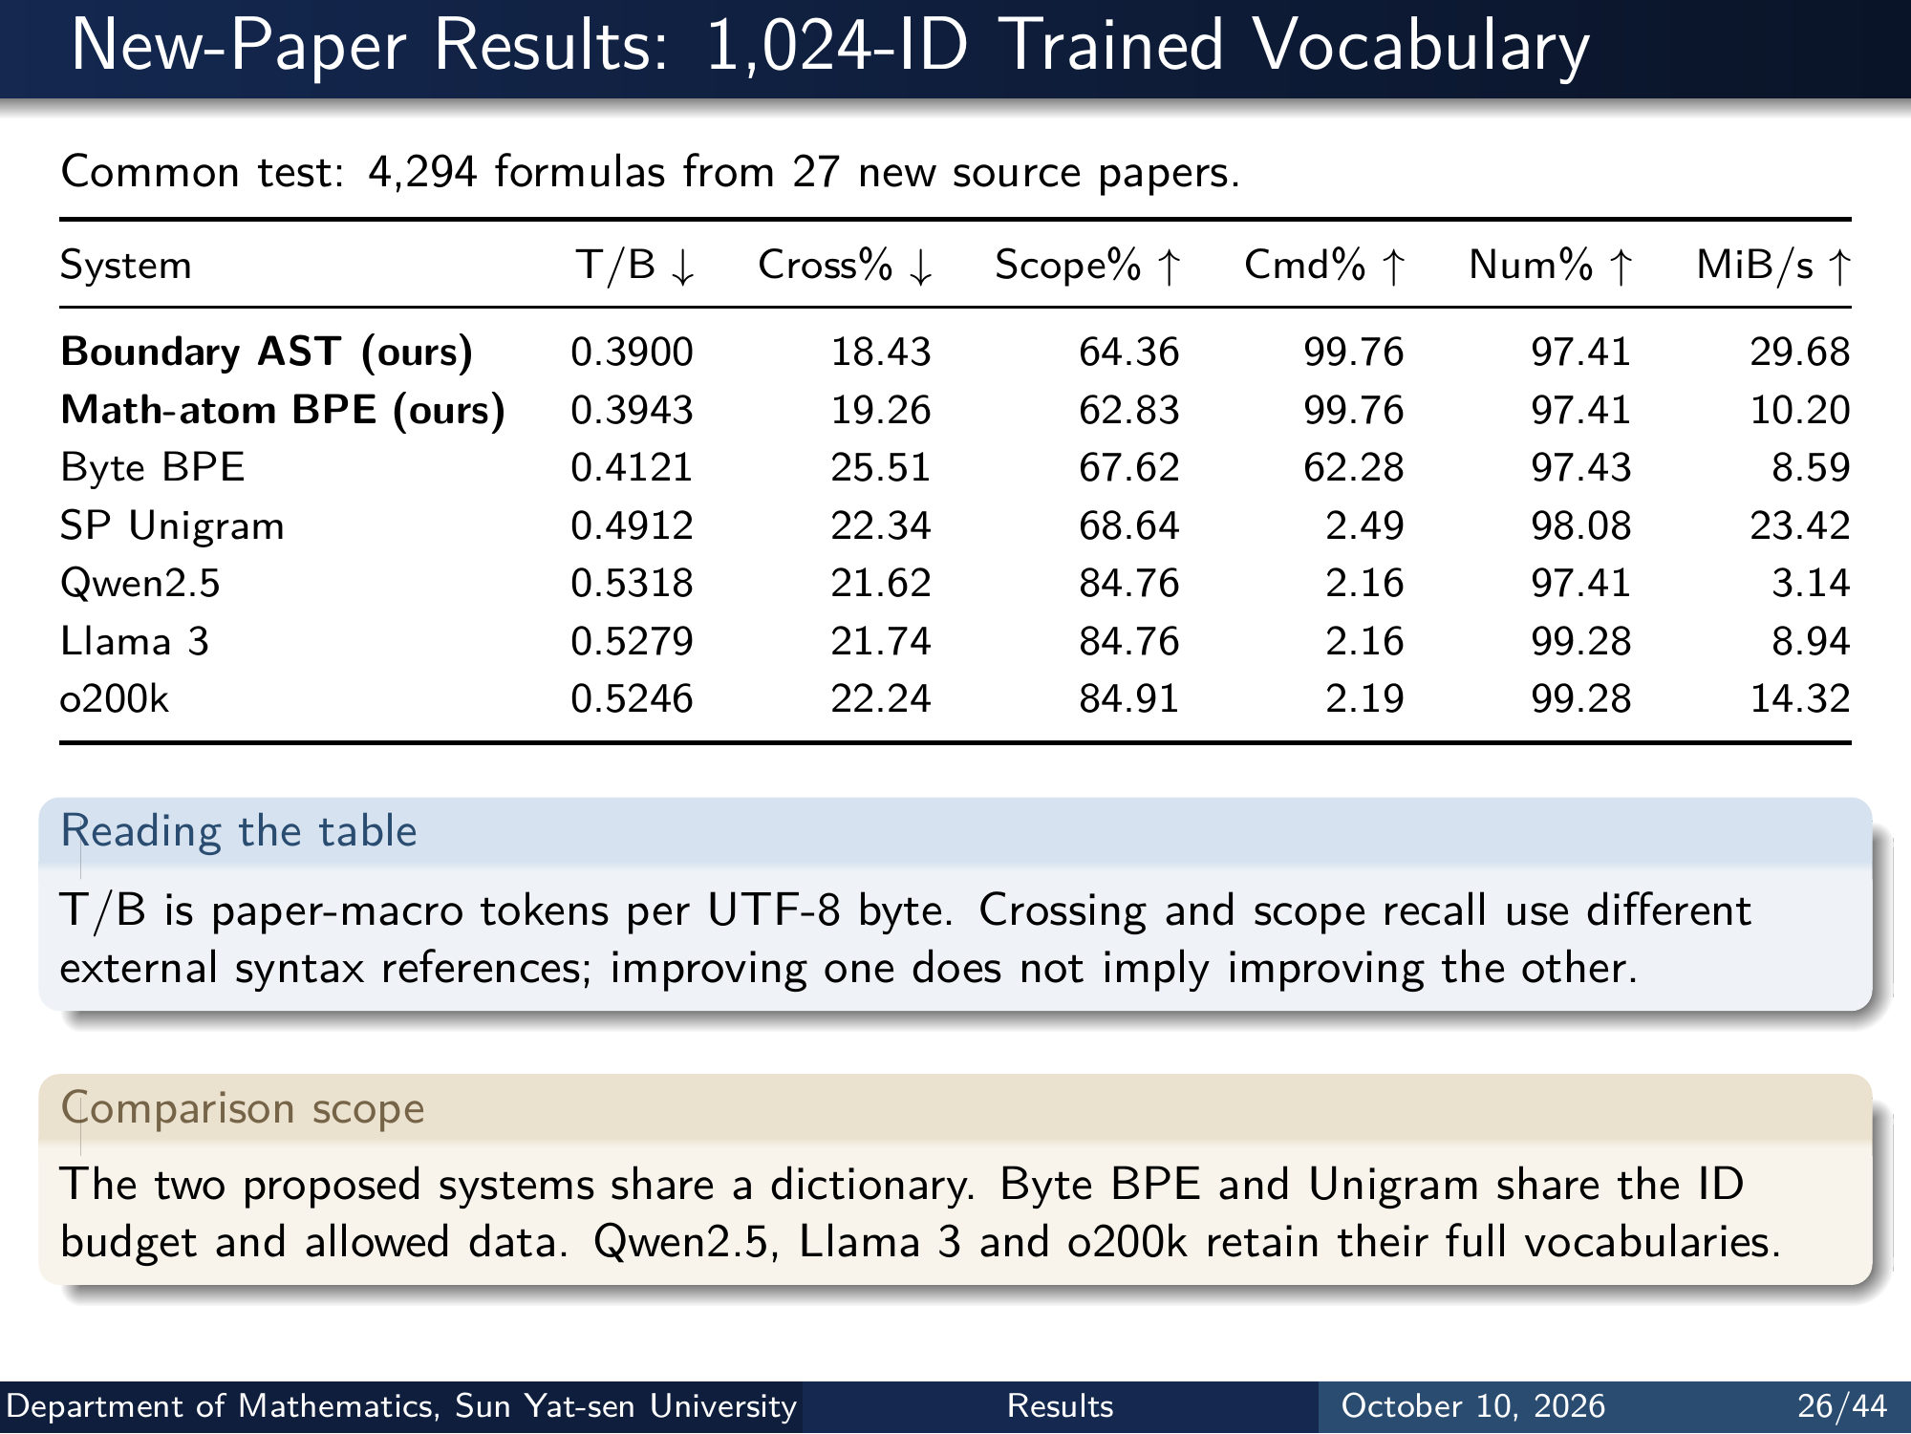
Notes:
New-Paper Results: 1,024-ID Trained Vocabulary
Common test: 4,294 formulas from 27 new source papers.
System T/B ↓ Cross% ↓ Scope% ↑ Cmd% ↑ Num% ↑ MiB/s ↑
Boundary AST (ours) 0.3900 18.43 64.36 99.76 97.41 29.68
Math-atom BPE (ours) 0.3943 19.26 62.83 99.76 97.41 10.20
Byte BPE 0.4121 25.51 67.62 62.28 97.43 8.59
SP Unigram 0.4912 22.34 68.64 2.49 98.08 23.42
Qwen2.5 0.5318 21.62 84.76 2.16 97.41 3.14
Llama 3 0.5279 21.74 84.76 2.16 99.28 8.94
o200k 0.5246 22.24 84.91 2.19 99.28 14.32
Reading the table
T/B is paper-macro tokens per UTF-8 byte. Crossing and scope recall use different
external syntax references; improving one does not imply improving the other.
Comparison scope
The two proposed systems share a dictionary. Byte BPE and Unigram share the ID
budget and allowed data. Qwen2.5, Llama 3 and o200k retain their full vocabularies.
Department of Mathematics, Sun Yat-sen University Results October 10, 2026 26/44
Editable master: mathematical_tokenizer.tex in companion source bundle; this page preserves the Beamer rendering.

Slide 28

Notes:
New-Paper Results: 2,048-ID Trained Vocabulary
Common test: 4,294 formulas from 27 new source papers.
System T/B ↓ Cross% ↓ Scope% ↑ Cmd% ↑ Num% ↑ MiB/s ↑
Boundary AST (ours) 0.3296 24.17 53.87 99.76 97.89 28.65
Math-atom BPE (ours) 0.3372 24.87 51.18 99.76 97.57 9.56
Byte BPE 0.3504 31.46 59.79 74.75 97.61 8.81
SP Unigram 0.4625 24.03 67.07 4.16 98.71 23.54
Qwen2.5 0.5318 21.62 84.76 2.16 97.41 3.14
Llama 3 0.5279 21.74 84.76 2.16 99.28 8.94
o200k 0.5246 22.24 84.91 2.19 99.28 14.32
Reading the table
T/B is paper-macro tokens per UTF-8 byte. Crossing and scope recall use different
external syntax references; improving one does not imply improving the other.
Comparison scope
The two proposed systems share a dictionary. Byte BPE and Unigram share the ID
budget and allowed data. Qwen2.5, Llama 3 and o200k retain their full vocabularies.
Department of Mathematics, Sun Yat-sen University Results October 10, 2026 27/44
Editable master: mathematical_tokenizer.tex in companion source bundle; this page preserves the Beamer rendering.

Slide 29
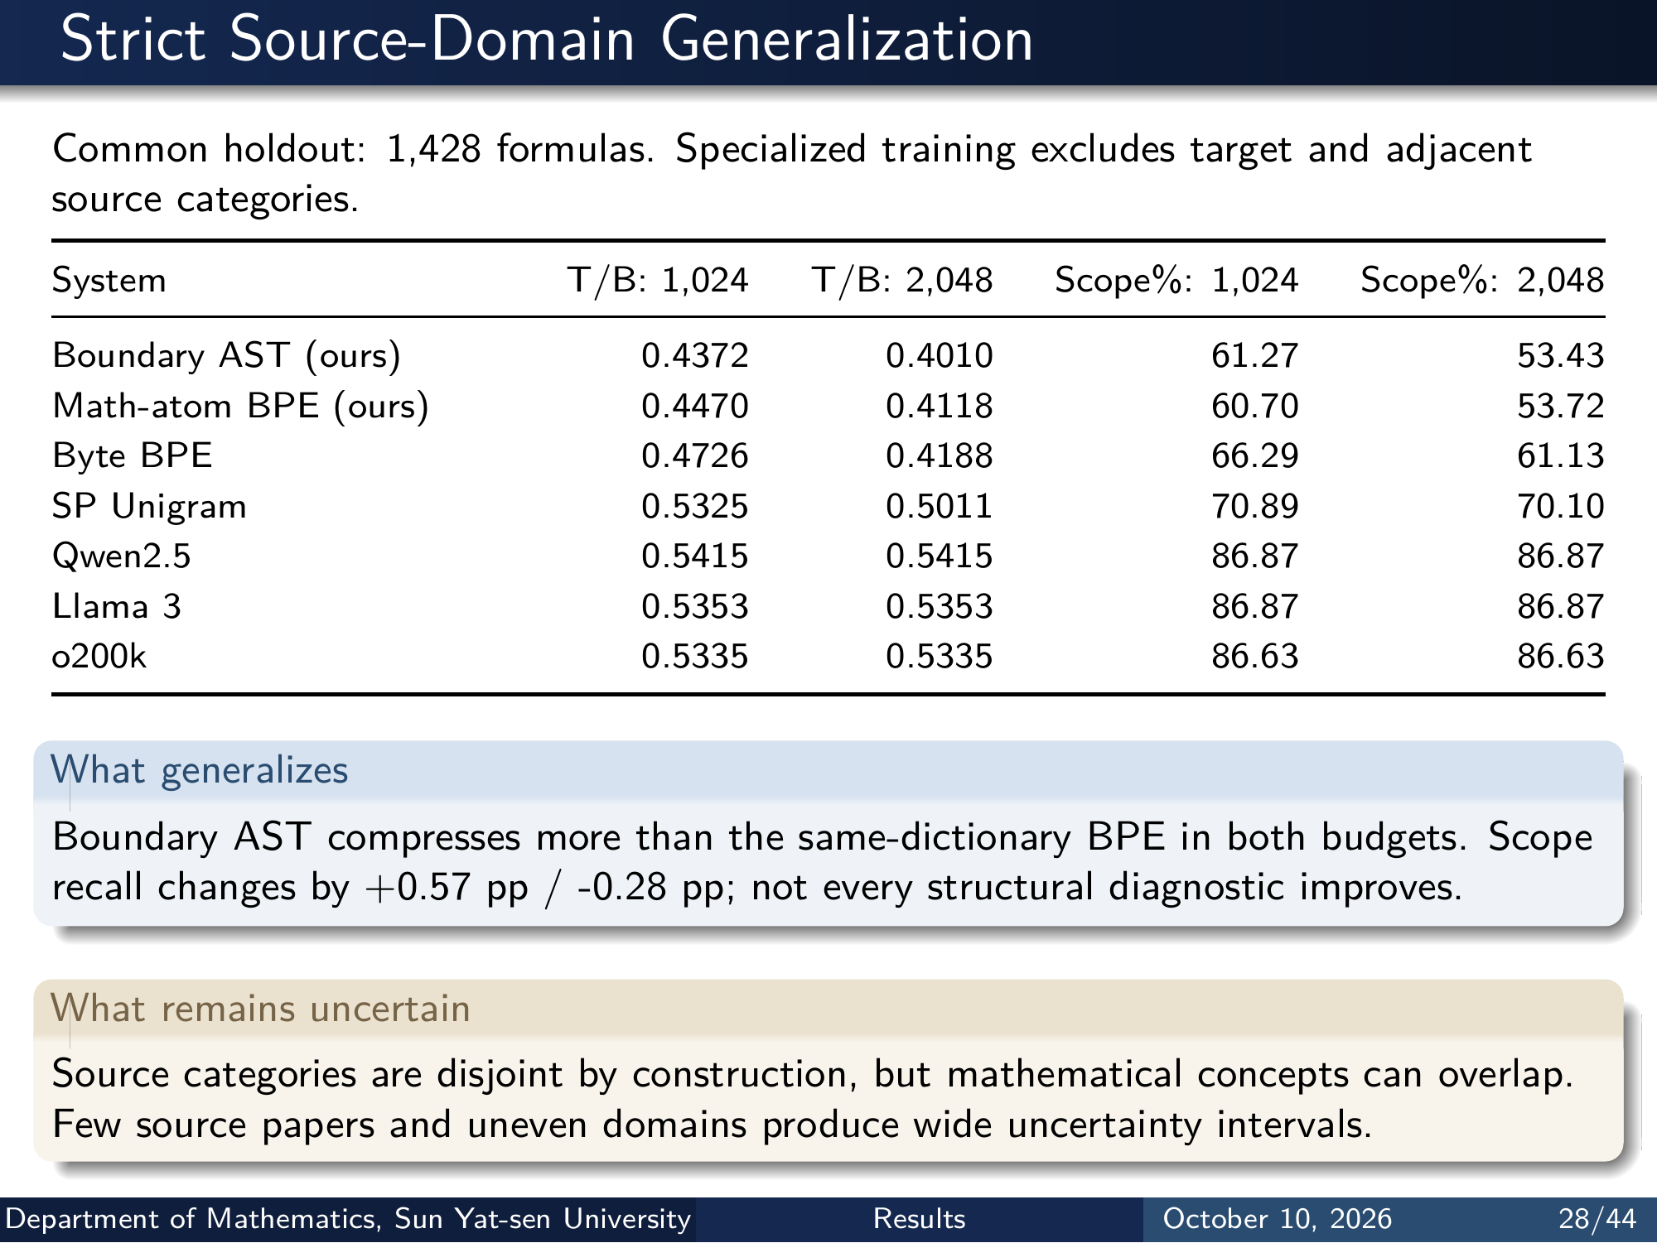
Notes:
Strict Source-Domain Generalization
Common holdout: 1,428 formulas. Specialized training excludes target and adjacent
source categories.
System T/B: 1,024 T/B: 2,048 Scope%: 1,024 Scope%: 2,048
Boundary AST (ours) 0.4372 0.4010 61.27 53.43
Math-atom BPE (ours) 0.4470 0.4118 60.70 53.72
Byte BPE 0.4726 0.4188 66.29 61.13
SP Unigram 0.5325 0.5011 70.89 70.10
Qwen2.5 0.5415 0.5415 86.87 86.87
Llama 3 0.5353 0.5353 86.87 86.87
o200k 0.5335 0.5335 86.63 86.63
What generalizes
Boundary AST compresses more than the same-dictionary BPE in both budgets. Scope
recall changes by +0.57 pp / -0.28 pp; not every structural diagnostic improves.
What remains uncertain
Source categories are disjoint by construction, but mathematical concepts can overlap.
Few source papers and uneven domains produce wide uncertainty intervals.
Department of Mathematics, Sun Yat-sen University Results October 10, 2026 28/44
Editable master: mathematical_tokenizer.tex in companion source bundle; this page preserves the Beamer rendering.

Slide 30
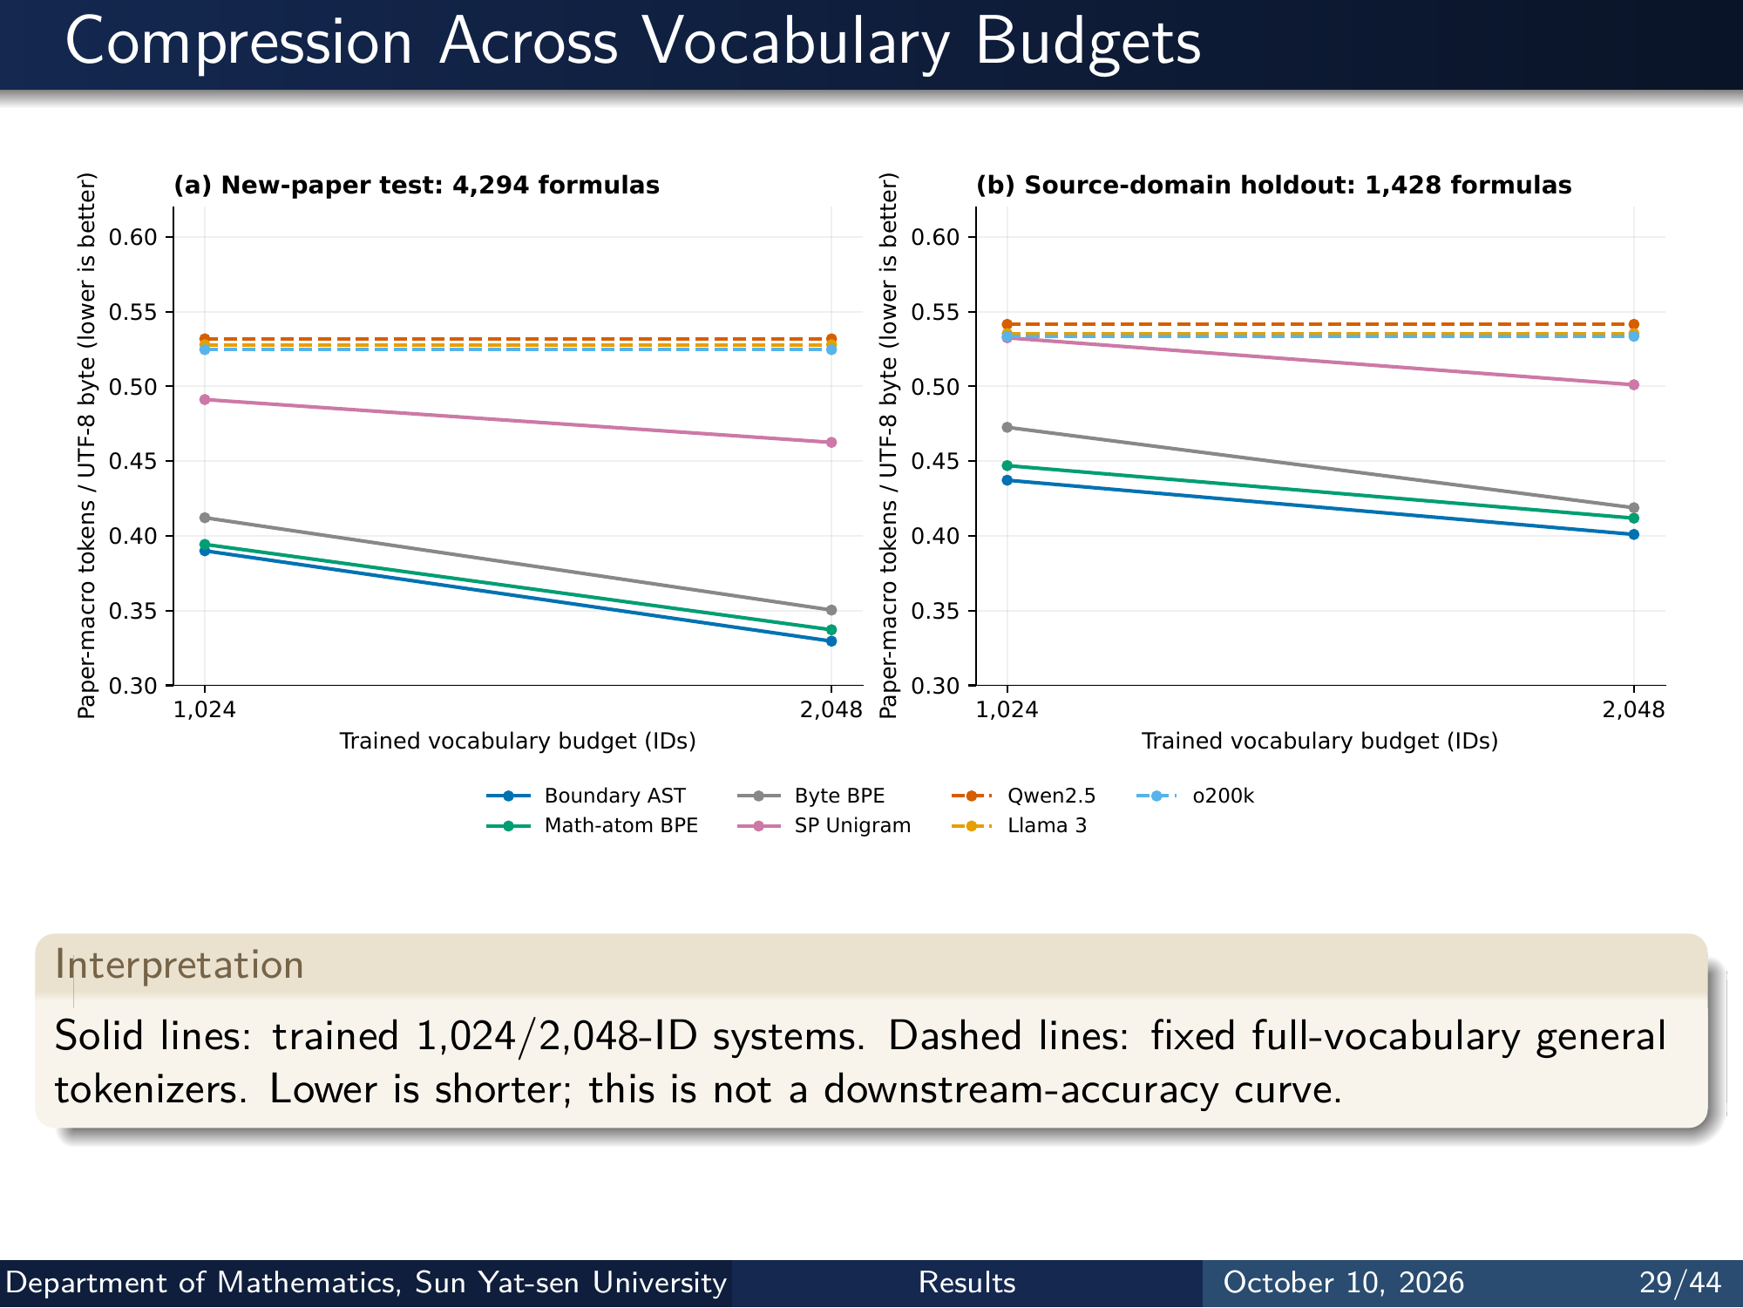
Notes:
Compression Across Vocabulary Budgets
1,024 2,048
Trained vocabulary budget (IDs)
0.30
0.35
0.40
0.45
0.50
0.55
0.60Paper-macro tokens / UTF-8 byte (lower is better)
(a) New-paper test: 4,294 formulas
1,024 2,048
Trained vocabulary budget (IDs)
0.30
0.35
0.40
0.45
0.50
0.55
0.60Paper-macro tokens / UTF-8 byte (lower is better)
(b) Source-domain holdout: 1,428 formulas
Boundary AST
Math-atom BPE
Byte BPE
SP Unigram
Qwen2.5
Llama 3
o200k
Interpretation
Solid lines: trained 1,024/2,048-ID systems. Dashed lines: fixed full-vocabulary general
tokenizers. Lower is shorter; this is not a downstream-accuracy curve.
Department of Mathematics, Sun Yat-sen University Results October 10, 2026 29/44
Editable master: mathematical_tokenizer.tex in companion source bundle; this page preserves the Beamer rendering.

Slide 31
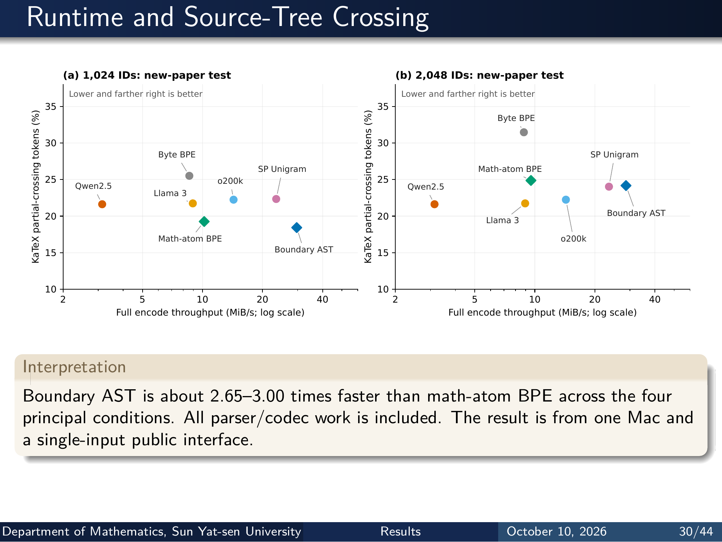
Notes:
Runtime and Source-Tree Crossing
2 5 10 20 40
Full encode throughput (MiB/s; log scale)
10
15
20
25
30
35KaT eX partial-crossing tokens (%)
Boundary AST
Math-atom BPE
Byte BPE
SP Unigram
Qwen2.5
Llama 3
o200k
Lower and farther right is better
(a) 1,024 IDs: new-paper test
2 5 10 20 40
Full encode throughput (MiB/s; log scale)
10
15
20
25
30
35KaT eX partial-crossing tokens (%)
Boundary AST
Math-atom BPE
Byte BPE
SP Unigram
Qwen2.5
Llama 3
o200k
Lower and farther right is better
(b) 2,048 IDs: new-paper test
Interpretation
Boundary AST is about 2.65–3.00 times faster than math-atom BPE across the four
principal conditions. All parser/codec work is included. The result is from one Mac and
a single-input public interface.
Department of Mathematics, Sun Yat-sen University Results October 10, 2026 30/44
Editable master: mathematical_tokenizer.tex in companion source bundle; this page preserves the Beamer rendering.

Slide 32
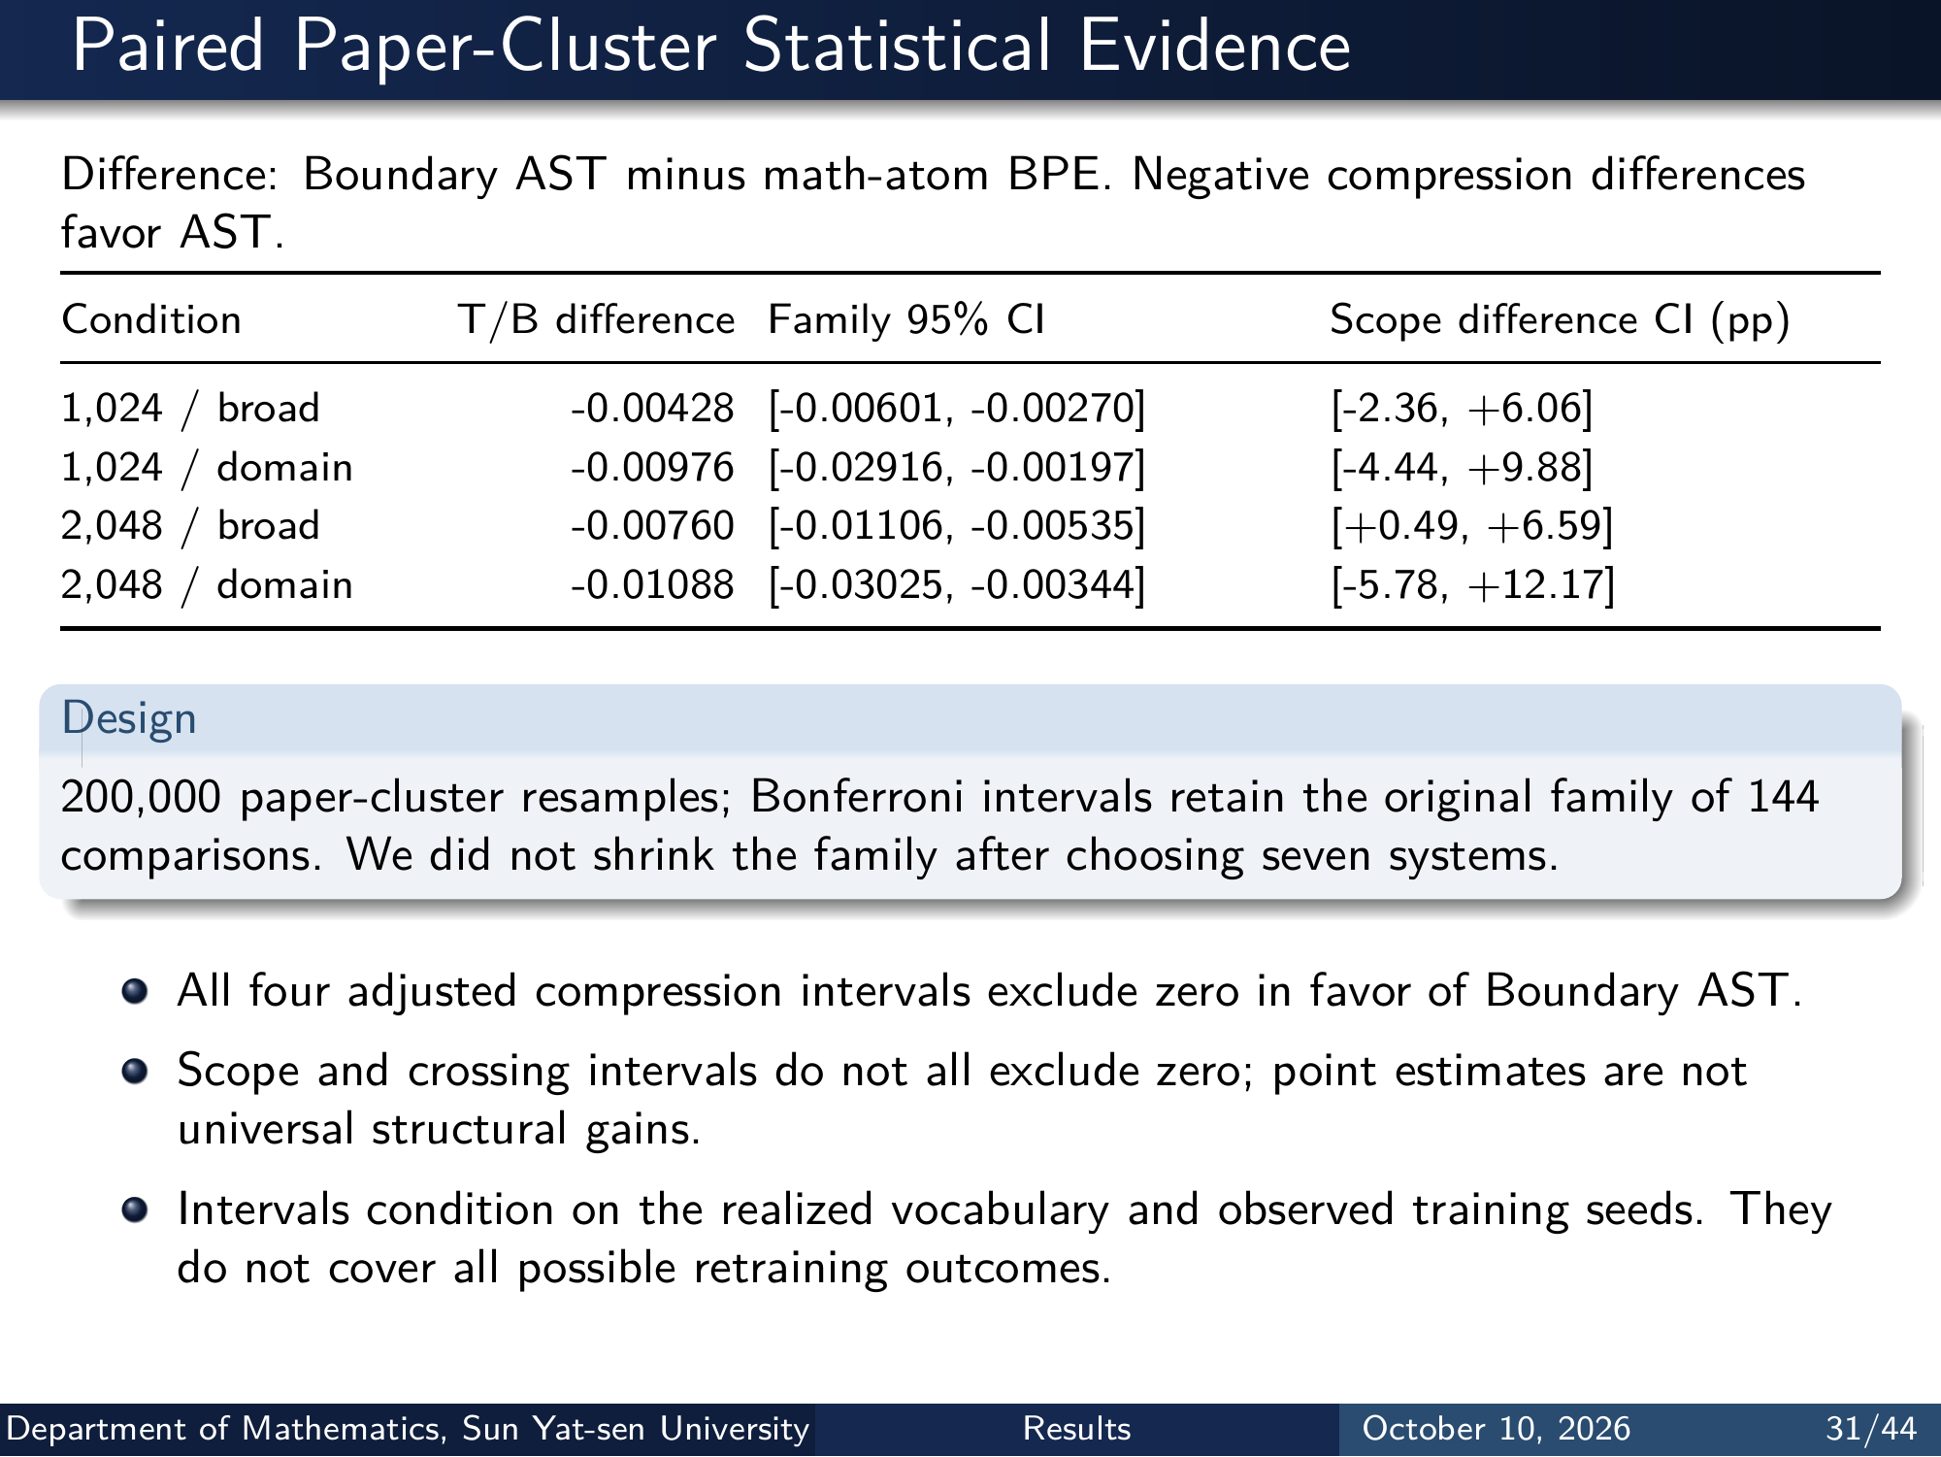
Notes:
Paired Paper-Cluster Statistical Evidence
Difference: Boundary AST minus math-atom BPE. Negative compression differences
favor AST.
Condition T/B difference Family 95% CI Scope difference CI (pp)
1,024 / broad -0.00428 [-0.00601, -0.00270] [-2.36, +6.06]
1,024 / domain -0.00976 [-0.02916, -0.00197] [-4.44, +9.88]
2,048 / broad -0.00760 [-0.01106, -0.00535] [+0.49, +6.59]
2,048 / domain -0.01088 [-0.03025, -0.00344] [-5.78, +12.17]
Design
200,000 paper-cluster resamples; Bonferroni intervals retain the original family of 144
comparisons. We did not shrink the family after choosing seven systems.
All four adjusted compression intervals exclude zero in favor of Boundary AST.
Scope and crossing intervals do not all exclude zero; point estimates are not
universal structural gains.
Intervals condition on the realized vocabulary and observed training seeds. They
do not cover all possible retraining outcomes.
Department of Mathematics, Sun Yat-sen University Results October 10, 2026 31/44
Editable master: mathematical_tokenizer.tex in companion source bundle; this page preserves the Beamer rendering.

Slide 33
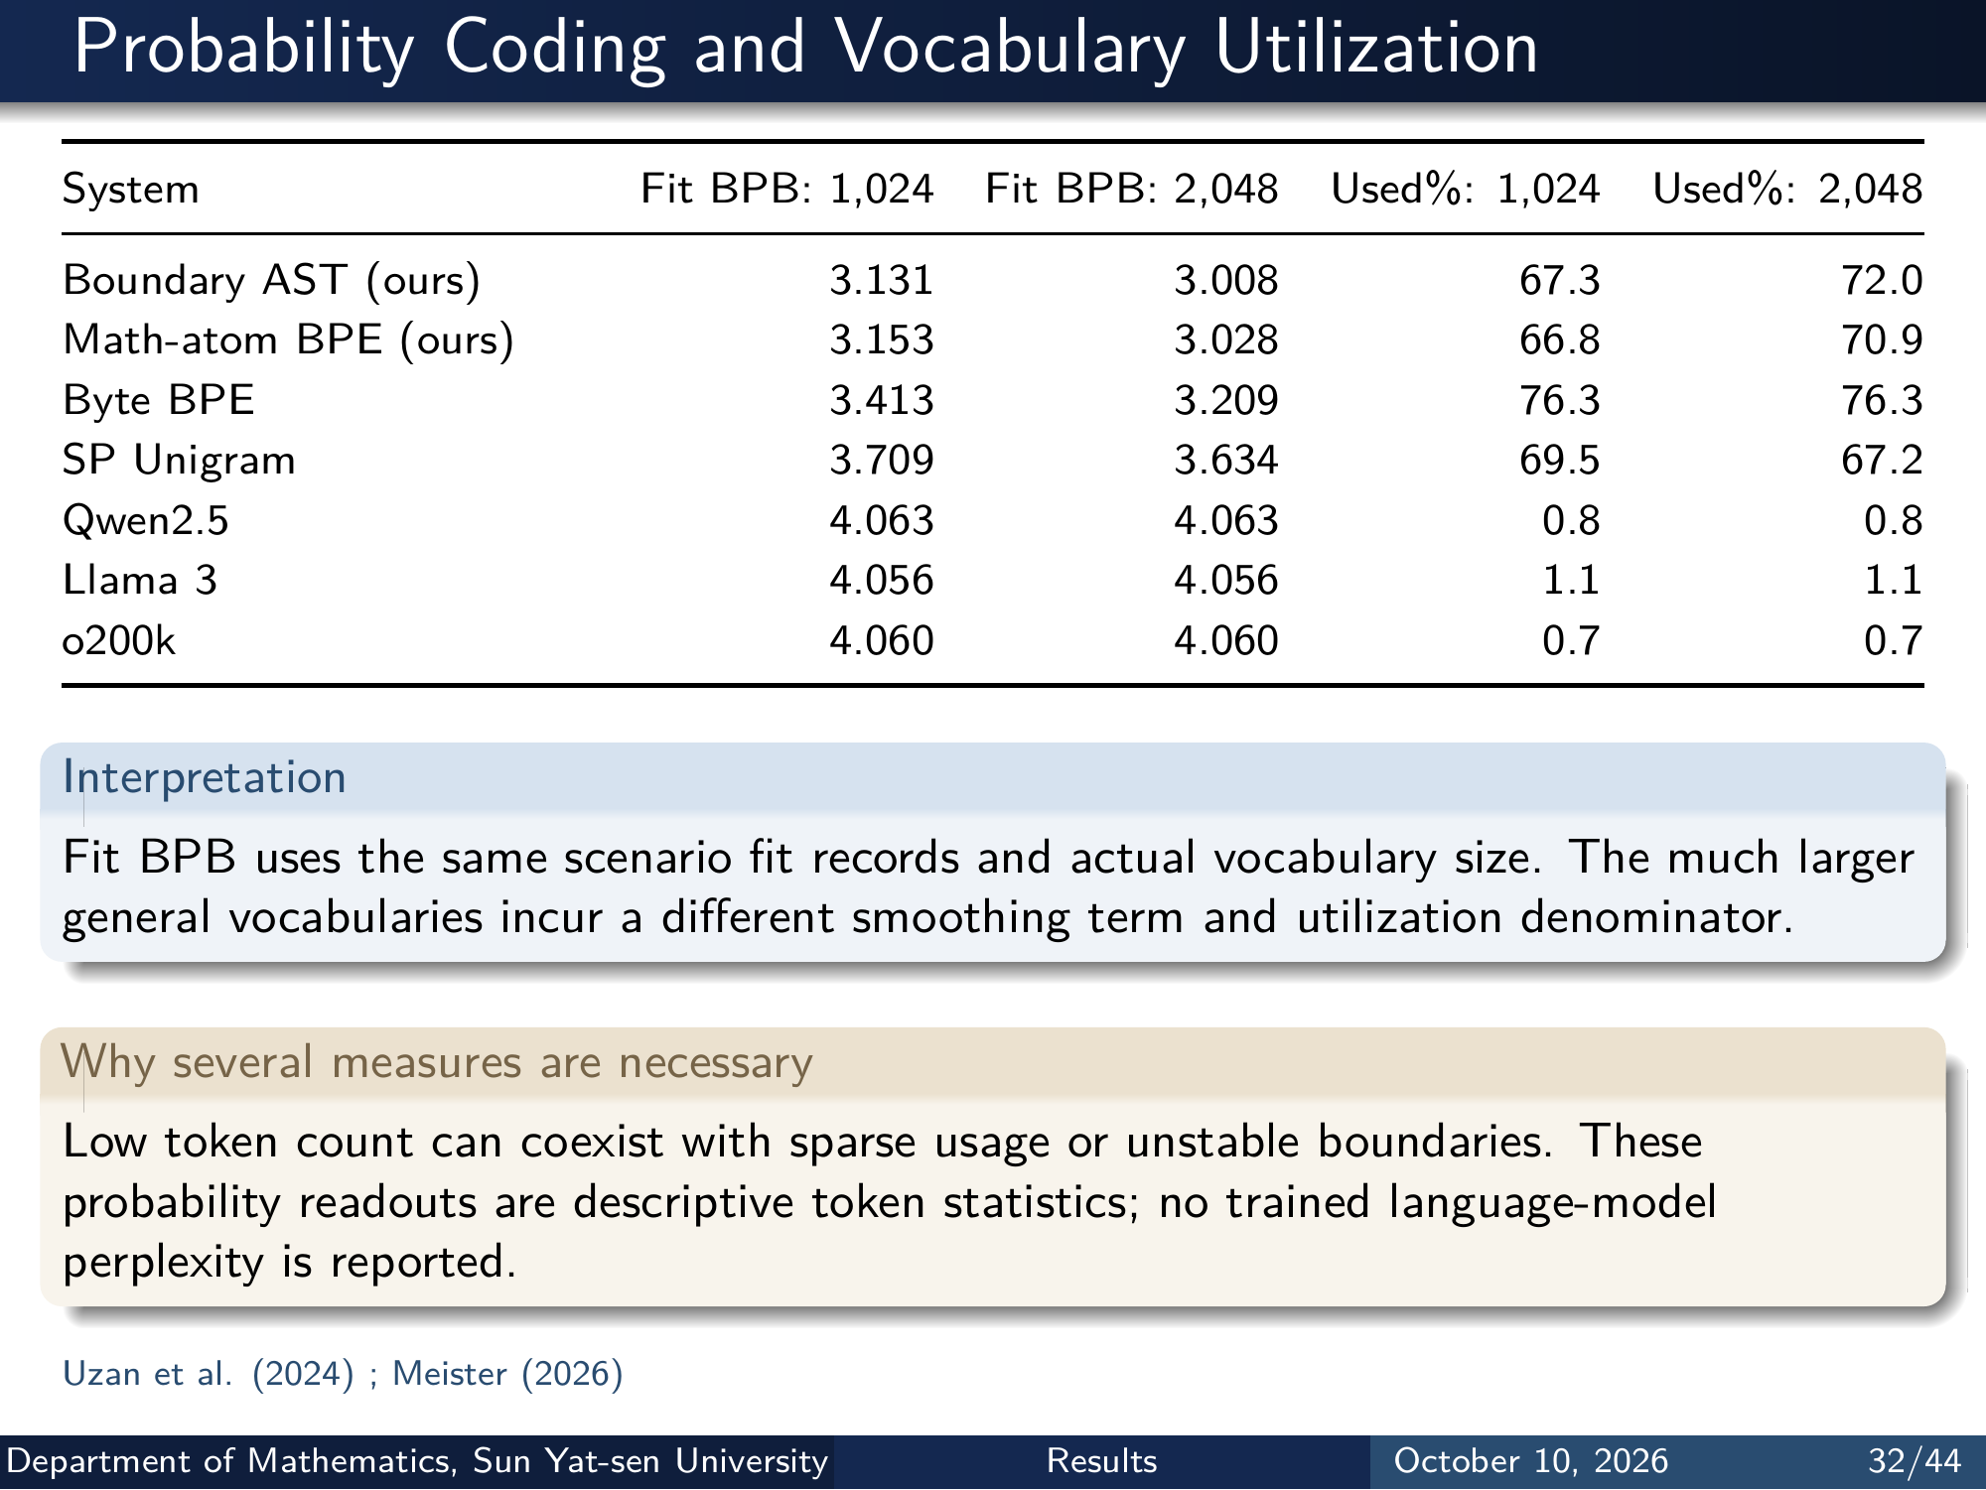
Notes:
Probability Coding and Vocabulary Utilization
System Fit BPB: 1,024 Fit BPB: 2,048 Used%: 1,024 Used%: 2,048
Boundary AST (ours) 3.131 3.008 67.3 72.0
Math-atom BPE (ours) 3.153 3.028 66.8 70.9
Byte BPE 3.413 3.209 76.3 76.3
SP Unigram 3.709 3.634 69.5 67.2
Qwen2.5 4.063 4.063 0.8 0.8
Llama 3 4.056 4.056 1.1 1.1
o200k 4.060 4.060 0.7 0.7
Interpretation
Fit BPB uses the same scenario fit records and actual vocabulary size. The much larger
general vocabularies incur a different smoothing term and utilization denominator.
Why several measures are necessary
Low token count can coexist with sparse usage or unstable boundaries. These
probability readouts are descriptive token statistics; no trained language-model
perplexity is reported.
Uzan et al. (2024) ; Meister (2026)
Department of Mathematics, Sun Yat-sen University Results October 10, 2026 32/44
Editable master: mathematical_tokenizer.tex in companion source bundle; this page preserves the Beamer rendering.

Slide 34
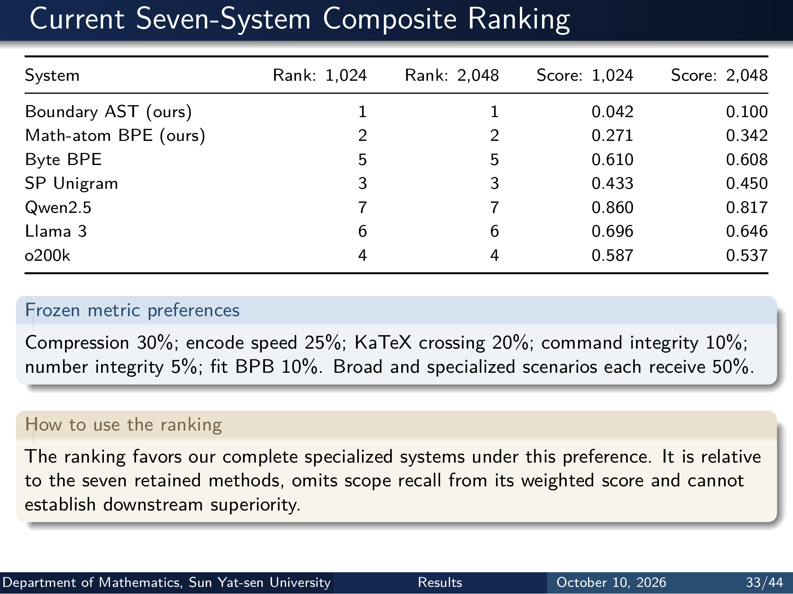
Notes:
Current Seven-System Composite Ranking
System Rank: 1,024 Rank: 2,048 Score: 1,024 Score: 2,048
Boundary AST (ours) 1 1 0.042 0.100
Math-atom BPE (ours) 2 2 0.271 0.342
Byte BPE 5 5 0.610 0.608
SP Unigram 3 3 0.433 0.450
Qwen2.5 7 7 0.860 0.817
Llama 3 6 6 0.696 0.646
o200k 4 4 0.587 0.537
Frozen metric preferences
Compression 30%; encode speed 25%; KaTeX crossing 20%; command integrity 10%;
number integrity 5%; fit BPB 10%. Broad and specialized scenarios each receive 50%.
How to use the ranking
The ranking favors our complete specialized systems under this preference. It is relative
to the seven retained methods, omits scope recall from its weighted score and cannot
establish downstream superiority.
Department of Mathematics, Sun Yat-sen University Results October 10, 2026 33/44
Editable master: mathematical_tokenizer.tex in companion source bundle; this page preserves the Beamer rendering.

Slide 35
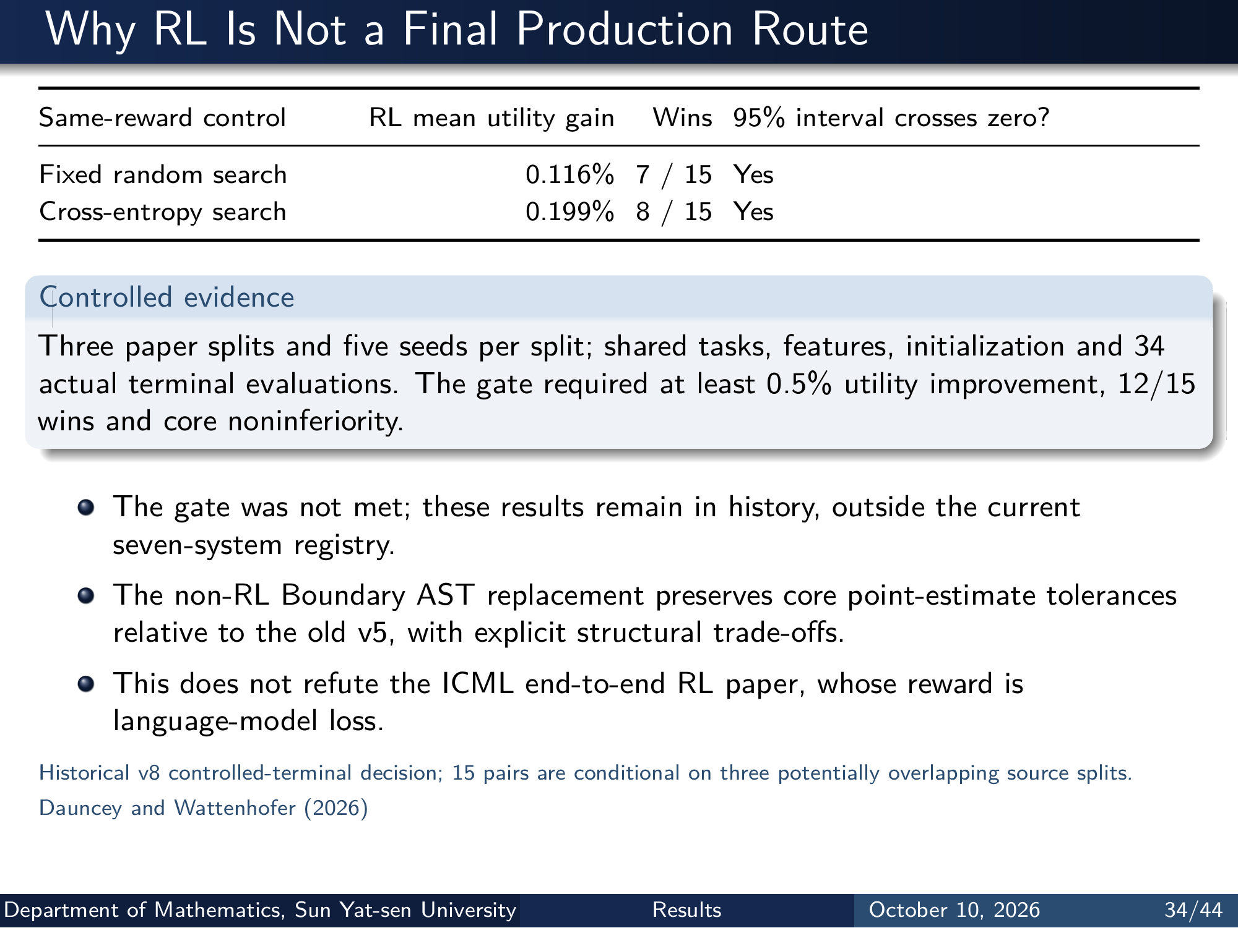
Notes:
Why RL Is Not a Final Production Route
Same-reward control RL mean utility gain Wins 95% interval crosses zero?
Fixed random search 0.116% 7 / 15 Yes
Cross-entropy search 0.199% 8 / 15 Yes
Controlled evidence
Three paper splits and five seeds per split; shared tasks, features, initialization and 34
actual terminal evaluations. The gate required at least 0.5% utility improvement, 12/15
wins and core noninferiority.
The gate was not met; these results remain in history, outside the current
seven-system registry.
The non-RL Boundary AST replacement preserves core point-estimate tolerances
relative to the old v5, with explicit structural trade-offs.
This does not refute the ICML end-to-end RL paper, whose reward is
language-model loss.
Historical v8 controlled-terminal decision; 15 pairs are conditional on three potentially overlapping source splits.
Dauncey and Wattenhofer (2026)
Department of Mathematics, Sun Yat-sen University Results October 10, 2026 34/44
Editable master: mathematical_tokenizer.tex in companion source bundle; this page preserves the Beamer rendering.

Slide 36
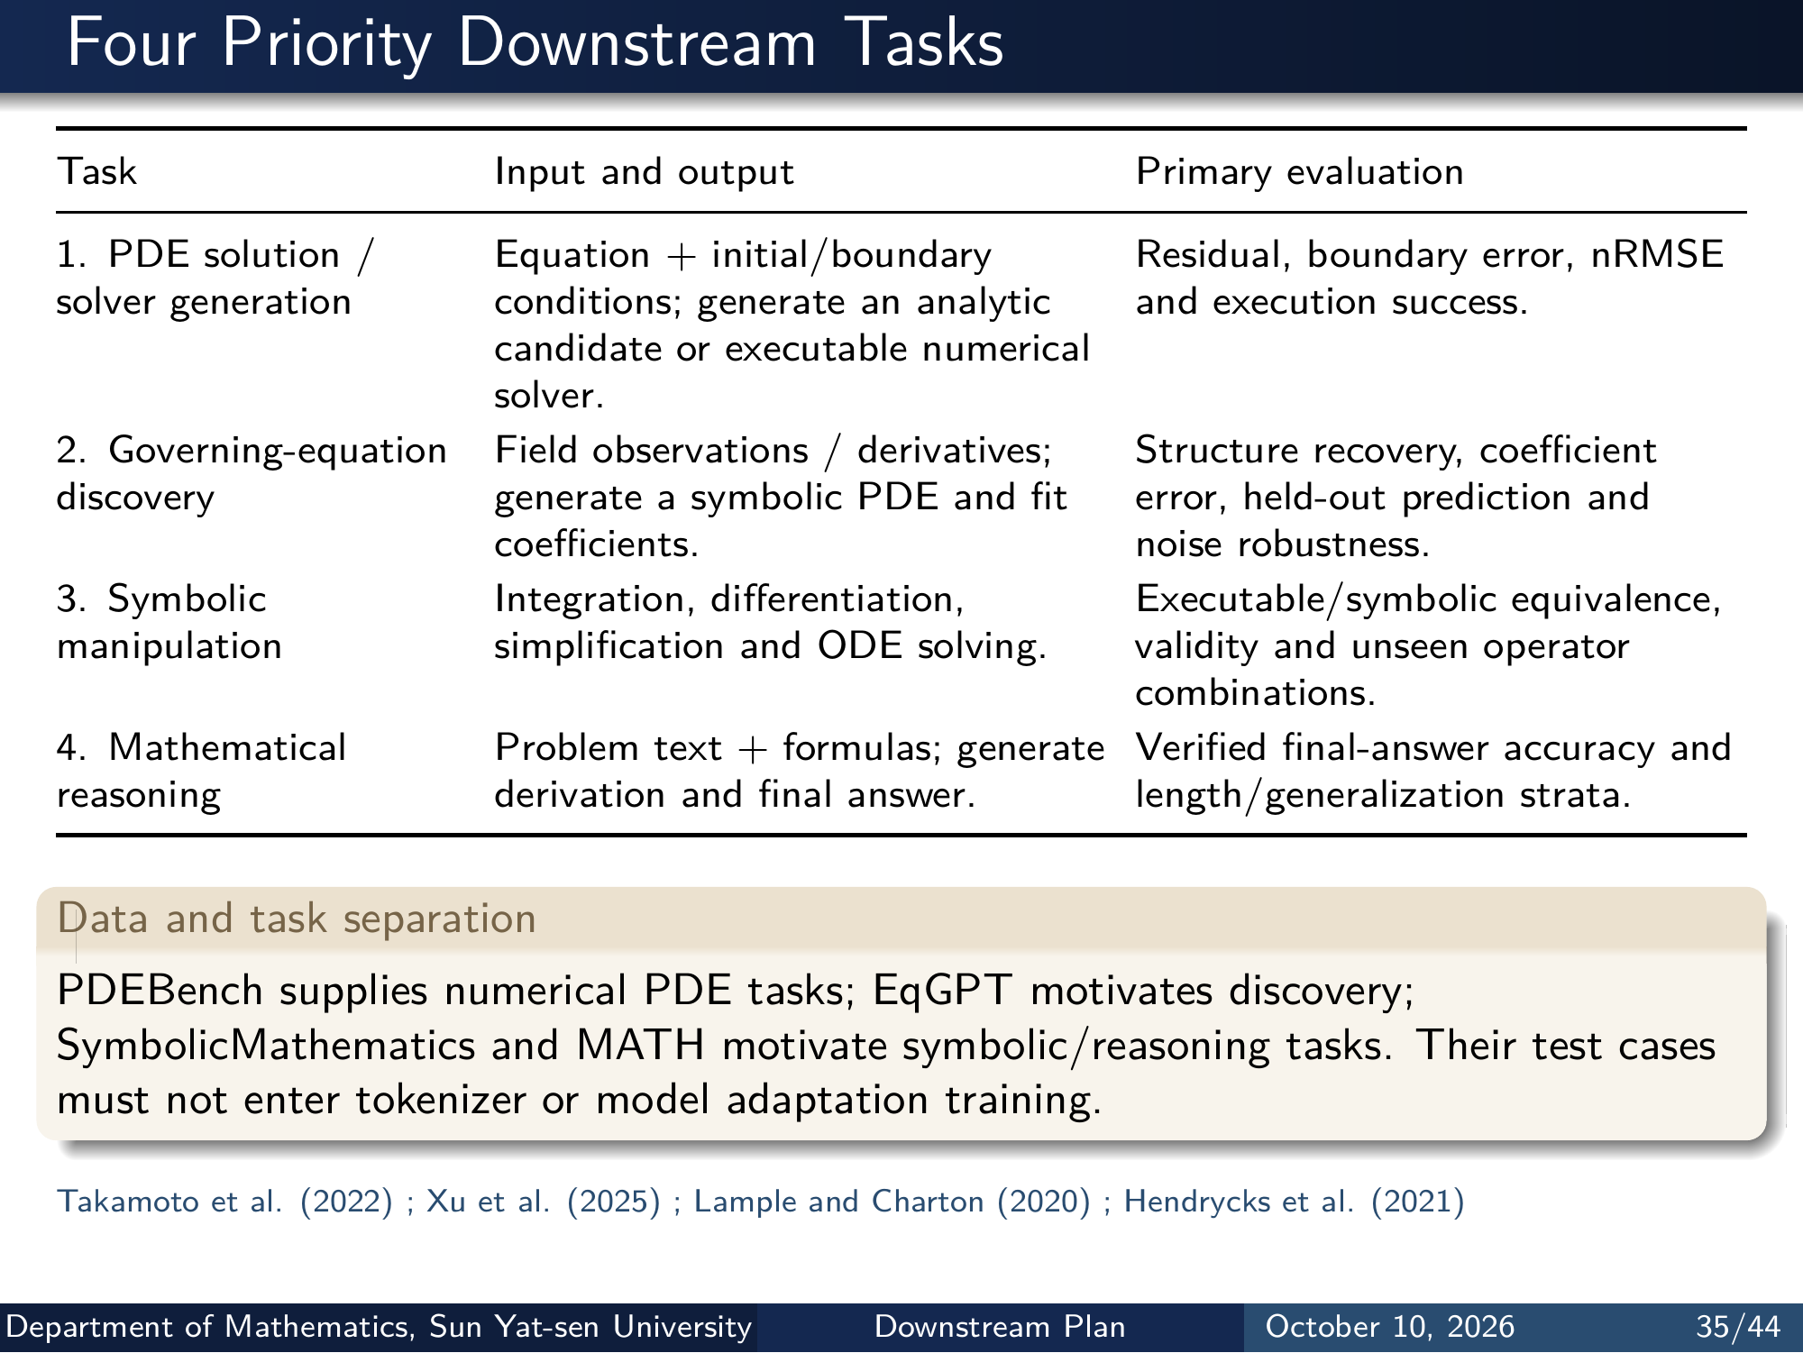
Notes:
Four Priority Downstream Tasks
Task Input and output Primary evaluation
1. PDE solution /
solver generation
Equation + initial/boundary
conditions; generate an analytic
candidate or executable numerical
solver.
Residual, boundary error, nRMSE
and execution success.
2. Governing-equation
discovery
Field observations / derivatives;
generate a symbolic PDE and fit
coeﬀicients.
Structure recovery, coeﬀicient
error, held-out prediction and
noise robustness.
3. Symbolic
manipulation
Integration, differentiation,
simplification and ODE solving.
Executable/symbolic equivalence,
validity and unseen operator
combinations.
4. Mathematical
reasoning
Problem text + formulas; generate
derivation and final answer.
Verified final-answer accuracy and
length/generalization strata.
Data and task separation
PDEBench supplies numerical PDE tasks; EqGPT motivates discovery;
SymbolicMathematics and MATH motivate symbolic/reasoning tasks. Their test cases
must not enter tokenizer or model adaptation training.
Takamoto et al. (2022) ; Xu et al. (2025) ; Lample and Charton (2020) ; Hendrycks et al. (2021)
Department of Mathematics, Sun Yat-sen University Downstream Plan October 10, 2026 35/44
Editable master: mathematical_tokenizer.tex in companion source bundle; this page preserves the Beamer rendering.

Slide 37
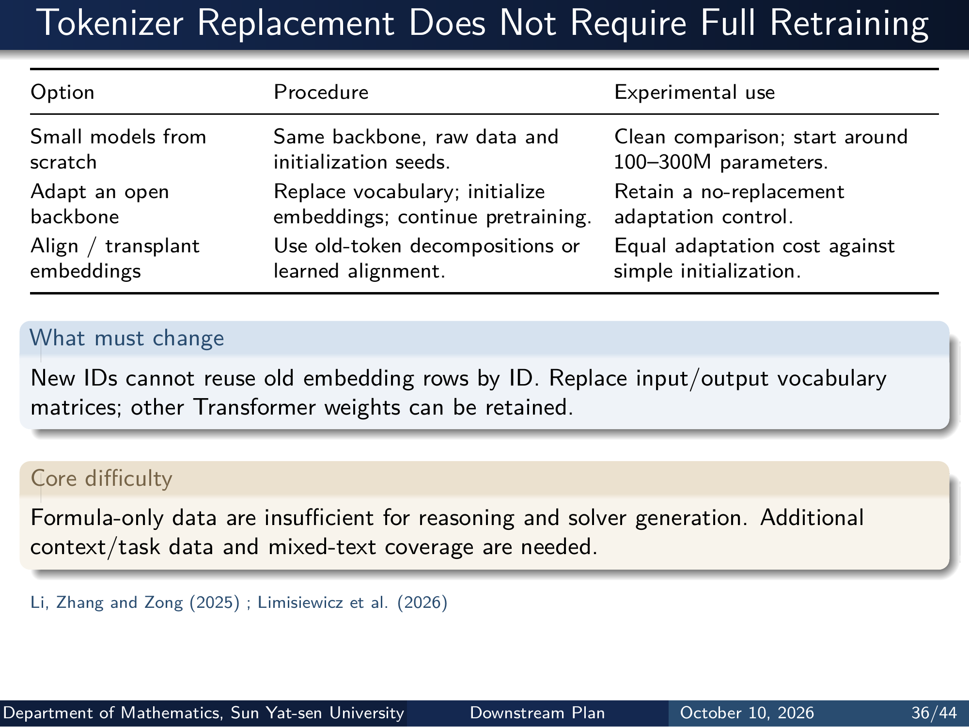
Notes:
Tokenizer Replacement Does Not Require Full Retraining
Option Procedure Experimental use
Small models from
scratch
Same backbone, raw data and
initialization seeds.
Clean comparison; start around
100–300M parameters.
Adapt an open
backbone
Replace vocabulary; initialize
embeddings; continue pretraining.
Retain a no-replacement
adaptation control.
Align / transplant
embeddings
Use old-token decompositions or
learned alignment.
Equal adaptation cost against
simple initialization.
What must change
New IDs cannot reuse old embedding rows by ID. Replace input/output vocabulary
matrices; other Transformer weights can be retained.
Core diﬀiculty
Formula-only data are insuﬀicient for reasoning and solver generation. Additional
context/task data and mixed-text coverage are needed.
Li, Zhang and Zong (2025) ; Limisiewicz et al. (2026)
Department of Mathematics, Sun Yat-sen University Downstream Plan October 10, 2026 36/44
Editable master: mathematical_tokenizer.tex in companion source bundle; this page preserves the Beamer rendering.

Slide 38
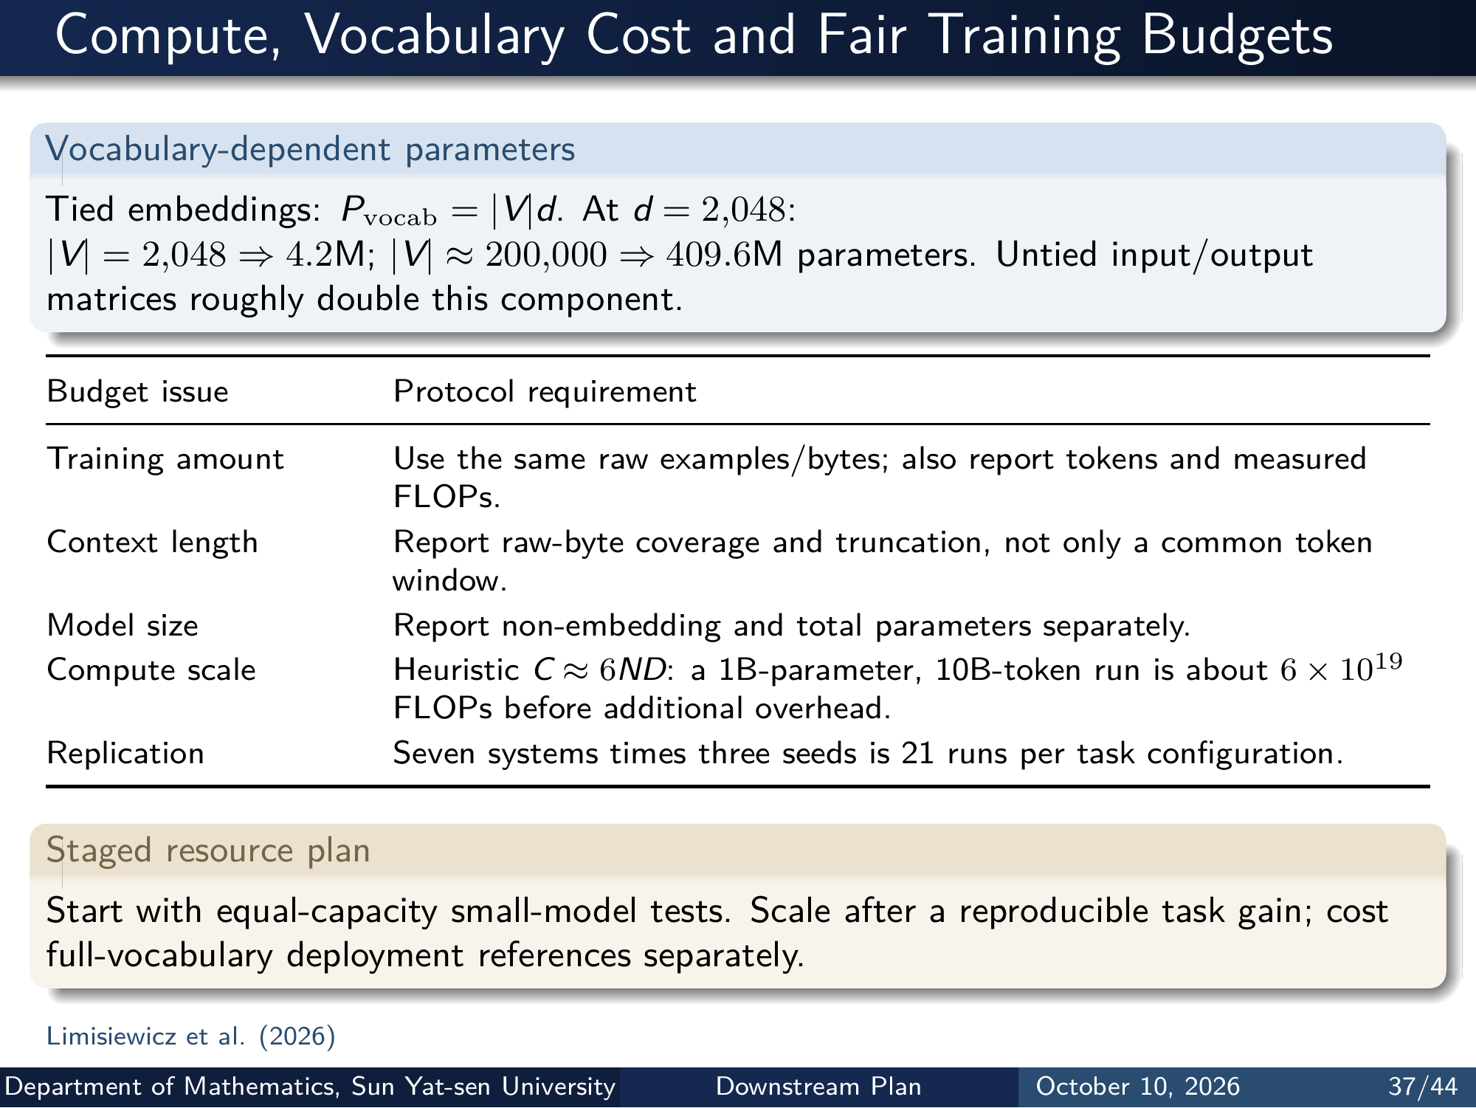
Notes:
Compute, Vocabulary Cost and Fair Training Budgets
Vocabulary-dependent parameters
Tied embeddings: Pvocab = |V|d. At d = 2,048:
|V| = 2,048 ⇒ 4.2M; |V| ≈ 200,000 ⇒ 409.6M parameters. Untied input/output
matrices roughly double this component.
Budget issue Protocol requirement
Training amount Use the same raw examples/bytes; also report tokens and measured
FLOPs.
Context length Report raw-byte coverage and truncation, not only a common token
window.
Model size Report non-embedding and total parameters separately.
Compute scale Heuristic C ≈ 6ND: a 1B-parameter, 10B-token run is about 6 × 1019
FLOPs before additional overhead.
Replication Seven systems times three seeds is 21 runs per task configuration.
Staged resource plan
Start with equal-capacity small-model tests. Scale after a reproducible task gain; cost
full-vocabulary deployment references separately.
Limisiewicz et al. (2026)
Department of Mathematics, Sun Yat-sen University Downstream Plan October 10, 2026 37/44
Editable master: mathematical_tokenizer.tex in companion source bundle; this page preserves the Beamer rendering.

Slide 39
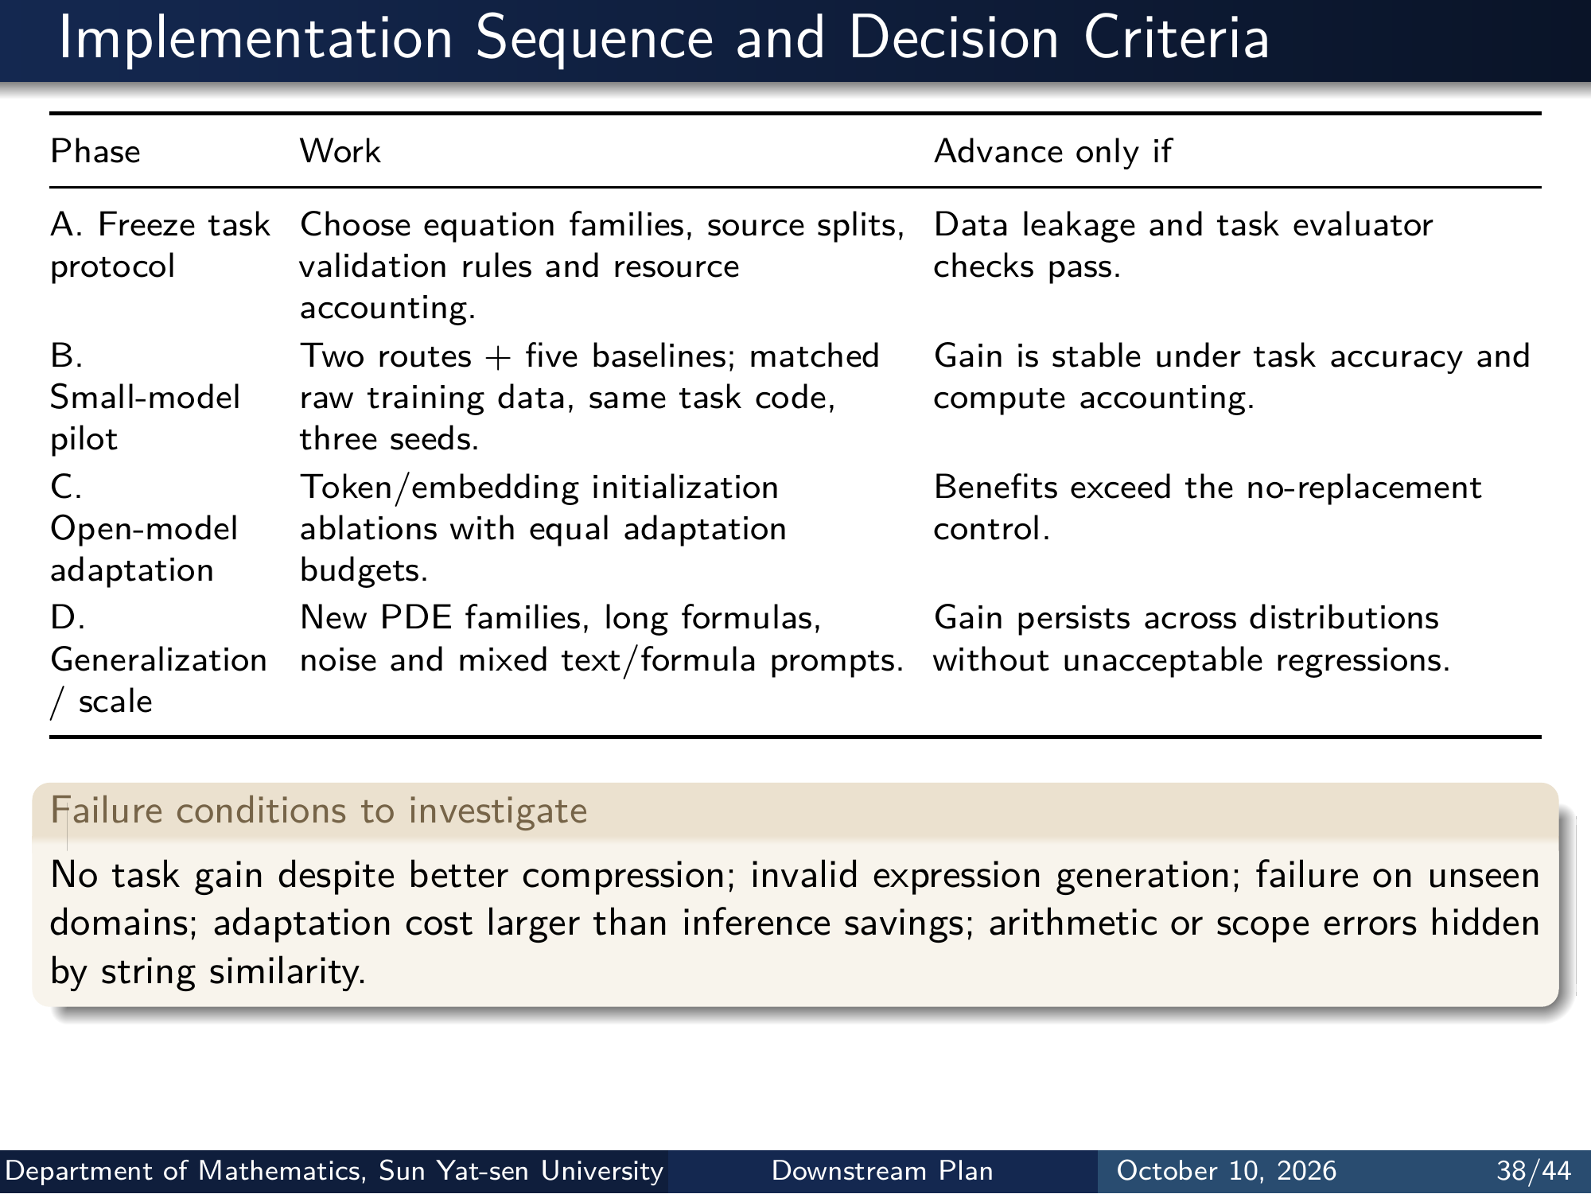
Notes:
Implementation Sequence and Decision Criteria
Phase Work Advance only if
A. Freeze task
protocol
Choose equation families, source splits,
validation rules and resource
accounting.
Data leakage and task evaluator
checks pass.
B.
Small-model
pilot
Two routes + five baselines; matched
raw training data, same task code,
three seeds.
Gain is stable under task accuracy and
compute accounting.
C.
Open-model
adaptation
Token/embedding initialization
ablations with equal adaptation
budgets.
Benefits exceed the no-replacement
control.
D.
Generalization
/ scale
New PDE families, long formulas,
noise and mixed text/formula prompts.
Gain persists across distributions
without unacceptable regressions.
Failure conditions to investigate
No task gain despite better compression; invalid expression generation; failure on unseen
domains; adaptation cost larger than inference savings; arithmetic or scope errors hidden
by string similarity.
Department of Mathematics, Sun Yat-sen University Downstream Plan October 10, 2026 38/44
Editable master: mathematical_tokenizer.tex in companion source bundle; this page preserves the Beamer rendering.

Slide 40
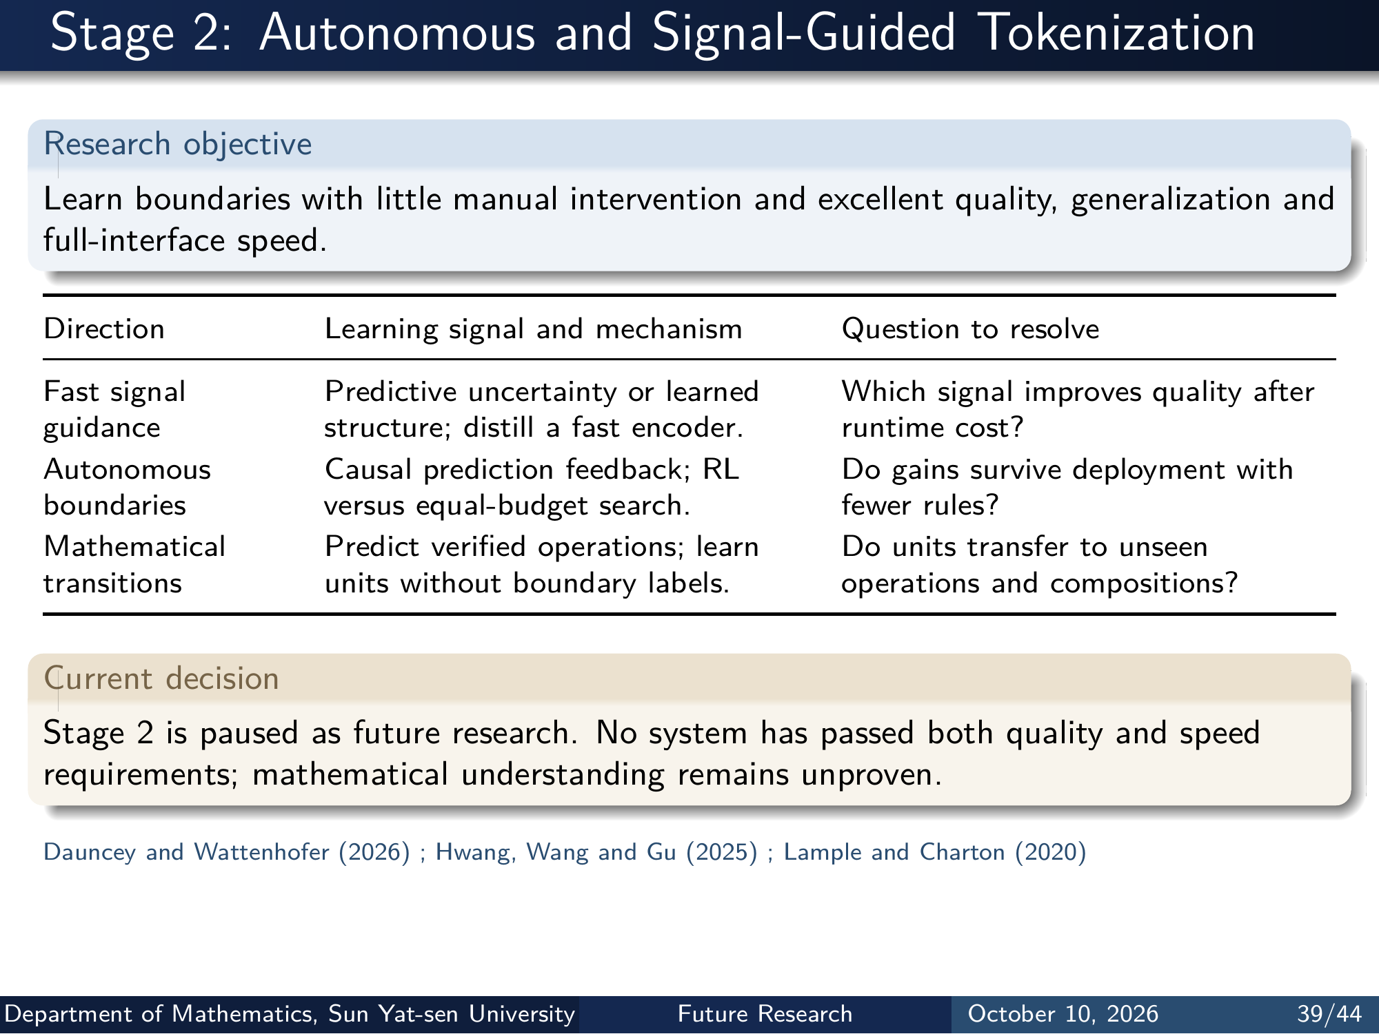
Notes:
Stage 2: Autonomous and Signal-Guided Tokenization
Research objective
Learn boundaries with little manual intervention and excellent quality, generalization and
full-interface speed.
Direction Learning signal and mechanism Question to resolve
Fast signal
guidance
Predictive uncertainty or learned
structure; distill a fast encoder.
Which signal improves quality after
runtime cost?
Autonomous
boundaries
Causal prediction feedback; RL
versus equal-budget search.
Do gains survive deployment with
fewer rules?
Mathematical
transitions
Predict verified operations; learn
units without boundary labels.
Do units transfer to unseen
operations and compositions?
Current decision
Stage 2 is paused as future research. No system has passed both quality and speed
requirements; mathematical understanding remains unproven.
Dauncey and Wattenhofer (2026) ; Hwang, Wang and Gu (2025) ; Lample and Charton (2020)
Department of Mathematics, Sun Yat-sen University Future Research October 10, 2026 39/44
Editable master: mathematical_tokenizer.tex in companion source bundle; this page preserves the Beamer rendering.

Slide 41
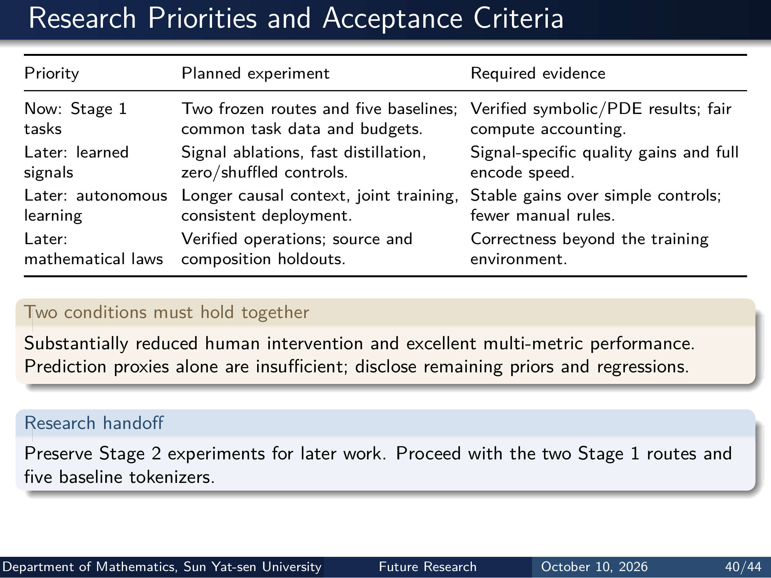
Notes:
Research Priorities and Acceptance Criteria
Priority Planned experiment Required evidence
Now: Stage 1
tasks
Two frozen routes and five baselines;
common task data and budgets.
Verified symbolic/PDE results; fair
compute accounting.
Later: learned
signals
Signal ablations, fast distillation,
zero/shuffled controls.
Signal-specific quality gains and full
encode speed.
Later: autonomous
learning
Longer causal context, joint training,
consistent deployment.
Stable gains over simple controls;
fewer manual rules.
Later:
mathematical laws
Verified operations; source and
composition holdouts.
Correctness beyond the training
environment.
Two conditions must hold together
Substantially reduced human intervention and excellent multi-metric performance.
Prediction proxies alone are insuﬀicient; disclose remaining priors and regressions.
Research handoff
Preserve Stage 2 experiments for later work. Proceed with the two Stage 1 routes and
five baseline tokenizers.
Department of Mathematics, Sun Yat-sen University Future Research October 10, 2026 40/44
Editable master: mathematical_tokenizer.tex in companion source bundle; this page preserves the Beamer rendering.

Slide 42
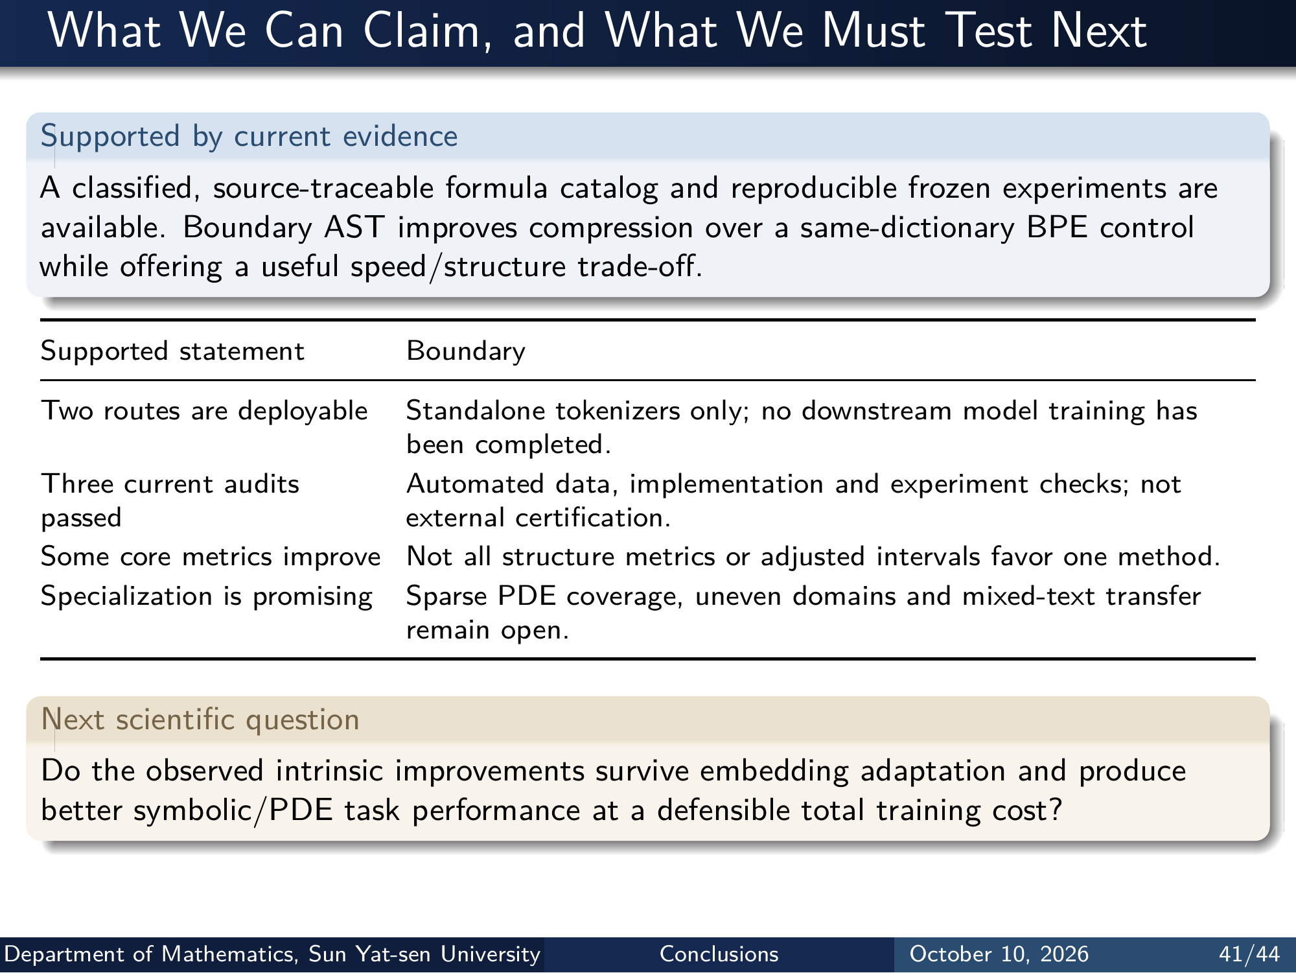
Notes:
What We Can Claim, and What We Must Test Next
Supported by current evidence
A classified, source-traceable formula catalog and reproducible frozen experiments are
available. Boundary AST improves compression over a same-dictionary BPE control
while offering a useful speed/structure trade-off.
Supported statement Boundary
Two routes are deployable Standalone tokenizers only; no downstream model training has
been completed.
Three current audits
passed
Automated data, implementation and experiment checks; not
external certification.
Some core metrics improve Not all structure metrics or adjusted intervals favor one method.
Specialization is promising Sparse PDE coverage, uneven domains and mixed-text transfer
remain open.
Next scientific question
Do the observed intrinsic improvements survive embedding adaptation and produce
better symbolic/PDE task performance at a defensible total training cost?
Department of Mathematics, Sun Yat-sen University Conclusions October 10, 2026 41/44
Editable master: mathematical_tokenizer.tex in companion source bundle; this page preserves the Beamer rendering.

Slide 43
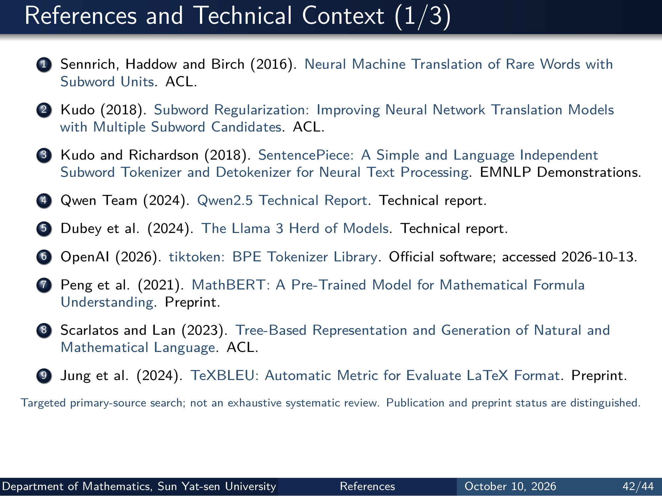
Notes:
References and Technical Context (1/3)
1 Sennrich, Haddow and Birch (2016). Neural Machine Translation of Rare Words with
Subword Units. ACL.
2 Kudo (2018). Subword Regularization: Improving Neural Network Translation Models
with Multiple Subword Candidates . ACL.
3 Kudo and Richardson (2018). SentencePiece: A Simple and Language Independent
Subword Tokenizer and Detokenizer for Neural Text Processing . EMNLP Demonstrations.
4 Qwen Team (2024). Qwen2.5 Technical Report . Technical report.
5 Dubey et al. (2024). The Llama 3 Herd of Models . Technical report.
6 OpenAI (2026). tiktoken: BPE Tokenizer Library . Oﬀicial software; accessed 2026-10-13.
7 Peng et al. (2021). MathBERT: A Pre-Trained Model for Mathematical Formula
Understanding. Preprint.
8 Scarlatos and Lan (2023). Tree-Based Representation and Generation of Natural and
Mathematical Language . ACL.
9 Jung et al. (2024). TeXBLEU: Automatic Metric for Evaluate LaTeX Format . Preprint.
Targeted primary-source search; not an exhaustive systematic review. Publication and preprint status are distinguished.
Department of Mathematics, Sun Yat-sen University References October 10, 2026 42/44
Editable master: mathematical_tokenizer.tex in companion source bundle; this page preserves the Beamer rendering.

Slide 44
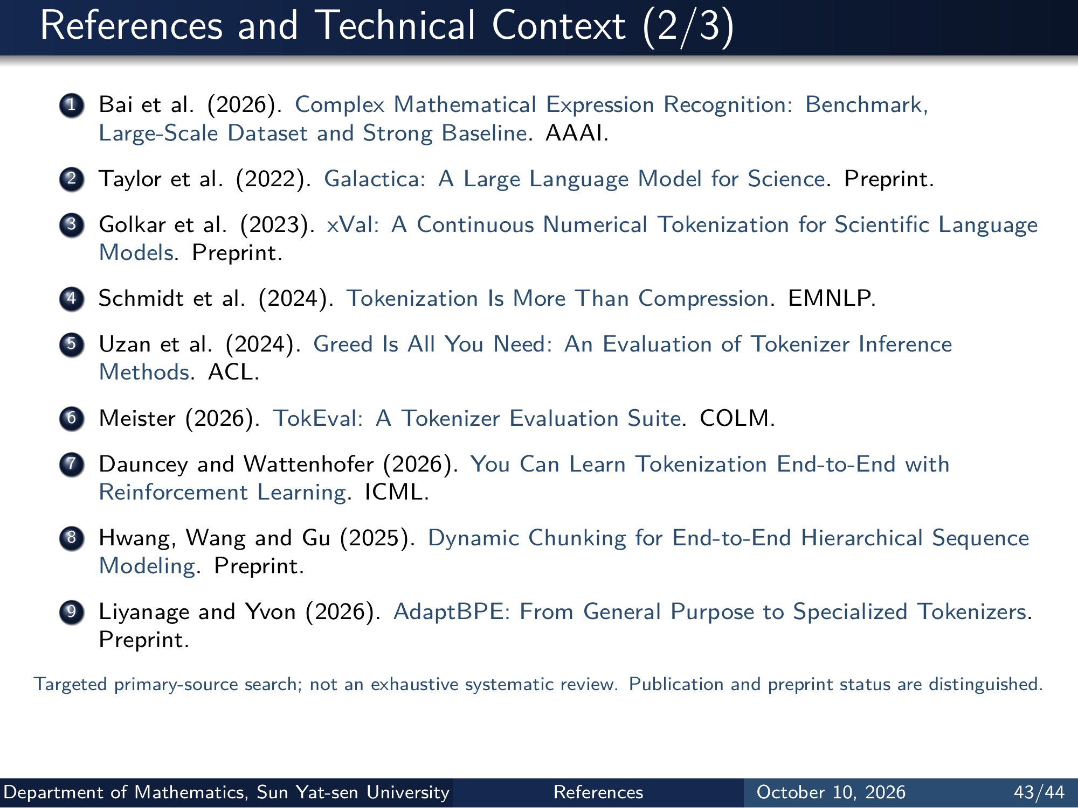
Notes:
References and Technical Context (2/3)
1 Bai et al. (2026). Complex Mathematical Expression Recognition: Benchmark,
Large-Scale Dataset and Strong Baseline . AAAI.
2 Taylor et al. (2022). Galactica: A Large Language Model for Science . Preprint.
3 Golkar et al. (2023). xVal: A Continuous Numerical Tokenization for Scientific Language
Models. Preprint.
4 Schmidt et al. (2024). Tokenization Is More Than Compression . EMNLP.
5 Uzan et al. (2024). Greed Is All You Need: An Evaluation of Tokenizer Inference
Methods. ACL.
6 Meister (2026). TokEval: A Tokenizer Evaluation Suite . COLM.
7 Dauncey and Wattenhofer (2026). You Can Learn Tokenization End-to-End with
Reinforcement Learning. ICML.
8 Hwang, Wang and Gu (2025). Dynamic Chunking for End-to-End Hierarchical Sequence
Modeling. Preprint.
9 Liyanage and Yvon (2026). AdaptBPE: From General Purpose to Specialized Tokenizers .
Preprint.
Targeted primary-source search; not an exhaustive systematic review. Publication and preprint status are distinguished.
Department of Mathematics, Sun Yat-sen University References October 10, 2026 43/44
Editable master: mathematical_tokenizer.tex in companion source bundle; this page preserves the Beamer rendering.

Slide 45
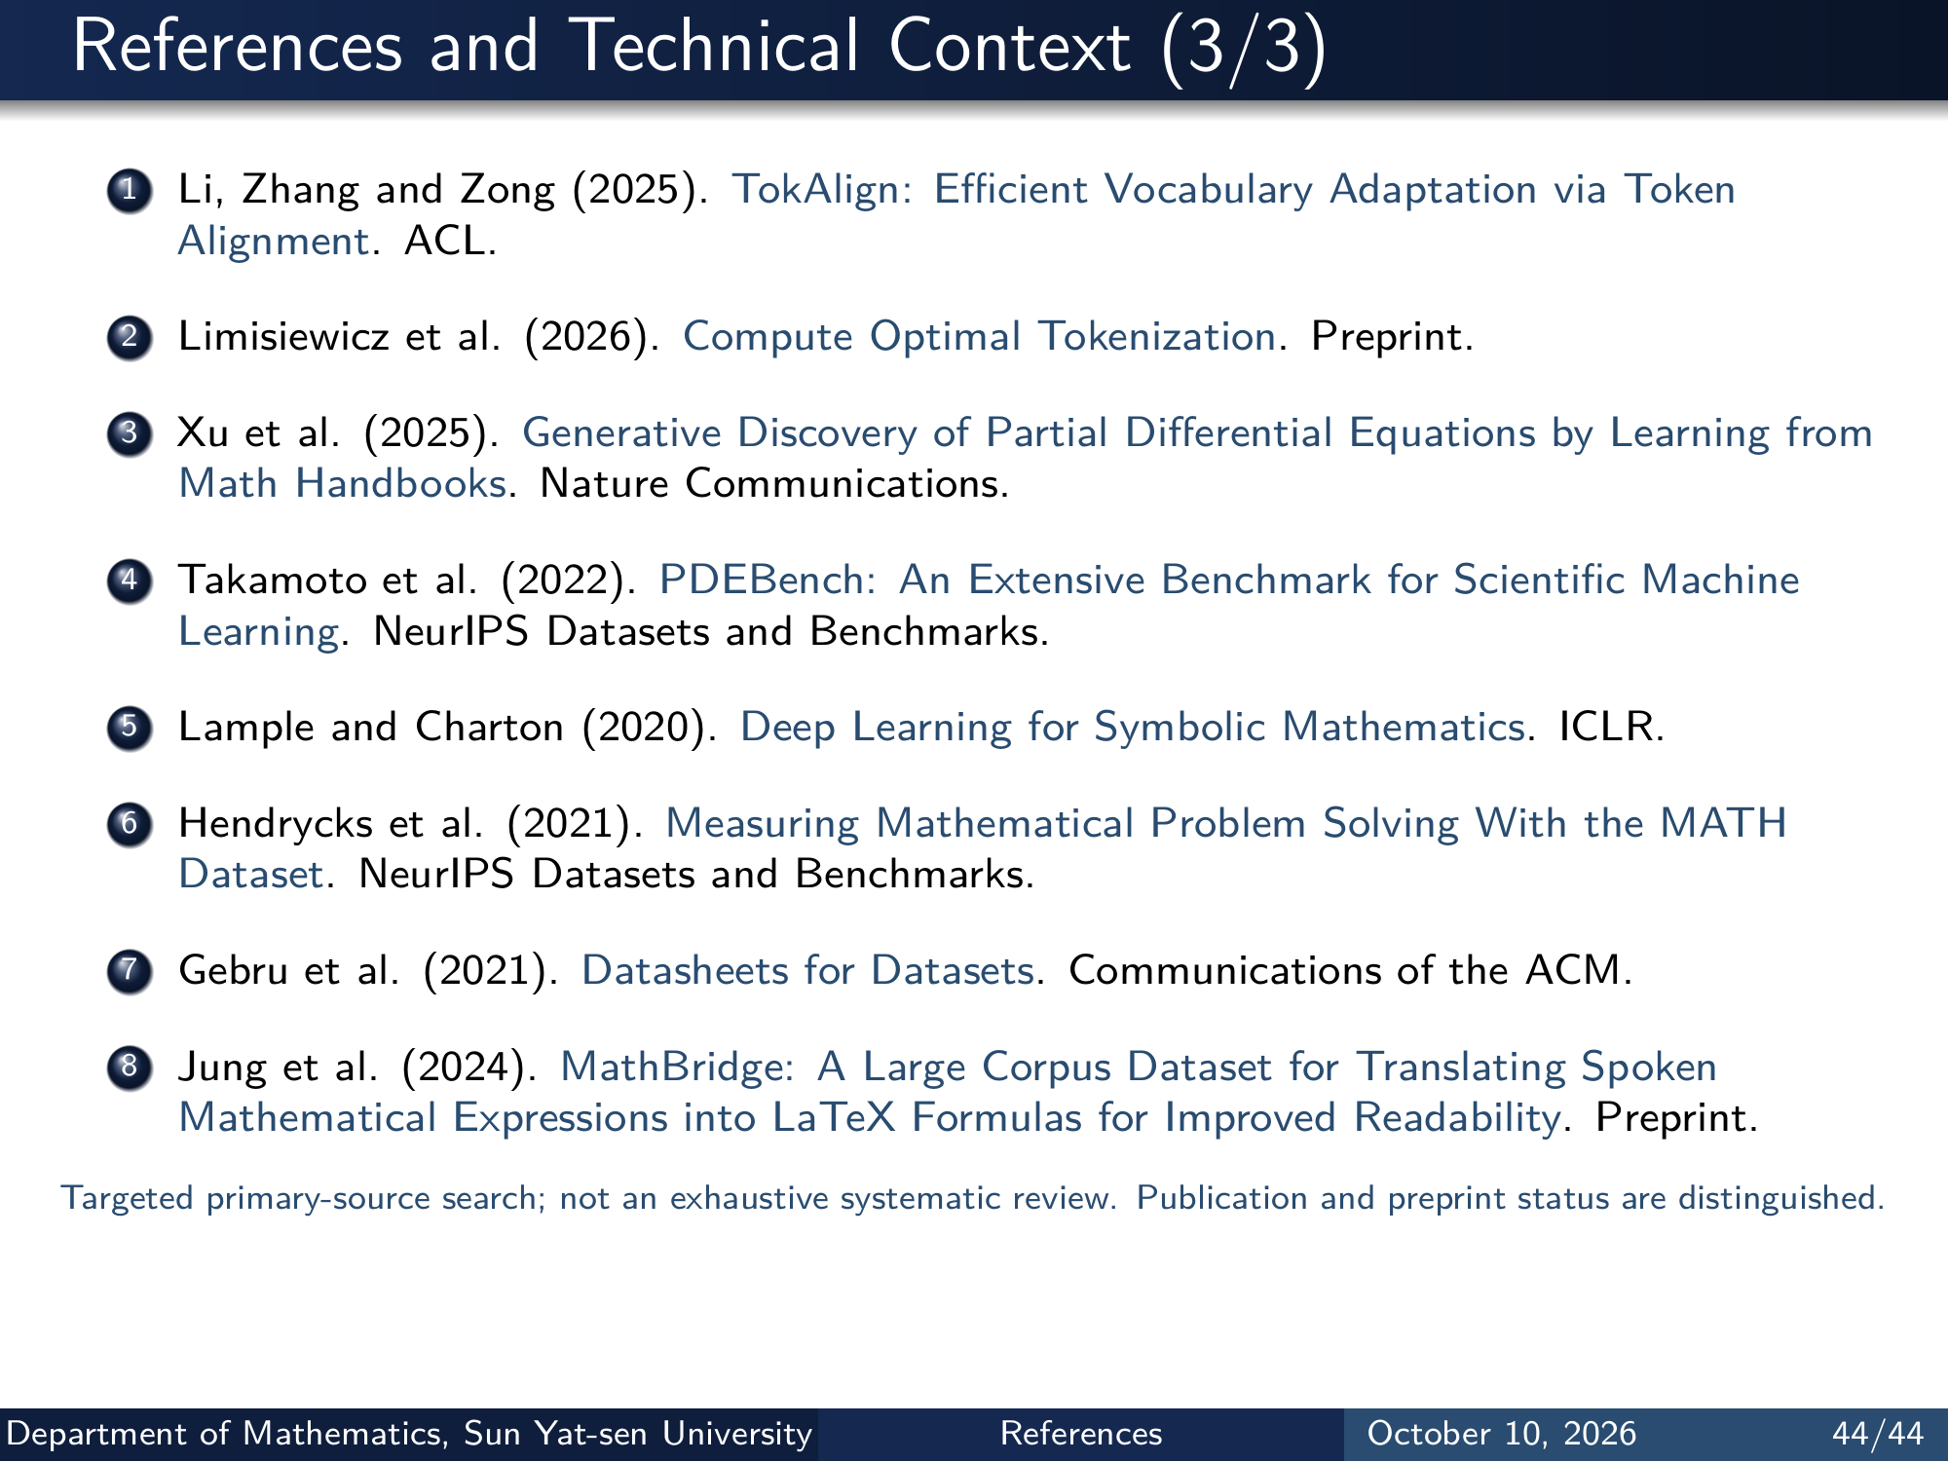
Notes:
References and Technical Context (3/3)
1 Li, Zhang and Zong (2025). TokAlign: Eﬀicient Vocabulary Adaptation via Token
Alignment. ACL.
2 Limisiewicz et al. (2026). Compute Optimal Tokenization . Preprint.
3 Xu et al. (2025). Generative Discovery of Partial Differential Equations by Learning from
Math Handbooks . Nature Communications.
4 Takamoto et al. (2022). PDEBench: An Extensive Benchmark for Scientific Machine
Learning. NeurIPS Datasets and Benchmarks.
5 Lample and Charton (2020). Deep Learning for Symbolic Mathematics . ICLR.
6 Hendrycks et al. (2021). Measuring Mathematical Problem Solving With the MATH
Dataset. NeurIPS Datasets and Benchmarks.
7 Gebru et al. (2021). Datasheets for Datasets . Communications of the ACM.
8 Jung et al. (2024). MathBridge: A Large Corpus Dataset for Translating Spoken
Mathematical Expressions into LaTeX Formulas for Improved Readability . Preprint.
Targeted primary-source search; not an exhaustive systematic review. Publication and preprint status are distinguished.
Department of Mathematics, Sun Yat-sen University References October 10, 2026 44/44
Editable master: mathematical_tokenizer.tex in companion source bundle; this page preserves the Beamer rendering.

