Slide 1
Surface Reconstruction from Point Set
An Implementation of
H. Hoppe et al., “Surface Reconstruction from Unorganized Points.” SIGGRAPH 92
W.Lorensen and H.Cline, “Marching Cubes: A High Resolution 3D Surface Construction Algorithm”, SIGGRAPH 87
Zhuoli Jiang, Rui Yang

Slide 2
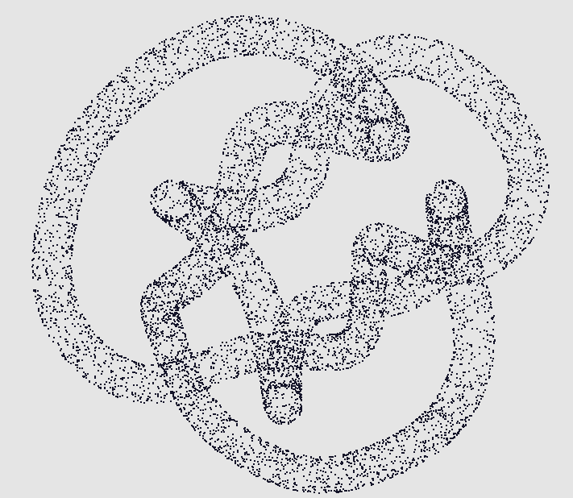
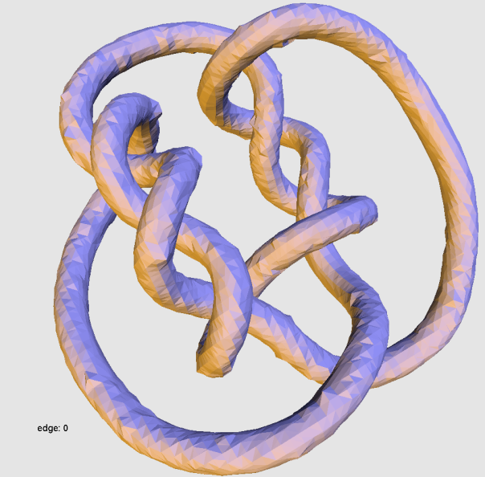
Introduction
The reconstruction of an initial piecewise-linear model
Cleanup
Simplification
fitting with curved surface patches

Slide 3

Background
Input: unorganized set of points $\{x_{1},x_{1},…x_{n}\}⊂R^{3}$ on or near unknown surface M
Output: an triangle mesh approximates M
Why is it useful?
- one algorithm solves a general problem can be used to solve others
- medical imagery, laser range scanners, contact probe digitizers, radar and seismic surveys, and mathematical models

Slide 4

Approach
kNN: finds centroid $o_{i}$ of tangent plane $p_{i}$ of $x_{i}$
PCA of kNN -> analyzes smallest eigenvalue is the +/- normal $n_{i}$ of $p_{i}$
EMST & Riemannian Graph -> propagate normal
SDF -> return signed shortest distance between input point p and the closest tangent plane
Marching Cubes -> use SDF to render triangle mesh

Slide 5





Implementation – tangent plane
K Nearest Neighbors
- k is picked by user; carefully picked if noise is high
- based on the Euclidean distance; forms $Nbhd(x_{i})$
- finds centroid $o_{i}$ of tangent plane $p_{i}$ for each point $x_{i}$
- can be adapted and automatically pick
Principle Component Analysis
- forms covariance matrix
$$CV=\sum_{y∈Nbhd(x_{i})}{(y−o_{i})}⨂(y−o_{i})$$
- PCA of ${CV}^{3∗3}$ got ${λ_{i}}^{1}≥{λ_{i}}^{2}≥{λ_{i}}^{3}$ and
$${{\hat{v}}_{i}}^{1}≥{{\hat{v}}_{i}}^{2}≥{{\hat{v}}_{i}}^{3}$$
- +/- ${{\hat{v}}_{i}}^{3}$ is the normal of plane pi
$${{\hat{v}}_{i}}^{1}$$
$${{\hat{v}}_{i}}^{3}$$
$${{\hat{v}}_{i}}^{2}$$
$$p_{i}$$

Slide 6
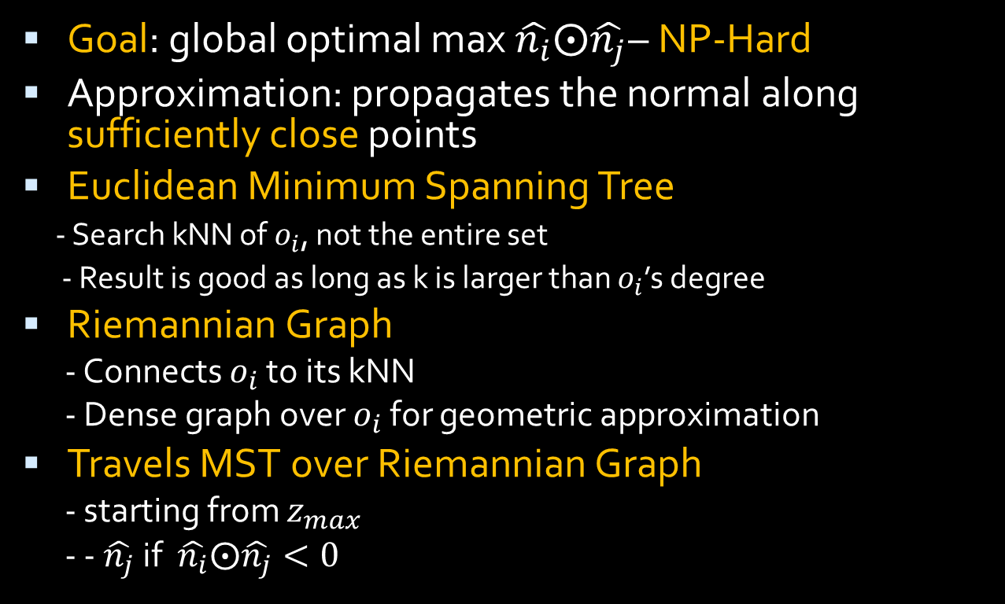
Implementation – Normal Propagation
Goal: global optimal max $\hat{n_{i}}⨀\hat{n_{j}}$– NP-Hard
Approximation: propagates the normal along sufficiently close points
Euclidean Minimum Spanning Tree
- Search kNN of $o_{i}$, not the entire set
- Result is good as long as k is larger than $o_{i}$’s degree
Riemannian Graph
- Connects $o_{i}$ to its kNN
- Dense graph over $o_{i}$ for geometric approximation
Travels MST over Riemannian Graph
- starting from $z_{max}$
- - $\hat{n_{j}}$ if $\hat{n_{i}}⨀\hat{n_{j}}<0$

Slide 7
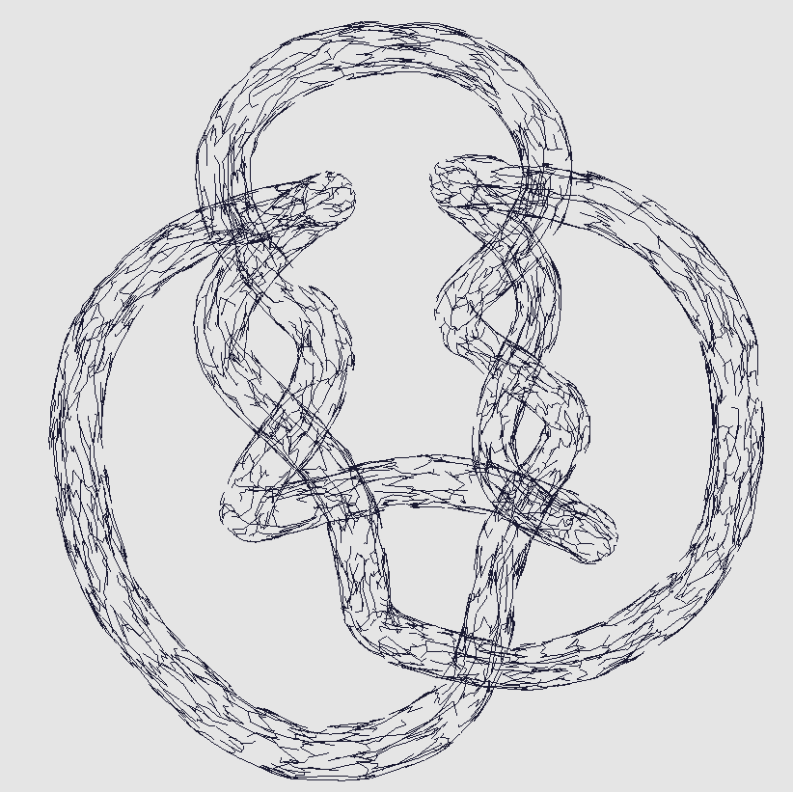
MST over Riemannian Graph

Slide 8
Normal Propagation

Slide 9

Implementation – Marching Cubes
Signed Distance Function
- Returns $f\left(p\right)=(p−o_{i})⨀$ $\hat{n_{i}}$
Marching Cubes

Slide 10
Limitation & Furtherwork
Data structure -> KD tree, Octree, R-tree etc.
Cube ambiguity problem
Duplicate vertices in output -> indexing vertices (degradation in performance)

Slide 11
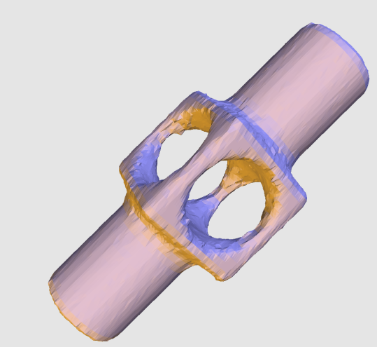
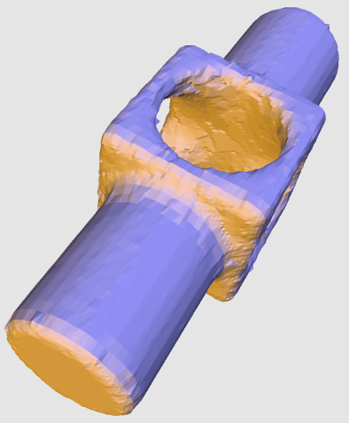
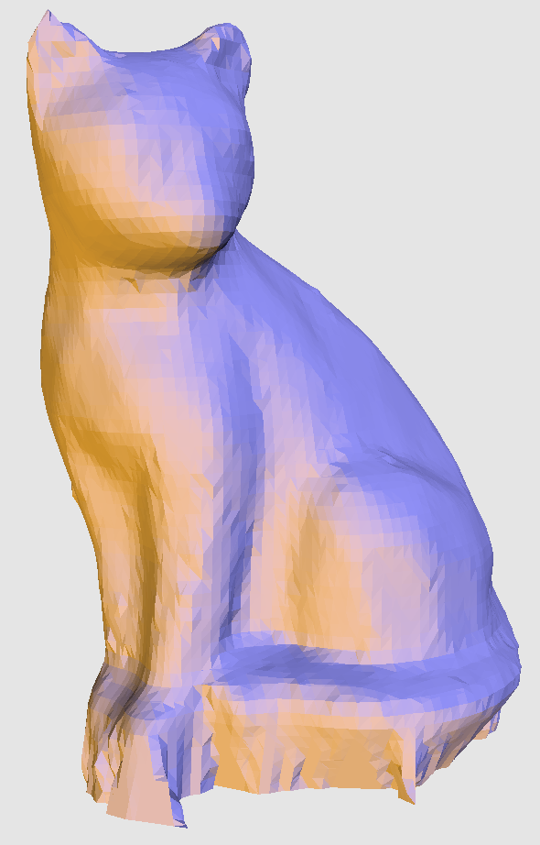
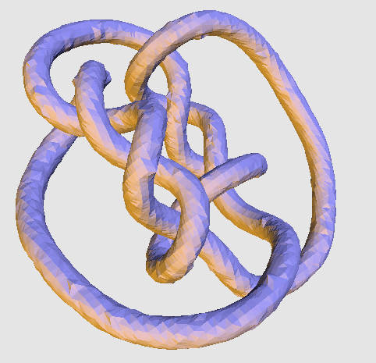
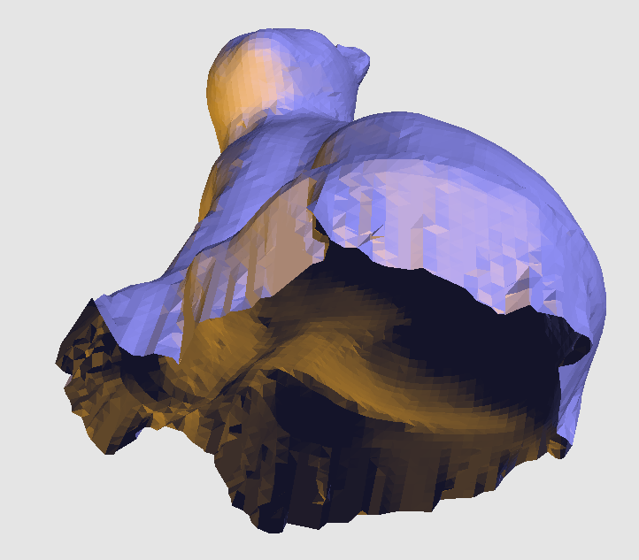
Results

Slide 12
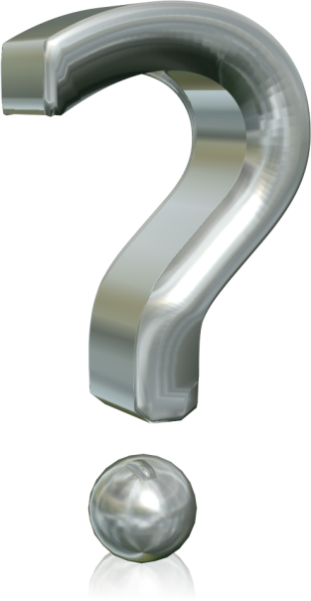
Thank You!
Question?

