Slide 1
Surface Reconstruction from Point Set
An Implementation of
H. Hoppe et al., “Surface Reconstruction from Unorganized Points.” SIGGRAPH 92
W.Lorensen and H.Cline, “Marching Cubes: A High Resolution 3D Surface Construction Algorithm”, SIGGRAPH 87
Zhuoli Jiang, Rui Yang

Slide 2
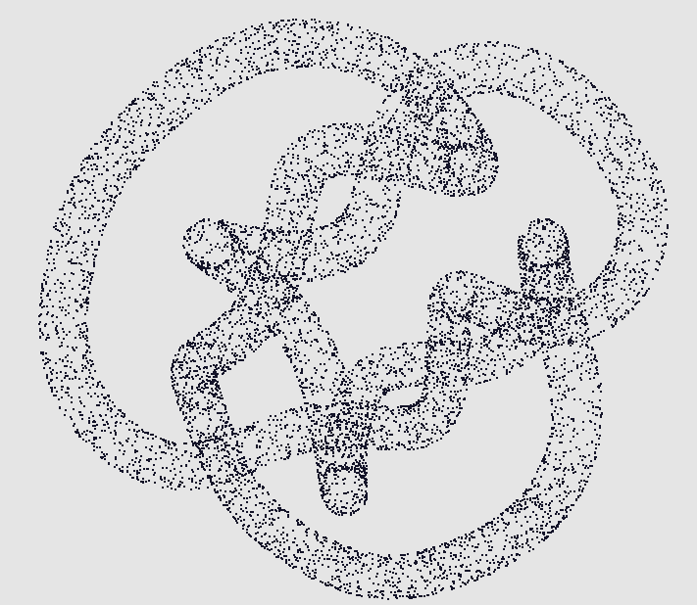
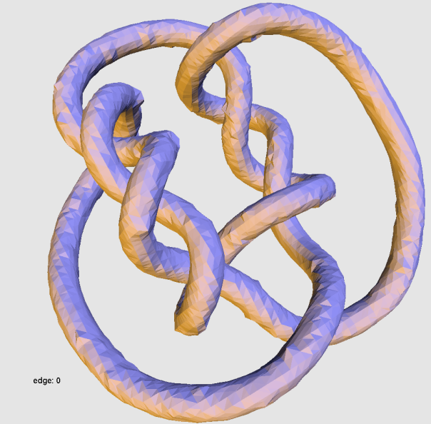
Introduction

Slide 3
Background

Slide 4
Approach

Slide 6
Implementation – Normal Propagation

Slide 7
MST over Riemannian Graph

Slide 8
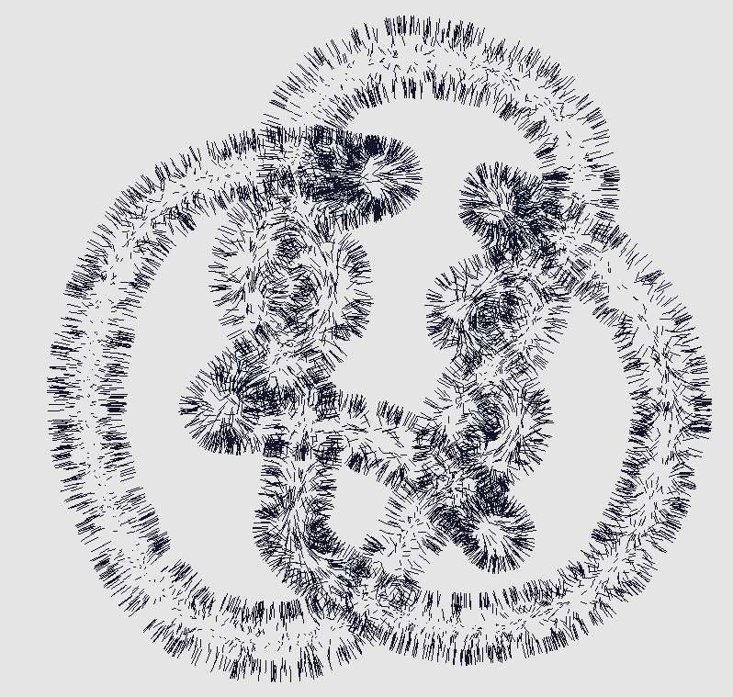
Normal Propagation

Slide 9
Implementation – Marching Cubes

Slide 10
Limitation & Furtherwork
Data structure -> KD tree, Octree, R-tree etc.
Cube ambiguity problem
Duplicate vertices in output -> indexing vertices (degradation in performance)

Slide 11
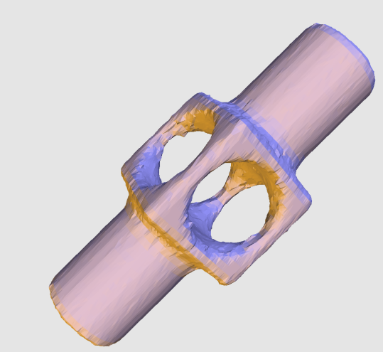
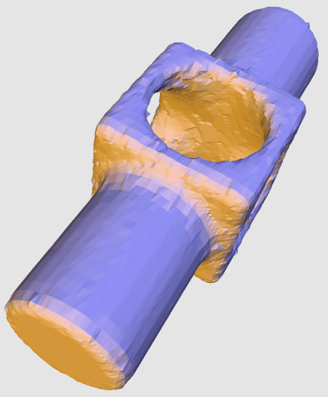
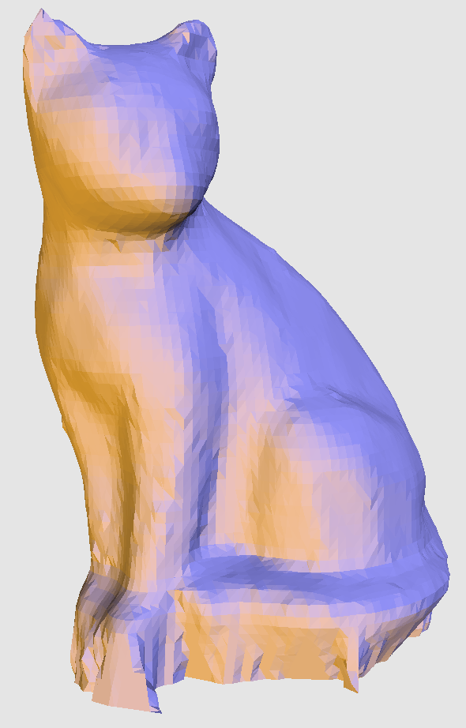
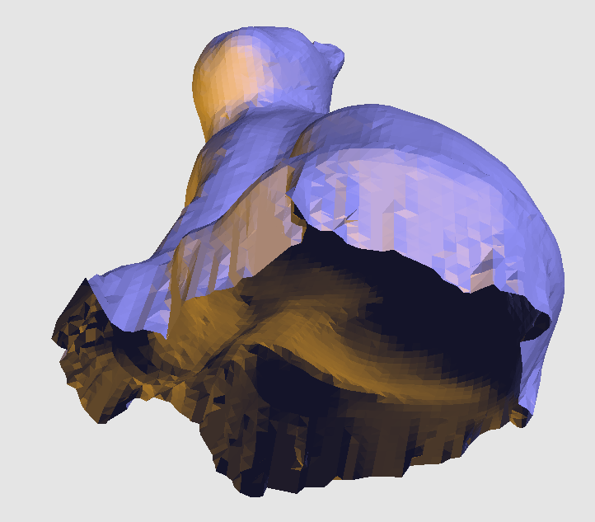
Results

Slide 12
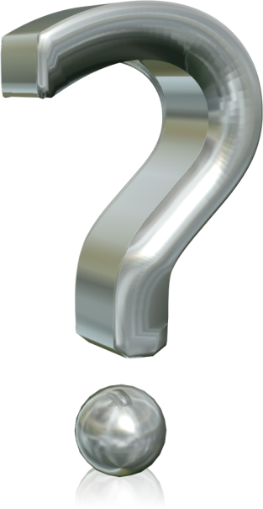
Thank You!
Question?

