Slide 1


AI Fake News Detector
Detection and Classification of Misinformation Using Artificial Intelligence
PRESENTED BY
Turki Ali Alrayeh
Bader Ahmed Alghamdi
Turki Mohammed Alsaiari
Supervised by Dr. Bader Mattar Alotaibi
Prince Sattam Bin Abdulaziz University · December 2025

Slide 2
CHAPTER 1
The Problem
Misinformation spreads faster than verified news — undermining health, politics, and public trust.
1
Lack of Transparency
Existing detectors return only a true/false label with no justification.
2
Manual Verification
Human fact-checkers cannot keep pace with online content volume.
3
Limited Accessibility
Most fact-checking platforms have complex or restricted interfaces.
4
Eroded User Trust
Without reasoning, users dismiss AI verdicts as unreliable.
AI Fake News Detector · PSAU 2025
2 / 15

Slide 3
CHAPTER 1
Project Objectives
Goals this project aims to achieve.
1
Build an AI-based web platform that detects fake news automatically.
2
Apply TF-IDF + Logistic Regression for fast and accurate classification.
3
Add an explainability layer (LIME) that reveals WHY a prediction was made.
4
Provide a confidence score and risk level for every analysed article.
5
Deliver the tool through a web application and a browser extension.
6
Encourage critical thinking about online news content.
AI Fake News Detector · PSAU 2025
3 / 15

Slide 4
CHAPTER 1
Proposed Solution
A web platform that turns a pasted article into an explained verdict in one step.
1
2
3
Input
Analyse
Explain
User pastes a news article into the web app.
Model classifies it as Real or Fake with a confidence score.
LIME highlights the words that drove the decision.
AI Fake News Detector · PSAU 2025
4 / 15

Slide 5
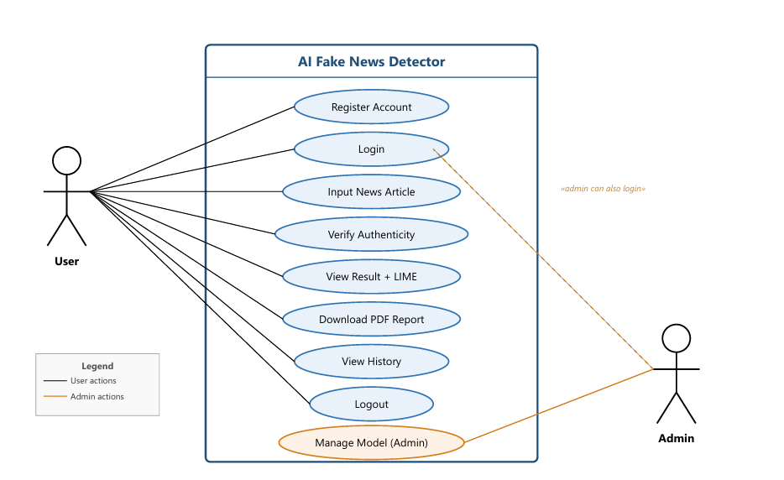
CHAPTER 3 — SYSTEM ANALYSIS
Use Case Diagram
How users and the admin interact with the system.
AI Fake News Detector · PSAU 2025
5 / 15

Slide 6
CHAPTER 4 — DESIGN
System Architecture
A three-tier separation of concerns.
1
Presentation Tier — React.js
Login, Analyse, Dashboard, Model Info, About Us + Chrome extension.
2
Application Tier — Flask (Python)
REST API, JWT authentication, ML inference, LIME explanation.
3
Data Tier — SQLite
Three tables (Users, History, Model_Info) + the trained .pkl pipeline.
AI Fake News Detector · PSAU 2025
6 / 15

Slide 7
CHAPTER 4
Technology Stack
Tools and frameworks used in the project.
R
React.js
F
Flask
SK
scikit-learn
Frontend single-page app
Python REST API backend
TF-IDF + Logistic Regression
L
LIME
SQ
SQLite
M3
Manifest V3
Explainable AI
Embedded database
Chrome extension
AI Fake News Detector · PSAU 2025
7 / 15

Slide 8
CHAPTER 5 — SYSTEM DESIGN
How It Works
From raw text to an explained verdict in under one second.
1
2
3
4
5
6
→
→
→
→
→
Input
Preprocess
TF-IDF
Classifier
LIME
Output
raw text
clean + lemmatise
vectorise
Logistic Reg.
explain
verdict + score
1
Preprocessing: lowercase, strip URLs and punctuation, remove stopwords, lemmatise.
2
TF-IDF Vectorisation: converts text into ~15,000 numerical features (unigrams + bigrams).
3
Logistic Regression: predicts Real or Fake and outputs a probabilistic confidence score.
AI Fake News Detector · PSAU 2025
8 / 15

Slide 9
CHAPTER 6 — DATASET ANALYSIS
Dataset & Model
Trained on the Kaggle Fake and Real News Dataset.
44,898
23,481
21,417
98.37%
TOTAL ARTICLES
FAKE NEWS
REAL NEWS
TEST ACCURACY
1
Class labels: Fake.csv → 0 | True.csv → 1.
2
Split: 80% training / 20% testing (stratified by class).
3
Chosen over SVM and Naïve Bayes for best balance of accuracy, speed, and explainability.
AI Fake News Detector · PSAU 2025
9 / 15

Slide 10
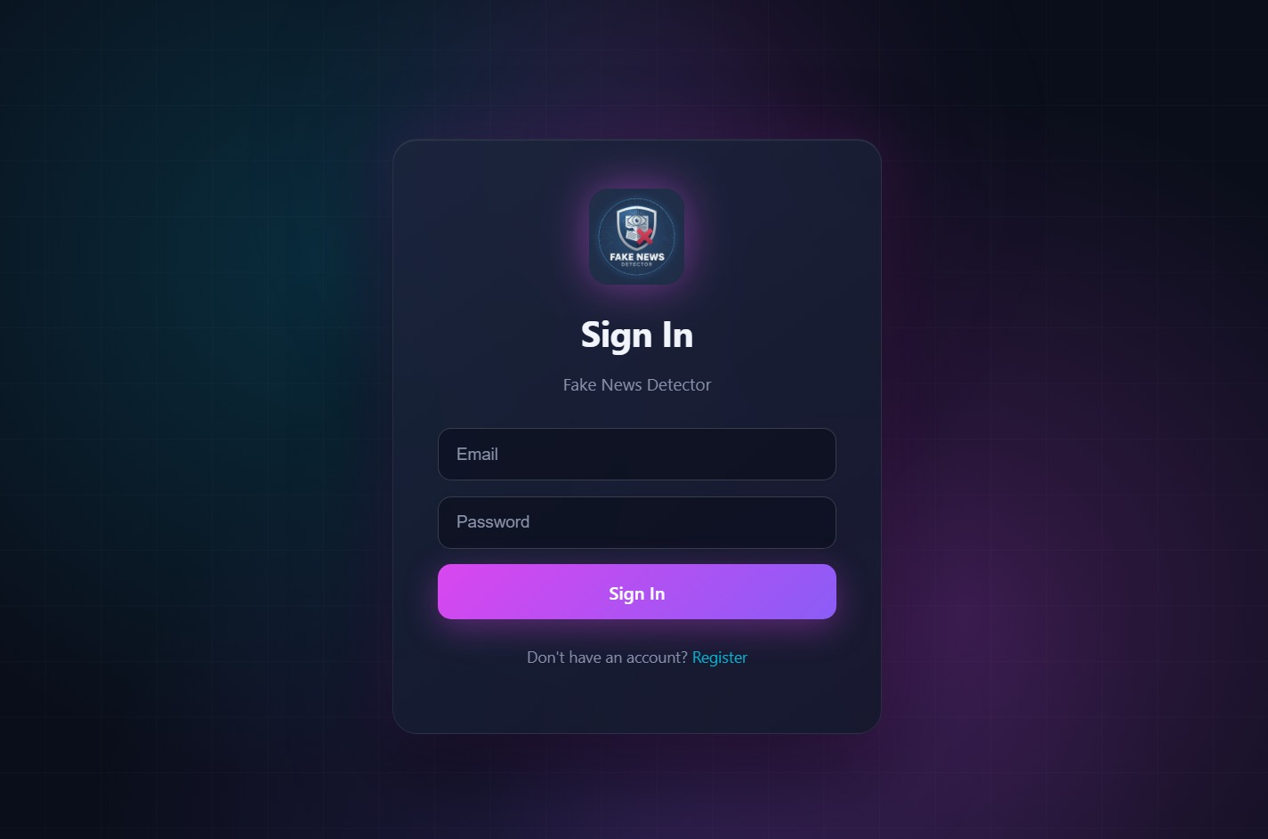
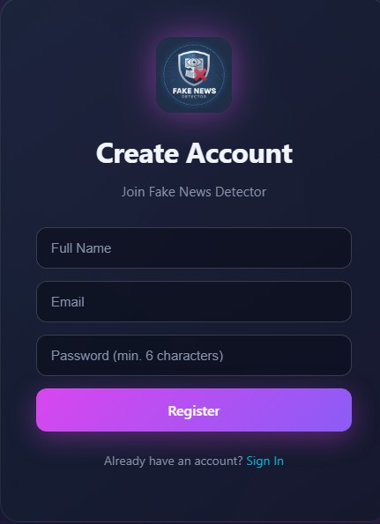
CHAPTER 6 — IMPLEMENTATION
Authentication Screens
Sign In and Create Account pages with secure SHA-256 hashing and JWT tokens.
Sign In Page
Create Account Page
AI Fake News Detector · PSAU 2025
10 / 15

Slide 11
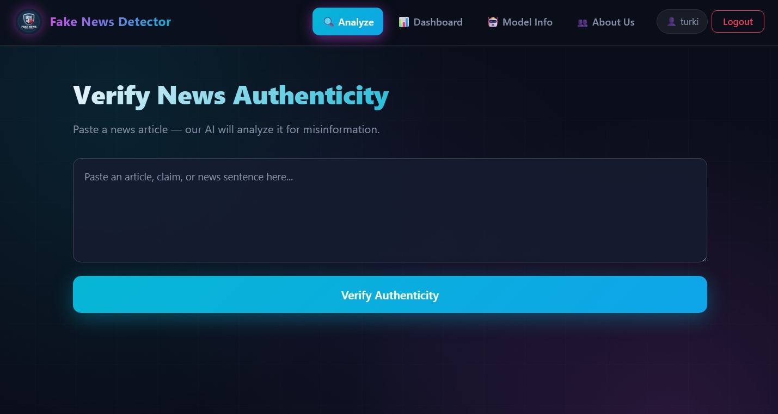
CHAPTER 6 — IMPLEMENTATION
Verify News — Analyze
Users paste an article; the model returns a verdict instantly.
Analyze page — paste an article and verify
AI Fake News Detector · PSAU 2025
11 / 15

Slide 12
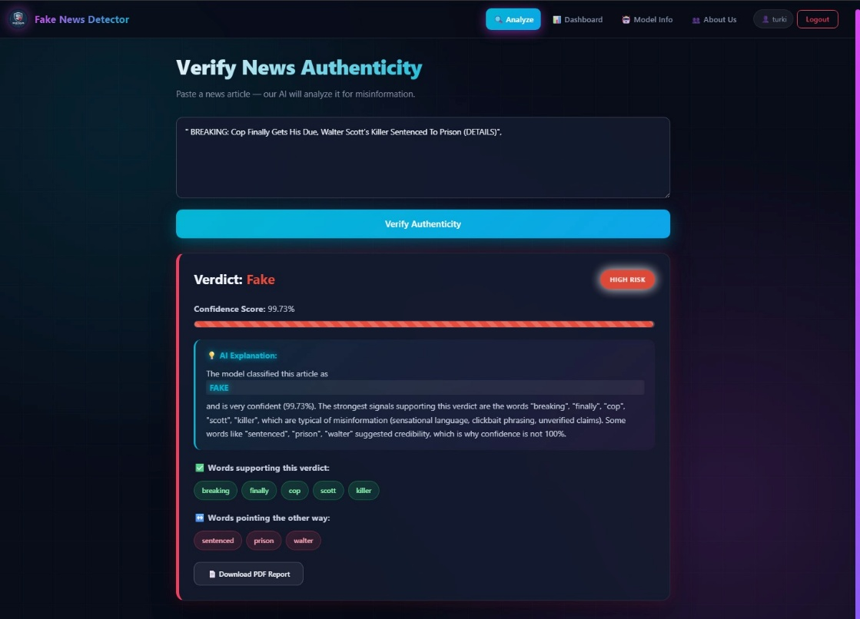
CHAPTER 6 — RESULTS
Detection Result
Example: a fake-news headline detected with 99.73% confidence — LIME explains why.
AI Fake News Detector · PSAU 2025
12 / 15
Verdict: FAKE · Supporting and opposing words highlighted

Slide 13
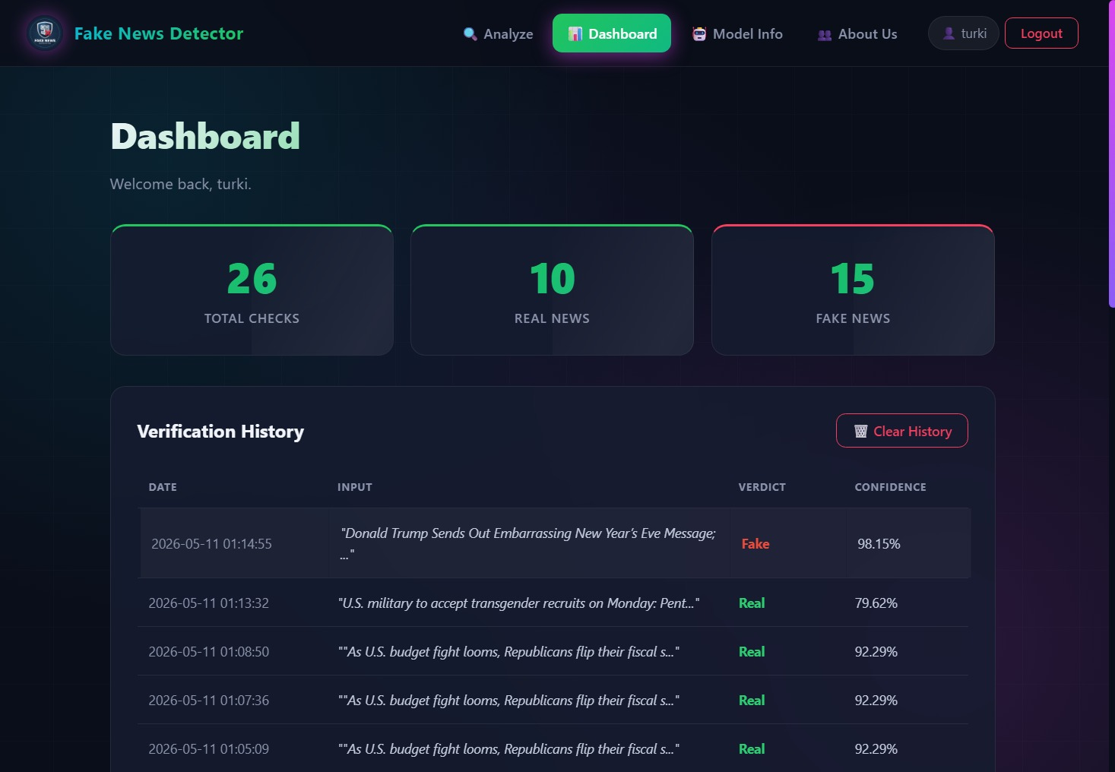
CHAPTER 6 — RESULTS
User Dashboard
Personal verification history with totals for Real and Fake checks.
Dashboard — total checks, real/fake counts, and full history
AI Fake News Detector · PSAU 2025
13 / 15

Slide 14
CHAPTER 7 — TESTING & EVALUATION
Testing & Results
Every major feature was validated against its acceptance criteria.
✓
User Registration
✓
User Authentication
✓
News Classification
PASSED
PASSED
PASSED
✓
PDF Report Export
✓
Dashboard Retrieval
✓
Model Metadata API
PASSED
PASSED
PASSED
Model accuracy: 98.37% Inference latency: ~50 ms / article Algorithm: TF-IDF + Logistic Regression
AI Fake News Detector · PSAU 2025
14 / 15

Slide 15
Thank You
Questions & Discussion
Turki Ali Alrayeh · Bader Ahmed Alghamdi · Turki Mohammed Alsaiari
Supervised by Dr. Bader Mattar Alotaibi
Prince Sattam Bin Abdulaziz University · December 2025
15 / 15

