Slide 1
Benefits of Implementing Gamication in Health & Well being and the Ethics behind It
Methods of engineering work, ac. year 2022/23
David Truhlar
ID: 120897
xtruhlar@stuba.sk
Slovak University of Technology in Bratislava
Faculty of Informatics and Information Technologies

Slide 2
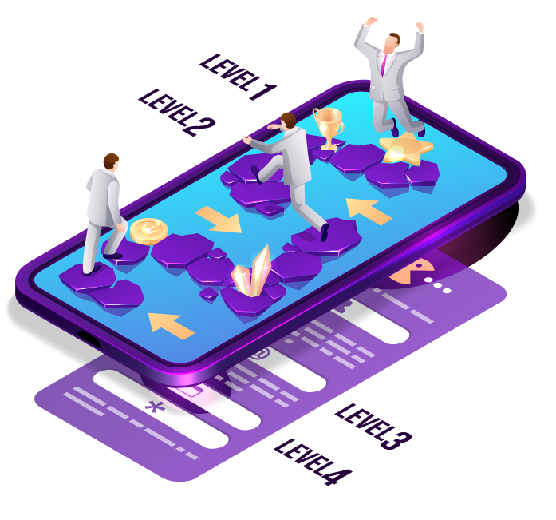
WHAT IS THIS PRESENTATION ABOUT?
Gamification in General
In Health
Benefits
Risks
Solutions
Summary
Picture 1.
David Truhlar
ID: 120897
xtruhlar@stuba.sk

Slide 3
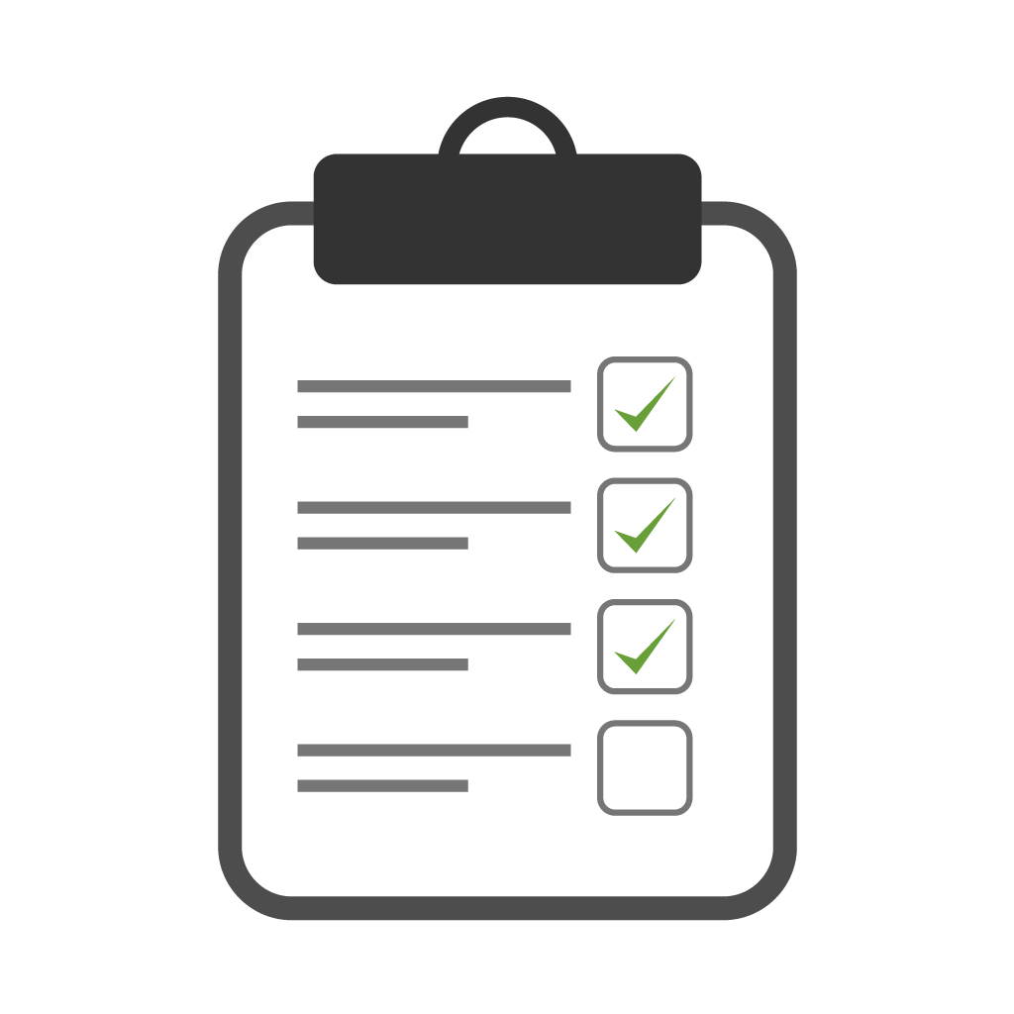
BENEFITS
Healthier life-style
Educated medical stuff
Reduction of bureaucratic processes
Picture 2.
David Truhlar
ID: 120897
xtruhlar@stuba.sk

Slide 4
App | Monthly unique users in millions
Sleep Cycle alarm clock | 1.4
Nike+ Running | 1.4
Walk with Map My Walk GPS Walking | 1.4
Garmin Connect Mobile | 1.7
My Calendar - Period Tracker | 1.9
Google Fit | 2.6
Weight Watchers | 3.7
S Health | 14.9
MyFitnessPal | 19.1
Fitbit | 27.4
Most popular health and fitness apps in the United States - May 2018, by monthly active users
Table 1.
David Truhlar
ID: 120897
xtruhlar@stuba.sk

Slide 5
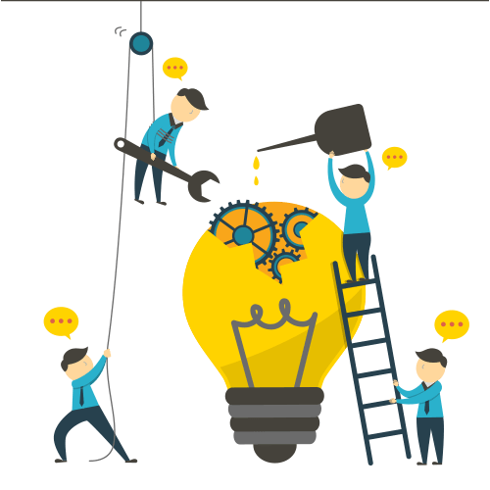
RISKS AND SOLUTIONS
Privacy
Privacy requirements
Misuse of medical records
Encrypting
Addiction
Usage limits
Picture 3.
David Truhlar
ID: 120897
xtruhlar@stuba.sk

Slide 6
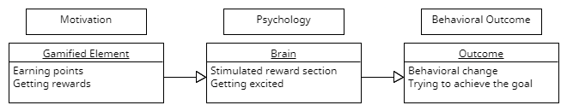
SUMMARY
Picture 4.
Benefits
Health condition
Education
Bureaucracy
Challenges
Privacy
Medical records
Addiction
David Truhlar
ID: 120897
xtruhlar@stuba.sk

Slide 7

References
7
Power Point template: https://www.slidescarnival.com/
Picture 1.: Freepick: https://www.freepick.com
Picture 2.: PNGTree: https://pngtree.com/
Picture 3.: PNGEGG: https://www.pngegg.com/
Graph 1.: Statista: https://www.statista.com/
Picture 4.: Juho Hamari, Jonna Koivisto, and Harri Sarsa. Does gamication work? - a literature review of empirical studies on gamication. In 2014 47th Hawaii International Conference on System Sciences, 2014.: https://www.researchgate.net/
David Truhlar
ID: 120897
xtruhlar@stuba.sk

