Slide 1
Evaluation of ⍴-stepping Algorithm for SSSP
Tian Xia

Slide 2
Motivation
What is SSSP?
SSSP is short for Single Source Shortest Path
Why SSSP is important?
Find directions between physical locations, extract information from Social Networking Application data, Robotic path…
Why we need to parallelize SSSP algorithm
Most applications of SSSP require real-time processing
Notes:
(1)
(2) The sssp algorithm can be used in plenty of real-world apps
(3) Most applications of SSSP require real-time processing, so we want to our sssp algorithm be more efficiently.

Slide 3
Background
Edge Relaxation
For the edge from the vertex u to the vertex v
if d[u]+w(u,v)<d[v]
d[u]+w(u,v)=d[v]
Seqential Algorithms
Doing edge relaxation in specific order
Dijkstra[1]
Start from source node, then doing Edge Relaxation on unvisited nearest node to visited part
Bellman-Ford[2]
Bellman-Ford relaxes all the edges out of all the vertices |V|-1 times
But we want to parallelize them!
u
1
3
v
s
5
Notes:
As we have learned from the undergrad courses, there are 2 well-known Seqential Algorithms can be used to solve sssp problems
The first on is djk, then second one is Bellman-Ford. These 2 algo are all solving sssp by doing edge relaxation in specific order.

Slide 4
Δ-stepping algorithm[3]
Bellman-ford:
Pick all edges and run V-1 times
Δ-stepping algorithm: a game changing method
Dijkstra + Bellman-Ford:
Djikstra: Pick up nearest node in the frontier (Pick only 1 edge)
src
Frontier: the neighbor set of all visited vertices
((i+1)Δ, (2+i)Δ)
Δ-stepping: All nodes in range
(iΔ, (1+i)Δ)
Notes:
Dijkstra only visits one vertex at a time and thus is work-efficient, but it is inherently sequential. Bellman-Ford visits all vertices in a step so it requires redundant work but can be easily parallelized.
So, in order to get work-efficient and easily parallelized. Δ-stepping algorithm combined Dijkstra + Bellman-Ford together.
The Δ-stepping algorithm will try to relax vertex whose shortest-path distances to the source are between iΔ i+1Δ, . Within each step, the algorithm resorts to running Bellman-Ford as substeps to determine the distances to such vertices.
These bf substeps can be papalized..
Hence, it require less work than Bellman-Ford, and have better parallelism than Dijkstra

Slide 5
Summary of Δ-stepping
Δ-stepping algorithm: a game changing method
∆<= min w(e): Degenerates into Dijkstra
∆=> max w(e): Degenerates into Bellman-Ford
∆-stepping wants to find easily computable fixed ∆ that yields a good compromise between these two extremes
Notes:
So shown before, the key parameter of delta-stepping is delta. If delta is too small, which smaller than the minimal weight, the algorithm will dege to djk(since it will only small amount of vertex in each steps )
However, if delta is too large.. It will dege into bf, since it will process all vertex in each sub step

Slide 6
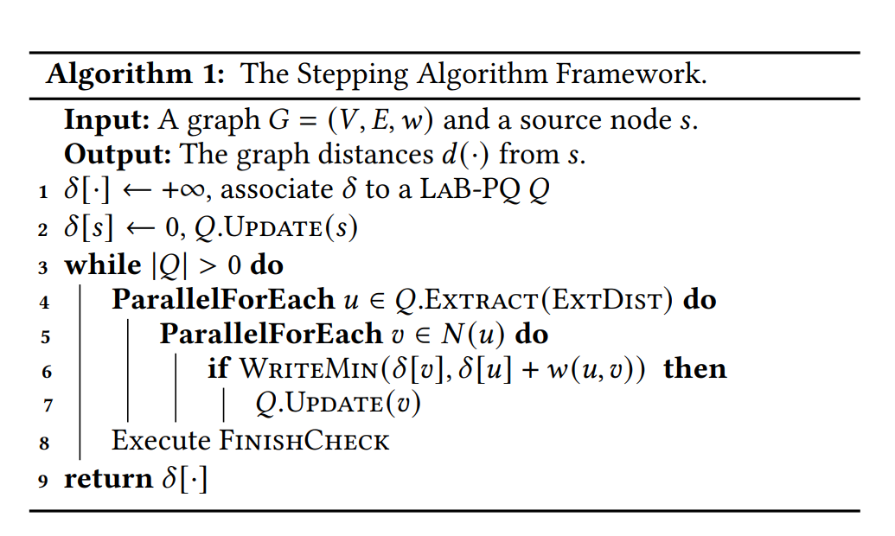
Implementation: Stepping Algortihm Framework
This framework requires two user-defined functions, ExtDist and FinishCheck.
Many SSSP algorithms can be instantiated by plugging in different ExtDist and FinishCheck functions
Notes:
Efficient stepping algorithms and implementations for parallel shortest paths
In each step, we process vertices with distances within a threshold 𝜃, which is computed by ExtDist and used as the parameter of Extract. The extracted vertices will relax their neighbors using WriteMin (Line 6). If successful, we call Update on the corresponding neighbor.

Slide 7
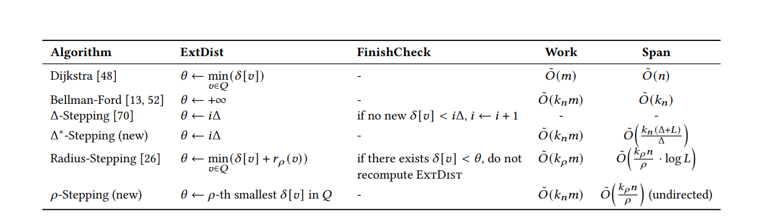
SSSP Algorithms in the stepping algorithm framework

Slide 8
⍴-stepping Algorithm[4]
A new stepping Algorithm:
𝜌-Stepping extracts the 𝜌 nearest vertices in the frontier, and relaxes their neighbors
-> 𝜌-th smallest 𝛿 [𝑣] in Q
-> It will increase it search range
𝜌-th smallest 𝛿 [𝑣] for each step.

Slide 9
Research Question
RQ1: Can p-stepping work on general graphs?
Tested on several graph datasets
RQ2: Is p-stepping outperform than other algorithm?
Comparing with other algorithm

Slide 10
Dataset
Name | Nodes | Edges
Wiki-Vote | 7115 | 103689
com-amazon | 334,863 | 925,872
web-stanford | 281,903 | 2,312,497
com-orkut | 3,072,441 | 117,185,083

Slide 11
Methods
Reimplementing the rho-stepping algorithm
Testing on the dataset with different sizes.
Using sequential version Dijkstra as baseline

Slide 12
Experiment
Process
Testing on stepping algorithms, and Bellman-Ford
Use each vertex as source node to find sssp
Run 10 round for each source node, and get average running time
Verified with running time of dijkstra
Metrics: Running time of algorithms

Slide 13
Result
 | com-orkut(OK) | Wiki-Vote | web-stanford | amazon
Δ-Stepping | 0.90333033 | 0.00126664 | 0.0094191 | 0.012360241
⍴-stepping | 0.82097256 | 0.00135531 | 0.0086923 | 0.011378397
Bellman-Ford | 0.91280997 | 0.00124240 | 0.0105609 | 0.012110078
Dijkstra (baseline) | 5.220662 | 0.00137284 | 0.0687417 | 0.054652069
Since there are millions of nodes in dataset OK
100 nodes randomly to run the testing.
1000 nodes are picked for other 3 datasets.

Slide 14
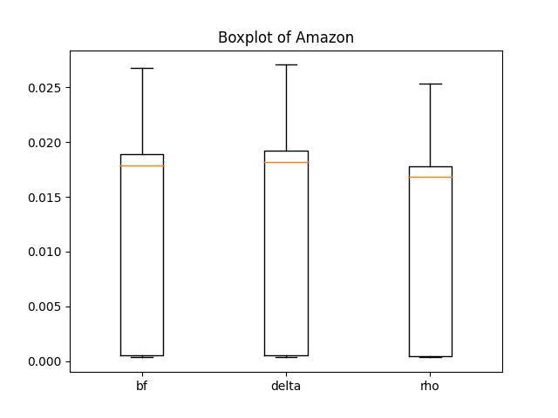
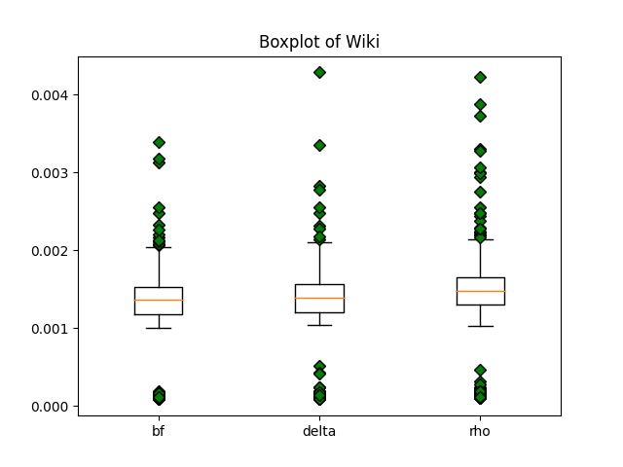
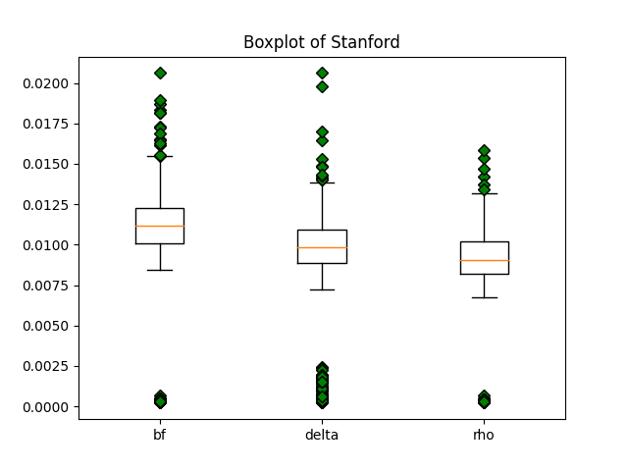
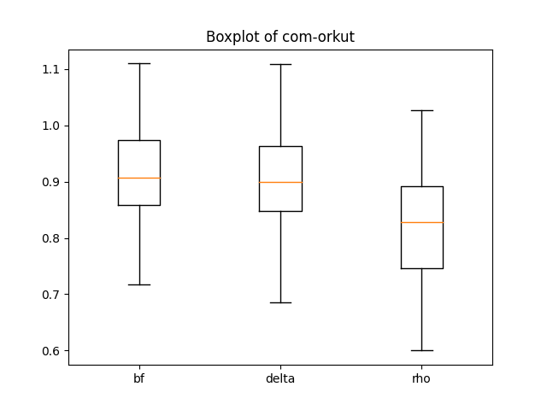

Slide 15
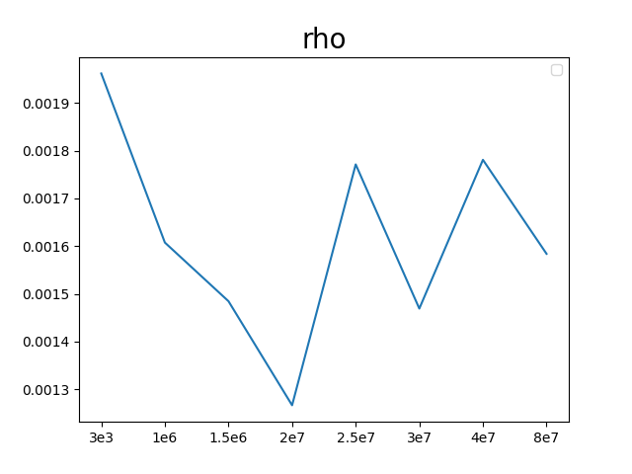
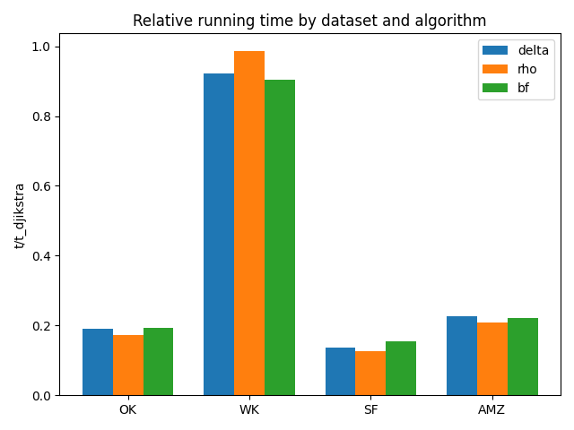

Slide 16
Questions
What is Edge Relaxation in SSSP algorithms?
The Δ-stepping algorithm will degenerates into what algorithm if ∆<= min w(e)?
What is main difference between Δ-stepping algorithm and 𝜌-stepping algorithm?

Slide 17
Reference
[1] Edsger W Dijkstra et al. A note on two problems in connexion with graphs.Numerischemathematik, 1(1):269–271, 195
[2] Richard Bellman. On a routing problem.Quarterly of applied mathematics, 16(1):87–90, 1958.
[3] Ulrich Meyer and Peter Sanders.δ-stepping: a parallelizable shortest path algorithm.Journal of Algorithms, 49(1):114–152, 2003
[4] Xiaojun Dong, Yan Gu, Yihan Sun, and Yunming Zhang. Efficient stepping algorithms and implementations for parallel shortest paths. In Proceedings of the 33rd ACM Symposium on Parallelism in Algorithms and Architectures, SPAA ’21, page 184–197,New York, NY, USA, 2021

