Slide 1
Evaluation of ⍴-stepping Algorithm for SSSP
Tian Xia

Slide 2
Motivation
What is SSSP?
SSSP is short for Single Source Shortest Path
Why SSSP is important?
find directions between physical locations, extract information from Social Networking Application data, Robotic path…
Why we need to parallelize SSSP algorithm
Most applications of SSSP require real-time processing

Slide 3
Background
Seqential Algorithms
Doing edge relaxation in specific order
Dijkstra
Start from source node, then doing Edge Relaxation on unvisited nearest node to visited part
Bellman-Ford
Bellman-Ford relaxes all the edges out of all the vertices |V|-1 times
But, we want to paralle them!
Edge Relaxation
For the edge from the vertex u to the vertex v
if d[u]+w(u,v)<d[v]
d[u]+w(u,v)=d[v]

Slide 4
Δ-stepping algorithm
Δ-stepping algorithm: a game changing method
Djikstra + Bellman-Ford:
Djikstra: Pick up nearest node in the frontier (Pick only 1 edge)
Processed nodes
Frontier: Neighbours of processed nodes
Δ-stepping: All nodes in range
(iΔ, (1+i)Δ)
Bellman-ford:
Pick all edges and run V-1 times

Slide 5
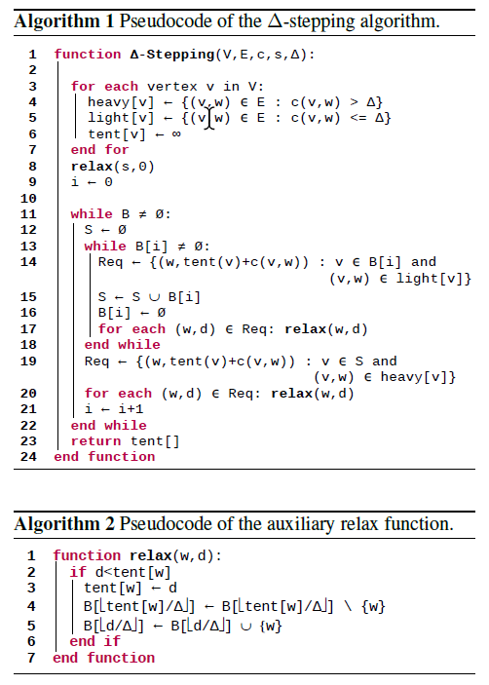
Pseuduocode of Δ-stepping

Slide 6
Summary of Δ-stepping
Δ-stepping algorithm: a game changing method
∆<= min w(e) : Degenerates into Dijkstra
∆=> max w(e): Degenerates into Bellman-Ford
∆-stepping wants to find easily computable fixed ∆ that yields a good compromise between these two extremes

Slide 7
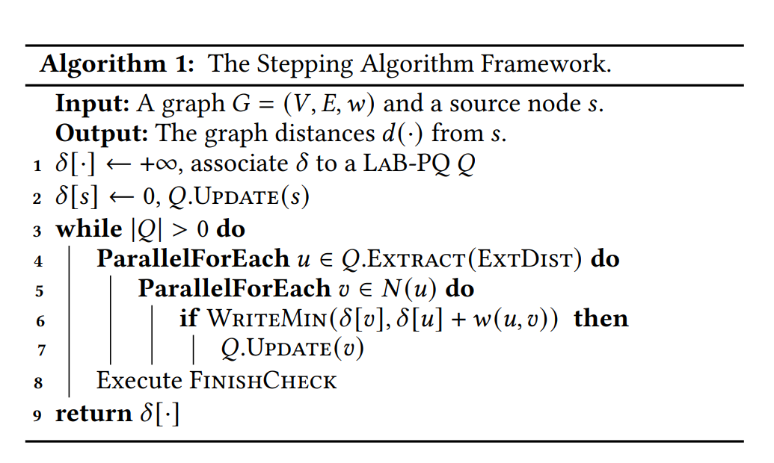
Stepping Algortihm Framework
This framework requires two user-defined functions, ExtDist and FinishCheck. Many SSSP algorithms can be instantiated by plugging in different ExtDist and FinishCheck functions

Slide 8
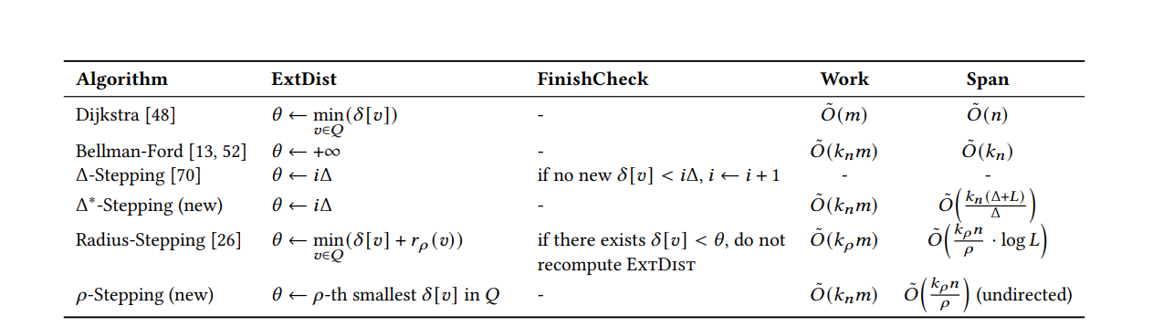
SSSP Algorithms in the stepping algorithm framework

Slide 9
⍴-stepping Algorithm
A new stepping Algorithm:
𝜌-Stepping extracts the 𝜌 nearest vertices in the frontier, and relaxes their neighbors
EXTDIST of ⍴-stepping
← 𝜌-th smallest 𝛿 [𝑣] in Q

Slide 10
Research Question
RQ1: Can p-stepping work on general graphs?
Tested on several graph datasets
RQ2: Is p-stepping outperform than other algorithm?
Comparing with other algorithm()

Slide 11
Dataset
Name | Nodes | Edges
Wiki-Vote | 7115 | 103689
com-amazon | 334,863 | 925,872
web-stanford | 281,903 | 2,312,497
com-orkut | 3,072,441 | 117,185,083

Slide 12
Experiment
Process
Testing on stepping algorithms, and Bellman-Ford
Use each Vertex as source node to find sssp
Run 10 round for each source node, and get avg running time
Verified with running time of dijkstra
Metrics: Running time of algorithms

Slide 13
Result
 | com-orkut* | Wiki-Vote | web-stanford
Δ-Stepping | 0.90333033 | 0.00126664 | 0.0094191
⍴-stepping | 0.82097256 | 0.00135531 | 0.0086923
Bellman-Ford | 0.91280997 | 0.00124240 | 0.0105609
Dijkstra | 5.220662 | 0.00137284 | 0.0687417
Since there are millions of nodes in dataset OK chosen 1000 nodes randomly to run the testing.

Slide 14
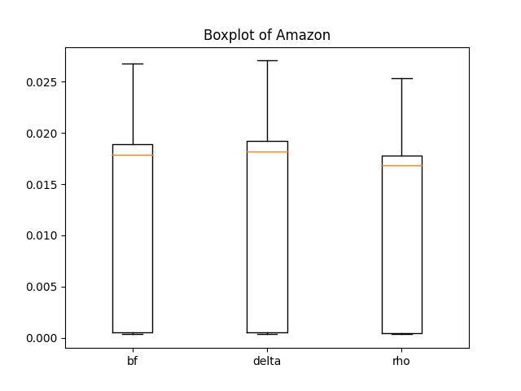
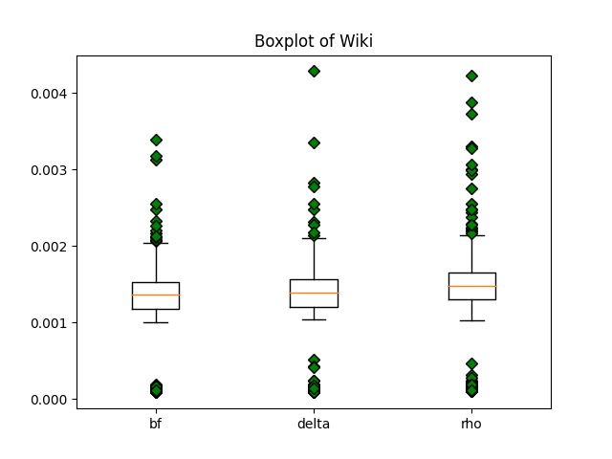
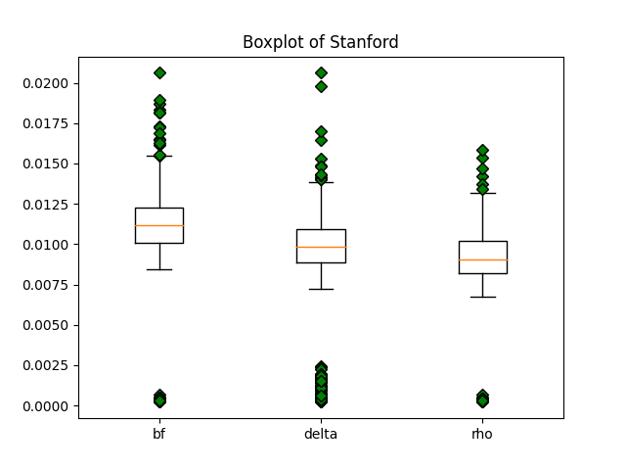
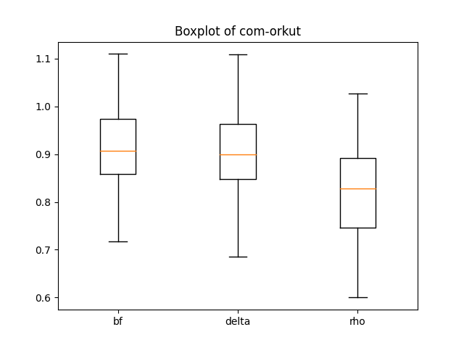

Slide 15
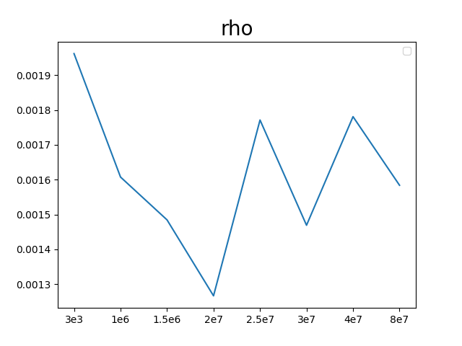
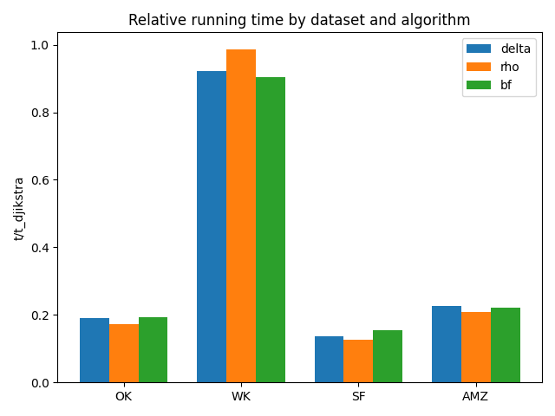

Slide 16
Questions
What is Edge Relaxation in SSSP algorithms?
The Δ-stepping algorithm will degenerates into what algorithm if ∆<= min w(e)?
What is main difference between Δ-stepping algorithm and 𝜌-stepping algorithm?

