Slide 1
Kubernetes

Slide 2
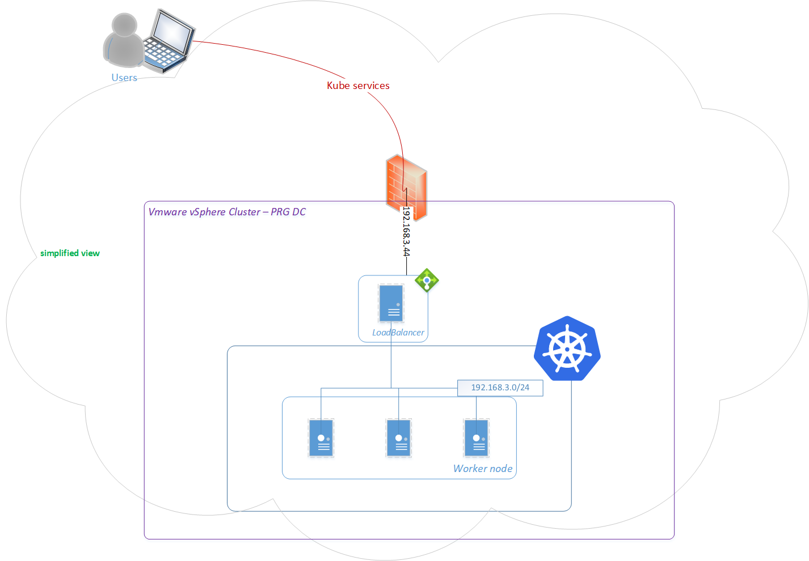
Example of R&D K8s in PRG

Slide 3
Passphrase
Nodes
Pods
Services
Resources

Slide 4
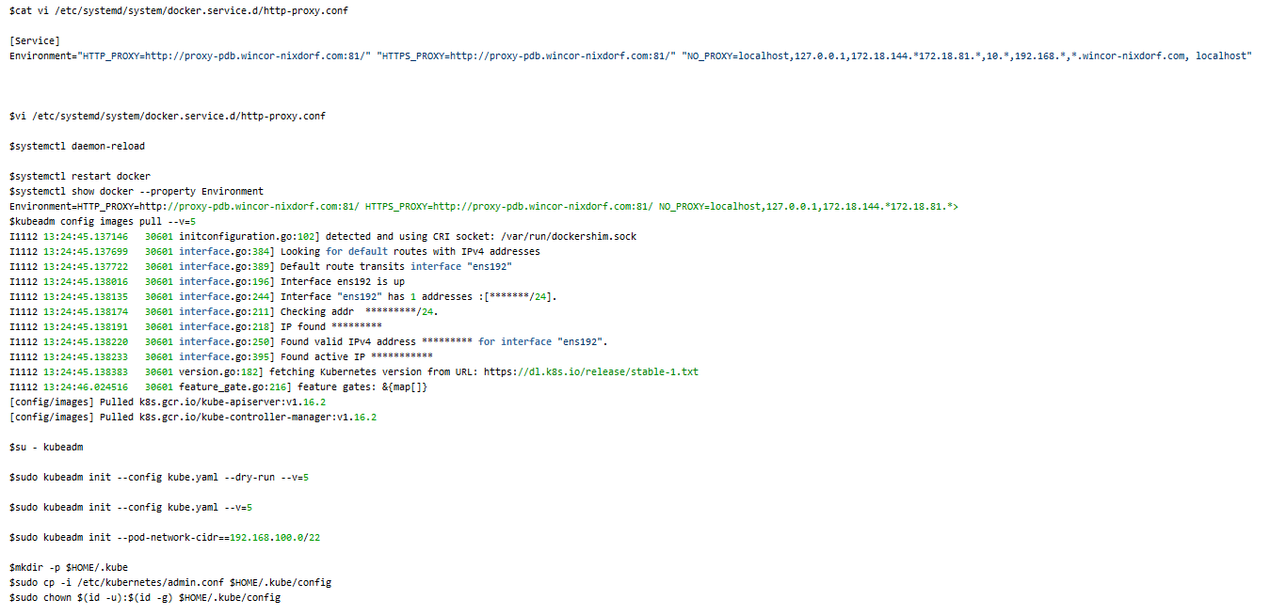
Initializing cluster

Slide 5
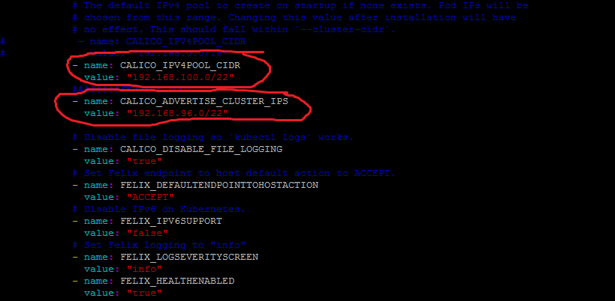
Network & Storage
Network Plugins
Storage types

Slide 6
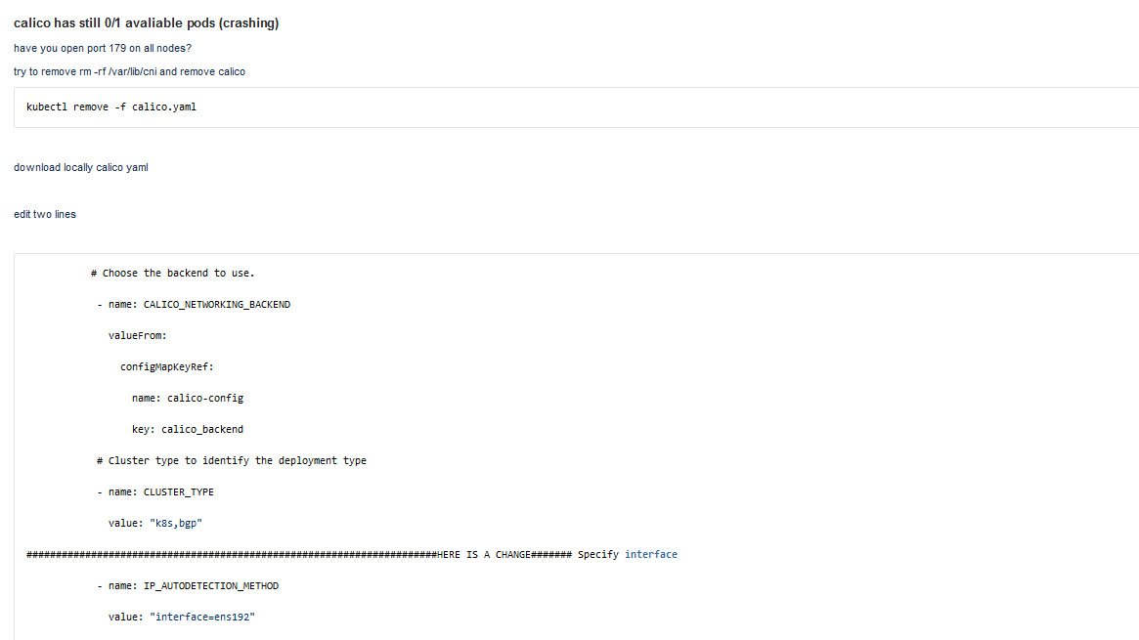
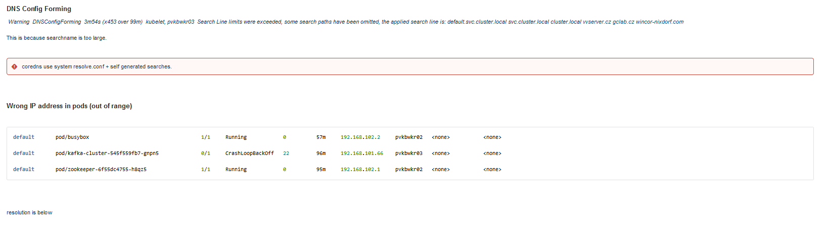
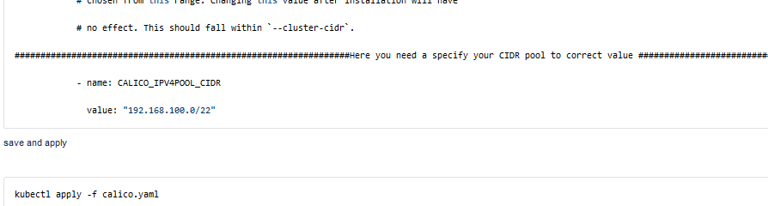
Network issues

Slide 7
Exposing service on baremetal
Nodeport
Internal Loadbalancer (Metallb)
External Loadbalancer (Haproxy, Ingress-nginx)

Slide 8
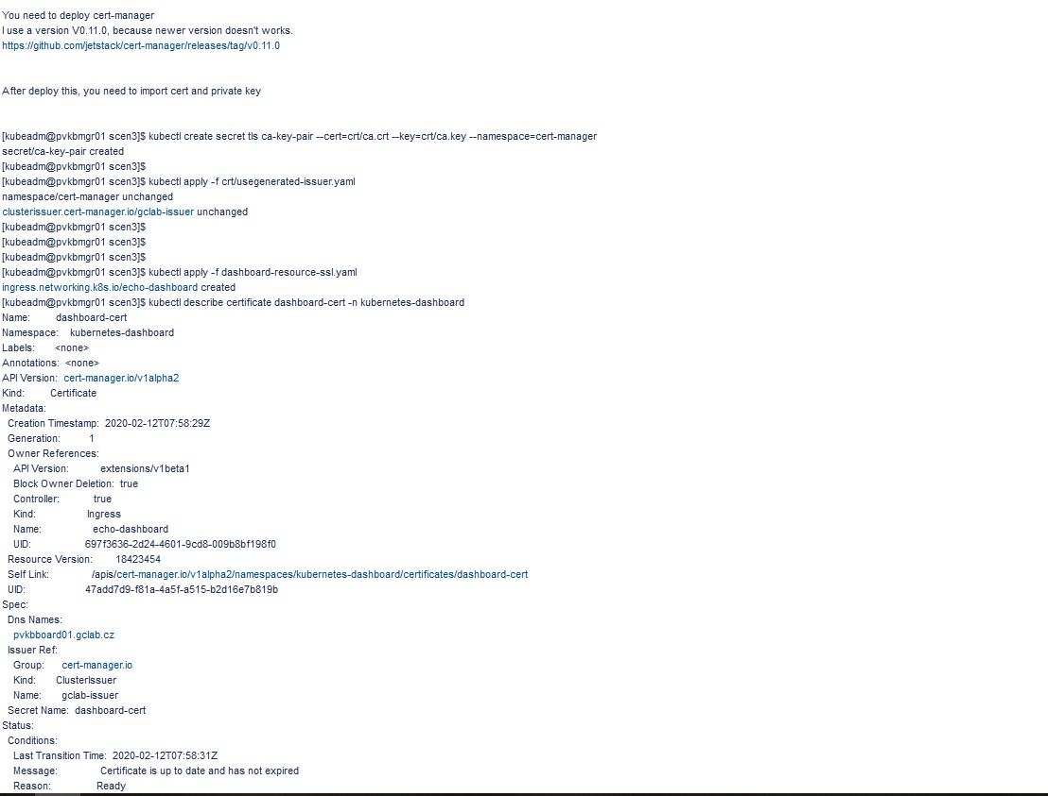
SSL access to service
kube-lego
Cert-manager

