Slide 1
xtUML and BridgePoint
Execution Rules
Notes:
1

Slide 2
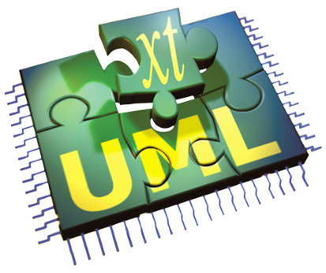
The xtUML method - Verification
Analysis – questioning, thinking, sketching...
  Descriptive UML diagrams
    use case, sequence, ...
Executable Modeling – formalizing the analysis:
  Component Diagrams (partitioning/interfaces)
  Class Diagrams (data)
  State Machines (control)
  Activities (processing)
Verification
  Interpretive Model Execution
Code generation
  Template and Rule-Based Translation

Slide 3
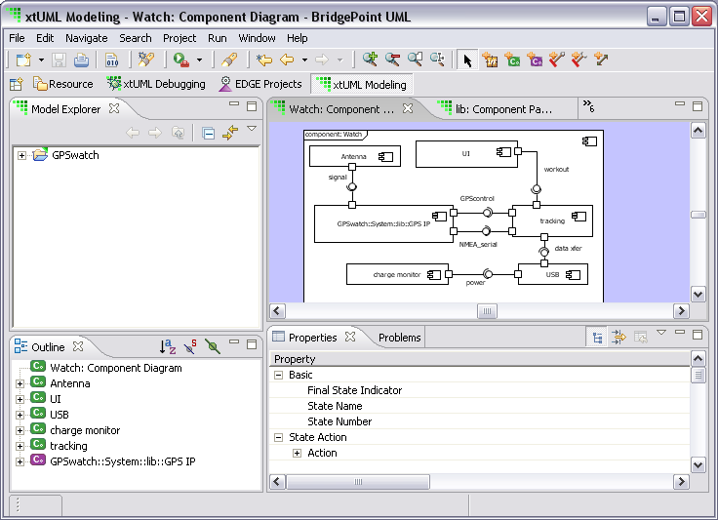
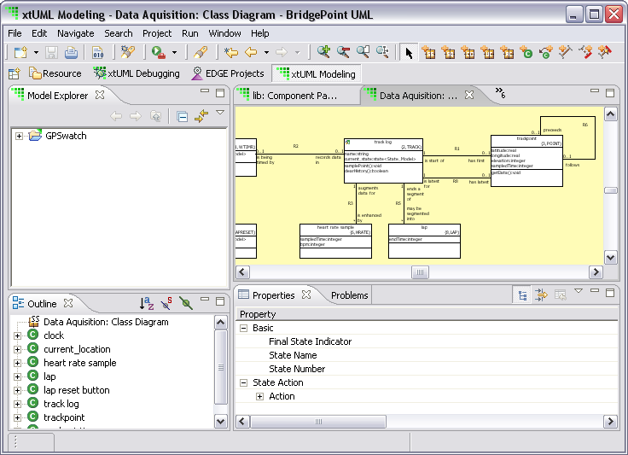
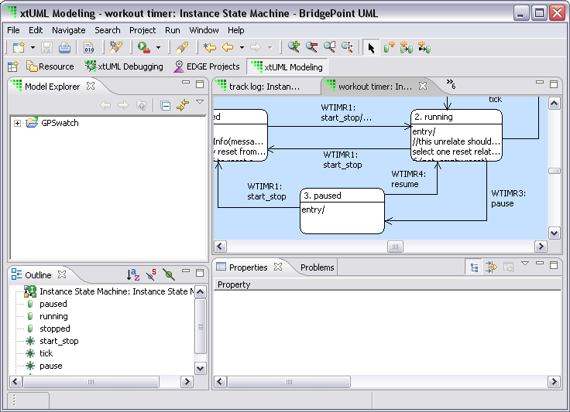
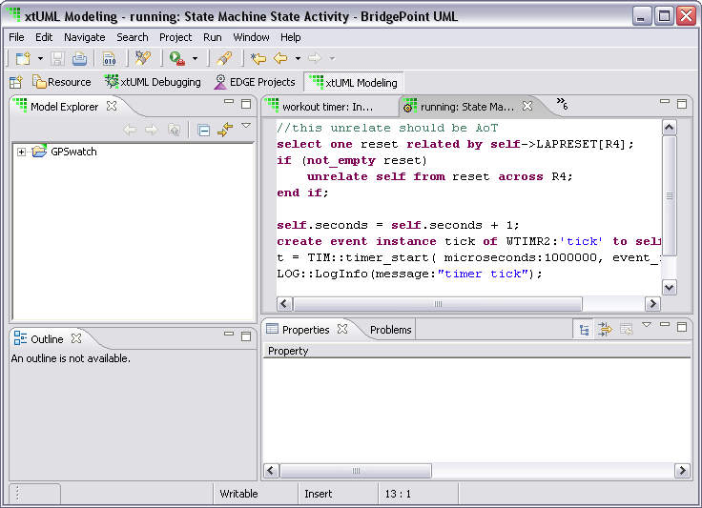
Execution Rules
Bottom Up
  Types of actions
  Homes for actions
  State models
  Event delivery
  Event ordering
  Delayed events
  Concurrency
  Interface messages
  Bridges

Slide 4
Types of Actions
create, delete instances
read, write attributes
read parameter values
relate, unrelate instances
invoke operations, set parameter values
send events, set parameter values
find instances
computation
create, read, write local variables
control: iterate, loop, decision
Do we need anything else?
Notes:
Activities are executed when in states or transitions.
Each state machine is an instance of the containing class and runs concurrently and independently of other state machines.
The SM remains in a state until an event is received, and only if that state expects a certain transaction to occur on that received event.
Each transitioning event advances only one state per event fire.

Slide 5
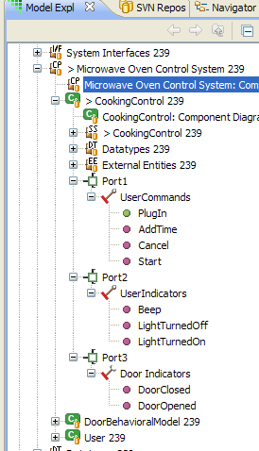
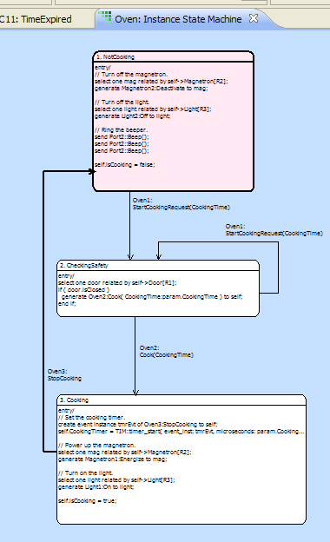
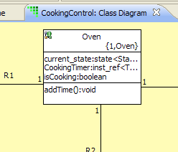
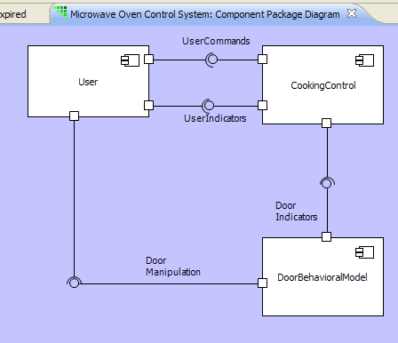
Homes for Actions
States
Transitions
Operations
  Instance-based
  Class-based
Ports
Mathematically-derived attributes
Bridge Operations
Functions

Slide 6
State Models
Capture lifecycles in state models
  Instance-based vs. Class-based
Start by naming the states
Define the legal transitions
Associate events with transitions
Actions take finite time
Transitions are considered instantaneous
All state machines execute concurrently
Synchronous creation
  No actions executed
  Lowest numbered state
Asynchronous creation
  Action executed
  Destination state for creation transition
Final state
Notes:
Background colors are different across instance based and class based state machines. ISMs are blue, CSM are green.
CSMs can received mapped signals and manage creation of instances.
Most state machines will be instance based.
States always run to completion before the SM takes the next event in the queue.

Slide 7
State Dispatch
Event delivery causes one of:
  Transition
  Ignore
  Error (“Can’t Happen”)
Transition:
  Execute actions on transition
  Execute actions within state
  Change current state
Ignore:
  Event is discarded, no state change, no actions
Error:
  System-level (as opposed to modeled) recovery invoked

Slide 8
Event Delivery
Events are reliable
Events do not interrupt executing actions
Order is preserved among sender/receiver pair
Self-directed events are delivered before others
Delayed events specify minimum delay
  Time EE provides timer operations and real-time clock
Currently:
  No guards
  No re-queuing
  No peeking or selecting among multiple events
Notes:
Events are reliable, they are never lost, but can possibly be queued and delayed.
Order is only preserved between a specific sender/receiver pair. Event 1 sent from B to A will always precede Event 2 sent from A to B, but Event 3 sent from C to A may precede the other events.

Slide 9
Concurrency
All state machines execute concurrently
Models of concurrency may vary
Full concurrency
  Actions on transitions and within states may preempt others
  Models must ensure data integrity
Interleaved
  Preemption occurs only on state boundaries
  Models may assume state atomicity
Consistent Data Access Set
  Like full concurrency
  Models may assume consistent data access set

Slide 10
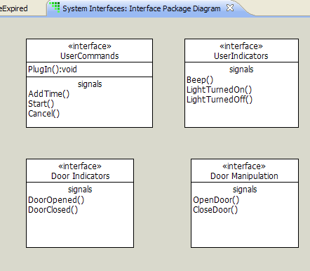
Interface Messages
Provide inter-component communication
Carry parameters
Asynchronous Signals
  May be mapped to class-based events
Synchronous Operations
  Future: May be mapped to class-based operations
Use actions in ports to define behavior

Slide 11
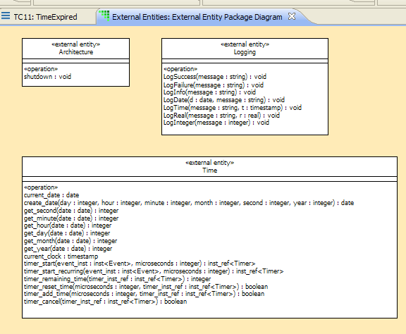
Bridges
Another form of synchronous operation
  Takes parameters
  Can be wired to external code or defined with OAL
Use for library functions
  Time
  Logging
  Math
Use for scaffolding
  OAL or Java for Verifier
  Hand-written code for target

Slide 12
Summary
These rules represent a 'contract' between the world of analysis and the world of implementation
The architecture undertakes to implement dynamic behavior according to the agreed semantics.

