Slide 1
xtUML and BridgePoint
Introduction
Notes:
1

Slide 2
Overview
xtUML Modeling
  Method
  Executable model hierarchy
  Relationship between model elements
  Analysis models
  Packages
Notes:
About 30-45 minutes to talk about
the method, xtUML
Model Elements used, two different sets, contributors to the code generation, and others used for documentation

Slide 3
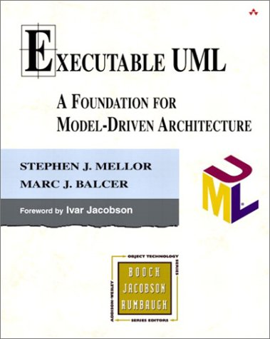


xtUML – Executable and Translatable UML
Defines a method, including:
  Semantics of diagrams
  Relationship between diagrams
  Action language
  Execution rules
  Order of construction
  Path to implementation
400+ pages
Notes:
Unlike standard UML, xtUML is not entirely ”free-form”. Relationships between diagrams and action language exist to fully describe the modeled domain.
xtUML is designed to be precise and complete enough not only for subject-matter-experts to completely describe the domain, but also to verify and generate platform-specific code.

Slide 4
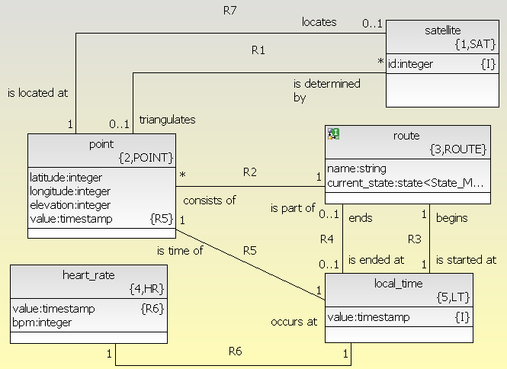
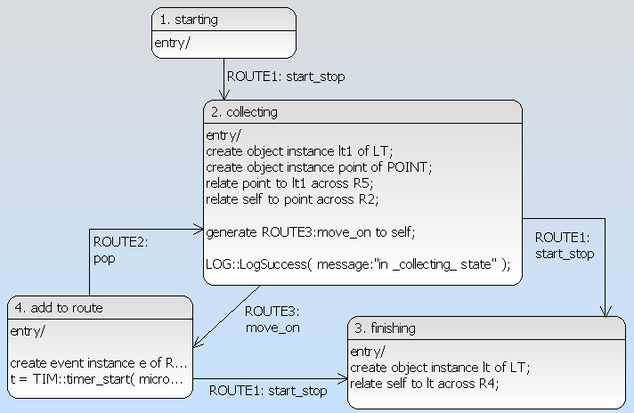
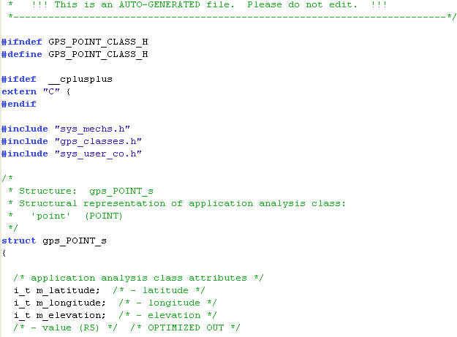
Graphical Models Increase Understanding
vs.
Diagrams
  Expose Abstractions
  Allow us to reason about correctness
Notes:
Models allow product stakeholders who are not programmers (executives, marketing, etc) to understand the software design and provide requirements and functionality input early in the development process.
xtUML is meant to be self-documenting. Documentation is by definition concurrent with the code.
These diagrams are more readable, easier to get an overview – and are write-once read-many.
This is work that we do anyway – either on white boards or in our heads.

Slide 5

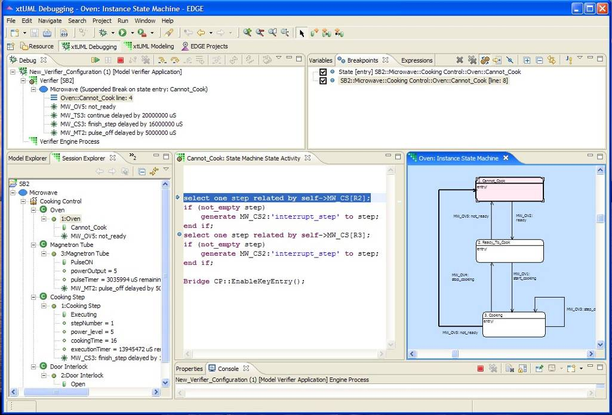
Execution: My piece runs, how about yours?
We find some defects through inspection, but…
…we find the rest by executing the code.
What if we could execute the application before choosing the:
  processor
  language
  OS?
Notes:
Using BridgePoint to develop platform-independent models allows the user to run the model as it is built, rather than generate code and then find errors.
Models are interpreted by the Model Verifier which supports a full-featured debugger; modification while running is also possible.

Slide 6
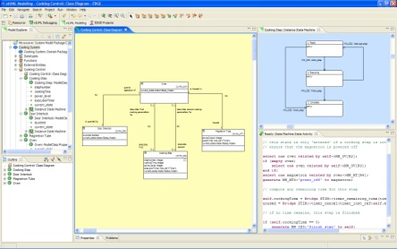



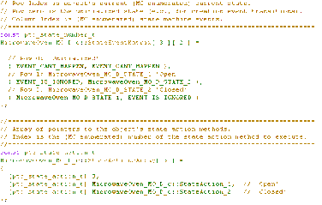
Compiling Models
Application Models
Marking Data
Rules & Templates
Translation Engine
Optimized Code
Notes:
The Model compiler is governed by sets of rules and templates.
Marking data adds constraints to the code generation for Finite State Machine implementation, tasking of classes, etc.
Marking data also connects the platform-independent model to the application-independent model compiler. It also allows for selection between different ways of mapping model elements to code.
Models are unchanged in the compilation/translation and are therefore still platform independent.

Slide 7
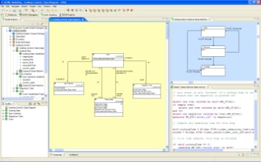
Separate Application from Implementation
Subject-matter experts focus on application
  Features and capabilities
  Intricacies of the application
Implementation experts focus on optimization
  Faster, smaller
  Less power
  Lower cost
Application Models
Model Compiler
Two Types of Reusable IP
Notes:
The application that we are intending to deliver – a radar system, a mobile device, a medical implement, etc. – is the subject that matters, and the experts in this field can use the modeling techniques to create, analyze and prove out the features and capabilities desired.
Then experts in the implementation – C code on an 8051 micro controller, C++ on a Linux-based system – can craft the Model Compiler features to produce efficient output code, standardized, reusable and supportable, for the selected target or targets. All analysts can benefit from enhancements to the model compiler. Not everyone needs to be a C/C++ expert using this translation method.

Slide 8



Reusable IP: Application Models
Platform-independent Application Models
  Reuse application models across platforms and product variants.
Notes:
Platform independent models allow for much quicker adaptation when platform requirements change.

Slide 9

Reusable IP: Model Compilers
Application-independent Model Compile
  Reuse one model compiler across many applications.
Site Link
Channel Controller
MC
MME
Notes:
Model compiler is somewhat ”opposite” of the PIM. Only one platform, but many applications.
Enhancements in the MC are applicable to all xtUML models run through.
A common MC allows for easier debug of the translation of multiple applications.

Slide 10
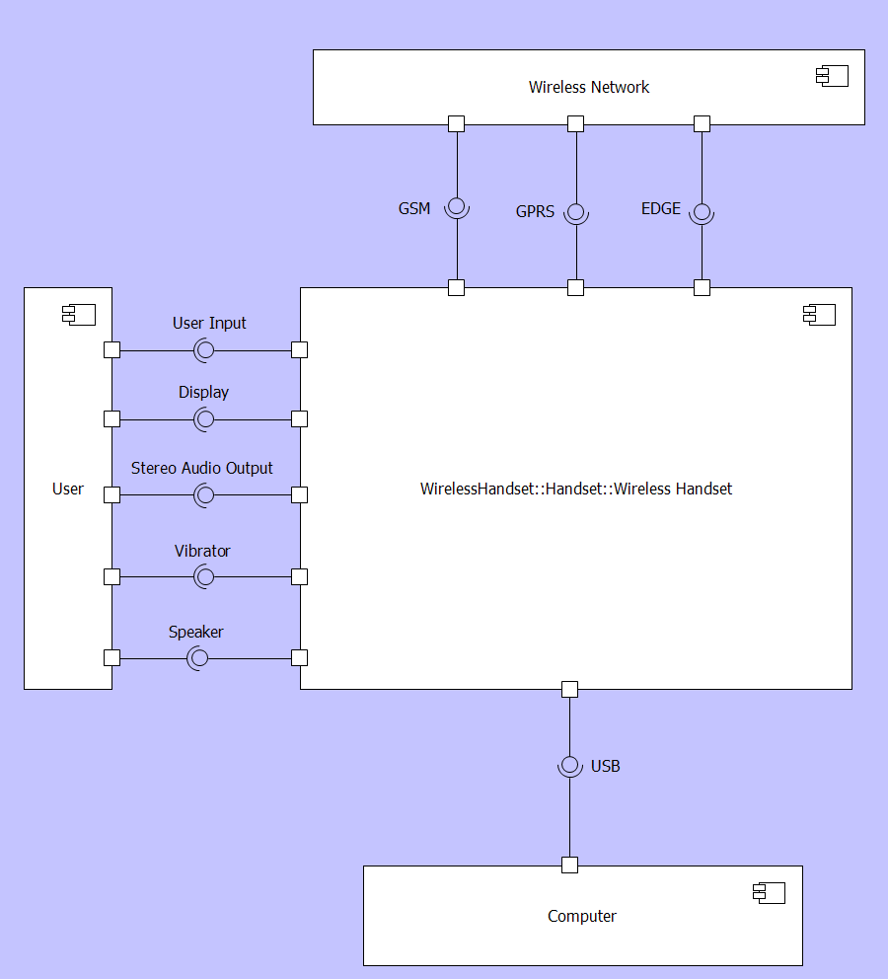
Getting Started
Analyze application using descriptive modeling
Divide and conquer
  Any boundary
  Hierarchically nesting
Define interfaces
  Operations and signals
Connect components
Notes:
One common use for UML is the specification of structure and interfaces.
You can use UML to divide a system into components along any boundary that makes sense.
You can nest these components hierarchically.
Then, you can specify the interfaces between the components.
Since interfaces can be formally defined, this type of UML modeling goes a long way toward removing the ambiguity of natural-language specifications.
Interfaces:
BALL = Provider/Server
CUP = Requirer/Client
Synchronous/Asynchronous = calls/signals

Slide 11
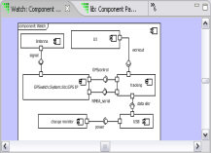
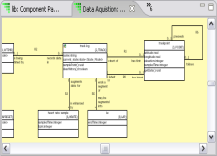
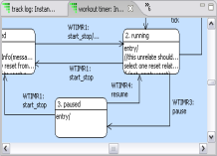
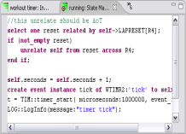
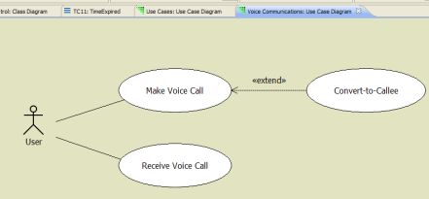
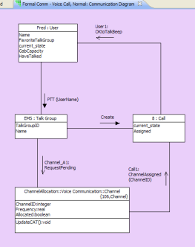
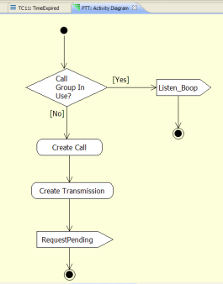
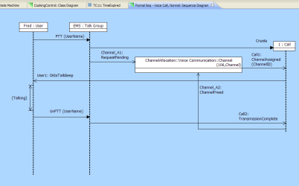
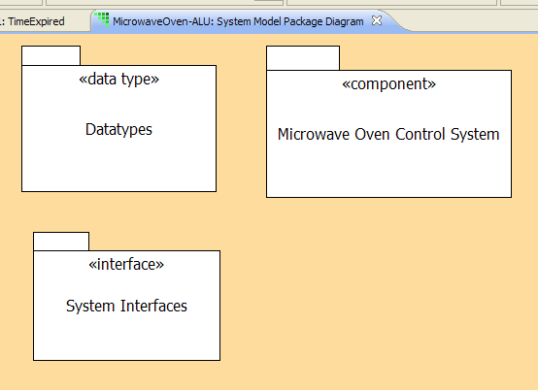
Relationship between Model Elements
Analysis, loosely coupled
  Use Case
  Sequence
  Communication
  Activity
Executable, tightly coupled:
  Component
  Class
  State
  Action
Package
Notes:
Executable model elements are the four core diagrams mentioned previously. Informal model elements can, in some cases, be formalized to act as executable elements.
Packages group elements together in the model structure.

Slide 12


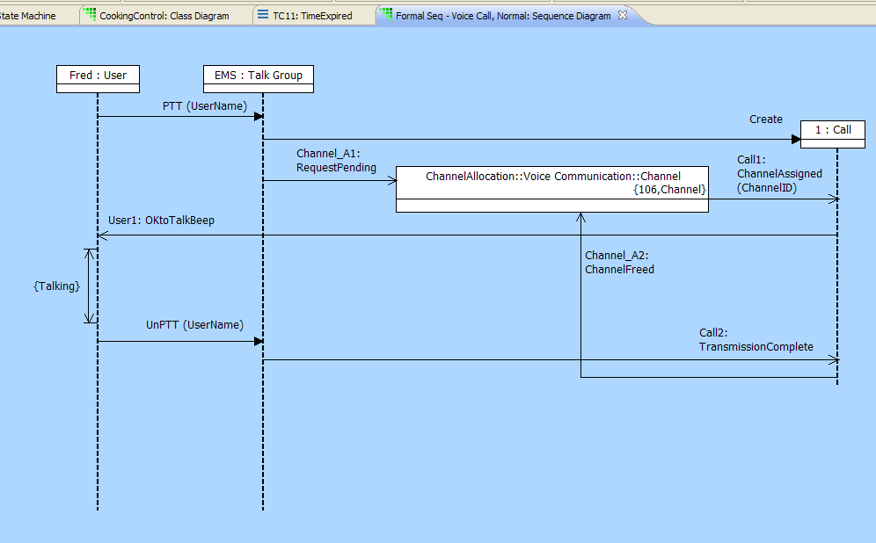

Analysis Models
Use as you see fit
Use Case
Sequence *
Communication *
Activity
* Sequence and Communication can be Formalized
These Diagrams are NOT translated.
Notes:
The primary function of the informal models is to facilitate understanding of the model domain between users. These diagrams are also placed on different color backgrounds for quick comprehension.

Slide 13



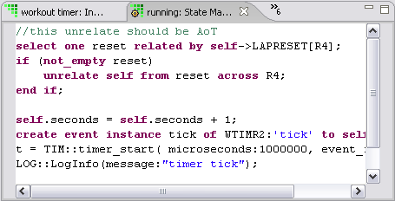
Executable Model Hierarchy
High level
Component Diagram
Decompose the application
Define Interfaces
Class Diagram
Abstractions, associations
Operations
State Diagram
Functional lifecycle
Event handling
Action Specification
Processing
Low level
These are the Translatable Diagrams.
Notes:
xtUML defines an order of construction in building models. Moving from high-level to the low-level through the four core diagrams and their respective purposes:
Component diagram: Structure
Class diagram: Data
State diagram: Control
Action specifications: Processing
Notice all diagrams are placed on different color backgrounds for ease of comprehension

Slide 14
Packages
Packages can contain: (anything)
  Package
  Activitys, Communications, Sequences, Use Cases
  Components, Interfaces, Data Types, Classes
Visibility and Namespacing
  Establish namespace
  Can limit visibility
Generic packages, per UML
  Namespace
  Visibility controls
  Separate diagram and
  package concepts

Slide 15


Summary – Steps in the xtUML Method
Analysis – questioning, thinking, sketching...
  Descriptive UML diagrams
    use case, sequence, ...
Executable Modeling – formalizing the analysis:
  Component Diagrams (partitioning/interfaces)
  Class Diagrams (data)
  State Machines (control)
  Activities (processing)
Verification
  Interpretive Model Execution
Code generation
  Template and Rule-Based Translation
Notes:
This slide summarized the xtUML method. As we progress through the training, we will revisit this methodology slide as concepts are detailed.

