Slide 1
xtUML and BridgePoint
Module 2
Tools
Notes:
1

Slide 2

Framework
Eclipse framework
  Uses Eclipse paradigm for consistency with other tools
Collection of Plug-ins, packaged as Eclipse extension
  Each release easily drops into existing Eclipse installation
Extension points
  Integrate with your own tools or those of other vendors
  Extend the capabilities of BP
Notes:
Eclipse based tools are a well established standard and growing in popularity.
Can run multiple tools in a single version of Eclipse, easy multitasking.
Good example of easy extension is revision management software. Vendors’ plugins integrate easily with Eclipse, independently of BP

Slide 3
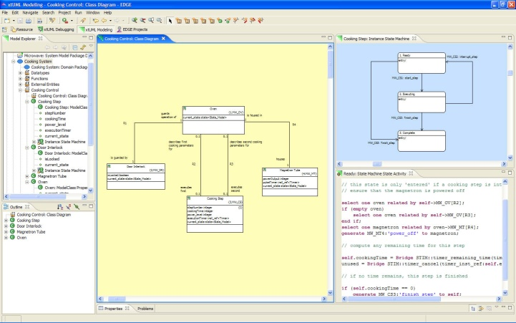
Eclipse terminology
Workspace – a collection of projects
Project – A container for resources
Resource – files and folders in a project
View – provides a way to navigate resources
Editors – tools that operate on resources
Perspective – a collection of views and editors designed to support a particular activity.
Notes:
Eclipse user interface is composed of several different components.
Together they provide a common ‘look and feel’ for many different Eclipse plugins

Slide 4
Workspace
Work area for any set of projects
Usually some directory in the file system
The workspace is specified when Eclipse starts
In this course, for instance, we may set the workspace to
  C:\training\workspaces\student
  All code will be saved in this directory
BridgePoint Model
BridgePoint Model
C++ Code
Documentation
Experimental Models
Documentation
Legacy Code
Legacy Code
Notes:
Workspace concept is standard practice for Eclipse. File resources, window preferences, tool settings are contained in here.

Slide 5
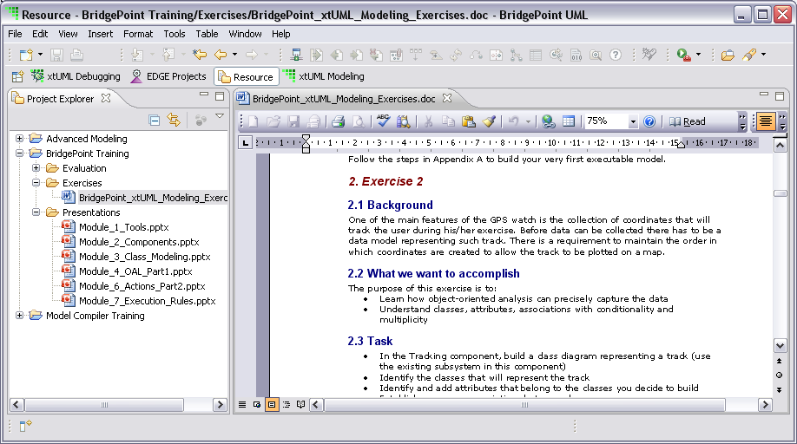
Projects, Resources, Views & Editors
View
Editor
Project
Notes:
Project Explorer shows all resources, 1:1 view of the file system. Other views display differently.
Windows can be maximized by double-click, reorganized, split, etc.

Slide 6
Perspective
Each Eclipse session contains one or more perspectives
Each perspective provides a set of functionality aimed at accomplishing a specific type of task or that works with specific types of resources
  For example, the C/C++ perspective combines views that you would commonly use while editing C/C++ source files
You might need switch perspectives frequently as you perform different tasks
Notes:
Example: In BP, the xtUML building perspective provides a different set of functionality than the xtUML Debugging perspective.

Slide 7
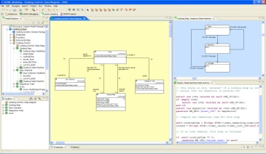
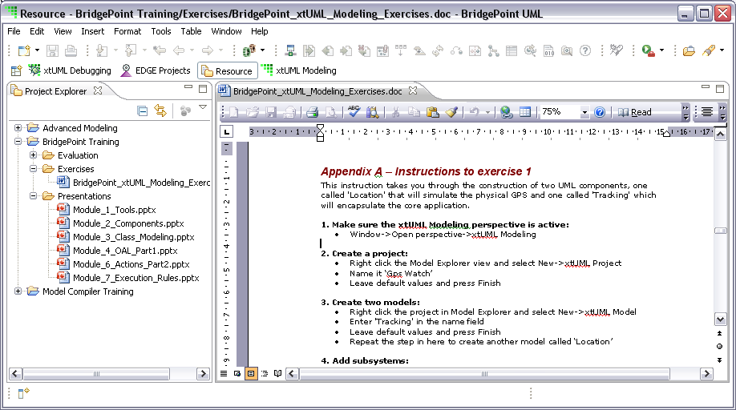


BridgePoint Perspectives
 | Tool | Perspective
 | Model Builder (UML)
 | Model Verifier (x)
 | Model Compiler (t)
xtUML Modeling
xtUML Debugging
C/C++
Java
C/C++
Notes:
These are the three parts of xtUML. Executable (x), translatable (t), UML. All encompass different portions of the same standard.

Slide 8
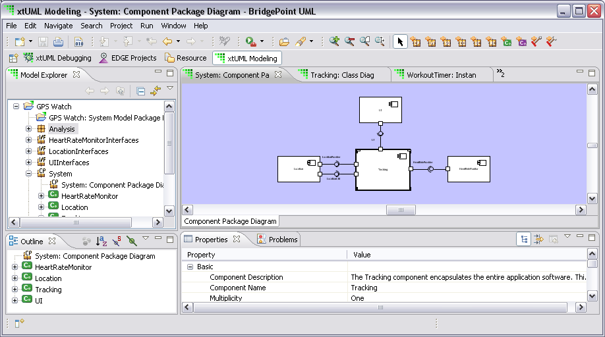
xtUML Modeling
Notes:
Where the xtUML model is created. Views, projects, and editor visible.
Model Explorer: strict tree view of the model structure
Outline: outline of the currenly selected item in Model Explorer
Properties: properties of the currenly selected item in Diagram Editor
Editor: in this perspective is a diagram editor

Slide 9
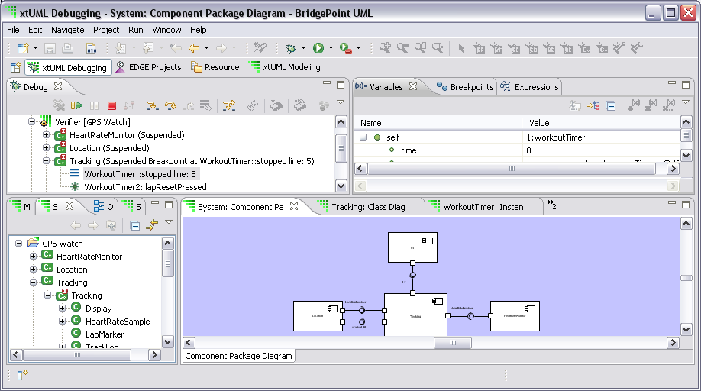
xtUML Debugging
Notes:
Similar to Model Builder, with addition of debug controls and variables, breakpoints, etc. Model is debugged in this perspective.
Debug window shows info of where program is stopped: breakpoints, events queued, etc.
Session explorer (name truncated in screen shot) is a dynamic version of Model Explorer. Shows instances of classes, current states, events, etc.

Slide 10
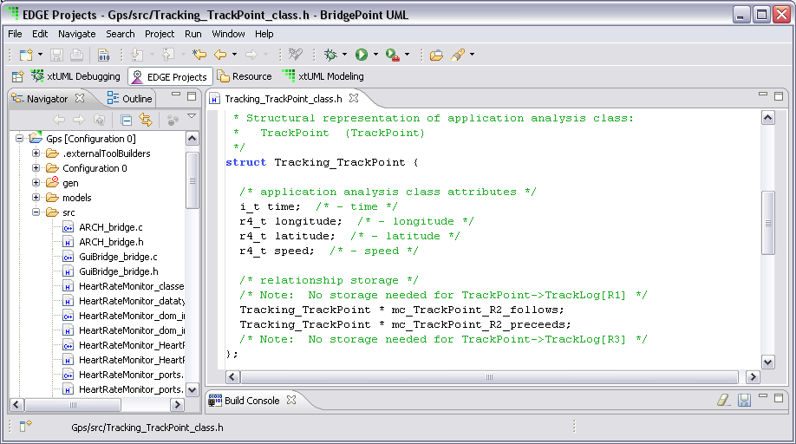
Model Compiler
Notes:
Transition to this perspective to generate ‘C’ code. EDGE is the underlying ‘C’ compiler—will produce an x86 Windows *.exe by default.
Does not show up by default on ‘Perspectives’ bar. Go to “Window” -> “Open Perspectives” -> “EDGE Projects”

Slide 11
Lab 1: Exercise 1
Loading a pre-existing project from an archive file
Notes:
Allow approximately 5 minutes for this lab.

