Slide 1
xtUML and BridgePoint
Module 6
Class Modeling
Notes:
1

Slide 2
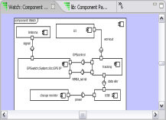
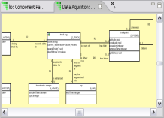
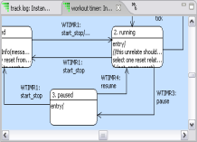
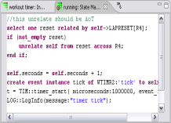
The xtUML method - Building Class Diagrams
Analysis – questioning, thinking, sketching...
  Descriptive UML diagrams
    use case, sequence, ...
Executable Modeling – formalizing the analysis:
  Component Diagrams (partitioning/interfaces)
  Class Diagrams (data)
  State Machines (control)
  Activities (processing)
Verification
  Interpretive Model Execution
Code generation
  Template and Rule-Based Translation

Slide 3
Class Diagrams
Identify the types of object the component is concerned with and draw them as classes.
Abstract the characteristics that define the classes; these are the class attributes.
The choice of classes and attributes depends on the purpose of the component.
Draw associations to represent real world relationships that exist between objects.
During execution, instances of these classes and associations will be created as necessary to represent the real world.

Slide 4
Some Common ‘Types' of Classes
Tangible objects
  Laser, Mirror, Motor...
Roles:
  User, Customer, Peripheral,...
Discovered classes:
  Account, Packet header, Proxy,...
Incident:
  Button press, Data sampling operation...
Interaction – between other classes:
  Channel assignment, Process step,...
Specification – shared characteristics:
  Common data shared by multiple instances of other classes
Notes:
One useful method of defining the classes in a domain is a ’Class Blitz’. Brainstorming a list of classes that are related; there are no wrong answers at this point in the analysis. The attributes and relationships between classes can come later in the design analysis. The Discovered category includes conceptual classes; things which represnt entities that are in the real word but which cannot be touched, e.g. ”Account’.

Slide 5
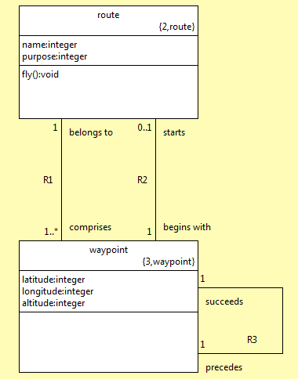
Class Diagram Elements
Class Name
Tags:
Class number
Keyletters
Attributes
{
{
Operations
Verb phrase
Association Label
Multiplicity
Conditionality
Notes:
All members of a class have the same characteristics and the same behavior
Class name: Not used in action language, can have spaces. Only for user understanding.
KEY letters: Used in Action Language and code generation; are an inclusion from previous versions of Schlaer-Mellor
Class number: Used for referencing class in action language.
Attributes: Describe the data necessary to describe a class instance.
Verb phrase: Not required, but useful for analyst comprehension when looking at the diagram. The verb phrase should be read in the form <class A> <verb phrase opposite class A> <class B>. Example, “waypoint starts route”, “route begins with waypoint”.
Association label: Used for navigation across relationships to connect/relate instances of classes together.
Multiplicity/Conditionality: Associations between two classes are defined by the number of class instances that participate with each other—this is the multiplicity.
Example in slide: first waypoint is related across R2, rest related across R1.

Slide 6

Class Blitz – Exercise
Build a class diagram of a clock
  Consider what discrete parts are in a clock
  Capture relationships between parts of the clock
  Place attributes in each class

Slide 7
Associations
An association is a domain relationship between classes.
Associations can be navigated to locate particular class instance.
Associations can be created in a class diagram as lines between classes.
An association relating to a class instance of the same type is called a Reflexive Association.
Notes:
Associations are effectively storage in the class for references to this or another class which will be related at some point.

Slide 8
Representing data relationships
A representation of a relationship between real world things
Binary associations – between two participant classes
  One-to-one [1:1]
  One-to-many [1:M]
  Many-to-many [M:M]
Unconditional, conditional, bi-conditional
  Either or both of participant classes may not always be related.
Association is 'reflexive' when each 'end' is the same class
  Navigation must then use verb phrase to distinguish 'direction'.
Any binary association may have its own characteristics
  Add an association class with attributes, associations, state model...
Generalization, specialization use a special association
  No verb phrases needed: 'is a' assumed

Slide 9
Multiplicity & Conditionality
Multiplicity – Can there be more than one?
Conditionality – Must there be one at all?
Conditionality | Multiplicity | Nomenclature
conditional | one | 0..1
conditional | many | *
unconditional | one | 1
unconditional | many | 1..*
Notes:
Only consider “zero”, “one” or “more than one”, no specific numbers (e.g. 2 or 7 etc.)

Slide 10
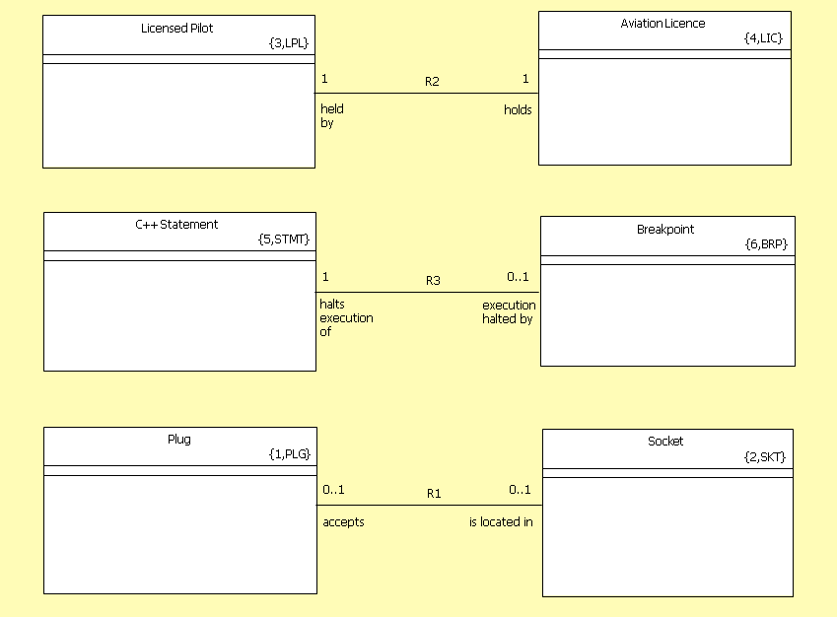
Examples: One

Slide 11
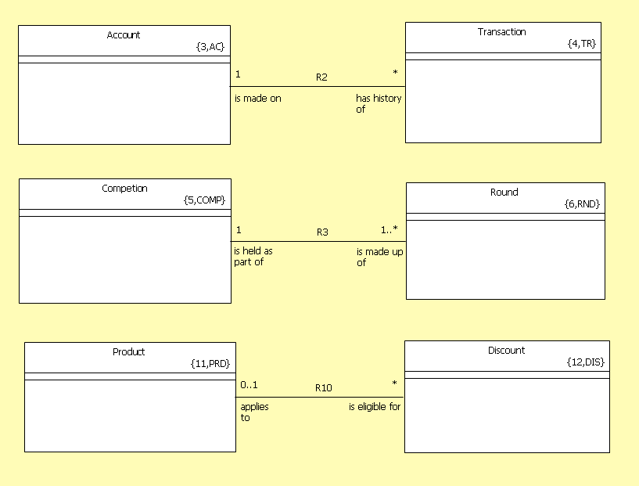
Examples: Many

Slide 12
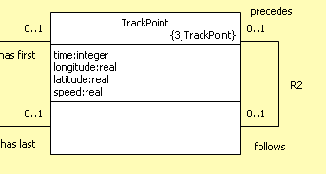
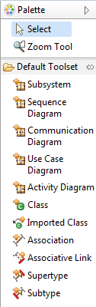
Reflexive associations
Associations between a pair of instances of the same class
Generally conditional with multiplicity of 1

Slide 13

Reflexive Associations: Exercise
Create a class diagram of a hand
Classes to use: palm, wrist, finger
Consider conditionality and multiplicity of
associations
Use at least one reflexive association

Slide 14
Lab 1: Exercise 4
Defining the functionality of our GPS Watch System
Notes:
Allow approximately 5 minutes for this lab.

Slide 15
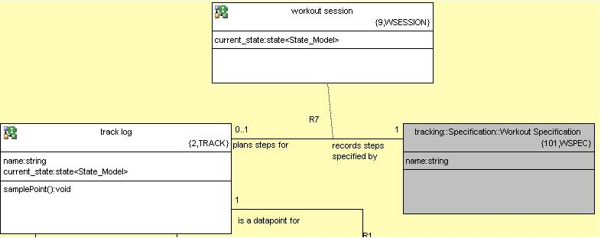
Association classes
Association class
Notes:
Association classes are used to contain attributes that hold data that isn’t properly part of either of the participating classes. An associative class is denoted by a dashed line drawn from another relationship line.
Instances of an association class come into existence when a relationship is created between the other two classes. Every pairing spawns one instance of an associative class. When the participating classes are unrelated, the association class is destroyed.
This type of class association is very common in communications.

Slide 16
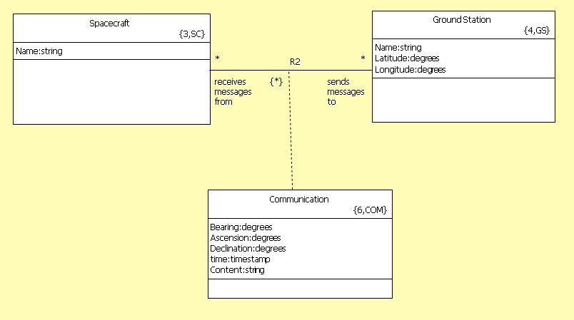
Another Associative Example
This indicates that the same Spacecraft and Ground Station can communicate multiple times

Slide 17
Generalization
Not all languages support inheritance
Multiple instances – allows reclassification/subtype migration
Much like 1:1 association
No polymorphic operation – only events
Use when there are interesting associations on subtypes
Model compiler can make may implement it with inheritance (where available) or even decide to flatten the structure
No calls to super
Future – inherited properties: operations and attributes
Notes:
Generalization is a form of inheritance. It allows the user to pull out attributes common to subclasses and put this data into a superclass. There are no “verb phrases” describing the relationship between superclass and subclass; the association is assumed to be only a “is a”.
Every instance of a supertype co-exists with an instance of the subtype; relationship is essentially 1:1 conditional.
Multiple hierarchy can exist: subtypes can have more than one supertype.
xtUML does not restrict the subclasses or superclasses from being involved in other associations. There can be multiple levels of generalization.

Slide 18
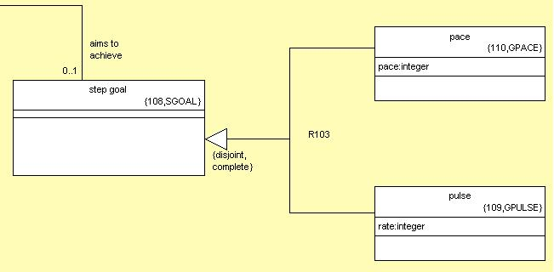
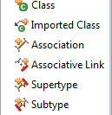
Generalization Example
No verb phrase,
“is a” assumed
Draw from parent type to intermediate point
Draw from child type to intermediate point

Slide 19
Construction Quality Class Diagrams
For associations, consider whether the relationship always holds true – conditionality – at each end.
Consider whether there may be more than one participant class at each end - multiplicity.
Choose meaningful names for classes; meaningful phrases for associations.
Write descriptions as you go! They may cause you to think again about your analysis.
Notes:
Events can be delivered to subtype from supertype.

Slide 20
Attributes
An attribute represents a characteristic shared by all of the instances of a class
Descriptive attributes represent inherent characteristics
  Trackpoint has latitude, longitude, elevation.
Naming attributes represent arbitrary labeling of instances
Which characteristics are considered relevant depends on the point of view – the “purpose” - of the application
  Trackpoint also requires time, but not air temperature, windspeed...
Notes:
Attributes serve the same function as Java class variables or C++ class members.

Slide 21
Quality Attributes
Each instance has exactly one value for each attribute
  Lots of “Not Applicable” may indicate the class should be split
  BP supports arrays as attributes, but these are intended to make interfacing with legacy code easier
All attributes are Atomic
  A need to 'parse' values suggests using separate attributes
Every attribute should characterize the entire instance
  Attributes related to other concepts should be in a separate class
  Attributes related to only a subset of the instance population suggests that some generalization is needed.
Notes:
Attributes serve the same function as Java class variables or C++ class members.

Slide 22
Identifying Attributes
Some attributes abstracted for a class represent values that may be used to uniquely find an instance, e.g.
  License Number
  WayPoint ID
  Ticket Number
Highlighting these attributes helps understanding of the subject matter being modeled
In xtUML we call such attributes ‘Identifying Attributes’

Slide 23
Identifiers
Sometimes, the value of more than one attribute is required to uniquely identify an instance
A group of one or more attributes required for instance identification is known as an ‘Identifier’
A class may have more than one Identifier as required (BridgePoint supports up to three Identifiers)

Slide 24
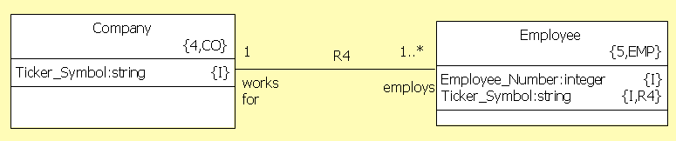
Association Formalization
Once a class has an identifier, it is possible formalize associations it participates in using its identifier
When this is done, a ‘copy’ of the attribute set is added to the attributes of class at the other end of the association being formalized
Attributes migrated in this way are called ‘Referential Attributes’

Slide 25
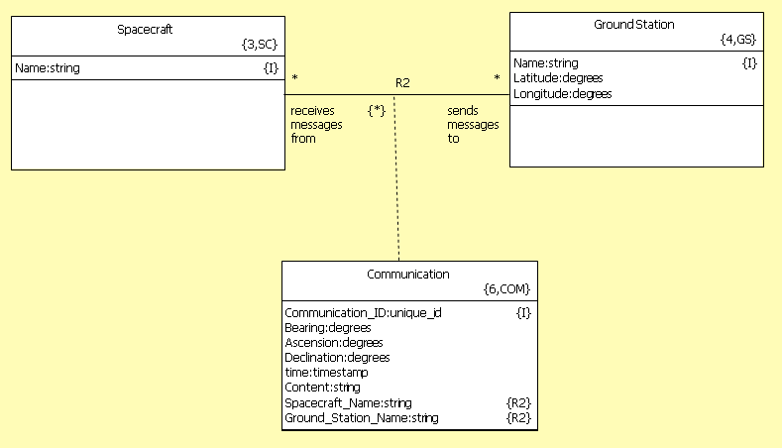
Formalized Spacecraft Example
Note that we abstracted a Communication_ID identifying attribute. We don’t want to use the Spacecraft and Groundstation ID’s to identify the Communication
Why Not?
You can add prefixes to Referential ID’s to disambiguate them
Notes:
A: Because the spacecraft can communicate multiple times with the ground station. The two ids alone are therefore insufficient to uniquely identify the Communication instance.
An alternative would have been to use Ground Station ID, Spacecraft ID and ‘time’ as the identifier.

Slide 26
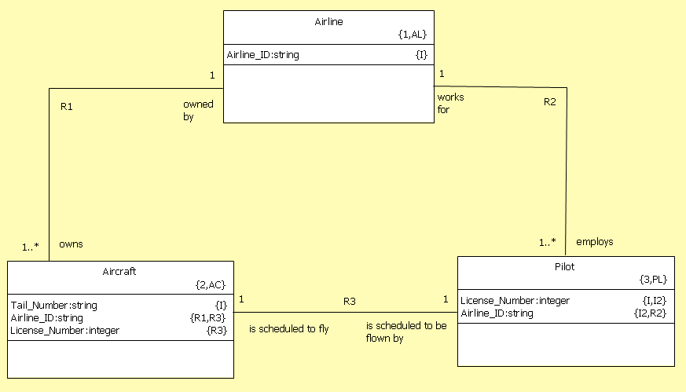
High Precision Modeling: Referential Combination
Where required, referential attributes may be combined
At first glance, it looks like this saves storage space. However, this is not the reason to do it. Combining referential attributes means something very precise
Example:
Airline_ID is combined here.
According to the rules of attribution covered earlier, Airline_ID may only take one value, this combined referential mandates that a pilot may only fly aircraft that his or her airline owns

Slide 27
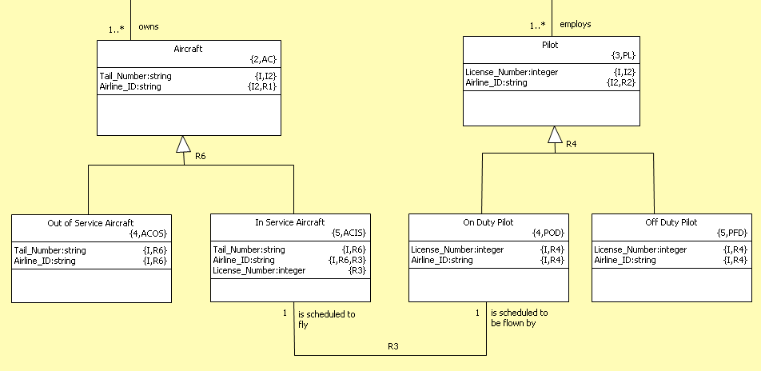
Leverage Generalization
Here, we have documented the constraint that only In Service Aircraft and On Duty Pilots will be doing any flying.

Slide 28
Paper Exercise: Putting it all together
The application is a Electronic schematic drawing and PCB layout tool.
  We are required to analyse the Library for it. This Library is to contain Integrated Circuits (for the schematic editor) and their associated physical Packages (for the PCB layout editor).
  Integrated circuits come in a variety of different packages to support different deployments, prototyping, large scale production, hardened applications (military space etc.).
  Every integrated circuit has connections for power, digital input and output etc.
  Every Package has physical pins that carry these connections to the outside world.
  For any given package, we must know which pin carries which connection.
  Pins may be left unconnected, but every connection must get to the outside or else the Package cannot function.

Slide 29
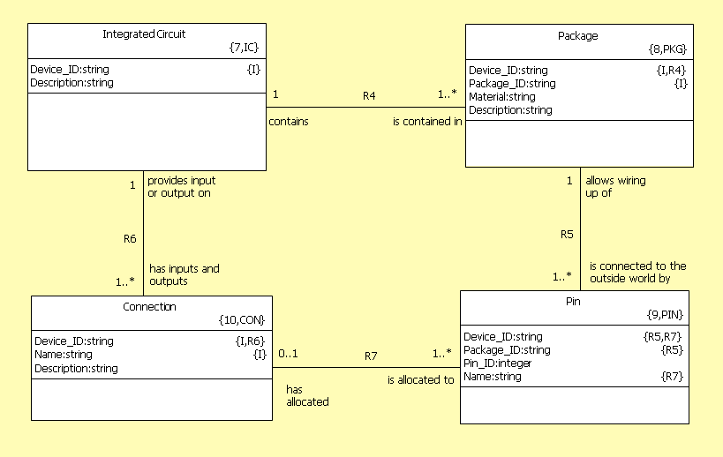
Paper Exercise: Solution

