Slide 1
xtUML and BridgePoint
Action Language Part 1
Notes:
1

Slide 2
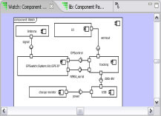
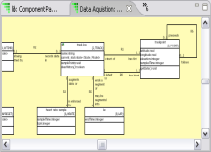
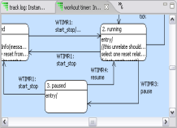
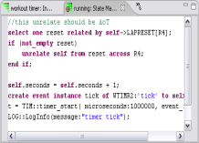
The xtUML method – Specifying Activities
Analysis – questioning, thinking, sketching...
  Descriptive UML diagrams
    use case, sequence, ...
Executable Modeling – formalizing the analysis:
  Component Diagrams (partitioning/interfaces)
  Class Diagrams (data)
  State Machines (control)
  Activities (processing)
Verification
  Interpretive Model Execution
Code generation
  Template and Rule-Based Translation

Slide 3
Activities
An activity specifies processing within the model
An action can be associated with the following modeled elements:
  states
  bridge operations
  functions
  class and instance-based operations
  mathematically-derived attributes
  interface reference operations and signals
The Object Action Language (OAL) is used to define the semantics for the processing that occurs in an action.
Notes:
OAL is the syntax that BridgePoint uses to interact with the other elements of the model: create instances of classes, assign values for variables, generate events to state machines, etc.
The action language is meant to be a natural syntax to aid in comprehension. The BridgePoint editor has real-time checking and contextual highlighting. There are analogs to conventional programming languages in many cases: there are control statements like ‘if’, ‘while’, ‘for each’; the user can create and set transitive variables, including structured types.

Slide 4
Object Action Language [OAL]
Since 2001, the UML standard has incorporated a defined action semantics... but has not yet defined a syntax for specifying actions.
Object Action Language is a concrete syntax which implements the UML standard
OAL is complete enough to be executable, but abstract enough that it does not prescribe implementation specifics.
create object instance request of REQ;
select one channel related by device->CHAN[R100];
assign device.priority = lastpriority + 1;
generate CHAN11:'host relinquish' to channel;
Notes:
Actions exist outside of the framework of a ‘main()’ function or routine, unlike conventional programming. Other purposes like file I/O, are left to the platform specific implementation of the model. xtUML is focused on the minimum set of specifications that form a functionally complete platform independent model.

Slide 5
What OAL can do:
Create and delete instances.
Link and unlink associations between instances.
Select instances across association links.
Select instances based on attribute values.
Read and write attribute values.
Compute new values.
Control statements.
Generate events.
Invoke interface operations.
Notes:
This set of operations is exactly the minimum needed to complete the formalization of how the component should work without committing to a specific implementation or platform.

Slide 6
Data Types
Implicit Typing
  All data items are implicitly typed by the value assigned to them on their first use within an action.
Simple Data Types
  Integer
  Real
  String
  Boolean
System Data Types
  Date
  Timestamp
  Unique ID
Reference Types
  Timer Handle
  Instance Handle
  Instance Handle Set
  Event Instance
  Component Handle
Notes:
Rich datatypes allow flexibility in modeling.

Slide 7
Operators
Arithmetic
  + - * / %
  Unary -
Boolean
  and or
  Unary not
Logical
  == !=
  < <= > >=
Assignment
  assign x = 1;
  Assign keyword optional
Instance Handles
  == !=
  empty not_empty
  cardinality
e.g.
expired = (account.balance == 0.00) and ((TIM::get_current_time() - last_pay_time) >=max_wait) ;
Notes:
Comprehensive operator support.

Slide 8
Expressions
a = 3 ; /* integer typed local variable */
assign x = 3.14 ; /* floating point value (real) */
y = 11.0 ; /* another real */
done = false; // boolean typed local variable
z = x + y * x; /* Operator Precedence */
b = a % 2; /* remainder operator */
s1 = “Hello”; /* String Variable – dynamic size */
s2 = “World!”; // C++ Comments also allowed
s3 = s1 + “ “ + s2; // String Concatenation
Notes:
Some example expression.

Slide 9
Lab 1: Exercise 5
Run the model in the xtUML Debugging Perspective
Notes:
Allow approximately 15-20 minutes for this lab.

Slide 10
IF Statement
No semicolon after the IF statement
As many ELIF clauses as desired
Nested IF statements allowed, END IF; terminates statement.
if (<Boolean or Logical equation>)
// do something
elif (<Boolean or Logical equation>)
// do something
else
// or something
end if;
if (empty firstPoint)
// this is the first trackPoint in the log
relate self to trackPoint across R1.'has first';
relate self to trackPoint across R3.'has last';
else
unrelate self from lastPoint across R3.'has last';
relate self to trackPoint across R3.'has last';
relate lastPoint to trackPoint across R2.'follows';
end if;

Slide 11
Loops
WHILE and FOR EACH. Use WHILE to implement a FOR loop.
Can be nested.
Defines a local scope.
for each mobile in mobiles
// do something
end for;
i = 0;
while (i < 4)
// do something
i = i + 1;
end while;
Notes:
No FOR loop available, only FOR EACH. Use the WHILE loop to implement, as is done in the example.

Slide 12
Nesting
for each this_Cabin in bank_Cabins
select one its_Shaft related by this_Cabin->Shaft[R2];
if (its_Shaft.In_service)
cab_delay = this_Cabin.Estimate_travel_delay(Floor:my_Floor.Name,
Calling_dir:param.Dir);
if ((cab_delay < shortest_delay) or (first_cabin))
shortest_delay = cab_delay;
param.OUT_Shaft = its_Shaft.ID;
end if;
end if; // in service
first_cabin = false;
end for;
Notes:
Just an example for discussion. Should be fairly clear to programmers.

Slide 13
Break and Continue
Break completely exits the inner-most loop
Continue exits the current iteration of the inner-most loop
while (CTL::create())
for each a in aset
if (a.name == "Jeff")
break;
end if;
create object instance b of B;
relate b to a across R1;
end for;
end while;
while (CTL::create())
for each a in aset
if (a.ID == 13)
continue;
end if;
create object instance b of B;
relate b to a across R1;
end for;
end while;

Slide 14
Functions
Function Invocation
Return value
Accessing Parameters
  param is a pre-pended keyword to access function arguments
::fnName(ParamName1:ParamValue1, …);
::start();
probe = ::getProbe(probeId: p);
return <expression>; // <expression> is optional
return “down”;
select any probe from instances of SP where
selected.probe_ID == param.probe_id;
trackPoint.latitude = param.location.latitude;

Slide 15
Attributes
Writing Attributes
  [assign] <instance handle>.<attribute> = <expression>;
  assign keyword is optional
Reading Attributes
Writing Mathematically Derived Attributes
  In Model Explorer, set as derived attribute
  Then select and Open With > Activity Editor
create object instance my_account of ACCT;
my_account.branch = rcvd_evt.this_branch;
myx = myrobot.x_position;
self.volume = self.length*self.width*self.height;
Notes:
Self is a predefined instance reference, with is automatically set and cannot be changed by the user.

Slide 16
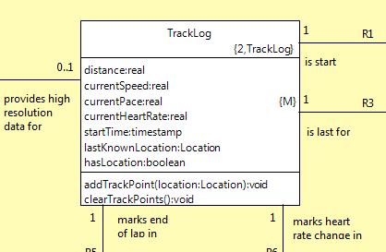
Mathematically Derived Attributes
Writing Mathematically Derived Attributes
  In Model Explorer, set as derived attribute
  Then select and Open With > Activity Editor
  self.volume = self.length * self.width * self.height;
  No return statement required
  Access attribute via self
  Mathematically derived attributes
  are read-only in all other places
Notes:
Self is a predefined instance reference, with is automatically set and cannot be changed by the user.

Slide 17
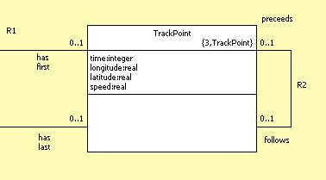
Create / delete statement
Syntax:
create object instance <instance handle> of <keyletter>;
create object instance of <keyletter>;
delete object instance <instance handle>;
create object instance trackPoint of TrackPoint;
delete object instance trackPoint;
Notes:
The ‘create’ statement is among the first things that the model actions will execute. Many aspects of OAL require that an instance of a class exist in order to function. Before any actions within the class can be executed, or any relationships used, there must first be an instance of the class itself. Attributes of any class instance are uninitialized at create time.
Class key letters are a form of ‘shorthand’ notation. Allows for more descriptive class names that may not fit the requirements of Action Language references (i.e. spaces, special characters).

Slide 18
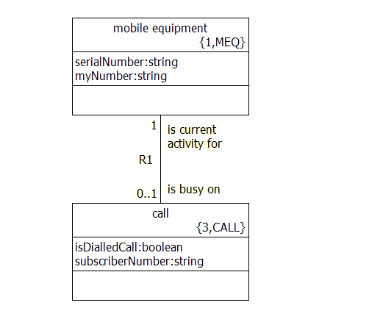
Relate / unrelate statement
OAL is used to manage relationships between specific instances of classes.
relate mobile to call across R1;
Local instance reference variable
Association label
unrelate mobile from call across R1;
Local instance reference variable
Notes:
Relationships are not instantiated as soon as the two involved classes are instantiated, they must be created using the ‘relate’ statement.
These relationships are a fundamental part of the model specification; can be used for selecting particular instances of classes.

Slide 19
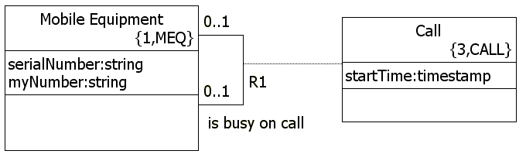
Relate / unrelate “using“ statement
Connecting two classes that have an associative class stemming from their relationship.
relate mobile1 to mobile2
across R1.’is busy on call’ using call;
Local instance reference variable
unrelate mobile1 from mobile2
across R1.’is busy on call’ using call;
Notes:
Relate/unrelate statements with the ‘using’ statement are used when connecting two classes that have an associative class stemming from their relationship. The relationship verb phrase after the relationship number can be added to improve clarity if needed. The verb phrase is optional unless it is a reflexive association.

Slide 20
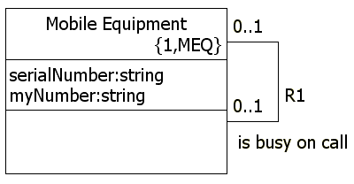
Select any / many
Selecting instances of a class
select any mobile from instances of MEQ;
Local instance reference variable
Key letters
select many mobiles from instances of MEQ
where selected.serialNumber > 10000;
Where clause
Notes:
The ‘select’ statement is a way to select instances of a class, either at random or instances that meet a certain qualification. These selections can be single objects, or a set of multiple objects, called an “object reference set”.
‘Selected’ refers to the current object, and serialNumber is an attribute of the object. For a set of selected objects, the ‘where selected…’ clause tests each object in succession.
‘select any’ returns a single object from the instances of the class. ‘select many’ returns all the objects of the class. Either can be combined with the ‘where’ clause to qualify the selection of objects.
First code example is known as a “blind” select. The local instance ref variable used should be tested for an empty reference after a blind select.
Test for empty anytime when selecting over a conditional relationship.

Slide 21
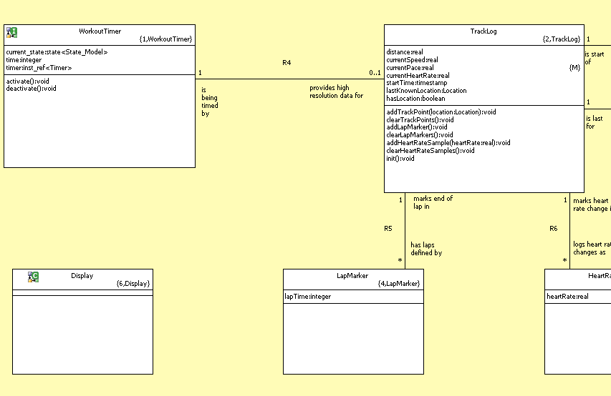
Select one / many … related by …
Select one requires the use of the related by clause
‘Self’ is the instance of the class that originates an action
select one timer related by self->WorkoutTimer[R4];
Local instance reference variable
Originating class instance
Key letters
Association
label
Notes:
The ‘select one/many … related by …’ statement is useful for selecting an instance of a class (or instances) that is related to a specific instance of the other participating class. The arrow points to the target class; in this example “call”.
The ‘select one’ construct is used when the target class (call) has a multiplicity of 1 or 0..1. Use the ‘select many’ construct when the multiplicity of the target class is 0..* or 1..*.
The ‘select one/many … related by …’ statement is useful for selecting an instance of a class (or instances) that is related to a specific instance of the other participating class. The arrow points to the target class; in this example “call”.

Slide 22
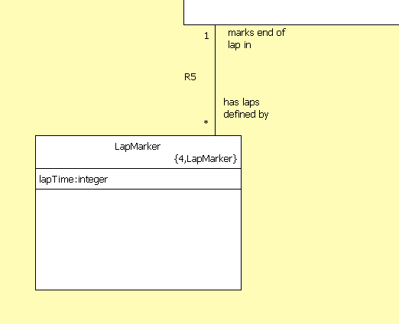
Example: Lap Time
select one timer related by self->WorkoutTimer[R4];
create object instance lapMarker of LapMarker;
lapMarker.lapTime = timer.time;
relate self to lapMarker across R5;
select many lapMarkers related by self->LapMarker[R5];
for each lapMarker in lapMarkers
unrelate self from lapMarker across R5;
delete object instance lapMarker;
end for;
Notes:
Here’s an example which uses many of the constructs describe. Select one and many, create and delete, relate and unrelate.

Slide 23
Lab 2: Exercise 1
Create a class diagram for the Tracking subsystem in the GPS Watch
Notes:
Allow approximately 15-20 minutes for this lab.

Slide 24
Control Structures
Example:
// Send a 'time for bed' event to all children 5 and under.
select many children from instances of C;
for each child in children
if (child.age <= 5)
while (child.awake)
generate C1:'time for bed' () to child;
if (not lights.out)
generate C2:'turn off lights' () to child;
end if;
end while;
end if;
end for;

Slide 25
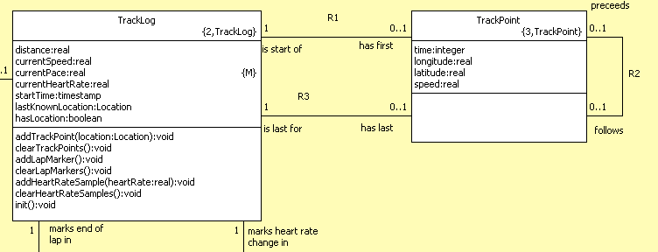
Example: Creating an Ordered List
At each TrackPoint update, this operation is run on an instance of TrackLog
create object instance trackPoint of TrackPoint;
trackPoint.time = workoutTimer.time;
trackPoint.longitude = param.location.longitude;
trackPoint.latitude = param.location.latitude;
select one firstPoint related by self->TrackPoint[R1];
select one lastPoint related by self->TrackPoint[R3];
if (empty firstPoint)
// this is the first trackPoint in the log
relate self to trackPoint across R1.'has first';
relate self to trackPoint across R3.'has last';
else
unrelate self from lastPoint across R3.'has last';
relate self to trackPoint across R3.'has last';
relate lastPoint to trackPoint across R2.'follows';
end if;
Select head of list
Select tail of list
Handle first point
Update new last point Relations

Slide 26
Lab 3: Exercise 1
Relate and unrelate class instances using OAL
Notes:
Allow approximately 15-20 minutes for this lab.

