Slide 1
Vista and BridgePoint
Bit-Accurate Behavior
Notes:
1

Slide 2

Part B - Agenda
Review of BridgePoint Modeling Environment
Introduction to Vista TLM Modeling
  TLM Modeling and Policies
  Using Vista TLM ModelBuilder
  Simulating TLM Models
Linking BridgePoint UML with Vista TLM
  The Recipe for exporting and importing models
  Executing these models in either environment
  Exploration
Advanced Topics
  Incorporating Coverage metrics
  Modeling Bit-accurate Behaviour

Slide 3
Modeling Arithmetic
Modelers typically start with a PIM where behaviors are captured with infinite precision
Physical limits are described in the requirements
  Employed in the model as Range Bound assertions and checks
Implementation specific characteristics left to Vista domain
  Likely to explore
    bit-widths
    rounding
    saturation
    truncation
Linkage between PIM and PSA is custom datatypes that are marked to appropriate systemC sc_datatypes.

Slide 4
Primer on SystemC Datatypes

Slide 5
SystemC Data Types
C++ Built-in Types
  bool - boolean (True or False)
  char - character or integer between -128 and 127
  int - integer
  float * - real number
  strings * - string of alphanumeric enclosed in “”
* not synthesisable

Slide 6
SystemC Data Types
Fixed Precision ints
  64 Bits
  sc_int<N>
  sc_uint<N>
Arbitrary Precision
  Up to 512 Bits
  sc_bigint<N>
  sc_biguint<N>
Eases modeling of fixed bit-length variables with only truncation
Most familiar to HW-centric modelers

Slide 7
SystemC Data Types
Fixed Point Types
  Useful in DSP applications
  Removes need for error prone translation to equivalent int format.
  Specify Quantization and Saturation Behavior
  sc_fixed<wl, iwl, q_mode, o_mode, n_bits>
    wl: Total Word Length
    iwl: Integer Word Length
    q_mode: Quantization Mode
    o_mode: Overflow Mode
    n_bits: Number of Saturated Bits

Slide 8
SystemC Data Types
bit and bit vector
  sc_bit, sc_bv<N>
four-state logic
  sc_logic, sc_lv<N>
    0: Logical 0
    1: Logical 1
    Z: High Impedance
    X: Unknown
Available for modeling logic and lower abstractions
Not suitable for PIM or PSA modeling.

Slide 9
SystemC Data Types
Common Characteristics
  Native C++ types (int, float, string) and SystemC types may be mixed.
  Equality and bitwise operators (==, <<, >>)
    All SystemC Data Types
  Arithmetic and relational operators (+, -, <, >)
    Numeric data types only
  Overloaded assignment operators
    Provides conversion between different data types.
    Conversion may truncate data when necessary.
      e.g.: myInt = myFloat;

Slide 10

SystemC Data Types
Utility Methods:
  Bit Select – get and set specific bits
  Range Select – get and set a range of bits
  Concatenation – join bits
  Bitwise Reduction
  Integer Conversion
  String input and output

Slide 11
SystemC Data Types
Bit Select
  Read or write to a specific bit in a variable.
  C++ operator[] overloaded to provide read/write access.
  e.g.
sc_int<4> myInt; // 4-bit signed integer
myInt[1] = true; // Set bit 1 to true.bool myBool bool b1 = myInt[0].to_bool(); // Read bit 0

Slide 12
SystemC Data Types
Part Select
  Read/write a contiguous subset of bits within the variable.
  Available methods:
    range(int, int)
    C++ operator()
  e.g.
sc_int<8> myInt = 2; // 00000010
myInt.range(3, 2) = myInt.range(1, 0); // 00001010

Slide 13
SystemC Data Types
Concatenation
  Concatenate the bits of two variables together.
  Available methods:
    concat(arg0, arg1)
    C++ comma operator “operator,”
sc_int<8> U1 = 2; // 00000010
sc_int<2> U2 = 1; // 01
sc_int<8> U3 = (true, U1.range(3,0), U2, U2[0]);
// U3 = 10010011
(U2[0], U1[0], U1.range(7,6)) = U1.range(3, 0);

Slide 14
SystemC Data Types
Bitwise Reduction
  Performs bitwise operation on all bits in integer or vector.
  Returns bool.
  Operations:
    and_reduce() - Bitwise AND between all bits
    nand_reduce() - Bitwise NAND between all bits
    or_reduce() - Bitwise OR between all bits
    nor_reduce() - Bitwise NOR between all bits
    xor_reduce() - Bitwise XOR between all bits
    xnor_reduce() - Bitwise XNOR between all bits

Slide 15
SystemC Data Types
Integer Conversion
  All SystemC data types
    accept C++ integer assignment.
    convert to C++ interger types
  Conversion Methods:
    to_int() - Convert to native int type
    to_uint() - Convert to native unsigned type
    to_long() - Convert to native long type
    to_ulong() - Convert to native unsigned long type
    to_uint64() - Convert to native 64-bit unsigned integer
    to_int64() - Convert to native 64-bit signed integer

Slide 16
SystemC Data Types
String input and output
  All SystemC data types
    can be set by reading from a C++ input text stream
    can print their value to a C++ output text stream
void scan(istream& input);
void print(ostream& output);

Slide 17
Recipe for Bit-Accurate Modeling

Slide 18
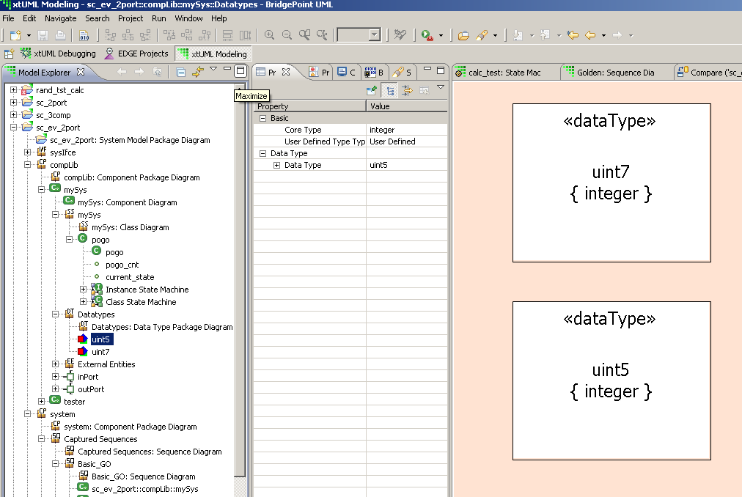
Step 1 – Custom Data Types
machine native types
  Typically choice of target language
  Typically multiples of 8
Create user data types
  Recommended
  Name must be unique within domain
  Code generation will translate to systemC datatype
Notes:
One common use for UML is the specification of structure and interfaces.
You can use UML to divide a system into components along any boundary that makes sense.
You can nest these components hierarchically.
Then, you can specify the interfaces between the components.
Since interfaces can be formally defined, this type of UML modeling goes a long way toward removing the ambiguity of natural-language specifications.
Interfaces:
BALL = Provider/Server
CUP = Requirer/Client
Synchronous/Asynchronous = calls/signals

Slide 19
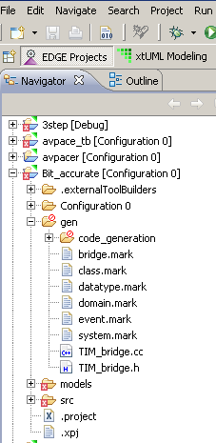
Step 2 - SystemC
SystemC datatypes offer a standardized library of types for modeling hardware
Extends native datatypes to model
  bit-width
  saturation
  rounding
Notes:
One common use for UML is the specification of structure and interfaces.
You can use UML to divide a system into components along any boundary that makes sense.
You can nest these components hierarchically.
Then, you can specify the interfaces between the components.
Since interfaces can be formally defined, this type of UML modeling goes a long way toward removing the ambiguity of natural-language specifications.
Interfaces:
BALL = Provider/Server
CUP = Requirer/Client
Synchronous/Asynchronous = calls/signals

Slide 20
What about AC Datatypes
The AC (Algorithmic C) datatypes are better for synthesis and hardware modeling
AC datatypes are compatible with systemC
BridgePoint will make the substitution in generated code
Requires manual inclusion of ac_int.h and ac_fixed.h
Notes:
One common use for UML is the specification of structure and interfaces.
You can use UML to divide a system into components along any boundary that makes sense.
You can nest these components hierarchically.
Then, you can specify the interfaces between the components.
Since interfaces can be formally defined, this type of UML modeling goes a long way toward removing the ambiguity of natural-language specifications.
Interfaces:
BALL = Provider/Server
CUP = Requirer/Client
Synchronous/Asynchronous = calls/signals

Slide 21
Step 3 – Defining the Mark
.invoke TagDataTypePrecision( "domain", "dt_name", "tagged_name", "initial_value" )
Where the input parameters are:
domain - Registered domain name. Use "*" to indictate a System Wide data
type (to be applied to all domains containing the user data type).
dt_name - Name of the data type as known in the application analysis.
tagged_name - Name of the data type as known in generated implementation
code (e.g., the 'precision' of the data type). Note (2).
initial_value - An optional specification of the default value for the
data type. Use "" for the architectural default (e.g., 0 for integer, 0.0 for real). Note (3).
.invoke TagDataTypePrecision( "*", "cnt5", "sc_int<5>", "0" )
.invoke TagDataTypePrecision( "*", "cnt7", "sc_int<7>", "0" )
Notes:
One common use for UML is the specification of structure and interfaces.
You can use UML to divide a system into components along any boundary that makes sense.
You can nest these components hierarchically.
Then, you can specify the interfaces between the components.
Since interfaces can be formally defined, this type of UML modeling goes a long way toward removing the ambiguity of natural-language specifications.
Interfaces:
BALL = Provider/Server
CUP = Requirer/Client
Synchronous/Asynchronous = calls/signals

Slide 22
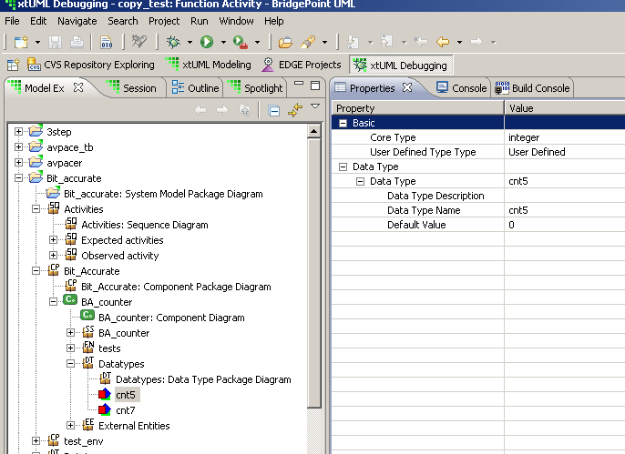
Generated Model
/*
* Structural representation of application analysis class:
* counter (COUNTER)
*/
class BA_counter_COUNTER {
public:
Escher_StateNumber_t current_state;
/* application analysis class attributes */
sc_int<5> counter; /* - counter */
/* - i_cnt7 */ /* OPTIMIZED OUT */
sc_int<5> step_size; /* - step_size */
Notes:
One common use for UML is the specification of structure and interfaces.
You can use UML to divide a system into components along any boundary that makes sense.
You can nest these components hierarchically.
Then, you can specify the interfaces between the components.
Since interfaces can be formally defined, this type of UML modeling goes a long way toward removing the ambiguity of natural-language specifications.
Interfaces:
BALL = Provider/Server
CUP = Requirer/Client
Synchronous/Asynchronous = calls/signals

